Slide 1
MA1 & MA2 Seminar
Spring 2024
Department of Film
Aalto University School of Arts, Design and Architecture

Slide 2
Course Objective & Info
The Master’s Thesis Seminar is course that supports students to begin making connections between their artistic practice and the process of writing.
The course is organised in contact teaching sessions, combined with assignments and peer work.
You are invited to share feedback in between the sessions.
Preferred channels of communication: Aalto email & MyCourses
Tämä kurssi tukee opiskelijoita luomaan yhteyksiä taiteellisen praktiikan ja kirjoittamisen prosessin välillä.
Kurssi koostuu lähiopetuksesta, tehtävistä ja vertaistyöskentelystä
Otamme mielellämme palautetta vastaan lähiopetuskerroilla ja niiden välillä
Suositellut yhteydenpitokanavat: Aalto email & MyCourses

Slide 3
Course Schedule
11.3.2024 – F101 Ryhmäopetus - F101 – Väre
25.3.2024 Combined session with MA1 & MA2
Q202 Ryhmäopetus - Q202 – Väre
15.4.2024 MA2 (NOW in Sisu!)
22.4.2024 MA2 15.00-19.00 Student presentations - Q202 Ryhmäopetus - Q202 – Väre
29.4.2024 MA1 – Q101 Ryhmäopetus - Q101 – Väre
13.5.2024 MA2 Q202 Ryhmäopetus - Q202 – Väre
20.5.2024 MA2 15.00-19.00 Student presentations - M202 Ryhmäopetus - M202 – Väre
The space is subject to change. Time: 15.00-17.00 unless other info

Slide 4
Schedule of the day / Aikataulu
15:00-15:30 Student presentation and discussion
15:30-15:40 Break / Tauko
15:40-16:10 Research methods / Tutkimusmenetelmät
16:10-17:00 Exercise and sharing / Harjoite ja purku

Slide 5
Methodology and Method
A research methodology is the systematic approach adopted by students, researchers, or scholars to conduct their study (research). It provides a structured framework for addressing a research problem, guiding the formulation of appropriate research questions, data collection methods, and techniques of analysis.
There are different types of research methods which use different tools for data collection.

Slide 6
Qualitative Research / Laadulliset menetelmät
Qualitative data is non-numeric information, such as in-depth interview transcripts, diaries, anthropological field notes, answers to open-ended survey questions, audio-visual recordings and images.(https://ukdataservice.ac.uk/learning-hub/qualitative-data/)
In the arts, qualitative research methods such as interviews, (auto)ethnographic observations, case studies, narrative inquiries, and content analyses can be used to generate nuanced, and context-specific insights into artistic practices, expressions, and aesthetic experiences.

Slide 7
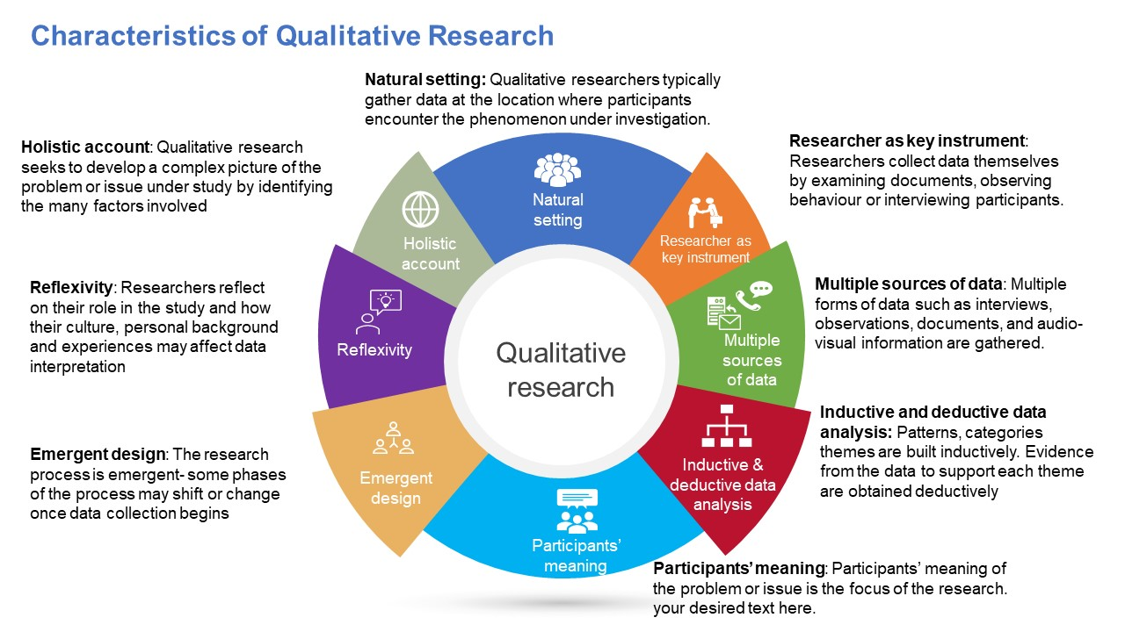
Figure: Characteristics of Qualitative Research by Bunmi Malau-Aduli and Faith Alele (https://jcu.pressbooks.pub/intro-res-methods-health/chapter/4-2-definitions-and-characteristics-of-qualitative-research/)

Slide 8
Qualitative Research Data Collection
Action Research: simultaneously investigating and solving an issue, seeks transformative change
Artistic Research (or Arts-Based Research): using artistic methods to express and understand something
Interviews: in-depth interactions between the research(s) and the participant(s) usually focused on experiences, perspectives, and opinions
Autoethnography: connecting the author’s personal experiences to wider political and societal phenomena, meanings and understanding
Case study Research: exploring in-depth a program, event, activity, process, or one or more participants
Internet Research: using internet-based resources and information

Slide 9
Qualitative Research Data Collection
Documentary Research: using official documents or personal documents as a source \
Ethnography: the description of peoples and cultures who interact over time
Focus Groups: the technique of using group interactions to collect data
Indigenous Research: Research in any field or discipline that is conducted by, grounded in or engaged with First Nations, Inuit, Métis or other Indigenous nations, communities, societies or individuals, and their wisdom, cultures, experiences or knowledge systems, as expressed in their dynamic forms, past and present. (https://research.ucalgary.ca/engage-research/indigenous-research-support-team/irst-resources/indigenous-research#:~:text=%E2%80%9CResearch%20in%20any%20field%20or,dynamic%20forms%2C%20past%20and%20present)
Narrative Research: includes life-story research, oral history, biography, personal experience methods, and narrative inquiry

Slide 10
Mixed Methods / Monimenetelmäisyys
“Mixed methods” usually refers to the research approach where the researchers collect and analyse both quantitative* and qualitative data within the same study.
Quantitative research gathers a range of numeric data and is used less frequently in the arts.
Surveys, is a common data collection methods in quantitative methodologies, where the researchers require their respondents to choose from pre-determined responses.

Slide 11
Artistic research
Research that defines art as its object in one way or another is generally called art research.
Art can, however, also offer a premise and an aim for research: a motive, a terrain, a context and a whole range of methods. This kind of research is often referred to as “artistic research”. It is not a counter concept of “scientific research”, but instead, its primary aim is to describe the framework of research in a way that does not simply reduce art to the subject matter of a study.
Artistic research is typically carried out by experts in various fields of art, i.e. artists – or artist-researchers, to be exact, because not all art is research. Artistic activities can be considered research only when they are done within a critical community.
https://www.uniarts.fi/en/general-info/what-is-artistic-research/

Slide 12
Taiteellinen tutkimus
Taide tutkimuskohteena, objektina
Taiteiden tutkimus tarkastelee taiteen eri osa-alueita, historiaa, tulkintoja ja merkityksiä sekä niiden suhdetta erilaisiin yhteiskunnan ja kulttuurin ilmiöihin. Taiteiden tutkimuksen opinnoissa syvennytään laaja-alaisesti taiteiden tutkimuksen historiaan, arjen ja populaarikulttuurin kysymyksiin, taiteellisten teosten analysointi- ja tulkintamenetelmiin sekä taidehallintoon. Suomalaisyliopistoissa taiteiden tutkimuksen piiriin kuuluvat muun muassa elokuva- ja televisiotutkimus, estetiikka, musiikkitiede, taidehistoria, teatteritiede ja yleinen kirjallisuustiede.
Tutkiminen taiteessa, taidetta tekemällä
Taiteellinen tutkimus on taiteellisen työskentelyn ja sen pohdinnan kontekstissa tehtävää tutkimusta. Se tarjoaa motiivin, maaston, kontekstin ja metodien kirjon tyypillisesti eri taiteen alojen osaajien eli taiteilijoiden käyttöön. Taiteellinen tutkimus ei ole tieteellisen tutkimuksen vastakäsite, vaan se kuvaa ennen kaikkea kriittisessä taideyhteisössä syntyviä tutkimusasetelmia.
(Koneen säätiö, uutiskirje 12.5.2022)

Slide 13
Terminological issues
Artistic research
Practise-based research
Practice-led research
https://cultureactioneurope.org/news/vienna-declaration-on-artistic-research/

Slide 14
Exercise
Go to Aaltodoc https://aaltodoc.aalto.fi/handle/123456789/23
Select a thesis and locate its method section (not always an easy task). Analyze the method section by considering the following questions.
How is the overall research design described? Does the thesis employ qualitative research, mixed methods, or artistic research? This section should provide clarity on the chosen approach and its rationale.

Slide 15
2. How were the data collected and analyzed in the thesis? Evaluate whether the methods for data collection and analysis are clearly outlined, allowing for potential replication of the study. Pay attention to details such as participant recruitment, data collection procedures, and analytical techniques utilized.
3. Is the method section clear and concise? Assess the clarity and conciseness of the method section by examining the language used and the level of detail provided. A well-written method section should be easily understandable and sufficiently detailed to convey the research process effectively.

Slide 16
Examples
Alaka, Akin. Finnish transnational film production: Collaboratives, production models and work culture (in English)
https://aaltodoc.aalto.fi/items/dac0326e-f8fc-415f-ac18-d64799b4749d
Ruuska, Jaakko. Elokuvan kolme ruumista (in Finnish)
https://aaltodoc.aalto.fi/items/fed3de97-0f0b-4efd-b4ea-07da9e8be3c7
Hislop, Jo. The Ungh, knowledge through emotional, sensorial and spatial forms of bodily being (in English)
https://aaltodoc.aalto.fi/items/f953e607-3f30-40dd-b98d-d932e1c7376f
Sorri, Salla. Autenttisuudesta elokuvassa (in Finnish)
https://aaltodoc.aalto.fi/server/api/core/bitstreams/cc686c64-c4b1-4949-a7ec-429c666556c7/content

Slide 17
Additional info
Timeline MA Thesis spring 2024
https://www.aalto.fi/en/programmes/masters-programme-in-art-and-media/thesis
Master’s thesis guide
https://mycourses.aalto.fi/pluginfile.php/1504906/mod_resource/content/2/Aalto%20ARTS%20Master%20Thesis%20Guide%202020%20v.2.pdf

