Slide 1
''Ours is a country without resources, except rocks and water. Having learned to survive and to cope with necessity gave birth to a culture of respect, of not wasting things, of looking for the best possible way to design. The presence of the mountains, of formerly wild nature, is a central element''
- Michael Jakob, maiseman historian ja teorian professori

Slide 2
Sveitsi
Identiteetti|minimalismi |luonto

Slide 3
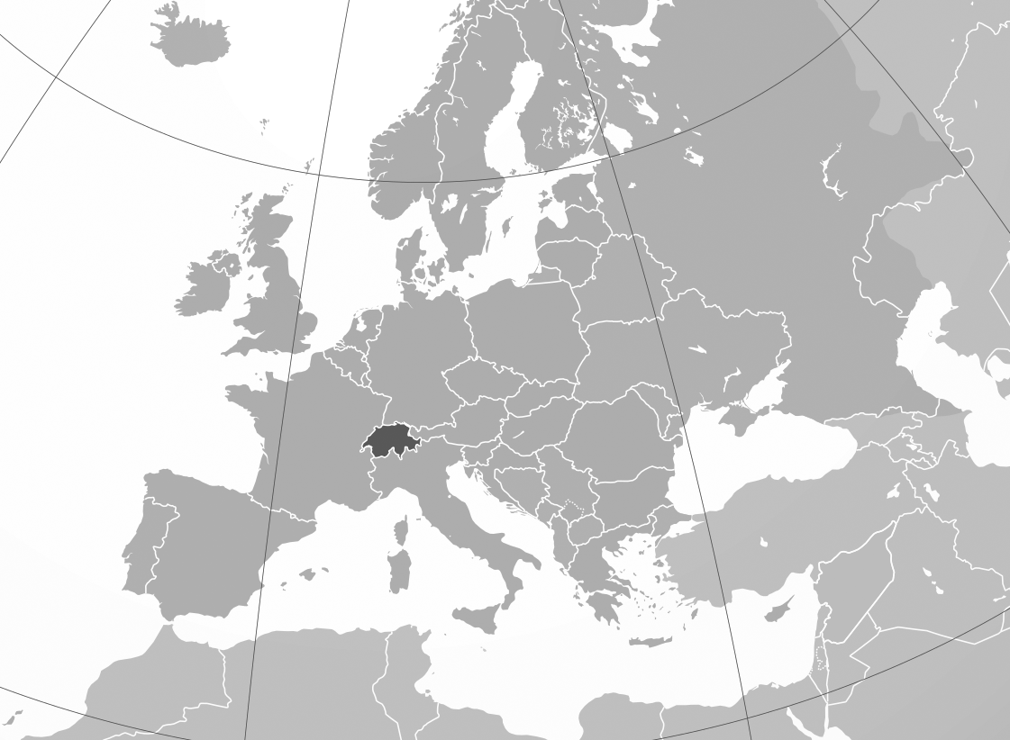
Pinta-ala: 41 285 km2 (Suomi yli 300 000 km2)
Väestö: 8,6 miljoonaa, josta pääosa asuu tasankoalueella. "Urban sprawl"
Neljä virallista kieltä: saksankielinen (63%), italiankielinen, ranskankielinen ja reto-romaani.
Zürich
Basel
Bern
Jura
Mittelland
Alpit
Geneve
Kuva: Europe-Switzerland.svg - Wikimedia Commons

Slide 5
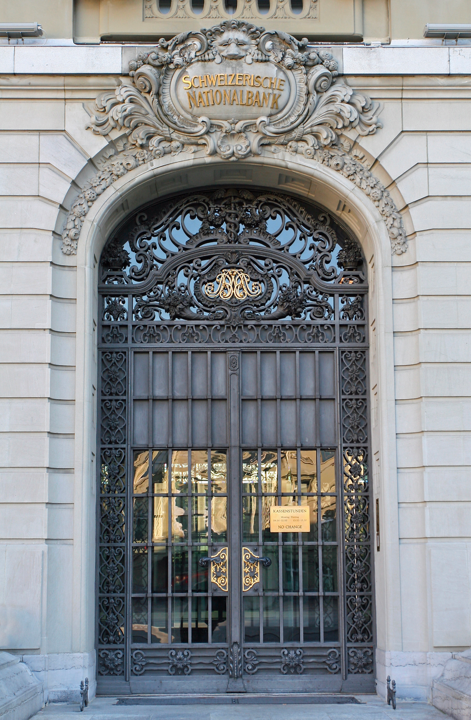
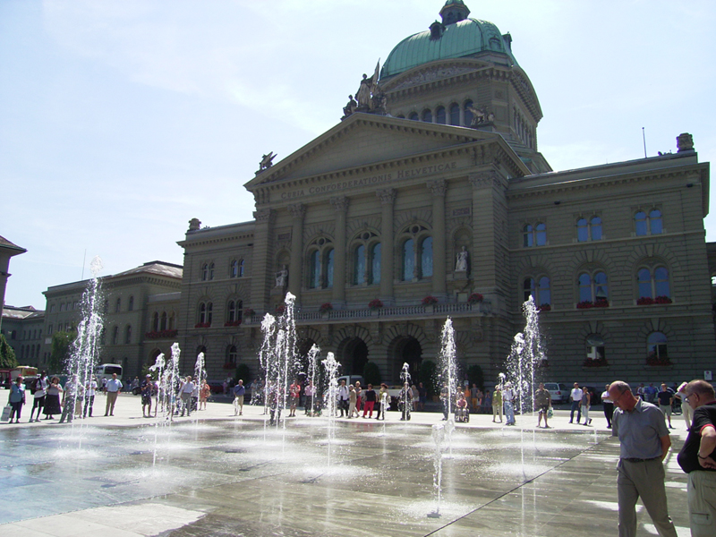
Wikimedia Commons
Wikimedia Commons
Sveitsin keskuspankki, Schweizerische-Nationalbank
1900-luku

Slide 6
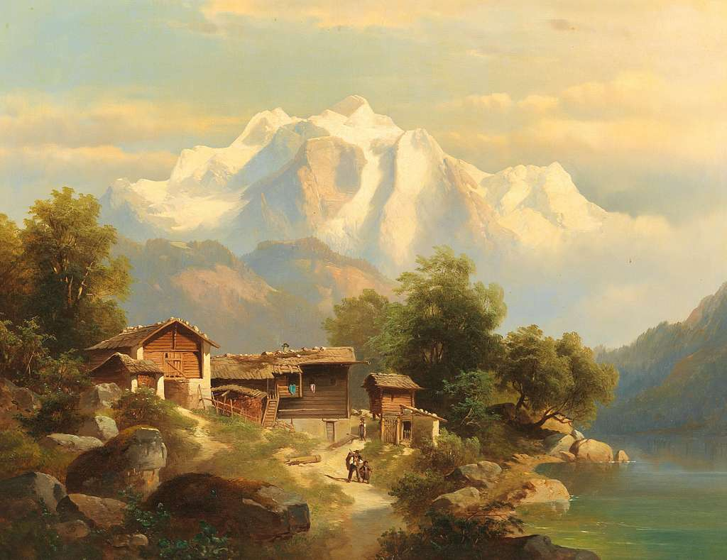
1900-luku

Slide 7
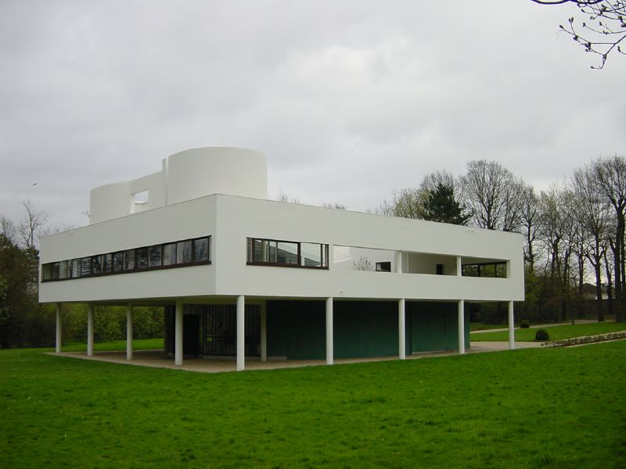
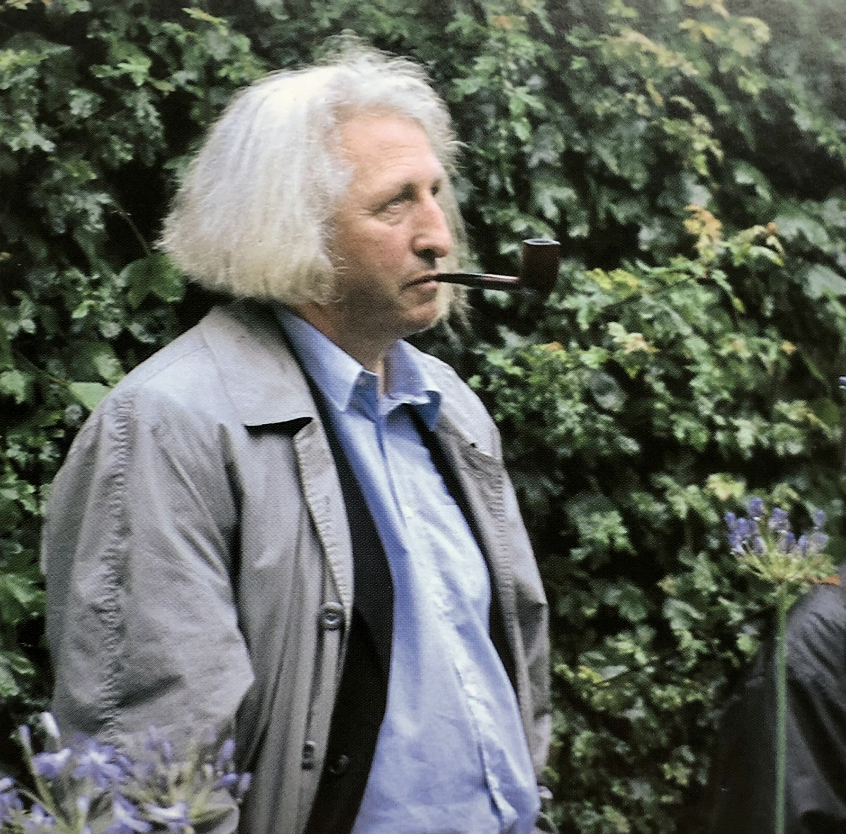
Arkkitehteja:
Le Corbusier (1887-1965)
Mario Botta (1943- )
Eduard Neuenschwander (1924-2013)
Maisema-arkkitehteja:
Gustav Ammann (1885–1955)
Ernst Cramer (1898-1980)
Walter Brugger (1924-2002)
Dieter Kienast (1945-1998)
Paolo Burgi (1947-)
Le Corbusier, Villa Savouye, (1928–30) kuva: Timothy Brown
Dieter Kienast
1900-luku

Slide 8
Ernst Cramer, Garten des Poeten (1959)
“the garden was not so much a garden as a sculpture to walk through”
(Kassler, 1964, Modern Gardens and the Landscape p. 57)
1900-luku
Wikimedia Commons

Slide 9
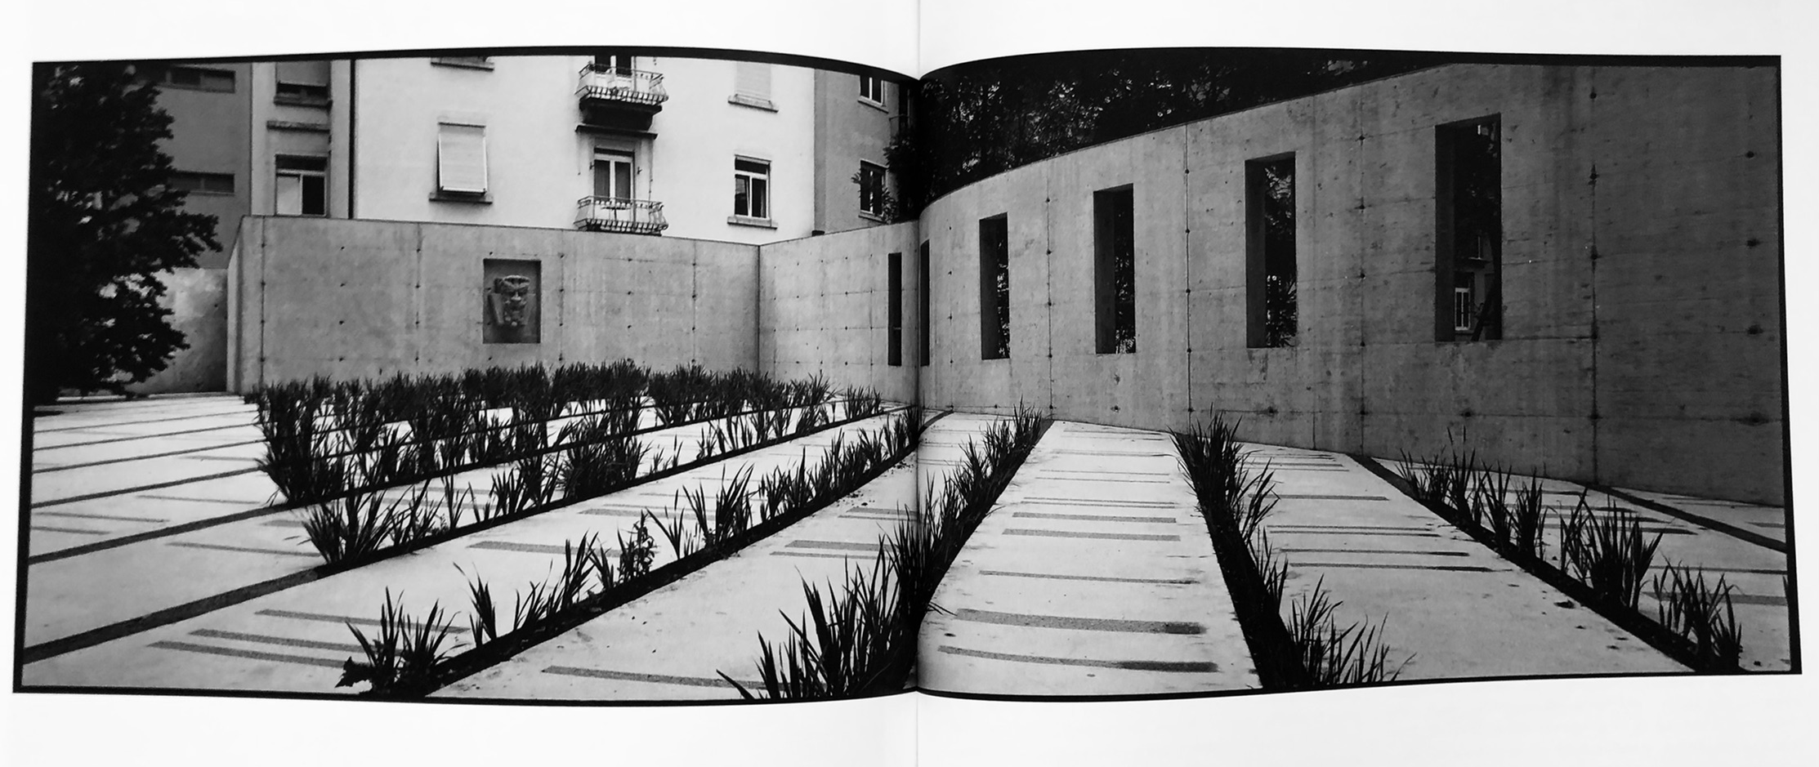
Dieter Kienast, Courtyard at the Reassurance Company Swiss Re in Zurich, (1994-1995) kuva: Christian Vogt
1900-luku

Slide 10
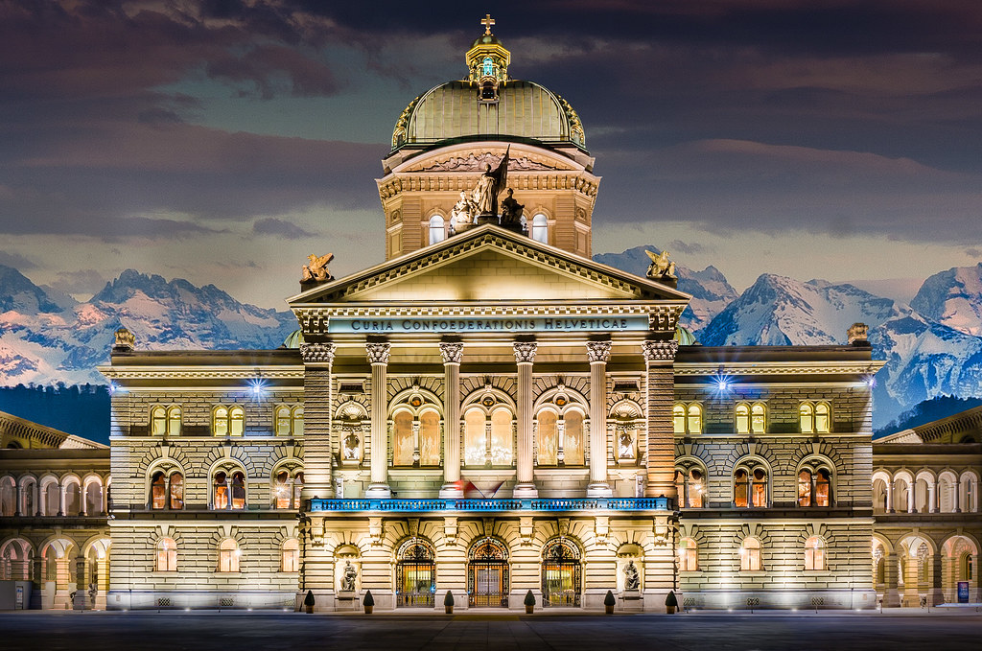
Swiss Landscape Concept (SLC), 2020)
Curia Confœderationis Helveticæ, Hans Wilhelm Auer 1902. Kuva: @baranco1 / flickr

Slide 11
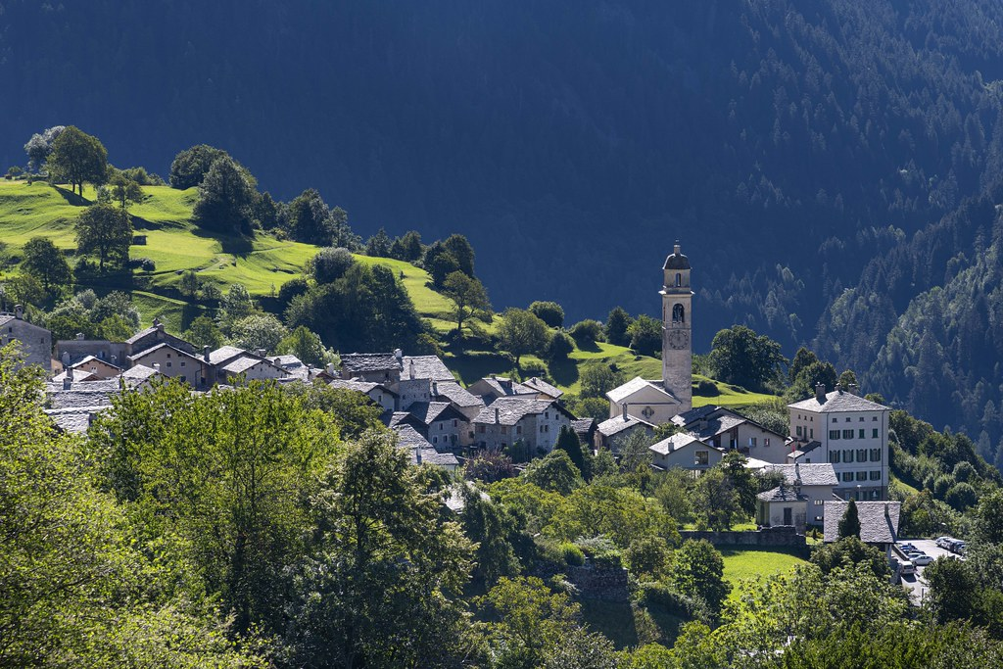
Soglio, Graubünden. Kuva: @kuhnmi / flickr

Slide 12
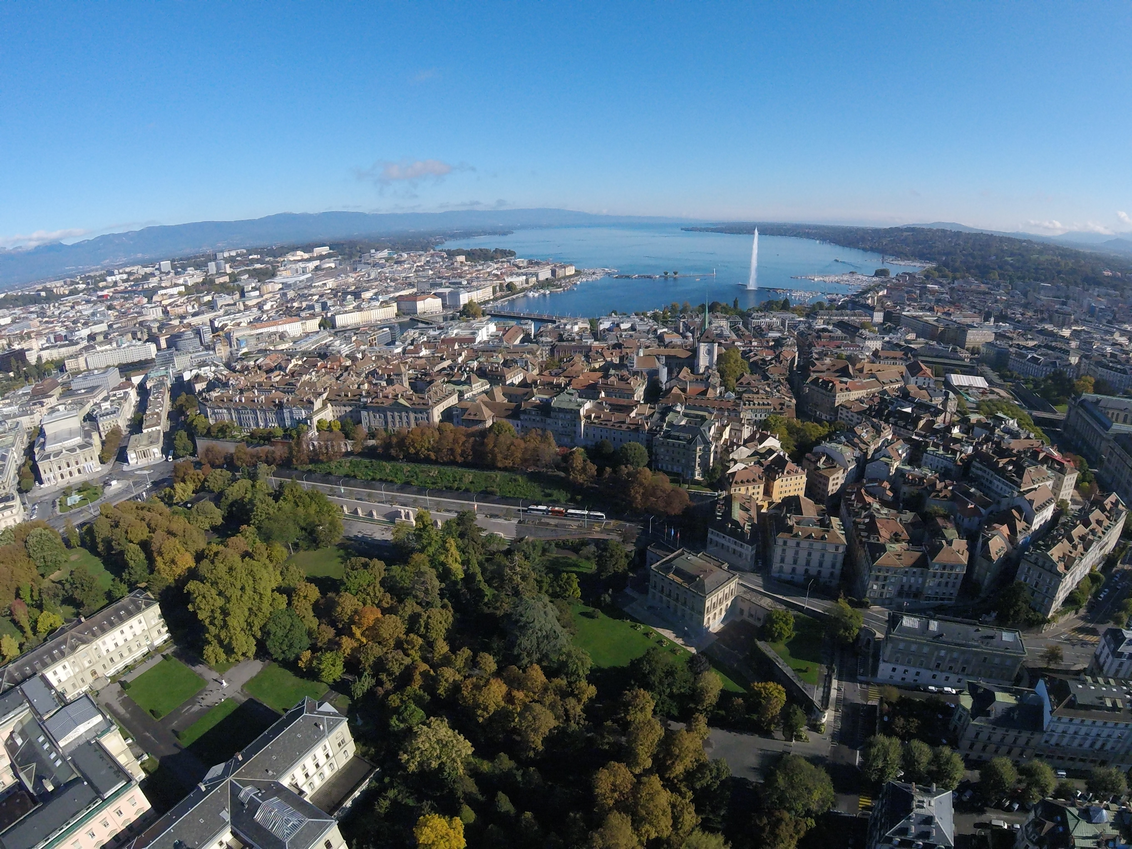
Genève Kuva: Alexey M., Wikimedia commons

Slide 13
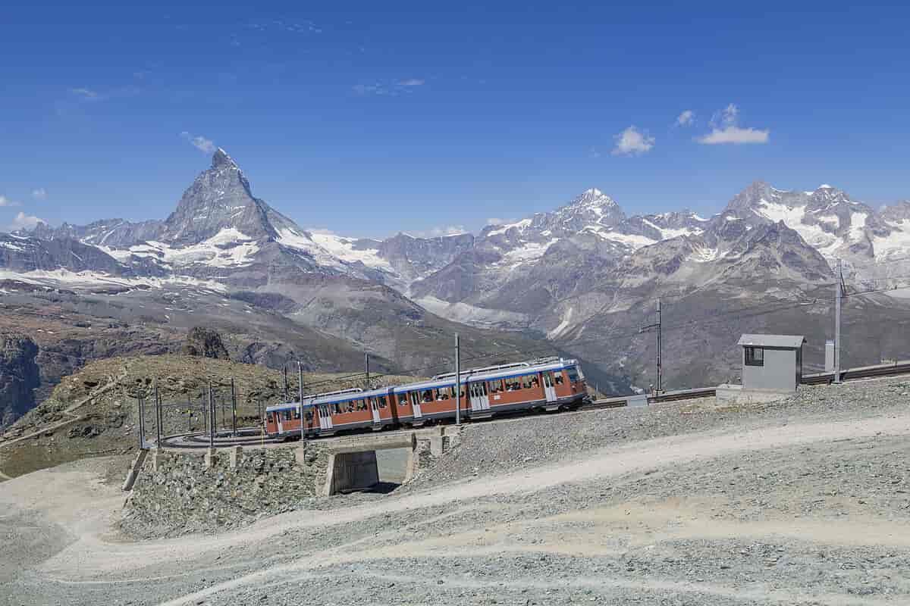
''There is, arguably, nothing more artificial than the Alps. In cities or lowlands, manmade things are clearly visible, but the barely visible—and sometimes invisible—system of mountains has been almost completely modified by humankind'' -M. Jakob
Zermatt, Valais. Kuva: Pascal Zingg. Creative Commons

Slide 14
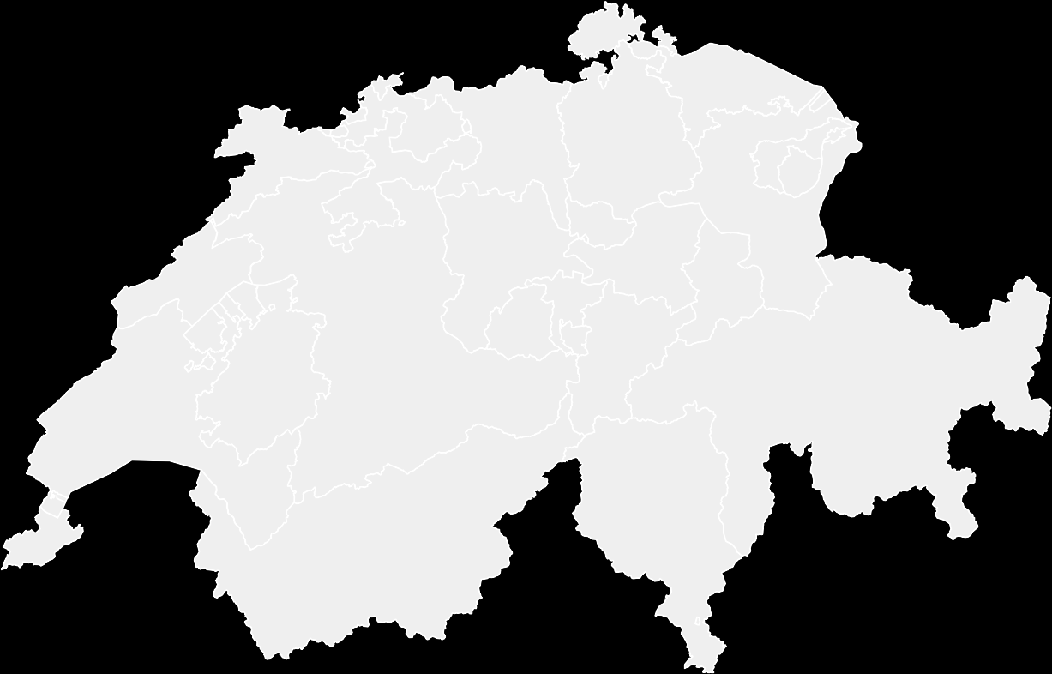
Aire-joen "ennallistaminen". Lully / Geneva

Slide 15
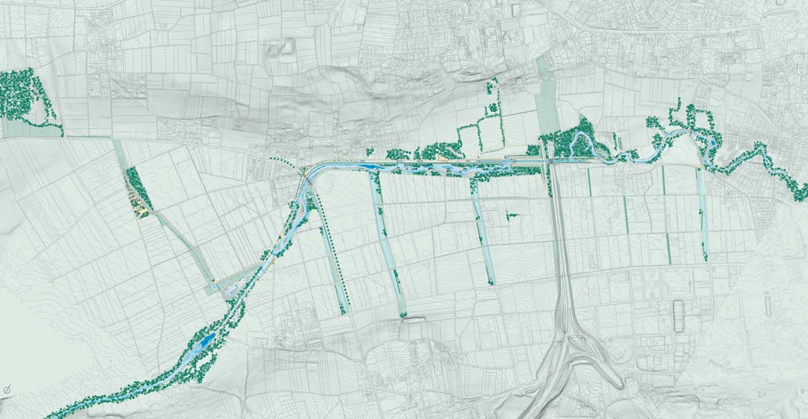
Aire-joen "ennallistaminen"
Kuva: Landscape architecture magazine 6/2019

Slide 16
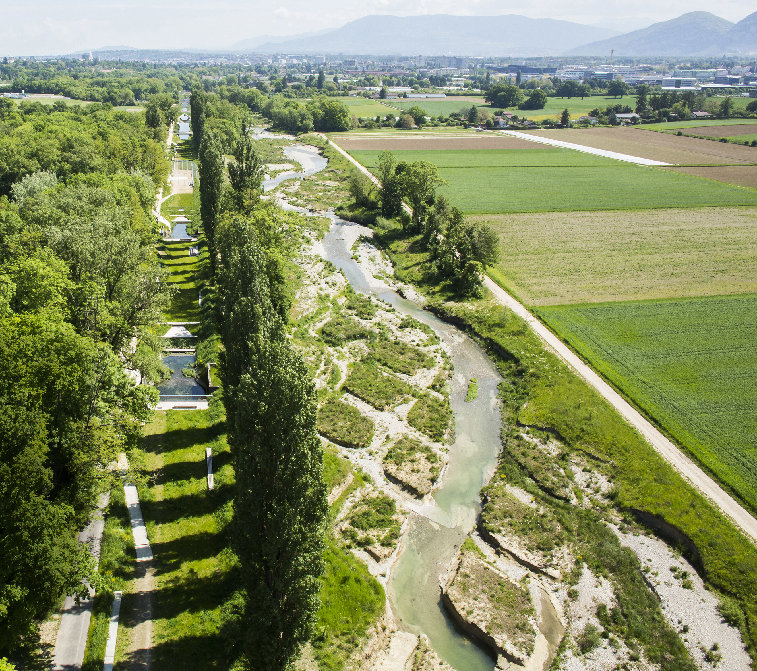
DESIGN TEAM
GROUP SUPERPOSITIONS:
ARCHITECTS GEORGES DESCOMBES AND ATELIER
DESCOMBES RAMPINI SA.
ENGINEERS B+C ENGINEERS,; ZSSA CIVIL ENGINEERS,
BIOLOGISTS BIOTEC APPLIED BIOLOGY SA
Aire-joen "ennallistaminen"

Slide 17
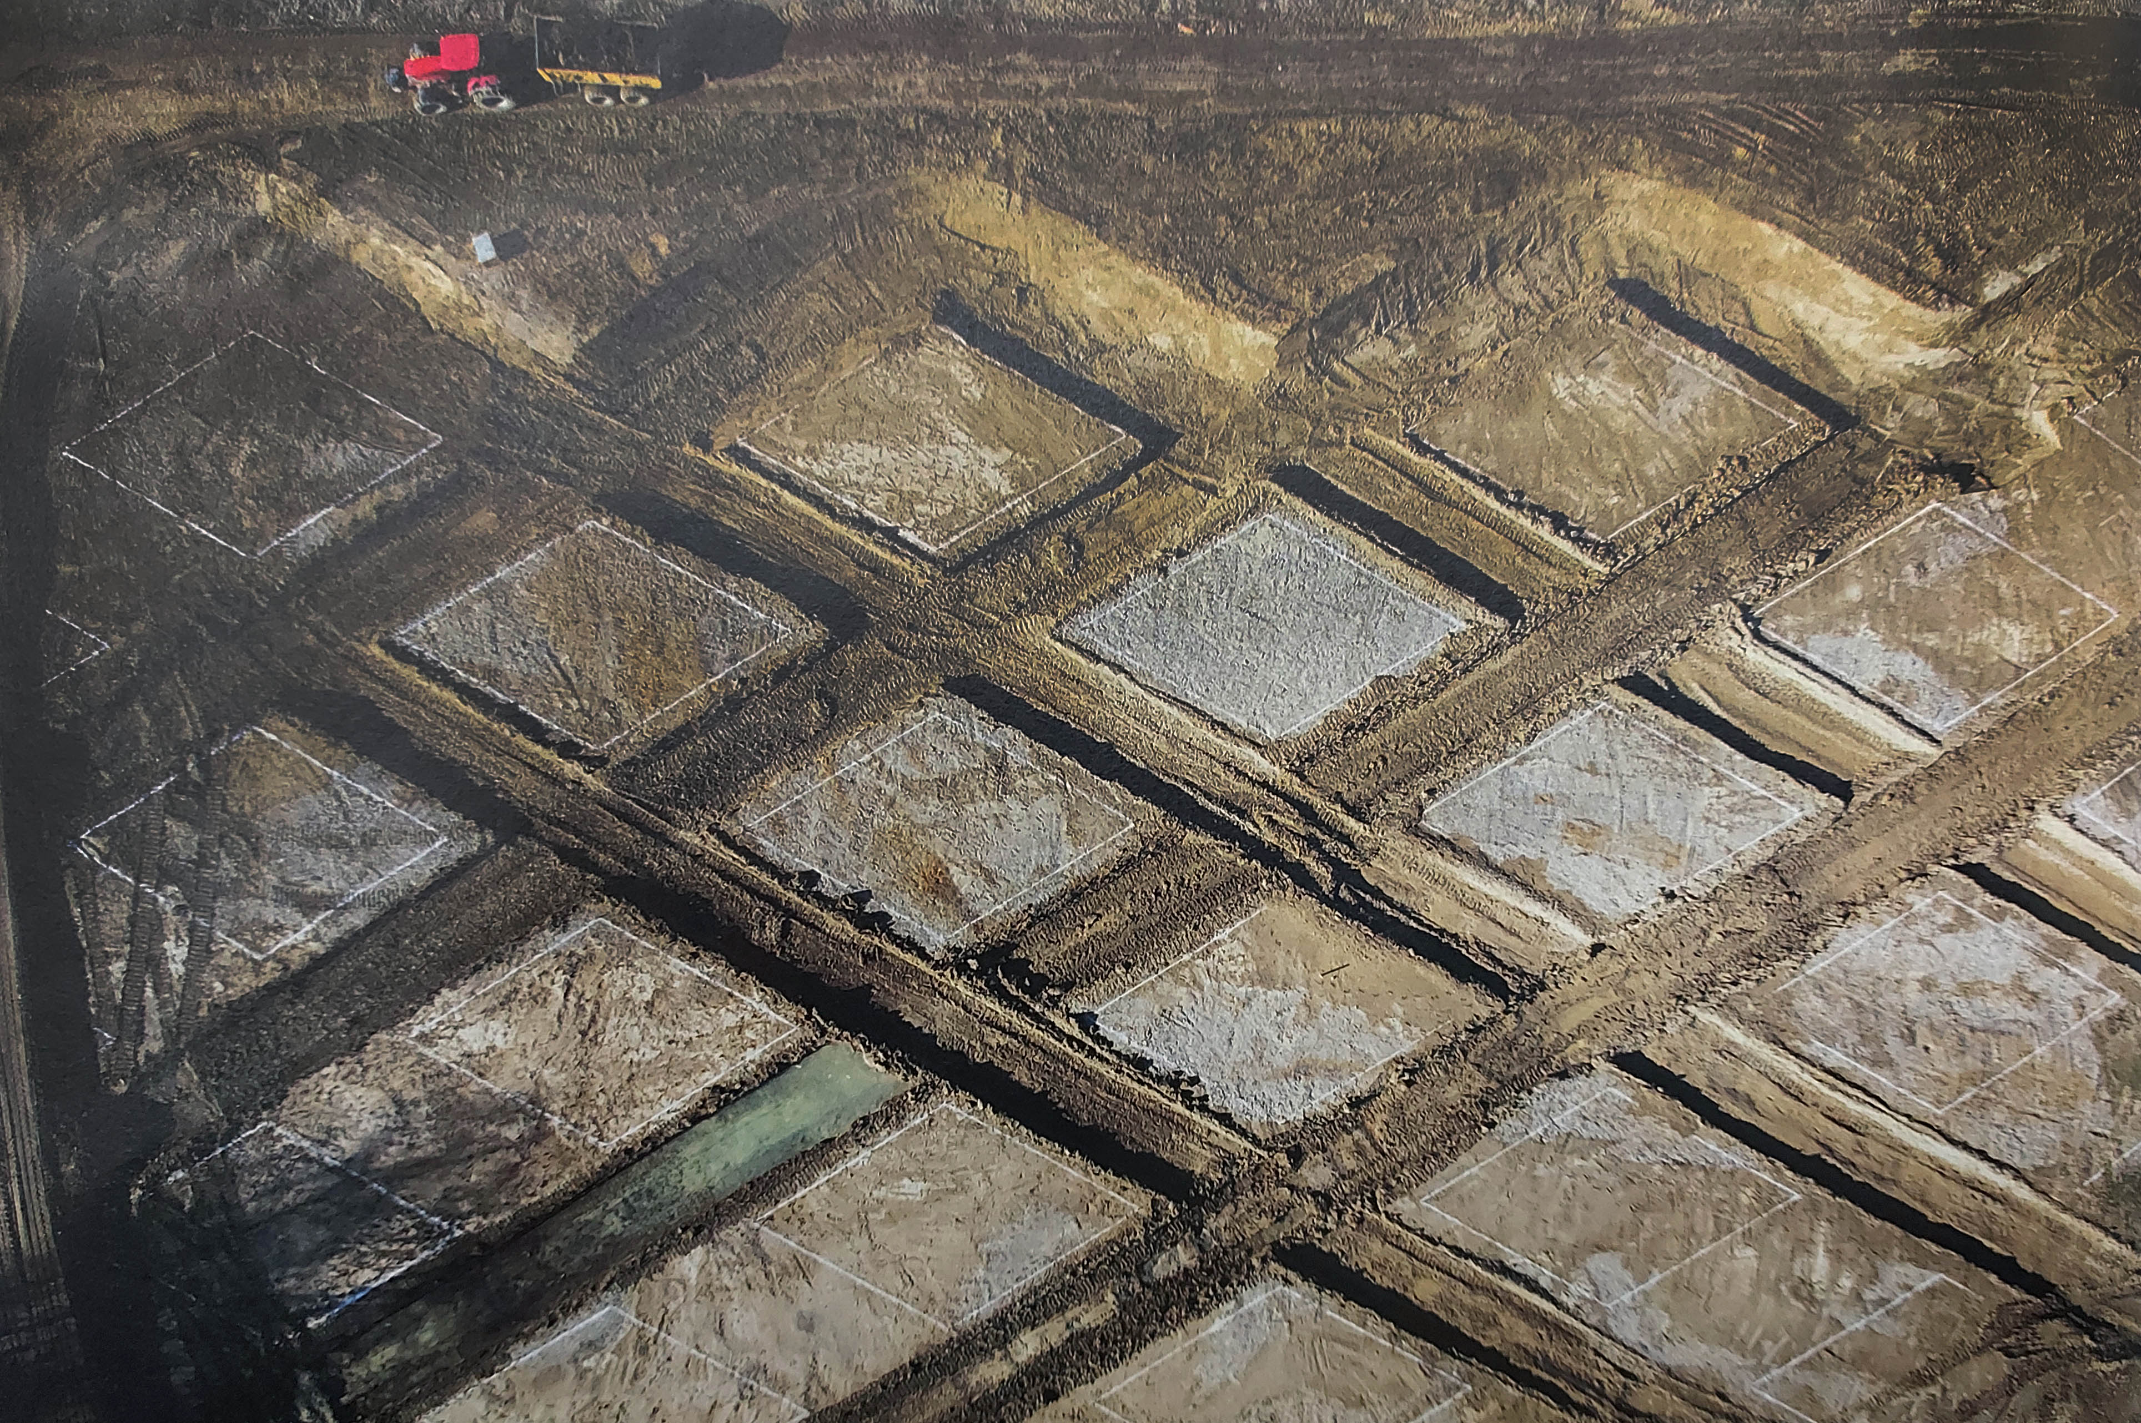
Aire-joen "ennallistaminen"
Kuva: Landscape architecture magazine 6/2019 ​

Slide 18
Cardada Obserrvation Platform. Studio Bürgi / Cardada
(Geological Observatory)

Slide 19
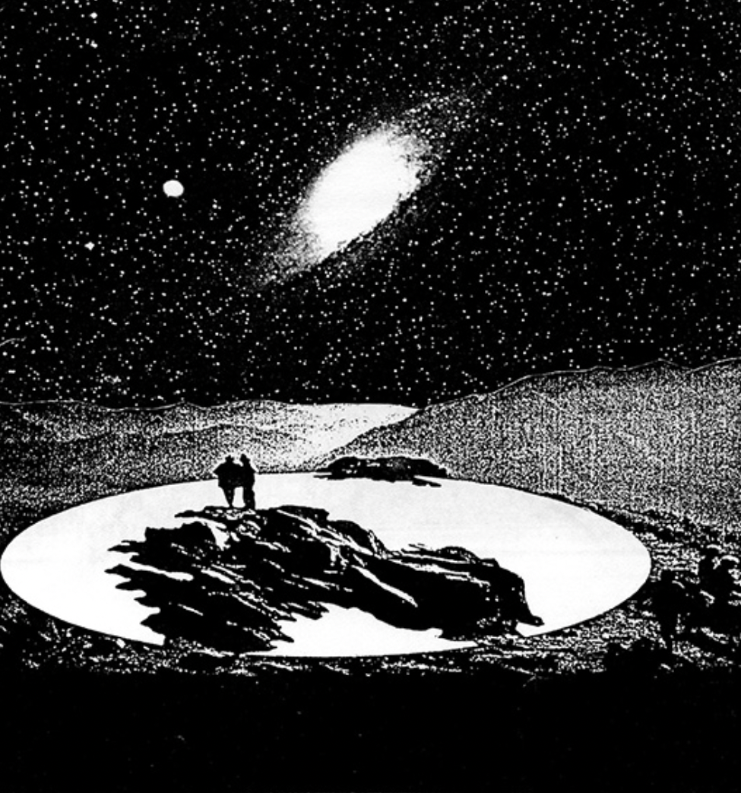
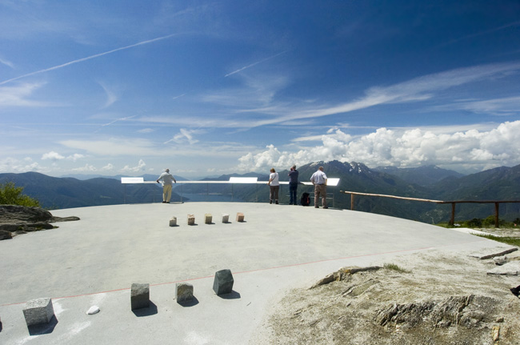
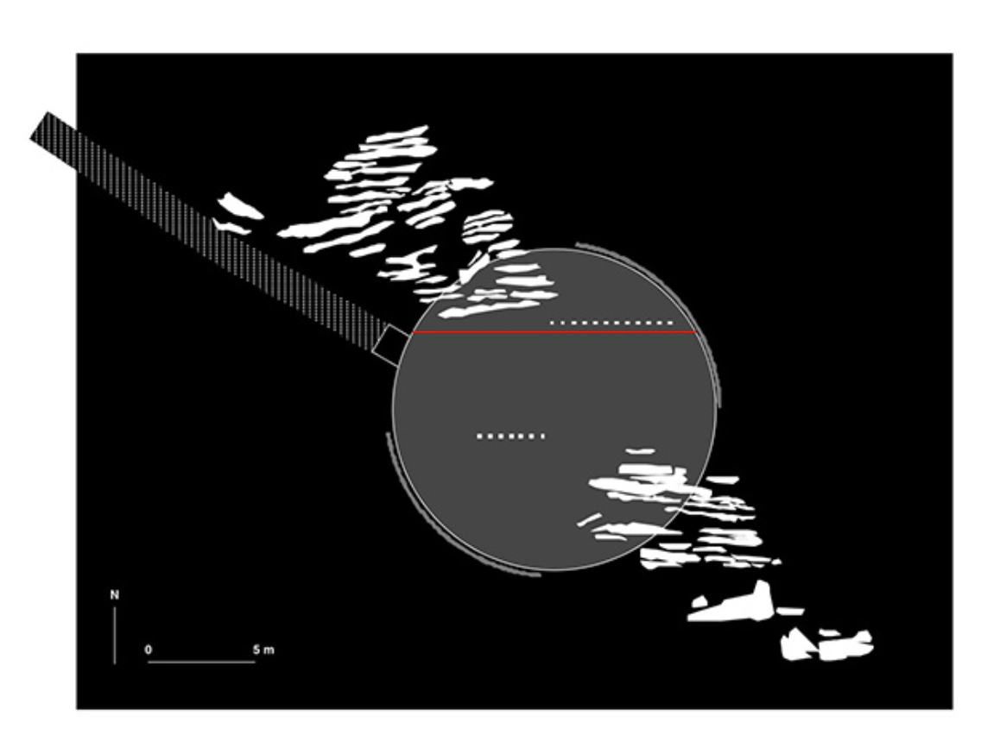
’’The platform rests on the mountaintop like the forgotten discus of some athletic Greek god…’’
Hugh Ryan toimittaja
Kuvat: Studio Bürgi

Slide 20
’’Oerliker Park’’. Grün Stadt Zürich / Zürich

Slide 21
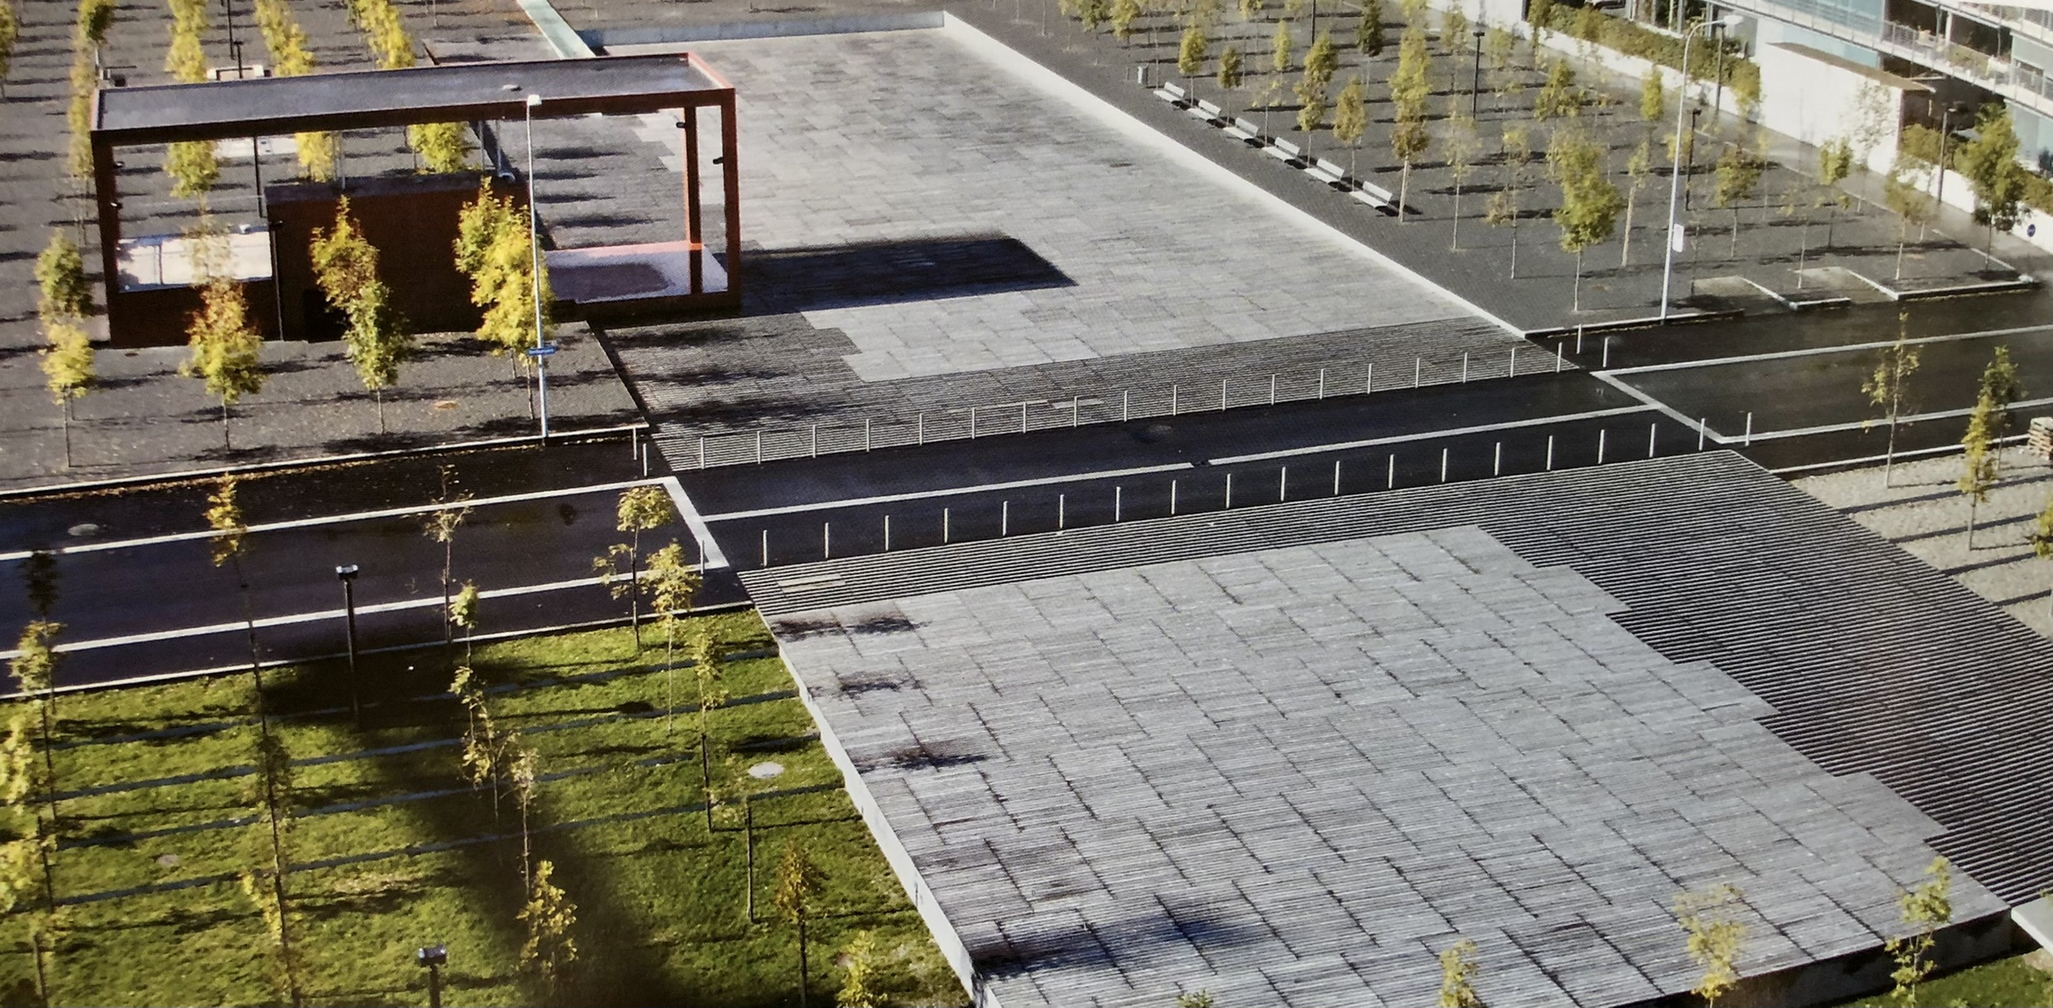
Kuva kirjasta: European Landscape Architecture
Oerliker Park, Zürich

Slide 22
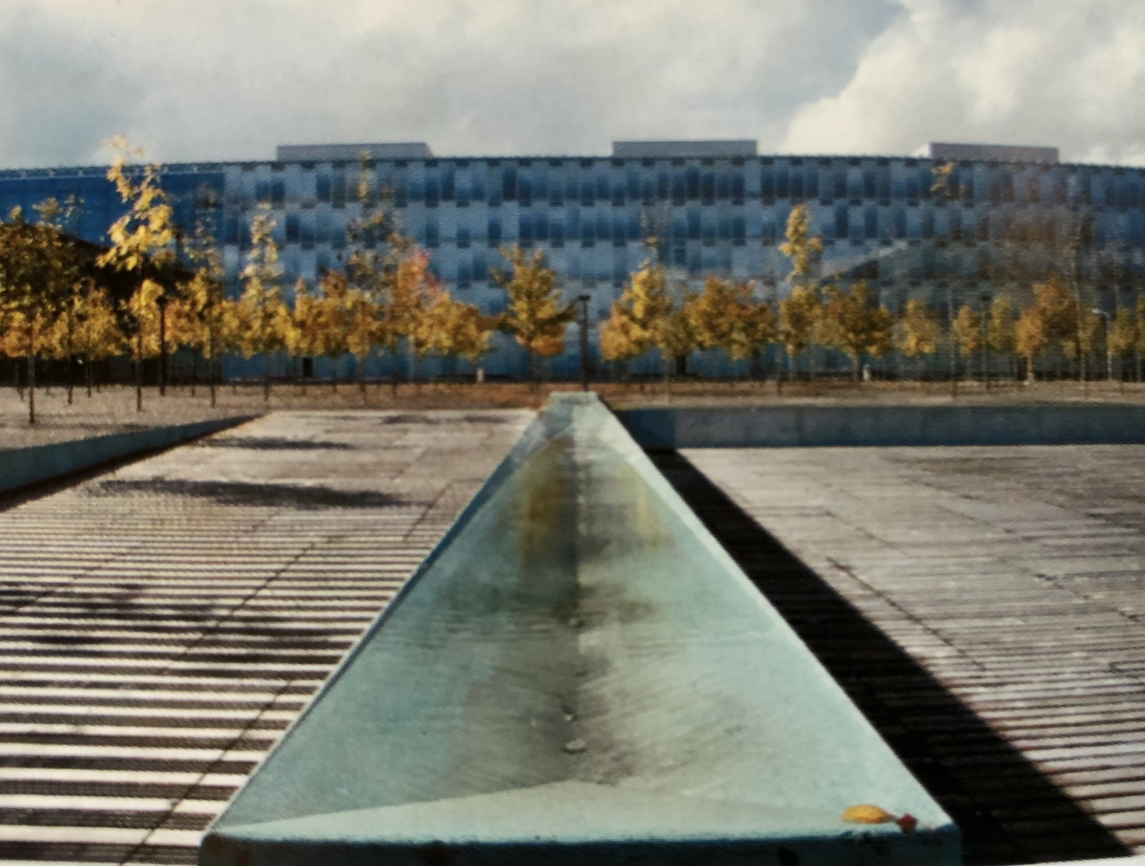
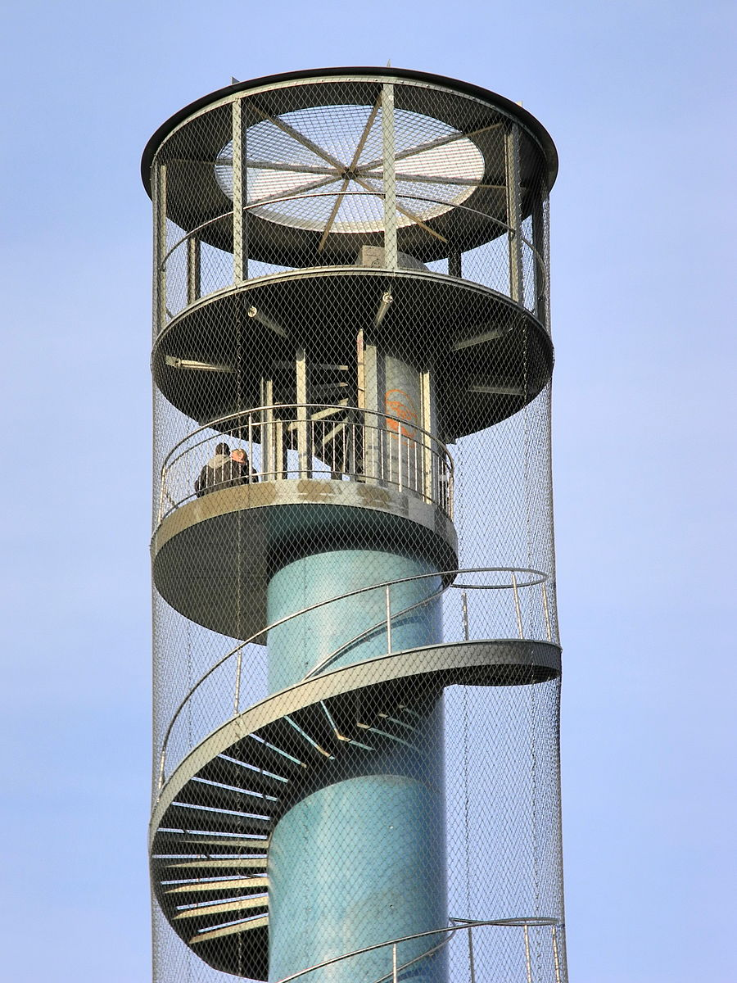
Wikimedia Commons
Wikimedia Commons
Kuva kirjasta: European Landscape Architecture
Oerliker Park, Zürich

Slide 23
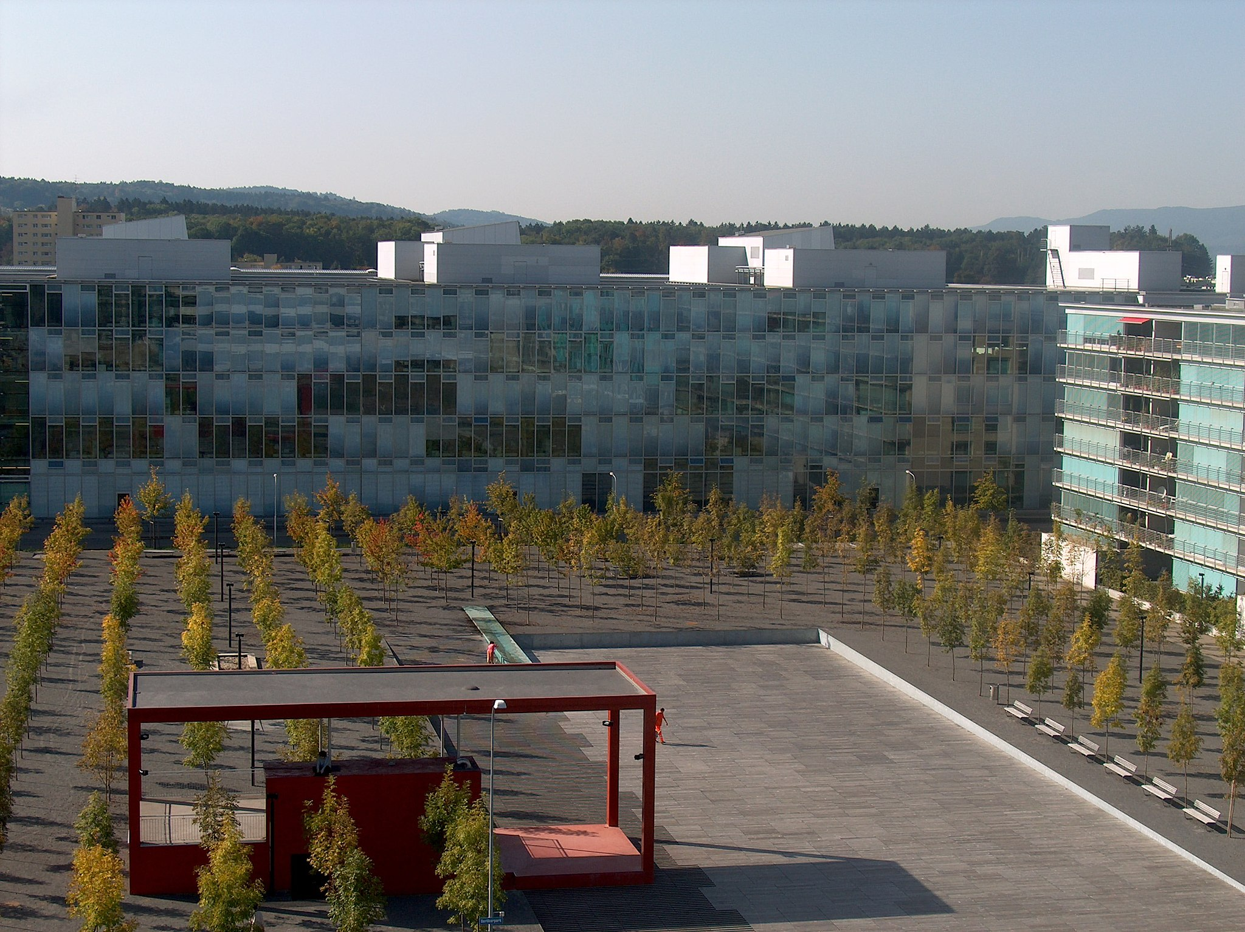
Oerliker Park, Zürich
Wikimedia Commons

Slide 24
’’Enea Baummuseum’’ / Enzo Enea 2010

Slide 25
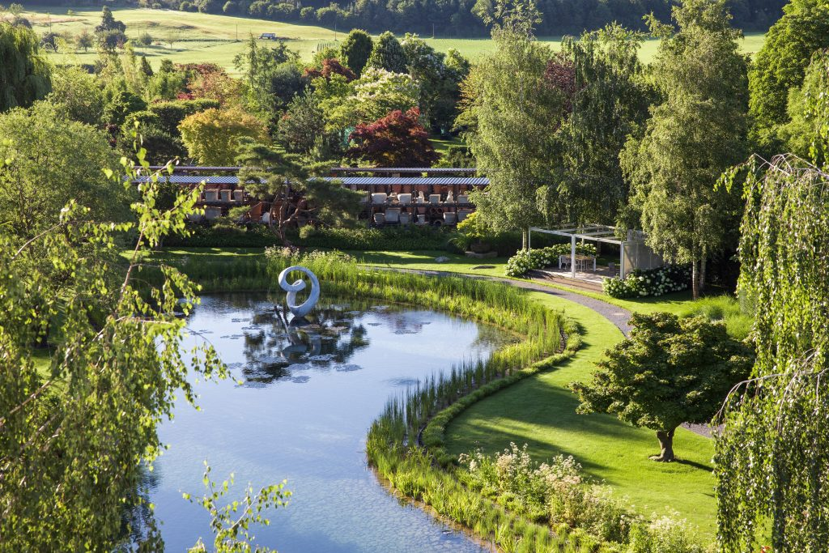
Kuva: Enea GmbH

Slide 26
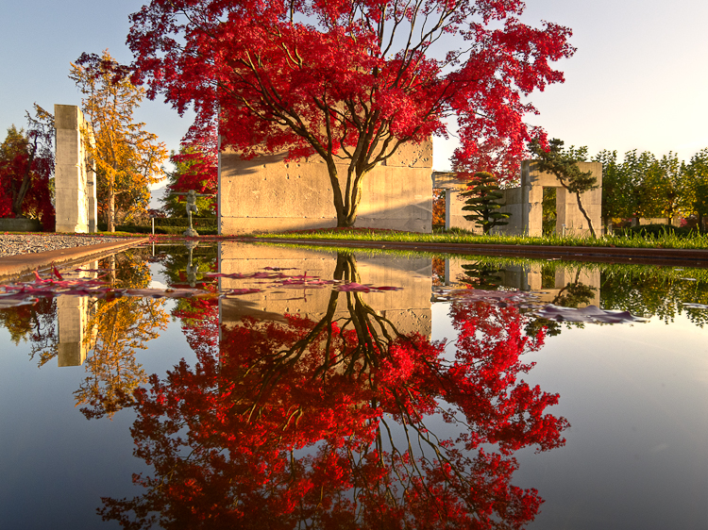
Kuva: Hans Loepfe, Wikimedia Commons

Slide 27
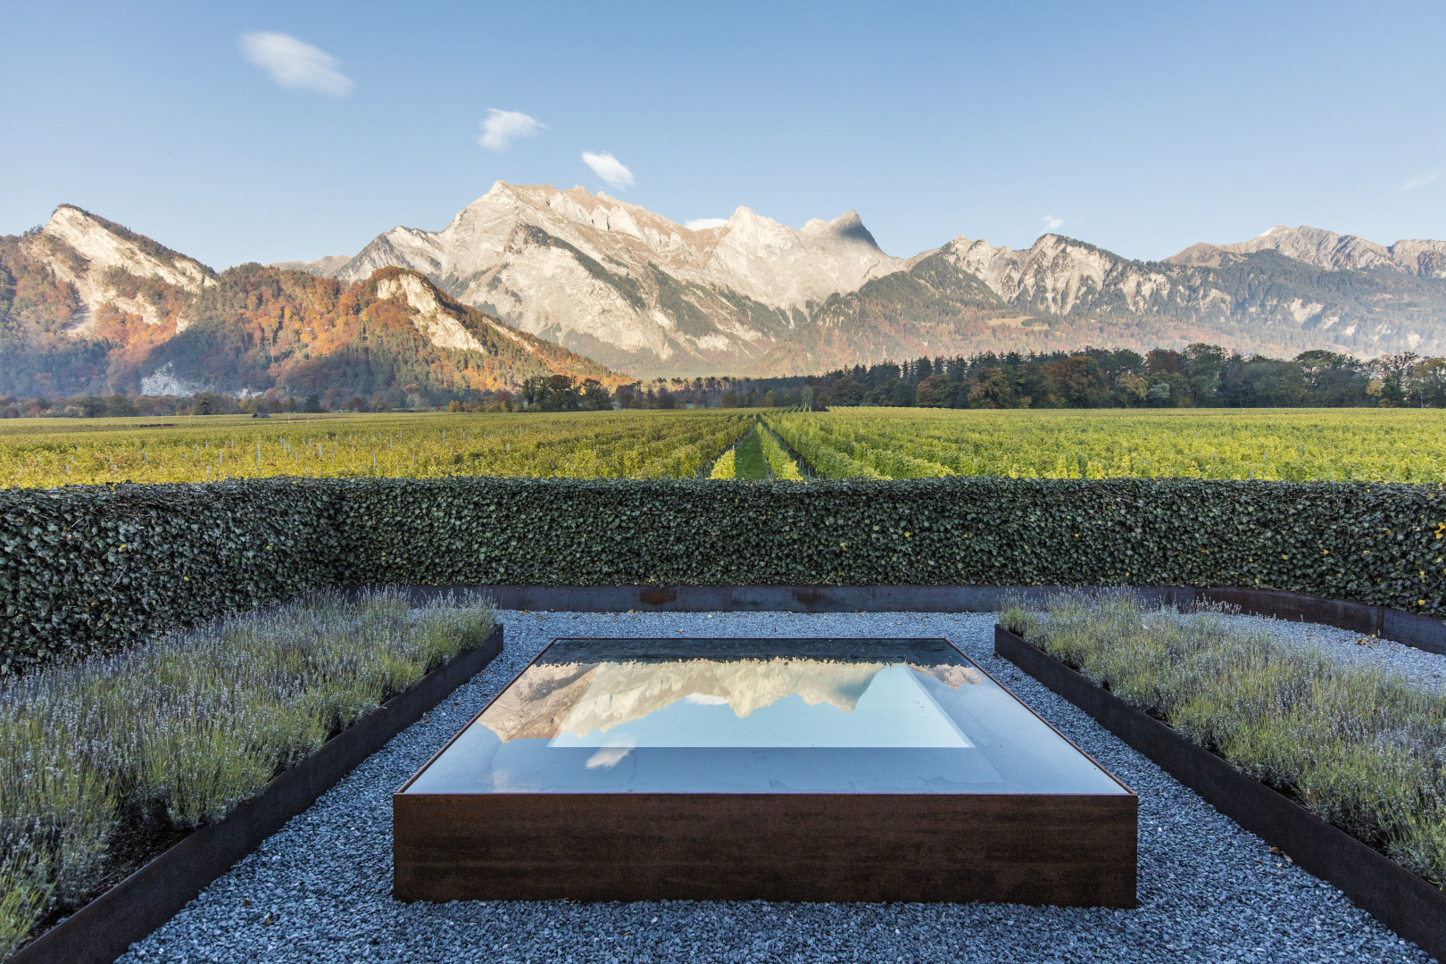
Fläsch Kuva: Enea GmbH

Slide 28
Lähteet:
Astbury, Jon. 2017. River Aire by Superpositions: ‘where the line between the natural and planned is blurred’. Architectural review. Viitattu 26.10.2022. https://www.architectural-review.com/buildings/river-aire-by-superpositions-where-the-line-between-the-natural-and-planned-is-blurred
LAE#3 'In Touch' essee: Art or Nature - A swiss debate. 2012. Claudia Moll
Viherympäristö 5/2009. S. 82 Hanna Keskinen
Dieter Kienast, julkaisija Basel : Birkäuser Verlag, 2004.
Girot, Christophe, and Dora Imhof. Thinking the Contemporary Landscape. Ed. Christophe Girot and Dora Imhof. New York: Princeton Architectural Press, 2017. Print. DIETER KIENAST AND THE TOPO- LOGICAL AND PHENOMENOLOGICAL DIMENSION OF LANDSCAPE ARCHITECTURE—Anette Freytag
Kaleva-artikkeli, Riitta Sarasti, 2005 https://www.kaleva.fi/sveitsin-vauraus-rakennettiin-maahanmuuttajien-avu/2006120 28.10.2022
Stadt Zurich: Oerliker Park https://www.stadt-zuerich.ch/ted/de/index/gsz/natur-erleben/park-und-gruenanlagen/parkanlagen-von-az/oerlikerpark.html 28.10.2022
IFLA Europe julkaisu. 2021. https://iflaeurope.eu/index.php/site/news-single/the-landscape-architecture-education-in-switzerland-celebrates-its-50th-anniversary 28.10.2022
https://www.eda.admin.ch/aboutswitzerland/en/home/wirtschaft/uebersicht/wirtschaft---fakten-und-zahlen.html 28.10.2022
Studio Bürgi. Reconsidering a mountain. http://www.burgi.ch/index.php/portfolio/reconsidering-a-mountain/

Slide 29
Lähteet:
The History of Higher Landscape Architecture Education at Eth Zurich, Switzerland. ByDunja Richter. 2022. https://www.taylorfrancis.com/chapters/edit/10.4324/9781003212645-28/history-higher-landscape-architecture-education-eth-zurich-switzerland-dunja-richter
Rosenberg, Elissa. Before and After. The revitalization of the Aire River, Switzerland. Landscape architecture magazine, june 2019, 126-133.
Wikipedia-artikkeli: Sveitsi https://fi.wikipedia.org/wiki/Sveitsi 28.10.2022
Wikipedia-artikkeli: Ernst Cramer https://de.wikipedia.org/wiki/Ernst_Cramer_(Gartenarchitekt) 28.10.2022
Wikipedia-artikkeli: DIeter Kienast https://de.wikipedia.org/wiki/Dieter_Kienast 28.10.2022
Wikipedia-artikkeli: Oerliker Park https://en.wikipedia.org/wiki/Oerliker_Park 28.10.2022
Wikipedia-artikkeli: Sveitsi. https://fi.wikipedia.org/wiki/Sveitsi. 30.10.2022
Wikipedia-artikkeli: Mittelland. https://fi.wikipedia.org/wiki/Sveitsia.org/wiki/Mittelland. 20.10.2022
Enea, Weingut https://www.enea.ch/project/weingut-davaz/
Enea, Enea Baummuseum https://www.enea.ch/baummuseum/
Federal Office for the Environment FOEN, 2020. Swiss Landscape Concept, landscape and nature in federal policy areas. https://www.bafu.admin.ch/bafu/en/home/topics/landscape/publications-studies/publications/swiss-landscape-concept.html
Shrabonti Bagchi, The times of India. ‘Understand the past to build the future’. https://timesofindia.indiatimes.com/city/bengaluru/understand-the-past-to-build-the-future/articleshow/30075865.cms
Michael Jakob. ‘On mountains’. http://www.transfer-arch.com/monograph/mountains/

Slide 30
Valokuvalähteet:
1900-luku:
Marc-Lautenbacher, CC BY-SA 4.0 <https://creativecommons.org/licenses/by-sa/4.0>, via Wikimedia Commons https://commons.wikimedia.org/wiki/File:PORTAL_Schweizerische-Nationalbank_Bern.jpg 28.10.2022
Chm, CC BY-SA 2.0 DE <https://creativecommons.org/licenses/by-sa/2.0/de/deed.en>, via Wikimedia Commons https://commons.wikimedia.org/wiki/File:Bundesplatz_2004.jpg 28.10.2022
Timothy Brown, CC BY 2.0 https://flic.kr/p/2G9aEs 28.10.2022
Dean, Martin R., Udo. Weilacher, and Thomas. Göbel-Gross. Dieter Kienast. Basel: Birkäuser Verlag, 2004. Print. S. 284, julkaisija. Valokuvat kirjassa: Christian Vogt
https://picryl.com/media/franz-barbarini-scene-in-switzerland-14a188
Ernst F. Cramer, CC BY-SA 3.0 <https://creativecommons.org/licenses/by-sa/3.0>, via Wikimedia Commons https://commons.wikimedia.org/wiki/File:Garten-des-Poeten.jpg 28.10.2022
Aukeama kirjasta Dieter Kienast, sivut 210-211, julkaisija Basel : Birkäuser Verlag, 2004. Kuva: Christian Vogt
Flickr-user @kuhnmi. https://www.flickr.com/photos/31176607@N05/50350082437/in/photostream/
Hans Loepfe CC SA 2.5 https://www.halo-photographs.com/2011-Baummuseum-Enea/content/G12_001876_7_8.html
Flickr-user @baranco1 CC BY-SA 2.0 https://www.flickr.com/photos/59159233@N04/14190334461
Studio Bürgi http://www.burgi.ch/index.php/portfolio/reconsidering-a-mountain/
Pascal Zingg, CC BY-NC-SA 2.0 https://snl.no/Zermatt
Enea, Weingut https://www.enea.ch/project/weingut-davaz/
Enea, Enea Baummuseum https://www.enea.ch/baummuseum/

Slide 31
Valokuvalähteet:
Oerliker Park:
Zöch, Peter., and Gesa Loschwitz-Himmel. Europäische Landschaftsarchitektur : ausgewählte Projekte von 2000 bis heute = European landscape architecture : squares, parks and promenades: recent projects. München: Callwey, 2005. Print. S. 82
Grün Stadt Zürich, CC BY-SA 3.0 <https://creativecommons.org/licenses/by-sa/3.0>, via Wikimedia Commons https://commons.wikimedia.org/wiki/File:Oerliker-park-ost-west.JPG 28.10.2022
Grün Stadt Zürich, CC BY-SA 3.0 <https://creativecommons.org/licenses/by-sa/3.0>, via Wikimedia Commons https://commons.wikimedia.org/wiki/File:%27Blauer_Turm%27_im_Oerlikerpark_in_Z%C3%BCrich_2012-04-18_19-14-24_(P7000).JPG 28.10.2022
Grün Stadt Zürich, CC BY-SA 3.0 <https://creativecommons.org/licenses/by-sa/3.0>, via Wikimedia Commons https://commons.wikimedia.org/wiki/File:Blick-vom-turm_oerliker-park.JPG 28.10.2022

