Slide 2
ENFORCEMENT
Notes:
Quote from in Google v. Spain at 31
(2013)

Slide 3
Introduction

Slide 4
Agenda
Repetition
What is the point of enforcement?
Enforcement classic
Enforcement alternative ways
Discussion: We need more funding

Slide 5
Learning objective (= you should know this after the lecture)
Why enforcement is essential? (+ 4 modalities from Lessig)
Is it different with information law?
Classical enforcement - be able to name some cases; critizise effectiveness
Alternative ways of enforcement (covering also activists), discuss pro/con

Slide 6
repetition

Slide 7
Activity

Slide 8
Let's turn the tables
You have 5 min.
Come up with 3 questions about last lecture- put those on a piece of paper and we will collect them.

Slide 9
Introduction to Enforcement

Slide 10
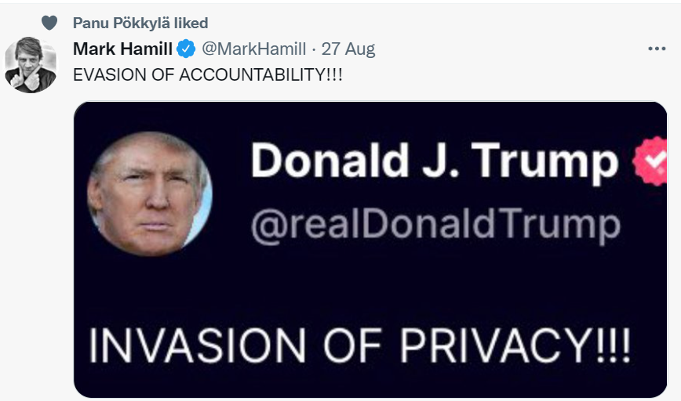

Slide 11
Activity

Slide 12
How could we enforce rules? Why do you follow rules?
Think about different methods.
Here is an example that might help:
Let's suppose we want to stop people from smoking, how do we do this?

Slide 13
Enforcement is essential to understand any area of law
Law is all about binding rules
Enforcement is here understood in the widest possible way: How do we achieve behavioral changes through rules?
Lessig: four modalities of regulation
Law, societal norms, architecture and markets
Enforcement might lead to development of the law (➔ example of cases?)
Notes:
Note: we focus on Privacy

Slide 14
How we are going to address this in DP?
Who is enforcing?
Data Protection Authorities
Individuals
Third-party watch dogs

Slide 15
Administrative = via DPA

Slide 16
The administrative approach
Under GDPR all Member States must have DPAs (different names: ICP, ICO, Ombudsman)
Often prompted by compliants by citizens; but also own initiative
Often cheaper and faster than the judicial option
Very flexible
Reviews of decisions often end up going to courts
See, e.g., GDPR, art. 77, 83

Slide 17
Enforcement under the GDPR
10 Mio or up to 2 % of the total worldwide annual turnover of the preceding financial year
Most obligations of controllers and processors
For example: privacy by default (25), records (30), data breaches notification (33)
20 Mio or up to 4 % of the total worldwide annual turnover of the preceding financial year
Conditions for consent and other conditions for processing (5, 6,7,9)
Data subject rights (12-22)
Transfer of data (44-49)
Non-compliances with orders from a DPA for stopping data flows (58)

Slide 18
Activity

Slide 19
Individual work
Let's assume there was a violation of data protection law.
Please come up with criteria why the fine should be higher/lower than usual.

Slide 20
Enforcement under the GDPR – Criteria for fines (1)
(a) the nature, gravity and duration of the infringement taking into account the nature scope or purpose of the processing concerned as well as the number of data subjects affected and the level of damage suffered by them;
(b) the intentional or negligent character of the infringement;
(c) any action taken by the controller or processor to mitigate the damage suffered by data subjects;
(d) the degree of responsibility of the controller or processor taking into account technical and organisational measures implemented by them pursuant to Articles 25 and 32;
(e) any relevant previous infringements by the controller or processor;

Slide 21
Enforcement under the GDPR – Criteria for fines (1)
(f) the degree of cooperation with the supervisory authority, in order to remedy the infringement and mitigate the possible adverse effects of the infringement;
(g) the categories of personal data affected by the infringement;
(h) the manner in which the infringement became known to the supervisory authority, in particular whether, and if so to what extent, the controller or processor notified the infringement;
(i) where measures referred to in Article 58(2) have previously been ordered against the controller or processor concerned with regard to the same subject-matter, compliance with those measures;
(j) adherence to approved codes of conduct pursuant to Article 40 or approved certification mechanisms pursuant to Article 42; and
(k) any other aggravating or mitigating factor applicable to the circumstances of the case, such as financial benefits gained, or losses avoided, directly or indirectly, from the infringement

Slide 22
Often DPAs are in the news, as they can issue fines
Enforcement tracker
GDPR Hub

Slide 23
Highest fines imposed for GDPR infringement
In Europe
In Finland
1.2 billion euros
Meta Platforms Ireland Limited
Imposed in April 2023
Issued by Ireland’s Data Protection Commission
750 000 euros
Alektum (a debt collection agency)
Imposed in January 2023

Slide 24
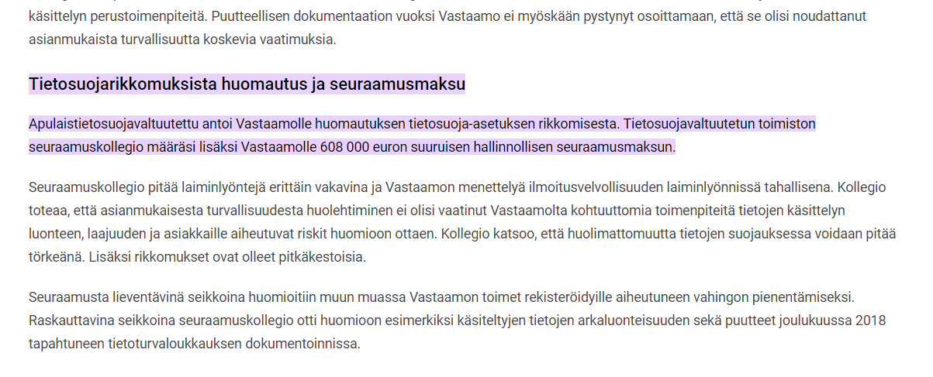
Another high fine 746 million
Amazon: On July 2021, Luxembourg National Commission for DP issued as decision, claiming that Amazon Europe did not comply with the GDPR 746 million Euro.
Net profit in 2020: 21.331 million US turnover closer to 350 million US
From net profit, this about 3 % (i.e. AMAZON would have to work about 10 days for this).

Slide 25
Some numbers
Google
In January 2019, the CNIL fined Google €50 million (about $57.26 million)
Google’s total revenues from 2019 was (more or less) $161,857 million
The fine was about 0.035% of Google’s revenue. To put it another way, Google’s revenue was about 2,829.7 times higher than the fine
Facebook
In July 2019, the FTC fined Facebook $5 billion
Facebook’s total revenue for 2019 was (more or less) $70.7 billion
The fine was about 7% of Facebook’s revenue. To put it another way, Facebook’s revenue was about 14 times larger than the fine

Slide 26
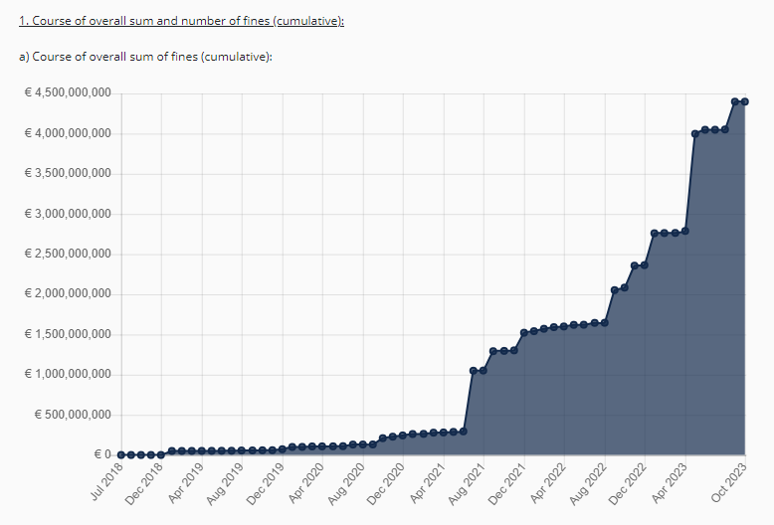
Over 2 billion in cumulative fines so far
That is about 2x of what is was a year ago!
Notes:
(note: double from last year! 2022=

Slide 27
Over 4 billion in cumulative fines so far
Highest fine per country
Total number of fines

Slide 28
What else could data protection authorities do? (see: 57)
Consent agreement
Usually mandatory audits for x years
Usually agreement to cease doing something.
Start criminal proceedings
Raise objections
Conduct investigations
Forbid certain processings

Slide 29
Criminal enforcement (RL)
Secrets
Violation of business secrets (Ch. 30, Sec.5)
Dissemination of private information (Ch. 24, Sec. 9)
Breaking professional secrecy (Ch. 40, Sec 5)
Official leak secrets (Ch. 38, Sec. 1)
Communication invasion
Eaveesdroping (e.g. Ch.24, Sec. 5 )
Message interception (Ch. 38, Sec. 3)
Hacking and etc.
Interference in a computer system (Ch. 38, Sec. 7a)
Endangerment of data processing (Ch. 34, Sec.9a)
Other
Crimes against national security (e.g. Ch. 12, Sec. 7)
Invasion of privacy (e.g. Ch.24, Sec. 1)
Data protection offence (e.g. export of data) (Ch. 38, Sec. 9)

Slide 30
Individuals

Slide 31
What can individuals do?
Direct actions
Using third parties
Art. 77: DPAs
Art. 80: NGOs
Controllers/processors (Art. 79 + 82)
Against DPAs (Art. 78)
Notes:
Solove

Slide 32
Activity

Slide 33
Should you be able to get compensation for non-material damage?

Slide 34
Case
Student L (inspired by a course on data protection law) discovers a lot of problems with processing of start-up company S. S uses a cloud service provider C.
Among others, there was no privacy policy on S‘s website and L‘s personal data hosted by C for S has been lost due to a criminal attack on the servers of C, which have not been properly secured.
When L asks for compensation, S says:
L cannot get compensation as there was no damage, just a few log data were publically available, not real personal data
L cannot get compensation from S, as it was all C‘s fault
Notes:
Solove

Slide 35
Case Summary Google v. Vidal (2015)
FACTS/PROCEEDING
Google allegedly circumvented privacy settings in the Safari browser (settled with FTC)
Google collected information about the Claimant’s internet usage, in particular BGI, i.e. Browser generated information
QUESTION
For what harm can you claim damages?
Google v. Vidal-Hall [2015] EWCA Civ 311 [Damage for distress?]
Notes:

Google v. Vidal-Hall [2015] EWCA Civ 311 is a case involving a dispute between Google and a group of individuals who claimed that Google had unlawfully collected and used their personal data without their consent. The case centers around the interpretation of the Data Protection Act 1998 and the European Union Directive on Data Protection. The claimants alleged that Google had bypassed the privacy settings on Apple's Safari browser to track and collect their personal data, including information relating to their online activities. Google argued that the claimants had not suffered any significant damage and therefore could not bring a claim for compensation. They contended that emotional distress alone did not constitute "damage" under the Data Protection Act. The Court of Appeal, however, ruled in favor of the claimants, holding that compensation for distress alone was sufficient to establish "damage" under the Act. The court acknowledged that the misuse of personal data could cause significant distress and harm to individuals, even if there was no financial loss involved. The decision expanded the scope for individuals to bring claims against organizations for data breaches and privacy violations. Furthermore, the court also ruled that the claimants could pursue their claims in the English courts, even though Google is headquartered in the United States. The court determined that Google's activities in the UK were sufficient to establish jurisdiction and that it would be in the interests of justice for the case to be heard in the UK. The judgment in Google v. Vidal-Hall marked a significant development in data protection law, establishing that individuals can claim compensation for emotional distress resulting from data breaches, even in the absence of financial loss. This decision strengthened the rights of individuals in protecting their personal data and holding organizations accountable for data privacy violations.

Slide 36
Case Summary Google v. Vidal
DECISION
Misuse of personal data is a tort
Claimants may recover damages for non-pecuniary damages
The directive as implemented in UK law protects privacy as a whole, not just economic rights
IMPORTANCE
Landmark case.
GDPR now recognizes this Europe wide

Slide 37
Case summary: Österreichische Post
FACTS
Since 2017, Österreichische Post AG, collected information on the political party affinities of the Austrian population.
With the assistance of an algorithm, it defined ‘target group addresses’ according to certain socio-demographic features.
UI has not consented to this processing, is upset, angered and offended - he would like 1000€ compensation.
QUESTION
Does fringement of the provisions of the GDPR automatically produces harm which gives rise to a right to compensation without the defendant having the possibility to demonstrate otherwise?

Slide 38
Case summary: Österreichische Post MAIN TAKE AWAY
The right to compensation under the GDPR is subject to three cumulative conditions:
infringement of the GDPR,
material or non-material damage resulting from the infringement,
and a causal link between the damage and the infringement.
So no automatic damage
But also no "threshold of seriousness" needed (no 51)
The right to compensation is not limited to non-material damage that reaches a certain threshold of seriousness, as the GDPR does not require such a restriction.
The assessment of damages and the determination of compensation payable in GDPR-related cases are left to the legal systems of each Member State, as long as the principles of equivalence and effectiveness are upheld. The aim is to ensure full and effective compensation for the damage suffered.

Slide 39
Case Summary Östereichische Post (2022) AG opinion Oct 2022
FACTS
Since 2017, Österreichische Post AG, collected information on the political party affinities of the Austrian population.
With the assistance of an algorithm, it defined ‘target group addresses’ according to certain socio-demographic features.
UI has not consented to this processing, is upset, angered and offended - he would like 1000€ compensation.
QUESTION
Does fringement of the provisions of the GDPR automatically produces harm which gives rise to a right to compensation without the defendant having the possibility to demonstrate otherwise?

Slide 40
Take aways
1. Damage must be proven (recital 27 et seq.). 2. GDPR does not have a punitive character (recital 35 et seq.). 3. GDPR does not contain an absolute presumption of damage (recital 56 et seq..). 4. Loss of control over data does not constitute damage per se (recital 61 et seq.). 5. Ergo: Minor breaches do not provide grounds for a claim for damages under GDPR (recital 95 et seq.)
Notes:
28 In accordance with that provision, compensation (10) is awarded specifically because prior damage has occurred. Therefore, there is an unequivocal requirement that the natural person concerned must have suffered damage as a result of an infringement of the GDPR.
49. From a theoretical perspective, an interpretation which, in the absence of any damage, entrusts the punitive function to civil liability creates the risk of making the compensatory mechanisms redundant with the punitive mechanisms.
77. The foregoing considerations, which are perhaps excessively abstract, lead me to assert that, where a data subject does not consent to processing and processing is carried out without another legitimate legal basis, that is not a ground for the data subject to receive financial compensation on account of the loss of control over his or her data, as though that loss of control itself amounted to damage that is eligible for compensation. (56) It remains to be seen (and must be proved) whether or not the data subject has also suffered damage. (57)
105. While the case-law of the Court permits the argument that, in the terms stated, a principle of compensation for non-material damage exists in EU law, I do not believe, however, that it is possible to infer from this a rule pursuant to which all non-material damage, regardless of how serious it is, is eligible for compensation.

Slide 41
Case Summary Östereichische Post (2022) AG opinion June 2022
FACTS
Individual wants information to whom his personal data has been disclosed
QUESTION
D
Tech companies
Amazon
Google
Telcos
Elisa
Others
RW
Österreichische Post

Slide 42
Third-Party Watch-Dogs

Slide 43
Third-party watchdogs
Sometimes, a pressure group or watchdog may want to bring an enforcement claim
NOYB
Digital Rights Ireland brought a very important case in governmental access to data
These groups usually have high levels of expertise and often have decent funding
However, rules of standing may get in the way
They often have more motivation to act than individuals (c.f. the privacy paradox). But should we actually be enforcing things if none of the affected parties care? What if they mispreresent the parties’ interests or seek a solution that the parties don’t like?

Slide 44
Class-action lawsuits?
Big in America
Allows multiple claimants to act together, theoretically increasing their power and voice
Much more cost efficient than having thousands of individual claims (an important factor given the number of people affected by a violation from a social media company)
Can lead to exploitative or overly tactical litigation (e.g. messing about with classes)
What about potential claimants who are not part of the suit?
Causes as many practical difficulties as it solves with international classes (e.g. means there is only a hearing in one country, but whose?)

Slide 45
Using third parties to enforce rights
Art. 77: DPAs
Art. 80 NGOs
Non-profits can exercise rights for individuals
Place of living, working or alleged infringement
DPAs must investigate (=> 78)
DPA must inform about outcome
With mandate
Without mandate! Where provided by MS law.
Notes:
80:
RIGHT of the individual to mandate
77 (complain to DPA), 78 (complain about the DPA) and 79 (right to an effective judicial remedy)
MS CAN also provide for compensation in MS law
Without mandate: only were provided under MS law

Slide 46
Alternative Ways of Enforcement

Slide 47
Overview: Alternative ways of enforcement
How something should be done
Privacy by Design (25)
Privacy by Default (25)
Privacy enhancing technologies PET
Accountability (documented compliance)
Mandatory notices (13/14) and documentation (30)
Privacy impact assessments (35)
Mandatory breach notifications (31, 32)
Creating third party enforcers
DPO: Data protection officer (37-39)
Right to sue (77-80)
Code of Conducts and Certifications (40-43)

Slide 48
Privacy by Design

Slide 49
Privacy by Design (PbD)
Promoted by Ann Cavoukian e.g. 7 principles
“Take care of privacy early in the process”
Common sense
Sometimes seen as the term emcompassing the rest
Most interesting question is actually how you design processes to implement privacy (”privacy engineering”)
Might be hooked to security engineering
Might save costs
If you want to know more:
Peter Hustinx: https://link.springer.com/article/10.1007/s12394-010-0061-z

Slide 50
Privacy by Design (PbD)

Slide 51
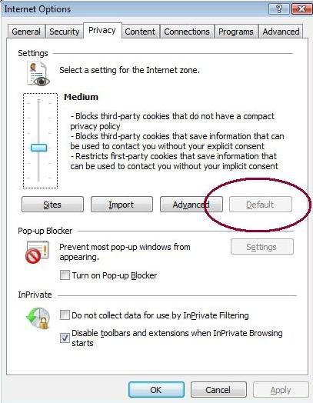
Privacy by Default
Sometimes seen as a subcategory of PbD
Examples
Does a Socialnetwork share everything – or only parts by Default?
What are the default settings in your browser?
Does your phone have geo-tagging for pictures on by default
Psychology (”nudge”)

Slide 52
ACCOUNTABILITY & Risk based Approach

Slide 53
2 principles help to address several problems
Accountability
Risk-based approach

Slide 54
Alternative ways of enforcement Terms (1)
Accountability
Core concept
Documented compliance, taking responsibility
Risk based approach
Risk = mentioned 75 times in GDPR
Risk = risk in relation to rights and freedoms of individuals = legal risk

Slide 55
What is typically part of a privacy program fostering accountability?
Executive oversight
Defining roles and responsibilities + staffing
Implementation of controls
Training and awareness program
Assessment part
Redress (people know where to go)
Defined processes
Notes:
Roles and responsibilities in abstract terms

Slide 56
Examples for risk based approach under the GDPR
Recital 74: "appropriate and effective measure"
Article 24, 32: Technical and organisational measures relative to the risk
Article 25: Data protection by Design and by default according to the risks involved
Article 33, 34: Notifications in data breach situations relevant to the risk
Article 35: DPIA
Article 39(2): Task of the DPO
Notes:
Right to sue ➔ has been changed under Albrecht ➔ also NGOs etc.

Slide 57
How to implement?

Slide 58
Structure of a Privacy Program
Privacy policy
Specific notifications (e.g. description of files)
Notifications to authorities
Documentation
Privacy Engineering (PbD)
Data Protection Impact Assessments
Appropriate Security Measures
External Communication
Risk Management
Governance
Internal Instructions
Privacy
Processes
Internal Policies (high level)
Guidelines & Instructions
Privacy Requirements
Training and Awareness
Incident Management
Subcontractor Management
International Data Transfers
Law Enforcement Access
Data Subject Access & Complaint Management

Slide 59
Enforcement through DPOs
The role of data protection officers
Reports to highest management level
Tasks (Art. 38, 39)
What happens if you don’t designate one? (=> fine)
No exception for SME
➔ DPO have been proven quite effective to build a privacy culture
Notes:
Right to sue ➔ has been changed under Albrecht ➔ also NGOs etc.

Slide 60
When do I need to appoint a DPO?
Public Authorities
(subject to limited exceptions)
Other organisations whose "core activities" require either
"regular and systematic monitoring" of individuals "on a large scale"
"large scale" processing of Sensitive Data or criminal records
Other organisations may appoint a DPO.
Groups of undertakings may appoint a single DPO providing they are accessible from each establishment.
A single DPO may also be designated for multiple public authorities/bodies.
Notes:
Right to sue ➔ has been changed under Albrecht ➔ also NGOs etc.

Slide 61
Increased "Documentation" Obligations
Subject to limited exemptions, data controllers and processors must maintain an internal, written record of processing activities. This must contain prescribed information and be made available to regulators on request.
Controllers | Processors
Name & contact details (of controller, joint controllers, representatives and any DPO) | Name & contact details (of processor, each relevant controller, their representatives and any DPO)
Purposes of processing
A description of the "categories of data subjects… and personal data" involved | A description of the "categories of processing" carried out on behalf of each controller
The "categories of recipients" (incl. those in non-EEA countries) who have received/will receive the data
Information on non-EEA data transfers, including the identification of destination countries and documentation of appropriate safeguards | Information on non-EEA data transfers, including the identification of destination countries and documentation of appropriate safeguards
Envisaged time limits for erasure of the different data categories
General description of technical and organisational security measures implemented | General description of technical and organisational security measures implemented

Slide 62
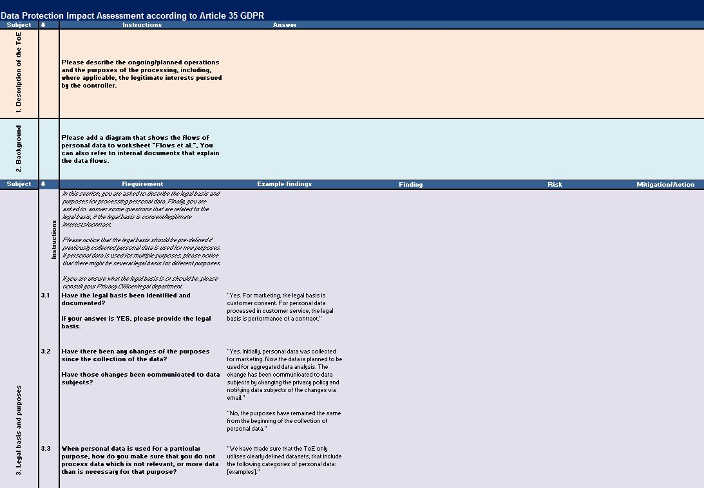
Data protection impact assessment

Slide 63
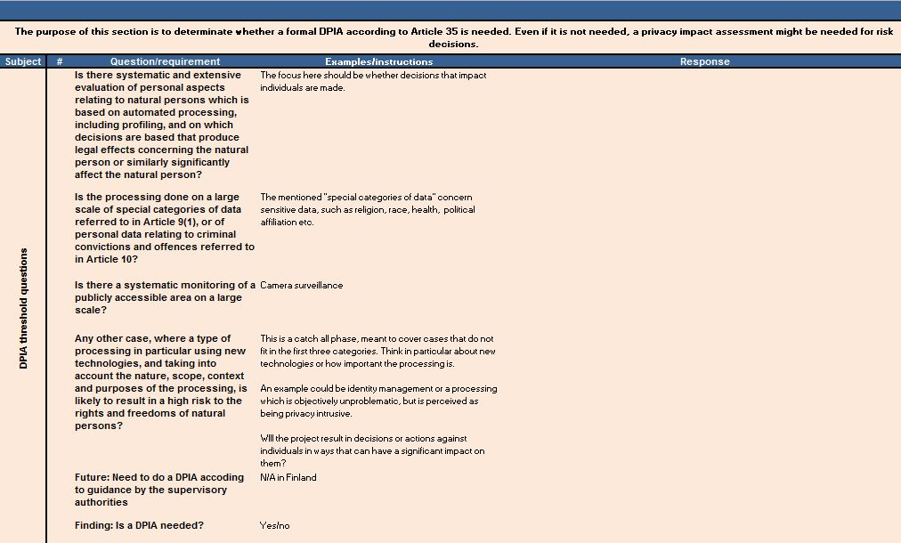
Privacy threshold analysis

Slide 64
Pressure/Information

Slide 65
Also in other areas (governance access), watch dogs play an important role. Electronic Frontier Foundation
In the “Atlas of Surveillance” everybody can search for “police tech, e.g. Cell-site simulators
“Who has your back” was a classic report on who reports on government surveillance

Slide 66
Any questions?

Slide 67
Activity

Slide 68
DEBATE (2min per speaker, 3 rounds)
Class is split into two groups:
I) SME organization “the middle is where it is“ (“Miwii“) believes that the whole enforcement under the GDPR has got out of hands.
II) Consumers for data governance (“Codaco“) believes that high fines are the only way forward.
Notes:
Note: difference between controllers and processors

Slide 69
Exam
Case study – write 3000-4000 words
Tipps:
There is typically irrelevant stuff in the case, you need to decide what is relevant and what is not.
Answer the question ask v. repeating the text of GDPR articles
Stay in the role, whatever the role is.
Parties might claim stuff, which is incorrect.
Rules
Indicate your sources. Lock up what plagiarism is if you do not know.
Indicate if and what for you used generative AI.

