Slide 1
THE MANAGEMENT PROCESS
The management process, Levels and areas of management, roles, skills, challenges of a manager.

Slide 2
OBJECTIVES TODAY
Review the four principle functions of a manager.
Understand the levels and areas of management.
Identify the roles an effective manager must play.
Discuss the skills of an outstanding manager.
Discuss the seven challenges faced by most managers.
Define the knowledge, soft skills, attitudes, and other characteristics needed for career readiness and discuss how they can be developed.

Slide 3
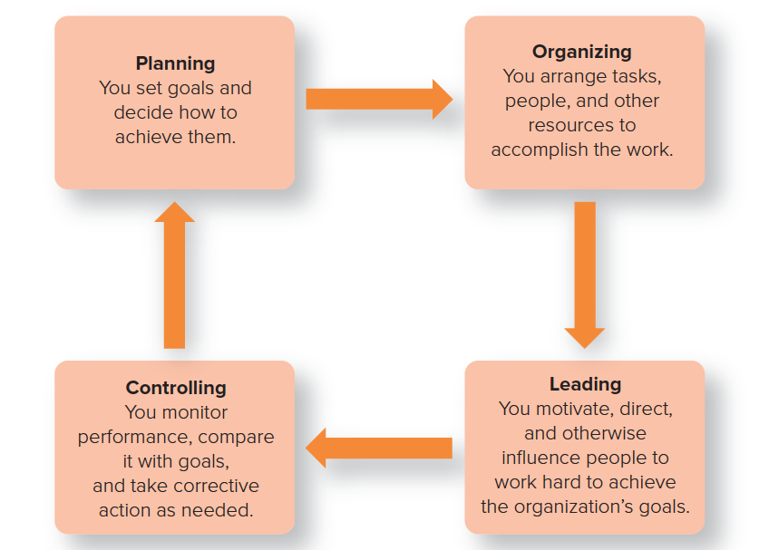
The MANAGEMENT PROCESS
Copyright ©McGraw-Hill Education. Permission required for reproduction or display.

Slide 4
QUESTION #1
Laura runs a sales and expense report at the end of each work day. Which management function is she performing?
A. leading
B. organizing
C. controlling
D. planning

Slide 5
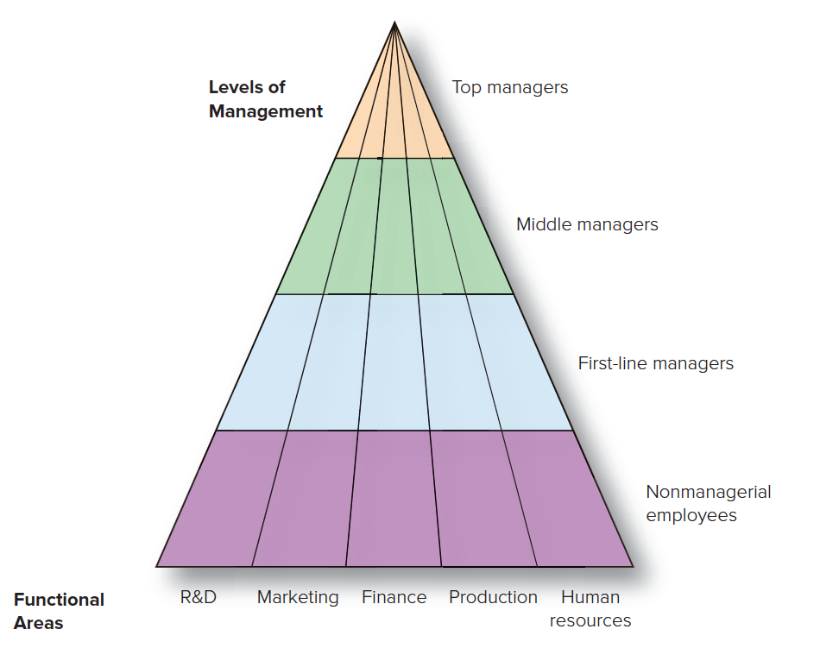
LEVELS and AREAS of MANAGEMENT
Copyright ©McGraw-Hill Education. Permission required for reproduction or display.

Slide 6
FOUR LEVELS of MANAGEMENT
Top managers
Make long-term decisions about the overall direction of the organization and establish the objectives, policies, and strategies for it.
Middle managers
Implement the policies and plans of the top managers above them and supervise and coordinate the activities of the first-line managers below them.
First-line managers
Make short-term operating decisions, directing the daily tasks of nonmanagerial personnel.
Team leader
Responsible for facilitating team activities toward achieving key results.

Slide 7
QUESTION #2
Alexandra supervises the food assembly line workers. What type of manager is she?
A. top manager
B. middle manager
C. first-line manager
D. general manager
Notes:
The correct answer is C. first-line manager.
Rationale: First-line managers direct the daily tasks of nonmanagerial (line workers) personnel.

Slide 8
FUNCTIONAL VERSUS GENERAL MANAGERS
Functional manager
What are they responsible for?
General manager
What are they responsible for?

Slide 9
MANAGERS for THREE TYPES of ORGANIZATIONS
For-profit organizations
Nonprofit organizations
Mutual-benefit organizations

Slide 10
THREE TYPES of MANAGERIAL ROLES ACCORDING TO HENRY MINTZBERG
Interpersonal roles
Informational roles
Decisional roles

Slide 11
QUESTION #3
CEO Annika Hurme sets the direction and strategy for Valio. What type of managerial role is she performing?
A. interpersonal
B. informational
C. decisional
D. conclusive
Notes:
The correct answer is A. interpersonal.
Rationale: An interpersonal manager would interact with employees as well as others outside of the organization. Often this means setting the direction of the organization and promoting the strategy. Interpersonal includes figurehead, leadership, and liaison roles. (See Table 1.1.)

Slide 12
ROLES MANAGERS MUST PLAY SUCCESSFULLY
The manager’s roles: Mintzberg’s useful findings
A manager relies more on verbal than on written communication.
A manager works long hours at an intense pace.
A manager’s work is characterized by fragmentation, brevity, and variety.

Slide 13
The SKILLS EXCEPTIONAL MANAGERS NEED
Technical skills
What are these?
Conceptual skills
What are these?
Human skills (soft skills)
What are these?

Slide 14
CHALLENGES to BEING an EXCEPTIONAL MANAGER
Managing for competitive advantage.
Managing for information technology.
Managing for diversity.
Managing for globalization.
5. Managing for ethical standards.
6. Managing for sustainability.
7. Managing for happiness and meaningfulness.

Slide 15
MANAGING for COMPETITIVE ADVANTAGE
Competitive advantage
The ability of an organization to produce goods or services more effectively than competitors do, thereby outperforming them.
What does having a competitive advantage mean?
Lets discuss!

Slide 16
MANAGING for INFORMATION TECHNOLOGY
By 2020, consumers worldwide spent $3.55 trillion online, double that of 2015.
Information technology has led to the growth of e-business, using the Internet to facilitate every aspect of running a business.
What are the implications of information technology?

Slide 17
MANAGING for DIVERSITY
The future won’t resemble the past.
What is likely to change in the area in the future?

Slide 18
MANAGING for GLOBALIZATION
How is the world changing?
What are the challenges for managers then?

Slide 19
MANAGING for ETHICAL STANDARDS
Ethical behavior is not just a nicety.
What does “ethical behaviour” mean?
Do you have examples for unethical behaviour?
What are the issues to observe?

Slide 20
MANAGING for SUSTAINABILITY
Do you have examples for companies credibly committing to sustainability?
What are the challenges for managers?
Does the ongoing climate discussion stand to significantly change the behaviour of businesses in the future?

Slide 21
MANAGING for HAPPINESS and MEANINGFULNESS
Many people agree that being a manager doesn’t make them happy.
Why do you think that is?
Research shows that a sense of meaningfulness in your life is associated with better health, work and life satisfaction, and performance.
How can we bring meaningfulness into our work and lives?

