Slide 1
DEVELOPMENT OF CURRENT PERSPECTIVES ON MANAGEMENT
Theories, approaches and their historical evolution

Slide 2
LEARNING OBJECTIVES
Understand how today’s view on management developed over time
Be able to place some of today’s management “buzzwords”

Slide 3
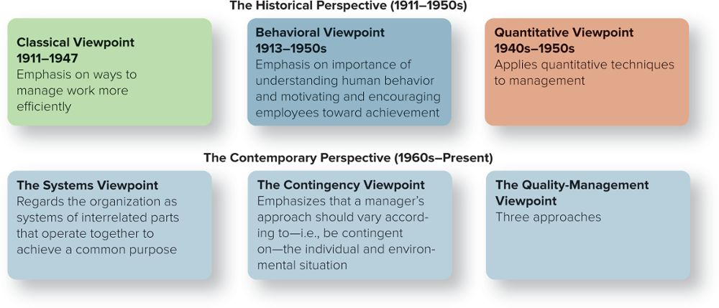
The TWO OVERARCHING PERSPECTIVES: HISTORICAL and CONTEMPORARY
Access the text alternative for these images.
Copyright ©McGraw-Hill Education. Permission required for reproduction or display.

Slide 4
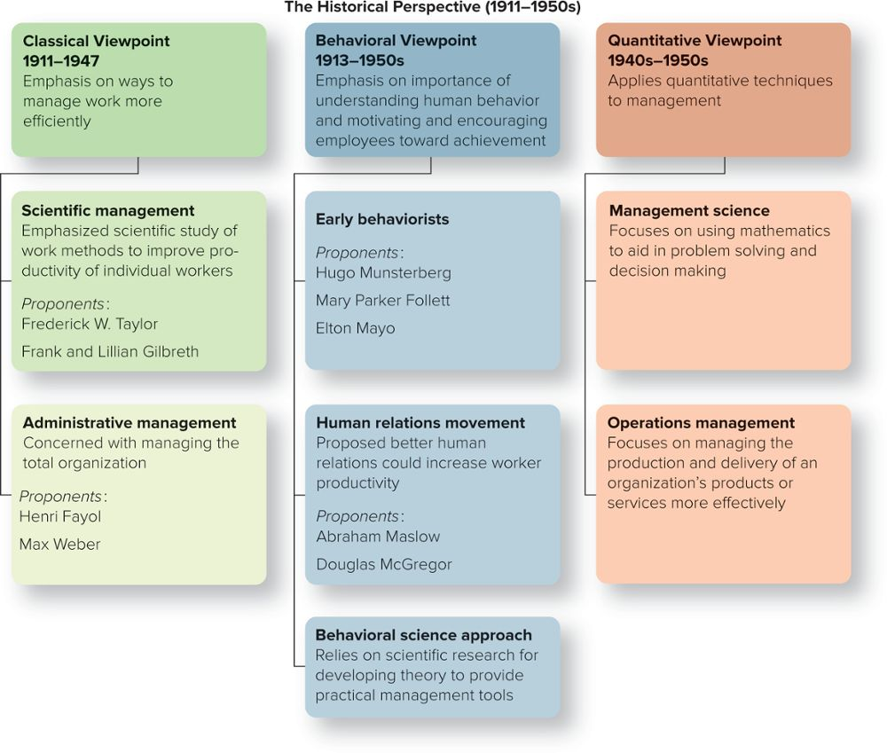
The HISTORICAL PERSPECTIVE: THREE VIEWPOINTS
Copyright ©McGraw-Hill Education. Permission required for reproduction or display.

Slide 5
CLASSICAL VIEWPOINT: SCIENTIFIC MANAGEMENT
Pioneered by Frederick W. Taylor and the Gilbreths in the early 1900s, scientific management
Emphasized the scientific study of work methods to improve the productivity of individual workers

Slide 6
SCIENTIFIC MANAGEMENT
Taylor’s principles of scientific management
Scientifically study each part of the task.
Carefully select workers with the right abilities.
Give workers the training and incentives to do the task properly.
Use scientific principles to plan the work methods.

Slide 7
The GILBRETHS and MOTION STUDIES
Lillian and Frank Gilbreth
Applied some ideas for improving efficiency to raising their 12 children.
Identified 17 basic motions and applied them to work processes (bricklaying, for example) to determine whether the tasks could be done more efficiently.
Demonstrated they could eliminate motions while reducing fatigue for some workers.

Slide 8
ADMINISTRATIVE MANAGEMENT – CHARLES CLINTON SPAULDING
Administrative management
Proposed “Fundamental Necessities” of Management.
Charles Clinton Spaulding (1874 to 1952)
Recognized as the “Father of African-American Management.”
Proposed eight “necessities” of management.
Suggested considerations such as:
The need for authority.
Division of labor.
Adequate capital.
Proper budgeting.
Cooperation.
Teamwork.

Slide 9
ADMINISTRATIVE MANAGEMENT – HENRI FAYOL
Administrative management
Concerned with managing the total organization.
Henri Fayol (1841 to 1925)
French engineer and industrialist.
First to identify the major functions of management.
Planning.
Organizing.
Leading.
Controlling.
Coordinating.

Slide 10
ADMINISTRATIVE MANAGEMENT – MAX WEBER
Max Weber (1864-1920)
German sociologist and philosopher.
Believed that a bureaucracy was a rational, efficient, ideal organization based on the principles of logic.
A well-defined hierarchy of authority.
Formal rules and procedures.
A clear division of labor.
Impersonality.
Careers based on merit.

Slide 11
WHY the CLASSICAL VIEWPOINT IS IMPORTANT
Work activity was amenable to a rational approach.
Through the application of scientific methods, time and motion studies, and job specialization it was possible to boost productivity.
It led to later innovations such as management by objectives, and goal setting.

Slide 12
The PROBLEM with the CLASSICAL VIEWPOINT
Too mechanistic
Tends to view humans as cogs within a machine, not taking into account the importance of human needs.
Copyright RainerPlendl/iStock/Getty Images RF

Slide 13
QUESTION #1
Which viewpoint emphasized the scientific study of work methods to improve the productivity of individual workers?
A. scientific management
B. administrative management
C. behavioral science
D. TQM

Slide 14
BEHAVIORAL VIEWPOINT: BEHAVIORISM, HUMAN RELATIONS, and BEHAVIORAL SCIENCE
Behavioral viewpoint
Emphasized the importance of understanding human behavior and motivating employees toward achievement.
Developed over three phases:
Early behaviorism.
The human relations movement.
Behavioral science.

Slide 15
EARLY BEHAVIORISM – HUGO MUNSTERBERG
Hugo Munsterberg
(1863 to 1916)
Known as the Father of Industrial Psychology.
Study jobs and determine which people are best suited to specific jobs.
Identify the psychological conditions under which employees do their best work.
Devise management strategies to influence employees to follow management’s interests.

Slide 16
EARLY BEHAVIORISM – MARY PARKER FOLLETT
Organizations should be operated as communities.
Conflicts should be resolved by managers and workers talking over differences and finding solutions that would satisfy both parties.
The work process should be controlled by workers with relevant knowledge; managers are facilitators.
Mary Parker Follett
(1868 to 1933)
A social worker and social philosopher, she made very important contributions to the fields of civics and sociology.

Slide 17
EARLY BEHAVIORISM – ELTON MAYO
Elton Mayo (1880 to 1949)
In the late 1920s, Mayo led a Harvard research group to conduct worker productivity studies at Western Electric’s Hawthorne (Chicago) plant.
Hawthorne effect
Employees worked harder if they received added attention, and thought that managers cared about their welfare and that supervisors paid special attention to them.

Slide 18
The HUMAN RELATIONS MOVEMENT
Proposed that better human relations could increase worker productivity.
Pioneered by Abraham Maslow (1908 to 1970) and Douglas McGregor (1906 to 1964).

Slide 19
DOUGLAS MCGREGOR – THEORY X VERSUS THEORY Y
Theory X
What does it consist of?
Theory Y
What does it consist of?

Slide 20
The BEHAVIORAL SCIENCE APPROACH
Behavioral science
Relies on scientific research for developing theories about human behavior that can be used to provide practical tools for managers.
The disciplines of behavioral science include psychology, sociology, anthropology, and economics.

Slide 21
QUESTION #2
Which viewpoint emphasized the importance of understanding human behavior and of motivating employees toward achievement?
scientific management
administrative management
behavioral
TQM

Slide 22
QUANTITATIVE VIEWPOINTS
Application to management of quantitative techniques, such as statistics and computer simulations.
Includes:
1. Management science. 2. Operations management.

Slide 23
MANAGEMENT SCIENCE
Focuses on using mathematics to aid in problem solving and decision making.

Slide 24
OPERATIONS MANAGEMENT
Focuses on managing the production and delivery of an organization’s products or services more effectively.
Concerned with work scheduling, production planning, facilities location and design, and optimum inventory levels.

Slide 25
QUESTION #3
Which viewpoint stresses the use of rational, science-based techniques and mathematical models to improve decision making and strategic planning?
A. scientific management
B. operations management
C. production management
D. management science
Notes:
The correct answer is D. management science.
Rationale: Sometimes called operations research, management science focuses on rational, science-based techniques and mathematical models in decision making and strategic planning. This viewpoint falls into the quantitative category.

Slide 26
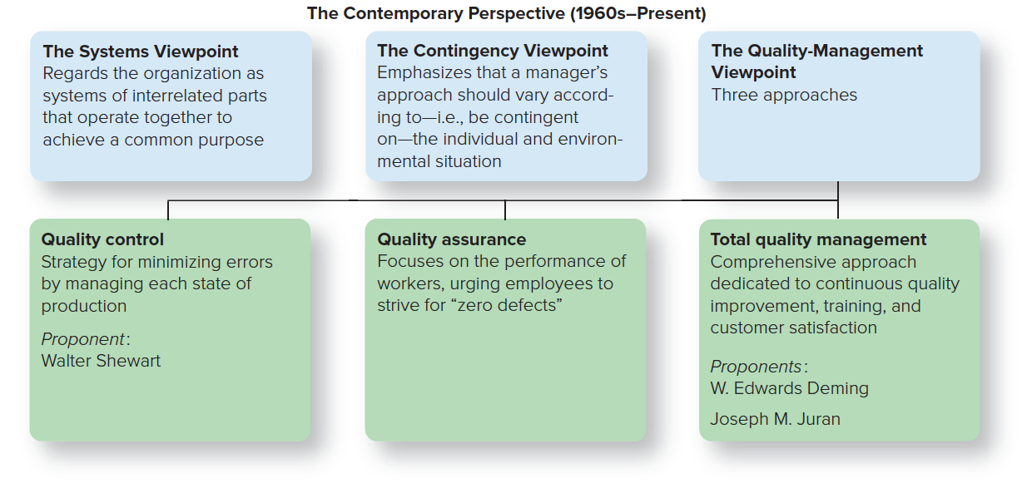
The CONTEMPORARY PERSPECTIVE
Copyright ©McGraw-Hill Education. Permission required for reproduction or display.

Slide 27
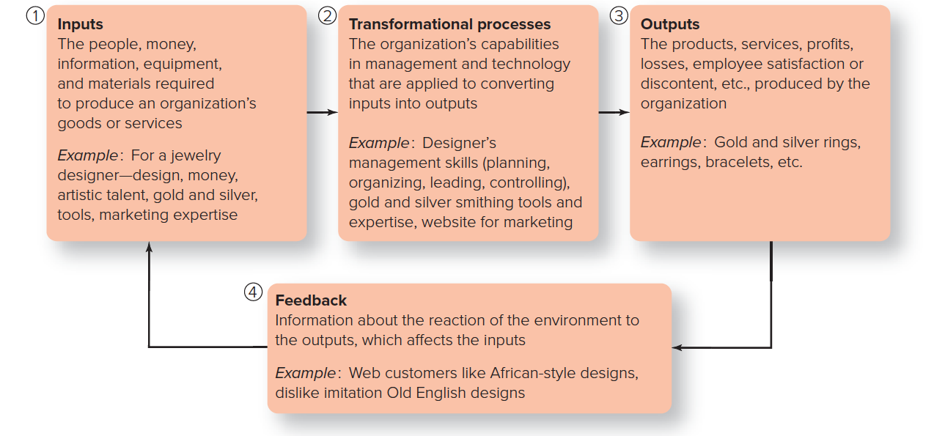
SYSTEMS VIEWPOINT
The Four Parts of a System
Access the text alternative for these images.
Copyright ©McGraw-Hill Education. Permission required for reproduction or display.

Slide 28
CLOSED VERSUS OPEN SYSTEMS
Closed systems
Organizations that have little interaction with their environment.
Open systems
Organizations that continually interact with their environment; have the potential to produce synergy.
Complexity theory – the ultimate open system
Recognizes that all complex systems are networks of many interdependent parts that interact with each other according to certain simple rules.

Slide 29
CONTINGENCY VIEWPOINT
Emphasizes that a manager’s approach should vary according to – that is, be contingent on – the individual and the environmental situation.
Most practical because it addresses problems on a case-by-case basis.

Slide 30
EVIDENCE-BASED MANAGEMENT
Translating principles based on best evidence into organizational practice, and bringing rationality to the decision-making process.
Research should follow the scientific method.
Observe events and gather facts.
Pose a possible solution or explanation based on those facts.
Make a prediction of future events.
Test the prediction under systematic conditions.

Slide 31
QUALITY-MANAGEMENT VIEWPOINT
Quality
Total ability of a product or service to meet customer needs.
Quality control
The strategy for minimizing errors by managing each stage of production.
Quality assurance
Focuses on the performance of workers, urging employees to strive for “zero defects.”

Slide 32
TOTAL QUALITY MANAGEMENT (TQM)
A comprehensive approach dedicated to continuous quality improvement, training, and customer satisfaction.
Make continuous improvement a priority.
Get every employee involved.
Listen to and learn from customers and employees.
Use accurate standards to identify and eliminate problems.

Slide 33
SIX SIGMA and ISO 9000
DMAIC
Series of steps called Define, Measure, Analyze, Improve, and Control.
DFSS (Design for Six Sigma)
Managers can employ to create new products or processes. Variation on the original approach that focuses on problem solving and process improvement.

