Slide 1
Planning The Foundation of Successful Management

Slide 2
LEARNING OBJECTIVES
Discuss the role of strategic management.
Compare mission, vision, and value statements.
Discuss the types and purposes of goals and plans.
Describe SMART goals and their implementation.
Outline the planning/control cycle.

Slide 3
PLANNING, STRATEGY and STRATEGIC MANAGEMENT
Planning is the first of the four functions in the management process.
Planning involves setting goals and deciding how to achieve them.
It also involves ensuring the plans are linked to the business strategy.

Slide 4
PLANNING: COPING with UNCERTAINTY
Three Definitions
Planning is defined as setting goals and deciding how to achieve them.
Planning is also coping with uncertainty by formulating future courses of action to achieve specified results.
A plan is a document that outlines how goals are going to be met.
Two Examples
Business plan: what is it exactly?
Business model: What is it exactly?

Slide 5
STRATEGY: SETTING LONG-TERM DIRECTION
Strategy or strategic plan
A large-scale action plan that sets the long-term goals and direction for an organization.
Represents an “educated guess” about what must be done in the long term for the survival or the prosperity of the organization or its principal parts.
Strategic plans generally reconsidered every year due to everchanging business conditions.

Slide 6
STRATEGIC MANAGEMENT
Strategic management
A process that involves managers from all parts of the organization in the formulation and the implementation of strategies and strategic goals.
From top management to middle managers to line manager.
Derives from an organization’s mission and vision.

Slide 7
WHY ARE PLANNING and STRATEGIC MANAGEMENT IMPORTANT?
Provide direction and momentum.
Encourage new ideas.
Develop a sustainable competitive advantage.

Slide 8
PROVIDING DIRECTION and MOMENTUM
Why are direction and momentum important?
Unless a plan is in place, managers may well focus on just whatever is in front of them, just “putting out fires.”
Managers might be so preoccupied with day-to-day pressures that their organizations can lose momentum.
Examples to consider:
What Amazon.com was to bookstores.
What Uber has been to taxicabs.
What blogs and Internet news meant for newspapers.
What microbreweries have been to major breweries like Carlsberg.

Slide 9
ENCOURAGING NEW IDEAS
Management scholar Gary Hamel says that companies such as Apple have been successful because they have been able to unleash the spirit of “strategy innovation.”
Strategy innovation
The ability to reinvent the basis of competition within existing industries—“bold new business models that put incumbents on the defensive.”

Slide 10
DEVELOPING a SUSTAINABLE COMPETITIVE ADVANTAGE
Competitive advantage
The ability of an organization to produce goods or services more effectively than its competitors do, thereby outperforming them.
Sustainable competitive advantage
Occurs when an organization is able to get and stay ahead in four areas.
Which ones?
…
…
…
…

Slide 11
MISSION, VISION, and VALUE STATEMENTS
Mission Statement
Express the purpose of the organization.
What is our reason for being?
Why are we here?
Vision Statement
A clear sense of the future and the actions needed to get there
What do we want to become?
Where do we want to go?
Value Statement
What the company stands for: its core priorities, the values its employees embody, and what its products contribute to the world
What values do we want to emphasize?

Slide 12
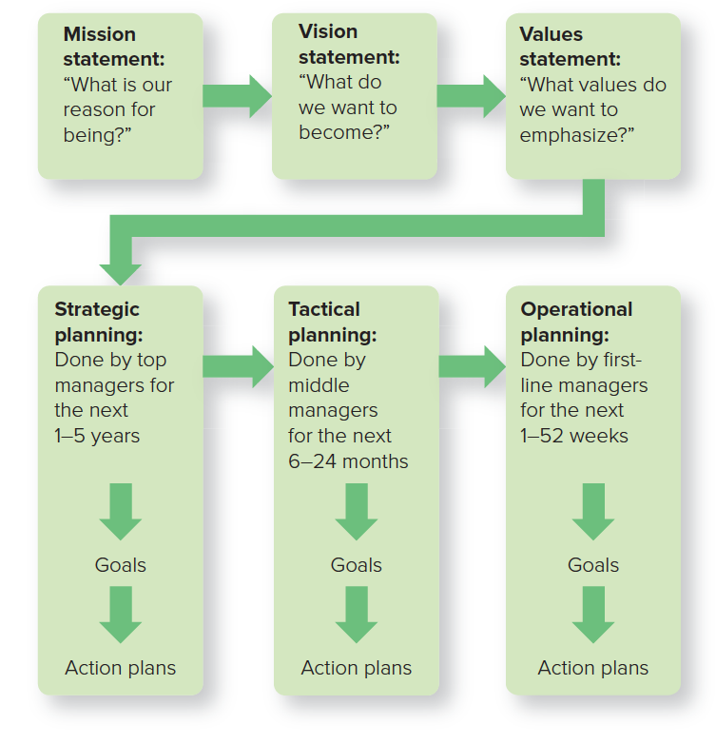
FUNDAMENTALS of PLANNING

Slide 13
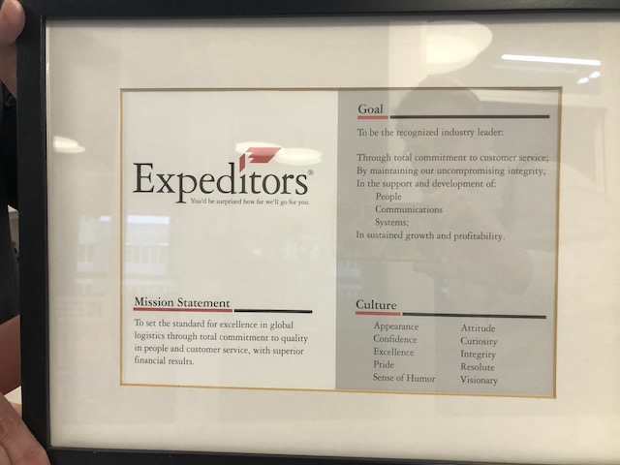
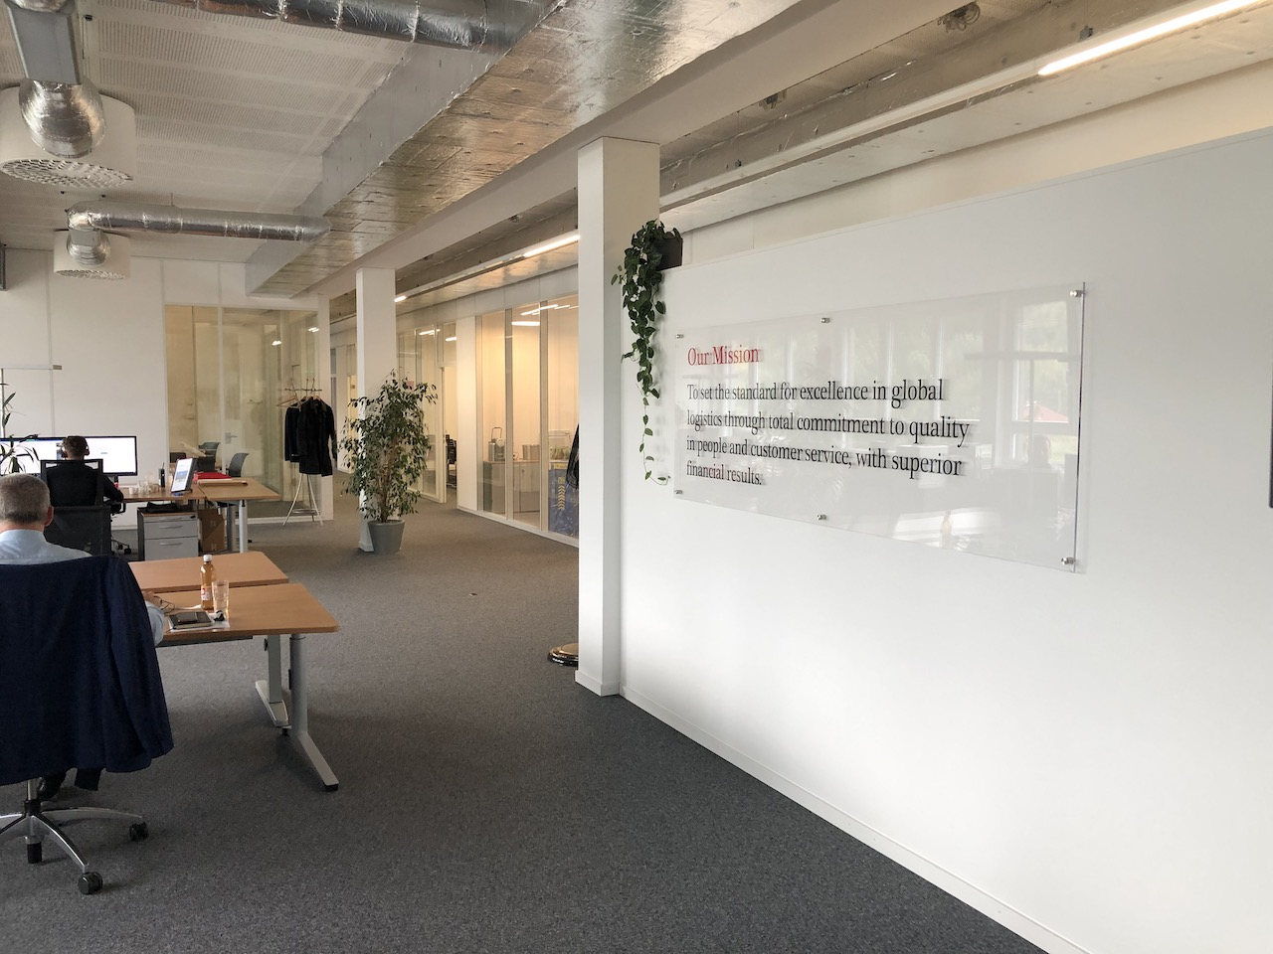
EXAMPLE: EXPEDITOR’S MISSION STATEMENT
©heromen30/Shutterstock
Notes:
Here is an example of how a mission, vision, and values statement work together to provide a cohesive message to customers and employees alike.

Slide 14
COCA-COLA: VISION STATEMENT
Vision Statement: Our vision serves as the framework for our Roadmap and guides every aspect of our business by describing what we need to accomplish in order to continue achieving sustainable, quality growth.
People—Be a great place to work where people are inspired to be the best they can.
Portfolio—Bring to the world a portfolio of quality beverage brands that anticipate and satisfy people's desires and needs.
Partners—Nurture a winning network of customers and suppliers; together we create mutual, enduring value.
Planet—Be a responsible citizen that makes a difference by helping build and support sustainable communities.
Profit—Maximize long-term return to shareowners while being mindful of our overall responsibilities.
Productivity—Be a highly effective, lean and fast-moving organization.

Slide 15
COCA-COLA: VALUES
Value Statement: Our values serve as a compass for our actions and describe how we behave in the world.
Leadership—The courage to shape a better future
Collaboration—Leverage collective genius
Integrity—Be real
Accountability—If it is to be, it’s up to me
Passion—Committed in heart and mind
Diversity—As inclusive as our brands
Quality —What we do, we do well

Slide 16
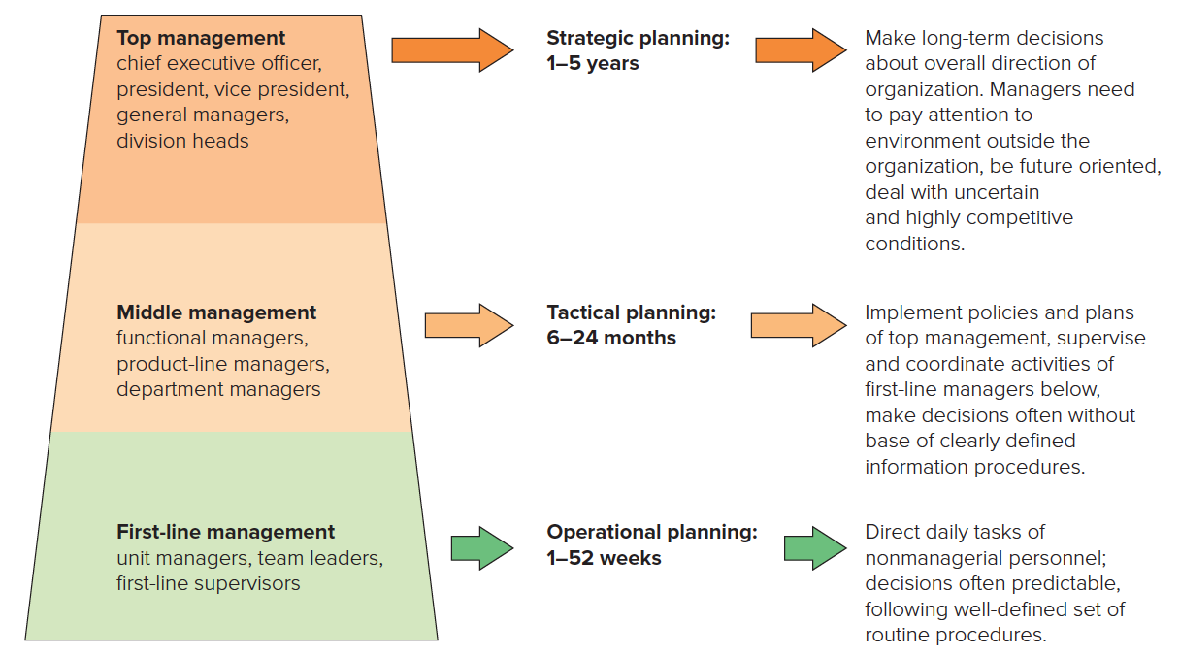
THREE TYPES of PLANNING for THREE LEVELS of MANAGEMENT

Slide 17
LONG-TERM and SHORT-TERM GOALS
GOALS
A specific commitment to achieve a measurable result within a stated period of time.
SHORT-TERM GOALS
LONG-TERM GOALS
Sometimes referred to as tactical or operational goals, or just plain goals.
Generally span 12 months and connected to strategic goals in a hierarchy known as a means-end chain.
Generally referred to as strategic goals.
Tend to span 1 to 5 years and focus on achieving the strategies identified in a company’s strategic plan.

Slide 18
STANDING PLANS and SINGLE-USE PLANS
PLAN | DESCRIPTION
Standing Plan | For activities that occur repeatedly over a period of time
Policy | Outlines general response to a designated problem or situation
Procedure | Outlines response to particular problems or circumstances
Rule | Designates specific required action
Single-use Plan | For activities not likely to be repeated in the future
Program | Encompasses a range of projects or activities
Project | Has less scope and complexity than a program

Slide 19
SMART GOALS
Specific: Goals should be stated in specific rather than vague terms.
Measurable: Whenever possible, goals should be measurable, or quantifiable.
Attainable: Goals should be challenging, of course, but above all they should be realistic and attainable.
Results-oriented: Only a few goals should be chosen—say, five for any work unit. And they should be results-oriented—they should support the organization’s vision.
Target dates: Goals should specify the target dates or deadline dates when they are to be to be obtained.

Slide 20
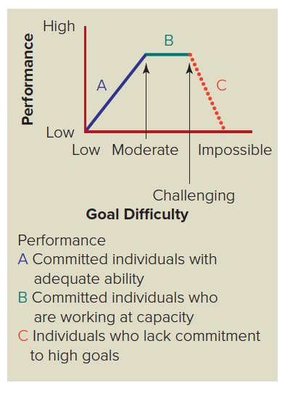
RELATIONSHIP BETWEEN GOAL DIFFICULTY and PERFORMANCE

Slide 21
MANAGEMENT BY OBJECTIVES: THE FOUR-STEP PROCESS for MOTIVATING EMPLOYEES
Managers and employees jointly set objectives for the employee.
Managers develop action plans.
Managers and employees periodically review the employee’s performance.
Managers make a performance appraisal and reward the employee according to results.
©Chris Ryan/age fotostock

Slide 22
THREE TYPES of OBJECTIVES USED in MBO
Performance Objectives
Focus Express the objective as an outcome or end-result.
Examples: ?
Behavioral Objectives
Focus Express the objective as the behaviors needed to achieve an outcome. Examples: ?
Learning Objectives
Focus Express the objective in terms of acquiring knowledge or competencies. Examples: ?

Slide 23
CASCADING GOALS: MAKING LOWER-LEVEL GOALS ALIGN with TOP GOALS
What has to happen for MBO goal-setting to be successful?
…
…
…

