Slide 1
STRATEGIC MANAGEMENT How Exceptional Managers Realize a Grand Design

Slide 2
TODAY
What is an effective strategy?
Strategic positioning
Go through the strategic management process together (five steps)
Look at some analytical tools together
Discuss Porter’s five competitive forces and the four techniques for formulating strategy.
How to enhance your strategic thinking.

Slide 3
WHAT IS an EFFECTIVE STRATEGY?
Hint: “Strategic positioning” developed by Michael Porter
What does strategic positioning strive to achieve?
What does it mean?

Slide 4
LEVELS of STRATEGY
Corporate-Level Strategy
Focuses on…
Business-Level Strategy
Focuses on…
Functional-Level Strategy
Focuses on…

Slide 5
STRATEGIC POSITIONING and ITS PRINCIPLES
Three key principles underlie strategic positioning.
Strategy is the creation of a unique and valuable position.
Few needs, many customers
Broad needs, few customers.
Broad needs, many customers.
Strategy requires trade-offs in competing.
Strategy involves creating a “fit” among activities.
EXAMPLES?

Slide 6
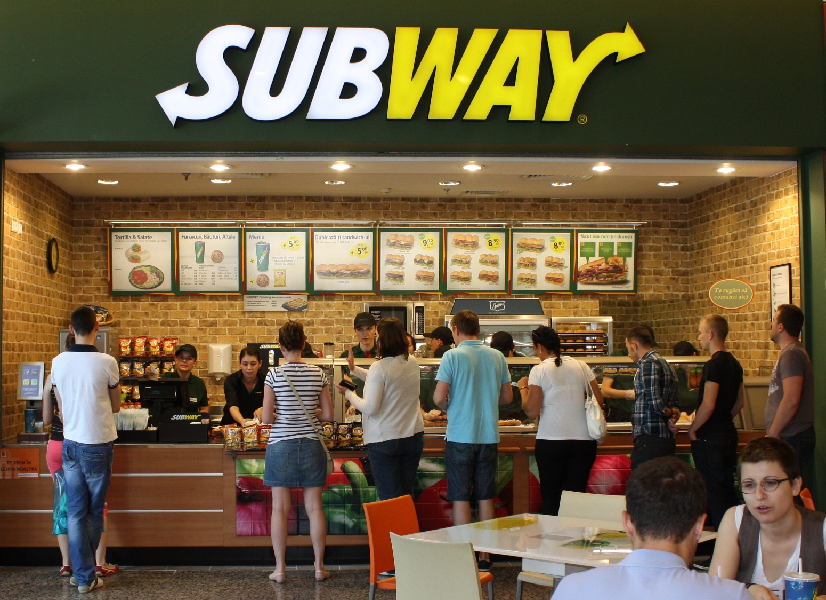
FIT: BOTH ARE RESTAURANTS, SO THEY’RE DOING THE SAME ACTIVITIES, AREN’T THEY?

Slide 7
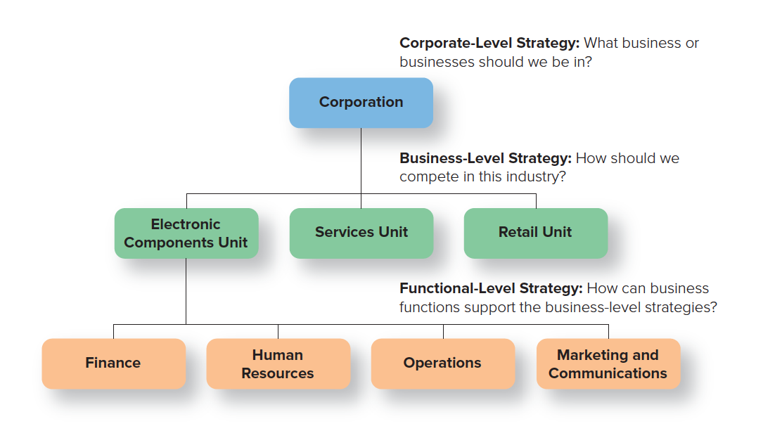
THREE LEVELS OF STRATEGY
Copyright ©McGraw-Hill Education. Permission required for reproduction or display.

Slide 8
The STRATEGIC-MANAGEMENT PROCESS

Slide 9
STEP 1a: ESTABLISHING the MISSION STATEMENT
Does your company’s mission statement answer these questions?
Who are our customers?
What are our major products or services?
In what geographical areas do we compete?
What is our basic technology?
What is our commitment to economic objectives?
What are our basic beliefs, values, aspirations, and philosophical priorities?
What are our major strengths and competitive advantages?
What are our public responsibilities, and what image do we wish to project?
What is our attitude toward our employees?
LETS WORK WITH AN EXAMPLE!

Slide 10
STEP 1b: ESTABLISHING the VISION STATEMENT
Does your company’s vision statement answer these questions:
Is it appropriate for the organization and for the times?
Does it set standards of excellence and reflect high ideals?
Does it clarify purpose and direction?
Does it inspire enthusiasm and encourage commitment?
Is it well articulated and easily understood?
Does it reflect the uniqueness of the organization, its distinctive competence, what it stands for, what it’s able to achieve?
Is it ambitious?

Slide 11
STEP 1c: ESTABLISHING the VALUES STATEMENT
Does your company’s values statement answer these questions:
Does it express the company’s distinctiveness, its view of the world?
Is it intended to guide all the organization’s actions, including how you treat employees, customers, etc.?
Is it tough, serving as the foundation on which difficult company decisions can be made?
Will it be unchanging, as valid 100 years from now as it is today?
Does it reflect the beliefs of those who truly care about the organization—the founders, CEO, and top executives—rather than represent a consensus of all employees?
Are the values expressed in the statement limited (five or so) and easy to remember, so that employees will have them top-of-mind when making decisions?
Would you want the organization to continue to hold these values, even if at some point they become a competitive disadvantage?

Slide 12
STEP 2: ASSESS the CURRENT REALITY
Assess the current reality
Look at where the organization stands internally and externally, to determine what’s working and what’s not.
See what can be changed so as to increase efficiency and effectiveness in achieving the organization’s vision.
Tools include competitive intelligence, SWOT analysis, forecasting, benchmarking, Porter’s model for industry analysis.

Slide 13
SWOT ANALYSIS (1 of 2)
Environmental scanning
Monitoring of an organization’s internal and external environments to detect early signs of opportunities and threats that may influence the firm’s plans.
SWOT, process for scanning:
Internal Strengths.
Internal Weaknesses.
External Opportunities.
External Threats.

Slide 14
SWOT ANALYSIS (2 of 2)

Slide 15
EXAMPLE: SWOT CHARACTERISTICS of our company we’re discussing here together
S—STRENGTHS (INTERNAL STRENGTHS) | W—WEAKNESSES (INTERNAL WEAKNESSES)
O—OPPORTUNITIES (EXTERNAL OPPORTUNITIES) | T—THREATS (EXTERNAL THREATS)
Copyright ©McGraw-Hill Education. Permission required for reproduction or display.

Slide 16
USING VRIO to ASSESS COMPETITIVE POTENTIAL
VRIO is a framework for analyzing a resource or capability to determine its competitive strategic question by answering four questions:
Value: Is the resource or capability valuable?
Rarity: Is the resource or capability currently controlled by only a few firms or no other firms?
Imitability: Is the resource or capability costly for other firms to imitate?
Organization: Is the firm organized to exploit the resource or capability?

Slide 17
BENCHMARKING: COMPARING with the BEST
Benchmarking
A process by which a company compares its performance with that of high-performing organizations.
How do we do it – exactly?
©Ingram Publishing

Slide 18
STEP 3: FORMULATE CORPORATE, BUSINESS, and FUNCTIONAL STRATEGIES
Grand strategy
Comes after assessing the current reality.
Strategy formulation is the process of choosing among different strategies and altering them to best fit the organization’s needs.
Translates the broad mission and vision statement into a corporate strategy which explains how the organization’s mission is to be accomplished.

Slide 19
THREE TYPES of CORPORATE STRATEGIES
Growth strategy
Involves expansion, as in sales revenues, market share, number of employees, or number of customers.
Stability
Involves little or no significant change.
Defensive
Involves reduction in the organization’s efforts.
Retrenchment.

Slide 20
HOW COMPANIES CAN IMPLEMENT a GRAND STRATEGY
GROWTH STRATEGY | STABILITY STRATEGY | DEFENSIVE STRATEGY
It can improve an existing product or service to attract more buyers. | It can go for a no-change strategy (if, for example, it has found that too-fast growth leads to foul-ups with orders and customer complaints). | It can reduce costs, as by freezing hiring or tightening expenses.
It can increase its promotion and marketing efforts to try to expand its market share. | It can go for a little-change strategy (if, for example, the company has been growing at breakneck speed and feels it needs a period of consolidation). | It can sell off (liquidate) assets—land, buildings, inventories, and the like.
It can expand its operations, as in taking over distribution or manufacturing previously handled by someone else. |  | It can gradually phase out product lines or services.
It can expand into new products or services. |  | It can divest part of its business, as in selling off entire divisions or subsidiaries.
It can acquire similar or complementary businesses. |  | It can declare bankruptcy.
It can merge with another company to form a larger company. |  | It an attempt a turnaround—do some retrenching, with a view toward restoring profitability.

Slide 21
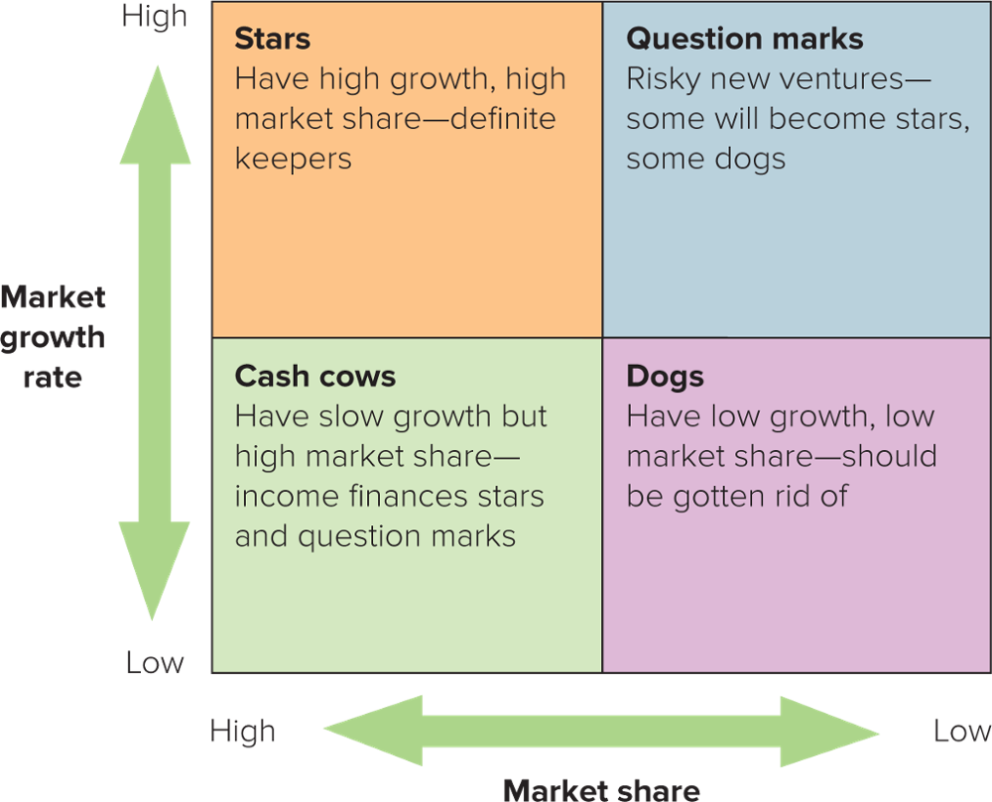
The BCG MATRIX
Copyright ©McGraw-Hill Education. Permission required for reproduction or display.

Slide 22
The DIVERSIFICATION STRATEGY
Diversification
Operating several businesses in order to spread the risk.
Products may be related or unrelated.
Vertical integration
Firm expands into businesses that provide the supplies it needs to make its products or that distribute and sell its products.

Slide 23
PORTER’S FIVE COMPETITIVE FORCES
Porter contends that business-level strategies originate in five primary competitive forces in the firm’s environment:
threat of new entrants.
bargaining power of suppliers.
bargaining power of buyers.
threats of substitute products or services.
rivalry among competitors.

Slide 24
PORTER’S FOUR COMPETITIVE STRATEGIES
Cost-leadership strategy
Keep the costs, and hence prices, of a product or service below those of competitors and target a wide market.
Differentiation strategy
Offer products that are of unique and superior value compared to those of competitors and target a wide market.
Cost-focus strategy
Keep the costs of a product below those of competitors and target a narrow market.
Focused-differentiation strategy
Offer products that are of unique and superior value compared to those of competitors and target a narrow market.

Slide 25
STEP 4: EXECUTE THE STRATEGY
Strategy implementation
Putting strategic plans into effect.
Means dealing with roadblocks within the organization’s structure and culture and seeing if the right people and control systems are available to execute the plans.
Essential for success and is considered the greatest challenge for managers.

Slide 26
EXECUTION: GETTING THINGS DONE
Execution
Consists of using questioning, analysis, and follow-through in order to mesh strategy with reality, align people with goals, and achieve results promised.

Slide 27
STEP 5: MAINTAIN STRATEGIC CONTROL: The FEEDBACK LOOP
Strategic control
Monitoring the execution of strategy and taking corrective action, if necessary.
To keep on track, you must:
engage people.
keep it simple.
stay focused.
keep moving.

