Slide 1
INDIVIDUAL & GROUP DECISION MAKING
How Managers Make Things Happen

Slide 2
LEARNING OBJECTIVES
Compare rational and nonrational decision making.
Describe how evidence-based management and business analytics contribute to decision making
Compare four decision-making styles
Outline the basics of group decision making

Slide 3
TWO KINDS of DECISION MAKING: RATIONAL AND NONRATIONAL
Decision
Choice made from among available alternatives.
Decision making
Process of identifying and choosing alternative courses of action.
Can be made rationally, but often it is nonrational.
System 1: intuitive and largely unconscious.
System 2: analytical and conscious.

Slide 4
RATIONAL DECISION MAKING
Rational model of decision making
Explains how managers should make decisions.
Assumes managers will make logical decisions that will be optimal in furthering the organization’s best interests.
Also called the classical model.
The Four Steps in Rational Decision Making
Copyright ©McGraw-Hill Education. Permission required for reproduction or display.

Slide 5
WHAT’S WRONG with the RATIONAL MODEL?
Assumption | Explanation
Complete information, no uncertainty | You should obtain complete, error-free information about all alternative courses of action and the consequences that would follow from each choice.
Logical, unemotional analysis | Having no prejudices or emotional blind spots, you can to logically evaluate the alternatives, ranking them from best to worst according to your personal preferences.
Best decision for the organization | Confident of the best future course of action, you coolly choose the alternative that you believe will most benefit the organization.
Copyright ©McGraw-Hill Education. Permission required for reproduction or display.

Slide 6
SOME HINDRANCES to PERFECTLY RATIONAL DECISION MAKING
What are they?

Slide 7
NONRATIONAL DECISION MAKING
Nonrational models of decision making
Assumes that decision making is nearly always uncertain and risky, making it difficult for managers to make optimal decisions.
Two types are discussed: satisficing and intuition.

Slide 8
BOUNDED RATIONALITY
Bounded rationality
Developed in the 1950s by economist Herbert Simon.
Suggests that the ability of decision makers to be rational is limited by numerous constraints.
Complexity, time and money, cognitive capacity.
Satisficing model
Because of constraints, managers don’t make an exhaustive search for the best alternative.
Instead, managers seek alternatives until they find one that is satisfactory, not optimal.
Lets work through this!

Slide 9
INTUITION MODEL
Intuition is making a choice without the use of conscious thought or logical inference.
Stems from both:
Expertise: A person’s explicit and tacit knowledge about a person, a situation, an object, or a decision opportunity—is known as a holistic hunch.
Automated experience: The involuntary emotional response to those same matters.

Slide 10
MAKING ETHICAL DECISIONS
Ethics Standards of right and wrong that influence behavior.
.
©Ing. Andrej Kaprinay/Shutterstock

Slide 11
EVIDENCE-BASED DECISION MAKING
Evidence-based management
The translation of principles based on best evidence into organizational practice.
Brings rationality to the decision-making process.
Why is this approach a problem for businesses?
(Hint: Think of the concept of competitive advantage)

Slide 12
WHAT MAKES IT HARD TO BE EVIDENCE BASED
There’s too much evidence.
There’s not enough good evidence.
The evidence doesn’t quite apply.
People are trying to mislead you.
You are trying to mislead you.
The side effects outweigh the cure.
Stories are more persuasive anyway.

Slide 13
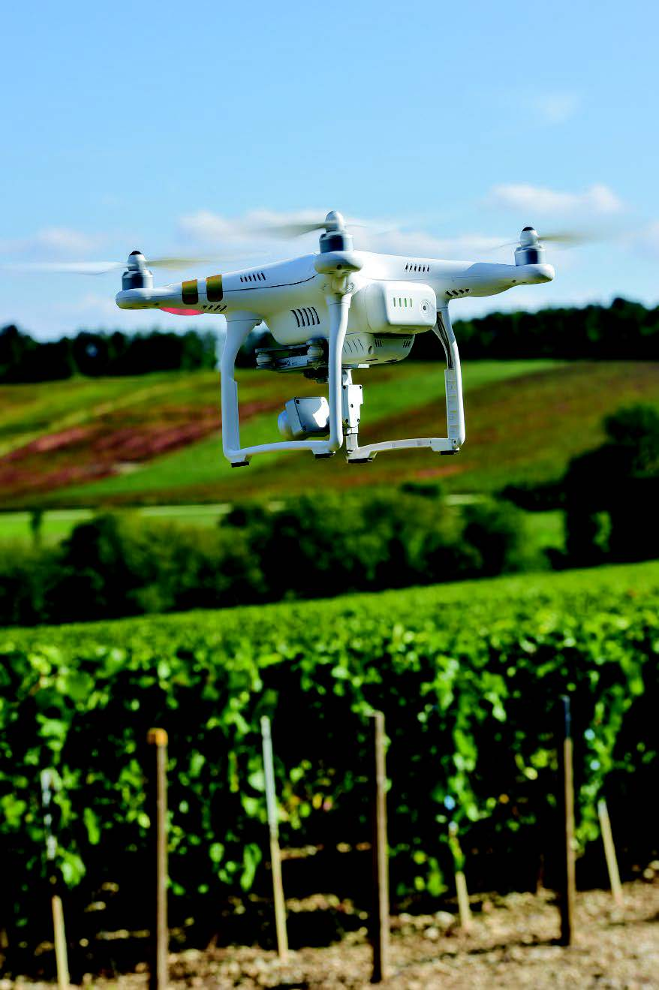
BUSINESS ANALYTICS
Business analytics
Sophisticated forms of business data analysis.
Examples: portfolio analysis, time-series forecast.
Predictive modeling
A data-mining technique used to predict future behavior and anticipate the consequences of change.
©freeprod/123RF

Slide 14
“BIG DATA”: WHAT IT IS, HOW IT'S USED
Big data
Includes not only data in corporate databases but also web-browsing data trails, social network communications, sensor data, and surveillance data.
Big data analytics
The process of examining large amounts of data of a variety of types to uncover hidden patterns, unknown correlations, and other useful information.

Slide 15
SOME USES of BIG DATA
Analyzing consumer behavior and spurring sales.
Improving hiring and personnel management.
Tracking movie, music, TV, and reading data.
Exploiting farm data.
Advancing health and medicine.
Aiding public policy.

Slide 16
GENERAL DECISION-MAKING STYLES
Decision-making style
Value orientation
Tolerance for ambiguity

Slide 17
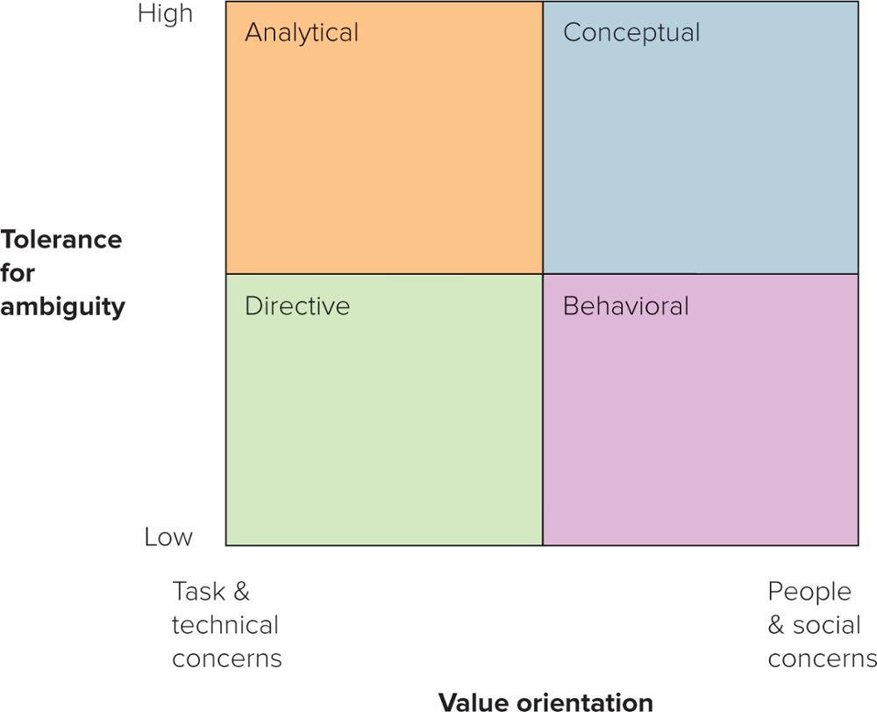
FOUR GENERAL DECISION-MAKING STYLES
Copyright ©McGraw-Hill Education. Permission required for reproduction or display.

Slide 18
WHICH STYLE DO YOU HAVE?
Knowledge of your decision-making style:
Helps you to understand yourself and facilitates self-improvement.
Can increase your ability to influence others by being aware of your—and their—style.
Gives you an awareness of how people can take the same information yet arrive at different decisions.

Slide 19
HOW to OVERCOME BARRIERS to DECISION MAKING
Four ineffective reactions:
Relaxed avoidance: Taking no action in the belief that there will be no great negative consequences.
Relaxed change: Realizing complete inaction will have negative consequences but opts for the first available alternative.
Defensive avoidance: Can’t find a good solution and follows by (a) procrastinating, (b) passing the buck, or (c) denying the risk.
Panic: So frantic to get rid of the problem that one can’t deal with the situation realistically.

Slide 20
THREE EFFECTIVE REACTIONS: DECIDING TO DECIDE
Importance
“How high priority is this situation?”
Credibility
“How believable is the information about the situation?”
Urgency
“How quickly must I act on the information about the situation?”

Slide 21
NINE COMMON DECISION-MAKING BIASES
The availability bias.
The representativeness bias.
The confirmation bias.
The sunk-cost bias.
The anchoring and adjustment bias.
The overconfidence bias.
The hindsight bias.
The framing bias.
The escalation of commitment bias.

Slide 22
GROUP DECISION MAKING: HOW to WORK with OTHERS
What are the advantages of group decision making?

Slide 23
DISADVANTAGES of GROUP DECISION MAKING
What are the disadvantages of group decision making?

Slide 24
SYMPTOMS of GROUPTHINK
Sense of invulnerability.
Rationalization.
Illusion of unanimity and peer pressure.
“The wisdom of crowds.”
Copyright Sam Edwards/agefotostock RF

Slide 25
CHARACTERISTICS of GROUP DECISION MAKING
They are less efficient.
Their size affects decision quality.
Optimal group size may be 5 or 7 people.
Odd group numbers are best.
They may be too confident.
Knowledge counts.

Slide 26
WHEN a GROUP CAN HELP in DECISION MAKING: THREE PRACTICAL GUIDELINES
When it can increase quality.
When it can increase acceptance.
When it can increase development.

