Slide 1
Organizational Structure, Design, & Culture

Slide 2
LEARNING OBJECTIVES
Understand why and how organisations develop and evolve
Describe typical organisational structures
Identify the factors that affect the design of an organization’s structure.
Understand how managers align vision and strategies with the organization’s culture and structure.
Explain how to characterize an organization’s culture.
Describe the process of culture change in an organization.
Get you to think in which kind of culture you may best fit in – and thrive!

Slide 3
REMINDER: The ORGANIZATION: THREE TYPES
For-profit organizations
Formed to make money, or profits, by offering products or services.
Nonprofit organizations
Formed to offer services to some clients, not to make a profit (example: hospitals, colleges).
Mutual-benefit organizations
Voluntary collectives whose purpose is to advance members’ interests (example: unions, trade associations).

Slide 4
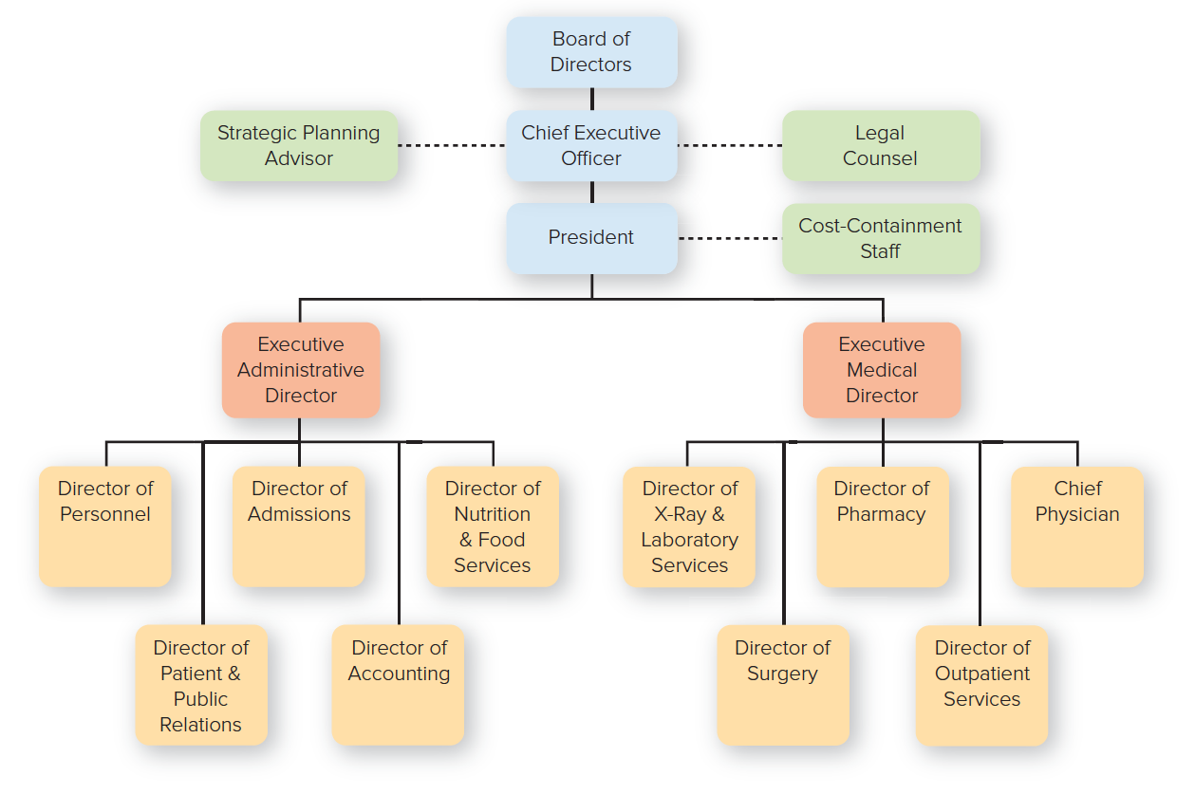
The ORGANIZATION CHART
Example for a Hospital
Copyright ©McGraw-Hill Education. Permission required for reproduction or display.

Slide 5
ORGANIZATIONAL STRUCTURE: WHO REPORTS to WHOM and WHO DOES WHAT
Organizational structure
A formal system of task and reporting relationships that coordinates and motivates an organization’s members so that they can work together to achieve the organization’s goals.
Concerned with who reports to whom and who specializes in what work.

Slide 6
BASIC TYPES of ORGANIZATIONAL STRUCTURES: SIMPLE STRUCTURE THIS IS HOW MOST COMPANIES LOOK LIKE WHEN THEY “START UP”
Authority is centralized in a single person with few rules and low work specialization.
Small firms all over the country are organized in this way.
An Owner
An Administrative Assistant
Copyright ©McGraw-Hill Education. Permission required for reproduction or display.

Slide 7
COMMON ELEMENTS of ORGANIZATIONS (1 of 2)
Four proposed by Edgar Schein:
Common purpose: gives everyone an understanding of the organization’s reason for being.
Coordinated effort: the coordination of individual effort into group-wide effort.
Division of labor: having discrete parts of a task done by different people.
Hierarchy of authority: making sure the right people do the right things at the right time (unity of command).

Slide 8
COMMON ELEMENTS of ORGANIZATIONS (2 of 2)
Three more that authorities agree on:
Span of control: the number of people reporting directly to a given manager; narrow or wide.
Authority: accountability, responsibility, and delegation; line versus staff positions.
Centralized versus decentralized authority: who makes decisions; upper management or middle.

Slide 9
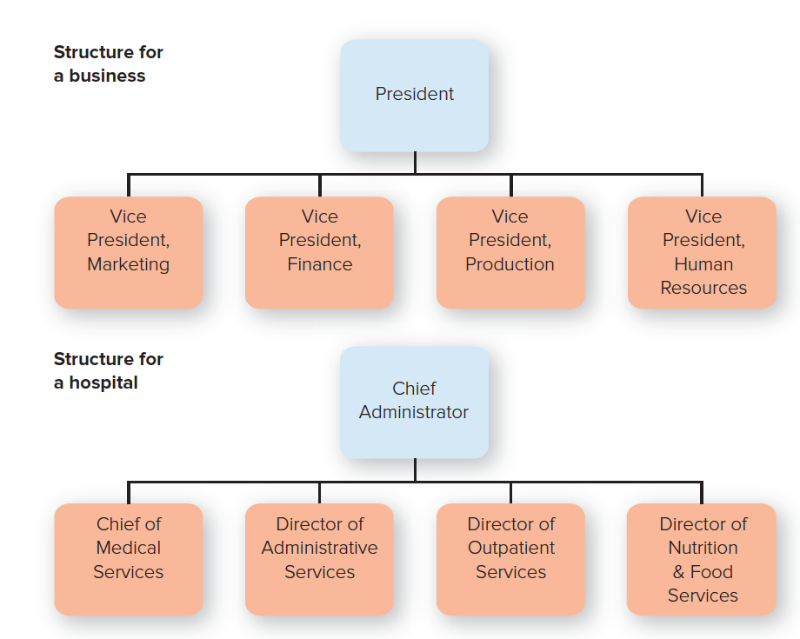
BASIC TYPES of ORGANIZATIONAL STRUCTURES: FUNCTIONAL STRUCTURE
People with similar occupational specialties are put together in formal groups.
Copyright ©McGraw-Hill Education. Permission required for reproduction or display.

Slide 10
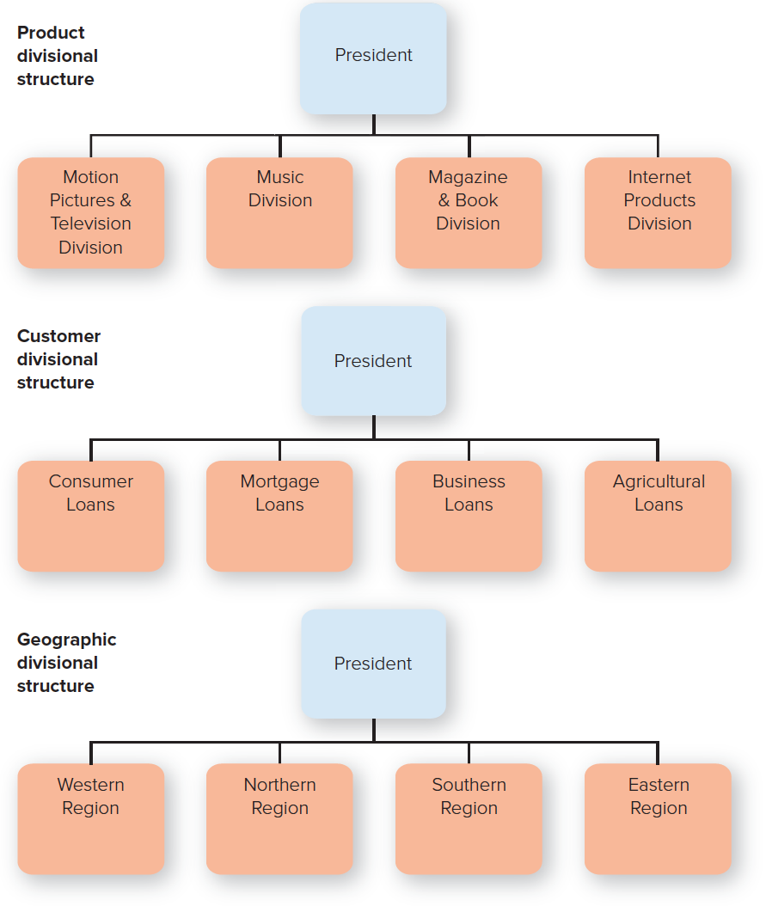
BASIC TYPES of ORGANIZATIONAL STRUCTURES: DIVISIONAL STRUCTURE
People with diverse occupational specialties are put together in formal groups by similar products, customers or geographic regions.
Copyright ©McGraw-Hill Education. Permission required for reproduction or display.

Slide 11
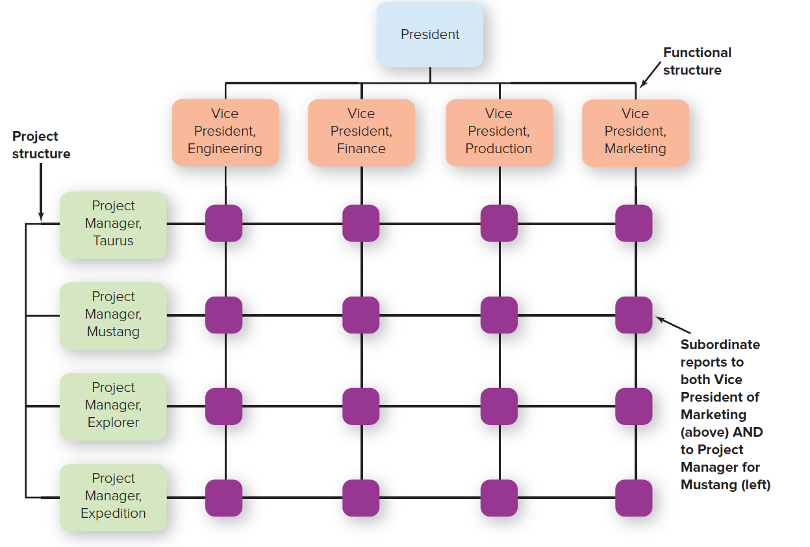
BASIC TYPES of ORGANIZATIONAL STRUCTURES: MATRIX STRUCTURE
Matrix structure:
Combines functional and divisional chains of command in a grid so that there are two command structures: vertical and horizontal.
Copyright ©McGraw-Hill Education. Permission required for reproduction or display.

Slide 12
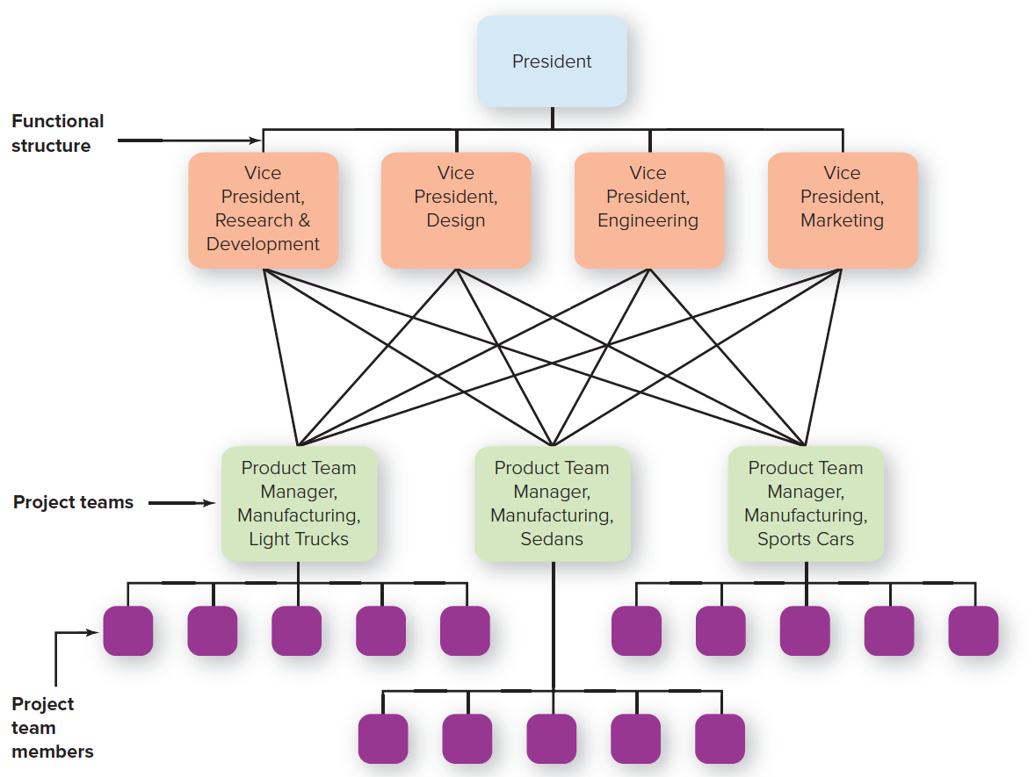
BASIC TYPES of ORGANIZATIONAL STRUCTURES: THE HORIZONTAL DESIGN
Horizontal Design:
Teams or workgroups, either temporary or permanent, are used to improve collaboration and work on shared tasks by breaking down internal boundaries.
Copyright ©McGraw-Hill Education. Permission required for reproduction or display.

Slide 13
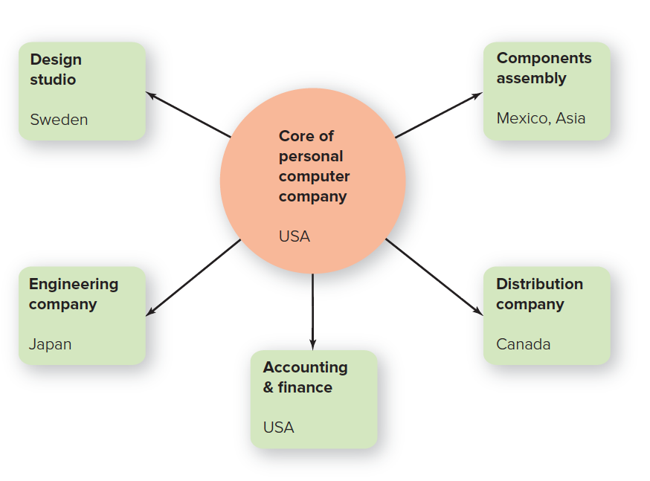
BASIC TYPES of ORGANIZATIONAL STRUCTURES: The HOLLOW or NETWORK STRUCTURE
Hollow or Network Structure:
The organization has a central core of key functions and outsources other functions to vendors who can do them cheaper or faster.
Copyright ©McGraw-Hill Education. Permission required for reproduction or display.

Slide 14
FACTORS in CREATING the BEST STRUCTURE
Contingency design
The process of fitting the organization to its environment.
Three factors to consider:
Environment: mechanistic versus organic.
Environment: differentiation versus integration.
Link between strategy, culture, and structure.
Hotels often have mechanistic designs.

Slide 15
MECHANISTIC VERSUS ORGANIC ORGANIZATIONS
MECHANISTIC ORGANIZATIONS | ORGANIC ORGANIZATIONS
Centralized hierarchy of authority | Decentralized hierarchy of authority
Many rules and procedures | Few rules and procedures
Specialized tasks | Shared tasks
Formalized communication | Informal communication
Few teams or task forces | Many teams or task forces
Narrow span of control, taller structures | Wider span of control, flatter structures

Slide 16
DIFFERENTIATION VERSUS INTEGRATION
Differentiation
Tendency of the parts of an organization to disperse and fragment.
Different product divisions; possible forces that push organization apart.
Integration
Tendency of the parts of an organization to draw together to achieve a common purpose.
Formal chain of command, standard rules and procedures, frequent communication and coordination.

Slide 17
LINK BETWEEN STRATEGY, CULTURE, and STRUCTURE
Aligning strategy, culture, and structure
Organizational culture and organizational structure should be aligned with its vision and strategies.
If managers change the strategy of the organization, they need to change the culture and structure to support it.
Similarly, as companies grow, the culture and structure need to grow with it.

Slide 18
ORGANIZATIONAL CULTURE: The SHARED ASSUMPTIONS THAT AFFECT HOW WORK GETS DONE
Organizational culture
The set of shared, taken-for-granted implicit assumptions that a group holds and that determines how it perceives, thinks about, and reacts to its various environments.
What drives an organizational culture?
…

Slide 19
DRIVERS and FLOW of ORGANIZATIONAL CULTURE
Copyright ©McGraw-Hill Education. Permission required for reproduction or display.

Slide 20
THREE LEVELS of ORGANIZATIONAL CULTURE
Level 1: Observable Artifact: Physical Manifestations of Culture
Examples?
Level 2: Espoused Values: Explicitly Stated Values and Norms
Level 3: Basic Assumptions: Core Values of the Organization

Slide 21
FOUR TYPES of ORGANIZATIONAL CULTURE (1 of 2)
Clan culture
Internal focus.
Flexibility over stability.
Collaboration among employees.
Example: Google, Zappo’s
Adhocracy (“flexible organization”) culture
External focus.
Values flexibility.
Adaptable, creative, and quick to respond to changes in the marketplace.
Example: Start-Ups, Google in its early days, Apple, Facebook
In essence: «We’re all in this together!»
»High risk, high reward!»

Slide 22
FOUR TYPES of ORGANIZATIONAL CULTURE (2 of 2)
»Make it, or break it!»
Market culture
Focused on the external environment
Values stability and control
Driven by competition and a strong desire to deliver results
Uber, Tesla, Amazon
Hierarchy culture
Has an internal focus
Values stability and control over flexibility
Formalized, structured work environment
Helpful to manage risk and operationally efficient
Banks, government institutions, military, oil&gas companies,
»Stay the course and don't rock the boat!»
©SWNS/Alamy Stock Photo

Slide 23
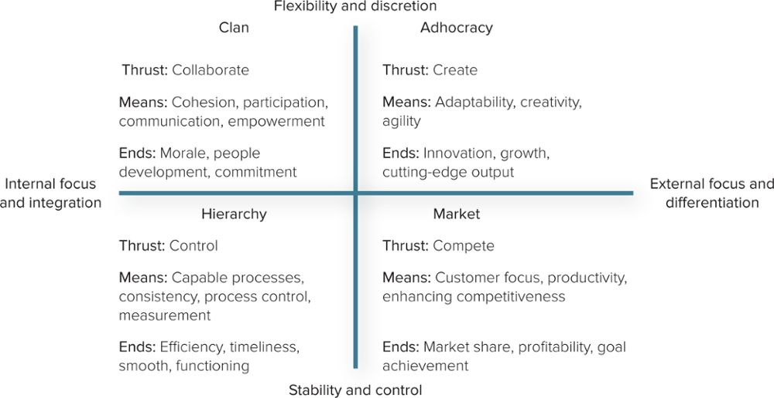
COMPETING VALUES FRAMEWORK
Source: Adapted from K.S. Cameron, R.E. Quinn, J. Degraff, and A.V. Thakor, Competing Values Leadership (Northampton, MA: Edward Elgar, 2006), p. 32.
Copyright ©McGraw-Hill Education. Permission required for reproduction or display.

Slide 24
HOW EMPLOYEES LEARN CULTURE
Symbols: an object, an act, a quality, or event that conveys meaning to others.
Stories: narrative based on true events repeated—and sometimes embellished upon—to emphasize a particular value.
Heroes: person whose accomplishments embody the values of the organization.
Rites and rituals: activities and ceremonies that celebrate important occasions and accomplishment.
Organizational socialization: the process by which people learn the values, norms, and required behaviors of an organization.

Slide 25
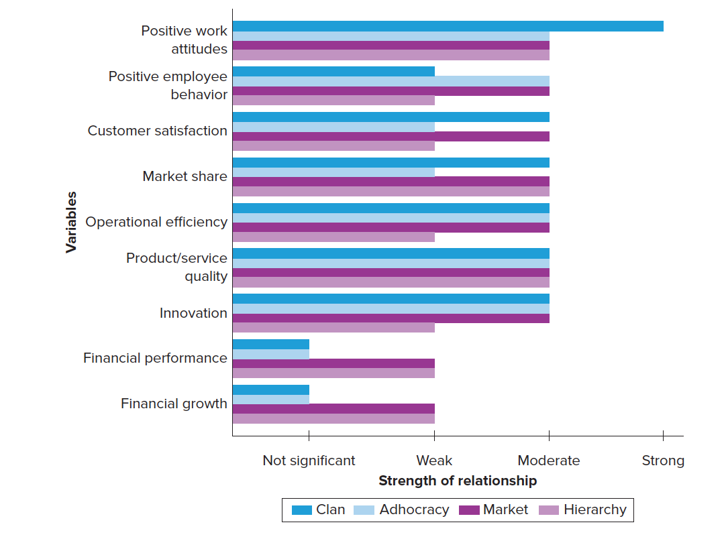
The IMPORTANCE of CULTURE
What organizational benefits are associated with what organizational cultures?
Source: A.Y. Ou, C. Harnell, A. Kinicki, E. Karam, and D. Choi, “Culture in Context: A Meta-analysis of the Nomological Network of Organizational Culture.” Presentation as part of symposium Connecting Culture and Context: Insights from Organizational Culture Theory and Research at the 2016 National Academy of Management meeting in Anaheim, California. s
Copyright ©McGraw-Hill Education. Permission required for reproduction or display.

Slide 26
THE RESULTS REVEALED…
An organization’s culture matters.
Employees have more positive work attitudes when working in organizations with clan cultures.
Clan and market cultures are more likely to deliver higher customer satisfaction and market share.
Operational outcomes, quality, and innovation are more strongly related to clan, adhocracy, and market cultures than to hierarchical ones.
An organization’s financial performance is not strongly related to organizational culture.
Companies with market cultures tend to have more positive organizational outcomes.

Slide 27
WHAT DOES IT MEAN to “FIT”? ANTICIPATING a JOB INTERVIEW
The four most frequently asked interview questions used by hiring managers, according to a survey involving 285,000 kinds of interview questions.
What’s your favorite movie?
What’s your favorite website?
What makes you uncomfortable?
What’s the last book you read for fun?
Person-organization fit
Reflects the extent to which your personality and values match the climate and culture in an organization.

Slide 28
A DOZEN WAYS to CHANGE ORGANIZATIONAL CULTURE (1 of 2)
Formal statements: mission, vision, values.
Language, slogans, sayings, and acronym.
Rites and rituals.
Stories, legends, and myth.
Leader reactions to crises.
Role modeling, training, and coaching.

Slide 29
A DOZEN WAYS to CHANGE ORGANIZATIONAL CULTURE (2 of 2)
Through physical design.
With rewards, titles, promotions, and bonuses.
Establishing goals and performance criteria.
Through measurable and controllable activities.
By changing organizational structure.
Using organizational systems and procedures.

