Slide 1
Module C3
Bottlenecks in recycling of energy systems
AAE-E3120 / AAE-E3121
Circular Economy for Energy Storage​
Šimon Jech

Slide 2
Reflection on previous topics
Lecture Journal
What are the different stages in recycling of electronic waste and what is the purpose of each of the steps?
(DO NOT reflect on reduce, refurbish, reuse etc., reflect on the industrial recycling), it is not important to be fully correct but rather what you remember.

Slide 3
Learning outcomes
Understand what are the bottlenecks in current recycling of energy related technologies?

Slide 4
Overview of recycling – back to A2
K. Miettunen, A. Santasalo-Aarnio, “Eco-design for dye solar cells: from hazardous waste to profitable recovery” J. Cleaner Production, 320 (2021) 128743. https://doi.org/10.1016/j.jclepro.2021.128743

Slide 5
Bottlenecks
General
Material
Economic
Environ-mental

Slide 6
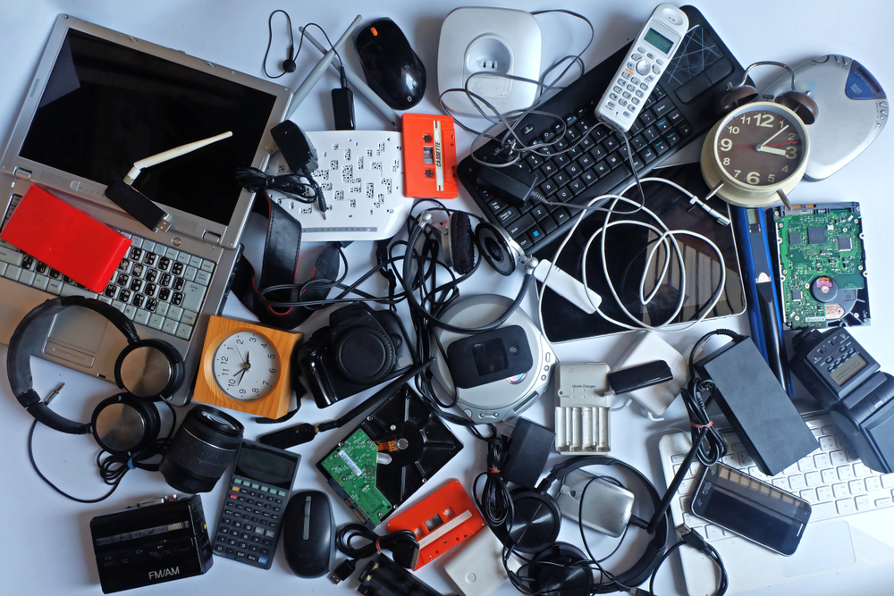
General Bottleneck
Collection issue
Hording devices
Incorrect disposal
Transportation
https://www.letsrecycle.com/news/uk-households-hoarding-20-7m-electrical-items/

Slide 7
General Bottleneck
Pre-treatment
What do we do with the device before material recovery
Dismantling standards / guidelines not existent
To crush or not to crush?

Slide 8
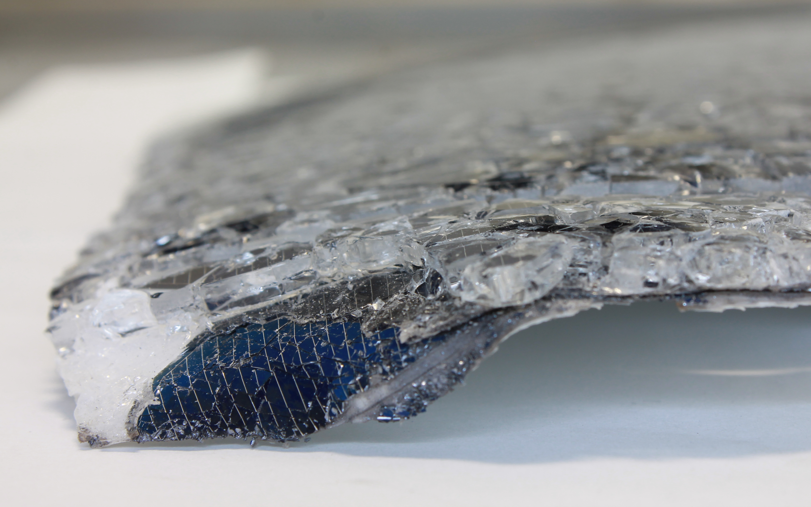
Recycling not taken into account
General Bottleneck
Glued parts
Sealed parts
Multilayer materials
Designed to break not to last

Slide 9
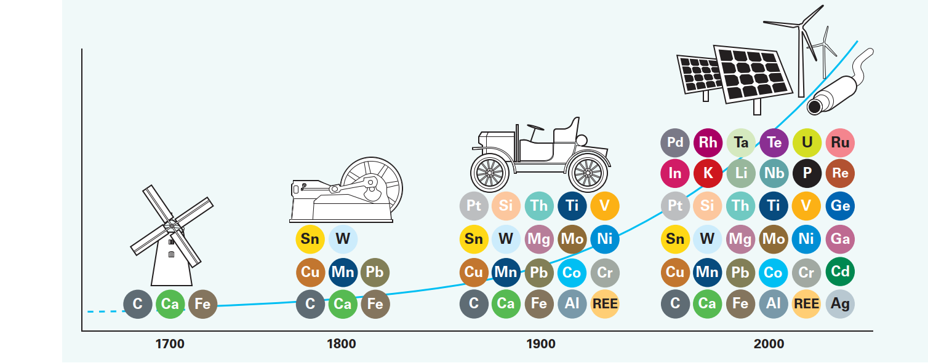
Material Bottleneck
Device complexity
Zepf V., Reller A., Rennie C., Ashfield M. & Simmons J.,
BP (2014): Materials critical to the energy industry.
An introduction. 2nd edition.
Notes:
Multilayer material
use of more and more different elements
Different chemistries, compostions

Slide 10
Hazardous materials
Material Bottleneck
Environmental
Bottleneck
Zepf V., Reller A., Rennie C., Ashfield M. & Simmons J.,
BP (2014): Materials critical to the energy industry.
An introduction. 2nd edition.

Slide 11
Environmental impact
Environmental
Bottleneck
Emissions from the process
We need to evaluate the benefits vs. impact
Transportation
End of life treatment is usually centralized
Exporting waste to 3rd countries
Exposure of workers

Slide 12
Material Bottleneck
Policy
Economic Bottleneck
WEEE Targets
80 % mass
29 %
Embodied energy
25 %
value
Solar panel composition (Thomassen et al., 2021, 10.1016/J.RESCONREC.2021.105917
WEEE - https://eur-lex.europa.eu/legal-
content/EN/TXT/?uri=CELEX:02012L0019-20180704.

Slide 13
Economical hurdles
Economic Bottleneck
Recycling
Too expensive to be profitable
Unknown market for secondary materials

Slide 14
Low amount of waste
Economic Bottleneck
Not enough to drive profitable recycling
Example Photovoltaic waste:
14 kt collected in EU – 2018 ¹
18 kt to be profitable (high Ag content)
43 kt (low Ag content) ²
¹https://ec.europa.eu/eurostat/databrowser/view/env_waselee__custom_8419408/default/table?lang=en
² Granata, et al. (2022). https://doi.org/10.1016/J.JCLEPRO.2022.132384

Slide 15
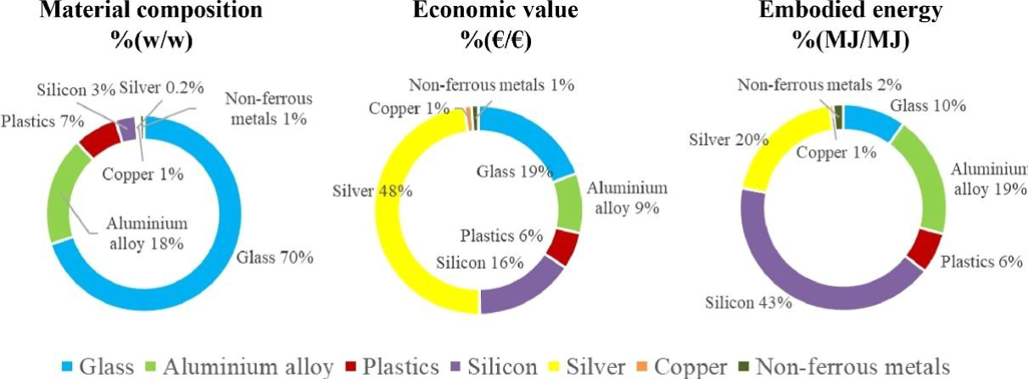
Low amount of valuable materials
Economic Bottleneck
Solar panel composition (Thomassen et al., 2021, 10.1016/J.RESCONREC.2021.105917

Slide 16
Challenges in Re-use / Repair
Economic Bottleneck
Repair
Technologically too complicated
Too expensive
Reuse
Quality assurance?
Lifetime prediction uncertainty
Too expensive compared with new one
~100 EUR new panel
Tsanakas, et al. (2020) https://doi.org/10.1002/PIP.3193

Slide 17
Lecture Journal
What do you think could be the bottlenecks relevant for your storage technology?
Are there any other bottlenecks that you can think of?

Slide 18
Si solar panels – main bottlenecks

Slide 19
Main bottlenecks – Si solar panels
Encapsulant
Low amounts of End-of-life panels
Low cost of new panels
cell
5 mm

Slide 20
Take-home message
Recycling is important for Circular Economy, but there are still many challenges to overcome.

Slide 21
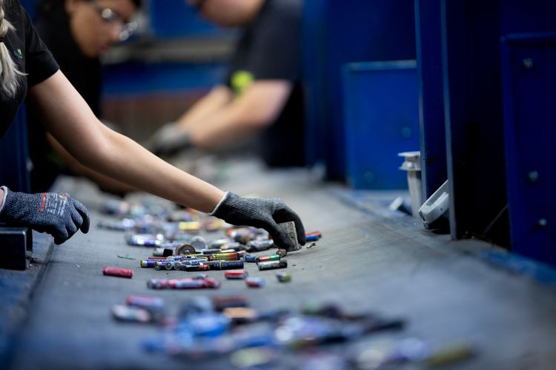
Sorting
Need to sort different kinds of:
Batteries
Solar panels
https://www.sortbat.be/expertise/sorting-batteries

Slide 22
In summary
Not enough waste 🙈
Struggle to compete with primary production
Not enough valuables
Re-use, repair too expensive
Device complexity
Recycling is not taken into account
Policy?

Slide 23
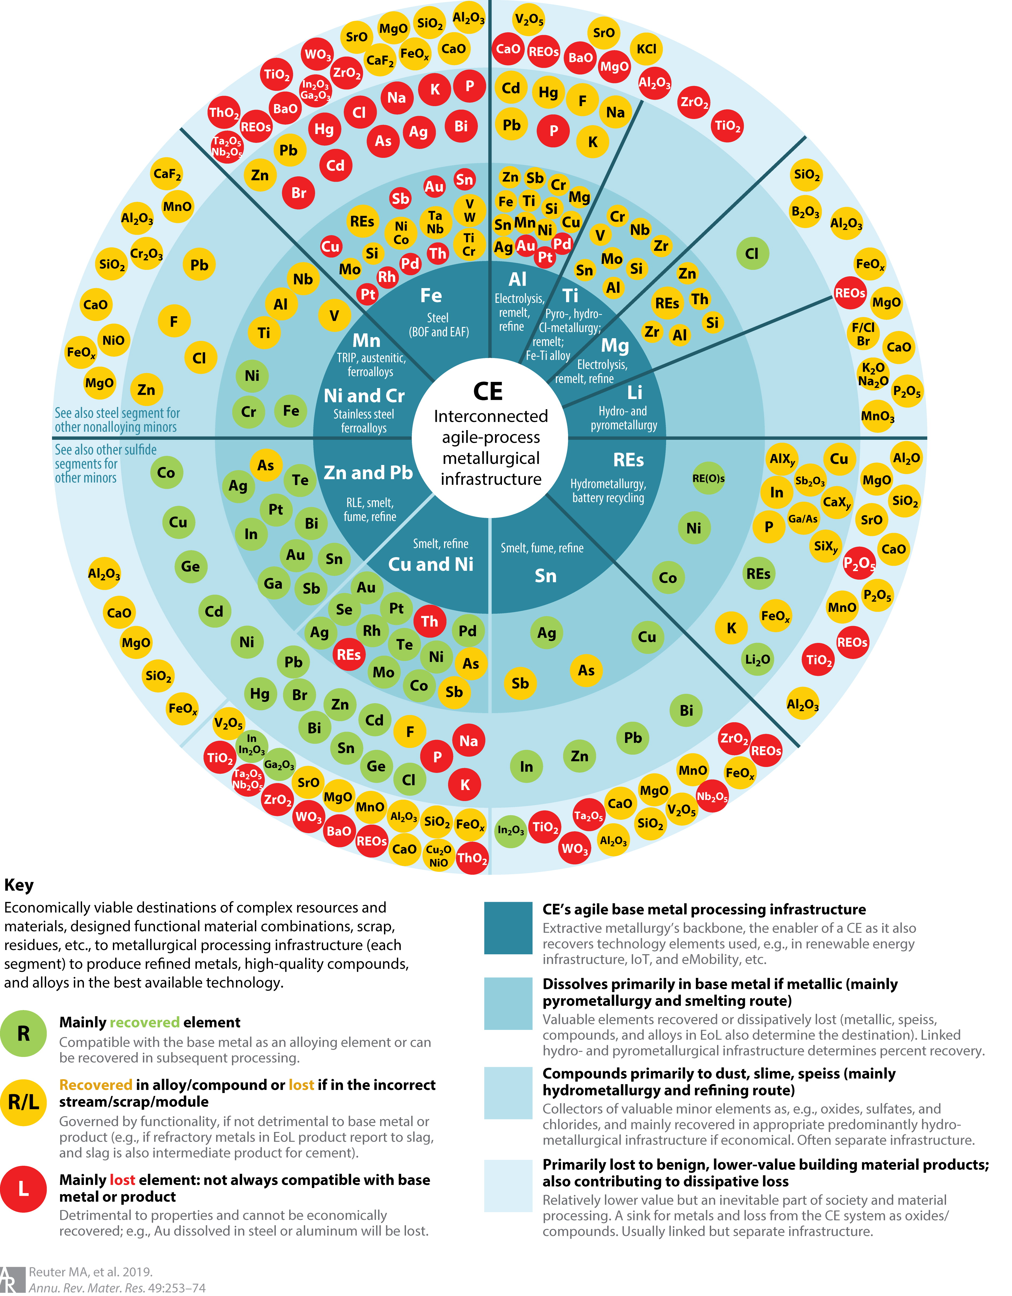
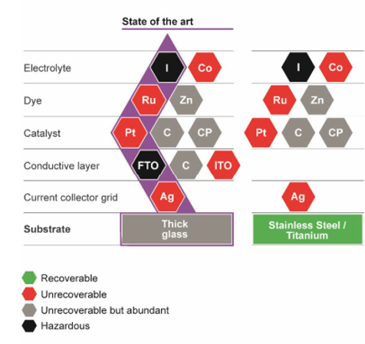
M – unrecoverable materials
K. Miettunen, A. Santasalo-Aarnio,. https://doi.org/10.1016/j.jclepro.2021.128743
Reuter et al., (2019). https://doi.org/10.1146/ANNUREV-MATSCI-070218-010057

