Slide 1
HUMAN RESOURCE MANAGEMENT
Getting the Right People for Managerial Success

Slide 2
TODAY
Discuss the importance of strategic human resource management.
Discuss ways to recruit and hire the right people.
How to manage and develop the employees working for a company

Slide 3
HUMAN RESOURCE MANAGEMENT
Human resource management (HRM)
Consists of the activities managers perform to plan for, attract, develop, and retain an effective workforce.
Human capital
The economic or productive potential of employee knowledge, experience, and actions.
Knowledge worker
Someone whose occupation is principally concerned with generating or interpreting information, as opposed to manual labor.
Social capital
The economic or productive potential of strong, trusting, and cooperative relationships.

Slide 4
The STRATEGIC HRM PROCESS
Strategic human resource planning consists of developing a systematic, comprehensive strategy for:
Understanding current employee needs.
Predicting future employee needs.
Copyright ©McGraw-Hill Education. Permission required for reproduction or display.

Slide 5
UNDERSTANDING CURRENT EMPLOYEE NEEDS
Job analysis
Determining the basic elements of a job by observation and analysis.
Job description
Summarizes what the holder of the job does and how and why he or she does it.
Job specification
Describes the minimum qualifications a person must have to perform a job successfully.

Slide 6
PREDICTING FUTURE EMPLOYEE NEEDS
Predicting future needs
Become knowledgeable about the staffing the organization might need.
Know the likely sources for staffing.
Human resource inventory
A report listing your organization’s employees by name, education, training, languages, and other important information.
Why is this a key activity for a company?
Copyright dennizn/Shutterstock RF

Slide 7
RECRUITMENT and SELECTION
Recruitment
Process of locating and attracting qualified applicants for jobs open in the organization.
“5% of your workforce produces 26% of your output.”
Internal: hiring from the inside.
External: hiring from the outside.

Slide 8
INTERNAL and EXTERNAL RECRUITING: ADVANTAGES and DISADVANTAGES
Internal and External Recruiting Advantages | Internal and External Recruiting Disadvantages
INTERNAL RECRUITING ADVANTAGES | INTERNAL RECRUITING DISADVANTAGES
Employees tend to be inspired to greater effort and loyalty. Morale is enhanced because they realize that working hard and staying put can result in more opportunities. The whole process of advertising, interviewing, and so on is cheaper. There are fewer risks. Internal candidates are already known and are familiar with the organization. | Internal recruitment restricts the competition for positions and limits the pool of fresh talent and fresh viewpoints. It may encourage employees to assume that longevity and seniority will automatically result in promotion. Whenever a job is filled, it creates a vacancy elsewhere in the organization.
EXTERNAL RECRUITING ADVANTAGES | EXTERNAL RECRUITING DISADVANTAGES
Applicants may have specialized knowledge and experience. Applicants may have fresh viewpoints. | The recruitment process is more expensive and takes longer. The risks are higher because the persons hired are less well known.
Copyright ©McGraw-Hill Education. Permission required for reproduction or display.

Slide 9
WHICH EXTERNAL RECRUITING METHODS WORK BEST?
Most effective sources
Employee referrals.
What do you think about E-recruitment tools (member directories, social media such as LinkedIn, “dot-jobs” websites)?
Realistic job preview
What happens in a job preview? Do you think it’s effective?

Slide 10
SELECTION: HOW to CHOOSE the BEST PERSON for the JOB
What is the ultimate objective of all this?
Selection process
Screening of job applicants to hire the best candidate.
Involves three components:
Background information.
Interviews.
Employment tests.
Copyright Cultura/Getty Images RF

Slide 11
INTERVIEWING: UNSTRUCTURED
Unstructured interview
No fixed set of questions and no systematic scoring procedure.
Involves asking probing questions to find out what the applicant is like.
What would possible questions be?

Slide 12
INTERVIEWING: STRUCTURED
Structured interview
Asking each applicant the same questions and comparing their responses to a standardized set of answers.
Type 1: Situational interview
Focuses on hypothetical situations.
Type 2: Behavioral interview
Explore what applicants have actually done in the past.

Slide 13
EMPLOYMENT TESTS (1 of 2)
Ability tests
Measure physical abilities, strength and stamina, mechanical ability, mental abilities, and clerical abilities.
Performance tests
Also known as skills tests, measure performance on actual job tasks—so-called job tryouts.
May take place in an assessment center.

Slide 14
EMPLOYMENT TESTS (2 of 2)
Personality tests
Measure such personality traits as emotional intelligence, social intelligence, resilience, personal adaptability, and need for achievement.
May include career-assessment tests.
Integrity tests
Assess attitudes and experiences related to a person’s honesty, dependability, trustworthiness, reliability, and pro-social behavior.
Do you think it’s better to honestly answer the questions or to provide ones that make them appear more suited for the job?

Slide 15
COMPENSATION and BENEFITS
Compensation
Wages or salaries, incentives, and benefits.
Base pay
Basic wage or salary paid employees in exchange for doing their job.
Incentives
Commissions, bonuses, profit-sharing plans, and stock options.
Benefits
Health insurance, dental insurance, life insurance, disability protection, retirement plans, holidays off, sick days and vacation days, recreation options, health club memberships, family leave, discounts.

Slide 16
FIVE STEPS in the LEARNING and DEVELOPMENT PROCESS
Copyright ©McGraw-Hill Education. Permission required for reproduction or display.

Slide 17
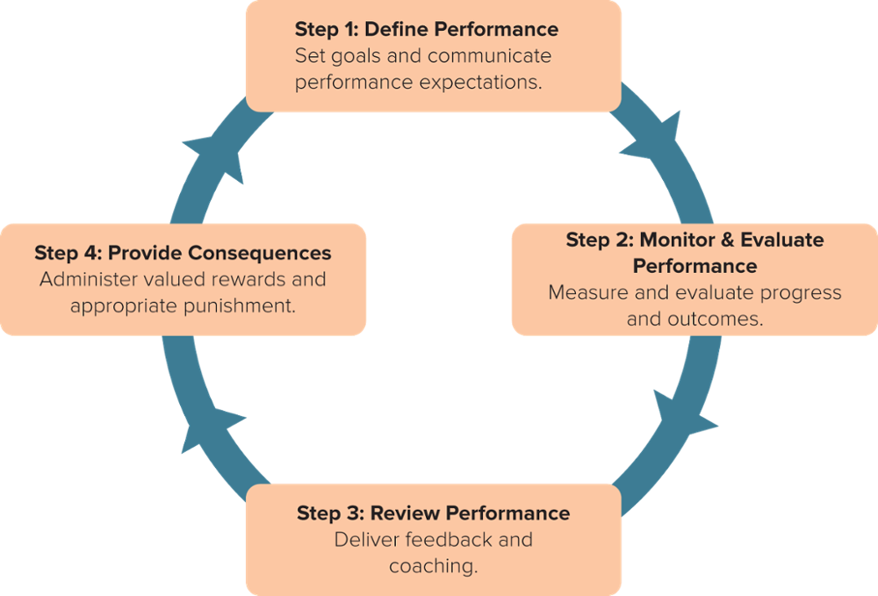
PERFORMANCE APPRAISAL (1 of 4)
Performance management
Set of processes and managerial behaviors that involve defining, monitoring, measuring, evaluating, and providing consequences for performance expectations.
Source: Adapted from A.J. Kinicki, K.J.L. Jacobson, S.J. Peterson, and G.E. Prussia, “Development and Validation of the Performance Management Behavior Questionnaire,” Personnel Psychology, 66 (2013), pp. 1-45.
Copyright ©McGraw-Hill Education. Permission required for reproduction or display.

Slide 18
PERFORMANCE APPRAISAL (2 of 4)
Performance appraisal
Also called a performance review.
Consists of:
Assessing an employee’s performance.
Providing feedback.
Copyright Asia Images Group/Getty Images RF

Slide 19
PERFORMANCE APPRAISAL (3 of 4)
Objective appraisal
Based on fact and often numerical.
Measures desired results.
Harder to challenge legally: reduced personal bias.
Copyright stevecoleimages/Getty Images RF

Slide 20
Who Should Make Performance Appraisals?
Peers and subordinates?
Customers and clients?
Self-Appraisal?
Managers?
YOUR PERFORMANCE
Example: 360-degree assessment.
Employees are appraised not only by their managerial superiors but also by peers, subordinates, and sometimes clients.
Typically, an employee chooses evaluators (6 to 12 people) who fill out anonymous forms, the results of which are tabulated by computer.
Employee goes over results with his or her manager and together they put into place a long-term plan for performance goals.

Slide 21
EFFECTIVE PERFORMANCE FEEDBACK
One approach is to think of yourself as a coach.
Remember to deliver at least one positive message to balance any negative feedback you must convey.
Take a problem-solving approach and avoid criticism.
Be specific and direct in describing the employee’s performance and in identifying the improvement desired.
Get the employees input.
Follow up.

Slide 22
PROMOTIONS, TRANSFERS, DISCIPLINE, and DISMISSALS
Promotion: moving upward to a higher-level position.
Transfer: moving sideways with similar responsibilities.
Discipline and demotion: the threat of moving downward.
Dismissal: moving out of the organization through layoffs, downsizings, and firings.

Slide 23
EXIT INTERVIEWS – THEY ARE IMPORTANT!
Exit interview
A formal conversation to find out why an employee is leaving and to learn about potential problems in the organization.
What is the usefulness of exit interviews?
Copyright Vgstockstudio/Shutterstock RF

