Slide 1
ORGANIZATIONAL CHANGE & INNOVATION
Lifelong Challenges for the Exceptional Manager

Slide 2
LEARNING OBJECTIVES
Discuss what managers should know about organizational change.
Discuss three types of change, Lewin’s change model, and the systems approach to change.
Discuss the purpose of organizational development.
Discuss the approaches toward innovation and components of an innovation system.
Discuss ways managers can help employees overcome fear of change

Slide 3
The NATURE of CHANGE in ORGANIZATIONS
What will you be called on to deal with?

Slide 4
TWO TYPES of CHANGE
Reactive change
…
Proactive (or planned) change
…
©cookelma/Getty Images

Slide 5
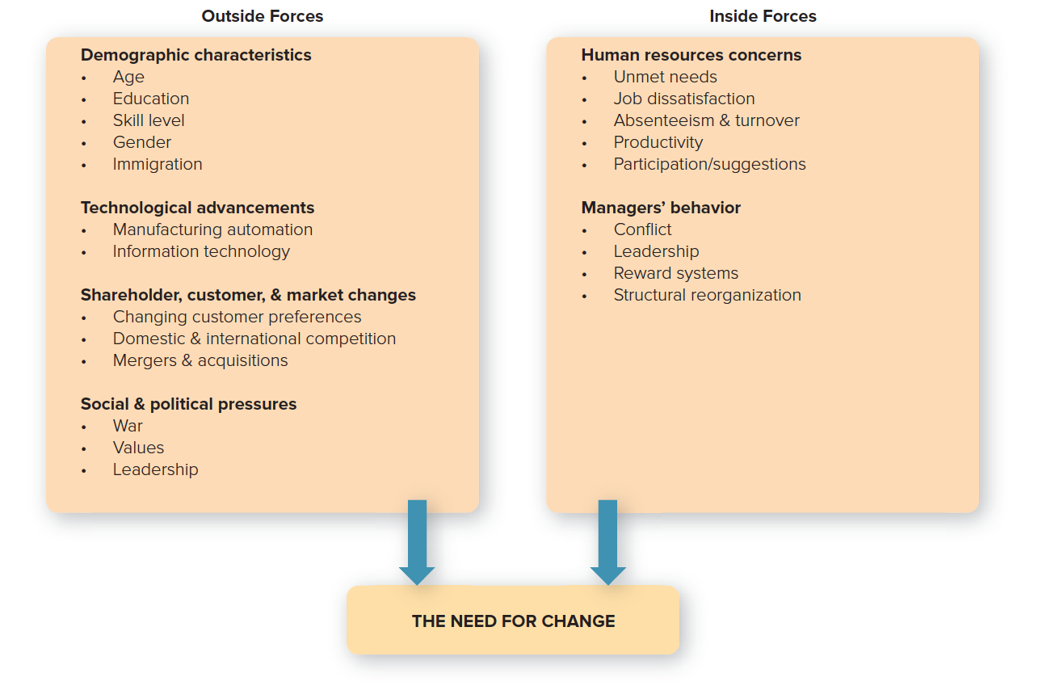
FORCES for CHANGE
Copyright ©McGraw-Hill Education. Permission required for reproduction or display.

Slide 6
TYPES and MODELS of CHANGE
Three types of change:
Least threatening: Adaptive change.
Reintroduction of a familiar practice.
Somewhat threatening: Innovative change.
Introduction of a practice that is new to the organization.
Very threatening: Radically innovative change.
Involves introducing a practice that is new to the industry.

Slide 7
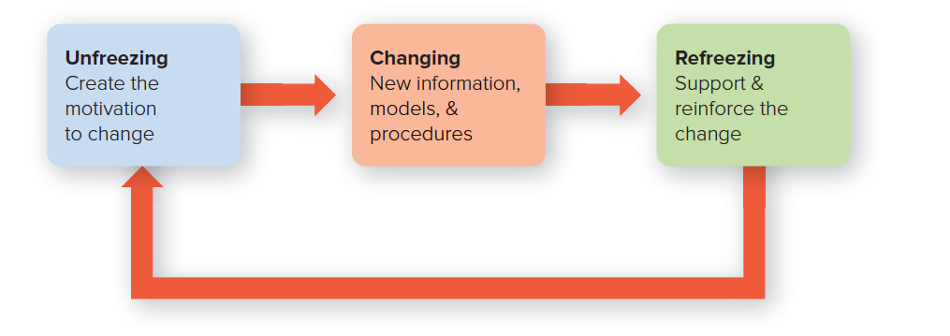
LEWIN’S CHANGE MODEL
Copyright ©McGraw-Hill Education. Permission required for reproduction or display.

Slide 8
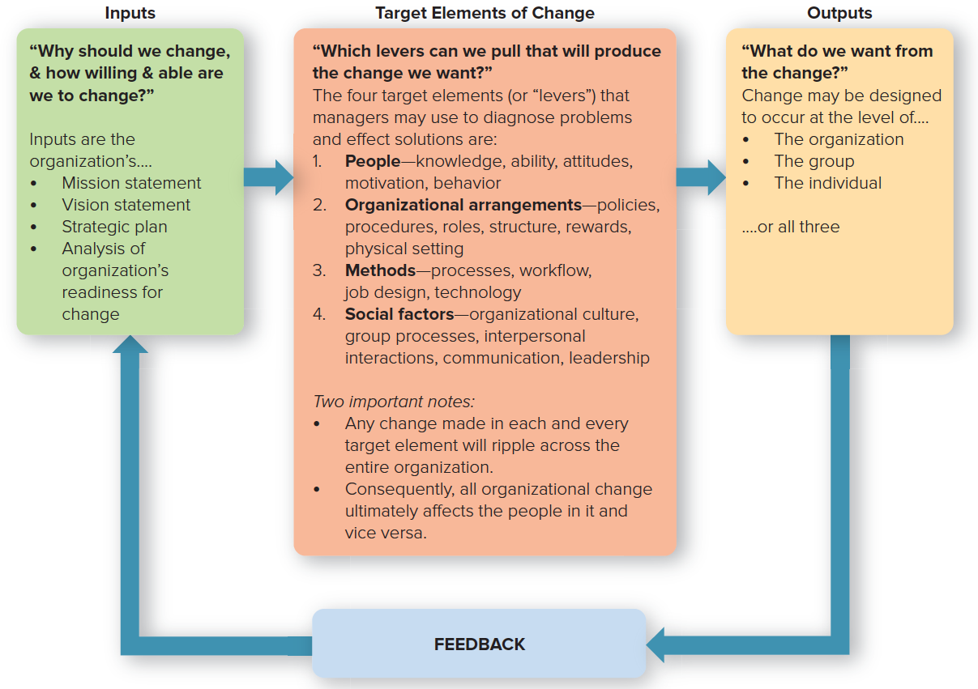
A SYSTEMS APPROACH to CHANGE
Source: Based on A. Kinicki and M. Fugate, Organizational Behavior: A Practical, Problem-Solving Approach (New York: McGraw-Hill Education, 2016) Figure 16.4, p. 567, which was adapted from D.R. Fuqua and D. J. Kurplus, “Conceptual Models in Organizational Consultation,” Journal of Counseling and Development, July to August 1993, pp. 602-618; D.A. Nadler and M.L. Tushman, “Organizational Frame Bending: Principles for Managing Reorientation,” Academy of Management Executive, August 1989, pp. 194-203.
Copyright ©McGraw-Hill Education. Permission required for reproduction or display.

Slide 9
ORGANIZATIONAL DEVELOPMENT
Organization development (OD)
Set of techniques for implementing planned change to make people and organizations more effective.
Change agent
A consultant with a background in behavioral sciences who can be a catalyst in helping organizations deal with old problems in new ways.

Slide 10
WHAT CAN OD BE USED for?
Managing conflict: An OD expert or “executive coach” can help advise on how to improve relationships within the organization.
Revitalizing organizations: OD experts can help by opening communication, fostering innovation, and dealing with stress.
Adapting to mergers: OD experts can help integrate two firms with varying cultures, products, and procedures.

Slide 11
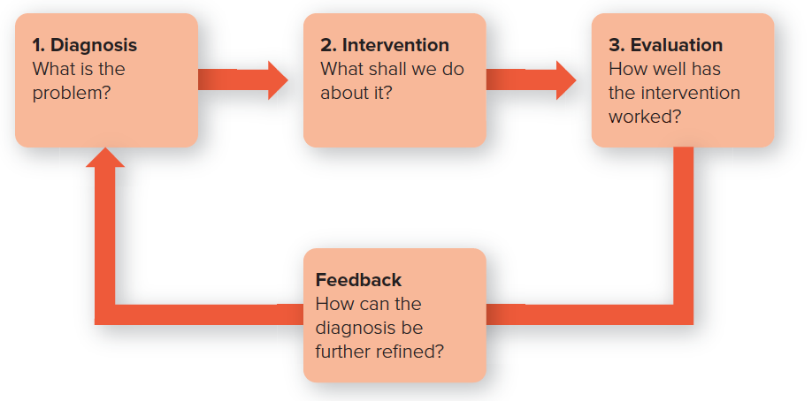
HOW OD WORKS
Figure 10.4: The OD Process
Sources: Adapted from W.L. French and C.H. Bell Jr., Organization Development: Behavioral Interventions for Organizational Improvement (Englewood Cliffs, NJ: Prentice Hall. 1978); E. G Huse and T. G. Cummings, Organizational Development and Change, 3rd ed. (St. Paul: West, 1985).
Copyright ©McGraw-Hill Education. Permission required for reproduction or display.

Slide 12
The EFFECTIVENESS of OD
Success tends to include multiple interventions.
It is more likely to succeed with management support.
It has more success when oriented to achieve both short and long-term results.
OD is affected by cross-cultural considerations.
©Image Source/Glow Images

Slide 13
TYPES of INNOVATION
Product innovation
Change in the appearance or performance of a product or the creation of a new one.
Process innovation
Change in the way a product is conceived, manufactured, or disseminated.

Slide 14
FOCUS of the INNOVATION
Improvement innovations enhance or upgrade an existing product, service, or process.
These types of innovations are often incremental and are less likely to generate significant amounts of new revenue.
New-direction innovations are a totally new or different approach to a product, service, process or industry.
The invention of breakthrough products or services that are aimed at creating brand new markets and customers.

Slide 15
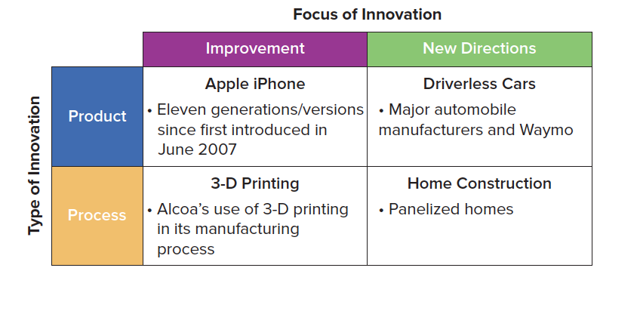
APPROACHES toward INNOVATION
Copyright ©McGraw-Hill Education. Permission required for reproduction or display.

Slide 16
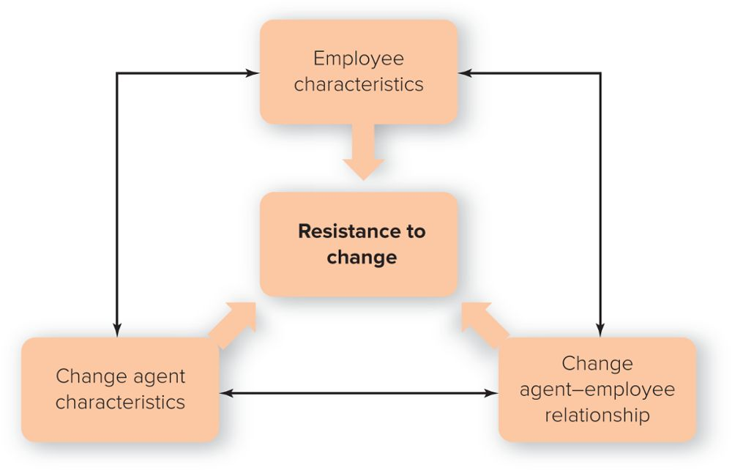
The THREAT of CHANGE: MANAGING EMPLOYEE FEAR and RESISTANCE
Resistance to change
An emotional or behavioral response to real or imagined threats to an established work routine.
Source: Adapted from R. Kreitner and A. Kinicki. Organizational Behavior, 9th ed. (Burr Ridge, IL: McGraw-Hill/Irwin, 2010), p. 549.
Copyright ©McGraw-Hill Education. Permission required for reproduction or display.

Slide 17
TEN REASONS EMPLOYEES RESIST CHANGE
Individual’s predisposition toward change.
Surprise and fear of the unknown.
Climate of mistrust.
Fear of failure.
Loss of status or job security.
Peer pressure.
Disruption of cultural traditions or group relationships.
Personality conflicts.
Lack of tact or poor timing.
Nonreinforcing reward system.

