Slide 1
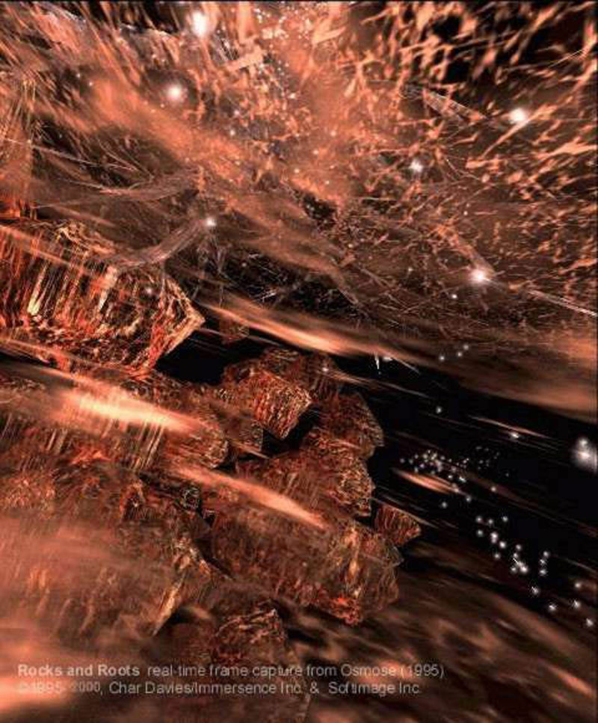
Anthropology of the senses,
Towards a Holistic
Understanding of Virtual Reality
By Lily Díaz-Kommonen
Professor of New Media
Designing and creating virtual
worlds – AXM-E404
23 October 2023

Slide 2
Part One
Is a holistic approach important?

Slide 3
Holistic understanding
Valorisation of human experience: Good for the human and for the environment; good for the personal and the collective.
The notion of multisensory signals within a humanistic framework as a positive step towards the developing design methods that foster sustainability.
  Being in tune with the world around
  Allowing yourself to invite that world into your living experiences
  Ensuring that our interactions in and with the world are sustainable.
Notes:
I would argue that the most important item that you could learn about VR relates to being able to understand it in a different way. One in which there is a valorization of the human experience in the world. This implies a relational perspective through which our being in the world has an effect on the being in the world of other creatures and entities.
EXAMPLE: Presence of anthropogenic hazards – hazards caused by human action or inaction such – as artificial light pollution.

Slide 4
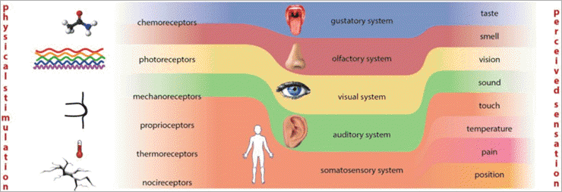
Holistic understanding
The visual sense is only one part of the human sensorium.
Even in Antiquity, the exalted position of sight was tempered by the conviction that all senses were “perfectly formed in their own right”. This could be evidenced in the fact the colours, sounds, smells and touch can only be received by one and only one organ.” ^{[1]}
[1] Sears, E. 1993. “Sensory Perception and its Metaphors in the Time of Richard of Fournival. In Medicine
and the Five Senses, ed. WF Bynum, & R. Porter, 17–39, Cambridge University Press.
[2] Softwarare Testing, “Organization of Human Perception”, available at https://www.softwaretestinghelp.com/what-is-virtual-reality/#Introduction_To_Computer_Graphics_And_Human_Perception. (Accessed 22/10/2023.)
Notes:
Sight came to distance itself significantly from the other senses in terms of cultural impor­tance only in the eighteenth and nineteenth cen­turies, when vision became associated with the growing field of science. The “inquiring and penetrating gaze of the scientist” becomes the metaphor for the acquisition of knowledge. Foucault, The Order of Things, 1973.

Slide 5
Holistic understanding
Yet, though the visual sense is only one part of the human sensorium, it is often used as if ‘by proxy’ to measure our response to everything.
  See what I mean?”
  “Can’t you see what is happening?”
From the late 18th century and the Enlightenment, the role of sight in Western society was further enlarged so as to becomes synonymous with knowledge.
These developments can be researched and studied from a cultural-historical perspective. ^{[2]}
[2] Howes, David, 2002, “Nose-wise: Olfactory Metaphors in Mind”, in Rouby, C., Benoist Schaal, D., Gervais, R., & A. Holley, (eds.), Olfaction, Taste and Cognition, Cambridge, UK: Cambridge University Press.
Notes:
From the late 18th century and the Enlightenment, the role of sight in Western society was further enlarged so as to becomes synonymous with knowledge.
These developments can be researched and studied from a cultural-historical perspective. Nevertheless, this topic is too large and demanding to study within this course. If you are interested in learning more please contact me after you have completed the course. ☺

Slide 6
Holistic understanding
And the so-called ‘animalistic senses’ like smell, taste and touch that were once associated with the intellect:
  Nose-wise – clever
  English words such as ‘sagacious’ and ‘sage’ both which refer to intelligence are based on Latin words meaning to have a good sense of smell.
  Words associated with thinking and understanding such as to apprehend, to grasp, have a tactile sensibility.
  Tactile synonyms to intelligence: acute, sharp, penetrating.
  Have been relegated to the background.
[2] Howes, David, 2002, “Nose-wise: Olfactory Metaphors in Mind”, in Rouby, C., Benoist Schaal, D., Gervais, R., & A. Holley, (eds.), Olfaction, Taste and Cognition, Cambridge, UK: Cambridge University Press.

Slide 7
Holistic understanding
According to psychologist Rudolf Arnheim, “… one can indulge in smells and tastes but one can hardly think in them.” ^{[3]}
What knowledge about the nature of cognition might be obtained from using the so-called lower senses in place of vision as metaphor? Here are some examples:
  Sense of smell used to acquire knowledge, as is the case of the farmer and her crops, taste and smell are also used to test the patient’s bodily emanations. ^{[4]}
  Touch as used to ascertain a person’s pulse and temperature,
FIVE MINUTES BREAK FOR DISCUSSION FOLLOWED BY CONTRIBUTIONS
[3] Arnheim, Rudolf, 1969, 2004, Visual Thinking, Berkeley: University of California Press, p. 18.
[4] Classen, Constance, 1998, Towards an Anthropology of the Senses, Oxford, UK: Blackwell Publishers.
Notes:
And with this there has come a degradation of the other sense. Yet in recent years we have also experienced a move towards more recognition of the role of other senses. Consider how of the salient markers of Covid-19 was the loss of smell and taste. Also remember Bertolucci’s The Last Emperor? Pu Yi’s attendants pay particular attention to the little boy’s excrement as a sign of good health.

Slide 8
Part Two
Hierarchy of the senses or relativist perspective?

Slide 9
Anthropology of the senses
Through our senses, we experience our bod­ies and the world, together.
Sight, hearing, touch, taste and smell are not only means of apprehending physical phenomena, but also avenues for the transmission of cultural values.
Given that perception is conditioned by culture, it follows that the ways in which people perceive the world may vary as cultures vary.
  Universalist: Sensory experiences are the same for everybody,
  Relativist: Sensory experiences vary across cultural contexts. ^{[4]}
[4] Classen, Constance, 1998, Towards an Anthropology of the Senses, Oxford, UK: Blackwell Publishers.
Notes:
The cultural construction of sensory perception conditions our experience and understanding of our bodies and the world at a fundamental level. Senses are not necessarily ‘windows’ to the world but rather like the rest of the body have followed suit in a complex process that involves a co-evolution of biology and culture into adaptation. The human body is a tightly integrated solution that, perhaps until recent times, fit neatly within the general ecosystem.

Slide 10
Sensory model
Sensory meanings and values form the sensory model espoused by a society, according to which the members of that society ‘make sense’ of the world, or translate sensory perceptions and concepts into a particular ‘worldview’.
This sensory model will provide the basic perceptual paradigm to be followed or resisted.
  Ex: The use of perfume to comply with a certain aesthetic; the rejection of certain class of people—workers, immigrants, older people—on the basis of their ‘smell’.
Consider the term empiricism, a philosophical and scientific perspective – that also translates to research methods – in which human knowledge is regarded as coming from experiences we gather and observe through our senses.
[4] Classen, Constance, 1998, Towards an Anthropology of the Senses, Oxford, UK: Blackwell Publishers.
Notes:
As is the case with the positivist paradigm, the trend is towards universalist claims (e.g. seeking and finding models that allow us to explain phenomena from generalized perspective). However, there are ways in which we can observe the differences. This is through the study of language.

Slide 11
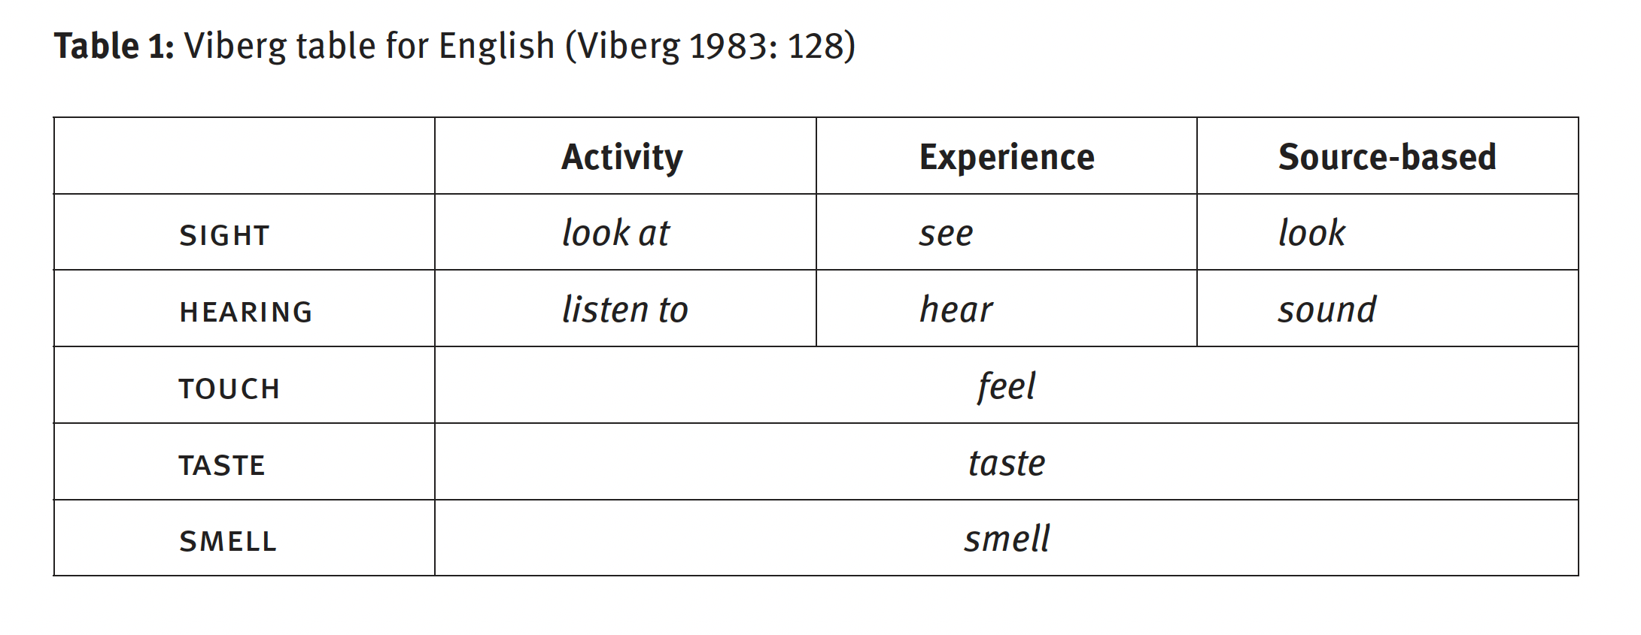
Human Sensorium
Sight > Hearing > Touch > Taste, Smell ^{[5]}
[5] Viberg, Åke. 1983. “The verbs of perception: A typological study”. Linguistics 21, 123–162.
[6] San Roque, L., et al. (2015). “Vision verbs dominate in conversation across cultures, but the ranking of non-visual verbs varies”, Cognitive Linguistics 26(1): 31 – 60.

Slide 12
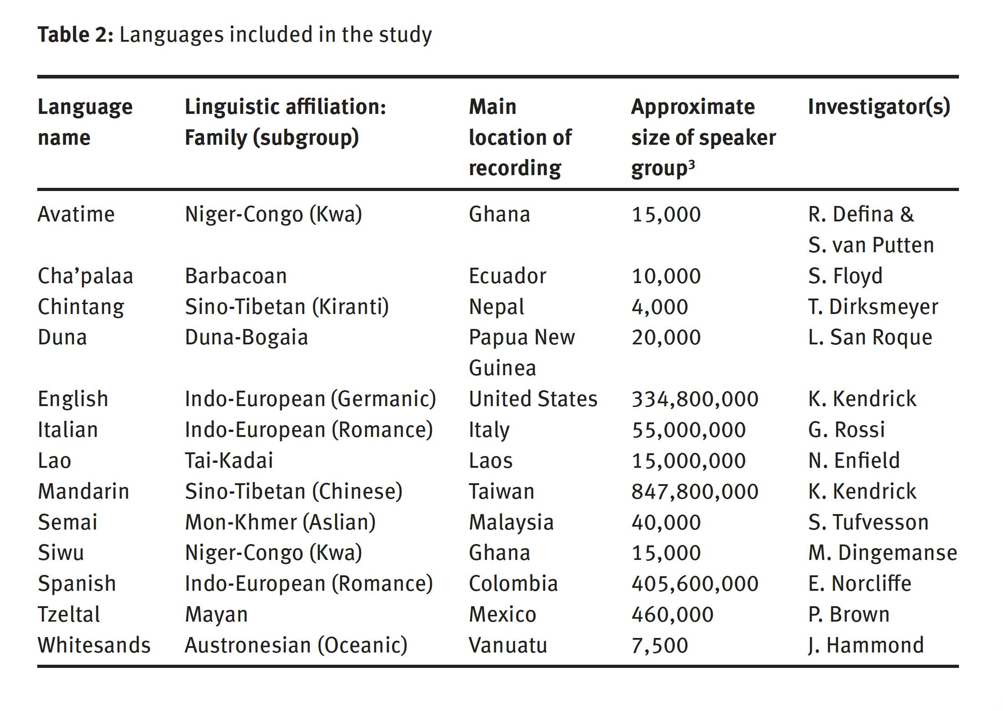
Human Sensorium
[6] San Roque, L., et al. 2015. Ibid.
Notes:
San Roque et al. 2015 experiment. Examining the use of basic perception terms in spontaneous conversation across 13 diverse languages and cultures. Analysed the frequency of perception words to test two universalist hypotheses: that sight is always a dominant sense, and that the relative ranking of the senses was the same across different cultures. They found that references to sight outstrip references to the other senses, suggesting a pan-human preoccupation with visual phenomena. However, the relative frequency of the other senses was found to vary cross-linguistically. Cultural relativity was conspicuous as exemplified by the high ranking of smell in Semai people (a semi-sedentary ethnic group living in the center of the Malay Peninsula in Southeast Asia).

Slide 13
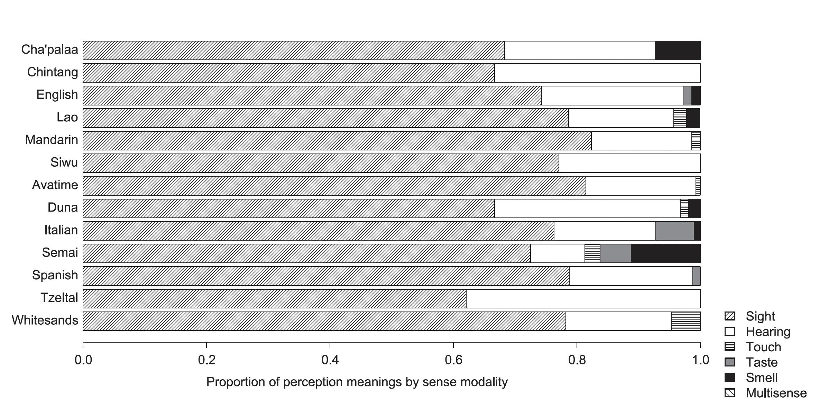
Human Sensorium
[6] San Roque, L., et al. 2015. Ibid.

Slide 14
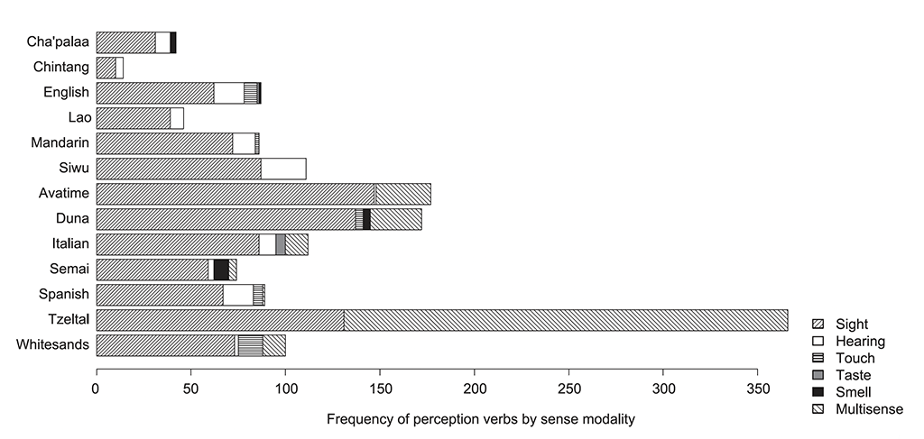
Human Sensorium
[6] San Roque, L., et al. 2015. Ibid.

Slide 15
Human Sensorium
First, do frequency measures concur with the view that vision is the most dominant sense cross-linguistically, as has been asserted in the previous literature?
Does the rank ordering of the five senses reveal a universal hierarchy, or point towards understanding the salience of the senses as a matter of cultural variation?
Face-to-face conversations in 13 diverse languages and cultures: (i) the frequency of basic perception words of different sensory modalities, and (ii) the frequency of references to physical perception using those words seem to vary.
Although the visual dominance hypothesis was strongly supported by the data, the findings did not conclusively support the existence of a universal hierarchy of the senses. ^{[7]}
Notes:
San Roque et al. 2015 experiment. Examining the use of basic perception terms in spontaneous conversation across 13 diverse languages and cultures. Analysed the frequency of perception words to test two universalist hypotheses: that sight is always a dominant sense, and that the relative ranking of the senses was the same across different cultures. They found that references to sight outstrip references to the other senses, suggesting a pan-human preoccupation with visual phenomena. However, the relative frequency of the other senses was found to vary cross-linguistically. Cultural relativity was conspicuous as exemplified by the high ranking of smell in Semai people (a semi-sedentary ethnic group living in the center of the Malay Peninsula in Southeast Asia).

Slide 16
Part Three
Design-oriented approach

Slide 17
Is VR a Medium?
Virtual reality is the use of computer mediated communications (CMC) systems to deliver artificial, multi-sensory experiences that envelop humans in a 4D space.

Slide 18
Difference between Screen and Scene
‘Spectating’
‘Performing’
Traditional forms of visual representation
Mimesis
Watching
Dynamic temporal processes
Kinesis
Inhabiting
[9] Salter, Chris, 2010, Entangled. Technology and the Transformation of Performance, Cambridge MA: The MIT Press.
Notes:
In between these two is the interaction and the so-called Enactive paradigm that is emerging in contemporary theory and practice. This implies a removal of the line between an observer and participatory action. (Think about Myron Kruger’s Videoplace)

Slide 19
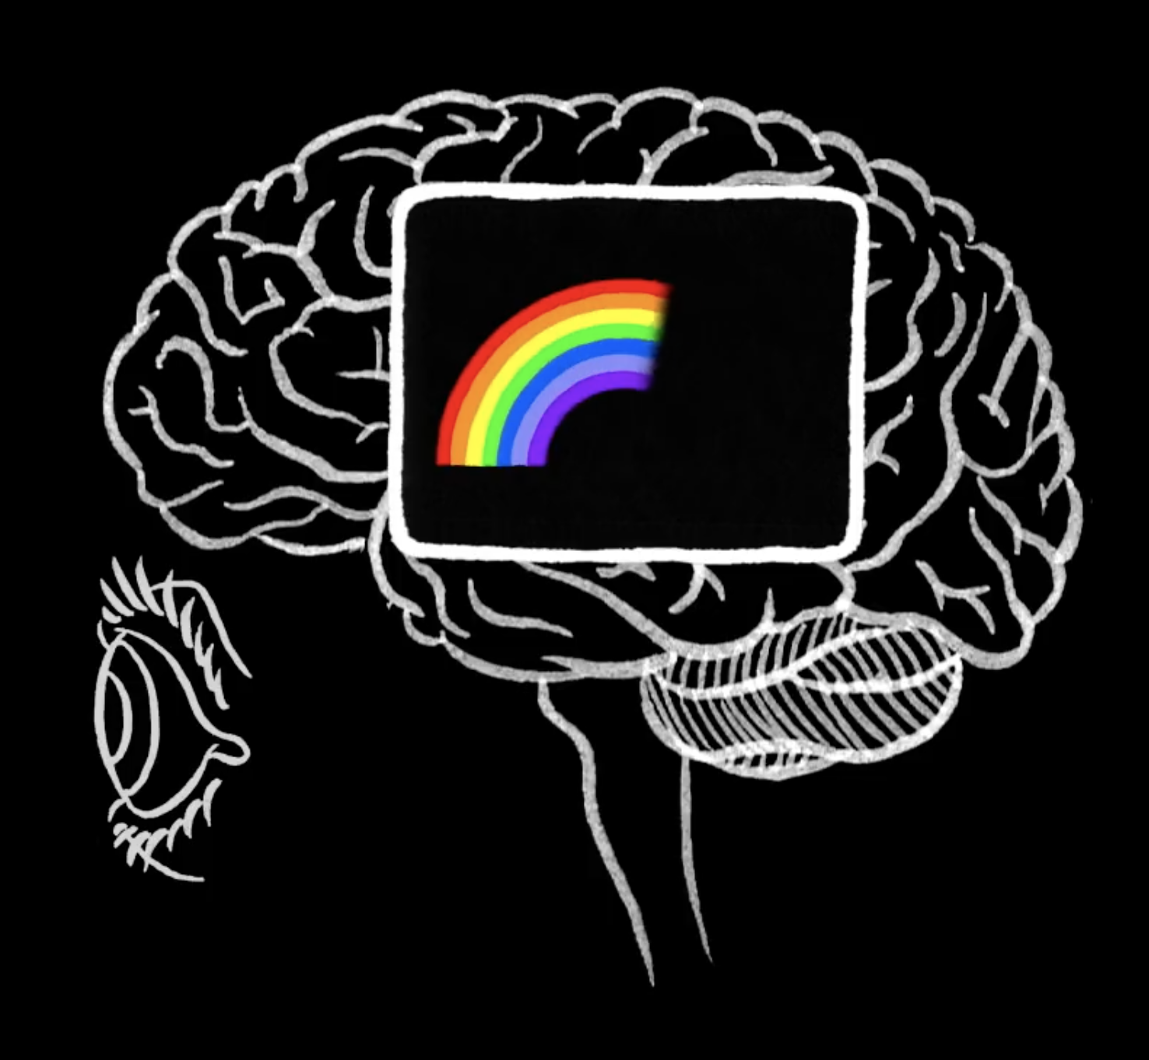
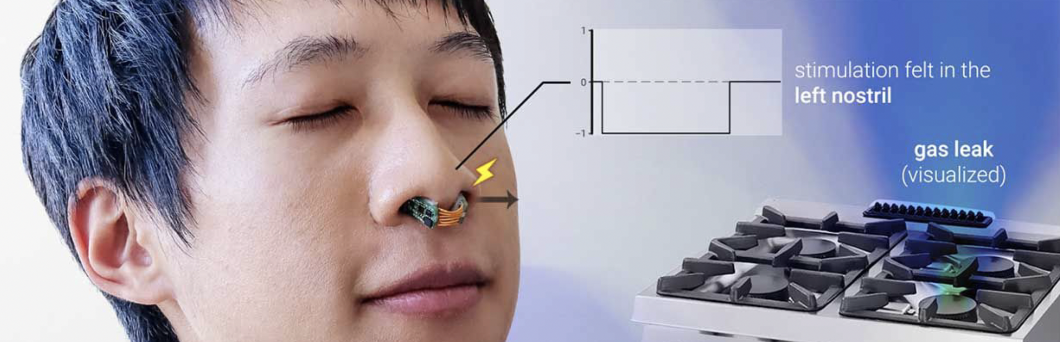
Focus on spatiality
Distal sense: Sensitive to stimuli coming from the outside environment and at variable distance, such as light.
  Example: Vision
Proximal sense: Perceived when they come into direct contact with the artefacts that stimulate them.
  Example: Smell
Kinesthetics sense: Perception both conscious and unconscious of one’s
own body movements.
[8] Ackerman, E. “Digital Nose Stimulation Enables Smelling in Stereo”, IEEE Spectrum, 13 May 2021.

Slide 20
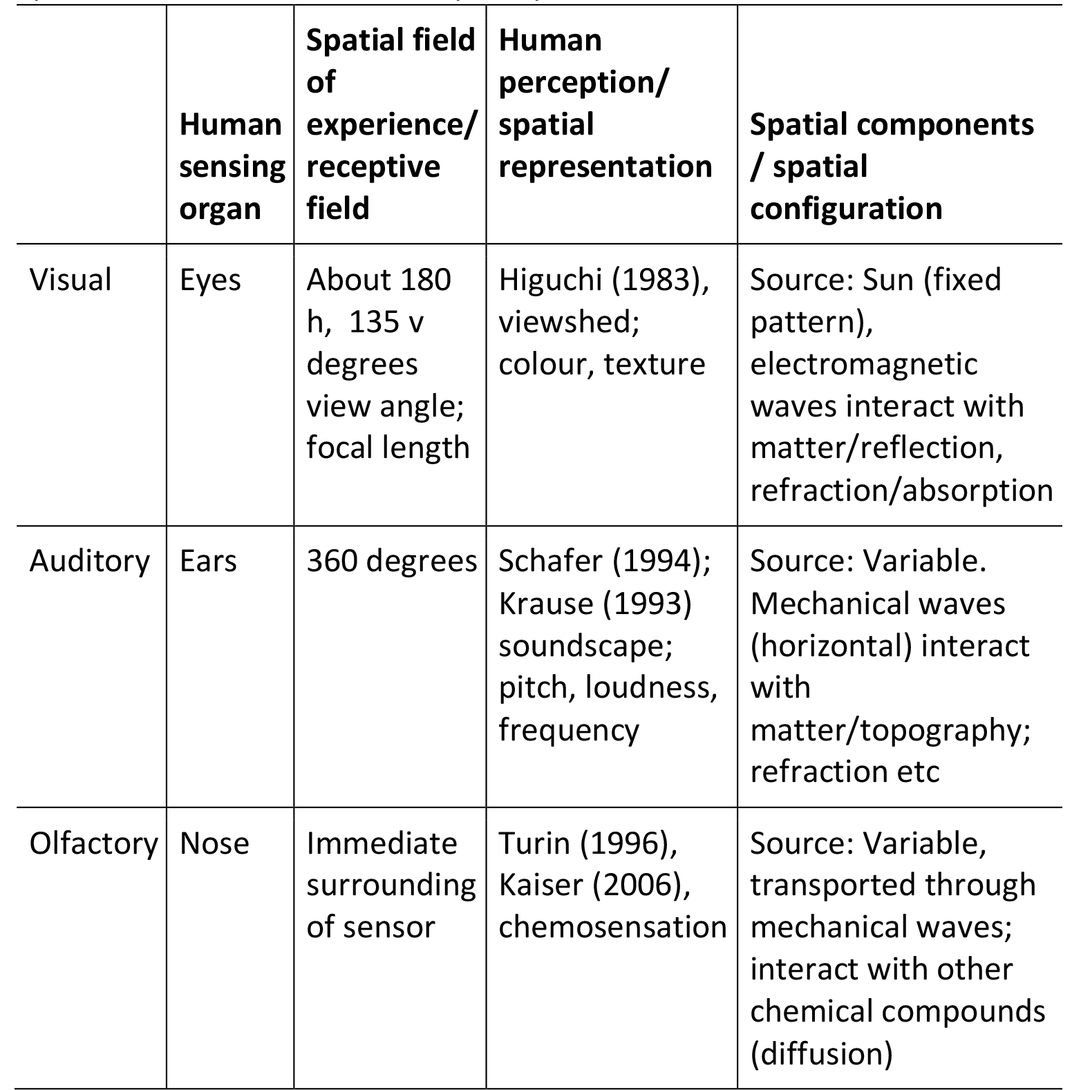
Study representational affordances
[7] Van Der Elst, J., Richards-Rissetto, H. Díaz-Kommonen, L. (2018). “Rural Sense, Value,
Heritage and Sensory Landscapes, Developing a Design-oriented Approach”, Landscape Review, 18(1) 56–71.
Notes:
Rather than a focus on sight and perhaps a bit of sound, perhaps we could develop more structured ways to approach our neuroplasticity (e.g. is the ability of the brain to modify its connections or re-wire itself). This is what allows the brain to develop from infancy into adulthood and possibly one way in which we can account for cultural variations.

Slide 21
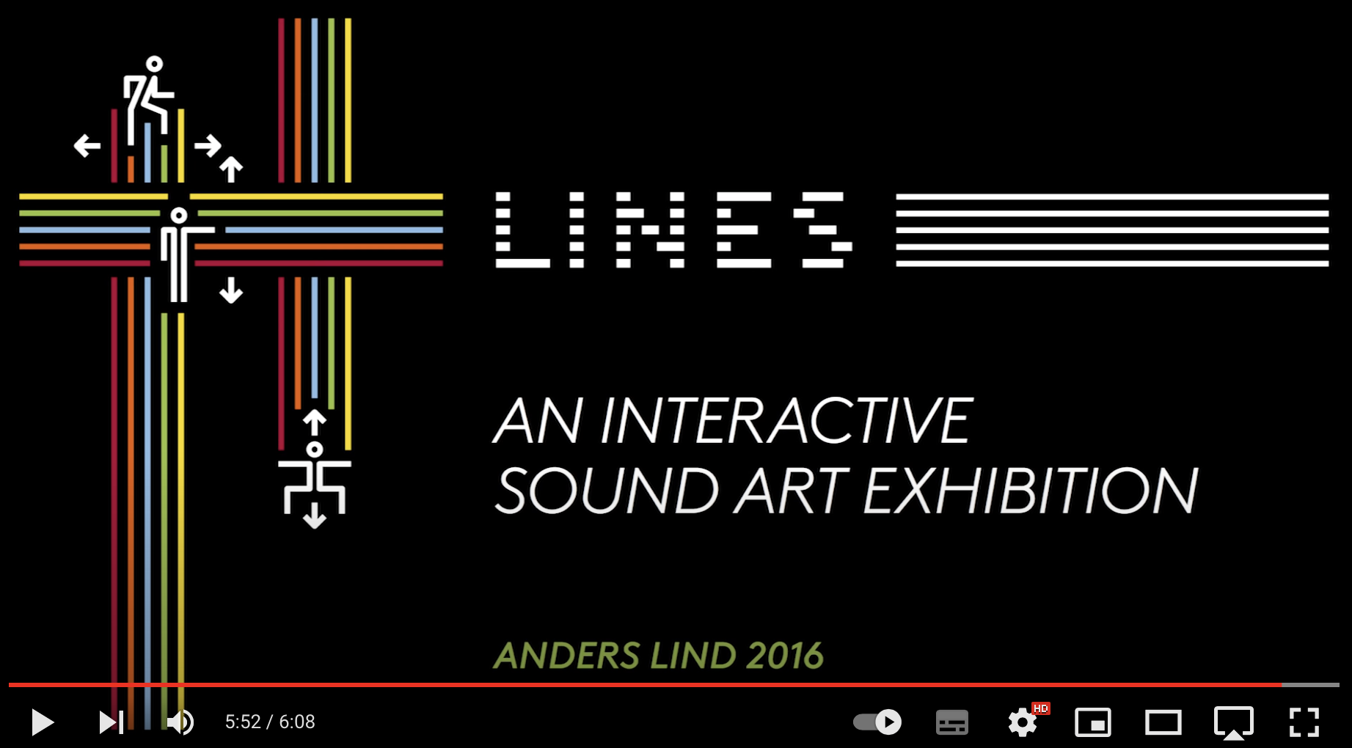
https://cycling74.com/projects/lines-interactive-sound-art-exhibition
https://www.youtube.com/watch?v=hP36xoPXDnM

Slide 22
Conclusions
Human sensorium: Though sense of sight is possibly the most salient, all our senses also make important contributions to our everyday experiences.
Human sensory model might be relative and possibly culturally influenced.
What about you? Have you reflected about which of the senses might be more prevalent/relevant for you?
How will you consider these factors of our multiple senses and how they come together within our experiences when designing for VR?
What can you learn about what Anders Lind is doing in his installation that you might use in the works you are going to create this semester?

Slide 23
Sources
[1] Sears, E. 1993. “Sensory Perception and its Metaphors in the Time of Richard of Fournival. In Medicine
and the Five Senses, ed. WF Bynum, & R. Porter, 17–39, Cambridge University Press.
[2] Howes, David, 2002, “Nose-wise: Olfactory Metaphors in Mind”, in Rouby, C., Benoist Schaal, D., Gervais, R., & A. Holley, (eds.), Olfaction, Taste and Cognition, Cambridge, UK: Cambridge University Press.
[3] Arnheim, Rudolf, 1969, 2004, Visual Thinking, Berkeley: University of California Press, p. 18.
[4] Classen, Constance, 1998, Towards an Anthropology of the Senses, Oxford, UK: Blackwell Publishers.
[5] Viberg, Åke. 1983. “The verbs of perception: A typological study”. Linguistics 21, 123–162.
[6] San Roque, L., et al. (2015). “Vision verbs dominate in conversation across cultures, but the ranking of non-visual verbs varies”, Cognitive Linguistics 26(1): 31 – 60.
[7] Van Der Elst, J., Richards-Rissetto, H. Díaz-Kommonen, L. (2018). Rural Sense, Value, Heritage and Sensory Landscapes, Developing a Design-oriented Approach, Landscape Review, 18(1) 56–71.
[8] Ackerman, E. “Digital Nose Stimulation Enables Smelling in Stereo”, IEEE Spectrum, 13 May 202.
[9] Salter, Chris, 2010, Entangled. Technology and the Transformation of Performance, Cambridge MA: The MIT Press.
Notes:
Sight came to distance itself significantly from the other senses in terms of cultural impor­tance only in the eighteenth and nineteenth cen­turies, when vision became associated with the burgeoning field of science. The enquiring and penetrating gaze of the scientist became the metaphor for the acquisition of knowledge at this time (Foucault, 1973).

