Slide 1
Good Life Engine course. Learning yourself.
Lidia Rauramo, Anna Dementyeva, Rahim Ahsanullah

Slide 2
GLE kick-off survey

Slide 3
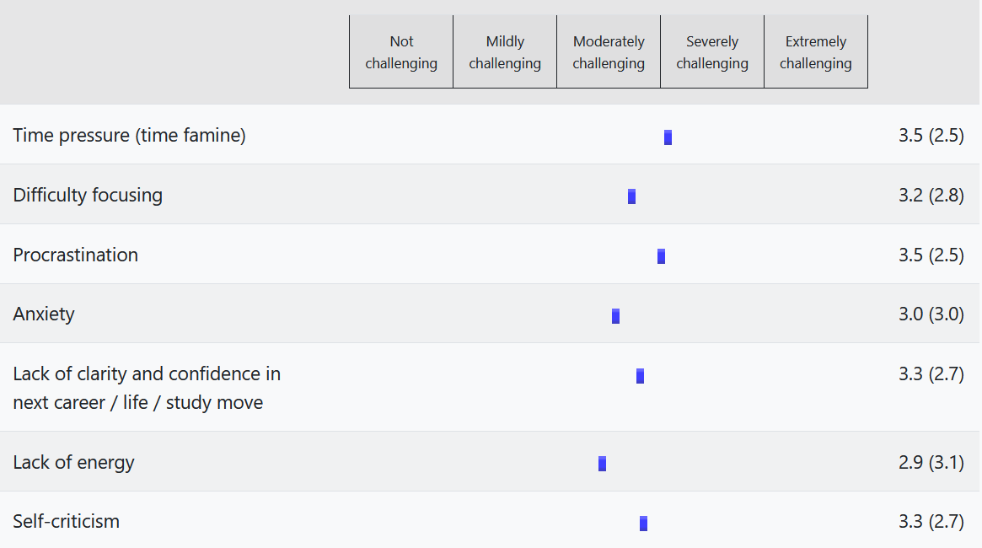
How would you rate these challenges in terms of their impacts on your personal life?

Slide 4
Why do you join the Good Life Engine course?

Slide 5
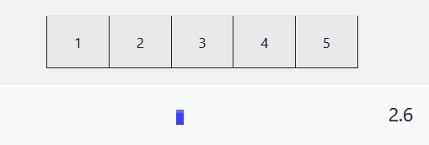
How well do you manage to work on your own dreams and goals alongside typical life chores?

Slide 6
Exercise #1.
Discuss in groups can you help someone if you need help? (can you fix someone if you are not fixed?)
Notes:
Oprah Winfrey: Oprah grew up in poverty and faced many challenges, including sexual abuse, but she went on to become one of the most successful and influential media personalities in the world.
J.K. Rowling: Rowling's family did not support her desire to become a writer, but she persisted and went on to create one of the most successful book series of all time, the Harry Potter series.
Steve Jobs: Jobs was adopted and his biological parents did not support his pursuit of a career in technology, but he went on to co-found Apple and become one of the most successful entrepreneurs in history.
Arnold Schwarzenegger: Schwarzenegger's family did not support his passion for bodybuilding, but he went on to become one of the most successful bodybuilders in history and later transitioned into a successful acting career and political career.
Michael Jordan: Jordan's family did not initially support his passion for basketball, but he went on to become one of the greatest basketball players of all time and a successful entrepreneur.

Slide 7
Recap from the Inner Development Goals Summit.
Notes:
Leading toward loosing connection, being disconnected from each other

Slide 8
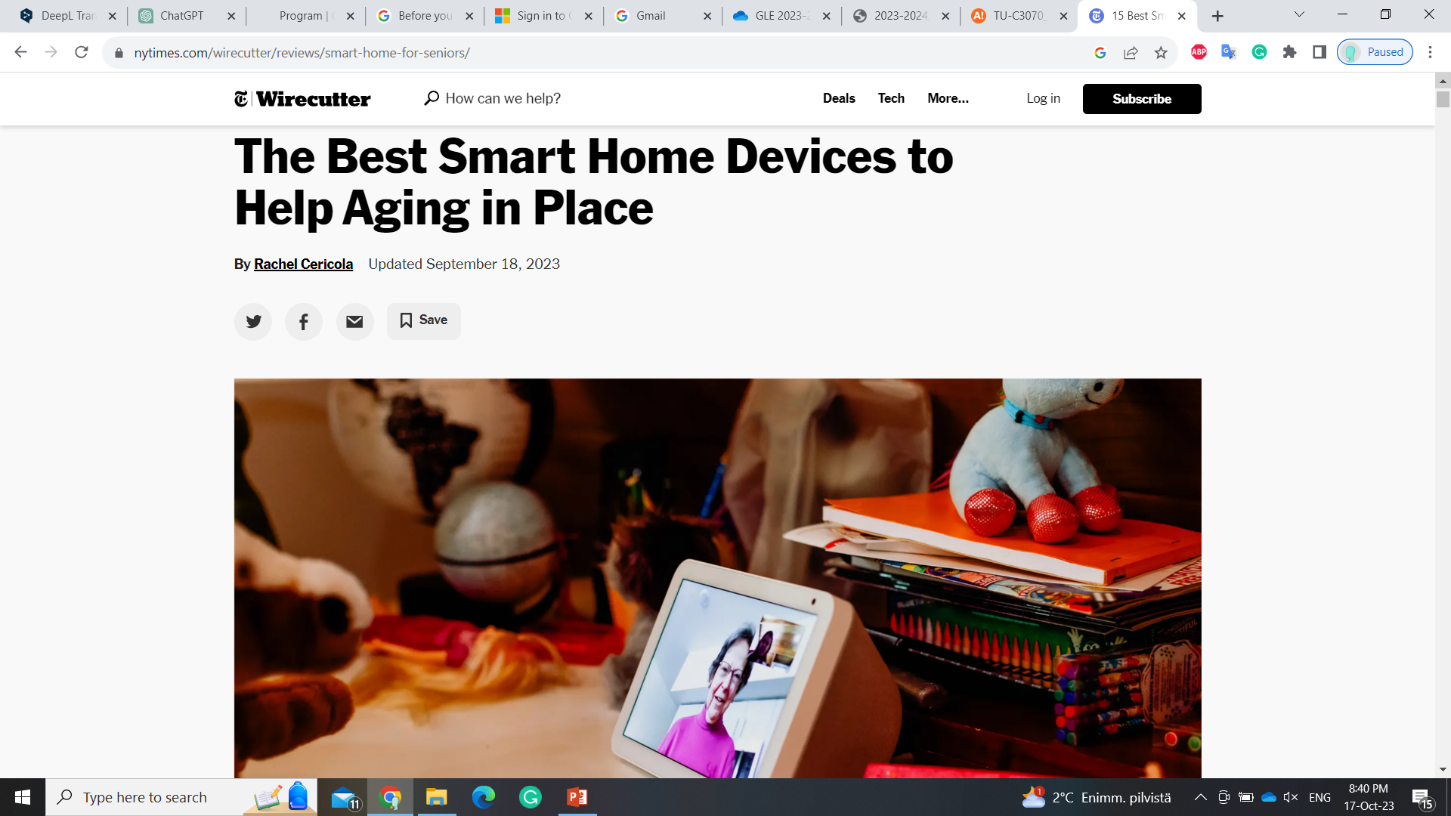
Notes:
Is what we need? Meanwhile in blue zones....

Slide 9
“For far too many people, loneliness is the sad reality of modern life”
The UK’s former Prime Minister Theresa May, 2018
Notes:
https://www.forbes.com/sites/neilhowe/2019/05/03/millennials-and-the-loneliness-epidemic/#328fc0d77676
According to a 2018 survey from The Economist and the Kaiser Family Foundation (KFF), more than two in ten adults in the United States (22%) and the United Kingdom (23%) say they always or often feel lonely, lack companionship, or feel left out or isolated.
The scourge (бич) of loneliness is an issue that we’re going to hear ever-more about in the years to comeю
loneliness is the number one fear of young people today—ranking ahead of losing a home or a job. Fully 42% of Millennial women are more afraid of loneliness than a cancer diagnosis, by far the highest share of any generation. This fear has been ingrained into the very lexicon of Millennials, immortalized in acronyms like “FOMO” and its many companion terms.
Generation Z (ages 18-22) had the highest loneliness scores, followed by the millennials (ages 23-37). The Greatest Generation (adults ages 72 and older) were the least lonely (https://psychcentral.com/blog/understanding-the-loneliness-epidemic/)
The spiritual divide: increasing levels of burnout and depression—resulting in the loss of meaning and the loss of Self. With the capital ‘S’ Self I mean not the current ego self but the highest future potential. More than 800K people per year commit suicide—a number that is greater than the sum of people who are killed by war, murder, and natural disasters combined. Every forty seconds there is one suicide.
Scharmer, Otto. The Essentials of Theory U: Core Principles and Applications . Berrett-Koehler Publishers. Kindle Edition.

Slide 10
WHY?
Notes:
1. Social media
2. that loneliness is more prevalent among millennials because it’s contagious. She cites a 2009 study by researchers at the University of Chicago, the University of California-San Diego, and Harvard that found that participants are 52 percent more likely to be lonely if someone they’re directly connected to is lonely. Why? “Lonely people are less able to pick up on positive social stimuli, like others’ attention and commitment signals, so they withdraw prematurely – in many cases before they’re actually socially isolated,” she explains. “Their inexplicable withdrawal may, in turn, make their close connections feel lonely too.”

Slide 11
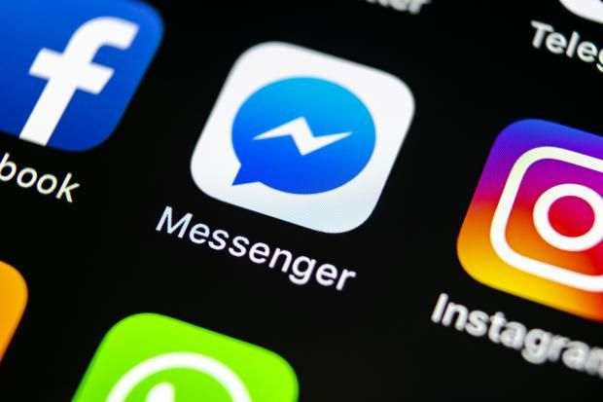
79%of smartphone owners check their device within 15 min. of waking up every morning.
People on average check their phones 34 times per day.
However, industry insiders believe that number is closer to an astounding 150 daily sessions.
We’re hooked!
Eyal, Nir. Hooked. Penguin Books Ltd.
Notes:
Every day we are bombarded with thousands of marketing messages, emails, texts, and social media posts. Our focus is exhausted. Human-to-human communication is at its lowest because of Facebook, Instagram, Youtube, Tinder and other online services and social apps. We are lacking the skills to present ourselves a
The other explanation she offers is too much time online. “The Internet temporarily enhances the social satisfaction and behavior of lonely people, who are more likely to go online when they feel isolated, depressed, or anxious,” she writes - https://psychcentral.com/blog/understanding-the-loneliness-epidemic/
If the principle of energy follows attention is true, we need to cultivate and focus our attention. We all live in a culture where technologies and multitasking inhibit our capacity to sustain focused attention. The biggest enemy of our capacity to sustain attention is of course in our own pockets—the smartphones that help us in one moment and distract us in another. Research shows that a smartphone on your desk drains your brainpower even if it is turned face down and you do not even look at it.
Scharmer, Otto. The Essentials of Theory U: Core Principles and Applications . Berrett-Koehler Publishers. Kindle Edition.
Hyperkinetic environment in which we live. Never in history has the human brain been asked to track so many data points

Slide 12
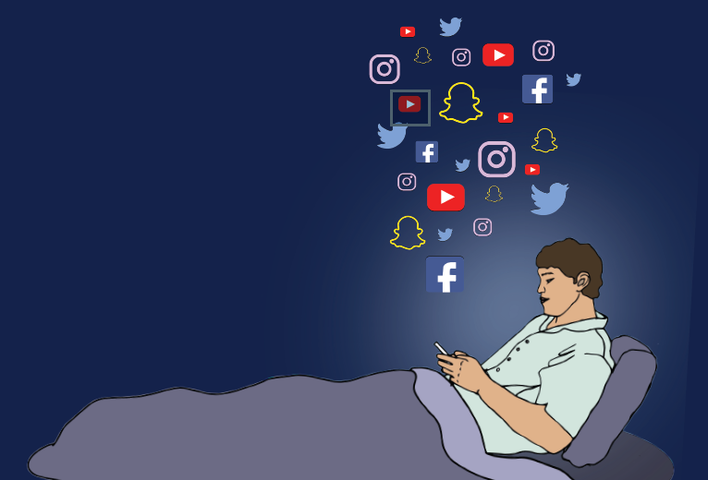
ADT instead of ADD. ADT – an attention deficit trait, caused by brain overload. The core symptoms are distractibility, inner frenzy, and impatience.
©lidia.borisova@aalto.fi; duy.tran@aalto.fi
Notes:
Addiction to the “dope”
This “dope” is violent and complex stimulation of the senses, which makes them progressively less sensitive and thus in need of yet more violent stimulation. We crave distraction—a panorama of sights, sounds, thrills, and titillations into which as much as possible must be crowded in the shortest possible time.´
“We are so anxious for pleasure that we can never get enough of it. We stimulate our sense organs until they become insensitive, so that if pleasure is to continue they must have stronger and stronger stimulants. In self-defense the body gets ill from the strain, but the brain wants to go on and on. The brain is in pursuit of happiness” Alan Watts
New technology created a shorter concentration span. Attention span - the length of time that someone can keep their thoughts and interest fixed on something (Oxford dictionary).
Also it created our addiction to frequent dopamine injections. When we get like or message – we have a dopamine injection. We started to be addicted to it and we can’t stay too long without it. We are not resilient anymore.
Before person easily could live without constant social approval for days and days, now we can barely survive few hours. Try to put your phone away and not check messages -how long could you manage to do it?
https://www.forlearningminds.com/article/clip_thinking
These days, we are more entrenched in media than we ever have been. Most of us will spend our evenings playing games, watching TV or watching films. On a special occasion, we might head to the cinema.
At work meanwhile, we are constantly online, reading stories and turning them into news, or dealing with software and managing data. Browsing the web is a large part of about 99% of jobs – and it’s that means many of us spend a good 8-10 hours a day looking at one screen.
‘Clip thinking’ is one term that has been used to describe the changes that media has introduced to our thinking. This refers to how used we now are to receiving information in a narrative manner – we’ve become accustomed to being told entertaining stories
We’re so used to getting information in a certain format – as short segments of narrative – that we struggle with anything longer or more complex. We end up flicking from one task to the next and failing to concentrate on anything for longer than a few minutes.
Tik Tok social media is the quintessence of clip thinking. This channel and the fact that my children use it terrifies me. I understand that their ways of thinking are very different from mine. I became extremely anxious only after five minutes of watching it. I force myself to use it because it is the modern way to create your personal brand and I cannot ignore it.
Clip thinking" is a term used to describe the impact of media on our thought process. It refers to the way in which we have become accustomed to receiving information through captivating stories, instead of comprehensive analysis. The format of short, narrative segments has become so ingrained in our media consumption that it affects our ability to focus on anything more lengthy or intricate. This leads to a tendency to constantly switch between tasks and a difficulty in sustaining attention for more than a few minutes.
Things are worse across the web, where many studies show we now have shorter attention spans than ever before. Again, we’re used to getting the information we’re looking for in seconds. Did you know that the average ‘bounce rate’ for most websites is about 1 second? That means that most people spend only one second on a website before leaving – often that’s because they can’t be bothered to wait for the website to load! We search for information, click on it and then leave because it doesn’t arrive fast enough.

Slide 13
People with ADT have difficulty staying organized, setting priorities, and managing time.
©lidia.borisova@aalto.fi; duy.tran@aalto.fi
Notes:
The sufferer doesn’t experience a single crisis but rather a series of minor emergencies while he or she tries harder and harder to keep up.
Shouldering a responsibility to “suck it up” and not complain as the workload increases, executives with ADT do whatever they can to handle a load they simply cannot manage as well as they’d like. The ADT sufferer therefore feels a constant low level of panic and guilt. Facing a tidal wave of tasks, the executive becomes increasingly hurried, curt, peremptory, and unfocused, while pretending that everything is fine” says Edward Hallowell, MD, is a psychiatrist, served as an instructor at Harvard Medical School (https://hbr.org/2005/01/overloaded-circuits-why-smart-people-underperform). ADD is a mdeical condition, something that people are born with. However, ADT is an acquired condition that we acquire being an active member of the digital world.

Slide 14
Exercise #2.
Dashboard exercise.
Notes:
Ask how did their energy crisis assignment go

Slide 15
Step #1. Exercise #2. Assess Where you are?
HEALTH
4 areas dashboard
LOVE
PLAY
WORK
*Designing your life” methodology from Stanford Life Design Lab
©lidia.rauramo@aalto.fi
Notes:
Comment from the student: is it like we should strive for 100% in love and health, but not as much in work. Because how good it would be to have 100% in work?
Let’s check that we have a white board for this exercise
In order to start where we are, we need to break life down into some discrete areas—health, work, play, and love.
emotional health, physical health, and mental health.
How healthy you are will factor significantly into how you assess the quality of your life.
A well-designed life is supported by a healthy body, an engaged mind, and often, though not always, some form of spiritual practice.
If you are in startup you can’t afford to get sick
Play is all about joy.
Play is any activity that brings you joy when you do it.
Play is about activity that brings joy just for the pure sake of the doing of it.

Slide 16
HEALTH
LOVE
PLAY
HEALTH (50%)
LOVE (90%)
PLAY (20%)
WORK
WORK (100%)

Slide 17
Fill your dashboard
HEALTH
LOVE
PLAY
WORK
©lidia.rauramo@aalto.fi

Slide 18
Are you happy right now with where your gauges stand in each of these four areas?
©lidia.rauramo@aalto.fi
Notes:
Are you happy right now with where your gauges stand in each of these four areas?
Those who say YES can leave the classroom ☺

Slide 19
Build your inner core
"You have to charge your batteries with more energy than you draw out of them"
Aki Hintsa, The Core
©Lidia Rauramo, Aalto Ventures Program

Slide 20
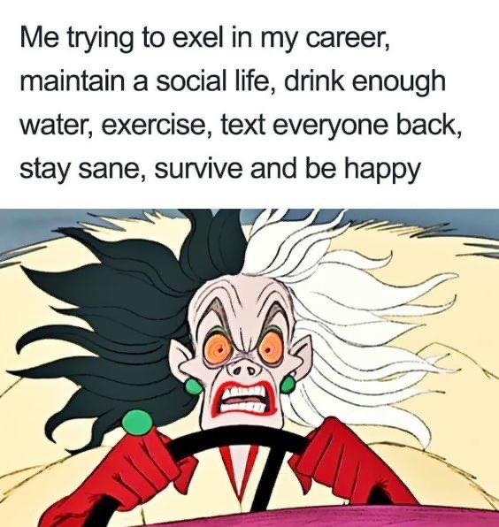
XXI century typical human
©Lidia Rauramo, Aalto Ventures Program
Notes:
Don’t worry – you are normal, we all are like this

Slide 21
Looks familiar?
“Throughout whole my adult life, I have had this feeling that I do not do enough”
GLE student 2021-2022
©Lidia Rauramo, Aalto Ventures Program
Notes:
Let’s start with challenges. Looks familiar?
Raise your hands who experience the same?

Slide 22
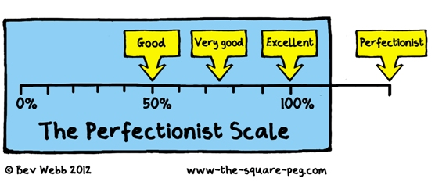
to unrealistically high personal standards,
a preoccupation with mistakes,
doubts about actions,
a desire to control everything,
selective filtering of information to emphasize our failures and mistakes,
and polarized thinking: all or nothing
Perfectionism and Self-criticism lead to
©Lidia Rauramo, Aalto Ventures Program

Slide 23
Can’t do it perfectly
Won’t learn
Someone can do it better than me
Shouldn’t even try
Someone will notice that I can’t
Perfectionism and Self-criticism lead to
*Eeva Jakonsalo
©Lidia Rauramo, Aalto Ventures Program

Slide 24
" Most of us have been primed to aim for success. We’ve been schooled from an early age to focus on good grades, regular promotions, performance awards. As a result, most of us see failure as an unacceptable. The working culture also rewards only performance. The more senior the manager, the grater the social and psychological penalty for being fallible. Most organizations reward success and penalize failure"
*Amy C. Edmondson, “Teaming”
©Lidia Rauramo, Aalto Ventures Program
Notes:
The critical side also might be an integral part of our personality. We cannot just take it away from us. We cannot just make the step from a self-critical person to a self-compassioned one but we can be aware of this trait and be smoother to ourselves.
The remedy against the marathon towards perfectionism is to let yourself not be ideal. The definition of something or someone ideal means that it is a direction to follow, not the real human. Otherwise, it won’t have a label of “ideal”. So why are we trying to reach the ideal if it is unreachable, instead of just loving our strengths and accepting our imperfections? Our imperfections are making us human.
The main mistake of self-critical people and perfectionists is to think that getting joy from life is in conflict with advancing your career and studies, that having free time and a social life hinders work achievements. Later on I will explain how to change this misconception. The solution is to work on habits of thinking (mindsets), embrace self-compassion, re-assess life values and goals, learn how to work smart, not hard, and not delay living until some illusionary future moment.

Slide 25
Reasons. Why we feel and think this way?
Growth and fixed mindset
I believe that my intelligence/character can be developed. My true potential is unknowable.
I believe that my intelligence/character is inherent and static.
My potential is determined at birth, it doesn’t change.
©Lidia Rauramo, Aalto Ventures Program
Notes:
First, it tends to get interpreted wrong. People will suggest that the growth mindset research suggests you can change your IQ, or that there’s no such thing as talent and “smartness,” which simply isn’t true, and isn’t suggested anywhere in the growth mindset research.
Important to remember - inborn ability (including but not limited to IQ) matters a lot
Critics: https://slatestarcodex.com/2015/04/08/no-clarity-around-growth-mindset-yet/

Slide 26
NEGATIVITY BIAS
Recall and think about insults more than compliments
Respond more –emotionally and physically –to negative stimuli
Dwell on unpleasant or traumatic events more than pleasant ones
Focus our attention more quickly on negative rather than positive information*.
©Lidia Rauramo, Aalto Ventures Program

Slide 27
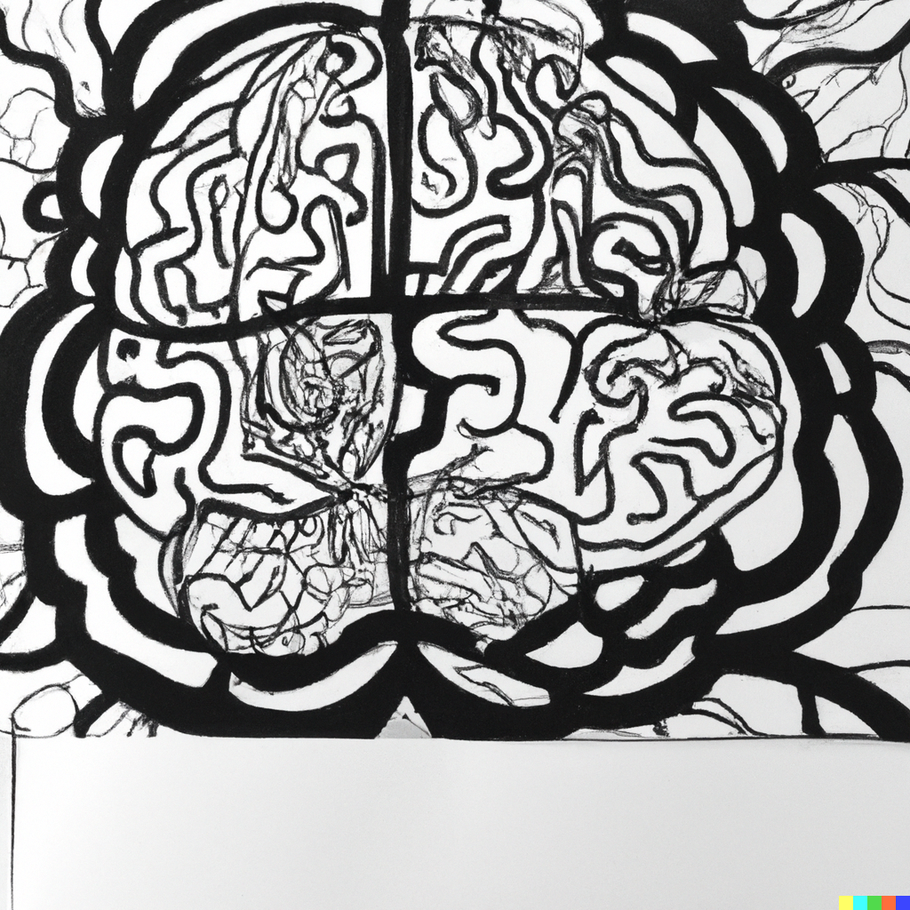
NEUROPLASTICITY
©Lidia Rauramo, Aalto Ventures Program
Notes:
Neuroplasticity, also known as neural plasticity, or brain plasticity, is the ability of neural networks in the brain to change through growth and reorganization. It is when the brain is rewired to function in some way that differs from how it previously functioned

Slide 28
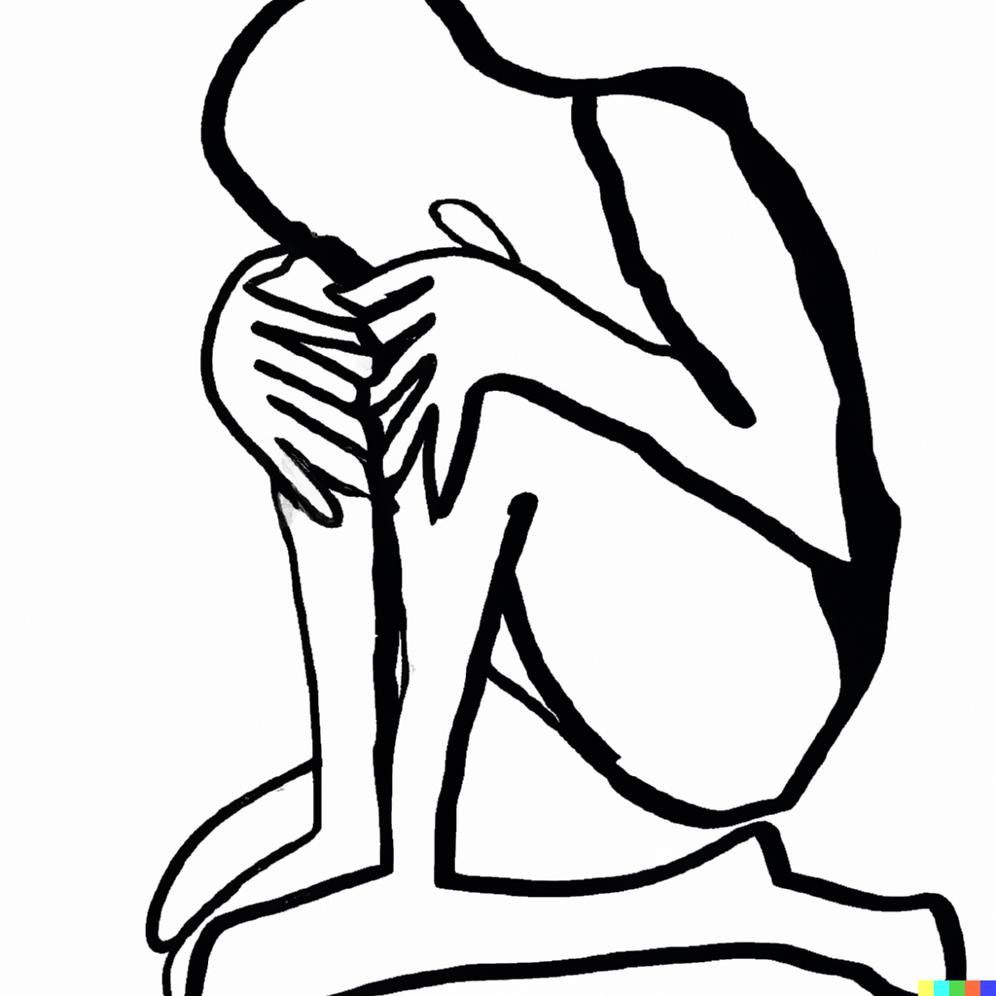
FIXED MINDSET + NEGATIVITY BIAS + NEUROPLASTICITY
©Lidia Rauramo, Aalto Ventures Program
Notes:
I AM NOT worthy
I can not do it
I must be perfect

Slide 29
FIXED MINDSET + NEGATIVITY BIAS + NEUROPLASTICITY
INSUFFICIENCY
WORTHLESSNESS
PERFECTIONISM
©Lidia Rauramo, Aalto Ventures Program
Notes:
I AM NOT worthy
I can not do it
I must be perfect
I’m not[ . . . ] enough / I’m not worthy / I can’t

Slide 30
“The way we think determines our life”, “The elasticity of our brain means that we have the ability to change our brain pathways, and therefore our life, for a better tomorrow”. Dr Tara Swart (neuroscientist), the Source
©Lidia Rauramo, Aalto Ventures Program
Notes:
Why we should work on our ways of thinking

Slide 31
Exercise #4.
Tick-Tock.
*Michael, Michael. Thinkertoys

Slide 32
Step #1. Tick
Imagine yourself in a recent failure situation. How did you feel? What your inner voice was saying to you?
After you are ready with your list, name your nagging voice. Remember to name it with respect, because it has good intentions.
©Lidia Rauramo, Aalto Ventures Program
Notes:
Something like, you can not do that, you will never succeed in it, you don’t have talent, charisma, etc. Write down all typical words that your inner critic is repeating to you in times of crisis. If you have some goals you want to achieve, write down those negative thoughts that are preventing you from realizing your goals.
Here are examples of my inner voice when I did this exercise:
You are too old;
You didn’t reach much at your age and you won’t reach in the future because you are too old;
You wasted so much time in your life;
You are not where you could be because you wasted your time and you can not correct this;
You are not lucky, you have health problems, you are not charming, you are complaining too much – all these are you;
You are not doing enough and well enough sport, work, parenting;
Etc.

Slide 33
Step #2. Self-compassion mode
How do I really feel?
©Lidia Rauramo, Aalto Ventures Program
Notes:
Sit quietly and examine your “Tik” list. Gain awareness of how you're distorting things in an irrational manner and exaggerating them beyond their actual significance. Close your eyes and imagine that you are walking under nice weather. And you see your good friend or loved one. A very dear friend of yours walking towards you. You didn’t see your friend for a while and you a very happy to see him/her. You hug each other and you ask your friend – how do you feel? How do you really feel? How have you been lately? And your friend tells you everything, good and bad, ups, and downs. You just listen, you don’t judge or jump to give advice, and you are there for him/her. And while you are in this feeling of compassion, imagine that this friend is yourself. Ask yourself – how am I? How do I really feel? Probably hug yourself.

Slide 34
Step #3. Tock
Substitute an objective, positive thought for each subjective, negative one. Write down a compassionate sentence to every negative sentence you wrote previously. A good tip -to all “I am not ... enough” sentences you can add “yet” in the end.
Give this compassionate voice a name.
“May I be happy, may I be healthy and well, may I be safe, may I be loved, may I live a good life with the people I love, may things turn well for me”.
©Lidia Rauramo, Aalto Ventures Program

Slide 35
How to practice self compassion?
Notice your self-talk
Practice Self-compassion and self-kindness using your mind
Self-kindness entails being understanding, warm, and supportive toward oneself. Rather than harshly judging oneself for personal inadequacies, the self is offered kindness and unconditional acceptance.
Practice Self-compassion in physical way (heart and body exercise)
Take a moment to show yourself kindness. Wrap your arms around your own shoulders, as if you are giving yourself a warm embrace.
©Lidia Rauramo, Aalto Ventures Program
Notes:
1. It can be helpful to pay attention to your self-talk during times of failure or challenge as this can enable you to reduce self-criticism and cultivate self-compassion. For instance, instead of engaging in negative self-talk such as "I'm so stupid! How could I have done that?", you could choose to say something like "I did my best given the circumstances. It's alright to make mistakes, and anyone can experience moments of absent-mindedness in the same situation. This is not the end of the world."
2. Create a record of everything that concerns you at the moment. Then, for each item on your list, provide a compassionate expression toward yourself as if someone else were saying the words. It is like writing a kind letter you your friend, only in this case your friend is you. For example, "I'm sorry you're worried about losing X. You've worked hard for so long, and it would be devastating if you can't find a way to preserve it." If you're having trouble thinking of what to say to yourself, consider what a supportive friend or family member would say if you told them about your concern.
3. Allow yourself to feel comforted by this gesture. Prepare a warm cup of tea and take a few moments to sit quietly, allowing everything to sink in - both the pain and sadness. If tears come, don't hold them back, let them flow freely. Let yourself feel what you feel without judging whether it is ok to feel this way or not. Whether you will try to get rid or neglect as hard as you can your emotions and feelings, they will not disappear. You will waste a huge amount of energy only to explode afterward.

Slide 36
When we have 1 conscious thought, we have at the same time 200 subconscious thoughts over which we don’t have any control (Kahneman, D., Thinking, Fast and Slow, 2011)
SYSTEM 1
SYSTEM 2
©Lidia Rauramo, Aalto Ventures Program

Slide 37
System 1 thinking is a near-instantaneous process; it happens automatically, intuitively, and with little effort. It's driven by instinct and our experiences.
When we have 1 conscious thought, we have at the same time 200 subconscious thoughts over which we don’t have any control (Kahneman, D., Thinking, Fast and Slow, 2011)
SYSTEM 1
System 2 is slow, logical, analytical, thinking process is visible.
SYSTEM 2
©Lidia Rauramo, Aalto Ventures Program
Notes:
Prone to mistakes
Unconscious processes underlie the
way we deliberate and plan our lives—
and for good reason. Automatic judgments,
for one, are essential for dodging
an oncoming car or bus.
SYSTEM 1 – without our awareness
2 modes of thought:
S1 - Fast, automatic, frequent, emotional, stereotypic, unconscious, prone to make mistakes
S2 - Slow, effortful, infrequent, logical, calculating, conscious, analytical, everything can be tracked back and we can check if we did the mistake or not.

Slide 38
©Lidia Rauramo, Aalto Ventures Program

Slide 39
The Cognitive Triangle
Cognition (Thoughts)
Behaviours
Emotions (Feelings)
Only behavior can be
observed directly!
*Adapted from the book Viisas Mieli, by Sadeniemi & al

Slide 40
The Cognitive Triangle
rational, cognitive brain
Cognition (Thoughts)
Behaviours
Emotions (Feelings)
Only behavior can be
observed directly!
the limbic system, known as the mammalian brain
*Adapted from the book Viisas Mieli, by Sadeniemi & al

Slide 42
The Cognitive Triangle
Cognition (Thoughts)
Behaviours
Emotions (Feelings)
Only behavior can be
observed directly!
*Adapted from the book Viisas Mieli, by Sadeniemi & al

Slide 43
Anxiety vs. stress
According to the American Psychological Association, stress is a response to a specific situation or demand that challenges or exceeds the person’s resources or abilities, while anxiety is a persistent and excessive worry that interferes with daily activities. Stress can be positive or negative, depending on how the person copes with it, while anxiety is usually negative and can impair the person’s functioning.
©Lidia Rauramo, Aalto Ventures Program

Slide 44
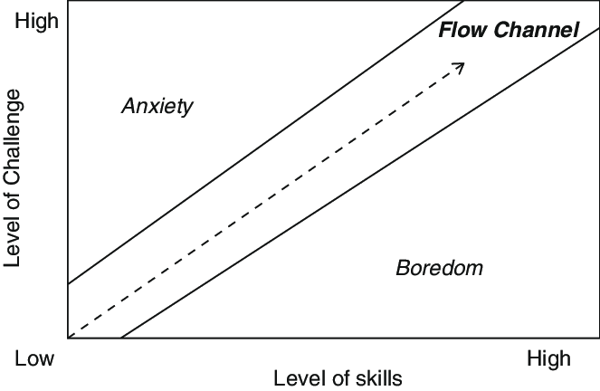
We need challenges
* https://www.researchgate.net/figure/Csikszentmihalyis-flow-channel-shows-the-relation-between-challenges-and-player-skills_fig1_322207098
©Lidia Rauramo, Aalto Ventures Program

Slide 45
Eustress
Eustress refers to a type of stress that is positive and beneficial for an individual's performance.
It is different than distress, which is the type of stress that is typically associated with negative outcomes such as anxiety, depression, and physical illness (Hans Selye, 1956).
©Lidia Rauramo, Aalto Ventures Program

Slide 46
Optimal performance is actually happing outside the comfort zone, but not too far from it
Danger
Optimum performance
Comfort zone
*Jaakko Kopra, Medical Manager, Ph.D., MBA, Adj Prof, Pharmacologist, Public Speaker, and a guest lecturer at the Good Life Engine course
©Lidia Rauramo, Aalto Ventures Program

Slide 47
Danger
Recent danger area transforms into optimum performance zone
Optimum performance
Comfort zone
©Lidia Rauramo, Aalto Ventures Program
Notes:
Sometimes to overcome your fear or anxiety from the situation you can not change, you can go even further into the perceived “danger” area. That will actually expand your “optimal performance” zone and make the previous danger less difficult to cope with as shown on the picture below.
My example of bouldering experience

Slide 48
Homework (in MyCourses):
Answer 4 questions in your learning diary
Keep on with the chosen routine
Do empowering visualization exercise – in MyCourses
Read article about growth and fixed mindset – in MyCourses
Define your zones of stability
©Lidia Rauramo, Aalto Ventures Program

Slide 49
Exercise #2.
Mental energy pyramid.

Slide 50
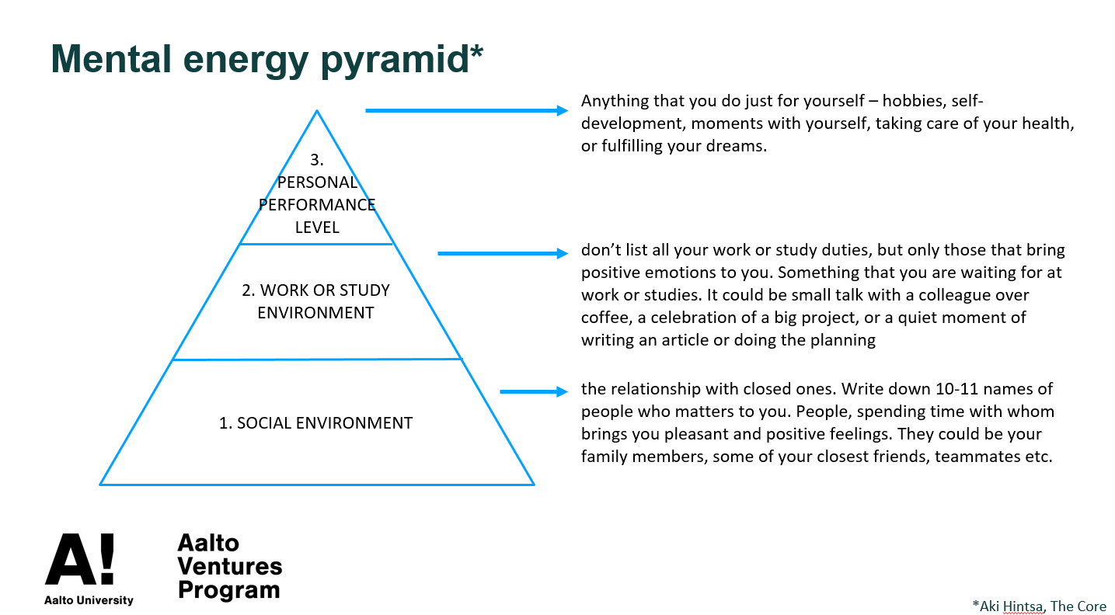
Why the pyramid shape? Is it really the pyramid or could the blocks have different places?
©lidia.rauramo@aalto.fi

Slide 51
©lidia.rauramo@aalto.fi

Slide 52
©lidia.rauramo@aalto.fi

Slide 53
©lidia.rauramo@aalto.fi

Slide 54
Attendance
https://link.webropolsurveys.com/S/C4BF74E5C49D1AAB

Slide 55
©Lidia Rauramo, Aalto Ventures Program

