Slide 1
MOTIVATING EMPLOYEES
Achieving Superior Performance in the Workplace

Slide 2
LEARNING OBJECTIVES
Explain the role of motivation in accomplishing goals.
Identify the needs that motivate most employees.
Discuss similarities and differences among three process theories.
Discuss how to use four types of reinforcement.

Slide 3
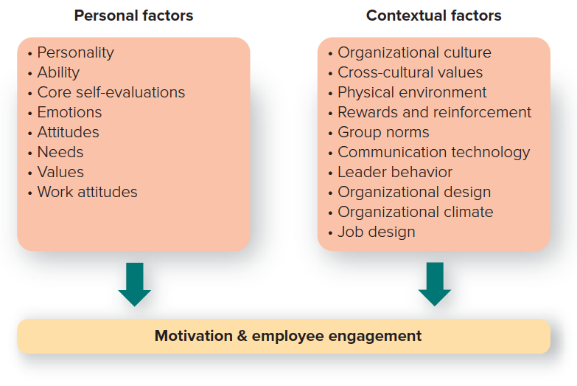
MOTIVATION: WHAT IT IS, WHY IT’S IMPORTANT (1 of 2)
Motivation
The psychological processes that arouse and direct goal-directed behavior.
Copyright ©McGraw-Hill Education. Permission required for reproduction or display.

Slide 4
MOTIVATION: WHAT IT IS, WHY IT’S IMPORTANT (2 of 2)
Extrinsic rewards
Payoff a person receives from others for performing a particular task.
Intrinsic rewards
Satisfaction a person receives from performing the particular task itself.
Copyright ©McGraw-Hill Education. Permission required for reproduction or display.

Slide 5
WHY IS MOTIVATION IMPORTANT?
You want to motivate people to:
Join your organization.
Stay with your organization.
Show up for work at your organization.
Be engaged while at your organization.
Do extra for your organization.

Slide 6
FOUR MAJOR PERSPECTIVES on MOTIVATION
The four major perspectives on motivation:
Content theories emphasize needs as motivators.
Process theories focus on thoughts and perceptions that motivate behavior.
Job Design theories focus on designing jobs that lead to employee satisfaction and performance.
Reinforcement theory is based on the notion that motivation is a function of behavioral consequences and not unmet needs.

Slide 7
CONTENT PERSPECTIVES on MOTIVATION
Content perspectives .
Theories that emphasize the needs that motivate people.
Four Theories:
Maslow’s hierarchy of needs theory.
McClelland’s acquired needs theory.
Deci and Ryan’s self-determination theory.
Herzberg’s two-factor theory.
Needs.
Physiological or psychological deficiencies that arouse behavior.
Content theorists ask, “What kind of needs motivate employees in the workplace?”

Slide 8
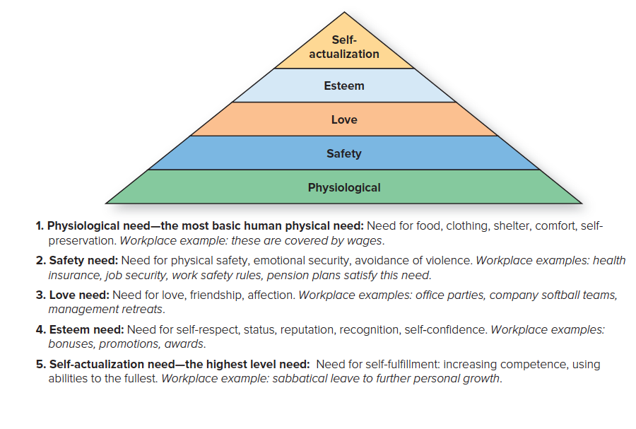
MASLOW’S HIERARCHY of NEEDS

Slide 9
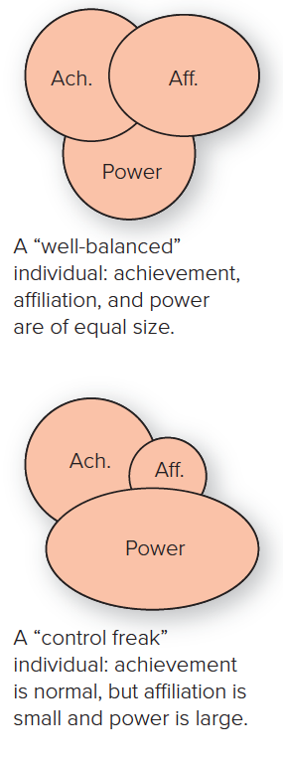
MCCLELLAND’S ACQUIRED NEEDS THEORY
Needs Theory
Three needs are major motives determining people’s behavior in the workplace:
Achievement: desire to achieve excellence in challenging tasks.
Affiliation: desire for friendly and warm relationships.
Power: desire to influence or control others.
Copyright ©McGraw-Hill Education. Permission required for reproduction or display.

Slide 10
DECI and RYAN’S SELF-DETERMINATION THEORY
Self-determination theory
Assumes people are driven to try to grow and attain fulfillment, with their behavior and well-being influenced by three innate needs: competence, autonomy, and relatedness.
Focuses primarily on intrinsic motivation and rewards.

Slide 11
The THREE INNATE NEEDS
Competence
People need to feel qualified, knowledgeable, and capable of completing a goal or task and to learn different skills.
Autonomy
People need to feel they have the freedom and the discretion to determine what they want to do and how they want to do it.
Relatedness
People need to feel a sense of belonging, of attachment to others.

Slide 12
HERZBERG’S TWO-FACTOR THEORY (1 of 2)
Two-factor theory
Proposed that work satisfaction and dissatisfaction arise from two different factors—work satisfaction from so-called motivating factors and work dissatisfaction from so-called hygiene factors.
Hygiene factors: associated with job dissatisfaction which affect the job context in which people work.
Motivating factors: associated with job satisfaction, which affects the job content or the rewards of work performance.
Copyright Baris Simsek/Getty Images RF

Slide 13
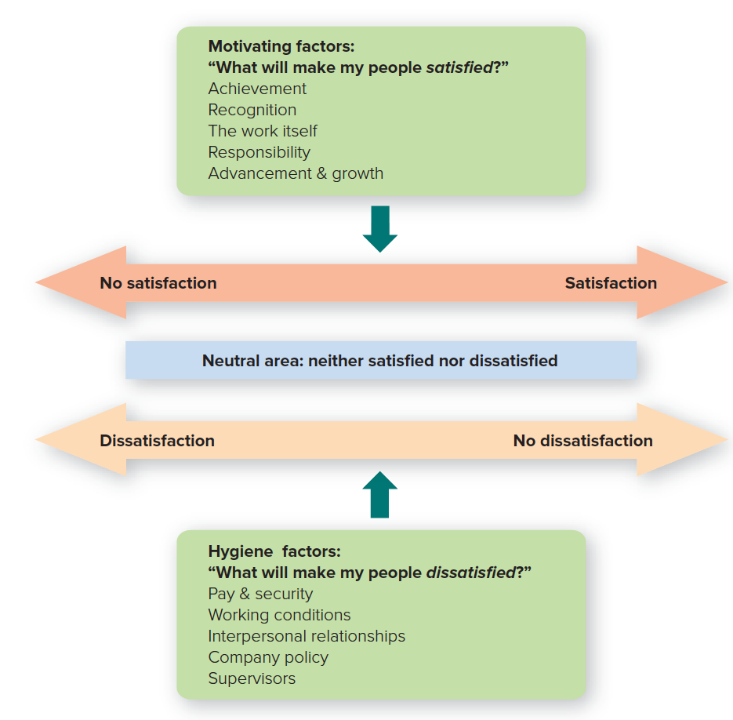
HERZBERG’S TWO-FACTOR THEORY (2 of 2)
Copyright ©McGraw-Hill Education. Permission required for reproduction or display.

Slide 14
A COMPARISON of the CONTENT THEORIES
Copyright ©McGraw-Hill Education. Permission required for reproduction or display.

Slide 15
PROCESS PERSPECTIVES on EMPLOYEE MOTIVATION
Process perspectives
Concerned with the thought processes by which people decide how to act.
How employees choose behavior to meet their needs.
Process theories.
Equity or justice theory.
Expectancy theory.
Goal-setting theory.

Slide 16
EQUITY / JUSTICE THEORY (1 of 2)
Equity theory
A model of motivation that explains how people strive for fairness and justice in social exchanges or give-and-take relationships.
Based on cognitive dissonance, the psychological discomfort people experience between their cognitive attitude and incompatible behavior.

Slide 17
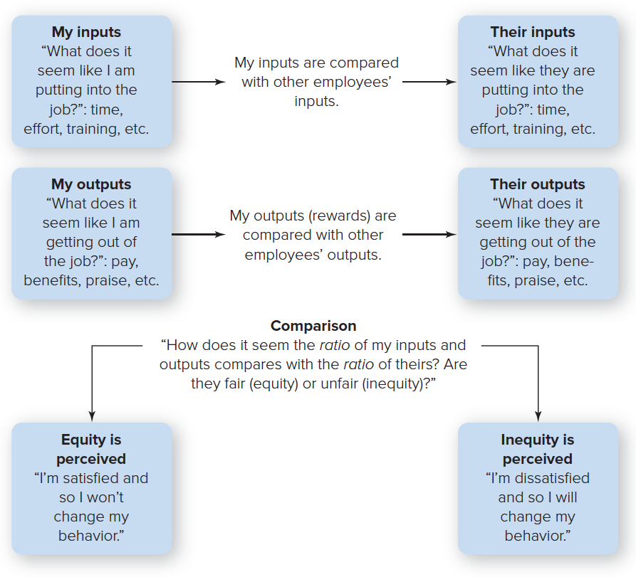
EQUITY/JUSTICE THEORY (2 of 2)
Copyright ©McGraw-Hill Education. Permission required for reproduction or display.

Slide 18
SOME WAYS EMPLOYEES TRY to REDUCE INEQUITY
How employees may try to reduce inequity.
They will reduce their inputs: They will do less work, take long breaks, call in “sick” on Mondays, leave early on Fridays, and so on.
They will try to change the outputs or rewards they receive: They will lobby the boss for a raise, or they will pilfer company equipment.
They will distort the inequity: They will exaggerate how hard they work so they can complain they’re not paid what they’re worth.
They will change the object of comparison: They may compare themselves with another person instead of the original one.
They will leave the situation: They will quit, transfer, or shift to another reference group.

Slide 19
The ELEMENTS of JUSTICE THEORY
Distributive justice
“How fairly are rewards being given out?”
Procedural justice
“How fair is the process for handing out rewards?”
Interactional justice
“How fairly am I being treated when rewards are given out?”

Slide 20
FIVE PRACTICAL LESSONS from EQUITY and JUSTICE THEORIES
Employee perceptions are what count.
Employee want a voice in decisions that affect them.
Employees should be given an appeals process.
Leader behavior matters.
A climate for justice makes a difference.

Slide 21
EXPECTANCY THEORY (1 of 2)
Expectancy Theory
Suggests that people are motivated by two things:
How much they want something.
How likely they think they are to get it.
Three elements to expectancy theory:
Expectancy: belief that a particular level of effort will lead to a particular level of performance.
Instrumentality: expectation that successful performance of the task will lead to the desired outcome.
Valence: the value a worker assigns to an outcome.

Slide 22
EXPECTANCY THEORY (2 of 2)
Copyright ©McGraw-Hill Education. Permission required for reproduction or display.

Slide 23
USING EXPECTANCY THEORY to MOTIVATE EMPLOYEES
What rewards do your employees value?
What are the job objectives and the performance level you desire?
Are the rewards linked to performance?
Do employees believe you will deliver the right rewards for the right performance?

Slide 24
GOAL-SETTING THEORY (1 of 3)
Goal-setting theory
Suggests that employees can be motivated by goals that are specific and challenging but achievable.
Four motivational mechanisms:
Directs your attention.
Regulates the effort expended.
Increases your persistence.
Fosters use of strategic and action plans.

Slide 25
GOAL-SETTING THEORY (2 of 3)
Stretch Goals are goals some companies adopt that are beyond what they are actually expected to achieve.
Learning goal orientation sees goals as a way of developing competence through the acquisition of new skills.
Performance goal orientation sees them as a way of demonstrating and validating a competence we already have by seeking the approval of others.

Slide 26
GOAL-SETTING THEORY (3 of 3)
Practical considerations of goal-setting theory:
Goals should be specific.
Certain conditions are necessary for goal-setting to work.
Goals should be linked to action plans.
Performance feedback and participation in deciding how to achieve goals are necessary but not sufficient for goal-setting to work.

Slide 27
JOB DESIGN PERSPECTIVES on MOTIVATION
Job design
Division of an organization’s work among its employees.
The application of motivational theories to jobs to increase satisfaction and performance.
Two techniques:
Fitting people to jobs (scientific management).
Fitting jobs to people (enlargement or enrichment).

Slide 28
REINFORCEMENT PERSPECTIVES on MOTIVATION
Reinforcement theory
Suggests that behavior with positive consequences tends to be repeated, whereas behavior with negative consequences tends not to be repeated.
Pioneered by B.F. Skinner (operant conditioning) and Edward Thorndike (law of effect).
Use of reinforcement theory to change human behavior is called behavior modification.

Slide 29
FOUR TYPES of REINFORCEMENT (1 of 2)
Positive reinforcement
Use of positive consequences to strengthen a particular behavior.
Negative reinforcement
Strengthening a behavior by withdrawing something negative.
Extinction
Weakening behavior by ignoring it or making sure it is not reinforced.
Punishment
Weakening behavior by presenting something negative or withdrawing something positive.

Slide 30
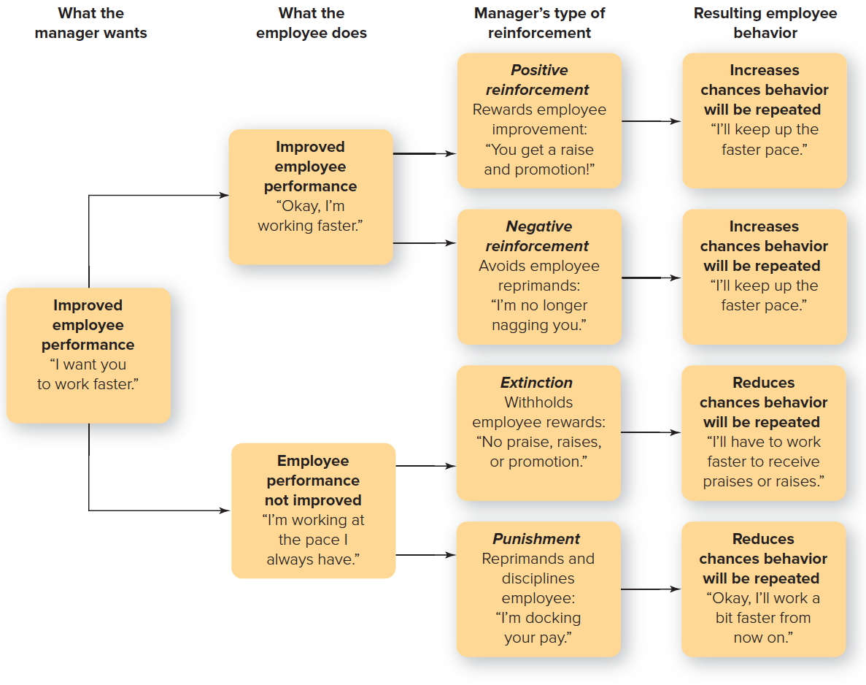
FOUR TYPES of REINFORCEMENT (2 of 2)
Copyright ©McGraw-Hill Education. Permission required for reproduction or display.

Slide 31
USING REINFORCEMENT to MOTIVATE EMPLOYEES
Positive reinforcement
Reward only desirable behavior.
Give rewards as soon as possible.
Be clear about what behavior is desired.
Have different rewards and recognize individual differences.
Punishment
Punish only undesirable behavior.
Give reprimands or disciplinary actions as soon as possible.
Be clear about what behavior is desirable.
Administer punishment in private.
Combine punishment and positive reinforcement.

Slide 32
USING COMPENSATION, NONMONETARY INCENTIVES, and OTHER REWARDS to MOTIVATE
Compensation
Monetary rewards.
Nonmonetary incentives:
Work–life balance.
Ability to expand skills.
Positive work environment.
Finding meaning in work.

Slide 33
POPULAR INCENTIVE COMPENSATION PLANS
Pay for performance.
Piece rate.
Sales commission.
Bonuses.
Profit-sharing.
Gainsharing.
Stock options.
Pay for knowledge.

Slide 34
FINDING MEANING in WORK
Meaningfulness
The sense of belonging to and serving something that you believe is bigger than yourself.
Suggestions for building meaning into your life:
Identify activities you love doing.
Find a way to build your natural strengths into your personal and work life.
Go out and help someone.

