Slide 1
POWER INFLUENCE, & LEADERSHIP
From Becoming a Manager to Becoming a Leader

Slide 2
LEARNING OBJECTIVES
Develop self-awareness!
Describe managers’ appropriate use of power and influence.
Identify traits and characteristics of successful leaders.
Identify behaviors of successful leaders.

Slide 3
The NATURE of LEADERSHIP
Leadership
The ability to influence employees to voluntarily pursue organizational goals.
Managerial leadership
Process of influencing others to understand and agree what needs to be done and the process of facilitating individual and collective efforts to accomplish shared objectives.

Slide 4
CHARACTERISTICS of MANAGERS and LEADERS
BEING A MANAGER MEANS:
BEING A LEADER MEANS:
Planning, organizing, directing, controlling.
Executing plans and delivering goods and services.
Managing resources.
Being conscientious.
Putting customers first, responding to and acting for customers.
Mistakes can happen when managers don’t appreciate people are the key resource, underlead by treating people like other resources, or fail to be held accountable.
Being visionary.
Being inspiring, setting the tone, and articulating the vision.
Managing people.
Being inspirational (charismatic).
Acting decisively.
Putting people first, responding to and acting for followers.
Mistakes can happen when leaders choose the wrong goal, direction, or inspiration; overlead; or fail to implement the vision.
Source: Adapted from P. Lorenzi, “Managing for the Common Good: Prosocial Leadership,” Organizational Dynamics 33, no. 3 (2004), p. 286.
Copyright ©McGraw-Hill Education. Permission required for reproduction or display.

Slide 5
LETS THINK ABOUT EXAMPLES OF GREAT LEADERS AND MANAGERS
?

Slide 6
FIVE SOURCES of POWER
Legitimate power
Results from managers’ formal positions within the organization.
Reward power
Results from managers’ authority to reward their subordinates.
Coercive power
Results from managers’ authority to punish their subordinates.
Expert power
Results from one’s specialized information or expertise.
Referent power
Derived from one’s personal attraction (strong, visionary leadership).

Slide 7
WHAT IS YOUR DREAM IN LIFE RIGHT NOW?
Take a few minutes to reflect and write down what it is in one sentence!

Slide 8
COMMON INFLUENCE TACTICS
SOFT TACTICS
HARD TACTICS
Integration.
Personal appeals.
Inspirational appeals.
Consultation.
Rational persuasion.
Exchange tactics.
Coalition tactics.
Pressure tactics.
Legitimating tactics.

Slide 9
MATCH TACTICS to INFLUENCE OUTCOMES
Research has shown the following:
Rational persuasion, consultation, collaboration, and inspirational appeals are most effective.
Be authentic to your values and beliefs.
Consult rather than legitimate.
“Glad handing” is not a good long-term strategy.
Show subtle flattery and agreement.
Learn how to influence.

Slide 10
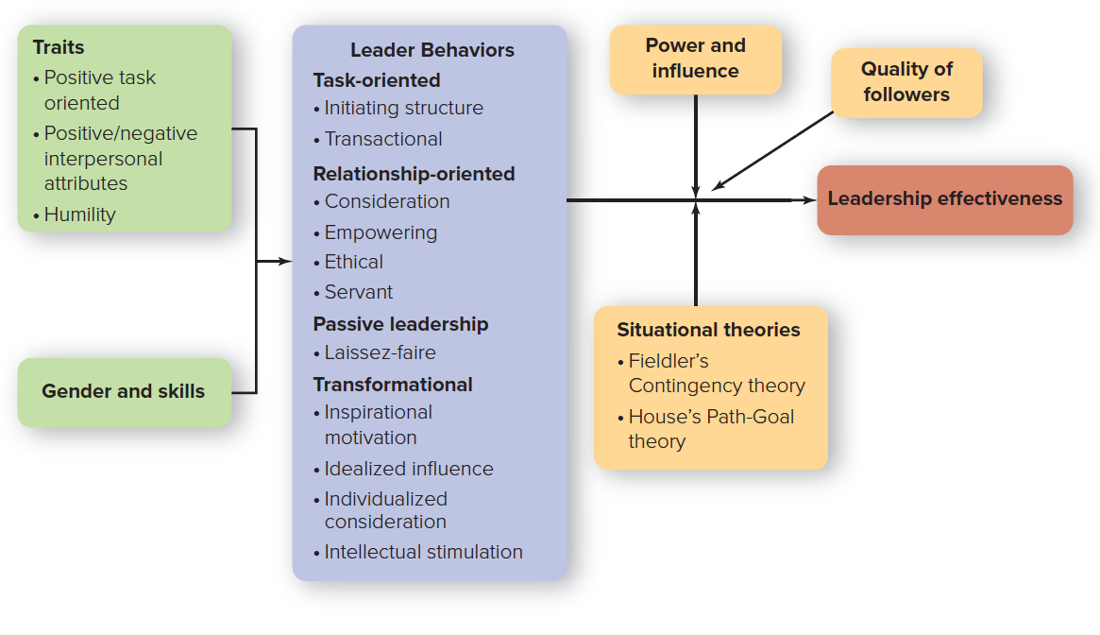
AN INTEGRATED MODEL OF LEADERSHIP
Copyright ©McGraw-Hill Education. Permission required for reproduction or display.

Slide 11
TRAIT APPROACHES to LEADERSHIP
Trait approaches to leadership attempt to identify distinctive characteristics that account for the effectiveness of leaders.
Positive Task-Oriented Traits | Positive or Negative Interpersonal Attributes
Intelligence | Extraversion (+)
Conscientiousness | Agreeableness (+)
Openness to experience | Emotional intelligence (+)
Emotional stability | Narcissism (-)
Positive affect | Machiavellianism (−)
 | Psychopathy (−)
Copyright ©McGraw-Hill Education. Permission required for reproduction or display.

Slide 12
“DARK SIDE” TRAITS
Narcissism
Having a self-centered perspective, feelings of superiority, and a drive for personal power and glory.
Machiavellianism
Displaying a cynical view of human nature that condones opportunistic and unethical ways of manipulating people, putting results over principles.
Psychopathy
Characterized by lack of concern for others, impulsive behavior, and a lack of remorse when actions harm others.

Slide 13
LETS THINK ABOUT EXAMPLES OF PEOPLE DISPLAYING “DARK SIDE” TRAITS
?

Slide 14
FOUR BASIC SKILLS for LEADERS
WHAT LEADERS NEED | AND WHY
Cognitive abilities to identify problems and their causes in rapidly changing situations | Leaders must sometimes devise effective solutions in short time spans with limited information.
Interpersonal skills to influence and persuade others | Leaders need to work well with diverse people.
Business skills to maximize the use of organizational assets | Leaders increasingly need business skills as they advance. Three valuable skills that most people can develop are mindfulness, curiosity, and optimism.
Conceptual skills to draft an organization’s mission, vision, strategies, and implementation plans | Conceptual skills matter most for individuals in the top ranks of an organization. Entrepreneurs may have their strategic skills tested on a regular basis.
Source: Adapted from T.V. Mumford, M.A. Campion, and F.P. Morgeson, “Leadership Skills Strataplex: Leadership Skill Requirements across Organizational Levels,” Leadership Quarterly, 2007, pp. 154-166.
Copyright ©McGraw-Hill Education. Permission required for reproduction or display.

Slide 15
TRAIT THEORIES OFFER FOUR CONCLUSIONS
We cannot ignore the implications of leadership traits.
The traits suggest the qualities you should cultivate and avoid if you want to assume a leadership role in the future.
Organizations may want to include personality and trait assessments in their selection and evaluation processes.
Cross-cultural competency is an increasingly valued task-oriented trait. A global mind-set is your belief in your ability to influence dissimilar others in a global context.

Slide 16
BEHAVIORAL APPROACHES
Behavioral leadership approaches
Attempt to determine the distinctive styles used by effective leaders.
Divided into four categories:
Task-oriented behavior.
Relationship-oriented behavior.
Passive behavior.
Transformational behavior.

Slide 17
TASK-ORIENTED LEADER BEHAVIORS
Task-oriented leadership behaviors
These ensure that people, equipment, and other resources are used in an efficient way to accomplish the mission.
Two types:
Initiating-structure leadership organizes and defines what employees should be doing to maximize output.
Transactional leadership clarifies employees’ roles and task requirements and provides rewards and punishments contingent on performance.

Slide 18
RELATIONSHIP-ORIENTED LEADER BEHAVIORS
Relationship-oriented leadership
Primarily concerned with the leader’s interactions with his or her employees.
Four types:
Consideration.
Empowering leadership.
Ethical leadership.
Servant leadership.

Slide 19
PASSIVE LEADERSHIP
Passive leadership
Form of leadership behavior characterized by a lack of leadership skills.
Laissez-faire leadership
A form of “leadership” characterized by a general failure to take responsibility for leading.
©Digital Vision/Photodisc/Getty Images

Slide 20
SOME PRACTICAL IMPLICATIONS of the BEHAVIORAL APPROACHES
Two conclusions:
A leader’s behavior is more important than his or her traits. It is important to train managers on the various forms of task and relationship leadership.
There is no one best style of leadership. How effective a particular leadership behavior is depends on the situation at hand.

Slide 21
SITUATIONAL APPROACHES
Situational approaches to leadership
Belief that effective leadership behavior depends on the situation at hand.
Also called the contingency approach.
Two approaches:
The contingency leadership style.
The path-goal leadership style.

Slide 22
The CONTINGENCY LEADERSHIP MODEL
The contingency leadership model developed by Fiedler
Determining if a leader’s style is (1) task-oriented or (2) relationship-oriented and if that style is effective for the situation at hand.
Uses the least preferred coworker (LPC) scale, in which workers rank the coworker they least enjoyed working with and rate him or her: friendly/unfriendly, tense/relaxed, efficient/inefficient.
The higher the score, the more the relationship-oriented; the lower the score, the more task-oriented.

Slide 23
THREE DIMENSIONS of SITUATIONAL CONTROL
Leader-member relations
Reflects the extent to which the leader has the support, loyalty, and trust of the work group.
Task structure
Extent to which tasks are routine and easily understood.
Position power
Refers to how much power a leader has to make work assignments and reward and punish.

Slide 24
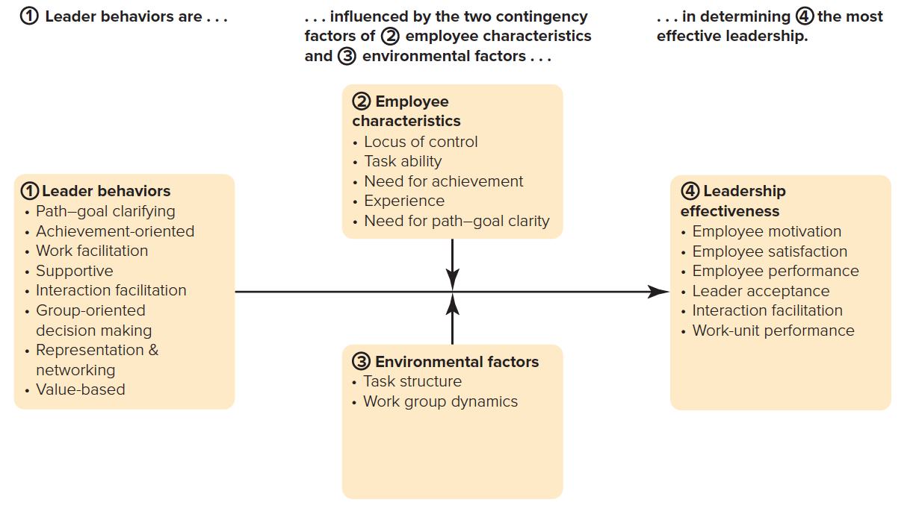
HOUSE’S PATH-GOAL THEORY
Copyright ©McGraw-Hill Education. Permission required for reproduction or display.

Slide 25
The USES of TRANSFORMATIONAL LEADERSHIP
Transformational leadership.
Employees are encouraged to pursue organizational goals over self-interests.
Leaders are influenced by individual characteristics and organizational culture.
Whereas transactional leaders try to get people to do ordinary things, transformational leaders encourage their people to do exceptional things.

Slide 26
FOUR KEY BEHAVIORS of TRANSFORMATIONAL LEADERSHIP
Inspirational motivation: “Let me share a vision that transcends us all.”
Idealized influence: “We are here to do the right thing.”
Individualized consideration: “You have the opportunity to grow and excel here.”
Intellectual stimulation: “Let me describe the great challenges we can conquer together.”

Slide 27
IMPLICATIONS of TRANSFORMATIONAL LEADERSHIP for MANAGERS
It can improve results for both individuals and groups.
You can prepare and practice being transformational.
It should be used for ethical reasons.

Slide 28
TWO ADDITIONAL PERSPECTIVES (2 of 2)
Leading with Humility
Humility is a relatively stable trait grounded in the belief that “something greater than the self exists.”
Five Key Qualities:
High self-awareness.
Openness to feedback.
Appreciation of others.
Low self-focus.
Appreciation of the greater good.

Slide 29
WHAT FOLLOWERS WANT
Followers seek and admire leaders who create feelings of:
Significance: The work followers do is meaningful and important.
Community: Followers trust and respect others to work in pursuit of organizational goals.
Excitement : People feel energetic and engaged at work.

