Slide 1

Many-body quantum mechanics: time-dependent perturbation theory
Jani-Petri Martikainen

Slide 2
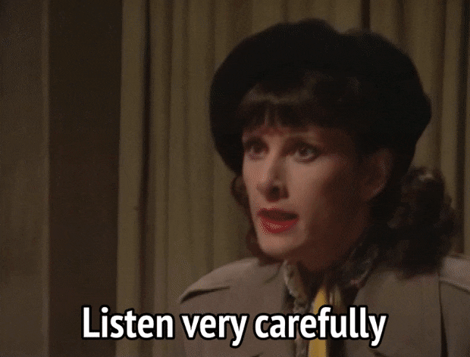
Practicalities
Responsible teacher: prof. Päivi Törmä
TA Jani-Petri Martikainen
  In case you have questions: jani-petri.martikainen@aalto.fi
  Also perhaps in N201b in Nanotalo
Exercises and lecture notes in MC by Monday at 12
Alert me if something is messed up in MC
Last lecture in N228 in Nanotalo

Slide 3
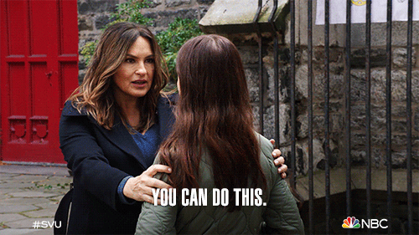
Level…
This is not the 1st course on QM
Assume familiarity with one-particle QM, Dirac notation, complex numbers etc…
Focus on many-body quantum mechanics
Needs some focus and thinking, but if prequisites met…has been doable

Slide 4

Practicalities
Exercise deadline: before the next session (check the paper)
  Return in MC
  Self-evaluation which I might change
  Exercises physically in Meitner also
In exercises some tips for next weeks set and also some discussion about earlier exercise…if time can also start working there
Will take pictures of the whiteboard to provide some help to those not present.

Slide 5
Practicalities
Two exams
  21.2 16:30-19:30 (Lectures 1-5) and
  17.4 16:30-19:30 (Lectures 6-12…more weight)
  If you cannot make it to the 1st midterm…welcome to the final exam 7.6 at 9-12
  At least 6 points per exam needed to pass

Slide 6
Practicalities
Grading (probably)
  0…13 from exercises
  0…48 exams
  0 or 2 from feedback
Last year 27 points gor you grade 1…roughly similar this year
Threshold for 5 was 55 points

Slide 7
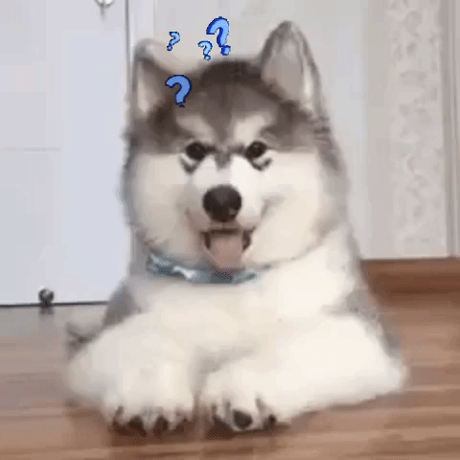
Did I forget something?

