Slide 1
Citations & referencing aids
Group 6: Alexandra, Matti, Michelle, Oskari

Slide 2
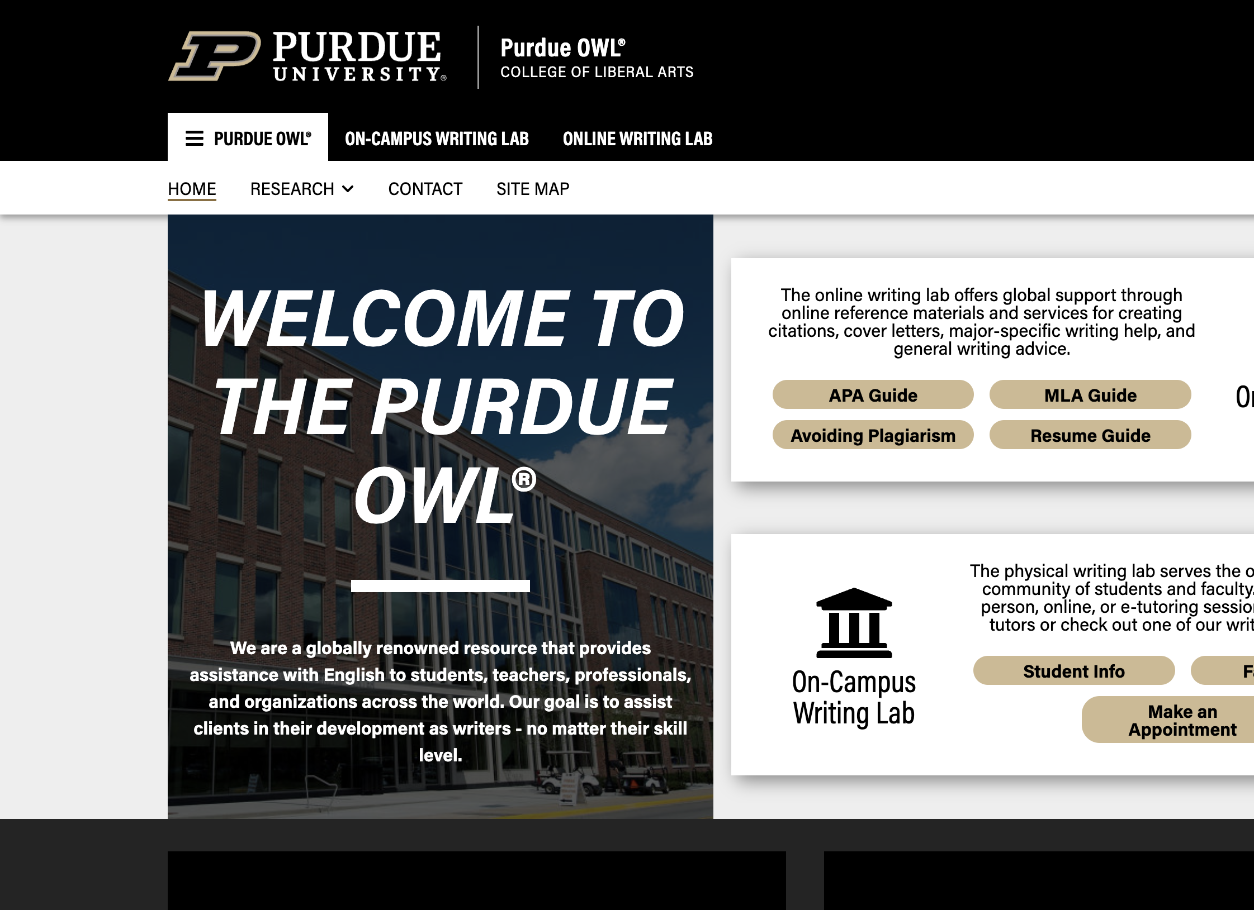
https://owl.purdue.edu/

Slide 3
https://www.mybib.com/

Slide 4
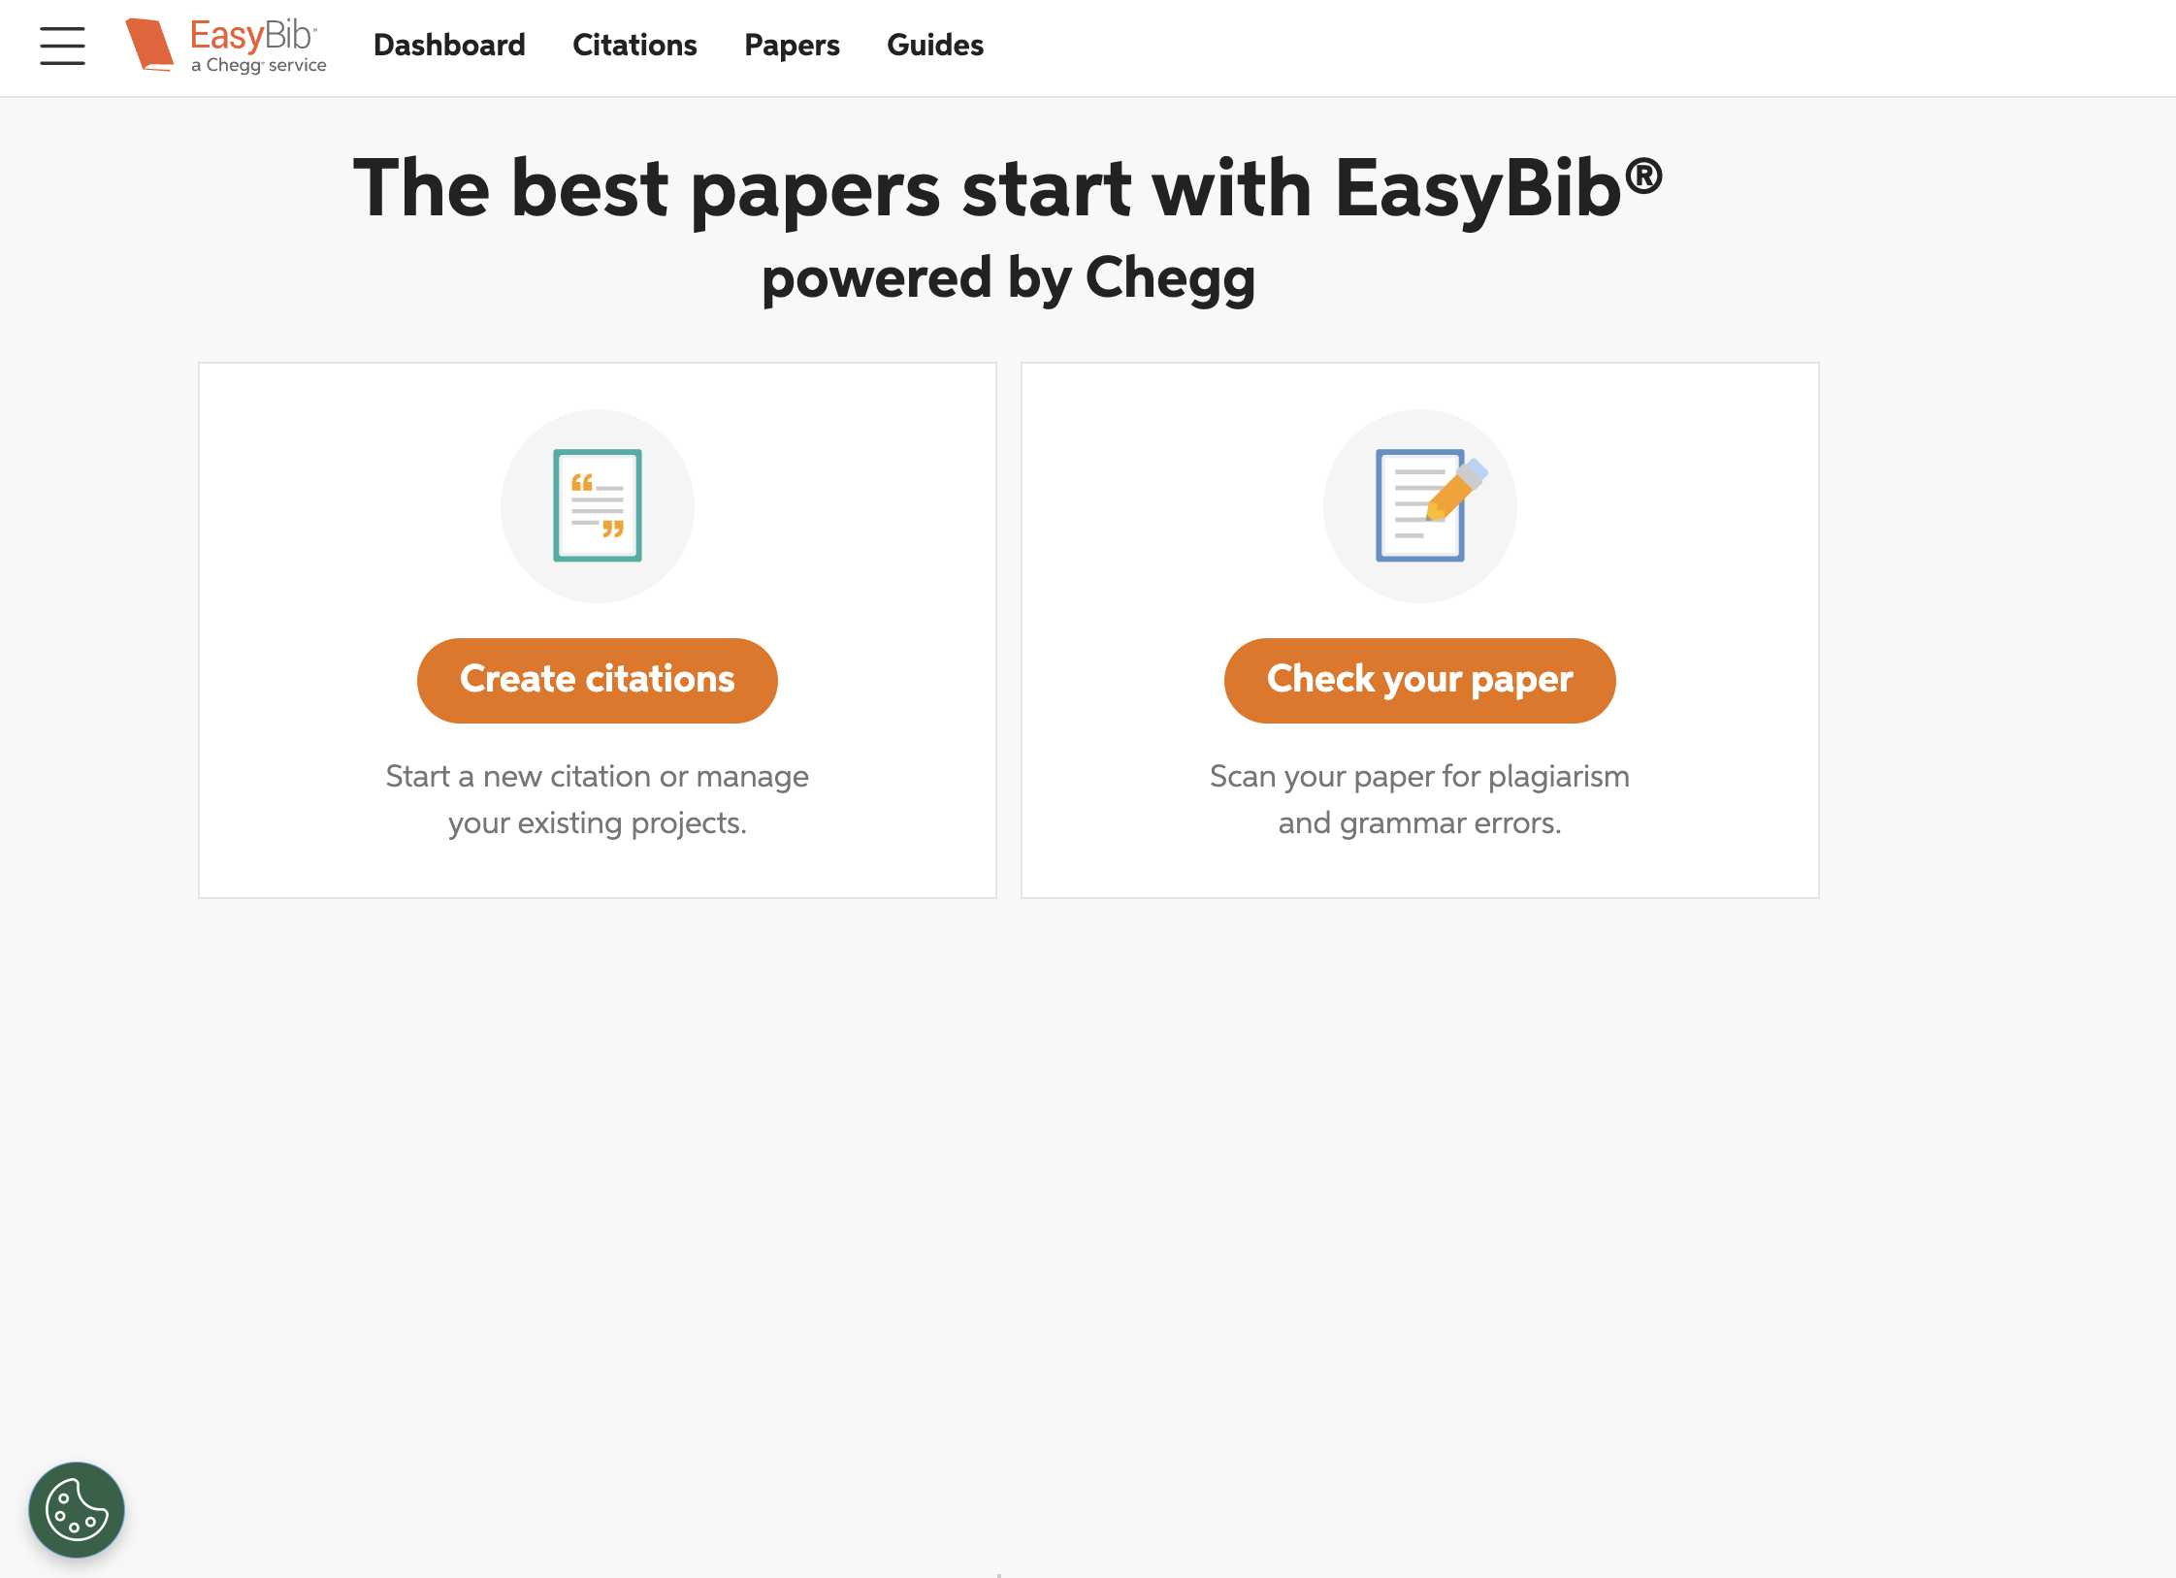
https://www.easybib.com

Slide 5
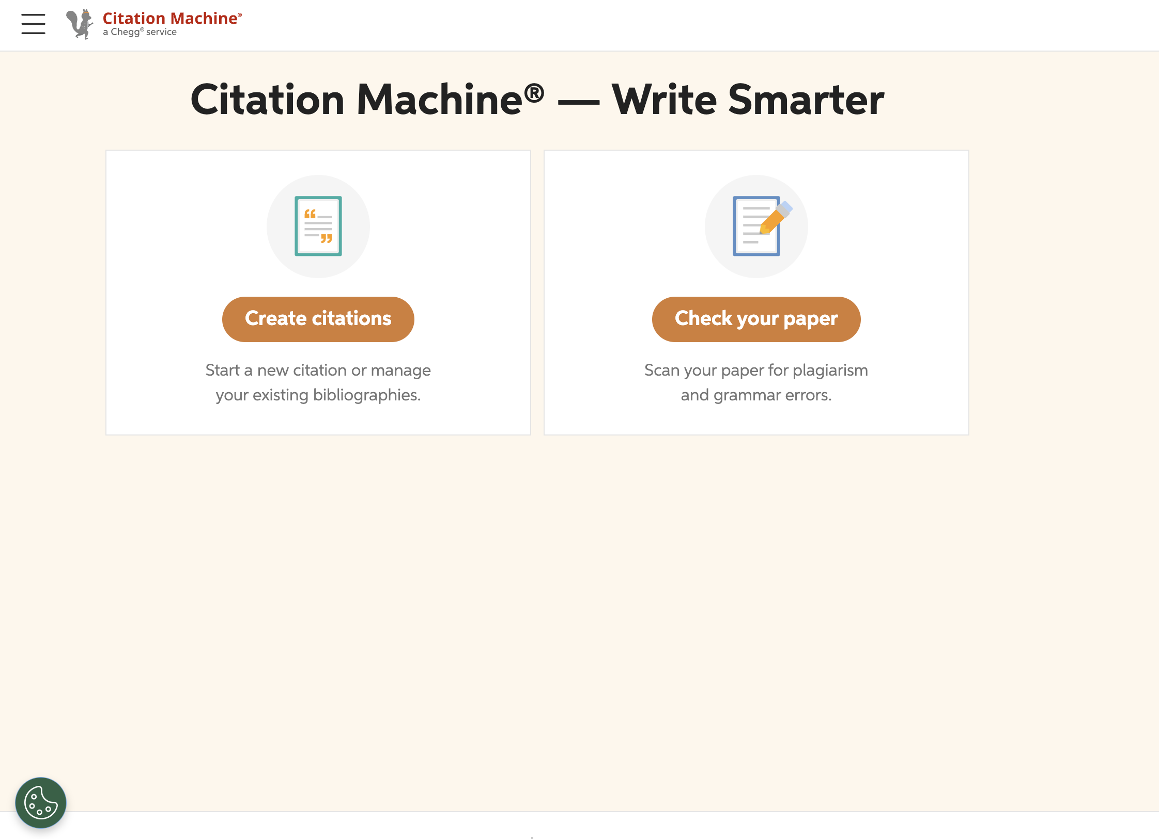
https://www.citationmachine.net

