Slide 1
Collocations
“A pair or group of words that are almost always put together to create a specific meaning”
Group 3

Slide 2
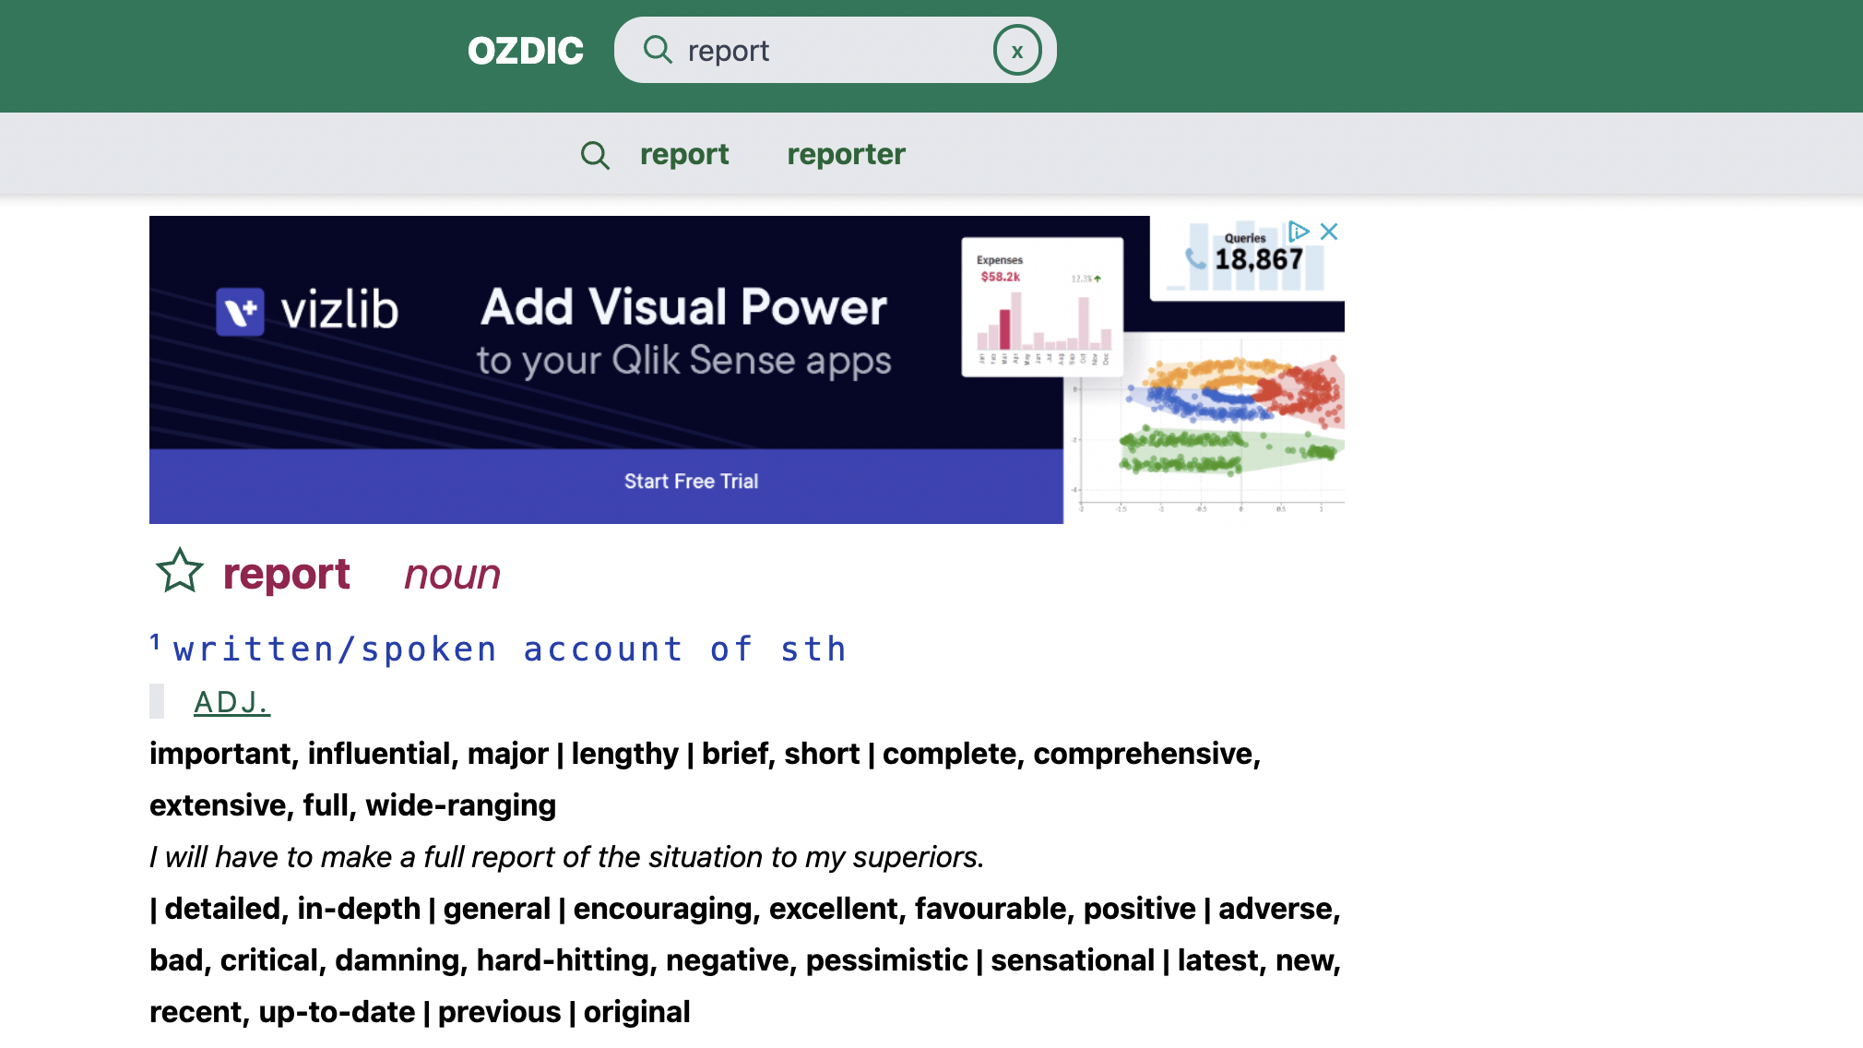

Slide 4
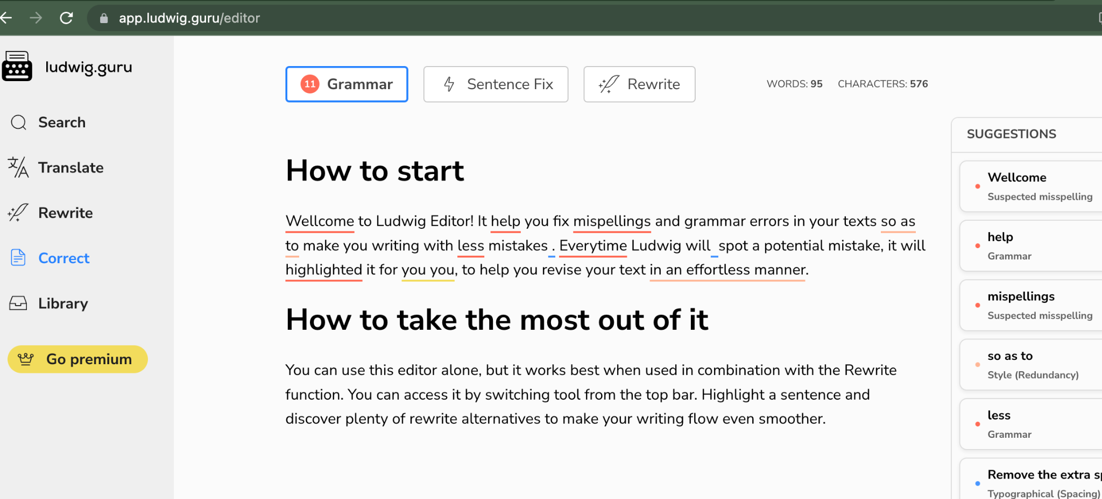

Slide 5
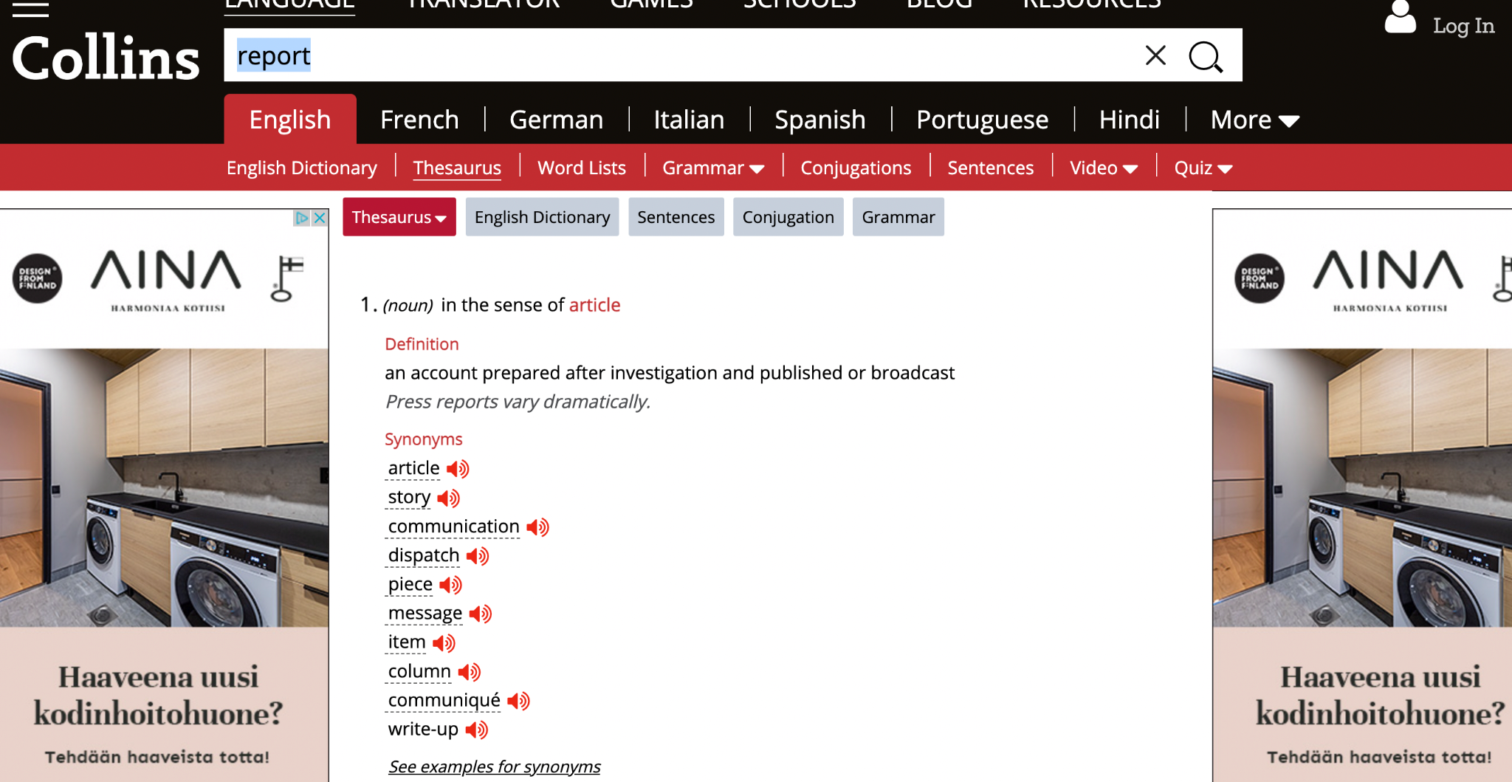

Slide 6
As was shown, the word report is most commonly paired with:
Influential
Important
And the word report is synonymous with article or piece

