Slide 1
Report Writing Tools
Group 7

Slide 2
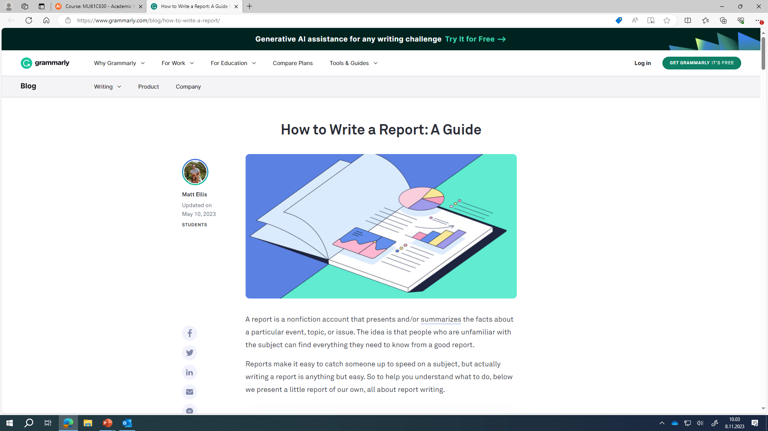
How to Write a Report: A Guide With Examples | Grammarly Blog

Slide 3
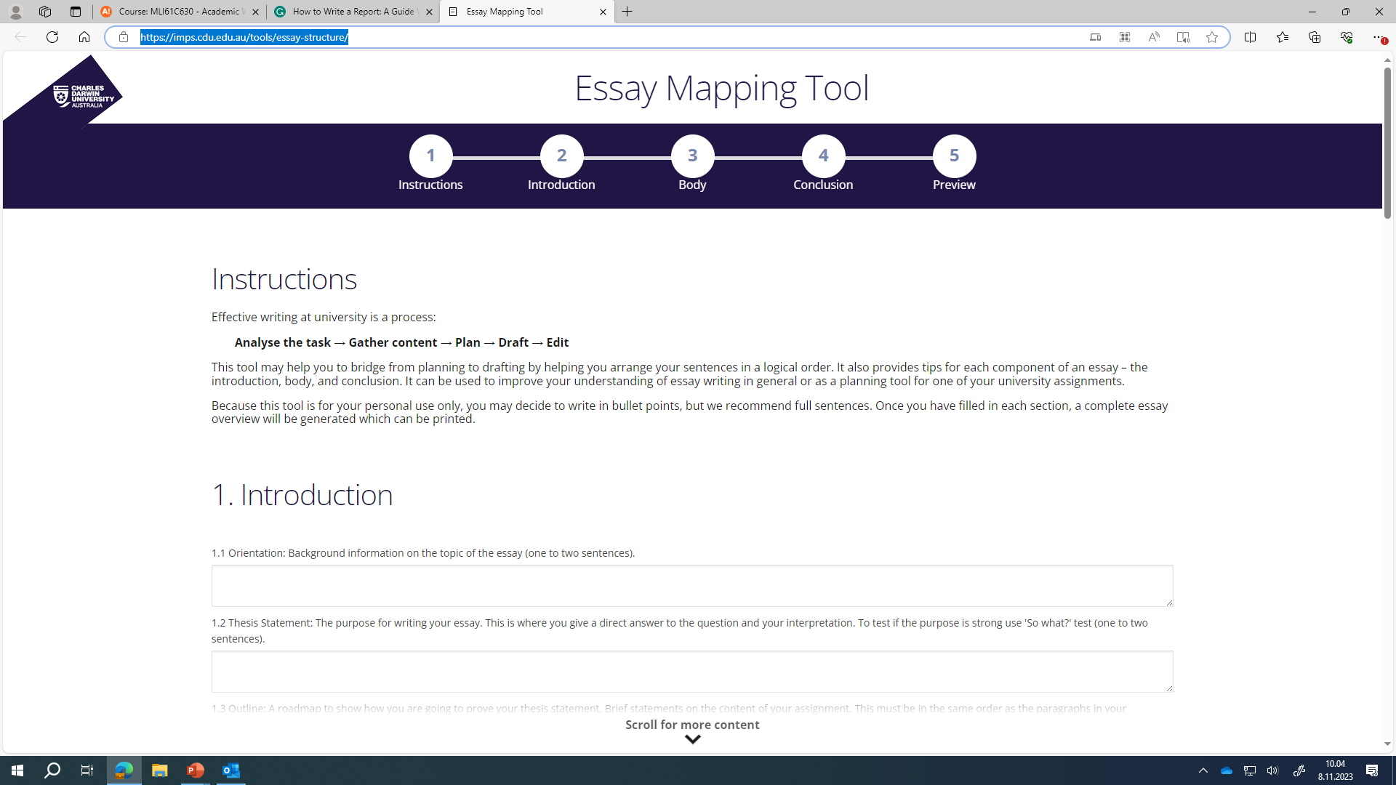
Essay Mapping Tool (cdu.edu.au)

