Slide 1
TikTok Rise to Global Market
Case Discussion

Slide 2
What is the main value Douyin delivers to its users?
 | Viewers | Video Developers
Value Proposition

Slide 3
What are the key components Douyin needs to create value?
 | Viewers | Video Developers
Value Proposition
Components for value Creation

Slide 4
Douyin Value Creation
 | Viewers | Video Developers
Value Proposition | -Quality of Videos -Quantity of Videos -Match between videos and user preferences | -Social Needs: A platform to gain appreciation and popularity -Monetary Needs: Opportunity to earn revenues
Components for value Creation | -Higher number of video developers -Diversity of video developers to match different user tastes -AI to match videos with user tastes | -Greater number of users -AI to match developers with right users -Availability of advertisers/sponsors for revenue generation

Slide 5
How Douyin successfully established a network in China to create value for its Chinese users?

Slide 6
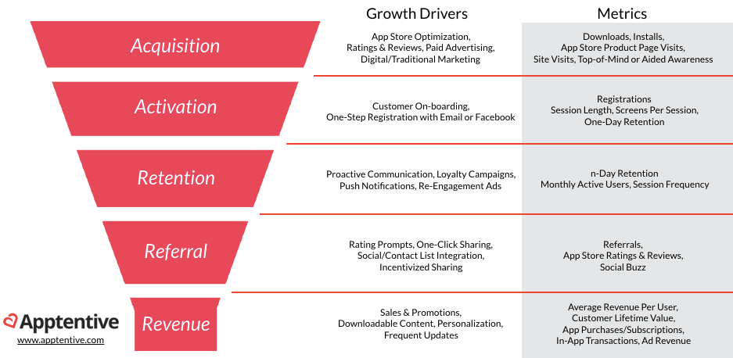
Growing a Digital Business- AARRR Model

Slide 7
Douyin Growth in China
AARRR Model | Douyin Strategy
Acquisition | -Marketing promotions with stars, TV channel, and companies -Start from Tier 1 and Tier 2 Cities (High Clout) -Encourage multihoming by integrating social sharing with QQ and Weibo
Activation | -Instant start of Videos to give a feeling of available content
Retention | -AI to match videos with user tastes -Suggest hot and trending videos to users -Personalized videos -Powerful and easy-to-use toolkits for video developers
Referral | -Social Referrals: Various Hashtags for encouraging users to invite friends -Influencer Referrals -Key Opinion Leaders
Revenue | -Advertising campaigns with companies -Cooperation with e-commerce platforms

Slide 8
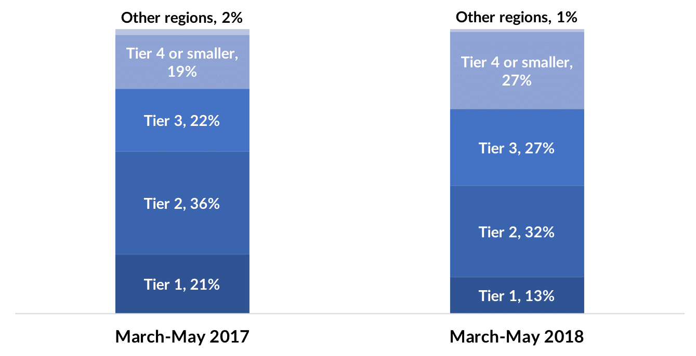
EVOLUTION OF THE LOCATION OF DOUYIN USERS

Slide 9
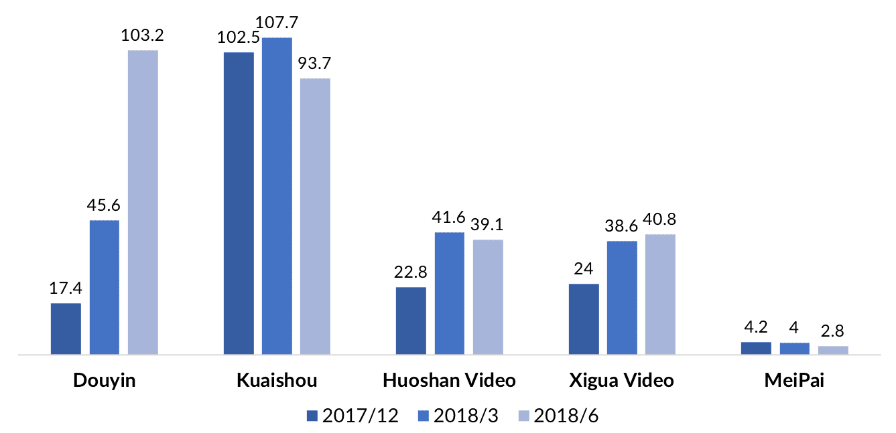
GROWTH IN THE NUMBER OF SHORT VIDEO APP USERS

Slide 10
What are the main strengths ByteDance developed by successfully operating Douyin in China?

Slide 11
Byte Dance Strengths
FSA-Firm-Specific Assets (Resources)
Technical features of the platform, including a robust AI system as well as internal learning from operating in China
Partners (Network)
Local network of video developers and viewers established in China

Slide 12
What are the main challenges ByteDance faced outside China?
AARRR Model | Challenges outside China
Acquisition
Activation
Retention
Referral
Revenue

Slide 13
What are the main challenges ByteDance faced outside China?
AARRR Model | Challenges outside China
Acquisition | -Content created by Chinese network may not attract users in foreign markets due to Cultural differences -Lack of cooperation by local stakeholders may cause difficulties in producing local content (i.e. videos) -Little market size of short video market in Asian countries and stiff competition in North American markets
Activation | -Any foreign users downloading the app may not find Chinese videos interesting, in case Douyin attempts to use its Chinese content in foreign markets
Retention | -Videos and hashtags that are considered hot in China may not be equally appealing in foreign markets -Powerful and easy-to-use toolkits may not attract video developers due to resistance to foreign platforms (particularly in Japan) and presence of local alternatives (particularly musical.ly in North America)
Referral | -Lower possibility of generating social Referrals as well as influencer referrals due to the absence of local networks, Chinese network may not have overseas connections to generate referrals
Revenue | -Impossible to attract advertisers or sponsors without establishing local networks

Slide 14
How may Byte Dance strengths help overcome the challenges outside China?
AARRR Model | Challenges outside China | Network | FSA/Resources
Acquisition
Activation
Retention
Referral
Revenue

Slide 15
Byte Dance Overcoming Overseas Challenges
AARRR Model | Challenges outside China | Network | FSA
Acquisition | -Lack of awareness about Douyin in foreign countries -Little market size of short video market in Asian countries and stiff competition in North American markets -Lack of cooperation by local stakeholders may cause difficulties in producing local content (i.e. videos) | -Content created by Chinese network may not attract users in foreign markets due to Cultural differences | -Experience of working with complementors and celebrities -Experience and Financial strength for offline promotion -Platform quality -Powerful and easy-to-use toolkits for video developers
Activation | -Any foreign users downloading the app may not find Chinese videos interesting, in case Douyin attempts to use its Chinese content in foreign markets |  | -Instant start of localized videos may give the feeling about available content
Retention | -Videos and hashtags that are considered hot in China may not be equally appealing in foreign markets -Powerful and easy-to-use toolkits may not attract video developers due to resistance to foreign platforms (particularly in Japan) and presence of local alternatives (particularly musical.ly in North America) |  | -AI to match videos with user tastes -Hot and trending videos to match tastes in each overseas country
Referral | -No possibility of generating social Referrals as well as influencer referrals due to the absence of local networks | -Overseas users may not be in the network of Chinese users -Overseas users may not be attracted to the opportunity of interacting with Douyin’s Chinese network | -Experience in working with users and celebrities to generate both social and influencer referrals
Revenue | -Impossible to attract advertisers or sponsors without establishing local networks | -Large Chinese network of Duoyin may not be attractive for foreign advertisers | -Copy revenue models from China

Slide 16
How ByteDance responded to the challenges of overseas expansion?

Slide 17
Main Lessons: Expanding Domestic success across borders
Even in a so called borderless digital world, people do not morph into one single global community. The Tower of Babel effect still persists, separating networks across national borders and imposing liabilities of outsidership to digital platforms.
Although digital platforms are available globally with relatively lower political, geographical, or economic barriers, digital firms still face user adoption barriers as users may not adopt a product without local content. Hence, localization is still important in a digital world.
A transnational mindset is needed for platform globalization where technological superiority and firm experiences are deployed on global scale but content and user interactions are largely localized.

Slide 18
Why TikTok acquired Musical.ly to enter North American market?

Slide 19
Why TikTok acquired Musical.ly to enter into North American market?
Competitive:
Difficult to dethrone established platforms even with higher platform quality
User networks are largely locked in with already existing platforms.
TikTok has previously been successful in markets with low or no competition
Even in China, the firm focused on Tier 1 and Tier 2 cities where competition was low
Strategic:
TikTok and Musical.ly offer synergies and complementary resources to each other.
Musical.ly brings an established network of North American and Western users
TikTok brings an established network of Asian users and expertise in AI.
Organizational:
Both Musical.ly and TikTok have been owned by Chinese owners

Slide 20
How merging TikTok and Musical.ly may or may not address these challenges?
Merging TikTok and Musical.ly |  | Keeping TikTok and Musical.ly separate
Pros | Cons | Pros | Cons

Slide 21
Decision
ByteDance decided to merge musical.ly in TikTok to create a unified global platform
The new platform incorporated the most popular elements from both platforms
Musical.ly users’ accounts, content, and fan base were automatically moved to TikTok
After the merger, TikTok added several new features such as enhanced creative tools and greenscreen-like background effects.

Slide 22
Strategic Rationale behind the decision
Leverage global network effects:
Creating a borderless ecosystem from Latin America to China to North America.
The merger means Tik Tok’s users in Asia and Musical.ly’s users in the US and Europe can now see content created by each other-- but, notably, not users in China
Pursuit of diverse content
Market research found that 48% churn rate was due to the lack of variety in the content
Capitalizing on higher clout?
While it was difficult to bring together local networks in low clout Asian countries due to differences in languages and user preferences, Muscial.ly provided TikTok with a large user base in high clout countries of Europe and USA. The popular appeal of Western cultures may enable TikTok to attract local networks from multiple countries to interact with users from high clout western countries. Such interactions may result into global network externalities as video developers may target geographically diverse segments and viewers may enjoy a greater variety of videos.

Slide 23
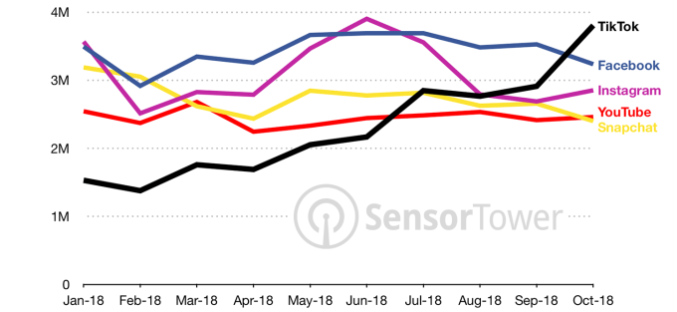
TIKTOK MONTHLY DOWNLOADS IN USA- 2018

Slide 24
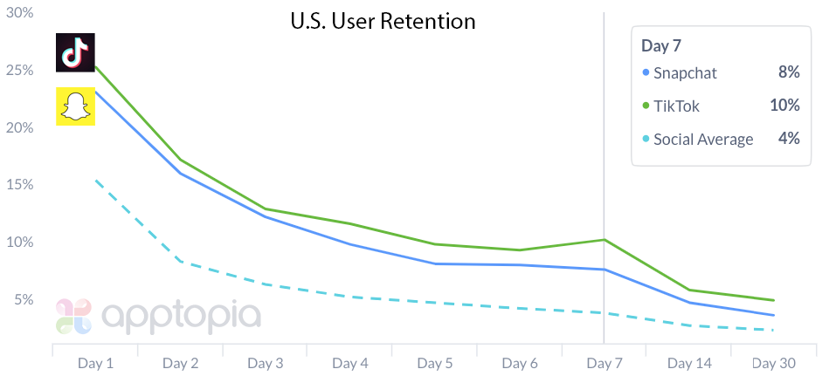
TIKTOK USER RETENTION IN USA AFTER MERGER

Slide 25
Key Takeaways
Ibusiness firms largely follow the sequence prescribed in AARRR model to grow by leveraging positive network externalities.
Network effects are largely bounded by national borders even in a seemingly borderless digital world due to liabilities of outsidership.
While cultivating local networks help platforms in international expansions, platforms in their later lifecycles need to harness global network effects to sustain their growth and to counter competitors harnessing global network effects.
One possible strategy to move from local networks to global networks is to leverage user networks in high clout regions
Supplementing networks with firm resources can lead to competitive advantage
Other examples:
Android SDK pack that made app development possible for primary school kids

