Slide 1

Deal Thesis driven approach to M&A

Slide 2
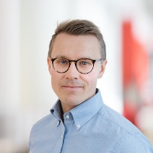
Introduction
Pyry Vauramo
Bain & Company
Partner at Bain & Company, based in Helsinki
13+ years in management consulting, working with leading private market investors and companies
  Involved in 100+ transactions, mostly on the buy-side as a due diligence advisor to PE, growth equity and infra investors
  Advising CEOs and management teams on strategy and value creation – often involving executing on strategic M&A transactions from due diligence to post-merger integration
  Sector focus on Technology (Software, IT Services), Telecom, and Advanced Manufacturing & Services
In addition to client work, lead recruiting for Bain in the Nordic region as well as locally in Helsinki
MSc. (Tech) in Industrial Engineering and Management + Aalto Finance student… drop-out ☺
Global management consulting firm, helping the world’s most ambitious executives across industries to define the future of their businesses
Founded in 1973 in Boston with an insurgent mindset and a mission to redefine management consulting by focusing on results, not reports
Today, global presence in 65 cities in 40 countries
  In the Nordics, 500+ employees of which 65+ in Helsinki
The leader in Private Equity and M&A consulting globally
  Private Equity consulting and Corporate M&A together constitutes more than 1/3 of Bain’s business globally
  Completed more than 18k due diligences for PE investors and Corporates
  Bain Partners are also investors into PE personally

Slide 3
overall_1_132428587649933190 columns_1_132428587649933190
Frequent, material acquirers outperform
Annual total shareholder returns (CAGR 2012-2022)
SERIAL ACQUIRERS
MOUNTAIN CLIMBERS
≥1 deals per year
8.4%
8.7%
Acquisition
Frequency
SELECTED FILL-INS
SELECTIVE LARGE BETS
<1 deal per year
5.7%
5.6%
INACTIVES
3.7%
≤50% of buyer’s
market cap
Cumulative Relative Deal Value
>50% of buyer’s market cap

Slide 4

Several factors are driving the need for new approaches to M&A
Higher pace of disruption driving more portfolio moves
Broader M&A types (e.g., scope deals, JV’s) to deliver on strategy
Deal competition is raising the bar in sourcing/ diligence
Shift in attitudes towards M&A
(e.g., regulatory, consumer)
Sustainability and ESG considerations moving front and center

Slide 5
Considering all deals you completed in the last three years that exceeded expectations, what were the three main reasons?
Clear deal thesis
Clear alignment on strategy
Conducted high-quality due diligence
Clear integration thesis
Developed the right operating model to integrate
and scale the business
Retained critical talent of acquired target
Evaluated culture/strategic fit early
Deployed (or developed) a proven playbook for integration
Aligned top leadership and decision rights early
Effective sizing and capture of revenue synergies
Effective sizing and capture of cost synergies
Enabled functional capability sharing early in the integration
0
10
20
30
40
50%
Note: Answered only by respondents who indicated that they had made acquisitions that exceeded expectations
Source: Bain M&A Practitioners’ 2023 Outlook Survey

Slide 6
What successful deals have in common
QUESTION
Considering all deals you completed in the last three years that exceeded expectations, what were the three main reasons?
Clear deal thesis
Clear alignment on strategy
Conducted high-quality due diligence
Clear integration thesis
Developed the right operating model to integrate
and scale the business
Retained critical talent of acquired target
Evaluated culture/strategic fit early
Deployed (or developed) a proven playbook for integration
Aligned top leadership and decision rights early
Effective sizing and capture of revenue synergies
Effective sizing and capture of cost synergies
Enabled functional capability sharing early in the integration
0
10
20
30
40
50%
Note: Answered only by respondents who indicated that they had made acquisitions that exceeded expectations
Source: Bain M&A Practitioners’ 2023 Outlook Survey

Slide 7

Clearly spells out:
  Why you are buying this business
  Why you are confident about future revenues and profits
How it reinforces your strategy
Describes specific, concrete benefits that are quantified in terms of cost, revenue, competitive advantage or earning power
Identifies the few things you need to do very well
to deliver on the deal thesis
Is simple and can be easily communicated;
it makes sense to all stakeholders, including investors and employees
Is written down and debated early on
An effective deal thesis…

Slide 8
A deal thesis must be a simple articulation of why this deal makes your company more valuable…
Industry segment poised for future growth and undergoing a transition to new technology
Join two leading brands, with an opportunity to gain share while realizing clear cost and revenue synergies through consolidation
Cyclical recovery will make this deal attractive now, supported by careful assessment of the underlying drivers
  Housing recovery to benefit the category
  Stable pricing (in spite of private label)
  Confidence in further penetration
A disruptive trend is taking hold, which the target company will help address
  Target will bring access to emerging technology that is going to displace existing products
  Worries about the new technology will not limit their use, with no indication of long-term issues
Leadership economics matter in this industry, and the acquisition will create a new 1.5x RMS position with opportunity for further share gain
  Target has a strong reputation with key customers and channel partners
  Target’s new product is believed to be superior to competitor offers
$X-YM in cost synergies through plant consolidation and G&A
  Benefits of consolidation outweigh costs/risks of moving equipment
  Acquisition unlocks G&A and procurement savings given overlap
$X-YM in revenue synergies from enhanced distribution
  Dealers want to sell both products and sales would be incremental

Slide 9
Each investment thesis is clearly bespoke – but there are some common archetypes
overall_0_131854674660917979 columns_1_131878881495515453
Strong/accelerating market growth
Strong market share
gain potential
Internationalize
Early adopters have demonstrated feasibility of strategy
Market in/about to enter high growth phase
Well-positioned business able to rapidly capture market share based on clear, sustainable competitive differentiation
Expand successful company from home market into adjacent foreign markets
Exploit
hidden assets
Buy-and-build
Cycle/timing
Operational
turnaround
Recognize hidden/underappreciated value within underutilized assets, e.g. brands and successfully capitalize on this hidden value
Consolidate series of smaller players to create a significant player in market and increase multiple
Invest in a business that is under pressure at/near bottom of (macro-economic/valuation/technology/product) cycle and that will recover/benefit from cycle turn
Poorly managed, underperforming business
Drive significant operational improvement (‘transformation’)

Slide 10

Typical pitfalls in the process without a robust deal thesis
Growth & M&A strategy
Sourcing & screening
Due
Diligence
Merger
Integration
Deal team generates deals that do not necessarily reinforce existing businesses and strategy
Business units drive the deal pipeline
No long term deal pipeline and outreach.
Early deal conversations not grounded in deal thesis and key requirements
Weak filters to screen out unattractive candidates early
Focus on the wrong issues or non-critical issues (functional compliance vs value drivers and underlying assumptions)
Insufficient focus on people risks, integration risks, or “soft” revenue synergies
Integrate every deal the same way – “whatever worked the last time”
Focus effort equally rather than on the 4 or 5 things that drive value and risk
Integrate the wrong things with the wrong combined operating model and “ways of doing business”

Slide 11


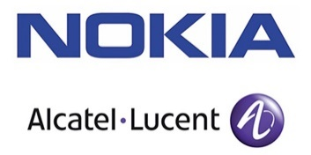
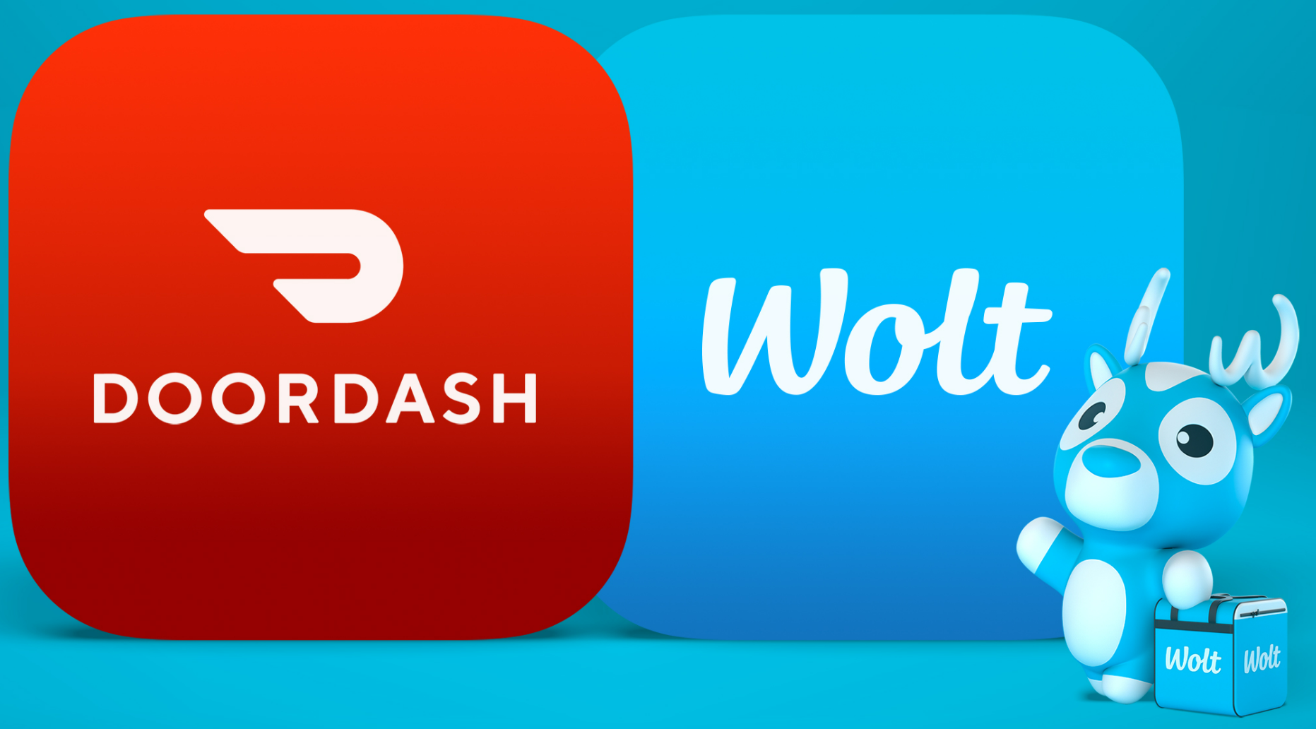




Deal thesis helps define what and how you integrate
PURE “SCALE” DEALS
PURE “SCOPE” DEALS
Degree of
integration
Integrate comprehensively
Integrate selectively (or use as portfolio play); cross-fertilize strengths
Organization
structure
Blend structures
Keep organizations separate, blend in selective areas; define role of center & functional superstructure
Executive
selection
Select a small proportion of the target’s executives - select more if target is larger or better performing
Retain a high proportion of the target’s executives
Talent
retention
Talent retention critical to short-term transition/integration
Talent retention critical to long-term success of company
Cultural
integration
Integrate the two cultures, typically by selecting the “best of both”
Preserve the two cultures if significant to business model; harmonize at the leadership level

Slide 12

Successful deals have both a compelling Deal Thesis and a clear Integration Thesis
INVESTMENT THESIS
A Deal Thesis
An Integration Thesis
Articulates why this deal makes your company more valuable and specific assertions that need
to be tested during diligence
Lays the groundwork for value capture, articulating what will be integrated, to what degree,
when and how
A DEAL THESIS SHOULD…
AN INTEGRATION THESIS SHOULD…
Spell out why you are buying this business and how it reinforces your strategy
Describe why you are confident about future revenues and profits
Identify key value levers and gives a clear understanding of how equity value is created
Be simple and easily communicated; understood by all stakeholders
Prioritize pivotal decisions required to capture full deal value and uncover risks in deals
Align the management team on critical structural and design decisions and drives early buy-in
Provide guidance on high-level steps required to effectively realize synergy estimates
Enable effective communication of deal to all stakeholders (investors, customers, vendors, etc.)

Slide 13
What successful deals have in common
QUESTION
Considering all deals you completed in the last three years that exceeded expectations, what were the three main reasons?
Clear deal thesis
Clear alignment on strategy
Conducted high-quality due diligence
Clear integration thesis
Developed the right operating model to integrate
and scale the business
Retained critical talent of acquired target
Evaluated culture/strategic fit early
Deployed (or developed) a proven playbook for integration
Aligned top leadership and decision rights early
Effective sizing and capture of revenue synergies
Effective sizing and capture of cost synergies
Enabled functional capability sharing early in the integration
0
10
20
30
40
50%
Note: Answered only by respondents who indicated that they had made acquisitions that exceeded expectations
Source: Bain M&A Practitioners’ 2023 Outlook Survey

Slide 14
Best practice due diligence addresses 6 core imperatives
Drive work from independent investment thesis
Rigorously test critical questions from the outside in
Think the
unthinkable
1
2
3
Identify upside opportunities
Take an integrated
view on the business
Create a bridge to
post-acquisition value creation
4
5
6

Slide 15
Integrated DD focuses on the core value drivers of the deal
COMMERCIAL EXCELLENCE
TECHNOLOGY & IT
What levers can be pulled to accelerate GTM – sales force, channel, marketing, pricing…?
What is the magnitude of upside and what investments are required to deliver it?
What is the state of the tech architecture, roadmap and capabilities?
Implications to competitiveness and investment needs?
COMMERCIAL /
STRATEGIC
What (really) is target's business definition
and model?
What is the market structure, size and profit pool outlook?
What is target's relative
competitive position
and how may this change?
OPERATIONAL EXCELLENCE
ESG / IMPACT
What are the cost/margin opportunities across sourcing and operations?
What changes would be required and
how difficult, costly and time-consuming are they to implement?
What are the material ESG issues, risks & opportunities?
How will these affect the deal?
SYNERGIES & DIS-SYNERGIES
PEOPLE, TALENT & CULTURE
What up- and downsides will integration trigger on top & bottom-line?
What will it take to realize the synergies and mitigate risks?
Is the talent model and current team equipped to deliver?
Will the deal trigger changes in culture or people?
Post-acquisition value creation and integration plan

Slide 16
Winner vs. loser deals – learnings from Private Equity
‘CLEAR WINNER’ deals have at least one of the following ‘winning factors’
‘CLEAR LOSER’ deals typically have one
or more of the following issues
1
Rapid market growth (10%+ in next 5 years, 7%+ in 10 years)
1
Unfavorable change in competitive dynamics
(e.g., low-cost, or digital-native/next-gen entrants)
2
Organic, “same store” market share gains (4%+ vs. market)
  Leading indicator: Outstanding, differentiated customer feedback
2
Unforeseen or underestimated technology/
business disruption
3
Continued geographic, product, or channel or adjacency expansion which adds 4%+ p.a. to revenue and EBITDA
3
Missed or misunderstood penetration curve
4
Accretive M&A, adding 4%+ p.a. growth revenue and EBITDA
4
Execution failures in M&A or buy-and-build strategy
5
Obvious strategic acquirers (incl. why they aren’t buying now)
5
Cyclical company hitting a recession <24 months into deal
6
Margin improvement of 20%+ during a 5-year holding period
6
Unrealistic margin improvement forecasts
To count, a ‘winning factor’ must contribute at least
4% CAGR to EBITDA growth
Downside of a materializing warning beacon can be huge - “more” winning factors doesn’t save the deal

Slide 17
What successful M&A deals have in common
Clear deal thesis
Clear alignment on strategy
Conducted high-quality due diligence
Clear integration thesis
Developed the right operating model to integrate
and scale the business
Retained critical talent of acquired target
Evaluated culture/strategic fit early
Deployed (or developed) a proven playbook for integration
Aligned top leadership and decision rights early
Effective sizing and capture of revenue synergies
Effective sizing and capture of cost synergies
Enabled functional capability sharing early in the integration
0
10
20
30
40
50%
Note: Answered only by respondents who indicated that they had made acquisitions that exceeded expectations
Source: Bain M&A Practitioners’ 2023 Outlook Survey

Slide 18
overall_1_132566795334953446 columns_1_132566795334953446
THANK YOU

