Slide 1
Some basics of M&As and the M&A process
Sami Itani
15 November, 2023
Aalto University School of Business

Slide 2
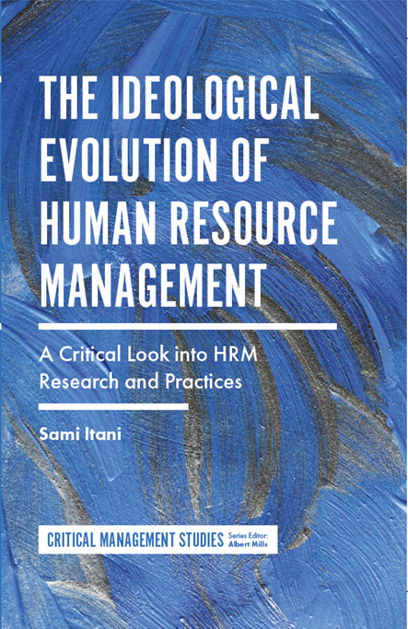
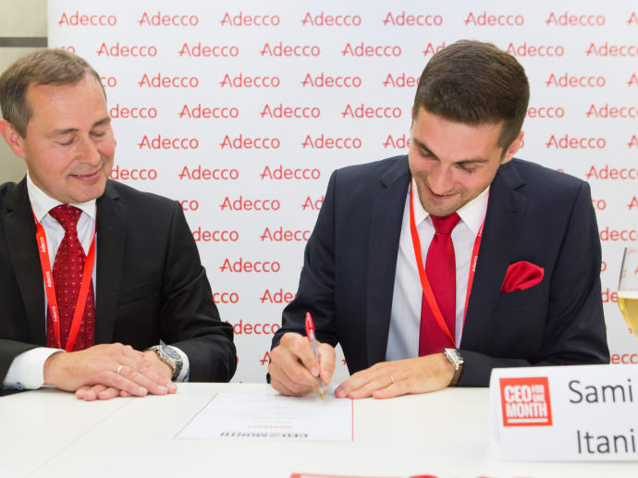
Sami in brief…
Home in Helsinki. Father of Emil and Oskar
Former decathlete
PhD in International Business
Business executive
Professor of Practice
Positions of trust & societal work
Book author & columnist

Slide 3
A little warm-up…
Notes:
Kysymys oppilaille omista työelämän M&A-kokemuksista ja mielikuvista ilmiöön liittyen

Slide 4
Why should we care about M&As?
An example of an organizational change
Involves many different issues pertinent to any change
A possibility to create value if planned and implemented well vs. incremental, costly and time-consuming internal development
One of the most challenging but also exciting managerial tasks
Goes beyond the organizational context to concern relational aspects (think about any serious relationship you have)
Money, power, fame, collapses, tragedies, emotions…
Media visibility…
Notes:
Merger vs acquisition
Stand-alone Absorption
Best of Both
Transformation

Slide 5
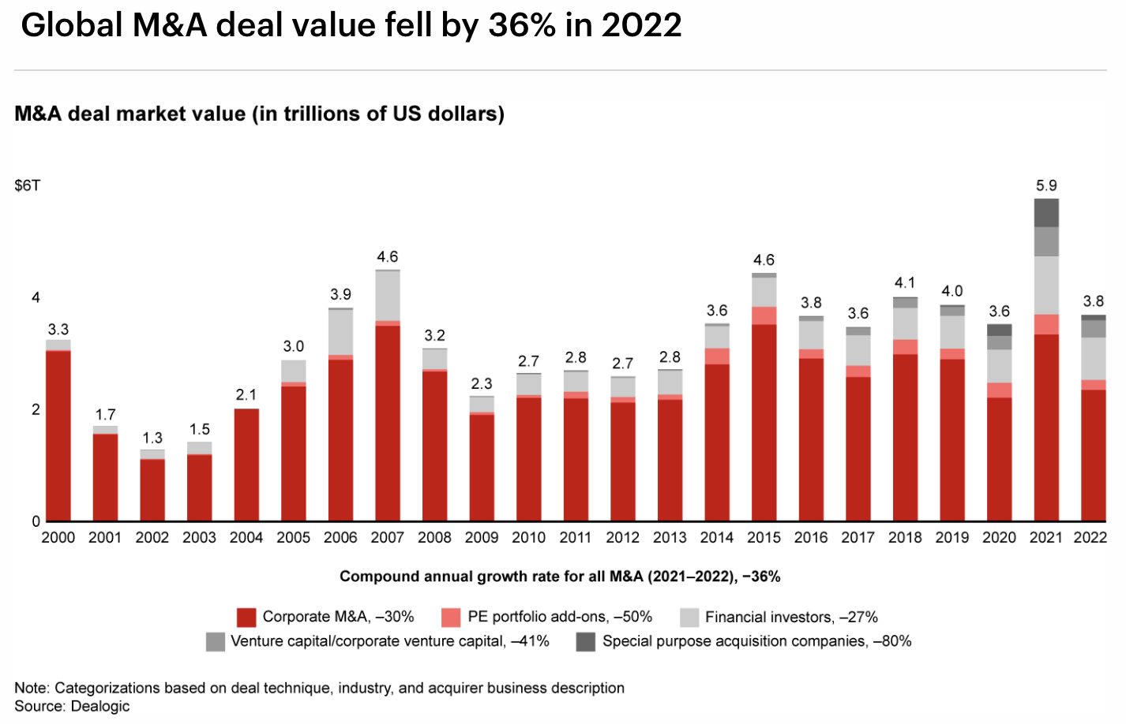
Source: Bain & Company, 2023
Notes:
Total M&A deal value reached all-time highs of $5.9 trillion in 2021.
Executives have a favorable outlook: 89% anticipate that their own deal activity will either stay the same or increase in 2022.

Slide 6
Notes:
Notion that Pyry can soon share with us what has happened in 2023

Slide 7
Impacts of COVID-19
Disruption from Covid-19 presented opportunities for strong competitors to try to gain market leadership through scale deals.
Accelerated pace of transformation for many industries: focus on remote options, food delivery etc.
High prices, increased competition: buyers are willing to pay a premium for high-margin, high-growth assets
“Covid-19 changed the dynamics of both in-person and direct distribution, leading several companies to turn to M&A to reshape their distribution footprint and capabilities”
(Bain & Company, 2022)

Slide 8
Contemporary key concerns
Previously expansionary fiscal policies, making capital plentiful, have rapidly changed
Macroeconomic complications: supply chain disruptions, inflation, labor shortages/greater competition for talent, and rising wages
Increasing salience of antitrust as a global political issue
Growing concern about the national security implications of M&A; increased regulatory scrutiny (making M&A deals demand more time and resources)
Cash-rich companies making strategic, bold moves
Source: Bain & Company, 2023

Slide 9
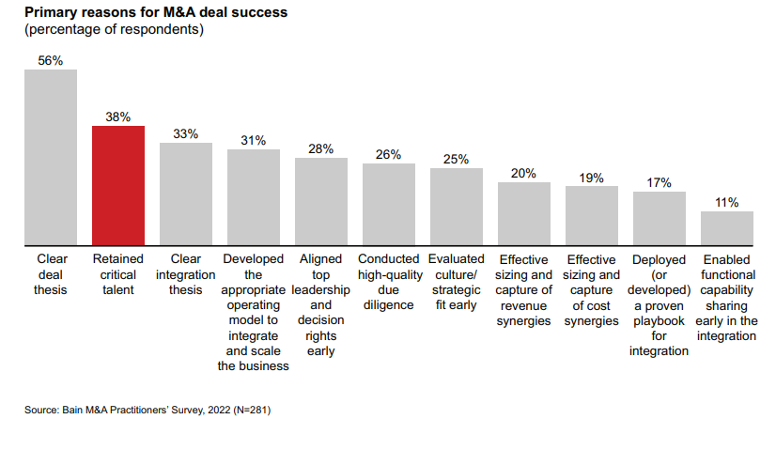
Talent retention as a hot topic
Notes:
Pyry’s focus on the Clear Deal Thesis…
Talent retention is seen as second-biggest contributor to deal success (clear deal thesis as the first)
Industries facing talent shortage, employees actively on the hunt for jobs
How to integrate top talent to make them stay? Especially difficult if merging across cultures.

Slide 10
Reasons for M&As
Realizing synergies (value creation)
Knowledge transfer ( = learning)
The acquisition strengthens the knowledge base of the company
Game theory
The acquisition is a response to the strategic moves of competitors
Fashion
The acquisition is part of a recent wave of acquisitions
Fame and glory / empire building
The acquisition is a means for the top management to strive for empire building and fame?

Slide 11
Why M&As frequently fail?
Wrong calculations of the potential value creation of the M&A?
No clear idea of how the M&A contributes to competitive advantage
Insufficient market/target knowledge; perhaps also because problems have been masked
Paid too much, perhaps the outcome of an escalation of commitment during negotiations
Managerial interests and ego enhancement lead to poor decisions
Perhaps done because ‘everybody else’ is doing M&As

Slide 12
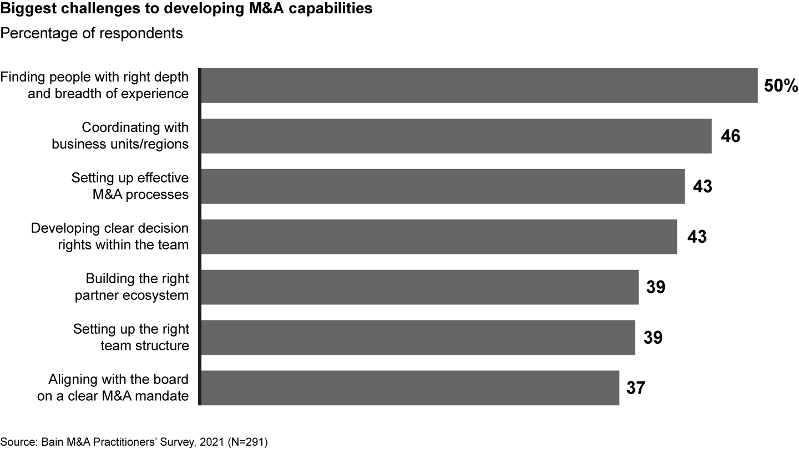

Slide 13
Five common traps to avoid in M&As By Professor Nuno Fernandes (IESE Business School), Harvard Business Review, Feb. 2021
Favoring “strategic” over financially savvy
Overpaying is the single biggest predictor of a disaster
In 2000 the AmericaOnline-TimeWarner merger valued at $350 billion, 10 years later 14% of that
Walking away because of cultural differences
One can prepare for and handle cultural differences; cf. Disney & Pixar 2006
3. Using investment bankers for valuation
- “there are perverse incentives at play”
Not linking deal-making with integration
5. Moving too slowly and with poor communication

Slide 14
M&As as a marriage (based on DeChesare)
Cultural Mismatch: Two people start off with a very similar mindset, but over time one person becomes more work or family-oriented, and the other does not. Communication often goes downhill as a result.
Romance = Successful Marriage: You might be madly in love with someone, but it doesn’t mean you should marry the person. For example, he or she might have small problems such as a drug addiction or a proclivity for murder.
What You Didn’t Know: You didn’t get to know the person well enough, which is how you never noticed that he/she has been arrested five times in the past. Or that you can’t live in the same house together.
Financial Failings: Right after you get married, the other person loses his/her job, becomes bored and lonely at home while you go to work, and then steals your money and your dog and flees halfway across the world. True story; it happened to a friend.
Your Reasons Were Stupid: For example, maybe you got married due to familial pressure, or due to the other person’s killer body. Or maybe you just made a horrible mistake in Vegas one night.
It’s Easy to Get Divorced: While this isn’t true everywhere, in plenty of countries it’s relatively easy to get a divorce. Sometimes there isn’t even much social stigma attached. So why bother to work things out if you can just hit the “reset” button and walk away?
Source: https://www.mergersandinquisitions.com/why-most-ma-deals-fail/

Slide 15
An M&A is not a deal, it is a process
CHALLENGES IN INTEGRATION:
avoiding overestimation of combination
benefits & underestimation of resistance forces
in-depth understanding of beliefs, values &
practices of the organisations
avoiding stereotyping, cultural prejudice, and “one size fits all” attitudes
ability to deal with conflicts of interest, politics and possible negative emotions
balancing between radical and cautious changes
acquiring the competences and knowledge / clients
investing in positive communication & identity building
Value creation & synergies
Cultures
Design
Politics and emotions
Learning
Identity and communication

Slide 16
Different perspectives on M&As
Value creation perspective
Design perspective
Justice and socio-political perspective
Sociocultural perspective
Emotions and identities perspective
Learning perspective

Slide 17
Value creation perspective
Value creation concerns way(s) to create value
Growth benefits: sell more (e.g., ‘power’ market share, more products or better technologies)
Cost benefits: sell cheaper (e.g., more efficient distribution system, buying suppliers)
Other synergies? (‘acquihires’ by Google)
Why care about value creation?
Overcome managers’ cognitive biases
Prevent “empire building”

Slide 18
Design perspective
The merged firm’s operating model is the “to be” model
P – processes and capabilities
O – organization (people, org structure, accountabilities, incentives, culture)
L – locations, buildings, infrastructure, other assets and resources
I – information systems, other support functions (e.g., software)
S – suppliers and business partners
M – management systems and processes
Why care about operating model design?
Deliver the intended values and synergies
Reduce uncertainty, resistance and talent departure

Slide 19
Justice and socio-political perspective
Justice
Perceived fairness in an organizational setting (distributive, informative, procedural justice)
Why care about justice?
Fairness reduces resistance and employee turnover
However, fairness reduces efficiency
Socio-political issues
Concern activities aimed at improving someone’s status or increasing power within an organization
Why care about socio-politics?
Politics can lead to suboptimal decisions and employee turnover
Notes:
Share/option owners vs regular employees
Talent due diligence bad: new roles filled by people with little understanding and rationale

Slide 20
Sociocultural perspective
Culture
“How we do things around here”
Examples: working time, customer relationships, speed of organizational processes, travel systems
There are country, organizational, individual cultures
Why care about culture?
Avoid resistance and sabotage, low satisfaction and motivation, and employee turnover
Ensure collaboration and knowledge transfer
Deliver intended values and synergies
Cultural differences can have positive and negative effects

Slide 21
Emotions and identity perspective
Emotions are feelings and moods
M&As are among the most emotional organizational processes
They can elicit positive (happiness, joy) and negative emotions (sadness, anger) in acquiring and target firm members
Why care about emotions?
Avoid resistance and sabotage, low satisfaction, employee turnover
Identity = a perception about “who we are” as a firm or a group
Identity clashes and conflicts – “us” vs. “them”
Why care about identity?
Ensure collaboration and knowledge transfer
Avoid low satisfaction and motivation, employee turnover, resistance

Slide 22
Learning perspective
Learning perspective 1 – deal-specific knowledge transfer
Concerns the transfer or skills, knowledge, capabilities from one firm to another
Why care about knowledge transfer?
Realize intended values and synergies
Learning perspective 2 – acquisition capability development
Learning across several deals that improves the acquirer’s capability to carry out acquisitions
Why care about learning about how to do acquisitions?
Avoid making mistakes
Improve the performance of each subsequent acquisition

Slide 23
Wrap up
An M&A is not a deal, it is a process
Value potential needs to be realized through interaction and collaboration between the merged units
This is hard → M&As fail often (or do not realize their potential)
Lots of reasons why M&As fail → cf. M&As as marriage
Still, M&As are popular ways to grow firms, access new markets and skills, and to consolidate
M&As also involve large sums of money, fame, power, media, etc.
M&A integration consists of several dimensions that need to be taken care of simultaneously and strategically

Slide 24
Time for a break…

