Slide 1
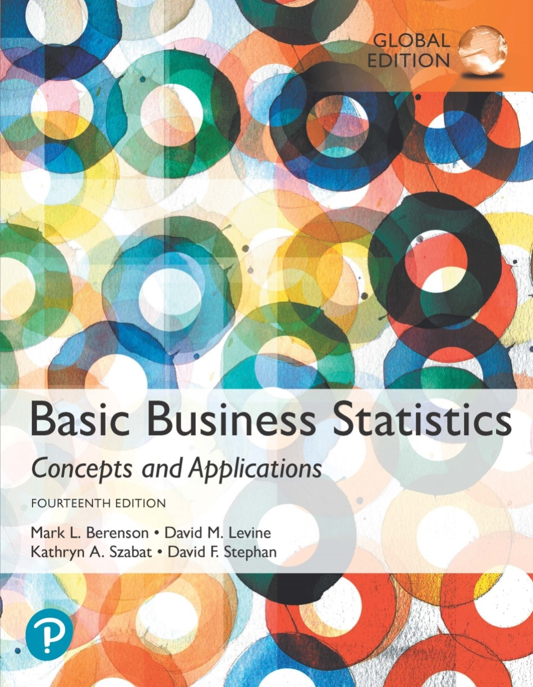
Chapter 1
Defining and Collecting Data

Slide 2
Before we begin…
Why have a course like this?
What do you expect to learn?
Why bother?

Slide 3
Business statistics provide a formal basis to:
  Summarize and visualize business data.
  Reach conclusions from business data.
  Make reliable predictions about business activities.
  Improve business processes.

Slide 4
But what does all that really mean?
We are very often (in all areas of life) required to make decisions under uncertainty.
  Should I bring an umbrella today?
  Should I go to university? If so, what should I study?

Slide 5
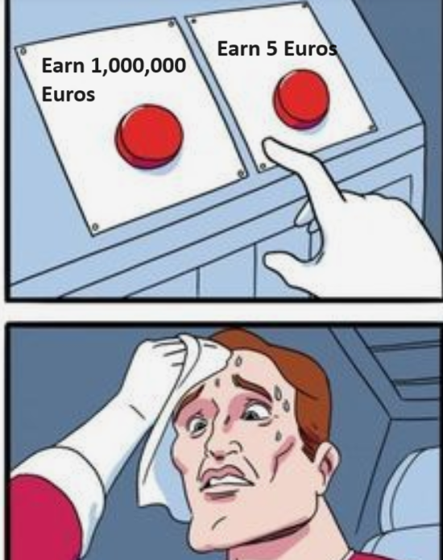
Making decisions under certainty is pretty easy (and thus no one is likely to pay you much to make those types of decision)

Slide 6
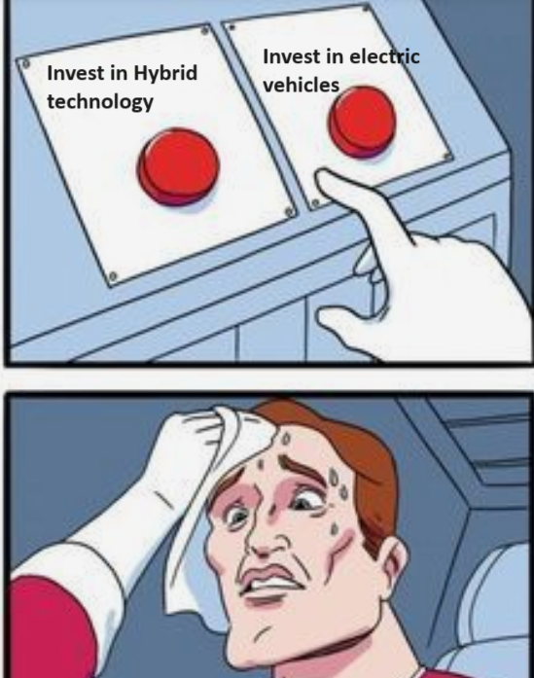
In business, your value is often linked to the quality of decisions you make with the outcome is uncertain

Slide 7
Can try to make those decisions based on observable evidence (data) or based on your “gut” (i.e. your subjective best guess/intuition)
Being able to understand what the data are telling us will be useful in making evidence-based decisions.
  (That’s not to say that going with your “gut” is necessarily bad! Sometimes experience can provide you with intuition on a decision.)

Slide 8
Book uses the “DCOVA” approach…
  Define the data you want to study to solve a problem or meet an objective.
  Collect the data from appropriate sources.
  Organize the data collected by developing tables.
  Visualize the data collected by developing charts.
  Analyze the data collected to reach conclusions and present those results.

Slide 9
A few terms to get us started
UNIT OF OBSERVATION
The thing that’s being observed
Ex: a sold house, a worker, a year
VARIABLE
A characteristic or property of the unit of observation
Ex: Sales price of home, # years with the firm, inflation rate
DATA
The set of values associated with one or more variables.
Ex: $435,000, 4 years, 3.4%
STATISTIC
A value that summarizes the data of a particular variable in a sample.
Ex: Mean= $302,549, 7.4 years, 2.4%

Slide 10
Descriptive Statistics
The basic statistics that help summarize and present data.
- - useful for “story-telling” – the narrative
- - a first step
Inferential Statistics
Methods that use data collected from a small group to reach conclusions about a larger group.
- - maybe a more rigorous data analysis
- - may be able to tell us more than descriptive stats

Slide 11
Can statistics lie?
Faulty or invalid statistics can be produced if:
  There is willful misuse or
  If tasks in DCOVA framework are applied incorrectly.
Many statistical methods are valid only if the data being analyzed have certain properties.
Inferential methods need a theoretical foundation…a logical causality (plausibly claim something directly causes something else).

Slide 12
Diving into Data…
Basically, variables can take one of two forms:
  Numerical and non-numerical (i.e. categorical/qualitative)
  We need to be able to figure out a way to understand what both types are telling us

Slide 13
Classifying Variables By Type
DCOVA
Categorical (qualitative/non-numerical) variables take categories as their values such as “yes”, “no”, or “blue”, “brown”, “green”.
Other examples?
Numerical (quantitative) variables have values that represent a counted or measured quantity.
  Discrete variables arise from a counting process.
    Examples?
  Continuous variables arise from a measuring process.
    Examples?

Slide 14
Examples of Types of Variables
DCOVA
Question | Responses | Variable Type
Do you have a Facebook profile? | Yes or No | Categorical
How many text messages have you sent in the past three days? | --------------- | Numerical (discrete)
How long did the mobile app update take to download? | --------------- | Numerical (continuous)

Slide 15
Types of Variables
DCOVA
Variables
Categorical
Numerical
Nominal
Ordinal
Discrete
Continuous
Examples:
Marital Status
Political Party
Eye Color
(Defined Categories)
Examples: Ratings
Good, Better, Best
Low, Med, High
(Ordered Categories)
Examples:
Number of Children
Defects per hour
(Counted items)
Examples:
Weight
Voltage
(Measured
characteristics)

Slide 16
When dealing with categorical data, sometime there is a logical order to the categories, sometimes not

Slide 17
Measurement Scales
DCOVA
A nominal scale classifies data into distinct categories in which no ranking is implied.
Categorical Variables Categories
Do you have a Facebook profile?
Type of investment
Cellular Provider
Yes, No
Growth, Value, Other
AT&T, Sprint, Verizon, Other, None

Slide 18

Measurement Scales (con’t.)
DCOVA
An ordinal scale classifies data into distinct categories in which ranking is implied.
Categorical Variable Ordered Categories
Student class designation | Freshman, Sophomore, Junior, Senior
Product satisfaction | Very unsatisfied, Fairly unsatisfied, Neutral, Fairly satisfied, Very satisfied
Faculty rank | Professor, Associate Professor, Assistant Professor, Instructor
Standard & Poor’s bond ratings | AAA, AA, A, BBB, BB, B, CCC, CC, C, DDD, DD, D
Student Grades | A, B, C, D, F

Slide 19
When dealing with numerical data, sometimes zero is meaningful, sometimes it is not
  Why does this matter?

Slide 20
Measurement Scales (con’t.)
DCOVA
Interval scale
  Book says: “is a type of ordinal scale in which the difference between measurements is a meaningful quantity but the measurements do not have a true zero point.”
  Another way to think about it: the space between the measurements is consistent, but the zero point is somewhat arbitrary.
    i.e. Temperature: 0 degrees is not the lowest temp can go
    Thus 10 degrees is not “twice as hot” as 5 degree
    IQ is another example

Slide 21
Measurement Scales (con’t.)
DCOVA
Ratio scale
  Book says: “is a type of ordinal scale in which the difference between the measurements is a meaningful quantity and the measurements have a true zero point.”
  Here, a zero value has meaning
    i.e. weight: 0 kilograms means something; a true starting point
    Thus 10 kilos is “twice as heavy” as 5 kilos
    Temp in Kelvins (0 is absolute zero!)
    Weekly sales, number of store locations, etc.

Slide 22
The only reason this might matter is that with ratio data, ratios have meaning
Ex:
  You got a 10% return while I only got a 5% return: your returns were twice as big as mine
  Yesterday it was 5 degrees, today it is 10 degrees: doesn’t make sense to say it’s twice as hot

Slide 23
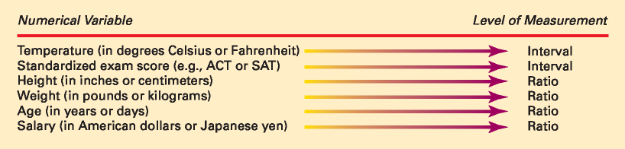
Interval and Ratio Scales
DCOVA

Slide 24
Where do data come from?
  Do we have information from every possible observation or are we trying to understand the “big picture” from a subset of the observations?

Slide 25
Data Is Collected From Either a Population or a Sample
DCOVA
POPULATION A population contains all the items or individuals of interest that you seek to study. SAMPLE A sample contains only a portion of a population of interest.

Slide 26
Population vs. Sample
DCOVA
Population
Sample
All the items or individuals about which you want to draw conclusion(s).
A portion of the population of items or individuals.
A Population of Size 40 A Sample of Size 4

Slide 27
Why rely on a sample?
DCOVA
Less time consuming than selecting every item in the population.
Less costly than selecting every item in the population.
Less cumbersome and more practical than analyzing the entire population.

Slide 28
Parameter or Statistic?
DCOVA
A population parameter summarizes the value of a specific variable for a population.
A sample statistic summarizes the value of a specific variable for sample data.

Slide 29
Say you are hired to do mkting research for a firm and they want to know how much money the average person in your country spends on cell phone apps per year.
This number does exist….
…but we’ll probably never know it.
We usually have to rely on sample statistics as guesses for population parameters.
We want µ--> we’ll have to settle for xbar

Slide 30
Sources Of Data Arise From The Following Activities
DCOVA
Capturing data generated by ongoing business activities.
Distributing data compiled by an organization or individual.
Compiling the responses from a survey.
Conducting a designed experiment and recording the outcomes.
Conducting an observational study and recording the results.

Slide 31
In your small group:
1) Think of a question a business (or other organization like Aalto or Proba) may want to answer
  Try to be fairly specific, like “What is the most cost-effective way for our clothing company, specializing in outdoor/activewear, to target the 18-24 demographic?”, not something general like “How do we increase profits?”
2) What statistics (or parameters) might help you answer the question?
3) What kind of data will this be?
4) Think of a few different ways you might get the data necessary to answer the question, then consider the advantages/disadvantages of each

Slide 32
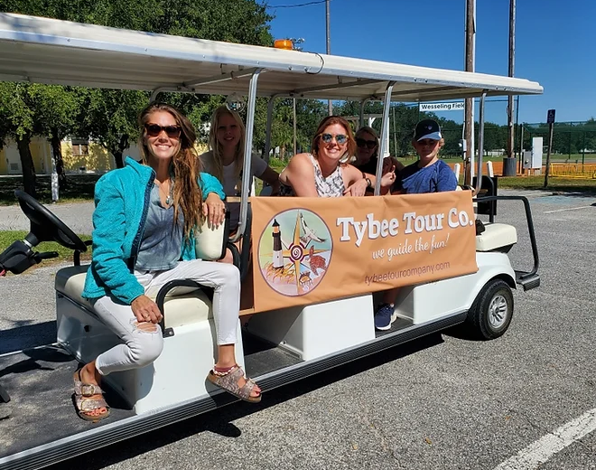
Example:
1) What type of tours should Tybee Tour Company add to their offering? Family tours focusing on the history and nature of the island or “pub crawl” type tours for young adults just who are just there for a good time?
2) avg age of visitor to Tybee Island, did you come to Tybee with children?
3) numerical/discrete, categorical/nominal
4) survey? Perhaps the Chamber of Commerce has info?

Slide 33
Where might we get our data?
Data might be available out there, we just need to find it!
Observational/secondary data
Or, it might not exist
  So if we want it, we may need to generate it ourselves
Primary data
Advantages and disadvantages of each?

Slide 34
Observational data (secondary data):
  Advantages:
    It’s there/available
    Probably cheap
    Maybe a large sample?
  Disadvantages:
    Maybe not specific enough to answer our question?
    Maybe not detailed enough?
      i.e. Tax assessor’s data on sale of each house in Savannah
    Messy?

Slide 35
Primary Data
  Survey
  Experiment
  Maybe expensive
  Maybe small sample size
    Each observation might cost you a lot of money!
    <Savannah St. Patrick’s day tourism survey>
  Need to know what you are doing!
    Can you think of any examples of bad survey designs?

Slide 36
A Sampling Process Begins With A Sampling Frame
DCOVA
The sampling frame is a listing of items that make up the population.
Frames are data sources such as population lists, directories, or maps.
Inaccurate or biased results can result if a frame excludes certain groups or portions of the population.
Using different frames to generate data can lead to dissimilar conclusions.

Slide 37
Observational Studies & Designed Experiments Have A Common Objective
DCOVA
Both are attempting to quantify the effect that a process change (called a treatment) has on a variable of interest.
  Almost always we are asking some form of the question: How does this variable affect that variable?
In an observational study, there is no direct control over which items receive the treatment.
In a designed experiment, there is direct control over which items receive the treatment.
  What are the implications of this?

Slide 38
Evaluate the following two scenarios:
  Your city institutes a new program “Head Start” where parents can enroll students to get an extra hour of help with school work before each morning.
  After a year, the average test scores of the children enrolled in Head Start are lower than for those that didn’t participate.
  “Head Start is a waste of time and actually caused students to get lower grades! We need to eliminate this program immediately.”

Slide 39
You are interested in measuring the impact of a university degree on earnings.
You collect a random sample of 1,000 working people between the ages of 28 and 30 and record their salaries and whether they completed university or not.
Those with uni degrees earned 70k euros (avg). Those without earned 40k euros (avg).
“Getting a uni degree increases a person’s earnings by 30k euros per year.”

Slide 40
Samples
For many reason, we are usually reliant upon samples of a population.
The way one draws the sample is pretty important.

Slide 41
Say you are interested in finding out the average number of alcoholic beverages Aalto/Mikkeli students drink in a week
Can you think of a good way to draw this sample? How about a bad way that will likely give you inaccurate results?
  Stand out in front of the library and ask people?
  Ask everyone in Intro to Stats?
  Ask everyone at Penti this week?
  Ask all your friends?

Slide 42
Types of Samples
DCOVA
Samples
Non Probability Samples
Probability Samples
Simple
Random
Stratified
Judgment
Convenience
Systematic
Cluster

Slide 43
Types of Samples:
Nonprobability Sample
DCOVA
In a nonprobability sample, items included are chosen without regard to their probability of occurrence.
  In convenience sampling, items are selected based only on the fact that they are easy, inexpensive, or convenient to sample.
    Can you think of some examples?
  In a judgment sample, you get the opinions of pre-selected experts in the subject matter.

Slide 44
Types of Samples:
Probability Sample
DCOVA
In a probability sample, items in the sample are chosen on the basis of known probabilities.
Probability Samples
Simple
Random
Systematic
Stratified
Cluster

Slide 45
Probability Sample:
Simple Random Sample
DCOVA
Every individual or item from the frame has an equal chance of being selected.
Selection may be with replacement (selected individual is returned to frame for possible reselection) or without replacement (selected individual isn’t returned to the frame).
Samples obtained from some random process, like a table of random numbers or computer random number generators.

Slide 46
Selecting a Simple Random Sample Using A Random Number Table
DCOVA
Sampling Frame For Population With 850 Items
Item Name Item #
Bev R. 001
Ulan X. 002
. .
. .
. .
. .
Joann P. 849
Paul F. 850
Portion Of A Random Number Table
49280 88924 35779 00283 81163 07275
11100 02340 12860 74697 96644 89439
09893 23997 20048 49420 88872 08401
The First 5 Items in a simple random sample
Item # 492
Item # 808
Item # 892 -- does not exist so ignore
Item # 435
Item # 779
Item # 002

Slide 47
Probability Sample:
Systematic Sample
DCOVA
Decide on sample size: n
Divide frame of N individuals into groups of k individuals: k=N/n
Randomly select one individual from the 1st group
Select every k^{th} individual thereafter
N = 40
n = 4
k = 10
First Group

Slide 48
Other examples of systematic sampling:
  Get a list of all students at a University and chose every 10th one
  Check the airport screening time of every 20th passenger passing through security

Slide 49
Probability Sample:
Stratified Sample
DCOVA
Divide population into two or more subgroups (called strata) according to some common characteristic.
A simple random sample is selected from each subgroup, with sample sizes proportional to strata sizes.
Samples from subgroups are combined into one.
This is a common technique when sampling population of voters, stratifying across racial or socio-economic lines.

Slide 50
This could be particularly useful in situations where one specific group is out there but difficult/expensive to collect data on

Slide 51
Ex: say I want to know the percentage of the population that supports a local initiative to close a public ice-skating rink to fund improvements to local parks
Population is 20% young (<25), 60% middle-aged, and 20% senior citizen (>65)
If young people are difficult to find, and seniors are easy to find, the simple random sample may over-sample older people and under sample younger ones

Slide 52
Thus, you may wish to stratify
  Make young people 20% of your sample, even if you have to spend a lot of resources to get enough to fill out the 20%
  Stop collecting info on senior citizens when you get to 20%, even if more observations from this group could be collected easily.

Slide 53
Cluster sampling:
When you collect several observations in a non-random manner from a cluster of observations that was drawn randomly.
  Collect info on customer satisfaction by getting the opinions of 100 shoppers who happen to be in your store on a certain day
  Conduct an exit poll in 10 of 100 districts

Slide 54
Probability Sample
Cluster Sample
DCOVA
Population is divided into several “clusters,” each representative of the population.
A simple random sample of clusters is selected.
All items in the selected clusters can be used, or items can be chosen from a cluster using another probability sampling technique.
A common application of cluster sampling involves election exit polls, where certain election districts are selected and sampled.
Population divided into 16 clusters.
Randomly selected clusters for sample

Slide 55
Probability Sample:
Comparing Sampling Methods
DCOVA
Simple random sample and Systematic sample:
  Simple to use.
  May not be a good representation of the population’s underlying characteristics.
Stratified sample:
  Ensures representation of individuals across the entire population.
Cluster sample:
  More cost effective.
  Less efficient (need larger sample to acquire the same level of precision).

Slide 56
Data Cleaning Is An Important Data Preprocessing Task Prior To Analysis
DCOVA
Data cleaning corrects irregularities in the data:
Invalid variable values, including:
  Non-numerical data for numerical variable.
  Invalid categorical values for a categorical variable.
  Numeric values outside a defined range.
Coding errors, including:
  Inconsistent categorical values.
  Inconsistent case for categorical values.
  Extraneous characters.
Data integration errors, including:
  Redundant columns.
  Duplicated rows.
  Differing column lengths.
  Different units of measure or scale for numerical variables.

Slide 57
Data Cleaning Cannot Be A Fully Automated Process
DCOVA
When performing data cleaning, always preserve a copy of the original data for later reference.
Data is often pretty messy
  (In real research, sometimes you spend more time getting the data into a usable form than actually doing analysis on it)

Slide 58
In your group, find at least 8 things that you’ll need to fix
Age | Bedroom | Bathrooms | Pool | Price
23 | 4 | 22 |  | 240
 | Three | 2.5 | No | $298,000
0 | 3.5 | Yes | no | 187000
1997 | 2 | 0 | Y | 200k
24 | 2down, 1 up | -1 | Yes | _198450
57 | 4 | 2 |  | $250000

Slide 59
Cleaning Invalid Variable Values Can Be Semi-Automated
DCOVA
Invalid variable values can be identified by simple scanning techniques, for example:
  Non-numeric entries for numerical variables.
  Values for categorical variables that don’t match a pre-defined category.
  Values for a numeric variable outside a pre-defined explicit range.

Slide 60
Getting started with cleaning data:
  Sort
    Look for outliers
    Will clump up responses of a type
      (hopefully, many errors will be all together)
  Find/replace command
  May have to drop the observation (or maybe even the variable) if it can’t be salvaged
  Always have a record of what you’ve done!
Never start analysis on data until you’ve carefully looked through it: “junk in, junk out”

Slide 61
Examples Of Coding Errors
DCOVA
Copy-and-paste or data import can result in poor recording or entry of data.
Categorical variable: Gender, Correct coding: F or M
Correctable error: Female.
Invalid data: New York.
Correctable or software tolerated: m.
Extraneous and nonprintable characters:
  Leading or trailing space(s): _F or F_.
  Other nonprintable characters may also be leading or trailing

Slide 62
Data Integration Errors From Combining Two Different Computerized Data Sources
DCOVA
Data integration errors often requires time-consuming manual effort.
Some examples:
  Variable names or definitions may differ.
  Duplicated rows (observations) may also occur.
  Different units of measurement (or scale) may not be obvious without human interpretation.

Slide 63
Data Can Be Formatted and / or Encoded In More Than One Way
DCOVA
Some electronic formats are more readily usable than others. (pdf vs csv)
Different encodings can impact the precision of numerical variables and can also impact data compatibility.
As you identify and choose sources of data you need to consider / deal with these issues.

Slide 64
A slight aside:
Any serious research project will probably report “summary statistics” for the variables used in the study
  Mean, std. dev., min and max
  Skimming the sum stats can be a good/easy first step to see if the authors were careful
  Do means, min’s, and max’s make sense?
  Do things that should add up to 1 actually equal 1?
    If the reported mean age of visitors to Tybee Island is 4 or the max age is 143, or %male+%female=124, you can probably stop reading the study (and maybe ask about getting your money back if you’re the client)

Slide 65
Recoding
Very often, even when you have clean data, you’ll need to recode observations.
Equations (and thus software) need numbers (not words) thus recoding qualitative data is very common.
But recoding quantitative data is also sometimes helpful or necessary

Slide 66
Recoding
Examples (qualitative):
“Pool”, “No Pool”
  New variable: POOL=1 if house has pool, 0 otherwise
“Languages spoken”
  New variable: BILINGUAL=1 if more than one listed, 0 otherwise
  Or perhaps NUMLANG=# of languages listed
“First year student”, “Second year”, etc.
  New var: YEAR= year of student
<Photo variables for MLS project>

Slide 67
Brief aside: what’s in a name???
Creating variable names is more art than science…
  Good to be descriptive
  Good to be short
  Good to be unambiguous
    Sometimes difficult to do all of these things at once

Slide 68
Coding an observation’s gender:
Bad: gender
Even worse: var1
Good: female
  For something with only two obvious categories, it’s a common convention for the var name to be the presence of the characteristic (delayed, precipitation, out_of_town, etc.)
Coding a region’s unemployment rate:
Maybe bad: uer
Maybe better: unemployment_rate_region
Probably better: unemp_rate

Slide 69
While not always possible, ideally, you’d like to create tables (and thus variable names) that would allow someone to get a basic idea of what you’re talking about without reading the body of the paper
  Sometimes easier said than done…
Bad/ambiguous var names make this difficult

Slide 70
So anyway…recoding!
Often you’ll want/need to transform your quantitative variables

Slide 71
After Collection It Is Often Helpful To Recode Some Variables
DCOVA
Recoding a variable can either supplement or replace the original variable.
Recoding a categorical variable involves redefining categories.
Recoding a numerical variable involves changing this variable into a categorical variable.
When recoding be sure that the new categories are mutually exclusive (categories do not overlap) and collectively exhaustive (categories cover all possible values).

Slide 72
Recoding
Examples (quantitative):
Variable: GDP
  New variable: GDP growth rate
Variable: PRICE (nominal)
  New variable: real_price
Variable: PRICE
  New variable: ln(price)
Variable: Average temperature for a day
  New variable: deviation from historical average

Slide 73
Recoding
More examples (quantitative):
In some situations, it may be desirable to recode continuous variables into discrete blocks
Variable: income, ranging from $0 to $40,000,000
New variables:
  LOW_INCOME=1 if income<$20,000, 0 otherwise
  MID_INCOME=1 if 20,000<=income<100,000
  HI_INCOME=1 if 100,000<=income<200,000
  VERYHI_INCOME=1 if 200,000<=income

Slide 74
A typical source of customer data is the survey
What are some obvious ways surveys can go wrong, and provide you with data that is of little use?

Slide 75
Evaluating Survey Worthiness
DCOVA
What is the purpose of the survey?
Is the survey based on a probability sample?
Coverage error – appropriate frame?
Nonresponse error – follow up.
Measurement error – good questions elicit good responses.
Sampling error – always exists.

Slide 76
Types of Survey Errors
DCOVA
Coverage error or selection bias:
  Exists if some groups are excluded from the frame and have no chance of being selected.
    Ex: Surveying students on campus today at 9:00am
Nonresponse error or bias:
  People who do not respond may be different from those who do respond.
    Ex: Retired people may have more time on their hands and thus be more likely to respond to your survey.
    Ex: People who really hate or really love your product may be more likely to respond
      <course evaluations>

Slide 77
Types of Survey Errors
DCOVA
Measurement error:
  Due to weaknesses in question design and / or respondent error.
    Ex: “Do you oppose Proposition 18, which continues the prohibition on Sunday alcohol sales?”
    Ex: “Do you believe that protecting the safely of our children is important by supporting the proposed tax increase to fund the interchange improvement project at the corner of 45th Street and Kirkman Lane?”
Sampling error:
  Variation from sample to sample will always exist.
    A sample stat will (probably) never match the true population parameter and different samples will generate different sample statistics.

Slide 78
Types of Survey Errors
(continued)
DCOVA
Coverage error
Nonresponse error
Sampling error
Measurement error
Excluded from frame
Non-responders may be different
Random differences from sample to sample
Bad or leading question

Slide 79
Note that one of those types is unavoidable: which one?
You will always have sampling error
  Not our fault!
Example: the true mean is 12. The mean of our perfectly constructed sample is 11.
i.e. our guess for the mean was wrong by 1
A different sample may have found the mean to equal 14, off by 2

Slide 80
Ethical Issues About Surveys
DCOVA
Any of these types of errors can be used to (unethically) influence the results.
Coverage error: exclude or “turn a blind eye” towards a group that is underrepresented if you think it’ll help get the results you want
Non-response: same as above
Measurement: easy to craft leading questions
Sampling: stop collecting data if you’ve got a result you like, collect more if you don’t

Slide 81

Ethical Issues About Surveys:
Supplemental slides

Slide 82
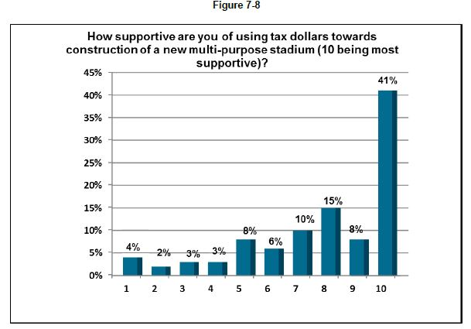
Spend public money…..

Slide 83
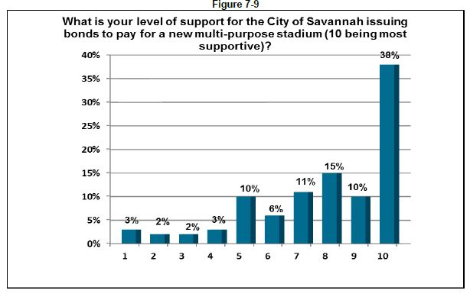
..borrow $$ if you need to…..

Slide 84
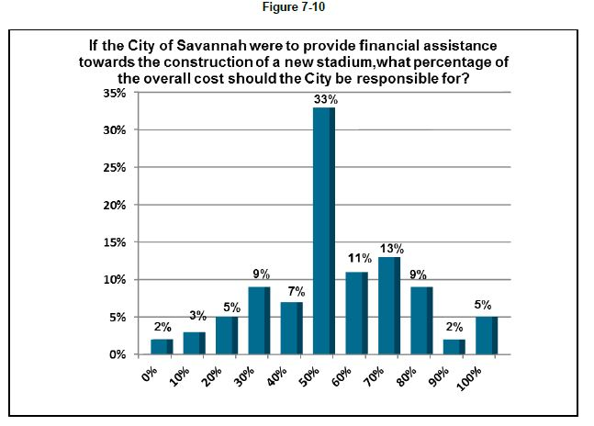
Tax $ for about half of it….

Slide 85
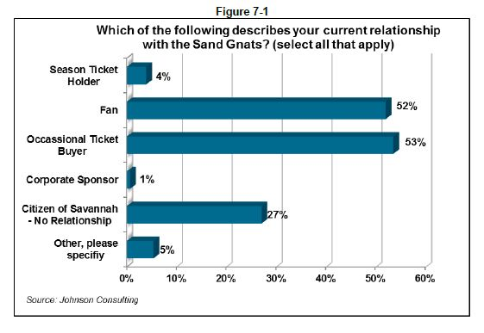
…wait, now who took your survey?

Slide 86
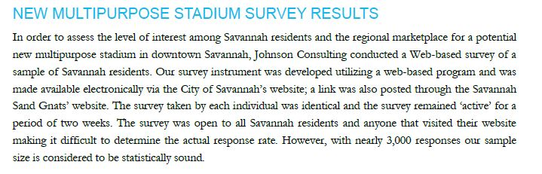
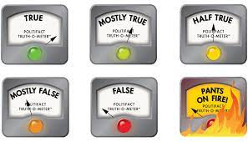

Look, we surveyed.
Hear the people!!
This is a lie.

Slide 87
Trustworthiness of Data & News
DCOVA
  China’s Economic Data
    CNBC (2016) https://www.cnbc.com/2016/01/19/what-is-chinas-actual-gdp-experts-weigh-in.html
    BBC (2106) https://www.bbc.com/news/business-35341869
    https://www.stlouisfed.org/publications/regional-economist/second-quarter-2017/chinas-economic-data-an-accurate-reflection-or-just-smoke-and-mirrors
  China’s Covid-19 Data
    Washington Post (2020) – why trust covid numbers?
    https://www.washingtonpost.com/opinions/2020/04/07/why-do-we-keep-treating-china-source-reliable-information/
  Consider “proxy” data:
    News-Medical.net (2020) – covid-19 data
    https://www.news-medical.net/news/20200608/Cremation-numbers-reveal-possible-suppression-of-true-COVID-19-data-in-China.aspx

Slide 88
Evaluating Trustworthiness of Data & News
DCOVA
  Is this a reliable source?
      https://geopoliticalfutures.com/china-admits-its-statistics-are-wrong/
      Interesting but probably junk……
      Compare its presentation to that of the News-Medical.net report
  Evaluation of websites for data and news
      https://guides.masslibsystem.org/fakenews
      https://library.bridgew.edu/c.php?g=590539&p=4086409
  Circular Reporting and Researcher Laziness
      https://www.youtube.com/watch?v=cSKGa_7XJkg&t=210s

Slide 89
For practice:
Pg 51, #1.8, 1.9
Pg 53: #1.15
Pg 55: 1.18, 1.20
Pg 59: 1.26
Pg 64: 1.40 (also give some examples, don’t just recite the definitions)
Pg 65: 1.52

