Slide 1
Welcome to Introduction to Statistics

Slide 2
A few quick words about me
Dr. Jason Beck (that’s me)
Originally from the state of Kentucky in the US

Slide 3
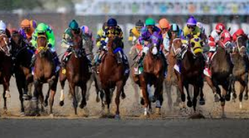

Slide 4
Moved to Savannah, Georgia to work at Georgia Southern University in 2009

Slide 5
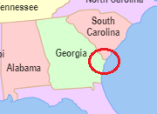

Slide 6
My 7th year teaching in this program
8th course
6th time in Mikkeli

Slide 8
I’m always interested in fun stuff going on and interesting places to hang out.
So please feel free to offer some suggestions!

Slide 9
Ok, now the boring (but more important) stuff:
jacenbeck@gmail.com
Office hours before class M-Th, F on request
Three Exams (not cumulative)
One each Friday
Three Homeworks
One due each Friday before the exam

Slide 10
Exam 1: 233
HW 1: 100
Exam 2: 233
HW 2: 100
Exam 3: 234
HW 3: 100
TOTAL: 1000 points

Slide 11
We need to make up one session!
I think we can make up this time by shortening breaks and coming in 30 min early each of the three exam sessions to review the HW

Slide 12
Homeworks will be group work (4-5 students)
I have assigned groups and will post on MyCouses

Slide 13
A few general notes/requests from me:
i) Please use your “official university name” on all turned in items
Feel free to also include your preferred name in parentheses, but I must have your official name
ii) Please note that the first break will begin roughly between 2:00 and 2:10 and the second between 3:05 and 3:15, but not necessarily exactly at that time.
I will not forget to give you your break. Don’t freak out.
iii) Please avoid leaving/returning during the lecture unless its an emergency
iv) Please avoid packing up before the class is over

