Slide 1
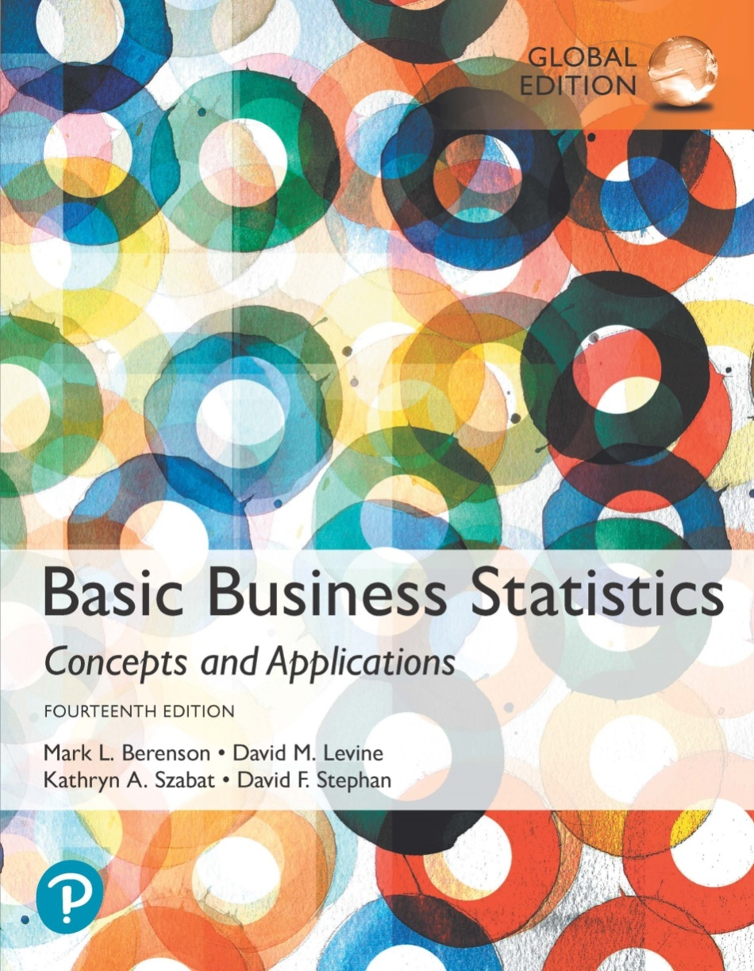
Chapter 2
Organizing and Visualizing Variables

Slide 2
Objectives
In this chapter you learn:
How to organize and visualize categorical variables.
How to organize and visualize numerical variables.
How to summarize a mix of variables.
How to avoid making common errors when organizing and visualizing variables.

Slide 3
Organizing Data Creates Both Tabular And Visual Summaries
DCOVA
Raw data can’t be easily interpreted, so we need ways to actually see/understand what they are telling us
This can guide further exploration and sometimes facilitate decision making.
Visual summaries enable rapid review of larger amounts of data & show possible significant patterns.

Slide 4
Let’s say you have categorical data:
How can you show an audience what it’s telling us?
Do you just want to report the numbers and keep it simple?
  One variable? →Use a summary table
  Two vars? →Use a contingency table

Slide 5
Categorical Data Are Organized By Utilizing Tables
DCOVA
Categorical Data
Tallying Data
One Categorical Variable
Two Categorical Variables
Summary Table
Contingency Table

Slide 6
Organizing Categorical Data: Summary Table
DCOVA
A summary table tallies the frequencies or percentages of items in a set of categories so that you can see differences between categories.
Devices Millennials Use to Watch Movies or Television Shows
Devices Used To Watch Movies or TV Shows | Percent
Television Set | 49%
Tablet | 9%
Smartphone | 10%
Laptop / Desktop | 32%
Source: Data extracted and adapted from A. Sharma, “Big Media Needs to Embrace Digital Shift Not Fight It,” Wall Street Journal, June 22, 2016, p. 1-2.

Slide 7
A Contingency Table Helps Organize Two or More Categorical Variables
DCOVA
Helps us to see connections between two or more categorical vars
Cross tabulates jointly the responses of the categorical variables.

Slide 8
Contingency Table - Example
DCOVA
A random sample of 400 invoices is drawn.
Each invoice is categorized as a small, medium, or large amount.
Each invoice is also examined to identify if there are any errors.
This data are then organized in the contingency table to the right.
Contingency Table Showing
Frequency of Invoices Categorized
By Size and The Presence Of Errors
 | No Errors | Errors | Total
Small Amount | 170 | 20 | 190
Medium Amount | 100 | 40 | 140
Large Amount | 65 | 5 | 70
Total | 335 | 65 | 400

Slide 9
Not terrible but could be improved upon…how?
Always ask: What’s the story that I’m trying to tell and how can I tell that in the clearest way?

Slide 10
Contingency Table Based On Percentage Of Overall Total
DCOVA
 | No Errors | Errors | Total
Small Amount | 170 | 20 | 190
Medium Amount | 100 | 40 | 140
Large Amount | 65 | 5 | 70
Total | 335 | 65 | 400
42.50% = 170 / 400
25.00% = 100 / 400
16.25% = 65 / 400
 | No Errors | Errors | Total
Small Amount | 42.50% | 5.00% | 47.50%
Medium Amount | 25.00% | 10.00% | 35.00%
Large Amount | 16.25% | 1.25% | 17.50%
Total | 83.75% | 16.25% | 100.0%
83.75% of sampled invoices have no errors and 47.50% of sampled invoices are for small amounts.

Slide 11
Again, not bad but in this scenario, we are probably trying to see where the problem is, i.e. Where are the errors occurring?

Slide 12
Contingency Table Based On Percentage of Row Totals
DCOVA
 | No Errors | Errors | Total
Small Amount | 170 | 20 | 190
Medium Amount | 100 | 40 | 140
Large Amount | 65 | 5 | 70
Total | 335 | 65 | 400
89.47% = 170 / 190
71.43% = 100 / 140
92.86% = 65 / 70
 | No Errors | Errors | Total
Small Amount | 89.47% | 10.53% | 100.0%
Medium Amount | 71.43% | 28.57% | 100.0%
Large Amount | 92.86% | 7.14% | 100.0%
Total | 83.75% | 16.25% | 100.0%
Medium invoices have a larger chance (28.57%) of having errors than small (10.53%) or large (7.14%) invoices.

Slide 13
This is getting pretty good: we can easily see that the error rate in the medium orders is 29%, much larger than in the other categories

Slide 14
Contingency Table Based On Percentage Of Column Totals
DCOVA
 | No Errors | Errors | Total
Small Amount | 170 | 20 | 190
Medium Amount | 100 | 40 | 140
Large Amount | 65 | 5 | 70
Total | 335 | 65 | 400
50.75% = 170 / 335
30.77% = 20 / 65
 | No Errors | Errors | Total
Small Amount | 50.75% | 30.77% | 47.50%
Medium Amount | 29.85% | 61.54% | 35.00%
Large Amount | 19.40% | 7.69% | 17.50%
Total | 100.0% | 100.0% | 100.0%
There is a 61.54% chance that invoices with errors are of medium size.

Slide 15
This is pretty good too: we can easily see that errors in the medium orders make up 62% of all errors.
Which way is best?

Slide 16
Tables Used For Organizing
Numerical Data
DCOVA
Numerical Data
Frequency
Distributions
Cumulative
Distributions
Ordered Array

Slide 17
Organizing Numerical Data:
Ordered Array
DCOVA
An ordered array is a sequence of data, in rank order, from the smallest value to the largest value.
Good to show range (minimum value to maximum value).
May help identify outliers (unusual observations).
Probably not practical with a large number of data points.
Probably not telling us much about the “typical” observation or how spread out/clustered they are

Slide 18
Organizing Numerical Data:
Ordered Array
DCOVA
Age of Surveyed College Students | Day Students
 | 16 | 17 | 17 | 18 | 18 | 18
 | 19 | 19 | 20 | 20 | 21 | 22
 | 22 | 25 | 27 | 32 | 38 | 42
 | Night Students
 | 18 | 18 | 19 | 19 | 20 | 21
 | 23 | 28 | 32 | 33 | 41 | 45

Slide 19
Organizing Numerical Data:
Frequency Distribution
DCOVA
The frequency distribution is a summary table in which the data are arranged into numerically ordered classes.
Decide on the size of the “buckets” (text calls these “class groupings”) and decide on how many buckets you’ll use.
Then put all the observations into their respective buckets, and report how many observations are in each bucket.
The number of buckets/classes depends on the number of values in the data. With a larger number of values, typically there are more classes. In general, a frequency distribution should have at least 5 but no more than 15 buckets/classes.

Slide 20
Organizing Numerical Data:
Frequency Distribution Example
DCOVA
Example: A manufacturer of insulation randomly selects 20 winter days and records the daily high temperature.
24, 35, 17, 21, 24, 37, 26, 46, 58, 30, 32, 13, 12, 38, 41, 43, 44, 27, 53, 27

Slide 21
Organizing Numerical Data:
Frequency Distribution Example
DCOVA
First, sort raw data in ascending order:
12, 13, 17, 21, 24, 24, 26, 27, 27, 30, 32, 35, 37, 38, 41, 43, 44, 46, 53, 58.
Find range: 58 - 12 = 46.
Select number of classes: 5 (usually between 5 and 15).
Compute class interval (width): 10 (46/5 then round up).
Determine class boundaries (limits):
    Class 1: 10 but less than 20.
    Class 2: 20 but less than 30.
    Class 3: 30 but less than 40.
    Class 4: 40 but less than 50.
    Class 5: 50 but less than 60.
Count observations & assign to classes.

Slide 22
Organizing Numerical Data: Frequency Distribution Example
DCOVA
Data in ordered array:
12, 13, 17, 21, 24, 24, 26, 27, 27, 30, 32, 35, 37, 38, 41, 43, 44, 46, 53, 58
Class Midpoints Frequency
10 but less than 20 15 3
20 but less than 30 25 6
30 but less than 40 35 5
40 but less than 50 45 4
50 but less than 60 55 2
Total 20

Slide 23
Good start, but how could be make the story easier to understand?

Slide 24
Organizing Numerical Data: Relative & Percent Frequency Distribution Example
DCOVA
Relative
Frequency
Class Frequency
Percentage
10 but less than 20 3 .15 15%
20 but less than 30 6 .30 30%
30 but less than 40 5 .25 25%
40 but less than 50 4 .20 20%
50 but less than 60 2 .10 10%
Total 20 1.00 100%
Relative Frequency = Frequency / Total, e.g. 0.10 = 2 / 20

Slide 25
Organizing Numerical Data: Cumulative Frequency Distribution Example
DCOVA
Cumulative Frequency
Cumulative Percentage
Class
Frequency
Percentage
10 but less than 20 3 15% 3 15%
20 but less than 30 6 30% 9 45%
30 but less than 40 5 25% 14 70%
40 but less than 50 4 20% 18 90%
50 but less than 60 2 10% 20 100%
Total 20 100% 20 100%
Cumulative Percentage = Cumulative Frequency / Total * 100 e.g. 45% = 100*9/20

Slide 26
Why Use a Frequency Distribution?
DCOVA
It condenses the raw data into a more useful form.
It allows for a quick visual interpretation of the data.
It enables the determination of the major characteristics of the data set including where the data are concentrated / clustered.

Slide 27
What are some ways one could get this wrong and create a misleading freq distribution table?
  Classes/bins/buckets too big
    Obscures what is going on
  Classes/buckets too small
    Information overload?
  Failure to give perspective?
    i.e. are 42 occurrences a lot or not?

Slide 28
Frequency Distributions:
Some Tips
DCOVA
Different class boundaries may provide different pictures for the same data (especially for smaller data sets).
Shifts in data concentration may show up when different class boundaries are chosen.
As the size of the data set increases, the impact of alterations in the selection of class boundaries is greatly reduced.
When comparing two or more groups with different sample sizes, you must use either a relative frequency or a percentage distribution.

Slide 29
Visualizing Categorical Data Through Graphical Displays
DCOVA
Categorical Data
Visualizing Data
Summary Table For One Variable
Contingency Table For Two Variables
Bar
Chart
Pareto
Chart
Side By Side Bar Chart
Doughnut Chart
Pie or Doughnut Chart

Slide 30
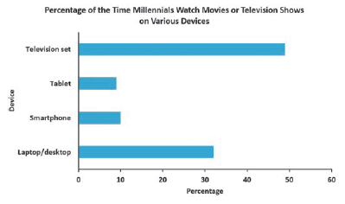
Visualizing Categorical Data:
The Bar Chart
DCOVA
The bar chart visualizes a categorical variable as a series of bars. The length of each bar represents either the frequency or percentage of values for each category. Each bar is separated by a gap.
Devices Used to Watch | Percent
Television Set | 49%
Tablet | 9%
Smartphone | 10%
Laptop / Desktop | 32%

Slide 31
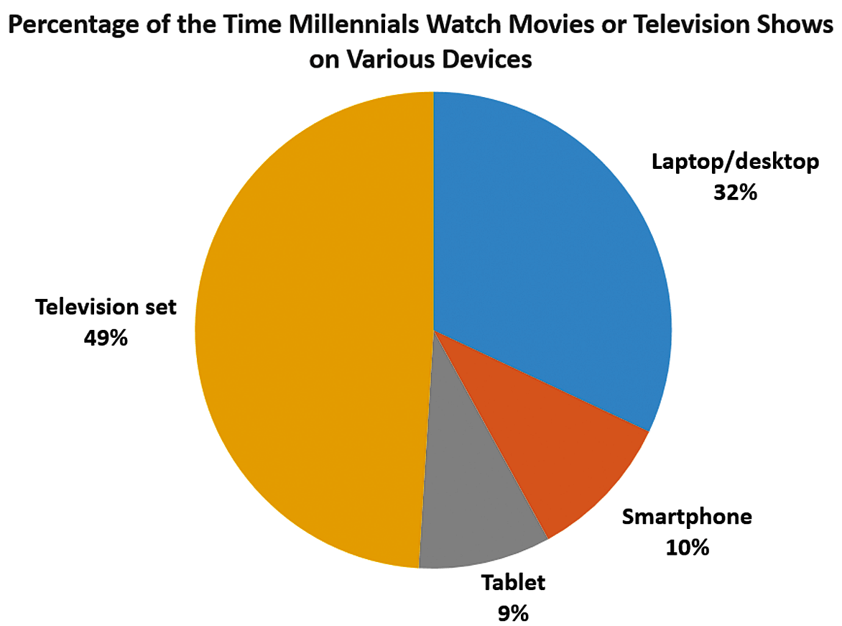
Visualizing Categorical Data:
The Pie Chart
DCOVA
The pie chart is a circle broken up into slices that represent categories. The size of each slice of the pie varies according to the percentage in each category.
Devices Used to Watch | Percent
Television Set | 49%
Tablet | 9%
Smartphone | 10%
Laptop / Desktop | 32%

Slide 32
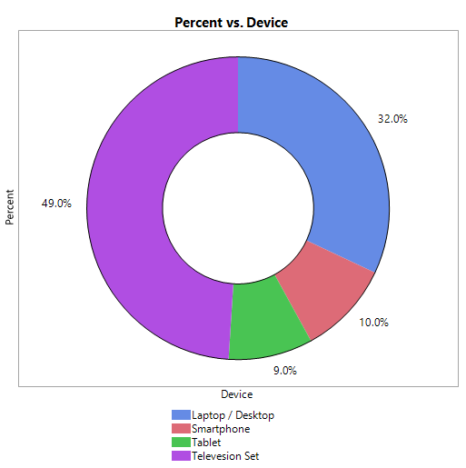
Visualizing Categorical Data:
The Doughnut Chart
DCOVA
The doughnut chart is the outer part of a circle broken up into pieces that represent categories. The size of each piece of the doughnut varies according to the percentage in each category.
Devices Used to Watch | Percent
Television Set | 49%
Tablet | 9%
Smartphone | 10%
Laptop / Desktop | 32%

Slide 33
Visualizing Categorical Data:
The Pareto Chart
DCOVA
Used to portray categorical data (nominal scale).
A vertical bar chart, where categories are shown in descending order of frequency.
A cumulative polygon is shown in the same graph.
Used to separate the “vital few” from the “trivial many.”

Slide 34
Visualizing Categorical Data:
The Pareto Chart (con’t)
DCOVA
Ordered Summary Table For Causes
Of Incomplete ATM Transactions
Cumulative
Cause Frequency Percent Percent
Warped card jammed 365 50.41% 50.41%
Card unreadable 234 32.32% 82.73%
ATM malfunctions 32 4.42% 87.15%
ATM out of cash 28 3.87% 91.02%
Invalid amount requested 23 3.18% 94.20%
Wrong keystroke 23 3.18% 97.38%
Lack of funds in account 19 2.62% 100.00%
Total 724 100.00%
Source: Data extracted from A. Bhalla, “Don’t Misuse the Pareto Principle,” Six Sigma Forum
Magazine, May 2009, pp. 15–18.

Slide 35
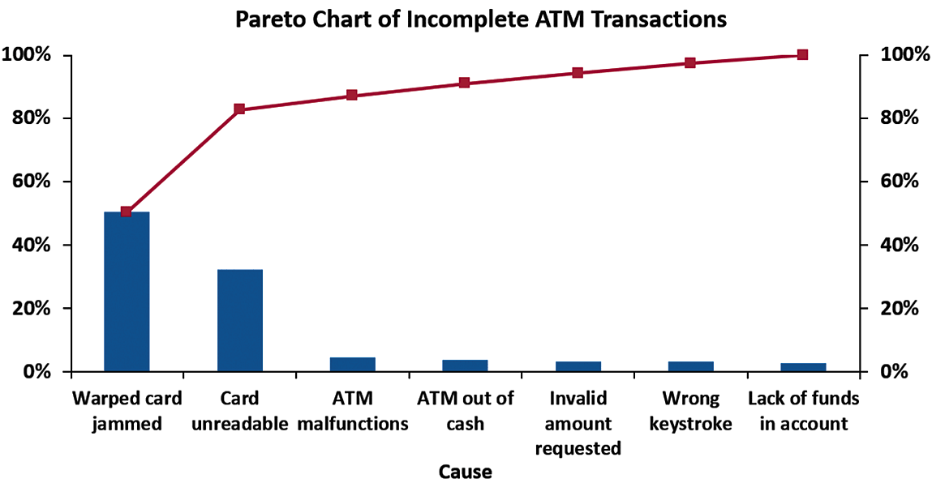
Visualizing Categorical Data:
The Pareto Chart (con’t)
DCOVA
The “Vital
Few”

Slide 36
Visualizing Numerical Data By Using Graphical Displays
DCOVA
Numerical Data
Frequency Distributions and
Cumulative Distributions
Ordered Array
Stem-and-Leaf
Display
Histogram
Polygon
Ogive

Slide 37
Stem-and-Leaf Display
DCOVA
A simple way to see how the data are distributed and where concentrations of data exist.
  METHOD: Separate the sorted data series
  into leading digits (the stems) and
  the trailing digits (the leaves).

Slide 38
Organizing Numerical Data:
Stem and Leaf Display
DCOVA
A stem-and-leaf display organizes data into groups (called stems) so that the values within each group (the leaves) branch out to the right on each row.
Age of College Students
Day Students Night Students
Age of Surveyed College Students | Day Students
 | 16 | 17 | 17 | 18 | 18 | 18
 | 19 | 19 | 20 | 20 | 21 | 22
 | 22 | 25 | 27 | 32 | 38 | 42
 | Night Students
 | 18 | 18 | 19 | 19 | 20 | 21
 | 23 | 28 | 32 | 33 | 41 | 45
Stem | Leaf
1 | 67788899
2 | 0012257
3 | 28
4 | 2
Stem | Leaf
1 | 8899
2 | 0138
3 | 23
4 | 15

Slide 39

Do people actually use ordered array and/or stem-and-leaf charts in the real word?
Maybe worth talking about for 5 min in an Intro Stats class, but seldom used in real presentations

Slide 40
Ok then, what should you use?
Bar charts and freq distributions are great, and can’t go wrong with a good old fashioned histogram

Slide 41
Visualizing Numerical Data:
The Histogram
DCOVA
A vertical bar chart of the data in a frequency distribution is called a histogram.
In a histogram there are no gaps between adjacent bars (←technically true, but people, including me, will usually call any bar chart displaying frequency distributions a histogram
The class boundaries (or class midpoints) are shown on the horizontal axis.
The vertical axis is either frequency, relative frequency, or percentage.
The height of the bars represent the frequency, relative frequency, or percentage.

Slide 42
Visualizing Numerical Data:
The Histogram
DCOVA
Relative
Frequency
Percentage
Class Frequency
10 but less than 20 3 .15 15
20 but less than 30 6 .30 30
30 but less than 40 5 .25 25
40 but less than 50 4 .20 20
50 but less than 60 2 .10 10
Total 20 1.00 100
Histogram: Temperature
(In a percentage histogram the vertical axis would be defined to show the percentage of observations per class).

Slide 43
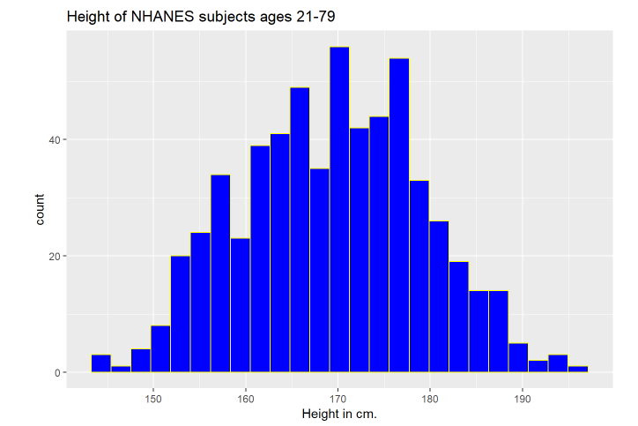

Slide 44
Questions to ask:
What is the range?
What should the class/bucket/bin sizes be?
What should go on the y-axis (frequency or relative frequency?)

Slide 45
Visualizing Numerical Data:
The Percentage Polygon
DCOVA
A percentage polygon is formed by having the midpoint of each class represent the data in that class and then connecting the sequence of midpoints at their respective class percentages.
The cumulative percentage polygon, or ogive, displays the variable of interest along the X axis, and the cumulative percentages along the Y axis.
Useful when there are two or more groups to compare.

Slide 46
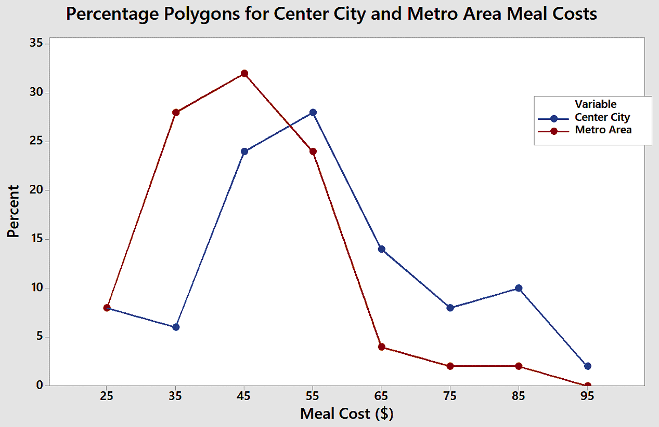
Visualizing Numerical Data:
The Frequency Polygon
DCOVA
Useful When Comparing Two or More Groups

Slide 47
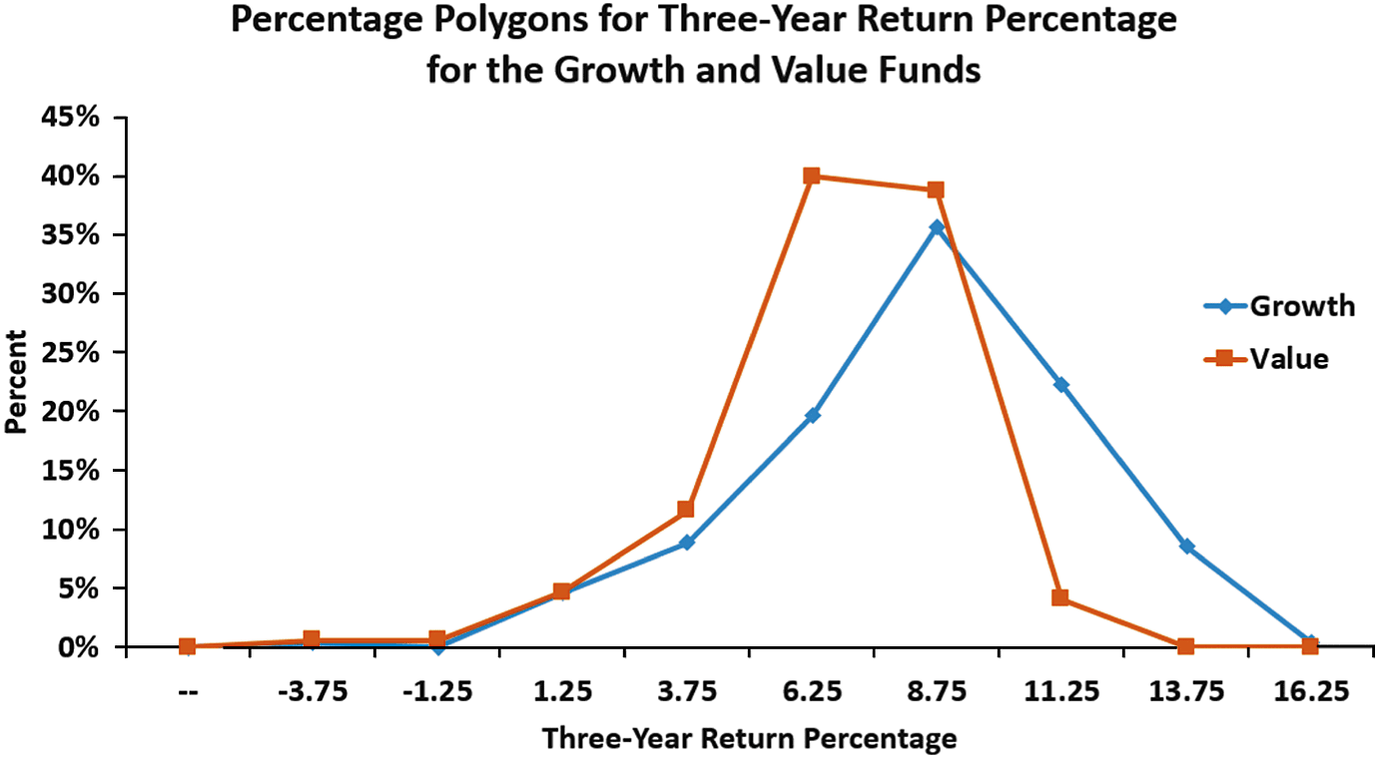
Visualizing Numerical Data:
The Percentage Polygon
DCOVA

Slide 48
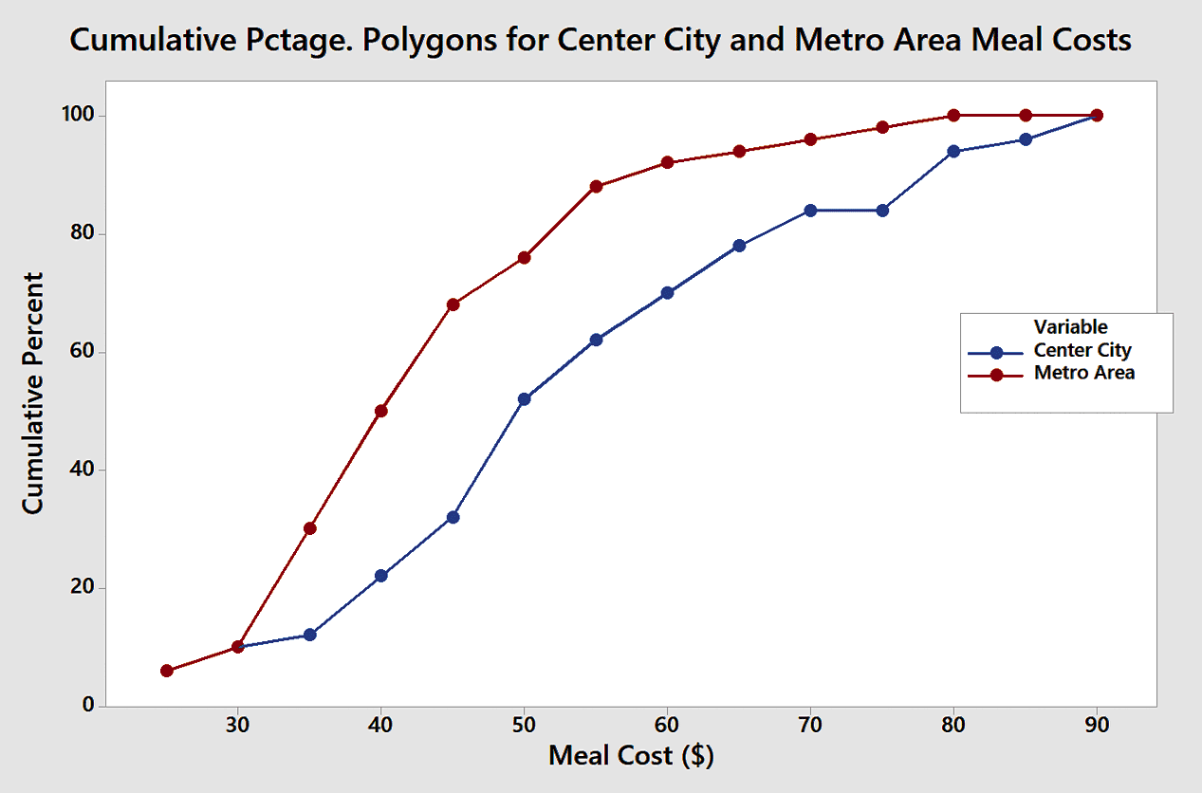
Visualizing Numerical Data:
The Cumulative Percentage Polygon (Ogive)
DCOVA
Useful When Comparing Two or More Groups

Slide 49
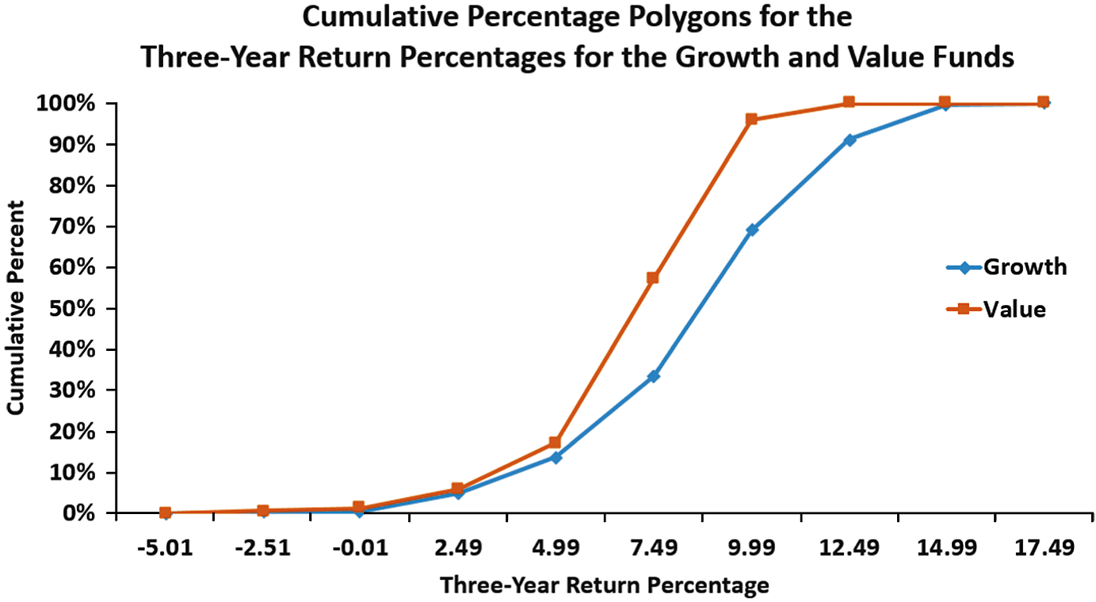
Visualizing Numerical Data:
The Cumulative Percentage Polygon (Ogive)
DCOVA

Slide 50
Visualizing Two Numerical Variables By Using Graphical Displays
DCOVA
Two Numerical Variables
Scatter Plot
Time-Series Plot

Slide 51
Visualizing Two Numerical Variables: The Scatter Plot
DCOVA
Scatter plots are used for numerical data consisting of paired observations taken from two numerical variables.
One variable’s values are displayed on the horizontal or X axis and the other variable’s values are displayed on the vertical or Y axis.
Scatter plots are used to examine possible relationships between two numerical variables.

Slide 52
Scatter Plot Example
DCOVA
Volume per day | Cost per day
23 | 125
26 | 140
29 | 146
33 | 160
38 | 167
42 | 170
50 | 188
55 | 195
60 | 200

Slide 53
Visualizing Two Numerical Variables: The Time Series Plot
DCOVA
A Time-Series Plot is used to study patterns in the values of a numeric variable over time.
The Time-Series Plot:
  Numeric variable’s values are on the vertical axis and the time period is on the horizontal axis.

Slide 54
Time Series Plot Example
DCOVA
Year | Number of Franchises
2009 | 43
2010 | 54
2011 | 60
2012 | 73
2013 | 82
2014 | 95
2015 | 107
2016 | 99
2017 | 95

Slide 55
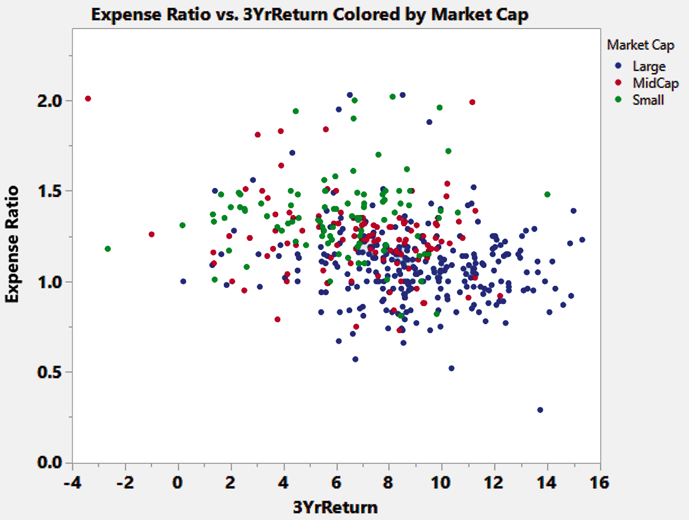
Colored Scatter Plots Visualize Both Numerical Variables & Categorical Variable(s)
Observations:
Large Market Capitalization Funds (red dots)
1. Relatively have best returns and lowest expense ratios.
2. Some have either low returns or high expense ratios or both.
DCOVA
JMP Colored
Scatter Plot

Slide 56
Bubble Charts Extend Scatter Plots
DCOVA
Use the size of points (called bubbles) to represent the value of an additional variable.

Slide 57
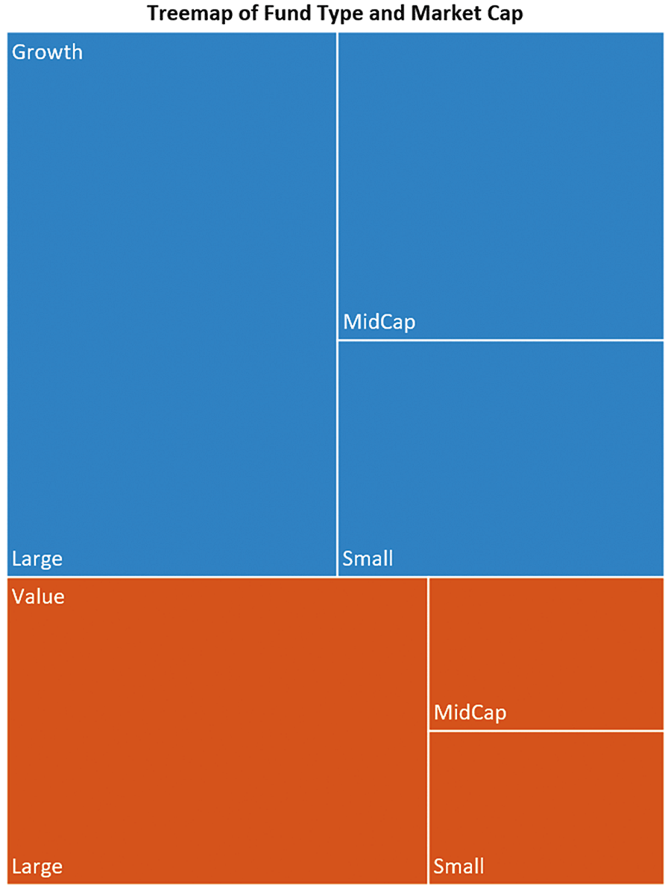
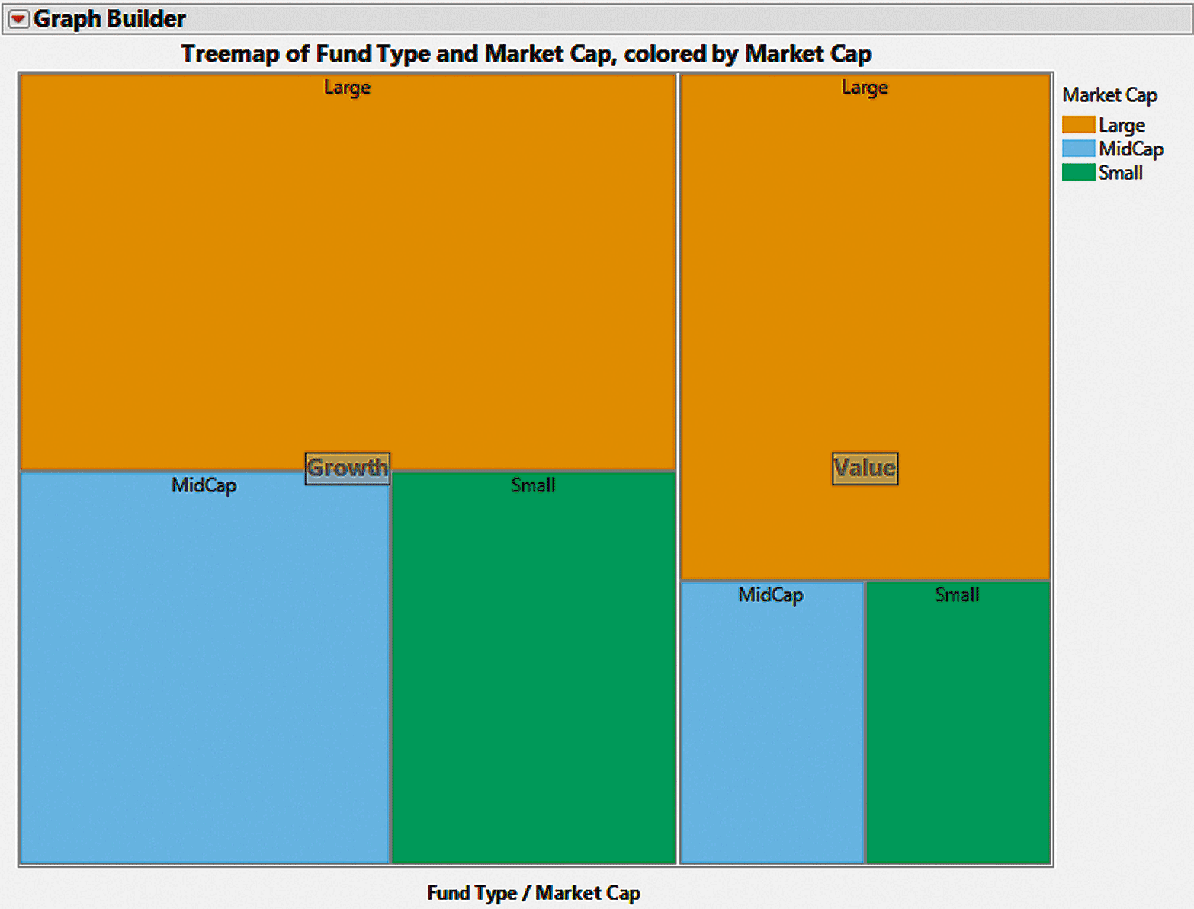
Treemaps Are Graphical Displays Of Contingency Tables
DCOVA
Excel Treemap:
Size of tiles correspond to the frequency in a cell.
JMP Treemap:
Size of tiles correspond to the value of the numeric variable Market Cap.

Slide 58
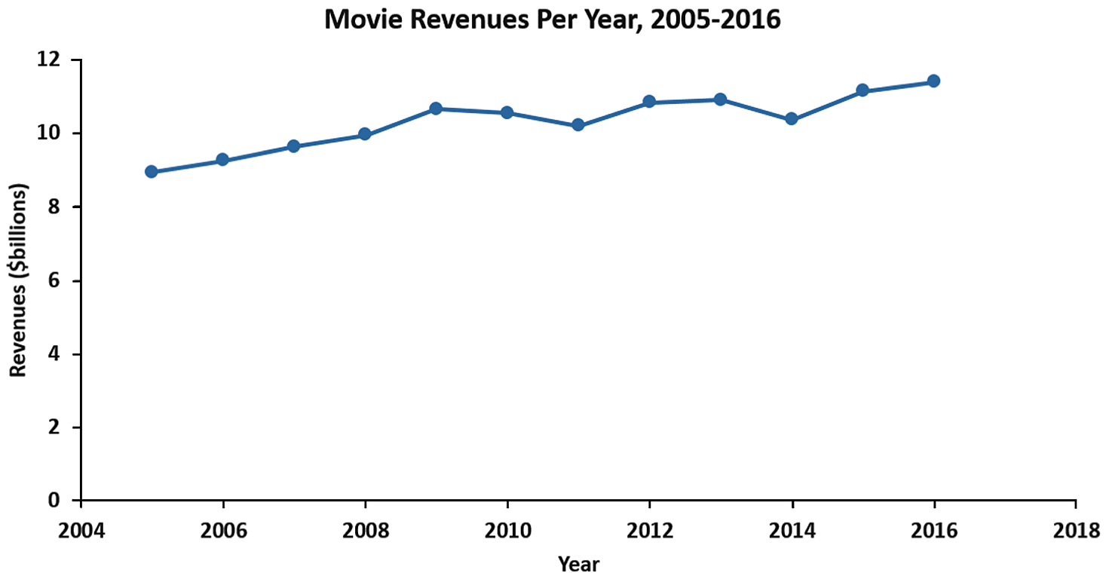
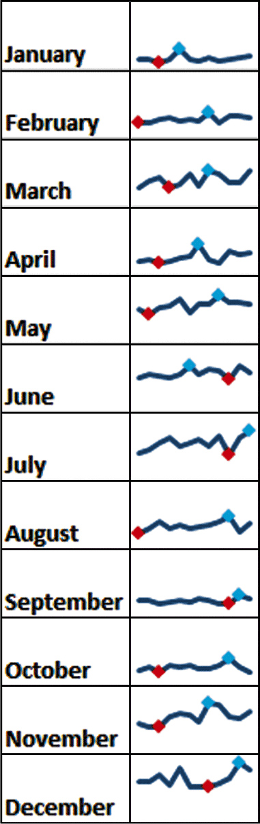
Sparklines Are Compact Time-Series Visualizations Of Numerical Variables
DCOVA
Movie revenues by week per month

Slide 59
To part 2 PPT for Chapter 2
DCOVA

