Slide 1

Chapter 2
Organizing and Visualizing Variables:
Part 2. Visualization Problems

Slide 2
Objectives
In this chapter you learn:
How to organize and visualize categorical variables.
How to organize and visualize numerical variables.
How to summarize a mix of variables.
How to avoid making common errors when organizing and visualizing variables.

Slide 3
In your small groups, critically assess each of the following visualizations and consider how each could be improved.

Slide 4
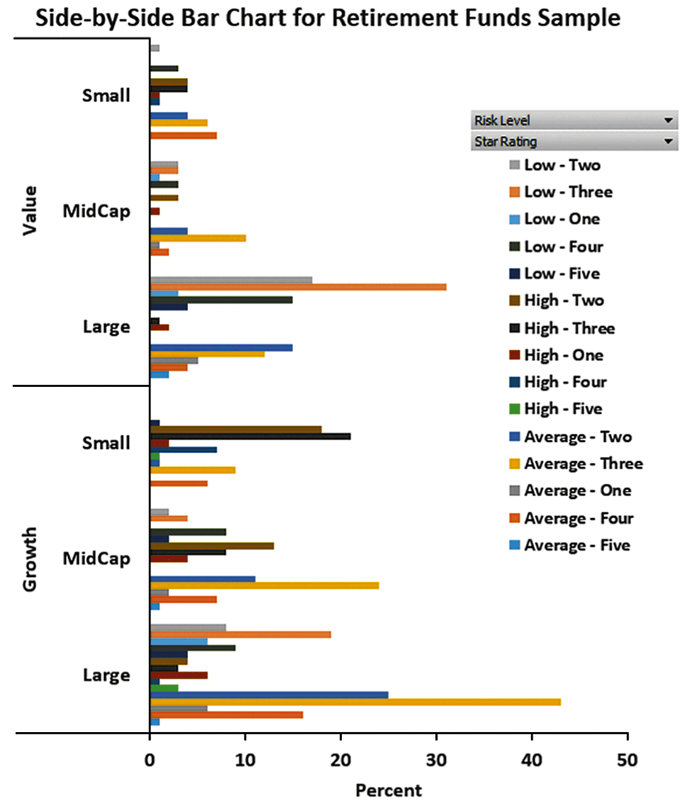
DCOVA

Slide 5
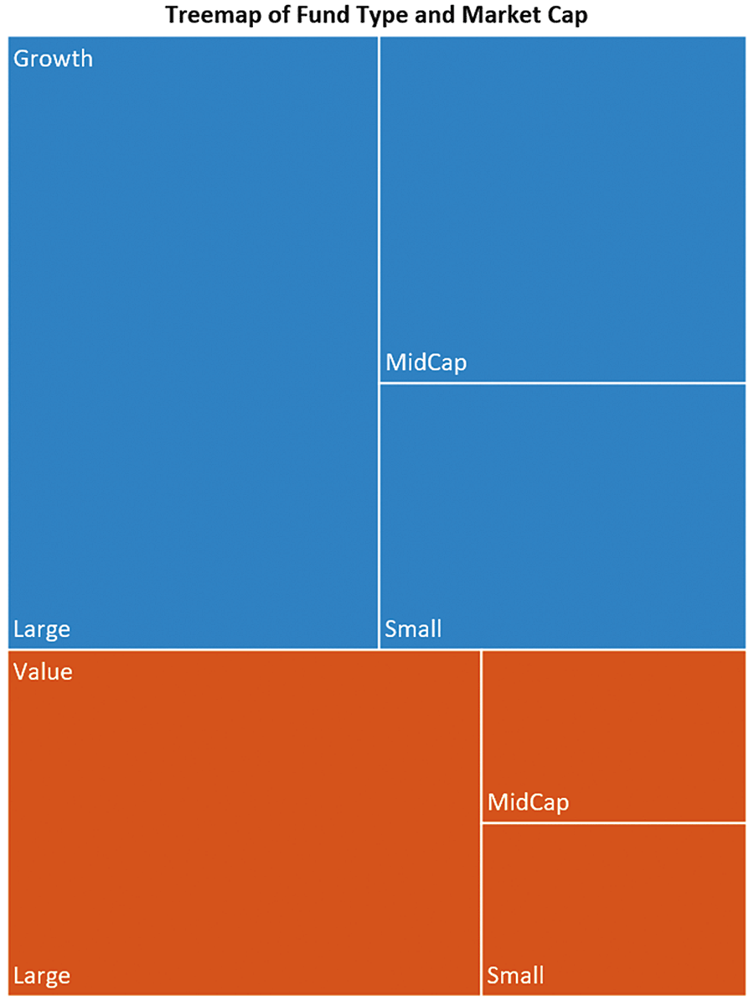
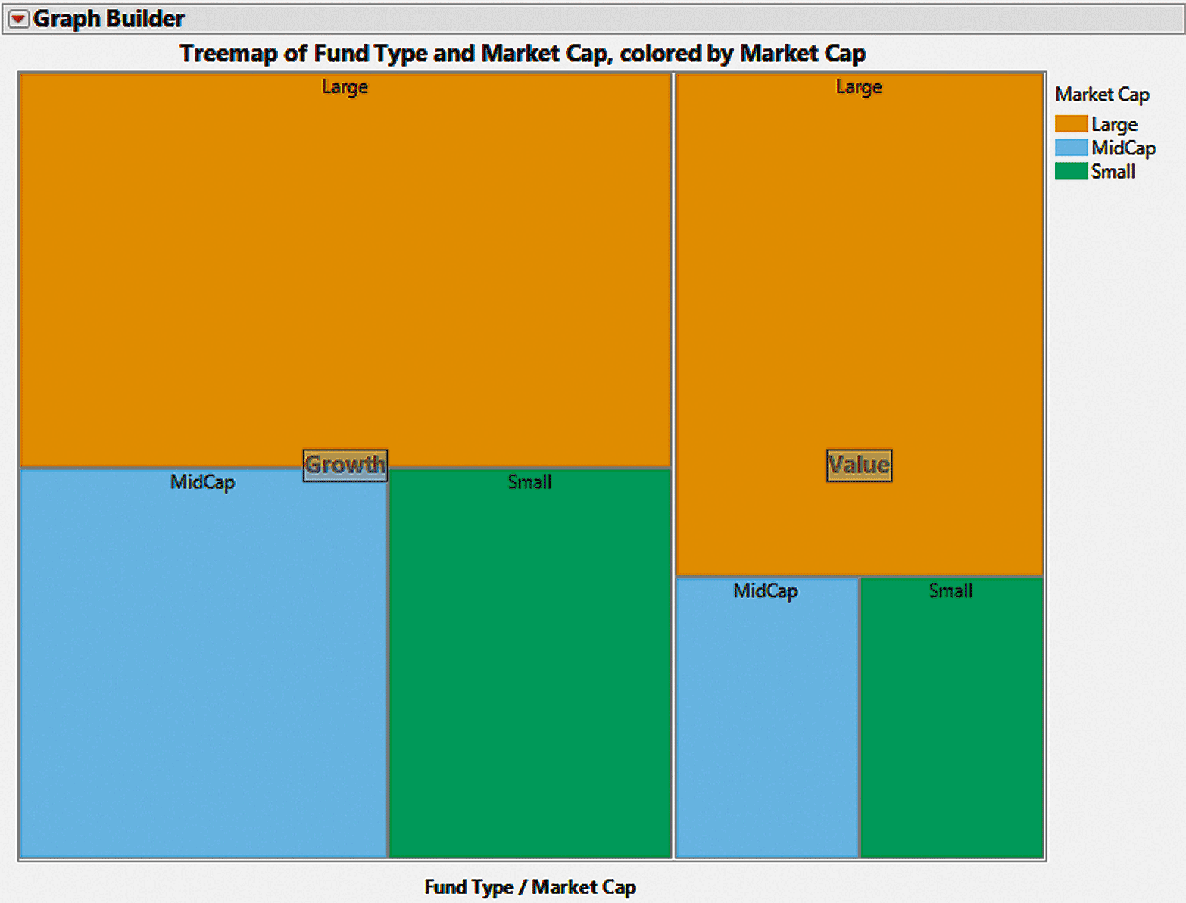
DCOVA
Excel Treemap:
Size of tiles correspond to the frequency in a cell.
JMP Treemap:
Size of tiles correspond to the value of the numeric variable Market Cap.

Slide 6
DCOVA
A’s received by students.
Freq.
300
200
100
0
FR
SO
JR
SR
FR = Freshmen, SO = Sophomore, JR = Junior, SR = Senior

Slide 7
DCOVA
Quarterly Sales
$
200
100
0
Q1
Q2
Q3
Q4

Slide 8
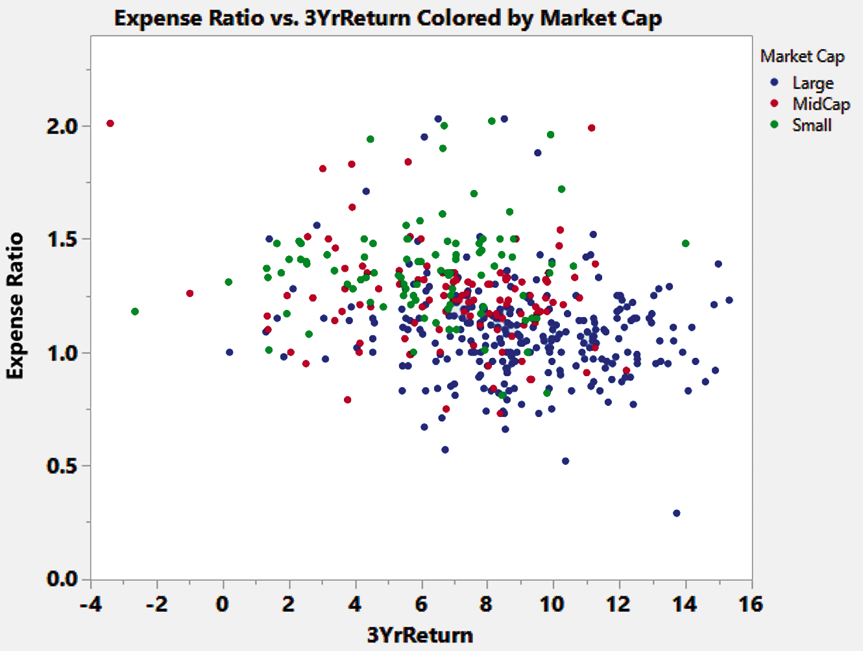

Slide 9
The Challenges in Organizing and Visualizing Variables
DCOVA
When organizing and visualizing data need to be mindful of:
  The limits of other’s ability to perceive and comprehend.
  Presentation issues that can undercut the usefulness of methods from this chapter.
It is easy to create summaries that:
  Obscure the data or
  Create false impressions.
  Contain Chartjunk

Slide 10
An Example Of Obscuring Data, Information Overload
DCOVA
Too Much Information

Slide 11
Treemaps Are Graphical Displays Of Contingency Tables
DCOVA
Excel Treemap:
Size of tiles correspond to the frequency in a cell.
JMP Treemap:
Size of tiles correspond to the value of the numeric variable Market Cap.

Slide 12
Treemaps Are Graphical Displays Of Contingency Tables
DCOVA
Excel Treemap:
Size of tiles correspond to the frequency in a cell.
JMP Treemap:
Size of tiles correspond to the value of the numeric variable Market Cap.
Not easy to interpret.

Slide 13
Colored Scatter Plots Visualize Both Numerical Variables & Categorical Variable(s)
DCOVA
Observations:
Large Market Capitalization Funds (red dots)
1. Relatively have best returns and lowest expense ratios.
2. Some have either low returns or high expense ratios or both.
Colored
Scatter Plot

Slide 14
Colored Scatter Plots Visualize Both Numerical Variables & Categorical Variable(s)
What can you see?
DCOVA
Observations:
Large Market Capitalization Funds (red dots)
1. Relatively have best returns and lowest expense ratios.
2. Some have either low returns or high expense ratios or both.
Colored
Scatter Plot

Slide 15
False Impressions caused by Data Manipulation
DCOVA
Selective summarization:
  Presenting only part of the data collected.
Improperly constructed charts:
  Potential pie chart issues.
  Improperly scaled axes.
  A Y axis that does not begin at the origin or is a broken axis missing intermediate values.
Chartjunk.

Slide 16
An Example of Selective Summarization, These Two Summarizations Tell Totally Different Stories
DCOVA
Company | Change from Prior Year | Company | Year 1 | Year 2 | Year 3
A | +7.2% | A | -22.6% | -33.2% | +7.2%
B | +24.4% | B | -4.5% | -41.9% | +24.4%
C | +24.9% | C | -18.5% | -31.5% | +24.9%
D | +24.8% | D | -29.4% | -48.1% | +24.8%
E | +12.5% | E | -1.9% | -25.3% | +12.5%
F | +35.1% | F | -1.6% | -37.8% | +35.1%
G | +29.7% | G | +7.4% | -13.6% | +29.7%

Slide 17
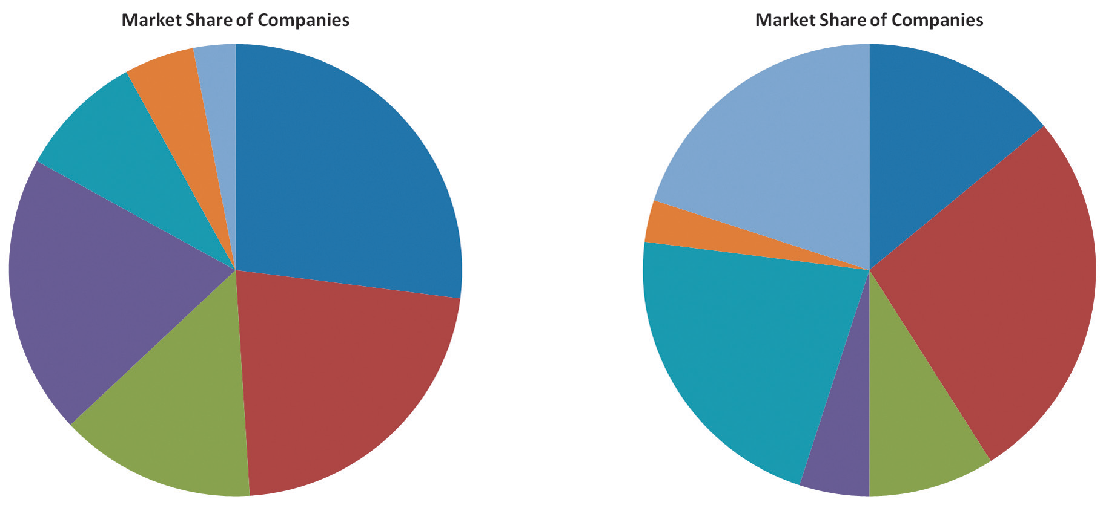
How Obvious Is It That Both Pie Charts Summarize The Same Data?
DCOVA
Why is it hard to tell? What would you do to improve?

Slide 18
Graphical Errors:
DCOVA
Bad Presentation
A’s received by students.
Freq.
300
200
100
0
FR
SO
JR
SR
FR = Freshmen, SO = Sophomore, JR = Junior, SR = Senior

Slide 19
Graphical Errors:
No Relative Basis
DCOVA
Bad Presentation
✓
Good Presentation
A’s received by students.
A’s received by students.
Freq.
%
300
30%
200
20%
100
10%
0
0%
FR
SO
JR
SR
FR
SO
JR
SR
FR = Freshmen, SO = Sophomore, JR = Junior, SR = Senior

Slide 20
Graphical Errors:
DCOVA
Bad Presentation
Quarterly Sales
$
200
100
0
Q1
Q2
Q3
Q4

Slide 21
Graphical Errors:
Compressing the Vertical Axis
DCOVA
✓
Bad Presentation
Good Presentation
Quarterly Sales
Quarterly Sales
$
$
200
50
100
25
0
0
Q1
Q2
Q3
Q4
Q1
Q2
Q3
Q4

Slide 22
Graphical Errors
DCOVA
Bad Presentation
Monthly Sales
$
45
42
39
36
J
F
M
A
M
J
Graphing the first six months of sales

Slide 23
Graphical Errors: No Zero Point on the Vertical Axis
DCOVA
Bad Presentation
✓
Good Presentations
Monthly Sales
$
Monthly Sales
$
45
45
42
42
39
39
36
36
0
J
F
M
A
M
J
J
F
M
A
M
J
Graphing the first six months of sales

Slide 24
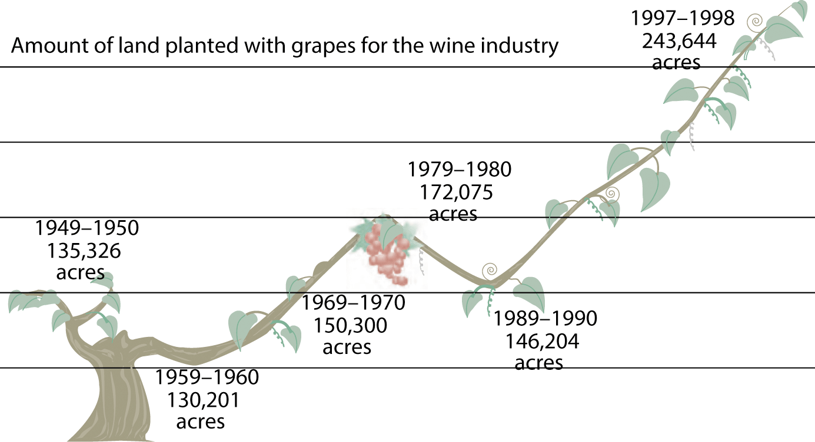
Graphical Errors
DCOVA
Bad Presentation
Left illustration adapted from S. Watterson, “Liquid Gold—Australians Are Changing the World of Wine. Even the French Seem Grateful.” Time, November 22, 1999, p. 68-69

Slide 25
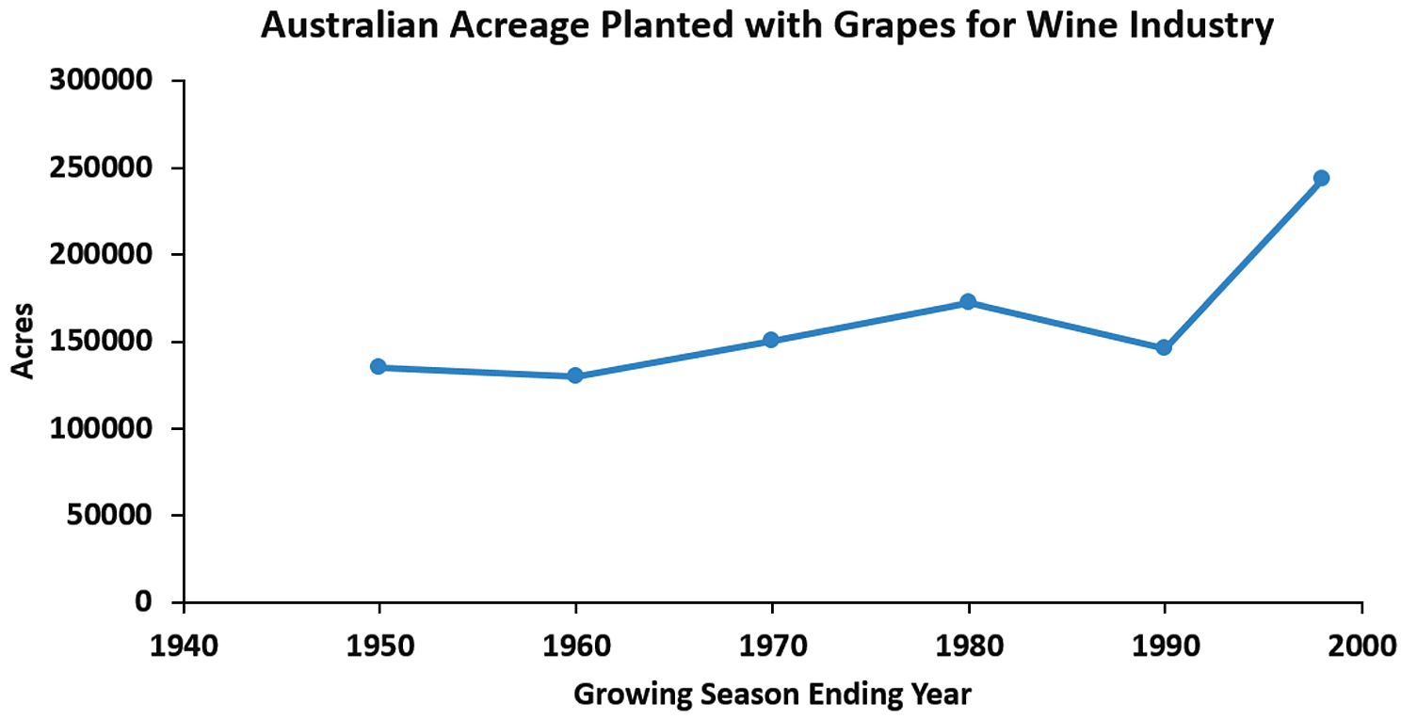
Graphical Errors: Chart Junk, Can You Identify The Junk?
DCOVA
✓
Bad Presentation
Good Presentation
Left illustration adapted from S. Watterson, “Liquid Gold—Australians Are Changing the World of Wine. Even the French Seem Grateful.” Time, November 22, 1999, p. 68-69

Slide 26
Note: Occasionally a little creativity in presentation might be appropriate depending on the situation/audience, but never at the expense of conveying the information

Slide 27
Best Practices for Constructing Visualizations
DCOVA
Use the simplest possible visualization.
Include a title & label all axes.
Include a scale for each axis if the chart contains axes.
Begin the scale for a vertical axis at zero & use a constant scale.
Generally, should avoid 3D or “exploded” effects & the use of chartjunk.
Use consistent colorings in charts meant to be compared.
Avoid using uncommon chart types including radar, surface, bubble, cone, and pyramid charts unless there is a good reason to use them

Slide 28
Questions for Practice
Pg 77: 2.8
Pg 84: 2.13
Pg 85: 2.20

