Slide 1
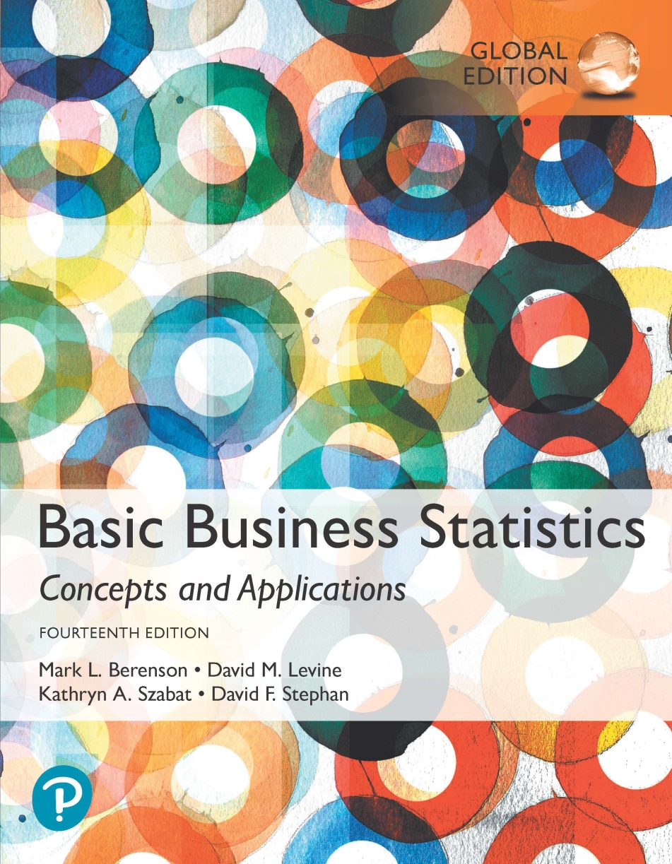
Chapter 3
Numerical Descriptive Measures

Slide 2
Objectives
In this chapter, you learn to:
Describe the properties of central tendency, variation, and shape in numerical variables.
Construct and interpret a boxplot.
Compute descriptive statistics for a population.
Calculate the covariance and the coefficient of correlation.

Slide 3
Summary Definitions
DCOVA
The central tendency is the extent to which the values of a numerical variable group around a typical or central value.
The variation is the amount of dispersion or scattering away from a central value that the values of a numerical variable show.
The shape is the pattern of the distribution of values from the lowest value to the highest value.

Slide 4
Measures of Central Tendency:
The Mean
DCOVA
The arithmetic mean (often just called the “mean”) is the most common measure of central tendency.
  For a sample of size n:
The i^{th} value
Pronounced x-bar
Sample size
Observed values

Slide 5
Means are great and we love them.
But are there any concerns with using the mean as a measure of central tendency?
Our room right now has some average level of wealth per person. What would happen to the average level of wealth per person if Jeff Bezos walked in?
The avg wealth per person in this room would be about $4 billion
If we’re hoping the mean is going to tell us what the typical person’s wealth is, we might be a little off….

Slide 6
Measures of Central Tendency:
The Mean (con’t)
DCOVA
The most common measure of central tendency.
Mean = sum of values divided by the number of values.
Affected by extreme values (outliers).
11 12 13 14 15 16 17 18 19 20
11 12 13 14 15 16 17 18 19 20
Mean = 13
Mean = 14

Slide 7
Measures of Central Tendency:
The Median
DCOVA
In an ordered array, the median is the “middle” number (50% above, 50% below).
Less sensitive than the mean to extreme values.
11 12 13 14 15 16 17 18 19 20
11 12 13 14 15 16 17 18 19 20
Median = 13
Median = 13

Slide 8
Measures of Central Tendency:
Locating the Median
DCOVA
The location of the median when the values are in numerical order (smallest to largest):
If the number of values is odd, the median is the middle number.
If the number of values is even, the median is the average of the two middle numbers.
Note that is not the value of the median, only the position of
the median in the ranked data.

Slide 9
Measures of Central Tendency:
The Mode
DCOVA
Value that occurs most often.
Not affected by extreme values.
Used for either numerical or categorical data.
There may be no mode.
There may be several modes.
0 1 2 3 4 5 6 7 8 9 10 11 12 13 14
0 1 2 3 4 5 6
Mode = 9
No Mode

Slide 10
What are some situations where you might prefer using median over mean as a measure of cent.tendency?

Slide 11
Measures of Central Tendency:
Review Example
DCOVA
House Prices:
$2,000,000
$ 500,000
$ 300,000
$ 100,000
$ 100,000
Sum $ 3,000,000
Mean: ($3,000,000/5)
= $600,000
Median: middle value of ranked data
= $300,000
Mode: most frequent value
= $100,000
DEMO

Slide 12
Measures of Central Tendency:
Which Measure to Choose?
DCOVA
The mean is generally used, unless extreme values (outliers) exist.
The median is often used, since the median is not sensitive to extreme values. For example, median home prices may be reported for a region; it is less sensitive to outliers.
In many situations it makes sense to report both the mean and the median.

Slide 13
Sometimes we should probably use the geometric mean, rather than the arithmetic mean
Arithmetic is fine when numbers go up linearly
  157,158,159,etc
Geometric is better when numbers go up non-linearly
  10%,11%,12%
    On a value of 50,000, 10% is 5,000, 11% is 5,500, etc

Slide 14
Easy way to remember which is better:
Do I add to get to the next value?
  Ex: Every time you take a step, you add one step to your total steps
  Use arithmetic mean
Do I multiply to get to the next value?
  Ex: Each year your investments increase by 3%
  Ex: Each hour the bacteria increase by 10%
  Use geometric mean

Slide 15
Measure of Central Tendency For The Rate Of Change Of A Variable Over Time:
The Geometric Mean & The Geometric Rate of Return
DCOVA
Geometric mean
  Used to measure the rate of change of a variable over time.
Geometric mean rate of return
  Measures the status of an investment over time.
  Where R_{i} is the rate of return in time period i.

Slide 16
The Geometric Mean & The Mean Rate of Return: Example
DCOVA
An investment of $100,000 declined to $50,000 at the end of year one and rebounded to $100,000 at end of year two:
50% decrease 100% increase
The overall two-year return is zero, since it started and ended at the same level.

Slide 17
The Geometric Mean & The Mean Rate of Return: Example (con’t)
DCOVA
Use the 1-year returns to compute the arithmetic mean and the geometric mean:
Arithmetic mean rate of return:
Misleading result
Geometric mean rate of return:
More
representative
result
DEMO

Slide 18
Measures of Central Tendency:
Summary
DCOVA
Central Tendency
Arithmetic Mean
Median
Mode
Geometric Mean
Middle value in the ordered array
Most frequently observed value
Rate of change of
a variable over time

Slide 19
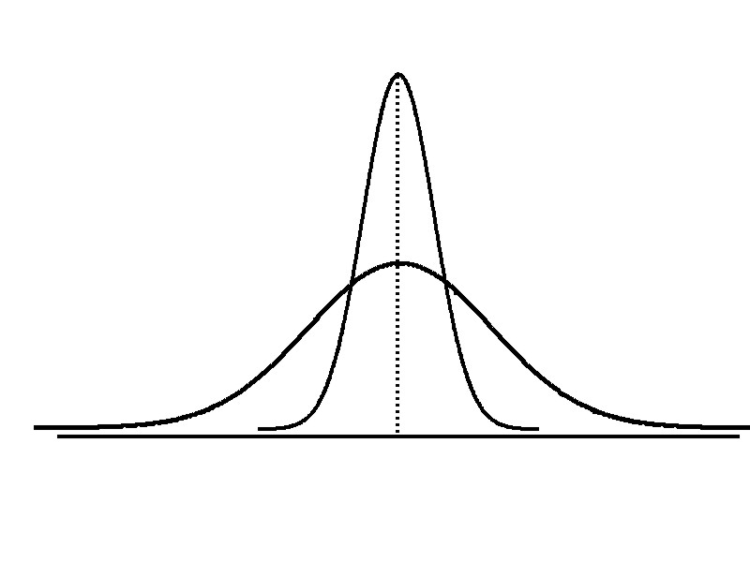
Measures of Variation
DCOVA
Variation
Range
Variance
Standard Deviation
Coefficient of Variation
Measures of variation give information on the spread or variability or dispersion of the data values.
Same center,
different variation

Slide 20
Measures of Variation:
The Range
DCOVA
Simplest measure of variation.
Difference between the largest and the smallest values:
Range = X_{largest} – X_{smallest}
Example:
0 1 2 3 4 5 6 7 8 9 10 11 12 13 14
Range = 13 - 1 = 12

Slide 21
Measures of Variation:
Why The Range Can Be Misleading
DCOVA
Does not account for how the data are distributed.
Sensitive to outliers
7 8 9 10 11 12
7 8 9 10 11 12
Range = 12 - 7 = 5
Range = 12 - 7 = 5
1,1,1,1,1,1,1,1,1,1,1,2,2,2,2,2,2,2,2,3,3,3,3,4,5
Range = 5 - 1 = 4
1,1,1,1,1,1,1,1,1,1,1,2,2,2,2,2,2,2,2,3,3,3,3,4,120
Range = 120 - 1 = 119

Slide 22
Measures of Variation:
The Sample Variance
DCOVA
Where
= arithmetic mean
n = sample size
X_{i} = i^{th} value of the variable X
Average (approximately) of squared deviations of values from the mean.
  Sample variance:

Slide 23
Measures of Variation:
The Sample Standard Deviation
DCOVA
Most commonly used measure of variation.
Shows variation about the mean.
Is the square root of the variance.
Has the same units as the original data.
  Sample standard deviation:

Slide 24
Measures of Variation:
The Sample Standard Deviation
DCOVA
Steps for Computing Standard Deviation:
1. Compute the difference between each value and the mean.
2. Square each difference.
3. Add the squared differences.
4. Divide this total by n-1 to get the sample variance.
5. Take the square root of the sample variance to get the sample standard deviation.

Slide 25
Measures of Variation:
Sample Standard Deviation Calculation Example
DCOVA
Sample
Data (X_{i}) : 10 12 14 15 17 18 18 24
n = 8 Mean = X = 16
A measure of the “average” scatter around the mean.

Slide 26
Measures of Variation:
Comparing Standard Deviations
DCOVA
Data A
Mean = 15.5
S = 3.338
11 12 13 14 15 16 17 18 19 20 21
Data B
Mean = 15.5
S = 0.926
11 12 13 14 15 16 17 18 19 20 21
Data C
Mean = 15.5
S = 4.567
11 12 13 14 15 16 17 18 19 20 21

Slide 27
For practice, calculate the std dev and variance for the following:
5,9,12,13,15
n= 5
Mean=54/5=10.8

Slide 28
Value | (value-mean) | (val-mean)sq
5 | -5.8 | 33.64
9 | -1.8 | 3.24
12 | 1.2 | 1.44
13 | 2.2 | 4.84
15 | 4.2 | 17.64
 |  | Sum of above: 60.8
 |  | Divided by n-1: 15.2

Slide 29
Variance is 15.2
Std deviation is 3.9
Excel can calculate this for us:
  Data analysis tool pack
  Descriptive Statistics
  Select input range
  Summary Statistics

Slide 30
Measures of Variation:
Comparing Standard Deviations
DCOVA
Smaller standard deviation
Larger standard deviation

Slide 31
Measures of Variation:
Summary Characteristics
DCOVA
The more the data are spread out, the greater the range, variance, and standard deviation.
The more the data are concentrated, the smaller the range, variance, and standard deviation.
If the values are all the same (no variation), all these measures will be zero.
None of these measures are ever negative.

Slide 32
Note that in isolation, std dev is hard to interpret
  Why? For example: What does a std dev of 143.4 mean?
The reason is that it is scaled by the mean of the data series
So if you are using large numbers (i.e. GDP of countries), the std deviation will be a “large” number even if the values have relatively little variation
If you are using small numbers (i.e. the volume of alcohol in various beers, 0.05, 0.04, etc) the std dev will be “small” even if the values are spread out

Slide 33
Luckily, there is a simple measure of how values are spread out that is insensitive to the scale of the numbers you are using.
Coefficient of variation
CV= (sample std.dev./sample mean)x100
Useful when comparing the size of variation across variables measured in different units.

Slide 34
Measures of Variation:
The Coefficient of Variation
DCOVA
Measures relative variation.
Always in percentage (%).
Shows variation relative to mean.
Can be used to compare the variability of two or more sets of data measured in different units.
DEMO

Slide 35
Measures of Variation:
Comparing Coefficients of Variation
DCOVA
Stock A:
  Mean price last year = $50.
  Standard deviation = $5.
Stock B:
  Mean price last year = $100.
  Standard deviation = $5.
Both stocks have the same standard deviation, but stock B is less variable relative to its mean price.

Slide 36
Measures of Variation:
Comparing Coefficients of Variation (con’t)
Stock A:
  Mean price last year = $50.
  Standard deviation = $5.
Stock C:
  Mean price last year = $8.
  Standard deviation = $2.
DCOVA
Stock C has a much smaller standard deviation but a much higher coefficient of variation

Slide 37
Recall our previous example:
5,9,12,13,15
What is the coef of variation?
Std dev: 3.9
Xbar: 10.8
CV= 0.36

Slide 38
Next, we will talk about Z-scores
The will be a Z-score value for each observation
Think of a Z-score as basically a measure of how extreme that particular value is from the mean.
Small Z-score: the value is close to the mean
Large Z-score: the value is far from the mean (extreme)

Slide 39
We said variance/std dev will always be positive, what about z-scores?
No, they will be positive if the observed value is bigger than the mean value and negative if the observed value is smaller than the mean.

Slide 40
Locating Extreme Outliers: Z-Score
DCOVA
To compute the Z-score of a data value, subtract the mean and divide by the standard deviation.
The Z-score is the number of standard deviations a data value is from the mean.
A data value can be considered an extreme value if its Z-score is less than -3.0 or greater than +3.0.
The larger the absolute value of the Z-score, the farther the data value is from the mean.

Slide 41
Locating Extreme Outliers:
Z-Score
DCOVA
where X represents the data value
X is the sample mean
S is the sample standard deviation

Slide 42
Are you an extreme value???
Avg height for males: 175 cm with std dev 7 cm
Avg height for females: 164 cm with std dev 6 cm
What is your z-score?
Anyone with a z>3 or <-3??
For me:
Z=(183-175)/7=1.14 (not that extreme☹)

Slide 43
Locating Extreme Outliers:
Z-Score
DCOVA
Suppose the mean math SAT score is 490, with a standard deviation of 100.
Compute the Z-score for a test score of 620. Is this value extreme?
A score of 620 is 1.3 standard deviations above the mean and would not be considered an outlier.

Slide 44
Value | (Val-mean) | (Val-mean)/StdDev
5 | -5.8 | -1.48768
9 | -1.8 | -0.46169
12 | 1.2 | 0.307795
13 | 2.2 | 0.564291
15 | 4.2 | 1.077282

Slide 45
In summary:
Positive Z means the value is greater than mean, negative means it’s less
“Small” Z means the value is close to the mean
“Large” Z means its far away.
What is “small/large”?
Z scores of less than -3 or more than 3 can be considered outliers/extreme values

Slide 46
For practice:
Your average commute to work is 18.2 minutes.
Of course random events (traffic, stop lights, etc) cause the time each day to vary, and thus the std dev of commute time is 3.4 minutes.
Based on what we just learned, how long would your commute have to be for it to be considered an extreme event?
>=28.4 minutes or <= 8 minutes

Slide 47
Reality check: why bother with this sort of measure?
  Data values will vary
  It is helpful to have an objective and agreed upon way to determine if a value is:
    Pretty normal?
    Somewhat larger or small?
    Extreme?

Slide 48
  Say the avg sales for your firm are $230,000 per month (with some variance, of course).
  After implementing a new mkting strategy, sales are $240,000 per month. Is this evidence that the mkting strategy works? Or does this fall within the normal variation and the new strategy didn’t do anything?
  If $240k is < std dev from the mean, perhaps we are not overwhelmed: a result like that is pretty typical even without the new mkting strategy!
  If $240k is 2+ std devs from the mean, that might be viewed as at least some evidence that the mkting strategy had an impact (not proof, though!)

Slide 49
Next, let’s talk about how the data are skewed or balanced.
Think about the distribution of heights in this room: probably pretty balanced around the mean.
  Might be close to a “Bell curve”
Think about the distribution of income (skewed right)
Think about the retirement age (skewed left)
Also are interested in how peaked or flat the distribution is

Slide 50
Shape of a Distribution
DCOVA
Describes how data are distributed.
Two useful shape related statistics are:
  Skewness:
    Measures the extent to which data values are not symmetrical.
  Kurtosis:
    Kurtosis measures the peakedness of the curve of the distribution—that is, how sharply the curve rises approaching the center of the distribution.

Slide 51
Shape of a Distribution (Skewness)
DCOVA
Measures the extent to which data is not symmetrical.
Left-Skewed
Symmetric
Right-Skewed
Mean < Median
Mean = Median
Median < Mean
Skewness
Statistic
< 0 0 >0

Slide 52
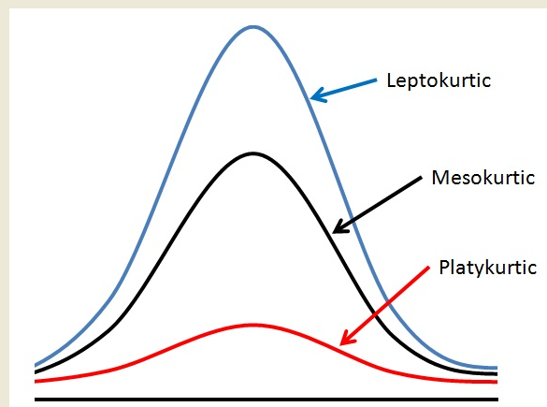
Shape of a Distribution -- Kurtosis measures how sharply the curve rises approaching the center of the distribution
DCOVA
Sharper Peak
Than Bell-Shaped
(Kurtosis > 0)
Bell-Shaped
(Kurtosis = 0)
Flatter Than
Bell-Shaped
(Kurtosis < 0)
DEMO

Slide 53
Kurtosis<0
  Flat
  Fat/thick ends
Kurtosis>0
  Peaked
  Thin ends

Slide 54
There are a couple of different ways to calculate kurtosis and we don’t need to bother with that, just need to know how to interpret (like on the last slide)

Slide 55
Exploring Numerical Data Using Quartiles
DCOVA
Can visualize the distribution of the values for a numerical variable by computing:
  The quartiles.
  The five-number summary.
  Constructing a boxplot.

Slide 56
Quartile Measures
DCOVA
Quartiles split the ranked data into 4 segments with an equal number of values per segment.
25%
25%
25%
25%
Q1
Q2
Q3
The first quartile, Q₁, is the value for which 25% of the values are smaller and 75% are larger.
Q₂ is the same as the median (50% of the values are smaller and 50% are larger).
Only 25% of the values are greater than the third quartile.

Slide 57
Quartile Measures:
Locating Quartiles
DCOVA
Find a quartile by determining the value in the appropriate position in the ranked data, where:
First quartile position: Q₁ = (n+1)(1/4) ranked value.
Second quartile position: Q₂ = (n+1)(1/2) ranked value.
Third quartile position: Q₃ = (n+1)(3/4) ranked value.
where n is the number of observed values.

Slide 58
Quartile Measures:
Calculation Rules
DCOVA
When calculating the ranked position use the following rules:
  If the result is a whole number then you’re good: use that.
  If the result is a fractional half (e.g. 2.5, 7.5, 8.5, etc.) then average the two corresponding data values.
  If the result is not a whole number or a fractional half then round the result to the nearest integer to find the ranked position.

Slide 59
Quartile Measures
Calculating The Quartiles: Example
DCOVA
Sample Data in Ordered Array: 11 12 13 16 16 17 18 21 22
(n = 9)
Q₁ is in the (9+1)/4 = 2.5 position of the ranked data,
so Q₁ = (12+13)/2 = 12.5.
Q₂ is in the (9+1)/2 = 5th position of the ranked data,
so Q₂ = median = 16.
Q₃ is in the (9+1)(3/4) = 7.5 position of the ranked data,
so Q₃ = (18+21)/2 = 19.5.
Q₁ and Q₃ are measures of non-central location.
Q₂ = median, is a measure of central tendency.

Slide 60
Quartile Measures:
The Interquartile Range (IQR)
25%
25%
25%
25%
DCOVA
The IQR is Q₃ – Q₁ and measures the spread in the middle 50% of the data.
The IQR is also called the midspread because it covers the middle 50% of the data.
The IQR is a measure of variability that is not influenced by outliers or extreme values.
Measures like Q₁, Q₃, and IQR that are not influenced by outliers are called resistant measures.

Slide 61
Calculating The Interquartile Range
DCOVA
Example:
Median
(Q₂)
X
X
Q₁
Q₃
minimum
maximum
25% 25% 25% 25%
12 30 45 57 70
Interquartile range
= 57 – 30 = 27

Slide 62
The Five Number Summary
DCOVA
The five numbers that help describe the center, spread and shape of data are:
  X_{smallest.}
  First Quartile (Q₁).
  Median (Q₂).
  Third Quartile (Q₃).
  X_{largest.}
DEMO

Slide 63
Five Number Summary and The Boxplot
DCOVA
The Boxplot: A Graphical display of the data based on the five-number summary:
X_{smallest} -- Q₁ -- Median -- Q₃ -- X_{largest}
Example:
25% of data 25% 25% 25% of data
of data of data
X_{smallest} Q₁ Median Q₃ X_{largest}

Slide 64
Five Number Summary:
Shape of Boxplots
DCOVA
If data are symmetric around the median then the box and central line are centered between the endpoints.
A Boxplot can be shown in either a vertical or horizontal orientation.
X_{smallest} Q₁ Median Q₃ X_{largest}

Slide 65
Distribution Shape and
The Boxplot
DCOVA
Left-Skewed
Symmetric
Right-Skewed
Q₁
Q₂
Q₃
Q₁
Q₂
Q₃
Q₁
Q₂
Q₃

Slide 66
Boxplot Example
DCOVA
Below is a Boxplot for the following data:
0 2 2 2 3 3 4 5 5 9 27
The data are right skewed, as the plot depicts.
X_{smallest} Q₁ Q₂ / Median Q₃ X_{largest}
0 2 3 5 27
0 2 3 5 27

Slide 67
Numerical Descriptive Measures for a Population
DCOVA
Descriptive statistics discussed previously described a sample, not the population.
Summary measures describing a population, called parameters, are denoted with Greek letters.
Important population parameters are the population mean, variance, and standard deviation.

Slide 68
Numerical Descriptive Measures for a Population: The mean µ
DCOVA
The population mean is the sum of the values in the population divided by the population size, N.
Where
μ = population mean
N = population size
X_{i} = i^{th} value of the variable X

Slide 69
Numerical Descriptive Measures For A Population: The Variance σ²
DCOVA
Where
μ = population mean
N = population size
X_{i} = i^{th} value of the variable X
Average of squared deviations of values from the mean.
  Population variance:

Slide 70
Numerical Descriptive Measures For A Population: The Standard Deviation σ
DCOVA
Most commonly used measure of variation.
Shows variation about the mean.
Is the square root of the population variance.
Has the same units as the original data.
  Population standard deviation:

Slide 71
Sample statistics versus population parameters
DCOVA
Measure | Population Parameter | Sample Statistic
Mean
Variance
Standard Deviation

Slide 72
We don’t spend a lot of time talking about population parameters in this class b/c usually in the real world, we don’t have them and can never get them.
We view our sample statistics as good (or at least as good as we’re going to get) guesses for the population parameters
  We usually don’t have mu, so we use xbar
  We usually don’t have sigma, so we use s

Slide 73
The Empirical Rule
DCOVA
The empirical rule approximates the variation of data in a symmetric mound-shaped distribution.
Approximately 68% of the data in a symmetric mound shaped distribution is within 1 standard deviation of the mean or µ ± 1σ.
68%
µ
µ ± 1σ

Slide 74
The Empirical Rule (normal distribution)
DCOVA
Approximately 95% of the data in a symmetric mound-shaped (normal?) distribution lies within two standard deviations of the mean, or µ ± 2σ.
Approximately 99.7% of the data in a symmetric mound-shaped distribution lies within three standard deviations of the mean, or µ ± 3σ.
95%
99.7%

Slide 75
Take care to note that this assumes a “symmetric, mound shaped” distribution!
Many distributions are indeed like this (or pretty close) but many are not!

Slide 76
Using the Empirical Rule
DCOVA
Suppose that the variable Math SAT scores is bell-shaped with a mean of 500 and a standard deviation of 90. Then:
  Approximately 68% of all test takers scored between 410 and 590, (500 ± 90).
  Approximately 95% of all test takers scored between 320 and 680, (500 ± 180).
  Approximately 99.7% of all test takers scored between 230 and 770, (500 ± 270).

Slide 77
So if the distribution is normal, we’ve got a good “rule of thumb” (the empirical rule).
Do we have a rule of thumb for data that’s not bell-shaped/approximately normal?
Yep. We have Chebyshev’s Theorem.
This is a rule of thumb for non-normal distributions in general.
  Not exact, but decent

Slide 78
Chebyshev’s Rule (non-normal distribution)
DCOVA
Regardless of how the data are distributed, at least
(1 - 1/k²) x 100% of the values will fall within k standard deviations of the mean (for k > 1).
  Examples:
(1 - 1/2²) x 100% = 75% ….............. k=2 (μ ± 2σ)
(1 - 1/3²) x 100% = 88.89% ……….. k=3 (μ ± 3σ)
At least
Within

Slide 79
Ex: The average attendee at a Savannah Bananas game spends $39.52 in the stadium (snacks, drinks, hats, etc) with a std. dev of $8.15.
We believe the distribution of this variable is non-normal/non-bell shaped.
According to C’s Rule, what interval (dollar range) should capture 95% of observations?

Slide 80
C’s Rule:
{(1 - 1/k²) x 100} of the vals will fall w/in K std devs
We want a 95% interval so:
(1 - 1/k²) x 100 =95, solve for k
(1 - 1/k²) =0.95
1/k² = 0.05
K²= 20
K = 4.47

Slide 81
The interval that captures 95% of observations is the mean +/- 4.47 std devs
(4.47*8.15)=36.43
39.52+36.43= $75.95
39.52-36.43= $3.09

Slide 82
Thus far, we’ve focused on describing one variable
  It’s mean/median/mode, std.dev., skew, etc
Often we’re also pretty interested in how two variables move
  Mkting expenditure and sales
  Education level and earnings
  Interest rate and stock price
  Size of the house and the selling price

Slide 83
Two Measures Of The Relationship
Between Two Numerical Variables
Scatter plots: visually examine the relationship between two numerical variables
Two quantitative measures of such relationships:
  Covariance
  Coefficient of Correlation

Slide 84
The Covariance
DCOVA
The covariance measures the strength of the linear relationship between two numerical variables (X & Y).
The sample covariance:
Note that no causal effect is implied.

Slide 85
Interpreting Covariance
DCOVA
Covariance between two variables:
cov(X,Y) > 0 X and Y tend to move in the same direction.
cov(X,Y) < 0 X and Y tend to move in opposite directions.
cov(X,Y) = 0 X and Y are independent.
The covariance has a difficulty:
  It is not possible to determine the relative strength of the relationship from the size of the covariance.

Slide 86
Coefficient of Correlation
DCOVA
Measures the relative strength of the linear relationship between two numerical variables.
Sample coefficient of correlation:
Where,

Slide 87
Features of the
Coefficient of Correlation
DCOVA
The population coefficient of correlation is referred as ρ.
The sample coefficient of correlation is referred to as r.
Either ρ or r have the following features:
  Unit free.
  Range between –1 and 1.
  The closer to –1, the stronger the negative linear relationship.
  The closer to 1, the stronger the positive linear relationship.
  The closer to 0, the weaker the linear relationship.

Slide 88
Scatter Plots of Sample Data with Various Coefficients of Correlation
Y
Y
DCOVA
X
X
r = -1
r = -.6
Y
Y
Y
X
X
X
r = +1
r = +.3
r = 0

Slide 89
Excel can (of course) calculate the covariance for us
  But be careful: note that the formulas are a little different in the population and the sample
  If you use the covariance function in the Data Analysis pack, it will give you the population cov, which is probably not what you want
    (although, if you have a large data set, will it matter much?)
=COVARIANCE.s(array1,array2)
  For example: covariance.s(A1:A50,B1:B50)

Slide 90
Pitfalls in Numerical
Descriptive Measures
DCOVA
Data analysis is objective:
  Should report the summary measures that best describe and communicate the important aspects of the data set.
Data interpretation is subjective:
  Should be done in fair, neutral and clear manner.

Slide 91
Ethical Considerations
DCOVA
Numerical descriptive measures:
Should document both good and bad results.
Should be presented in a fair, objective and neutral manner.
Should not use inappropriate summary measures to distort facts.

Slide 92
Chapter Summary
In this chapter we have discussed:
Describing the properties of central tendency, variation, and shape in numerical variables.
Constructing and interpreting a boxplot.
Computing descriptive summary measures for a population.
Calculating the covariance and the coefficient of correlation.

Slide 93
For practice:
Pg 166: 3.2
Pg 175: 3.32
Pg 183: 3.44

