Slide 1
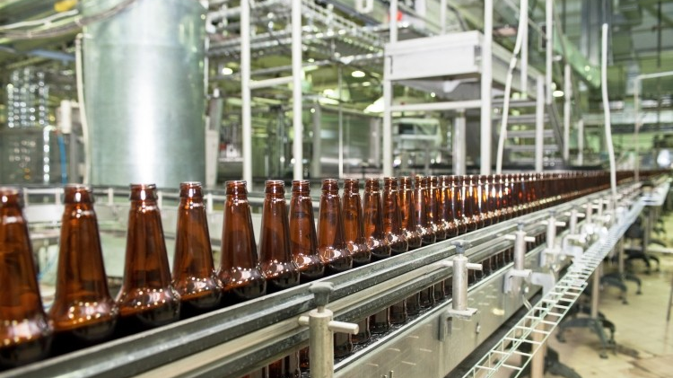
Carlsberg in Russia 2022: Strategic response to crisis
42E00101 CEMS Global Strategy
Group 6 (Arne Sirén, Huanqi Kaylin Liu, Leevi Mäkipää, Shoumorup Mukhopadhyay)
Fall 2023

Slide 2
Table of contents
1. Introduction
Background in Russia
Overview of dilemma faced by management
2. Analysis
External environment analysis
Internal capability analysis
3. Strategic response plan
Strategic options
Our recommendations
Notes:
Can delete this?

Slide 3
Challenges in Russia begin to pile up in 2008, culminating in the invasion of Ukraine
Timeline
2008
2011-2013
2014
2017
2017
2022
Russian economy is strongly affected by the financial crisis, halting its upward momentum
Russia introduces increases in beer duties and restrictions in marketing
Russia occupies and annexes Crimea
Russia introduces new tax increases and regulations
Russia introduces new tax increases and regulations
Russia
Russia attacks Ukraine
Carlsberg
2004
2008
2012
2014-2015
2017
2020
2021
2022
Carlsberg acquires Orkla, gaining a controlling stake in the Russian brewer BBH
Carlsberg and Heineken acquire S&N, which boosts Carlsberg’s position in Russia
Despite challenges, Carlsberg keeps a positive outlook on Russian market
Carlsberg faces declining sales in Russia due to economic sanctions and a weak rouble. The company considers selling its Russian business
Carlsberg loses further market share to competitors
Carlsberg launches new products, e.g. non-alcoholic beer to counter the negative market trend
Russia accounts 9,8% of Carlsberg’s global sales
Carlsberg's risks in Russia are fully realized

Slide 4
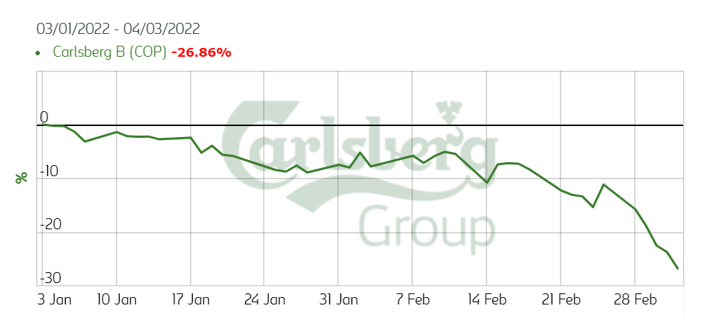
Carlsberg is facing a financial and ethical dilemma reacting to the Ukrainian crisis
1. Situation: Carlsberg in Russia
2. Complication: Russian invasion of Ukraine March 2022
Carlsberg is strongly committed to the Russian market through their subsidiary Baltic Beverages Holding (BBH)
Russian market comprised 9,8 % of Carlsberg’s total sales 2021
27 % market share in Russia (2021)
8400 employees in Russia
Carlsberg’s market share has decreased in the past 5 years while the total beer consumption has grown during the same period
3. Question: Stay or leave?
4. Answer: Potential sale process complicated
Leave:
Carlsberg face pressure from Danish media to leave Russia after invasion of Ukraine and risk reputational damage and boycotts in western markets if staying
Staying would mean financing the war indirectly by paying taxes
Stay:
Responsibility to provide jobs and salaries for loyal employees
If no suitable buyer is found and assets face risk of falling in government’s hands, temporary staying is justified
Sales price of Russian operations will be close to zero, well below market value of assets (non-current assets in Russia valued DKK 19,1 billion in 2021)
As of 2022 Carlsberg has not found suitable buyers
Possible investors must come from countries that have not imposed sanctions on Russia
Local Russian buyer candidates involve a risk of government connections

Slide 5
Carlsberg’s business environment in Russia in March 2022 is especially affected by
the challenges in political and economical factors
Effect on Carlsberg
Comments
P
The invasion of Ukraine by Russia significantly escalated geopolitical tensions and uncertainty in the region
Heavy political pressure from both domestic and international stakeholders to cease operations
Risk for potential countermeasures by the Russian government
olitical
0
1
2
3
4
5
E
conomical
Economic sanctions imposed by EU have effects on the Russian economy and consumers’ purchasing power
Carlsberg facing the risk of expropriating its assets in the country
EU sanctions preventing the transfer of cash resources
The devaluation of the Ruble leading to potential write-downs
0
1
2
3
4
5
S
ocial
Carlsberg is facing significant public pressure from politicians, the public and media to divest its business in Russia
The worsened brand image can have effects on other markets
Carlsberg facing dilemmas regarding the welfare of its employees in Russia
0
1
2
3
4
5
T
echnological
Increased risk for cybersecurity threats could pose a threat to Carlsberg's operations in Russia
Sanctions could potentially impact the import of brewing technology and equipment
0
1
2
3
4
5
E
nvironmental
Due to the current highly complex business environment environmental issues could hold not as high priority for Carlsberg
The availability of sustainable materials and procedures might not be available due to the disruptions in the supply chains
0
1
2
3
4
5
L
High risk for breach of intellectual property laws, which are crucial for protecting Carlsberg's brand and product recipes
Legal implications of complying with international sanctions imposed on Russia, especially regarding trade, financial transactions, and corporate governance
egal
0
1
2
3
4
5

Slide 6
Carlsberg’s strong engagement in Russia exposes it to risks
Strengths
Weaknesses
Leading global player in brewing industry with strong brand recognition and loyal customer base
Diverse product portfolio consisting of local brands and global premium brands
Mostly local production and nearshored supply chains makes global operations resilient
The company's transformation from a regional to a global player showcases its growth and expansion capabilities
Higher reliance on Russian (9,8 % of company’s global sales 2021) and eastern European markets (17,1 %; 2020) than competitors, leading to higher exposure to the risks in the area
Declining market share in shrinking market
Entry strategies to new markets heavily based on acquisitions
Weak control over local operations
S | W
O | T
Opportunities
Threats
Emerging markets offer opportunities for growth and potential to expand into new markers to reduce dependency on Russian market
Growth in non-alcoholic beer segment
Leveraging digital transformation for better market analytics and customer engagement
Enhancing sustainability practices to meet the growing demand for ethical products
Geopolitical instability leading to disruptions in operations
Critical supply chains threatened (gas and energy supply in Ukraine, aluminum for cans)
Risk of Russia nationalizing assets
Potential damage to brand reputation due to ethical complexities of the crisis
Cybersecurity threats

Slide 7
Carlsberg’s core competencies support resilience and recovery
Brewing expertise & quality
Innovation
Continue tradition of high-quality brewing, focusing on markets with growth potential
Leverage by innovating in product development to adapt to new market demand
CORE COMPETENCIES
Global presence & brand recognition
Distribution & supply chains
Leverage strong market position and brand strength to maintain customer loyalty even during times of crisis
Supply chain resilience is key to ensuring continuation of production with minimal disruption during geopolitical or economic turbulence

Slide 8
Carlsberg needs a graded response plan to respond to the emerging crisis
Possible External Scenarios facing Carlsberg
Continued Geopolitical Tension (MOST PROBABLE): Carlsberg could face ongoing challenges in Eastern European markets with a possibility for their further spread. Leveraging its crisis management competency, the firm would need to ensure operational continuity & ethical alignment with its broader values.
Market Recovery: If a ceasefire is agreed upon, tensions ease, markets stabilize & sanctions are withdrawn, Carlsberg can capitalize on its strong market position to drive growth and recover any lost market share.
Shift in Consumer Preferences: As consumer preferences evolve, possibly due to the shifting geo-political climate, Carlsberg's brand strength could be used to adapt product offerings to meet new demands – including offering newer product lines that can by-pass existing & future sanctions.
Possible Disengagement Strategies¹
 | Strategy | Description | Key objective
PERSEVERING | 1. Continue with current business model as status quo | Stay on course with no new investments | Meet basic stakeholder expectations while taking political risks
INNOVATING | 2. Stay and capitalize on the disruption | Pivot to fit changing circumstances | Introduce new products/services to adapt to the new reality
RETRENCHMENT (PARTIAL DISENGAGEMENT) | 3. Discontinue sale of International premium brands | Cut back on scope of business | Highly visible strategy that helps to balance pressures
 | 4. Discontinue technology transfer and staff training | Defensive strategy to lower costs | Satisfy public relation pressures while maintaining business
 | 5. Discontinue exports of intermediate goods to the operation | Comply with pressures to pare business | Highly visible strategy that helps to mould public opinion
EXIT (FULL DISENGAGEMENT) | 6. Liquidate operations | Complete financial write-off | Provide a strong signal to political stakeholders
 | 7. Sell operations to highest bidder | Minimise losses while exiting | Provide a strong signal to political leaders while minimizing losses
 | 8. Sell operations to buyer meeting ethical concerns | Meet ethical obligations while exiting | Protect property rights and brand value alignment
1) Meyer, K., & Estrin, S. 2023. It’s Hard to Say Goodbye: Managing Disengagement during Political Disruptions. AIB Insights, 23(2). https://doi.org/10.46697/001c.72023.

Slide 9
Evaluating Strategic Response Alternatives available (Scale 1 – 4)
 | Feasibility | Profitability | Risk | Time | Brand Image Impact | Effectiveness (Overall rank)¹
Description | How easy it is to undertake the initiative | How financially lucrative initiative is | Risks² associated with initiative | Time to implement the initiative | Public Relations Image | Our overall score for the initiative
1. Continue with current business model as status quo | 1 | 1 | 1 | 4 | 1 | 9
2. Stay and capitalize on the disruption | 2 | 4 | 1 | 2 | 1 | 14
3. Discontinue sale of International premium brands | 3 | 2 | 4 | 3 | 3 | 17
4. Discontinue technology transfer and staff training | 3 | 2 | 3 | 2 | 1 | 13
5. Discontinue exports of intermediate goods to the operation | 3 | 1 | 1 | 2 | 3 | 11
6. Liquidate operations | 4 | 1 | 1 | 4 | 4 | 15
7. Sell operations to highest bidder | 3 | 1 | 2 | 2 | 4 | 13
8. Sell operations to buyer meeting ethical concerns | 2 | 1 | 1 | 1 | 4 | 10
1) Overall rank calculated by summing all scores and giving 2x weight on profitability
2) Risks include e.g. financial risks, political risk, and implementation risks since launch
3) Higher values indicate a positive effect – more feasible, better profitability, less risky, lesser time & a solid brand image
Short-listed options

Slide 10
Strategic options depend on potential buyers and ethical judgement
 | Retrenchment - Discontinue sale of International premium brands | Exit – Liquidate Operations | Persevering – Stay and capitalize on disruption
 | Hold back selling and await possible suitable buyers while gradually trapping down operations | Liquidate Russian subsidiary BBH and exit the market | Exploit opportunity of growing market share when western competitors are leaving market
Advantages | Highly visible move that protects the brand image Defensive strategy that reduces costs, divestments, and narrows the scope of the business operations Opens up a window for the firm to look at potential buyers who would meet ethical requirements | Strong signal to political and media stakeholders Significant economic impact on the beer landscape in Russia Offset any other financial, political and brand image losses associated with continuing business in Russia | Maintain its market presence and potentially capitalize on recovery and rebuilding efforts Support the local economy as commitment to CSR Foster employee morale and loyalty in such challenging times
Disadvantages | Loss of high-margin component of the business Loss of expert talent & skill as the organization pares itself down Innovation & creativity stifled due to resource crunch, fewer product lines | Employees in Russia and Ukraine to lose livelihood Complete financial write-off probable due to lack of potential immediate buyers Asset Appropriation by Russian authorities create ethical complications | Safety and security risks for employees, assets, and operations Ongoing conflict can lead to operational disruptions, such as supply chain challenges, transportation Raises strong ethical considerations in the West
Activity | Production lines winded down due to fewer exports Actively look for a buyer meeting ethical concerns | Shut down all activites in plants & offices | Continued Product Innovation to capitalize on CSR support towards rebuilding Ukraine from Russian proceeds
Financials | Huge drop in sales revenue & possible change in market share | Zero revenue coming in from the region with complete walkover provided to competitors | Drop in revenue due to market conditions but will improve as the situation improves
 | Cost savings associated with production, marketing, and distribution | Huge costs incurred in terms of loss in assets & technology | Costs incurred to maintain the existing business model
 | Short-term profits may decrease but long-term profitability through reallocation | No short-term or long-term profits but relieves firm from navigating difficult waters in Russia & Ukraine | Long-term profits possible only if the situation improves
 | The strategic goal is to minimize the negative financial effects of the disruption while complying internal & external ethical standards | Access to wood supply through increasing awareness | Access to wood supply through a loss-leader product
1
2
3
Revenue
Costs
Profit

Slide 11
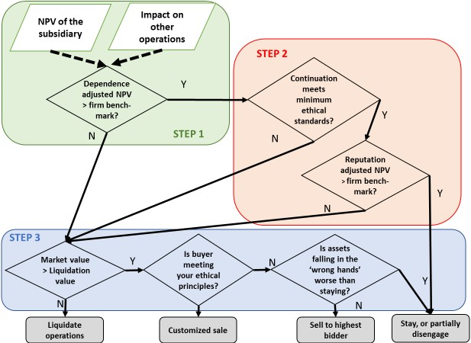
Internal ethical values and external reputational risks call for retrenchment
Financial impact¹
Relatively low mutual dependency between Carlsberg and BBH makes exit by sale a feasible possibility
Exit will damage global operations because of BBH’s big contribution to global sales and required supply chain restructurings
Ethical arguments
Reputational damage will have financial impact in western markets
Staying could be an ethical way to support local employees and to protect BBH from falling into control of players connected to the government
Formats of disengagement
In case of suitable buyer candidates, customized sale would be preferred
Risk of assets falling in the “wrong hands” or nationalization speaks against selling to highest bidder or local players
Staying, while limiting investments and marketing, is a way to protect assets
Retrenchment & Sale
1
Stay & capitalize on disruption
3
2
1) Meyer, K., & Estrin, S. 2023. It’s Hard to Say Goodbye: Managing Disengagement during Political Disruptions. AIB Insights, 23(2). https://doi.org/10.46697/001c.72023.

Slide 12
Recommendations
Immediate Actionable Steps
Carlsberg should immediately pare down its operations and presence in Russia & Ukraine with strategies such as restricting the sale of International premium beer.
With its operations on the downward slope, Carlsberg should actively look for potential clients – preferably ones satisfying ethical concerns – to sell their business.
It may become necessary to liquidate the business due to paucity of buyers. Hence, Carlsberg should utilize the intermediate time to develop a recovery package for its employees in Russia & Ukraine and also craft and implement asset expropriation prevention mechanisms through dialogue with political stakeholders.
Future Opportunities
c
Geo-political Risk Management:
Create a 'Geopolitical Risk Dashboard' that consolidates data from various sources to assess risk levels in different markets.
Establish a dedicated crisis management team to monitor and respond to geopolitical developments in real-time.
Market Diversification:
Identify and assess alternative markets with a focus on political stability and cultural affinity for beer consumption.
Develop a phased entry plan for these markets, starting with market research followed by test marketing and then full-scale launch.
Supply Chain Adaptation:
Conduct a supply chain vulnerability audit, focusing on suppliers from high-risk areas and seeking alternatives.
Invest in technology to improve supply chain visibility and agility, allowing for rapid response to disruptions.
Ethical and Sustainable Operations:
Amplify Carlsberg's sustainability initiatives, particularly in carbon footprint reduction, to strengthen its social responsibility profile.
Implement an 'Ethical Operations Framework' that guides decision-making in crises, ensuring alignment with global standards and local sensitivities

Slide 13
Appendix

Slide 14
Analytical tools leveraged for internal analysis & their limitations
SWOT
Core competencies
Comprehensive view of business situation with focus on internal capabilities (Strengths and Weaknesses) and Opportunities and Threats created by external factors
Helps direct strategic focus on critical areas
Simple and quickly implementable framework giving
Overview of sustainable competitive advantages
Helps organization to focus on their strengths instead of spreading resources too broadly
Core competencies enable organization to grow and innovate and show how adaptable or resilient to change they are
Limitations of SWOT
Limitations of core competencies analysis
Static View: The model may not capture fast-changing crises
Subjective Assessments: The analysis can be vary based on who conducts the analysis
No Priorities: lists factors without indicating which are most urgent
Action Steps: identifies areas for action but lacks for strategies
Internal Focus: The model miss critical external crisis factors
Inward Focus: Prioritizes internal abilities over external threats
Long-Term Bias: Core competencies are less adaptable to immediate crises
Resource Heavy: Requires significant investment, which is limited during crisis
Organizational Rigidity: May hiner quick pivoting response to crisis
Ethical Oversight: Does not inherently account for ethical dimensions of a crisis

