Slide 1
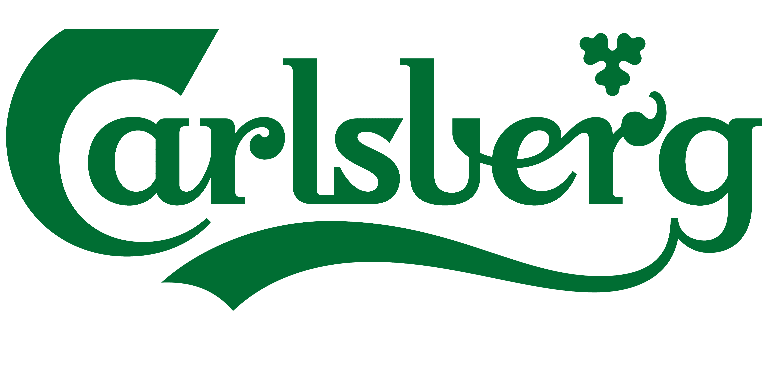
Market identification
and entry strategy
Asta Friman
Laura Putkinen
Robin Haapavaara Silja Abildsten

Slide 2
Table of contents
01
Executive Summary
02
Market Identification
03
Market Analysis
04
Entry Strategy

Slide 3
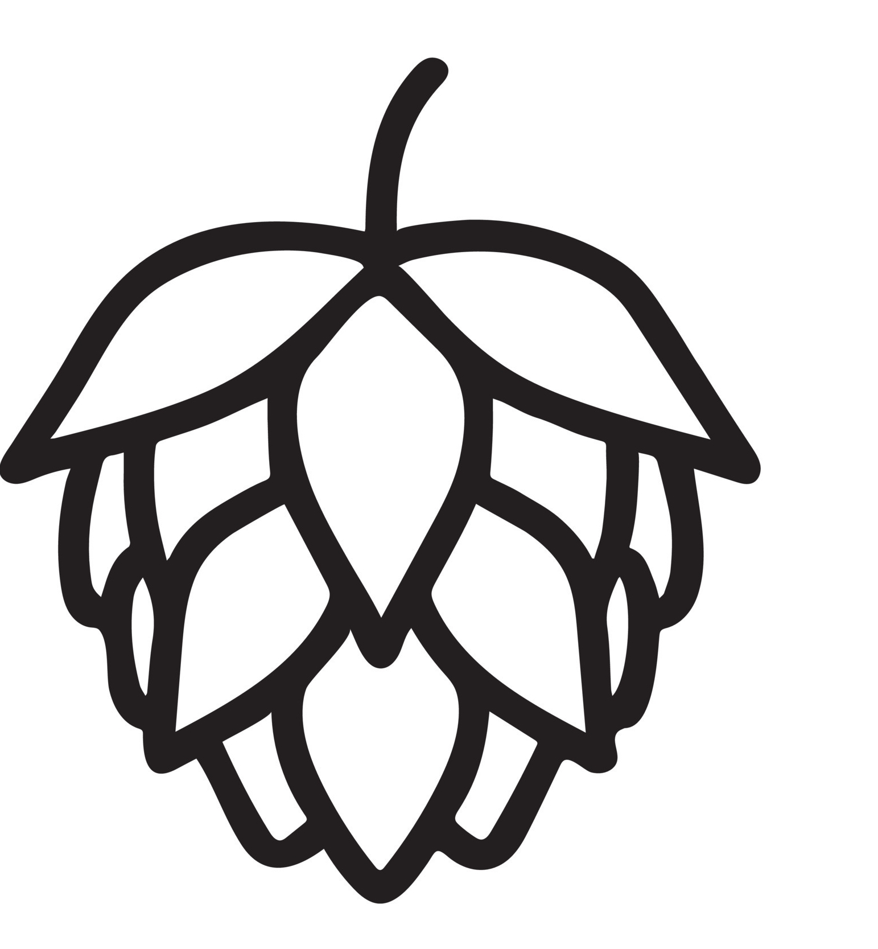
Executive Summary
Key figures
Purpose
Identify a potential market with Country Specific Advantages (CSA), which is the USA. Leverage Firm Specific Advantages (FSA) for market entry. Achieve market penetration, ensure access to raw materials, generate financial growth, and create a basis for further expansion to nearby and potentially lucrative markets.
Average beer consumption in the USA
1,5l / week
Portion of all global hops grown in the USA
40%
Key Assumptions and Trends
Acknowledge the potential adverse climate effects to agriculture when choosing the location for market entry. The overall beer consumption is declining in the USA, but the premium beer segment is growing. We assume that the big population and beer consumption per capita translate into bring profits.
Risk
Potential risks include the high competition in all customer segments, not being able to differentiate enough from competitors, droughts and wildfires especially in the Southern and Western USA, and difficulties in integrating local breweries and their practices to Carlsberg’s operations and culture.
Key Actions
Key actions involve market research, identifying breweries for acquisition, creating and optimizing value chains, creating mutually beneficial partnerships with companies to outsource operations from, and marketing the products to achieve interest and visibility in the target customer segments.
Recommendation
We recommend Carlsberg to enter the USA market through acquisition. The focus should be in the premium and craft beer segments to differentiate from competitors. The value chain must be carefully built so that the supply of raw materials won’t be endangered even if climate change accelerates in the following 10-20 years. Expertise of local breweries and corporate partners should be used to learn about the market and to adjust the value proposition accordingly.
U.S. Drought monitor. (n.d). & Mozny et al. (2023).

Slide 4
Porter's Five Forces: Strategic Overview of the Global Beer Industry
Bargaining Power of Suppliers: Medium-High
Climate change may cause distribution issues with barley and hop, but established breweries can negotiate favorable terms.
The global beer industry poses a moderate risk due to intense competition among established global companies. Moreover, external factors such as retailers, economic turmoil and climate change pose medium risk.
However, large and established brands are generally better positioned to navigate these challenges.
Threat of New Entrants: Medium-Low
Entering the beer market is feasible, but dominant brands have a significant competitive edge.
Threat of Substitute Products: Medium
Increased popularity among alternative beverages such as non-alcoholic drinks and health-oriented options presents a challenge.
Rivalry Among Existing Competitors: High
Intense competition with global companies and local breweries.
Bargaining Power of Buyers: Medium
Distributors and retailers have a moderate bargaining power determining the selection and availability of beer products.

Slide 5
Global Beer Market Trends
Sustainability
Health and Wellness
Globalization
Economic turmoil
Premium products
Stakeholders and legislation call for sustainability actions on all sectors, also affecting consumer preferences.
A growing health-conscious consumer base is shifting preferences toward healthier options, boosting the popularity of non-alcoholic and low-calorie beers.
The beer market is increasingly global, with consumers desiring local products, prompting breweries to adapt to both international taste and regional preferences.
Shifting economic conditions are impacting consumer spending habits. The industry must also navigate political events and emerging regulations.
Demand for premium, specialty, and craft beers is on the rise globally, with consumers willing to invest in high-quality, distinctive beers.

Slide 6
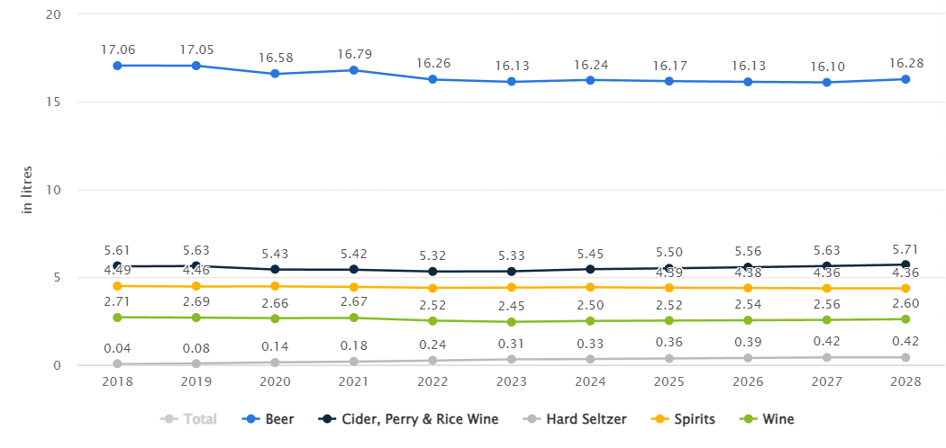
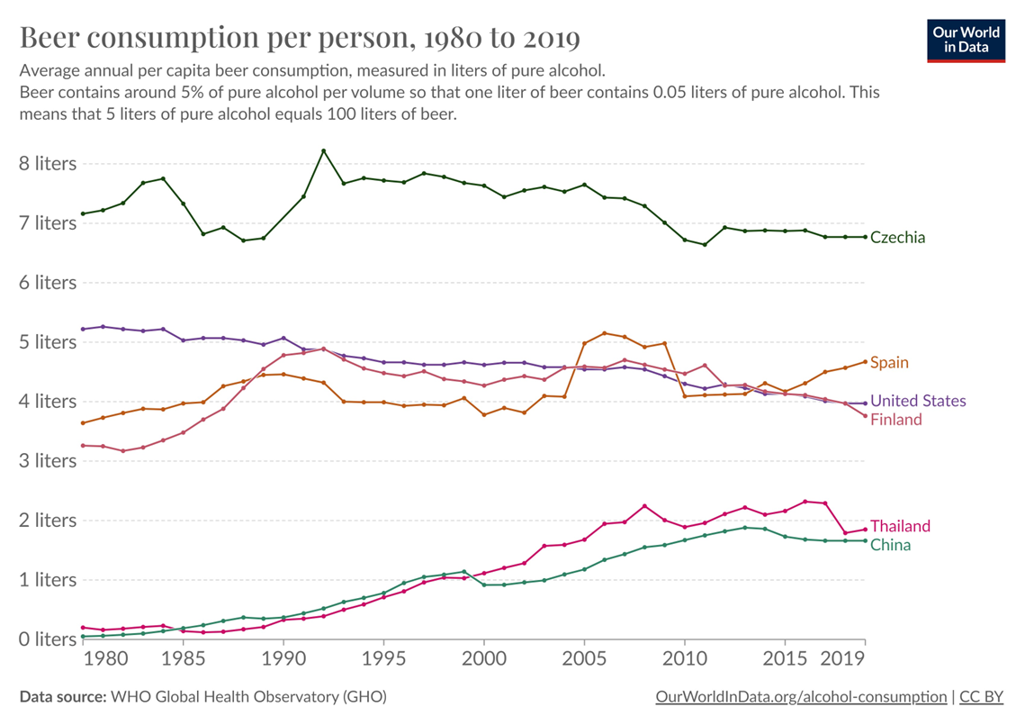
Beer consumption around the world
Beer consumption per person, 1980-2019
Beer consumption has been decreasing in all western markets including Czechia, the leading market in terms of beer consumption per person.
Alongside Czechia, Spain and the USA are leading the charts, while for total beer consumption, China and the USA rank the highest.
The diagram indicates an increase in Asian countries, however that too has slowed down significantly in the past years.
Average alcohol consumption volume per capita
Despite knowing that alcohol consumption has decreased the diagram shows us that beer still hold a strong market, despite having taken a small hit in 2022 and 2023.
In the prediction for the next years there can even be seen a slight increase in demand for beer.
The other competitors are still far behind on the prediction - therefore, beer can be seen as a good investment.
Our World in Data. (N.d.). & Statista (n.d.).
Notes:
Our World in Data. (n.d.). Beer consumption per person, 1982-2019 https://ourworldindata.org/grapher/beer-consumption-per-person?tab=chart&time=1982..2019&country=ESP~USA~CHN~FIN~THA~CZE
Statista. (n.d.). Alcoholic Drinks – Worldwide. https://www.statista.com/outlook/cmo/alcoholic-drinks/worldwide#volume
https://www.statista.com/outlook/cmo/alcoholic-drinks/worldwide#volume
https://ourworldindata.org/grapher/beer-consumption-per-person?tab=chart&time=1982..2019&country=ESP~USA~CHN~FIN~THA
https://wisevoter.com/country-rankings/beer-consumption-by-country/#united-states-of-America
Beer concumption has been decreasing in the USA and it is 20th biggest beer consumer per capita (72.7l). The world average is 54l. While for total beer consumption they rank 2nd in the world right after China (23,929,000,000l).

Slide 7
VRIO-T & Sustainable Competitive Advantages
Resources | Valuable | Rare | Imitability | Organized | Transferability | Conclusion
Global Brand Recognition | High: Offers strong customer loyalty and market share. | High: Few brands have such widespread recognition. | Low: Very difficult to replicate Carlsberg's long-standing brand identity. | High: Carlsberg effectively leverages its brand in marketing strategies. | High: The brand can be leveraged across markets. | Sustainable Competitive Advantage
Diverse Product Portfolio | High: Caters to a wide range of tastes and preferences. | Medium: Unique recipes and brews provide some level of rarity. | Medium: Complex to imitate but not impossible within the industry. | High: Capable of marketing and distributing diverse products. | High: Can adapt to different markets. | Competitive Strength, but not a standalone SCA
Sustainable Brewing Practices | High: Aligns with consumer values and reduces operational costs. | Low: Becoming more common as industry standards evolve. | Low: Practices can be adopted by others over time. | High: Part of Carlsberg's brand ethos and operational strategy. | High: Implementable across markets. | Necessary Practice, not an SCA
Research & Development (R&D) | High: Leads to innovative products and brewing efficiencies. | High: High investment in R&D is less common in the beer industry. | Low: Difficult to imitate due to complexity and innovation. | High: Well-structured to support R&D initiatives. | High: Applicable and advantageous across markets. | Sustainable Competitive Advantage
International Market Experience | High: Provides insights into diverse consumer behaviors. | High: Not all companies have such a broad international presence. | Low: Difficult to gain quickly, based on historical success. | High: Utilizes international experience in market strategies. | High: Insights are transferable to new markets | Sustainable Competitive Advantage

Slide 8
Carlsberg’s Three Sustainable Competitive Advantages
1
2
3
GLOBAL BRAND RECOGNITION
RESEARCH & DEVELOPMENT CAPABILITIES
INTERNATIONAL MARKET EXPERIENCE
Carlsberg's global brand, with its 170-year legacy, commands significant recognition, making it an important asset when entering new markets. This brand equity, steeped in a history of quality, is difficult for competitors to match and positions Carlsberg strongly for market expansion.
Carlsberg's R&D capabilities, spearheaded by its renowned Research Laboratory, drive innovation in brewing, yielding unique products and sustainable processes. This rare and inimitable strength offers Carlsberg a sustainable competitive edge.
Carlsberg's international experience offers insights crucial for adapting to diverse market conditions, a distinct advantage for entering differing market landscapes with high competition.

Slide 9
Carlsberg’s motivation for internationalization
01
EXPANSION AND GROWTH
Carlsberg aims to reach diverse consumer bases, capitalize on emerging trends, and fortify its global footprint through international expansion to ensure sustained financial growth and competitiveness.
02
SECURING SUSTAINABLE SUPPLY
Due to the uncertainties in future raw material supply and Carlsberg’s strong ESG focus on sustainable raw material sourcing, the company is exploring opportunities to secure its supply and to source more regeneratively grown raw materials.
03
REACHING STRATEGIC AIMS
Through market expansion, Carlsberg can aim to reach its strategic priorities of optimizing the management of its supply chain and pursuing value growth by expanding its premium category while keeping the mainstream beer category to bring scale and a solid backbone for the business.

Slide 10
PESTEL data analysis: The USA, Spain and Australia score the highest
POLITICAL
The Worldwide Governance Indicators (WGI): Political Stability and Absence of Violence/Terrorism
Top 10 markets by total score
ECONOMIC
Country population
GDP per capita
SOCIAL
Recorded alcohol per capita consumption: Beer consumption
TECHNOLOGICAL
The Cities of the Future Index: ePayments
ENVIRONMENTAL
The ND-GAIN Country Index
LEGAL
The Worldwide Governance Indicators (WGI): Control of corruption

Slide 11
Comparison of the top markets: The USA rises to the top
The markets’ position regarding megatrends
Resilience towards economic turmoil: As seen in the chart presenting household spending, the USA ranks by far the highest showing that despite global economic turmoil, households in the USA keep on consuming at high volumes.
Premium products: The US premium beer market is growing rapidly.
The strategic alignment of the markets
Securing sustainable supply: As seen in the second chart, the USA is the biggest producer of hop, the raw material under the highest risk during the next years. Furthermore, the USA is also among the top 10 biggest producers of the second most critical material, barley.
Expansion and growth: With two Latin American countries ranking in the top 10 in the PESTEL analysis, the USA holds a strategic position for Carlsberg’s further expansion.
Increasing the sales of premium beers: The US premium beer market is growing rapidly.
Total household spending by country 2022
Distribution of hop production volume worldwide in 2022
Billion USD

Slide 12
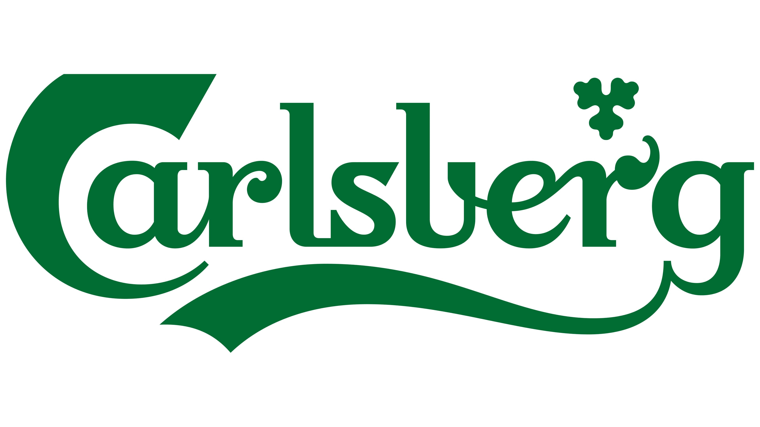
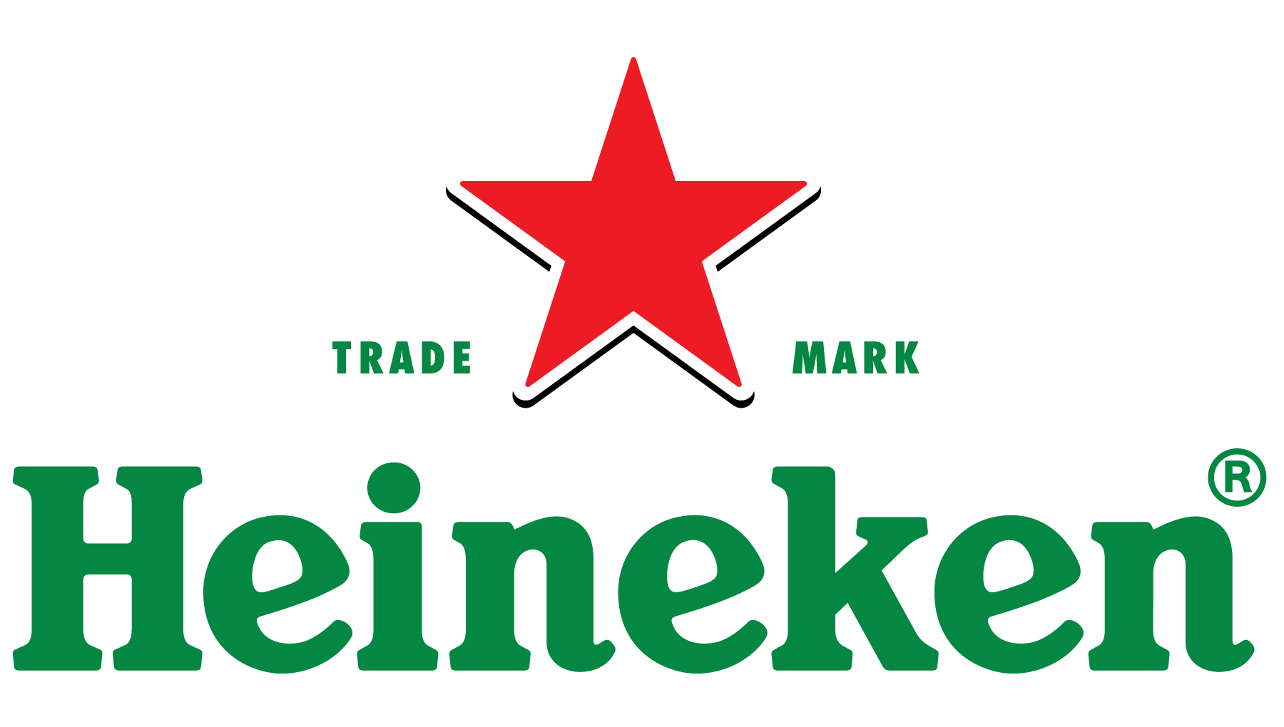
Competitor analysis
Total Revenue | USD 10.0 billion | USD 57.8 billion | USD 10.7 billion | USD 34,7 billion
US Market Share | - | 40,4% | 25,3% | 4,2%
Brand and Product Portfolio | Diverse portfolio including Carlsberg (mainstream), Tuborg, Kronenbourg 1664, and craft beer offerings. | Extensive portfolio with iconic brands like the mainstream brands Budweiser and Bud Light, and premium brands Corona and Stella Artois. | Diverse range of brands, including Coors Light (mainstream), Miller Lite (mainstream), and craft beer offerings such as the Blue Moon. | Global portfolio with brands like Heineken (premium), Amstel (premium), Desperados (specialty), and craft beer acquisitions like Lagunitas.
Brand awareness in the USA | No data available | Bud Light: 87% Corona: 87% Budweiser: 85% | Miller: 80% Coors: 79% Blue Moon: 74% | Heineken: 85%
Brand Image | Emphasizes quality and tradition, positioning itself as a reputable and heritage brand. | Diverse brand image, from the heritage of Budweiser to the contemporary appeal of craft and imported brands. | Positions itself with a mix of mainstream and craft brands, catering to a broad consumer base. | Projects a premium and sophisticated image, associated with quality and a cosmopolitan lifestyle.

Slide 13
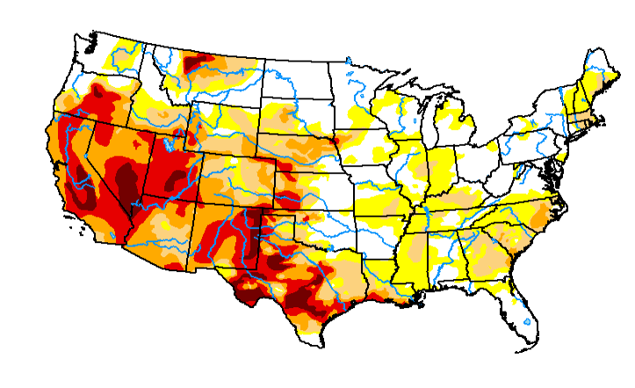
Securing supply and shorter supply chains through the US market
Strategic positioning for a more optimized supply chain and market expansion
The USA is the largest hop producer (40%). Hop production is located on the West Coast of the USA. In barley production, the USA ranks the 8th largest producer in the world with Idaho (33%), Montana (20%) and North Dakota (26%) being the biggest production states.
Short geographical proximity and good logistics connections would allow for lower costs and a more sustainable supply chain.
The geographical position would also be beneficial considering expansion to new markets in the area all the way from Canada to Latin America.
Barley production Hop production
Ensuring competitiveness through sustained hop and barley supply in the USA
Climate change is affecting agriculture significantly having a negative effect on hops and barley growth globally. Particularly hop production is at risk, as its production is predicted to decline up to 20% by 2050 due to droughts and wildfires globally. If this takes place, as indicated during the past 20 years, it will increase the troubles of the beer industry in general and push the prices up. The map from June 2022 showcasing droughts shows the severity of the problem in the USA. Barley production, on the other hand, is safer as it is located higher north where the droughts don’t reach.
While the situation is alarming, the conditions are even worse in many other parts of the world. To ensure its ability to sustain its competitiveness in the future, Carlsberg should ensure a secure supply in the USA and create strong local connections.
US drought monitor, June 2022
U.S. Drought monitor. (n.d), Mozny et al. (2023), Azizi. (2022) & Walling, (2023).
Notes:
https://www.ncbi.nlm.nih.gov/pmc/articles/PMC10564787/

Slide 14
Porter’s Five Forces Analysis: US Beer Industry
Bargaining Power of Suppliers: Medium
Stable supply chain with various domestic and international sources
Carlsberg’s global scale could lead to favorable supplier negotiations
The USA beer market is a dynamic and competitive environment, presenting significant opportunities for Carlsberg’s international expansion.
With a strategic focus on quality, innovation, and leveraging global experience, Carlsberg can effectively navigate market challenges and capitalize on consumer trends towards premium and diverse beer experiences.
Threat of New Entrants: Medium-Low
Competitive market with high entry barriers
Opportunities for established brands like Carlsberg due to global reputation
Rivalry Among Existing Competitors: High
Intense competition among major and smaller breweries.
Carlsberg can leverage international experience and brand recognition.
Threat of Substitute Products: Medium
Presence of alternatives like wine, spirits, non-alcoholic beverages
Beer’s unique social appeal and potential for low-alcohol innovations
Bargaining Power of Buyers: High
Diverse choices and premiumization trend increase consumer influence
Market receptive to new, quality products

Slide 15
Porter's Diamond Model Analysis: Entry into the US Beer Market
Firm Strategy, Structure, and Rivalry
High competitiveness in USA market
Need for unique selling proposition, leveraging European quality
Significant growth opportunities across diverse segments
Demand Conditions
Growing interest in premium and international beers
Large market potential for volume sales
Trend towards premium, specialty beer experiences
Factor Conditions
Skilled brewing labor force and educational resources
Established supply chain with quality ingredients and technology
Related and Supporting Industries
Complex but extensive distribution networks
Strong marketing and advertising sectors for brand building
Opportunities for local partnerships in distribution and retail
Opportunity for Carlsberg: Significant, with a need for strategic entry focusing on differentiation, supply chain utilization, and regulatory compliance.

Slide 16
Integration and Resources Grid
HIGH PRESSURE TO ADAPT TO LOCAL NEEDS
MODERATE PRESSURE TO LOWER COSTS
STRATEGIC IMPLICATIONS
Economies of Scale: Carlsberg’s global presence offers the potential for economies of scale in production and distribution, though local production may be necessary to minimize costs.
Supply Chain Optimization: Leveraging global supply chains while establishing local partnerships for raw materials can reduce costs.
Premium Pricing Strategy: Given Carlsberg's focus on premium and quality products, there may be less pressure to compete on price, allowing for a focus on value rather than cost-cutting.
Multidomestic Strategy: Carlsberg should adopt a multidomestic strategy, tailoring its products and marketing to regional preferences while leveraging its global brand strength and expertise.
Local Adaptation: Emphasis on local tastes, regulatory compliance, and marketing strategies will be crucial.
Leveraging premium products: Expanding their strategic goal for premium products in a market with high demand.
Global Synergies: Utilizing global best practices and economies of scale in areas like supply chain management, technology, and innovation.
Investment in Local Assets: Consider establishing breweries or partnerships within the USA to facilitate local adaptation while controlling costs.
Consumer Preferences: Carlsberg will need to adapt to the diverse taste preferences and beer culture in the USA, which may differ significantly from their primary markets.
Regulatory Landscape: The USA has complex alcohol distribution and regulatory frameworks varying by state, requiring localized strategies.
Market Dynamics: Different regions in the USA have varied beer consumption patterns and brand loyalties, necessitating a regionalized approach.

Slide 17
Past & current market entry strategies
Entry strategy depends on CSAs and FSAs
Exporting
Argumentation: mostly customer demand, no other (CSA)
Most used
Easiest and cheapest
Test the market before starting production locally
Flexibility to scale
Entry Modes of International Expansion
High
Wholly Owned Subsidiary
Licensing
Argumentation: if no clear advantages in producing in-house, corporate partners use country-specific knowledge and networks to take care of local operations
Rarely used
Less risk and costs
Comply with local regulations and trade barriers
Joint Venture
Extent of Investment and Risk
Strategic Alliance
Franchising
Licensing
Mergers & Acquisitions
Argumentation: cheaper production, access to raw materials, gaining expertise
Most expensive and risky
Quick market penetration due to established customer base
Synergies from larger scale
Gain market power
Diversification: premium brands, craft beer
Exporting
Low
Low
High
Degree of Ownership and Control
Notes:
Rapid Market Penetration: M&A can provide immediate access to established distribution networks, customer bases, and local market knowledge.

Slide 18
Mode of Entry – OLI advantages framework
Ownership
Location
Internalization
O
L
I
Foreign direct investment
Strong global brand
Unique recipes
Financial resources
Technology and expertise
Economies of scale
Cost efficiency
High and diverse demand
Large scale agriculture
Access to raw materials
Skilled and experienced labor force
Favorable regulations, ease of doing business index
Geographical proximity (also in the future)
Control of the supply chain
Protect intellectual property, mitigate the risk of leaking recipes or brewing methods
Market insights from ownership
Bring local expertise to Europe for R&D
Remain domestic
Produce at home and export
License

Slide 19
Value chain analysis: internalize or outsource
Suppliers
Production
Packaging
Logistics
Distribution
Internalize
Quality and consistency control
Less vulnerability to others' incentives
Long-term relationships with suppliers
Helps further expansion to nearby markets
Internalize
Core of the business
Quality and consistency control
Learn from acquired breweries
R&D
Internalize
Quality and consistency control
Agile responses to demand
OR Outsource
Might be cheaper to outsource
Established, high quality
Focus on core competencies
Outsource
Resource-intensive and complex
The core competency of the partner
Timely delivery
Efficiency
Flexibility as demand changes
Internalize
Control over premium products’ placement and presentation
OR Outsource
Gain established networks and expertise
Cost-efficiency
Focus on core competencies
How to choose:
Carlsberg should internalize the operations where they are able to use their core competencies to create value. Even if they had the capabilities of doing support activities, it would distract them from the most critical parts that grant a competitive advantage. Additionally, a logistics company can use its core competencies regarding logistics and thus create value and efficiency that wouldn’t be possible for Carlsberg. Overall, the quality-to-cost ratio is key.

Slide 20
Mode of Entry: Acquisition
REASONS FOR ACQUISITION
REQUIREMENTS FOR TARGET COMPANY
1.
Historical Success
Carlsberg has a history of successful acquisitions
Rapid Market Access
Instant market presence and customer base
Established Distribution Networks
Bypass the challenges of building new distribution channels
Brand Leverage
Capitalize on existing brand equity and loyalty
Regulatory Navigation
Benefit from the acquired company’s understanding of local regulations
Strategic Synergies
Combine strengths in product diversification, operational efficiency, and innovation
Intellectual Property Control Safeguards key brewing technologies and recipes
Market Position
A USA beer company with a strong market presence to enhance Carlsberg's market share
Brand Portfolio
A company with a diverse, quality product range that aligns with Carlsberg’s offerings
Distribution Networks
A company with established USA distribution channels for wider market access
Financial Health
A financially sound company offering a good investment return
Cultural Fit
Target company's culture aligns with Carlsberg's for seamless integration
Regulatory Feasibility
Considering the ease of regulatory approval in the acquisition process
2.
3.
4.
5.
6.
7.

Slide 21
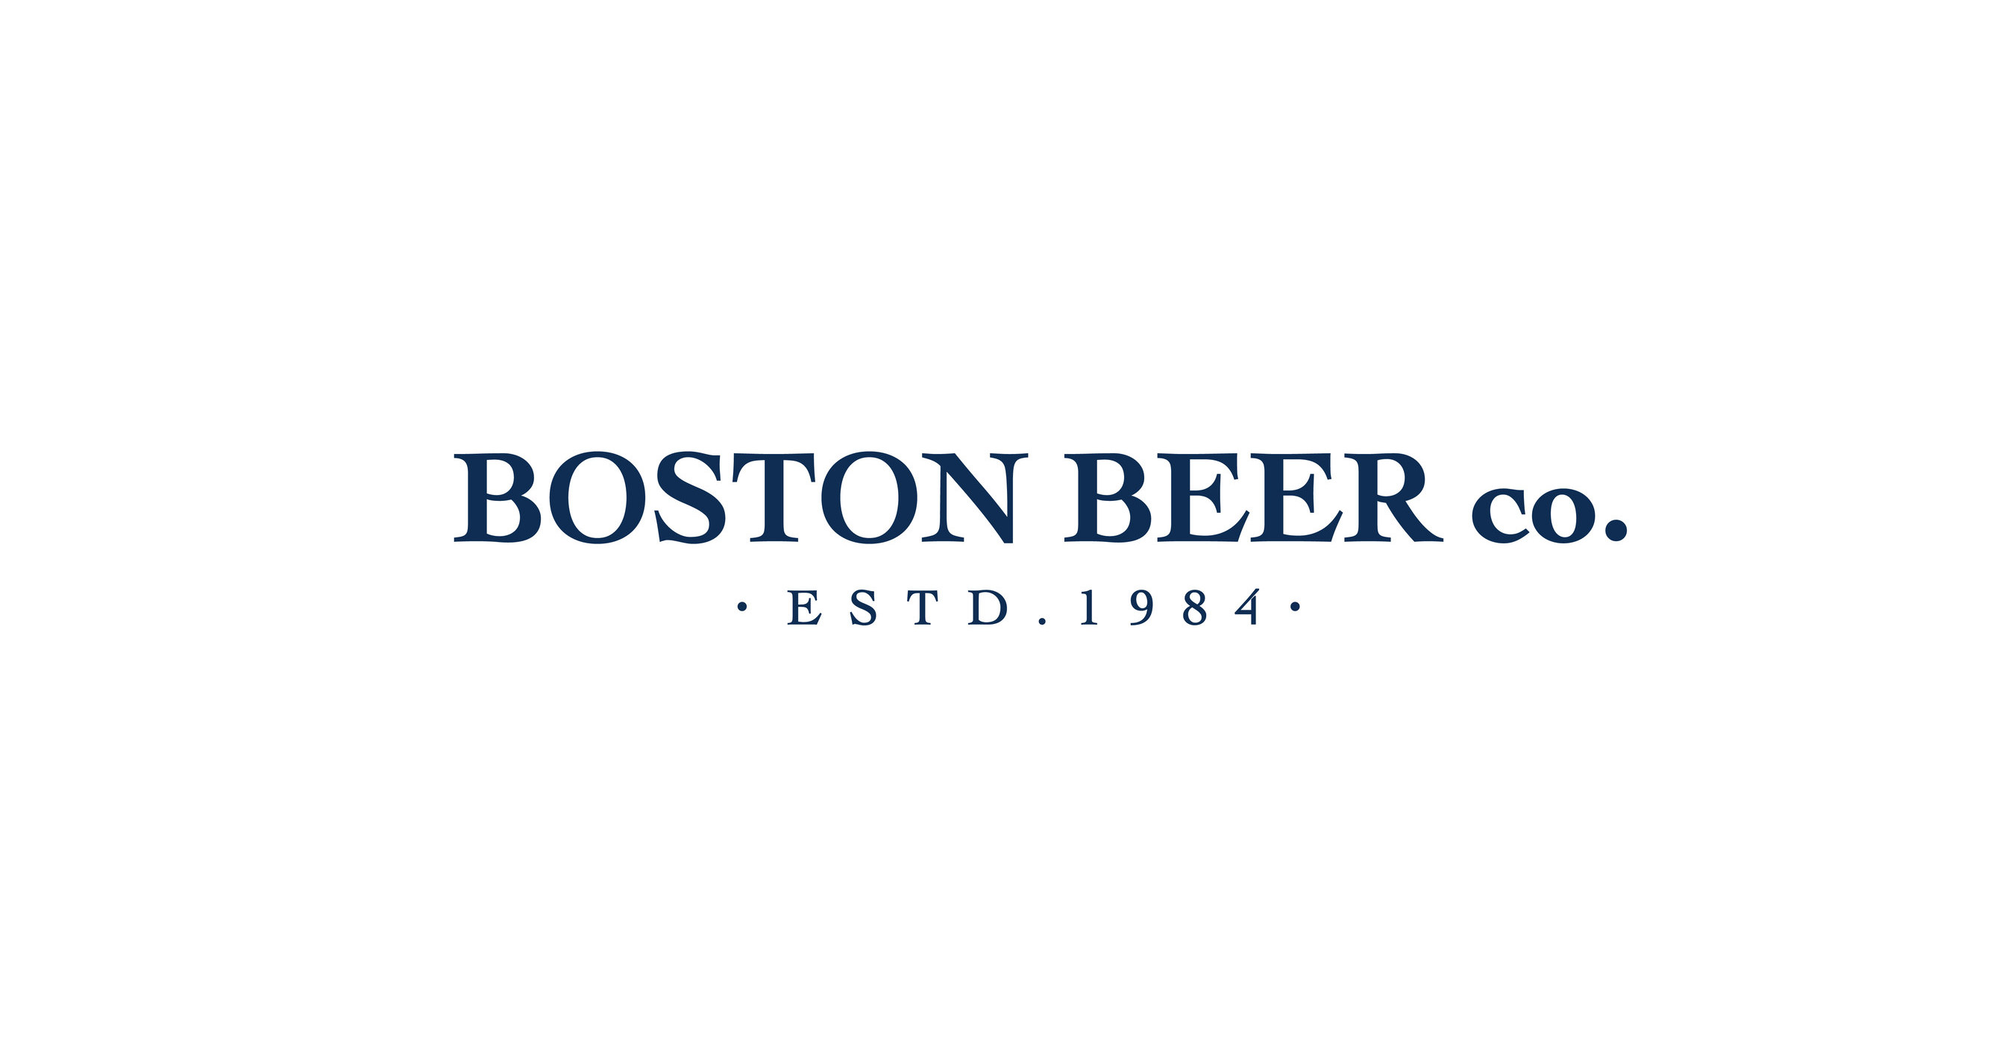
Target Company: Boston Beer
Attractive Target Company
Brand Alignment and Market Presence
Boston Beer, known for its Samuel Adams brand, aligns well with Carlsberg’s focus on quality. This acquisition would enhance Carlsberg's presence in the premium beer segment and diversify its product portfolio.
Financial Stability
Boston Beer’s strong financials, marked by steady growth and a solid cash flow, align with Carlsberg’s financial strategy and promise a stable platform for expansion.
Innovation and Product Diversification
Boston Beer’s innovative range, extending beyond craft beers, complements Carlsberg’s aim to offer a diverse product line, catering to a wider consumer base.
Strategic and Cultural Synergy
Both companies share a commitment to quality and innovation, suggesting a seamless cultural and operational integration, enhancing Carlsberg’s market strategy.
Enhanced Distribution Networks
Leveraging Boston Beer’s established distribution channels would facilitate broader market access for Carlsberg’s products across the USA
Company Overview
Boston Beer, founded in 1984, is a leading craft brewer in the USA, famous for Samuel Adams and a diverse beverage line. Offers a range including craft beers, ciders, and hard seltzers, showcasing innovation in the high-end beer market.
Financial Strength
Exhibits consistent revenue growth and strong cash flow, underlining market stability and potential for further expansion. Maintains a low debt-to-equity ratio, indicating financial resilience and capacity for growth investments.
Market Position
Strong presence in the USA craft beer segment, aligning with Carlsberg's premium market focus. Offers highly valuable insights for market penetration.

Slide 22
References
AbinBev (n.d.) Annual Report 2022. [online] Available at: <https://www.ab-inbev.com/assets/pressreleases/2023/FY%20Financial%20Report%202022.pdf> [Accessed 17 November 2023].
Azizi, J., Zarei, N., & Ali, S. (2022). The short-and long-term impacts of climate change on the irrigated barley yield in Iran: an application of dynamic ordinary least squares approach. Environmental Science and Pollution Research, 29(26), 40169-40177.
Carlsberg group (2023). Available at: <https://www.carlsberggroup.com> [Accessed 19 November 2023].
Lykken, A. (May 14, 2023. Eclectic Paradigm. A three-tiered review framework to determine if a Foreign Direct Investment (FDI) is advantageous. Wallstreetoasis. Available at: <https://www.wallstreetoasis.com/resources/skills/strategy/eclectic-paradigm> [Accessed 14 November 2023].
Mirev, N. (N.d.).
Molson Coors (2023). Molson Coors Beverage Company Reports 2022 Fourth Quarter and Full Year Results. [online] Available at: <https://ir.molsoncoors.com/news/news-details/2023/Molson-Coors-Beverage-Company-Reports-2022-Fourth-Quarter-and-Full-Year-Results/default.aspx> [Accessed 17 November 2023].
Mozny, M., Trnka, M., Vlach, V., Zalud, Z, Cejka, T., Hajkova, L., Potopova, V., Semenov, M., Semeradova, D., and Buntgen, U. . (2023). Climate-induced decline in the quality and quantity of European hops calls for immediate adaptation measures
OECD Data. (N.d.) Household spending. [online] Available at <https://data.oecd.org/hha/household-spending.htm> [Accessed 19 November 2023].
Our World in Data. (N.d.). Beer consumption per person, 1982-2019. [online] Available at:< https://ourworldindata.org/grapher/beer-consumption-per-person?tab=chart&time=1982..2019&country=ESP~USA~CHN~FIN~THA~CZE> [Accessed 18.11.2023].
Shahbandeh, M. (2023a). Distribution share of hop production volume worldwide in 2022, by leading country. [online] Available at <https://www.statista.com/statistics/757917/share-of-hop-production-worldwide-by-major-producer/>[Accessed 18 November 2023].
Shahbandeh, M. (2023b). Major barley producers worldwide in 2022/2023, by country* [online] Available at <https://www.statista.com/statistics/272760/barley-harvest-forecast/> [Accessed 17 November 2023].
Sridharan, M. (November 18, 2023). OLI – A Framework For International Expansion. Think Insights. Available at <https://thinkinsights.net/strategy/oli-framework/>[Accessed 15 November 2023].
Statista. (n.d.) Beer brand rankings in the U.S. [online] Available at: <https://www.statista.com/insights/consumer/brand-profiles/2/10/beer/united-states/#contentBox1> [Accessed 17 November 2023].
Statista. (n.d.). Alcoholic Drinks – Worldwide. [online] Available at: https://www.statista.com/outlook/cmo/alcoholic-drinks/worldwide#volume [Accessed: 18.11.2023].
U.S. Drought monitor. (n.d). https://droughtmonitor.unl.edu/Maps/CompareTwoWeeks.aspx
Walling, M. (2023). Climate change is ompacting hops and barley crops, frocig beer industry to adjust. [online] Available at: https://www.nbcphiladelphia.com/news/national-international/changing-climate/climate-change-is-impacting-hops-and-barley-crops-forcing-beer-industry-to-adjust/3693570/ [Accessed 17, November 2023]

Slide 23
Appendix

Slide 24
PESTEL: A description of the data analysis
 | Political | Economical |  | Social | Technological | Environmental | Legal
Data source | The Worldwide Governance Indicators (WGI): Political Stability and Absence of Violence/Terrorism | Country population | GDP per capita | Recorded alcohol per capita consumption: Beer consumption | The Cities of the Future Index: ePayments | The ND-GAIN Country Index | The Worldwide Governance Indicators (WGI): Control of corruption
Description | The indicator measures perceptions of the likelihood of political instability and/or politically- motivated violence, including terrorism. | The indicator calculates the de facto definition of population, which counts all residents regardless of legal status or citizenship. | The indicator provides per capita values for gross domestic product (GDP) expressed in current international dollars. | The indicator records the amount of alcohol consumed per capita (15+ years) over a calendar year in a country, in liters of pure alcohol recording the consumption from production, import, export, and sales data. | The score measures the prevalence of digital payments consisting of e.g. the percentage of the population that paid bills or bought something online in the past year. | The index summarizes a country's vulnerability to climate change and other global challenges in combination with its readiness to improve resilience. | The indicator captures perceptions of the extent to which public power is exercised for private gain, including both petty and grand forms of corruption, as well as "capture" of the state by elites and private interests.
Data provider | World Bank | World Bank | World Bank | World Health Organization | Easypark | Notre Dame | World Bank
Weight | 5% | 18% | 10% | 40% | 3% | 20% | 4%
Data regarding all six factors was sought from credible public data banks and was weighed considering its relevance for Carslberg as well as its credibility considering e.g. the prevalence of data gaps.

Slide 25
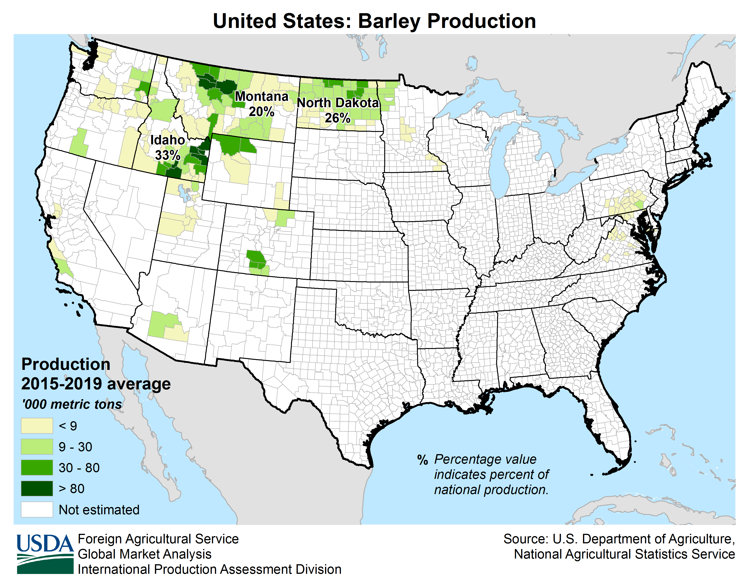
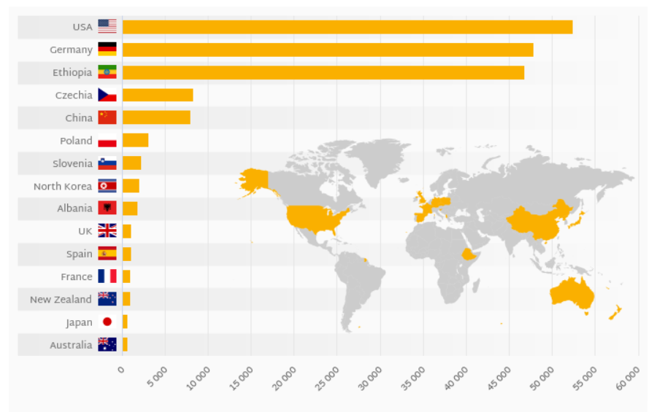
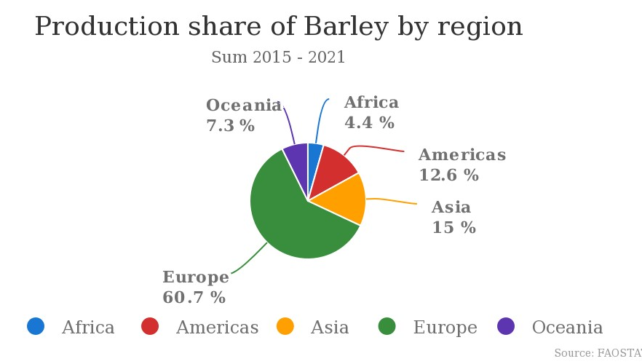
Visualisation on Barley and Hops Production in the USA and in the world
The map on the left shows how the production of Barley is distributed in the USA. It is clear that the production takes place mainly in the North and North-West. Also, USA is the third biggest region to produce barley, while they rank as number one in hops production. Hops is mainly produced in at the West coast, being very fragile to the changing climate and wildfires.
Notes:
https://www.helgilibrary.com/charts/which-country-produces-the-most-hops/
https://beermaverick.com/between-the-35th-and-55th-parallels-worlds-hop-production/
https://www.fao.org/faostat/en/#data/QCL/visualize
https://ipad.fas.usda.gov/rssiws/al/crop_production_maps/US/USA_Barley.png

Slide 26
PIILOTETTUJEN SLIDEJEN VARASTO

Slide 27
Executive summary
Purpose: evaluate Carlsberg’s internal capabilities against potential new markets
After market analysis, the USA was identified as most promising, yet it has challenges
Opportunities for growth: craft beer, premium brands
Big market, beer a part of culture
Porter’s Five Forces Analysis: highly competed industry
Overcome with brand, R & D, and internatilonal experience
Proposed market entry strategy – Acquisition
Firm and country specific advantages point to this being the optimal method
Value chain analysis:
Internalize core competencies that give advantage
Outsource support activities to locals with expertise

Slide 28
Introduction Market Identification Entry Strategies Executive Summary

Slide 29
Introduction Market Identification Entry Strategies Appendix

Slide 30
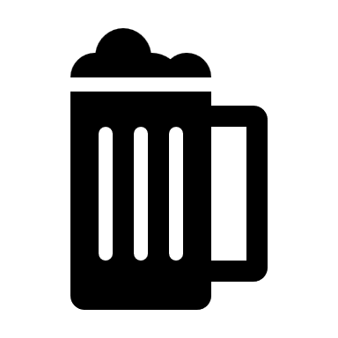
Global beer market trends
Sustainability
Health and wellness
Globalization
Economic/
Political
Special and craft beer
Stakeholders and legislation call for sustainability actions on all sectors. Sustainability can guide many people's decisions.
Many people are looking for healthier options instead of beer. ´The popularity of non-alcoholic drinks is on the increase.
World is becoming smaller through globalization. Going to foreign countries and making diverse products that fit the local preferences alongside to the mass global ones.
Global economy shifts can have a change in customer spending habits, leading to a possible need to re-evaluate marketing and pricing.
Political instabilities hit the alcohol industry heavily and new regulations.
There is an increasing interest and demand towards local special and craft beers around the world. People are willing to pay more for these products.

Slide 31
Further elaboration on beer industry trends
Nää appendix pitää salee numeroida jotenki sit ku redi
Health and wellness
- One reason behind the decrease in drinking can be thought to be because of a wellness boom. Many look for healthier options when thirsty. Therefore, Charlsberg could also want to take part in this by providing more non alcholoic options that they have alreday tested.
Sustainability
- Constant increase in the talks and should be though throughout charlsbergs actions. Legislation and user are calling for it on all areas of production and transport.
Special & craft beer
- Increasing momentum globally for these more unique and locally produced beers. Therefore, partnerships or aquisitions on craft breweries might not be a bad option. Drinking has been decreasing but more interets in specials and people are willing to pay for it more.
Globalization
- Diverse tastes and interest towards other cultures, for example westernising. Local tastes in international markets, different cultural preferences.
Political
Always a risky business with alchohol as the legislation can change and the firms have nothing to do except follow the new regulations weather it is on marketing, ingrediants, production or taxes. In the USA there seems not to have been any signiificant changes in legisltaion or policy, however as the political power can be at times unpredictaeble you dont know exactly what is to come
USA’s national minimum drinking age act already passed in 1984 and 21 years old was decided on the minimum drinking age.
Economy
Global economy shifts can influence consumer spending habits, adjusting marketing and pricing.

Slide 32
Beer consumption around the world
Average alcohol consumption volume per capita
Despite knowing that alcohol consumption has decreased the diagram shows us that beer still hold a strong market, despite having taken a small hit in 2022 and 2023.
In the prediction for the next years there can even be seen a slight increase in demand for beer.
The other competitors are still far behind on the prediction - therefore, beer can be seen as a good investment.
Beer consumption per person, 1980-2019
Beer consumption has been decreasing in most western markets including Czechia, the leading market in terms of beer consumption per person.
Alongside Czechia, Spain and the USA are leading the charts (in top 20), while for total beer consumption, China and the USA rank the highest.
The diagram indicates an increase in Asian countries, however that too has slowed down significantly in the past years.
https://ourworldindata.org/grapher/beer-consumption-per-person?tab=chart&time=1982..2019&country=ESP~USA~CHN~FIN~THA
https://www.statista.com/outlook/cmo/alcoholic-drinks/worldwide#volume
Notes:
https://www.statista.com/outlook/cmo/alcoholic-drinks/worldwide#volume
https://ourworldindata.org/grapher/beer-consumption-per-person?tab=chart&time=1982..2019&country=ESP~USA~CHN~FIN~THA
https://wisevoter.com/country-rankings/beer-consumption-by-country/#united-states-of-America
Beer concumption has been decreasing in the USA and it is 20th biggest beer consumer per capita (72.7l). The world average is 54l. While for total beer consumption they rank 2nd in the world right after China (23,929,000,000l).

Slide 33
Beer consumption around the world
Tää ehk kivempi ku edellinen emt saatte valita
Average alcohol consumption volume per capita
Despite knowing that alcohol consumption has decreased the diagram shows us that beer still hold a strong market, despite having taken a small hit in 2022 and 2023.
In the prediction for the next years there can even be seen a slight increase in demand for beer.
The other competitors are still far behind on the prediction - therefore, beer can be seen as a good investment.
Beer consumption per person, 1980-2019
Beer consumption has been decreasing in the USA and it is 20th biggest beer consumer per capita (72.7l). While for total beer consumption they rank 2nd in the world right after China.
Same trend in decline can also be seen with Czechia the number 1 drinkers, therefore it is not alarming in the case of the USA.
The diagram indicates an increase in Asian countries, however that too has slowed down significantly in the past years.
https://ourworldindata.org/grapher/beer-consumption-per-person?tab=chart&time=1982..2019&country=ESP~USA~CHN~FIN~THA
https://www.statista.com/outlook/cmo/alcoholic-drinks/worldwide#volume
Notes:
https://www.statista.com/outlook/cmo/alcoholic-drinks/worldwide#volume
https://ourworldindata.org/grapher/beer-consumption-per-person?tab=chart&time=1982..2019&country=ESP~USA~CHN~FIN~THA
https://wisevoter.com/country-rankings/beer-consumption-by-country/#united-states-of-America
Beer concumption has been decreasing in the USA and it is 20th biggest beer consumer per capita (72.7l). The world average is 54l. While for total beer consumption they rank 2nd in the world right after China (23,929,000,000l).

Slide 34
Beer consumption around the world
Average alcohol consumtion volume per capita world wide
Despite knowing that alcohol concumtion has decreased the diagram shows us that beer still hold a strong market, despite having taken a small hit in 2022 and 2023.
In the preiction for the next years there can even be seen a slight increase in demand for beer.
The other competitors are still far behind on the predictions, therefore beer can be seen as a good investment.
https://www.statista.com/outlook/cmo/alcoholic-drinks/worldwide#volume
Beer consumtion per person, 1980-2019
Beer concumption has been decreasing in the USA and it is 20th biggest beer consumer per capita (72.7l). While for total beer consumption they rank 2nd in the world right after China (23,929,000,000l).
Same trend in decline of beer drinking can also be seen with Czechia the numebr 1 drinkers, therefore it is not alarming in the case of the USA.
The diagram indicates an increase in Asian countries, however that too has slowed down significantly in the past years.
https://ourworldindata.org/grapher/beer-consumption-per-person?tab=chart&time=1982..2019&country=ESP~USA~CHN~FIN~THA
Notes:
https://www.statista.com/outlook/cmo/alcoholic-drinks/worldwide#volume
https://ourworldindata.org/grapher/beer-consumption-per-person?tab=chart&time=1982..2019&country=ESP~USA~CHN~FIN~THA
https://wisevoter.com/country-rankings/beer-consumption-by-country/#united-states-of-America
Beer concumption has been decreasing in the USA and it is 20th biggest beer consumer per capita (72.7l). The world average is 54l. While for total beer consumption they rank 2nd in the world right after China (23,929,000,000l).

Slide 35
VRIO-T & Sustainable Competitive Advantages
Resources | Valuable | Rare | Imitability | Organized | Transferability | Conclusion
Global Brand Recognition | High: Offers strong customer loyalty and market share. | High: Few brands have such widespread recognition. | Low: Very difficult to replicate Carlsberg's long-standing brand identity. | High: Carlsberg effectively leverages its brand in marketing strategies. | High: The brand can be leveraged across markets. | Sustainable Competitive Advantage
Diverse Product Portfolio | High: Caters to a wide range of tastes and preferences. | Medium: Unique recipes and brews provide some level of rarity. | Medium: Complex to imitate but not impossible within the industry. | High: Capable of marketing and distributing diverse products. | High: Can adapt to different markets. | Competitive Strength, but not a standalone SCA
Sustainable Brewing Practices | High: Aligns with consumer values and reduces operational costs. | Low: Becoming more common as industry standards evolve. | Low: Practices can be adopted by others over time. | High: Part of Carlsberg's brand ethos and operational strategy. | High: Implementable across markets. | Necessary Practice, not an SCA
Research & Development (R&D) | High: Leads to innovative products and brewing efficiencies. | High: High investment in R&D is less common in the beer industry. | Low: Difficult to imitate due to complexity and innovation. | High: Well-structured to support R&D initiatives. | High: Applicable and advantageous across markets. | Sustainable Competitive Advantage
International Market Experience | High: Provides insights into diverse consumer behaviors. | High: Not all companies have such a broad international presence. | Low: Difficult to gain quickly, based on historical success. | High: Utilizes international experience in market strategies. | High: Insights are transferable to new markets | Sustainable Competitive Advantage
SCA 1: GLOBAL BRAND RECOGNITION
Carlsberg's global brand, with its 170-year legacy, commands significant recognition, making it a formidable asset when entering new markets like the USA This brand equity, steeped in a history of quality, is difficult for competitors to match and positions Carlsberg strongly for market expansion.
SCA 2: RESEARCH & DEVELOPMENT (R&D) CAPABILITIES
Carlsberg's R&D capabilities, spearheaded by its renowned Research Laboratory, drive innovation in brewing, yielding unique products and sustainable processes. This rare and inimitable strength offers Carlsberg a sustainable competitive edge, particularly in the USA, where the market values innovation.
SCA 3: INTERNATIONAL MARKET EXPERIENCE
Carlsberg's international experience offers insights crucial for adapting to diverse market conditions, a distinct advantage for entering the varied USA market landscape.

Slide 36
Porter’s Five Forces Analysis: Global Beer Industry
Bargaining Power of Suppliers: Medium-High
Climate change may cause distribution issues with barley and hop. Established companies can negotiate more favorable contracts.
The global beer industry poses a moderate risk. It is a very competitive field with big global companies. The big brands have it easier but external factors such as retailers, trends and climate change can pose medium treats.
Threat of New Entrants: Medium-Low
The beer industry is somewhat easy to enter, but large established brands hold a power stance.
Threat of Substitute Products: Medium
Increase in the popularity of other alcoholic beverages or other trends like non-alcoholic or healthy options.
Rivalry Among Existing Competitors: High
Many players major global companies and local breweries.
Bargaining Power of Buyers: Medium
Distributors and retailers have a moderate bargaining power as they decide what products they want to sell.

Slide 37
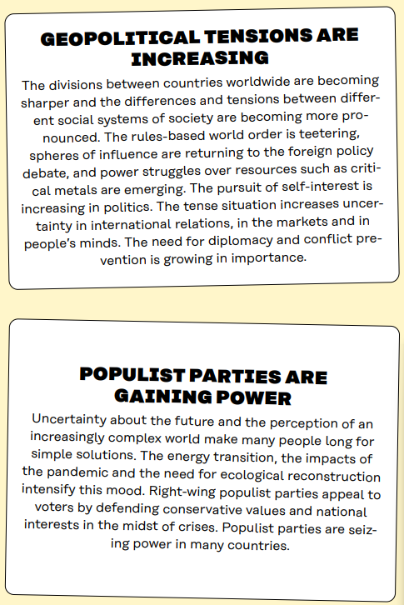
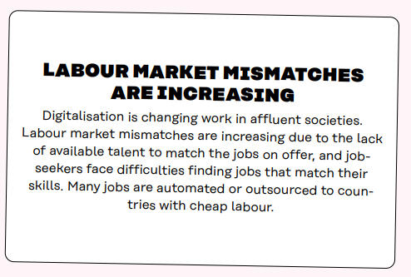
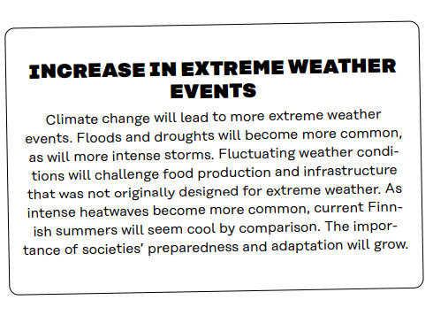
Megatrends
These megatrend can be aligned with our suggestions for Carlsberg
Notes:
’Sitran megatrendit, valkkasin nyt kaikista kategorioista jotain mitkä mun mielestä liittyy meidän aiheesee

Slide 38
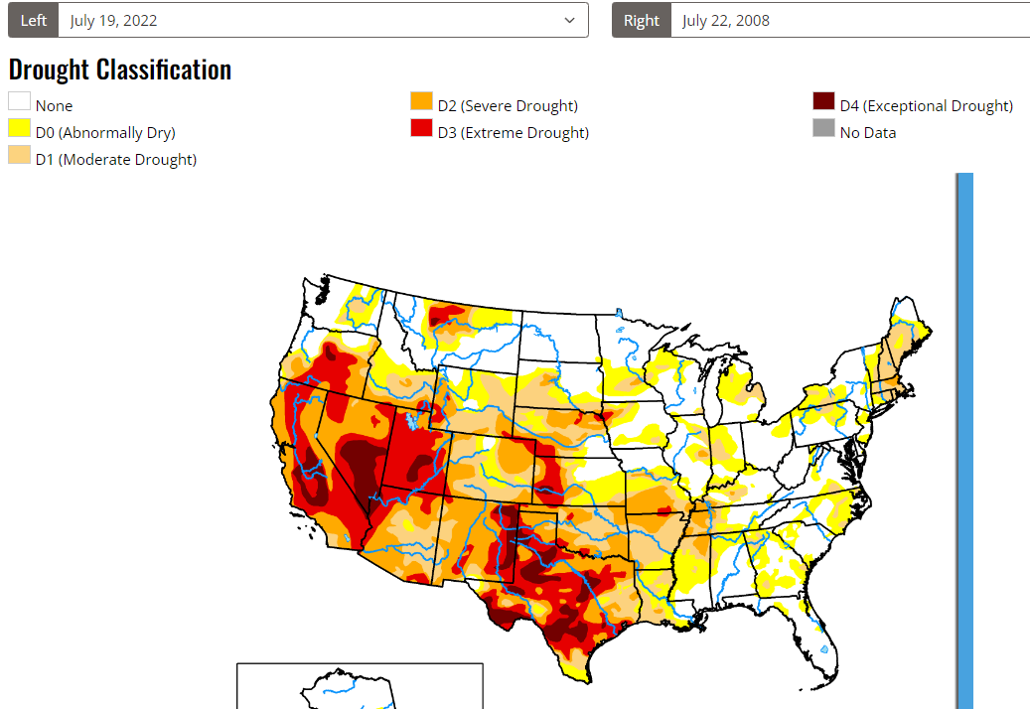
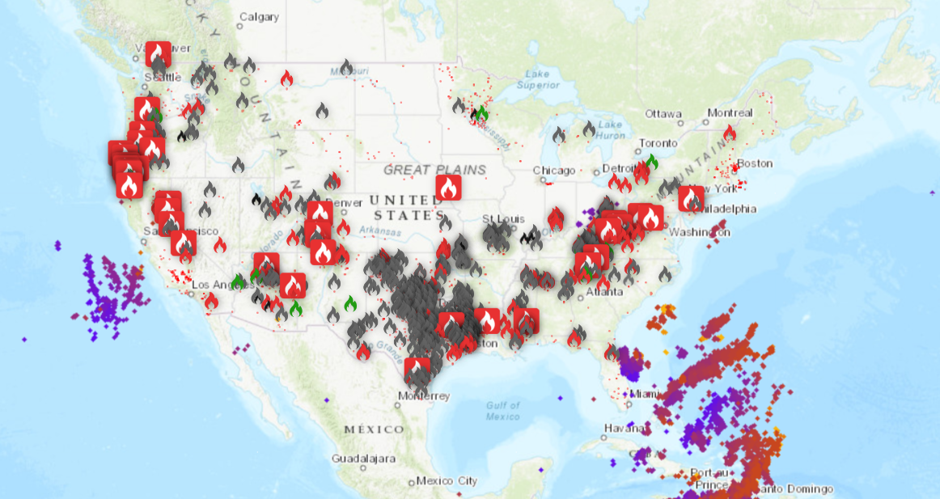
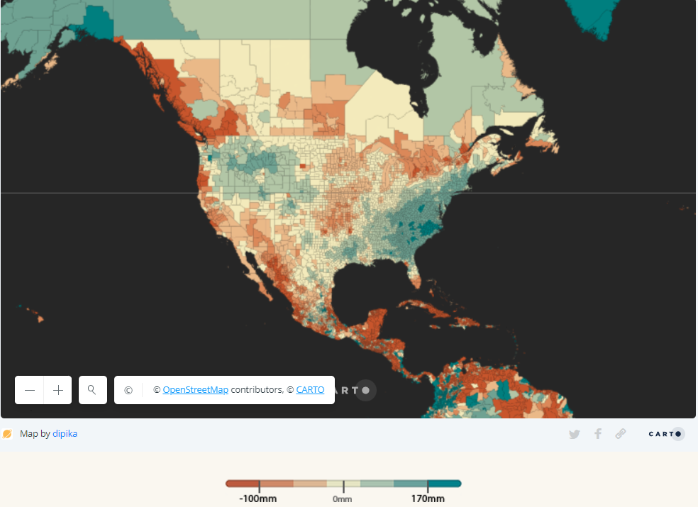
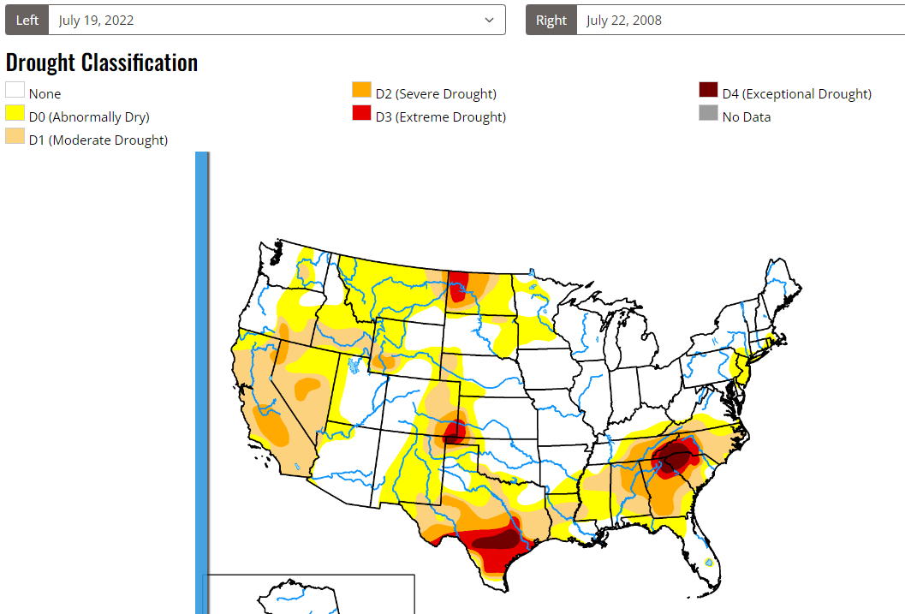
Maps showcasing drought change in the USA and wildfires
Notes:
https://www.fireweatheravalanche.org/fire/
https://therevelator.org/interactive-map-precipitation-2050/

Slide 39
Hop production – USA biggest producer
Notes:
https://beermaverick.com/between-the-35th-and-55th-parallels-worlds-hop-production/

Slide 40
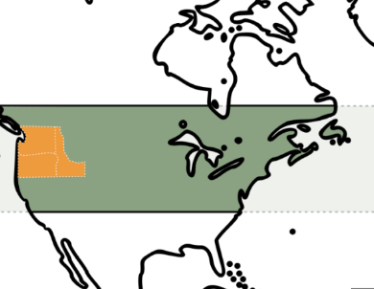
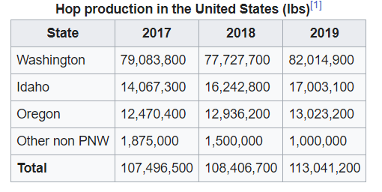
Hop production
(tonnes), 2021 or latest
- USA a significant player
- Predicted decrease of hop production upto 20% by 2050
-
Notes:
https://www.helgilibrary.com/charts/which-country-produces-the-most-hops/

Slide 41
The US market: Competitor analysis
Market share of major beer brands in the USA in 2023
Market share of major beer companies in the USA in 2023
Notes:
https://www.reuters.com/business/retail-consumer/ab-inbev-molson-coors-dent-us-craft-beer-competition-with-cheaper-six-packs-2023-06-12/

Slide 42
Key ingredients and geographical location
USA is the largest hop producer (40%). Hop production is located at the west coast in the USA.
In barley production USA is the 8th largest in the world and biggest production states are Idaho (33%), Montana (20%) and North Dakota(26%).
It is good to be geographically close to the source with good connections in order to keep enough hop for production at a decent price.
Having the needed ingredients locally allows the supply chain to be shorter and therefore more sustainable. This can also be beneficial in order to expand to new markets in the area all the way from Canada to Latin America.
Barley production
Hop production

Slide 43
Building competitive advantage on the geographical location
The USA is the largest hop producer (40%). Hop production is located on the West Coast of the USA.
In barley production, the USA ranks the 8th largest producer in the world with Idaho (33%), Montana (20%) and North Dakota (26%) being the biggest production states.
Short geographical proximity and good logistics connections would allow for lower costs and more sustainability within the supply chain.
The geographical position would also be beneficial considering expansion to new markets in the area all the way from Canada to Latin America.
Barley production
Hop production

Slide 44
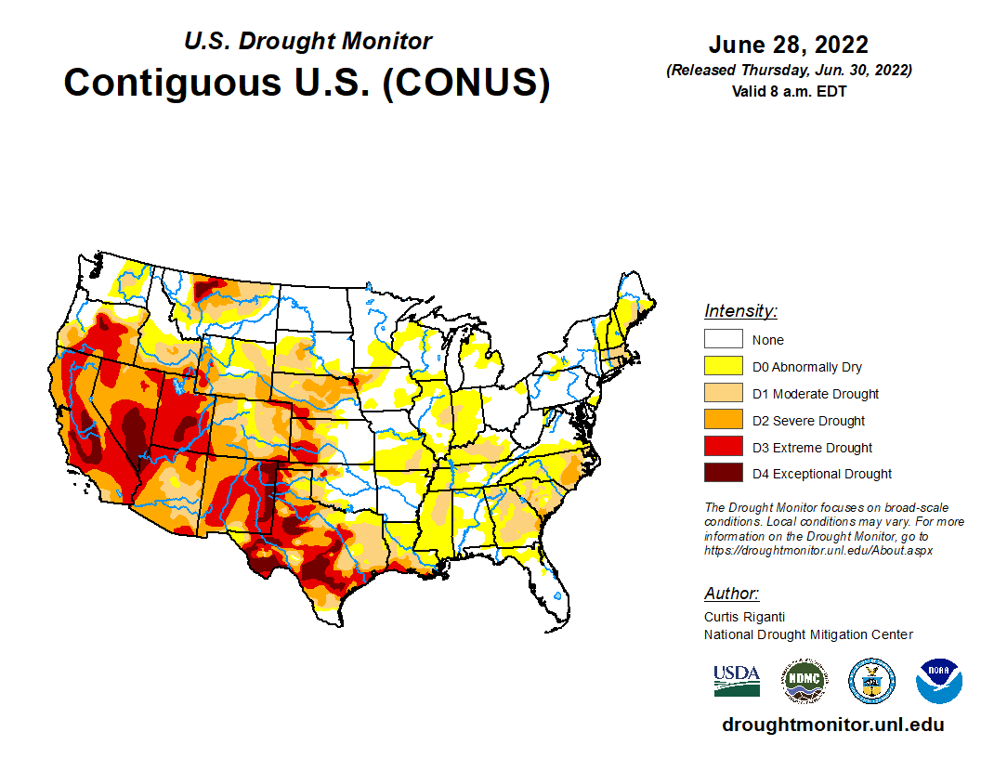
Areas most at risk due to climate change
” Climate change is anticipated to only further the challenges producers are already seeing in two key beer crops, hops and barley. Some hops and barley growers in the USA say they’ve already seen their crops impacted by extreme heat, drought and unpredictable growing seasons.”
Climate change is affecting agriculture significantly and this has a negative affect on hops and barley growth.
It is predicted that Hop production can decline up to 20% by 2050. Due to drought and wildfires that occur in the area.
Biggest treats: climate fluctuations, drought, pests and wildfires.
Here is one map from 2022 June showcasing drought and as can be seen it is a true problem, while being seasonal it still has effects on the growth.
Barley production is safer as it locates higher North where the drought doesn't reach.
→ Need to be in the area and create strong local connections to succeed
https://droughtmonitor.unl.edu/Maps/CompareTwoWeeks.aspx

Slide 45
Areas most at risk due to climate change
” Climate change is anticipated to only further the challenges producers are already seeing in two key beer crops, hops and barley. Some hops and barley growers in the USA say they’ve already seen their crops impacted by extreme heat, drought and unpredictable growing seasons.”
Climate change is affecting agriculture significantly and this has a negative affect on hops and barley growth.
It is predicted that Hop production can decline up to 20% by 2050. Due to drought and wild fires that occure in the area.
Biggest treats: climate fluctuations, drought, pests and wildfires.
Here is one map from 2022 June showcasing drought and as can be seen it is a true problem, while being seasonal it still has effects on the growth.
Barley production is safer as it locates higher North were the drought doesnt reach.
→ Need to be in the area and create strong strong local connections to succeed
https://droughtmonitor.unl.edu/Maps/CompareTwoWeeks.aspx

Slide 46
Securing supply and shorter supply chains through the US market
The USA is the largest hop producer (40%). Hop production is located on the West Coast of the USA.
In barley production, the USA ranks the 8th largest producer in the world with Idaho (33%), Montana (20%) and North Dakota (26%) being the biggest production states.
Short geographical proximity and good logistics connections would allow for lower costs and more sustainability within the supply chain.
The geographical position would also be beneficial considering expansion to new markets in the area all the way from Canada to Latin America.
Barley production Hop production
Climate change is affecting agriculture significantly having a negative effect on hops and barley growth globally. Many farmers have already experienced difficulties with extreme heat, drought and unpredictable seasons.
Particularly hop production is at risk, as its production is predicted to decline up to 20% by 2050 due to droughts and wildfires globally. If this takes place, as indicated during the past 20 years, it will increase the troubles of the beer industry in general and push the prices up.
The biggest global threats to hop production are climate fluctuations, drought, pests and wildfires. The map from June 2022 showcasing droughts shows the severity of the problem in the USA. Barley production, on the other hand, is safer as it is located higher north where the droughts don’t reach.
While the situation is alarming, the conditions are even worse in many other parts of the world. To create a competitive advantage for the future, Carlsberg should ensure secure supply in the USA and create strong local connections.
US drought monitor, June 2022
https://droughtmonitor.unl.edu/Maps/CompareTwoWeeks.aspx
Mozny, M., Trnka, M., Vlach, V., Zalud, Z, Cejka, T., Hajkova, L., Potopova, V., Semenov, M., Semeradova, D., and Buntgen, U. . (2023). Climate-induced decline in the quality and quantity of European hops calls for immediate adaptation measures
Notes:
https://www.ncbi.nlm.nih.gov/pmc/articles/PMC10564787/

Slide 47
Porter's Diamond Model Analysis: Entry into the US Beer Market
Firm Strategy, Structure, and Rivalry
High competitiveness in USA market
Need for unique selling proposition, leveraging European quality
Significant growth opportunities across diverse segments
Demand Conditions
Growing interest in premium and international beers
Large market potential for volume sales
Trend towards premium, specialty beer experiences
Factor Conditions
Skilled brewing labor force and educational resources
Established supply chain with quality ingredients and technology
Related and Supporting Industries
Complex but extensive distribution networks
Strong marketing and advertising sectors for brand building
Opportunities for local partnerships in distribution and retail
Opportunity for Carlsberg: Significant, with a need for strategic entry focusing on differentiation, supply chain utilization, and regulatory compliance.

Slide 48
Integration and Resources Grid
High Pressure to Adapt to Local Needs
Consumer Preferences: Carlsberg will need to adapt to the diverse taste preferences and beer culture in the USA, which may differ significantly from their primary markets.
Regulatory Landscape: The USA has complex alcohol distribution and regulatory frameworks varying by state, requiring localized strategies.
Market Dynamics: Different regions in the USA have varied beer consumption patterns and brand loyalties, necessitating a regionalized approach.
Moderate Pressure to Lower Costs
Economies of Scale: Carlsberg’s global presence offers the potential for economies of scale in production and distribution, though local production in the USA may be necessary to minimize costs.
Supply Chain Optimization: Leveraging global supply chains while establishing local partnerships for raw materials can reduce costs.
Premium Pricing Strategy: Given Carlsberg's focus on premium and quality products, there may be less pressure to compete on price, allowing for a focus on value rather than cost-cutting.
Strategic Implications
Multidomestic Strategy: Carlsberg should adopt a multidomestic strategy, tailoring its products and marketing to regional preferences while leveraging its global brand strength and expertise.
Local Adaptation: Emphasis on local tastes, regulatory compliance, and marketing strategies will be crucial.
Leveraging on premium products: Expanding their strategic goal for premium products in a market with high demand.
Global Synergies: Utilizing global best practices and economies of scale in areas like supply chain management, technology, and innovation.
Investment in Local Assets: Consider establishing breweries or partnerships within the USA to facilitate local adaptation while controlling costs.

Slide 49
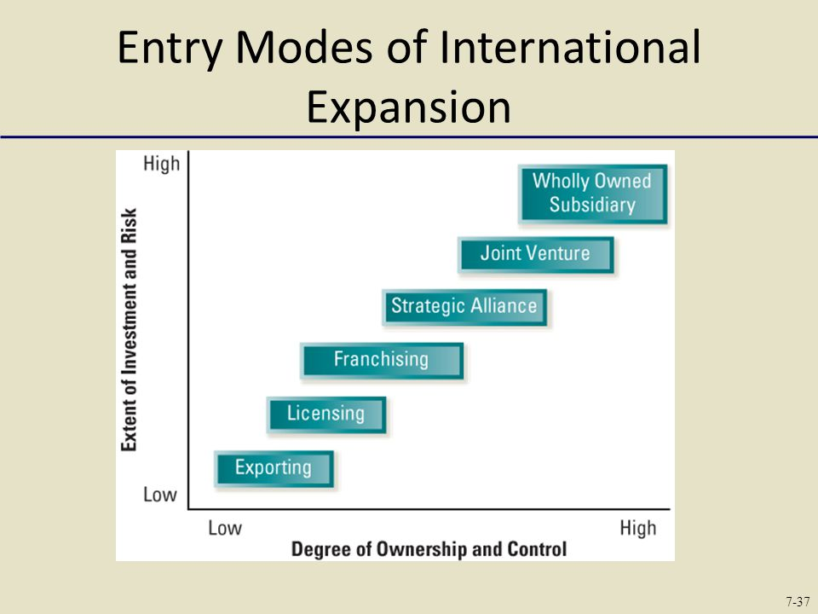
Past & current market entry strategies
Exporting
Most used
Easiest and cheapest
Test the market before starting production locally
Flexibility to scale
Reason: mostly customer demand, no other Country Specific Advantages (CSA)
Licensing
Rarely used
Less risk and costs
Comply with local regulations and trade barriers
Reasons: no clear advantage in producing in-house, corporate partners use country specific knowledge and networks to take care of local operations
Mergers & Acquisitions
Most expensive and risky
Quick market penetration
Synergies from larger scale
Gain market power
Diversification: premium brands, craft beer
Reasons: cheaper production, access raw materials, gain expertise
Notes:
Entry strategy depends on:
Country Specific Advantages (CSA)
Firm Specific Advantages (FSA)
Rapid Market Penetration: M&A can provide immediate access to established distribution networks, customer bases, and local market knowledge.

Slide 50
Mode of Entry – OLI framework
Entry to US
O
L
I
Brand
Recipes
Resources
Technology
Expertise
Economies of scale
Cost efficiency
High and diverse demand
Agriculture
Skilled labor force
Favorable regulations
(Future) Geographical proximity
Control of supply chain
Protect intellectual property
Market insights
Learn form target market
R & D

Slide 51
Value chain analysis: internalize or outsource
Suppliers
Production
Packaging
Logistics
Distribution
Internalize
Internalize
Internalize or Outsource
Outsource
Internalize or Outsource
Quality and consistency control
Less vulnerability to others' incentives
Long-term relationships with suppliers
Helps further expansion to nearby markets
Core of the business
Quality and consistency control
Learn from acquired breweries
R & D
Internalize:
Quality and consistency control
Agile responses to demand
Outsource:
Might be cheaper to outsource
Established, high quality
Focus on core competencies
Resource-intensive and complex
Core competency of the partner
Timely delivery
Efficiency
Flexibility as demand changes
Internalize:
Control over premium products’ placement and presentation
Outsource:
Gain established networks and expertise
Cost-efficiency
Focus on core competencies

Slide 52
Value chain analysis
As it is, Carlsberg enjoys economies of scale and has directed its production mostly to countries with cheap labor and resources such as in Eastern Europe and some Asian countries
It still brews in more expensive countries due to the highly skilled workers, technology, and infrastructure
If Latin America or Canada are entered, then Carlsberg might consider opening or acquiring breweries there
If USA entered, the company should utilize existing distributors to get market insights, ready connections to producers of raw materials and customers, and to better understand where and how to enter the USA Carlsberg could also do acquisitions to find synergies for efficiency, to learn about the local brewing practices, and to avoid having to enter a highly competed market with their own brand instead of helping to strengthen a local and established brand with the resources and expertise of the group
Carlsberg sources most of its barley from western Europe with France being the most important country. The region has been suffering from droughts and heat waves due to climate change and these problems are likely to escalate in the future. For this reason, and the possible cheap raw materials, the company could start sourcing it’s barley and hops from north-eastern Europe.
https://www.bloomberg.com/news/articles/2023-01-20/carlsberg-developing-beer-with-ingredients-than-can-survive-global-warming#xj4y7vzkg

Slide 53
Mode of Entry: OLI framework
Ownership advantage
"Eclectic paradigm or the OLI framework assumes that institutions will avoid transactions in the open market if the cost of completing the same actions internally, or in-house, carries a lower price."
Must have competitive advantage to overcome liability of foreignness
Advantages should be VRIO (valuable, rare, inimitable, and organizationally embedded.)
Strong brand, recipes, brewing expertise (experience, and skilled workers at global breweries), product development, economies of scale
Location advantage
Host country must offer advantages for internationalization or FDI to be worth it
Geographical, raw materials, low wages, skilled labor force, special taxes, lack of tariffs, or high demand (beer consumption is a significant part of the culture)
Usually require a partnership with a foreign investor in the target location to utilize them to their fullest potential
Cost and availability of resources
Internalization advantage
When it's better to produce in-house in a different market location rather than outsource
Control, supply chain flexibility, protect intellectual property
Control over whole value chain
Mitigate risks of leaking the recipe or brewing methods
Carlsberg exports, tested the market demand and learned consumer preferences
Gain further expertise by acquiring local (craft) breweries
Reasons for outsourcing:
Cheap, local expertise, focus on other activities​ e.g., value chain, marketing, or design
What is the company prioritizing in market entry?
Cheap / skilled labor, cheap / access to materials, energy etc.,
Think Insights (November 1, 2023) OLI – A Framework For International Expansion. Retrieved from https://thinkinsights.net/strategy/oli-framework/.
https://www.wallstreetoasis.com/resources/skills/strategy/eclectic-paradigm

Slide 54
Mode of Entry: Acquisition
REASONS FOR ACQUISITION
REQUIREMENTS FOR TARGET COMPANY
Market Position
A USA beer company with strong market presence to enhance Carlsberg's market share
Brand Portfolio
A company with a diverse, quality product range that aligns with Carlsberg’s offerings
Distribution Networks
A company with established USA distribution channels for wider market access
Financial Health
A financially sound company offering a good investment return
Cultural Fit
Target company's culture aligns with Carlsberg's for seamless integration
Regulatory Feasibility
Considering the ease of regulatory approval in the acquisition process
1.
Historical Success
Carlsberg has a history of successful acquisitions
Rapid Market Access
Instant market presence and customer base
Established Distribution Networks
Bypass the challenges of building new distribution channels
Brand Leverage
Capitalize on existing brand equity and loyalty
Regulatory Navigation
Benefit from the acquired company’s understanding of local regulations
Strategic Synergies
Combine strengths in product diversification, operational efficiency, and innovation
Intellectual Property Control Safeguards key brewing technologies and recipes
2.
3.
4.
5.
6.
7.

