Slide 1
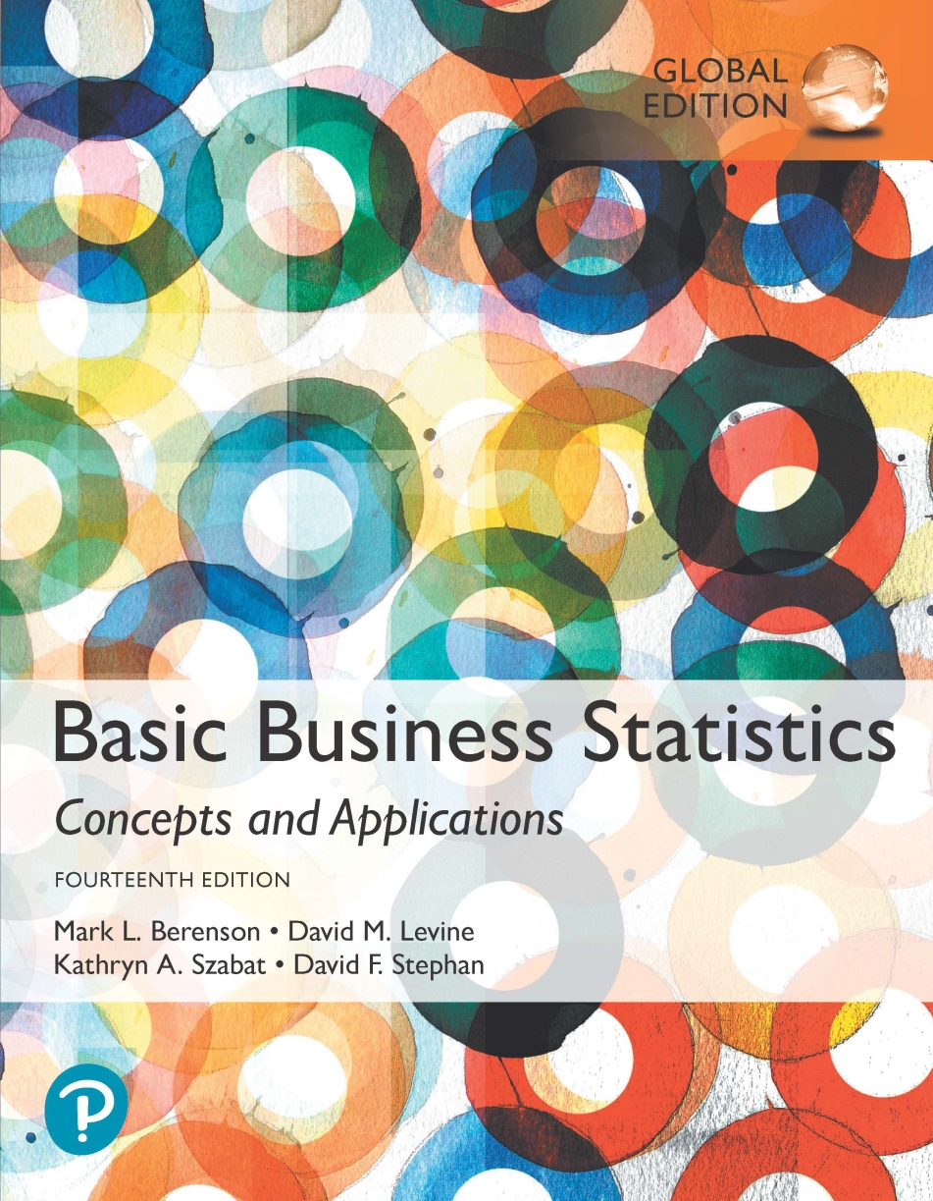
Chapter 6
The Normal Distribution and Other Continuous Distributions

Slide 2
Continuous Probability Distributions
A continuous variable is a variable that can assume any value on a continuum (can assume an uncountable number of values):
  thickness of an item.
  time required to complete a task.
  temperature of a solution.
  height, in inches.
These can potentially take on any value depending only on the ability to precisely and accurately measure.

Slide 3
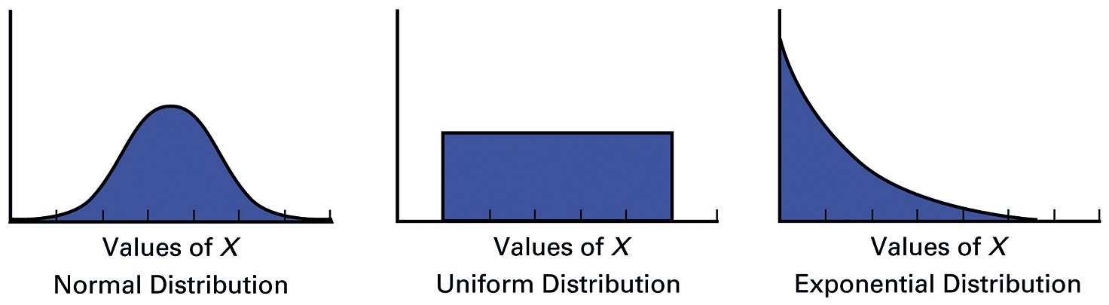
Continuous Probability Distributions Vary By Shape
Symmetrical
Bell-shaped
Ranges from
negative to
positive infinity
Symmetrical
Also known as
Rectangular
Distribution
Every value between
the smallest & largest
is equally likely
Right skewed
Mean > Median
Ranges from
zero to
positive infinity

Slide 4
The Normal Distribution
‘Bell Shaped.’
Symmetrical. .
Mean, Median and Mode are Equal.
Location is determined by the mean, μ.
Spread is determined by the standard deviation, σ.
The random variable has an infinite theoretical range:
-∞ to +∞.
f(X)
σ
X
μ
Mean
= Median
= Mode

Slide 5
The Normal Distribution Shape
f(X)
Changing μ shifts the distribution left or right.
Changing σ increases or decreases the spread.
σ
μ
X

Slide 6
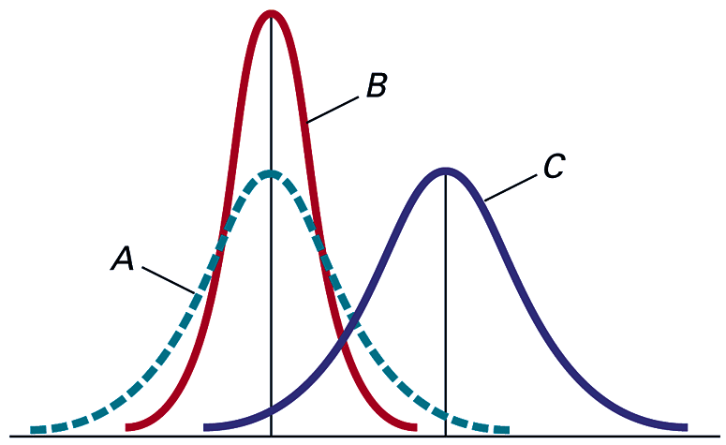
By varying the parameters μ and σ, we obtain different normal distributions
A and B have the same mean but different standard deviations.
B and C have different means and different standard deviations.

Slide 7
The Normal Distribution
Density Function
The formula for the normal probability density function is:
Where e = the mathematical constant approximated by 2.71828
π = the mathematical constant approximated by 3.14159
μ = the population mean
σ = the population standard deviation
X = any value of the continuous variable

Slide 8
The Standardized Normal
Any normal distribution (with any mean and standard deviation combination) can be transformed into the standardized normal distribution (Z).
To compute normal probabilities need to transform X units into Z units.
The standardized normal distribution (Z) has a mean of 0 and a standard deviation of 1.

Slide 9
Translation to the Standardized Normal Distribution
Translate from X to the standardized normal (the “Z” distribution) by subtracting the mean of X and dividing by its standard deviation:
The Z distribution always has mean = 0 and standard deviation = 1.

Slide 10
The Standardized
Normal Distribution
Also known as the “Z” distribution.
Mean is 0.
Standard Deviation is 1.
f(Z)
1
Z
0
Values above the mean have positive Z-values. Values below the mean have negative Z-values.

Slide 11
Any normal distribution can be “translated” into its standard-normal equivalent
Why do this???
Because we know everything about the standard normal distribution.
Each point on a particular normal distribution has an equivalent on the std normal

Slide 12
So for example: I’ve got a variable x and I want to know the odds of x>542 on the next random draw.
The var is distributed normally with mean 403 and std dev 135 (<- normal, but not std normal)
I will try to find the equivalent point (to 542) on the std normal.
And I can easily see the odds of the value being greater than that point.
Thus the odds of the value being > that the equivalent point on the std normal are the same as the odd of a random draw being>542 on the “real” distribution

Slide 13
The Standardized Normal Probability Density Function
The formula for the standardized normal probability density function is:
Where e = the mathematical constant approximated by 2.71828
π = the mathematical constant approximated by 3.14159
Z = any value of the standardized normal distribution

Slide 14
Example
If X is distributed normally with mean of 100 and standard deviation of 50, the Z value for X = 200 is:
This says that X = 200 is two standard deviations (2 increments of 50 units) above the mean of 100.

Slide 15
X=200 on the “real” distribution is equivalent to z=2 in the standard normal distribution

Slide 16
Comparing X and Z units
100
200
X
(μ = 100, σ = 50)
0
2.0
Z
(μ = 0, σ = 1)
Note that the shape of the distribution is the same, only the scale has changed. We can express the problem in the original units of X or in standardized units (Z).

Slide 17
Thus, if I know the probability of a new draw of z being higher than 2 in the std norm distribution (and I do know this), then I know the probability of a new random draw from the “real” distribution being higher than 200

Slide 18
Finding Normal Probabilities
Probability is measured by the area under the curve.
f(X)
P
(
a
≤
X
≤
b
)
=
P
(
a
<
X
<
b
)
(Note that the probability of any individual value is zero.)
a
b
X

Slide 19
Probability as
Area Under the Curve
The total area under the curve is 1.0, and the curve is symmetric, so half is above the mean, half is below.
f(X)
0.5
0.5
μ
X

Slide 20
The Standardized Normal Table
The Cumulative Standardized Normal table in the textbook (Appendix table E.2) gives the probability less than a desired value of Z (i.e., from negative infinity to Z).
0.9772
Example:
P(Z < 2.00) = 0.9772
0
2.00
Z

Slide 21
The Standardized Normal Table
(continued)
The column gives the value of Z to the second decimal point.
Z 0.00 0.01 0.02 …
0.0
0.1
The row shows the value of Z to the first decimal point.
.
.
.
The value within the table gives the probability from Z = − ∞ up to the desired Z value.
2.0
.9772
P(Z < 2.00) = 0.9772
2.0

Slide 22
General Procedure for Finding Normal Probabilities
To find P(a < X < b) when X is distributed normally:
Draw the normal curve for the problem in
terms of X.
Translate X-values to Z-values.
Use the Standardized Normal Table.

Slide 23
Finding Normal Probabilities
Let X represent the time it takes (in seconds) to download an image file from the internet.
Suppose X is normal with a mean of 18.0 seconds and a standard deviation of 5.0 seconds. Find P(X < 18.6).
X
18.0
18.6

Slide 24
Finding Normal Probabilities
(continued)
Let X represent the time it takes, in seconds to download an image file from the internet.
Suppose X is normal with a mean of 18.0 seconds and a standard deviation of 5.0 seconds. Find P(X < 18.6):
μ = 18
σ = 5
μ = 0
σ = 1
18
18.6
X
0
0.12
Z
P(X < 18.6)
P(Z < 0.12)

Slide 25
Solution: Finding P(Z < 0.12)
Standardized Normal Probability
Table (Portion)
P(X < 18.6)
= P(Z < 0.12)
Z
.00
.01
.02
0.5478
0.0
.5000
.5040
.5080
.5398
0.1
.5438
.5478
0.2
.5793
.5832
.5871
Z
0.3
.6179
.6217
.6255
0.00
0.12

Slide 26
Finding Normal
Upper Tail Probabilities
Suppose X is normal with mean 18.0 and standard deviation 5.0.
Now Find P(X > 18.6).
X
18.0
18.6

Slide 27
Finding Normal
Upper Tail Probabilities
(continued)
Now Find P(X > 18.6).
P(X > 18.6) = P(Z > 0.12) = 1.0 - P(Z ≤ 0.12)
= 1.0 - 0.5478 = 0.4522
0.5478
1.000
1.0 - 0.5478 = 0.4522
Z
Z
0
0
0.12
0.12

Slide 28
Finding a Normal Probability Between Two Values
Suppose X is normal with mean 18.0 and standard deviation 5.0. Find P(18 < X < 18.6).
Calculate Z-values:
18
18.6
X
0
0.12
Z
P(18 < X < 18.6)
= P(0 < Z < 0.12)

Slide 29
Solution: Finding P(0 < Z < 0.12)
P(18 < X < 18.6)
Standardized Normal Probability
Table (Portion)
= P(0 < Z < 0.12)
= P(Z < 0.12) – P(Z ≤ 0)
Z
.00
.01
.02
= 0.5478 - 0.5000 = 0.0478
0.0
.5000
.5040
.5080
0.0478
0.5000
0.1
.5398
.5438
.5478
0.2
.5793
.5832
.5871
0.3
.6179
.6217
.6255
Z
0.00
0.12

Slide 30
Probabilities in the Lower Tail
Suppose X is normal with mean 18.0 and standard deviation 5.0.
Now Find P(17.4 < X < 18).
X
18.0
17.4

Slide 31
Probabilities in the Lower Tail
(continued)
Now Find P(17.4 < X < 18):
P(17.4 < X < 18)
= P(-0.12 < Z < 0)
= P(Z < 0) – P(Z ≤ -0.12)
= 0.5000 - 0.4522 = 0.0478
0.0478
0.4522
The Normal distribution is symmetric, so this probability is the same as P(0 < Z < 0.12).
17.4
18.0
X
-0.12
0
Z

Slide 32
Empirical Rule
What can we say about the distribution of values around the mean? For any normal distribution:
f(X)
μ ± 1σ covers about 68.26% of X’s.
σ
σ
X
μ-1σ
μ
μ+1σ
68.26%

Slide 33
The Empirical Rule
(continued)
μ ± 2σ covers about 95.44% of X’s.
μ ± 3σ covers about 99.73% of X’s.
2σ
2σ
3σ
3σ
μ
x
μ
x
95.44%
99.73%

Slide 34
Given a Normal Probability
Find the X Value
Steps to find the X value for a known probability:
1. Find the Z value for the known probability.
2. Convert to X units using the formula:
Recall: solve for X as in:

Slide 35
Finding the X value for a Known Probability
(continued)
Example:
Let X represent the time it takes (in seconds) to download an image file from the internet.
Suppose X is normal with mean 18.0 and standard deviation 5.0.
Find X such that 20% of download times are less than X.
0.2000
?
18.0
X
?
0
Z

Slide 36
Find the Z value for
20% in the Lower Tail
1. Find the Z value for the known probability
Standardized Normal Probability
Table (Portion)
20% area in the lower tail is consistent with a Z value of -0.84.
Z
…
.03
.04
.05
-0.9
…
.1762
.1736
.1711
0.2000
-0.8
…
.2033
.2005
.1977
-0.7
…
.2327
.2296
.2266
?
18.0
X
-0.84
0
Z

Slide 37
Finding the X value
2. Convert to X units using the formula:
So 20% of the values from a distribution with mean 18.0 and standard deviation 5.0 are less than 13.80 seconds.

Slide 38
Just to be clear: questions like the ones we’ve been doing here will be on the exam.

Slide 39
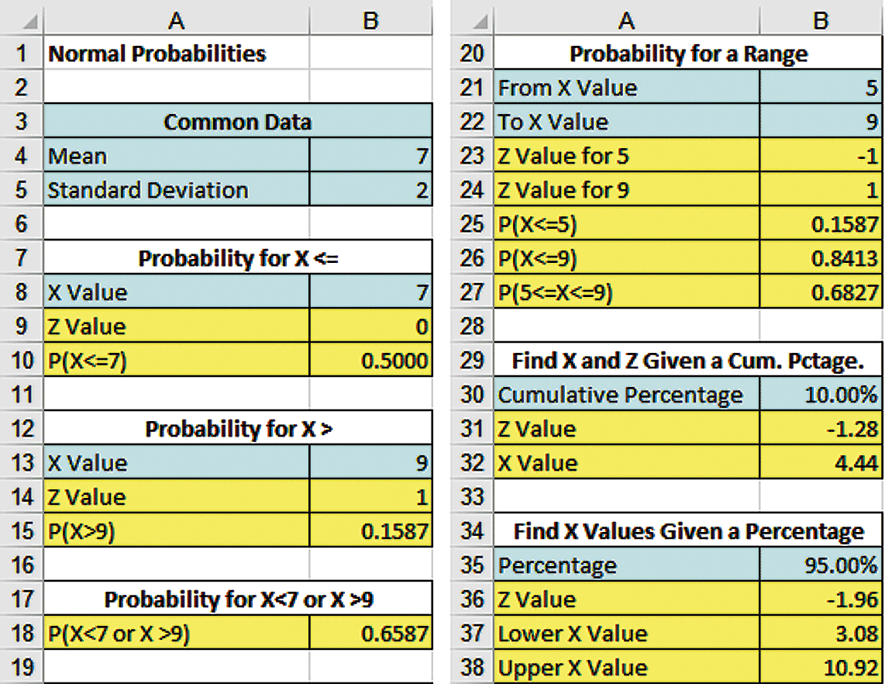
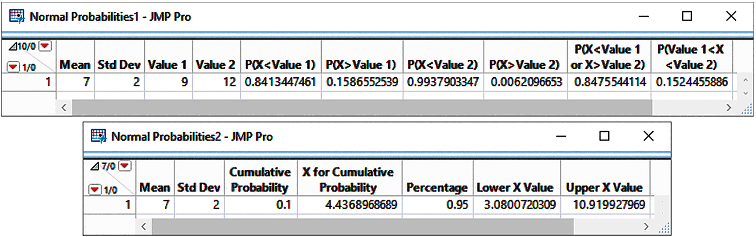
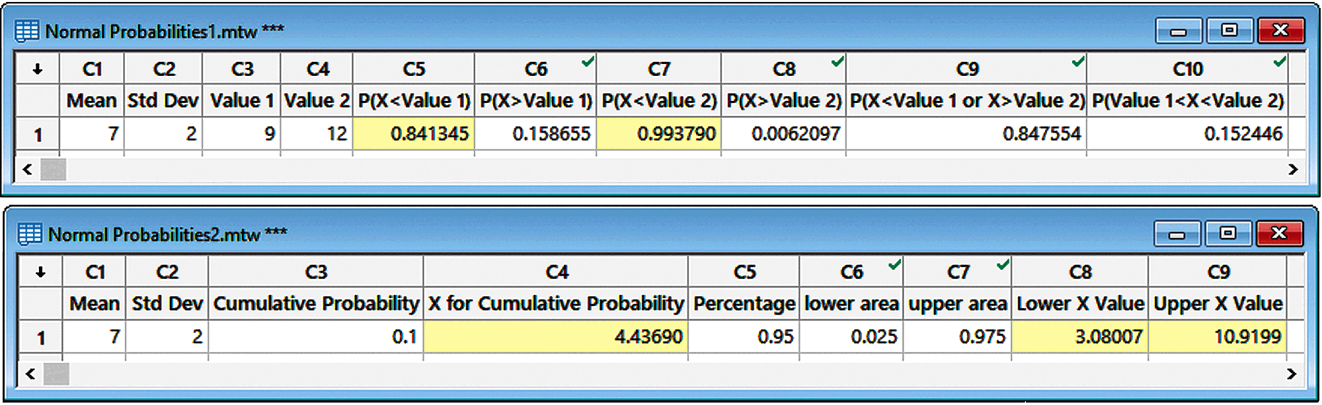
Excel (left), JMP (right), & Minitab (bottom) Templates For Computing Normal Probs.
X is normal with a mean of 7 and a standard deviation of 2 find:

Slide 40
Evaluating Normality
Not all continuous distributions are normal.
It is important to evaluate how well the data set is approximated by a normal distribution.
Normally distributed data should approximate the theoretical normal distribution:
  The normal distribution is bell shaped (symmetrical) where the mean is equal to the median.
  The empirical rule applies to the normal distribution.
  The interquartile range of a normal distribution is 1.33 standard deviations.

Slide 41
Evaluating Normality
(continued)
Comparing data characteristics to theoretical properties:
Construct charts or graphs:
  For small- or moderate-sized data sets, construct a stem-and-leaf display or a boxplot to check for symmetry.
  For large data sets, does the histogram look symmetric?
Compute descriptive summary measures
  Do the mean, median and mode have similar values?
  What is the skew? And kurtosis?
  Is the interquartile range approximately 1.33σ?
  Is the range approximately 6σ?

Slide 42
Evaluating Normality
(continued)
Comparing data characteristics to theoretical properties:
Observe the distribution of the data set:
  Do approximately 2/3 of the observations lie within mean ±1 standard deviation?
  Do approximately 95% of the observations lie within mean ±2 standard deviations?
Evaluate normal probability plot:
  Is the normal probability plot approximately linear (i.e. a straight line) with positive slope?

Slide 43
Constructing A Normal Probability Plot
(quantile-quartile plot)
Normal probability plot: basic idea
  We construct a comparison between where each value is vs. where it “should” be if the distribution was perfectly normal.
  Say you’ve got 9 observations, ordered from smallest to largest.
    The middle one, converted to the std normal distribution, “should” be equal to zero if the var is normally distributed.
  Divided the area left and right each into 10% chunks.
    The smallest observation “should” land at the first 10% chunk, the next at the 20% chunk, etc.
    The graph where they are vs. where they should be

Slide 44
Good explanation:
https://www.youtube.com/watch?v=X9_ISJ0YpGw

Slide 45
Constructing A Normal Probability Plot
(quantile-quartile plot)
Normal probability plot:
  Arrange data into ordered array.
  Find corresponding standardized normal quantile values (Z).
  Plot the pairs of points with observed data values (X) on the vertical axis and the standardized normal quantile values (Z) on the horizontal axis.
  Evaluate the plot for evidence of linearity.

Slide 46
The Normal Probability Plot
Interpretation
A normal probability plot for data from a normal distribution will be approximately linear.
X
90
60
30
-2
-1
0
1
2
Z

Slide 47
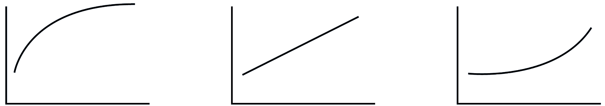
Normal Probability Plot
Interpretation
(continued)
Nonlinear plots indicate a deviation from normality.
Left-Skewed
Normal
Right-Skewed

Slide 48
“Is the assumption of normality ok for my data?”
If you really want to be cool, you can do a Normal Probability Plot.
A simpler way:

Slide 49
Are my mean/median and mode pretty close?
  If yes, that’s some evidence that the normality assumption could be ok
Do 2/3 of the obs lie +/- 1 std def of mean?
  If yes, that’s some evidence
Do most (95%) of obs lie +/- 2 std dev of mean?
  If yes, that’s some evidence
Are skewness and kurtosis coefs “close enough” to zero?
  If yes, that’s some evidence

Slide 50
In practice, of course we seldom get really well- behaved data.
It is the researcher’s decision whether to accept the assumption of normality.
Practically no data will fulfill all of the conditions on the previous slide.
Even if the population really is normal, the sample won’t perfectly fit all the above criterion because of_______

Slide 51
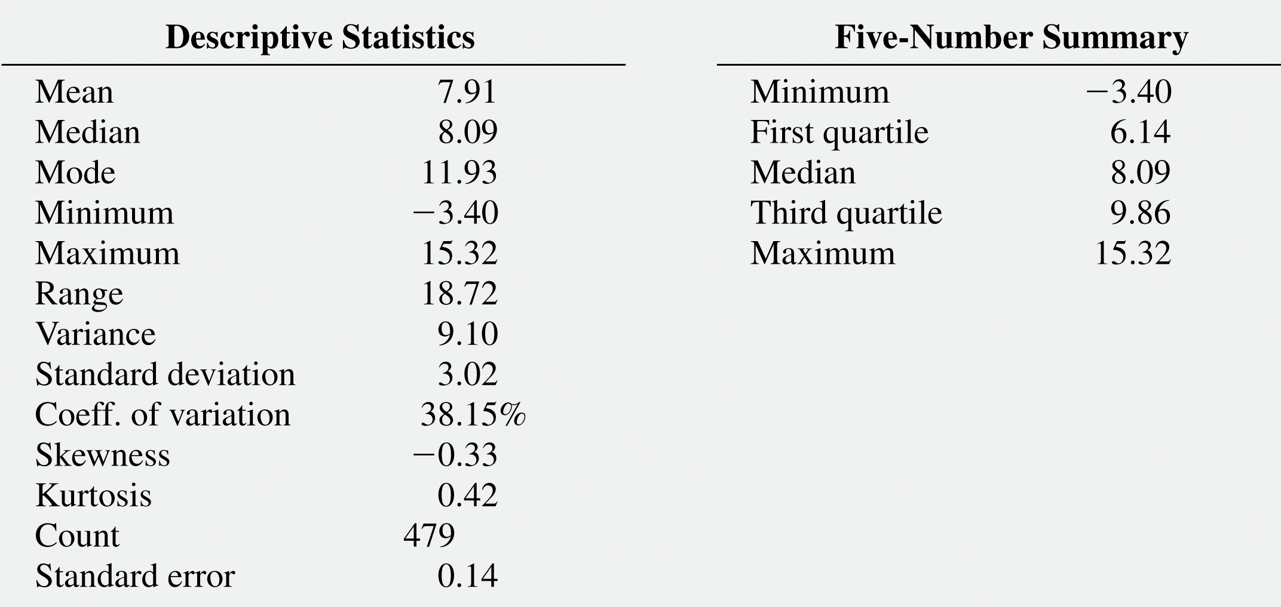
Evaluating Normality: Mutual Fund Returns
(continued)
Distribution is approximately normal, or at most, slightly left-skewed
The mean (7.91) is approximately the same as the median (8.09). (In a normal distribution the mean and median are equal.)
The interquartile range of 3.72 is approximately 1.23 standard deviations. (In a normal distribution the interquartile range is 1.33 standard deviations.)
The range of 18.72 is equal to 6.21 standard deviations. (In a normal distribution the range is 6 standard deviations.)
68.75% of the observations are within 1 standard deviation of the mean. (In a normal distribution this percentage is 68.26%.)
94.58% of the observations are within 2 standard deviations of the mean. (In a normal distribution this percentage is 95.44%.)
The skewness statistic is -0.33 and the kurtosis statistic is 0.42. (In a normal distribution, each of these statistics equals zero.)

Slide 52
The Uniform Distribution
The uniform distribution is a probability distribution that has equal probabilities for all possible outcomes of the random variable.
Also called a rectangular distribution.

Slide 53
Continuous Probability Distributions Vary By Shape
Symmetrical
Bell-shaped
Ranges from
negative to
positive infinity
Symmetrical
Also known as
Rectangular
Distribution
Every value between
the smallest & largest
is equally likely
Right skewed
Mean > Median
Ranges from
zero to
positive infinity

Slide 54
The Uniform Distribution
(continued)
The Continuous Uniform Distribution:
f(X) =
where
f(X) = value of the density function at any X value
a = minimum value of X
b = maximum value of X

Slide 55
Properties of the
Uniform Distribution
The mean of a uniform distribution is:
The standard deviation is:

Slide 56
Uniform Distribution Example
Example: Uniform probability distribution
over the range 2 ≤ X ≤ 6:
1
f(X) = = 0.25 for 2 ≤ X ≤ 6
6 - 2
f(X)
0.25
2
6
X

Slide 57
Uniform Distribution Example
(continued)
Example: Using the uniform probability distribution to find P(3 ≤ X ≤ 5):
P(3 ≤ X ≤ 5) = (Base)(Height) = (2)(0.25) = 0.5
f(X)
0.25
2
3
4
5
6
X

Slide 58
For Practice:
First, without Excel:
Pg 268: 6.10, a-c
A) Z=0.6
From table, 0.7257
B) Z1=-0.467-> c.prob= .3192
Z2=-0.67->c.prob=0.4721
Prob(65<x<71)=0.153

Slide 59
C) P(Z<?)=0.25
From table: Z=-0.67
-0.67=(X-72)/15
X=61.95

