Slide 1
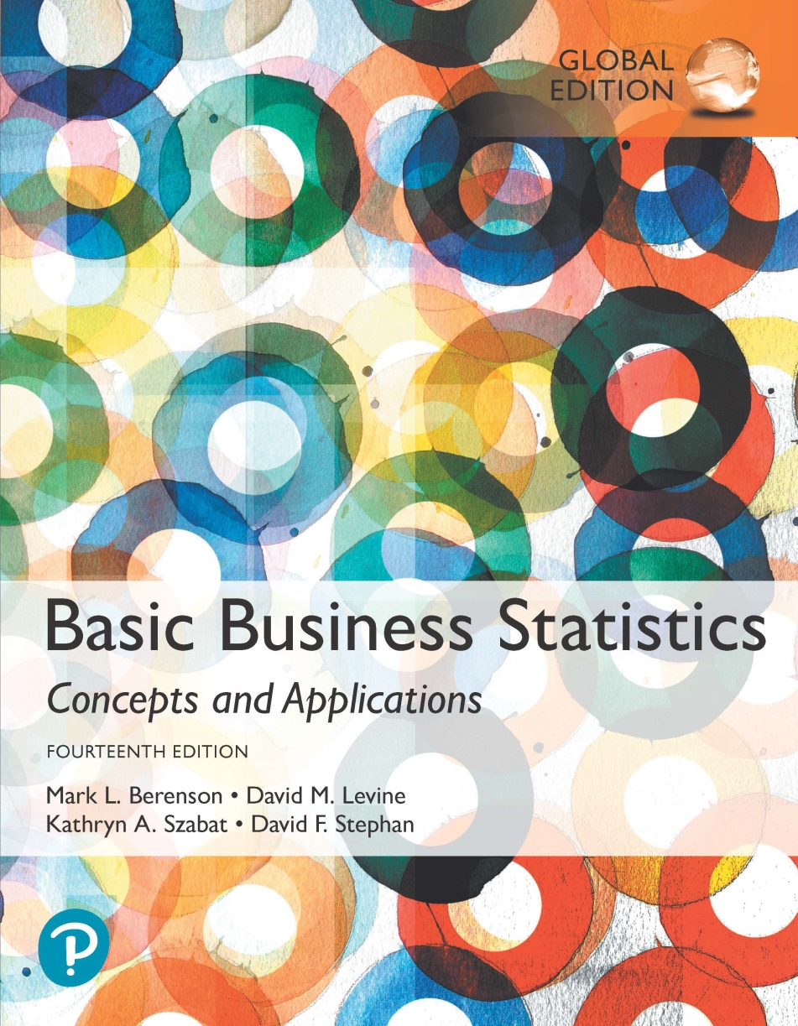
Chapter 8
Confidence Interval Estimation

Slide 2
Objectives
In this chapter, you learn:
To construct and interpret confidence interval estimates for the mean and the proportion.
To determine the sample size necessary to develop a confidence interval for the mean or proportion.

Slide 3
Chapter Outline
Content of this chapter
Confidence Intervals for the Population Mean, μ:
  when Population Standard Deviation σ is Known.
  when Population Standard Deviation σ is Unknown.
Confidence Intervals for the Population Proportion, π.
Determining the Required Sample Size.

Slide 4
Point and Interval Estimates
DCOVA
A point estimate is a single number.
A confidence interval provides additional information about the variability of the estimate.
Lower
Confidence
Limit
Upper
Confidence
Limit
Point Estimate
Width of
confidence interval

Slide 5
Point Estimates
DCOVA
We can estimate a
Population Parameter …
with a Sample
Statistic
(a Point Estimate)
Mean
μ
X
Proportion
π
p

Slide 6
Confidence Intervals
DCOVA
How much uncertainty is associated with a point estimate of a population parameter?
An interval estimate provides more information about a population characteristic than does a point estimate.
Such interval estimates are called confidence intervals.

Slide 7
Confidence Interval Estimate
DCOVA
An interval gives a range of values:
  Takes into consideration variation in sample statistics from sample to sample.
  Based on observations from 1 sample.
  Gives information about closeness to unknown population parameters.
  Stated in terms of level of confidence:
    e.g. 95% confident, 99% confident.
    Can never be 100% confident.

Slide 8
Confidence Interval Example
DCOVA
Cereal fill example
Population has µ = 368 and σ = 15.
If you take a sample of size n = 25 you know:
  368 ± 1.96 * 15 / 25 = (362.12, 373.88) contains 95% of the sample means of sample size 25.
  95% of the intervals formed in this manner will contain µ.
  When you don’t know µ, you use X to estimate µ.
    If X = 362.3 the interval is 362.3 ± 1.96 * 15 / 25 = (356.42, 368.18).
    Since 356.42 ≤ 368 ≤ 368.18 the interval based on this sample makes a correctly included µ.
But what about the intervals from other possible samples of size 25?

Slide 9
Point and Interval Estimates
DCOVA
A point estimate is a single number.
A confidence interval provides additional information about the variability of the estimate.
Pop mean, µ =368
Upper
Confidence
Limit
Lower
Confidence
Limit
Sample Xbar, 362
Width of
confidence interval

Slide 10
Confidence Interval Example
(continued)
DCOVA
Sample # | X | Lower Limit | Upper Limit | Contain µ?
1 | 362.30 | 356.42 | 368.18 | Yes
2 | 369.50 | 363.62 | 375.38 | Yes
3 | 360.00 | 354.12 | 365.88 | No
4 | 362.12 | 356.24 | 368.00 | Yes
5 | 373.88 | 368.00 | 379.76 | Yes

Slide 11
Confidence Interval Example
(continued)
DCOVA
In practice you only take one sample of size n.
In practice you do not know µ so you do not know if the interval actually contains µ.
However you do know that 95% of the intervals formed in this manner will contain µ.
Thus, based on the one sample you actually selected, you can be 95% confident your interval will contain µ (this is a 95% confidence interval).
Note: 95% confidence is based on the fact that we used Z = 1.96.

Slide 12
Estimation Process
DCOVA
Random Sample
We can be 95% confident that μ is between the interval we create
Population
Mean
X = 50
(mean, μ, is unknown)
Sample

Slide 13
General Formula
DCOVA
The general formula for all confidence intervals is:
Point Estimate ± (Critical Value)(Standard Error)
Where:
    Point Estimate is the sample statistic estimating the population parameter of interest.
    Critical Value is a table value based on the sampling distribution of the point estimate and the desired confidence level.
    Standard Error is the standard deviation of the point estimate.

Slide 14
Confidence Level
DCOVA
Confidence that the interval will contain the unknown population parameter.
A percentage (less than 100%).

Slide 15
Confidence Level, (1-α)
(continued)
DCOVA
Suppose confidence level = 95%.
Also written (1 - α) = 0.95, (so α = 0.05).
A relative frequency interpretation:
  95% of all the confidence intervals that can be constructed will contain the unknown true parameter.
A specific interval either will contain or will not contain the true parameter:
  No probability involved in a specific interval.

Slide 16
Confidence Intervals
DCOVA
Confidence
Intervals
Population
Mean
Population
Proportion
σ Known
σ Unknown

Slide 17
Confidence Interval for μ
(σ Known)
DCOVA
Assumptions:
  Population standard deviation σ is known.
  Population is normally distributed.
    Or If population is not normal, n > 30)
Confidence interval estimate:
where is the point estimate
Z_{α/2} is the normal distribution critical value for a probability of α/2 in each tail
is the standard error

Slide 18
Finding the Critical Value, Z_{α/2}
DCOVA
Consider a 95% confidence interval:
Z units:
Z_{α/2} = -1.96
0
Z_{α/2} = 1.96
X units:
Lower
Confidence
Limit
Upper
Confidence
Limit
Point Estimate
Point Estimate

Slide 19
Common Levels of Confidence
DCOVA
Commonly used confidence levels are 90%, 95%, and 99%.
Confidence Coefficient,
Confidence Level
Z_{α/2} value
80%
90%
95%
98%
99%
99.8%
99.9%
0.80
0.90
0.95
0.98
0.99
0.998
0.999
1.28
1.645
1.96
2.33
2.58
3.08
3.27

Slide 20
Intervals and Level of Confidence
DCOVA
Sampling Distribution of the Mean
x
Intervals extend from
to
x₁
x₂
(1-α)100%
of intervals constructed contain μ;
(α)100% do not.
Confidence Intervals

Slide 21
Example
DCOVA
A sample of 11 circuits from a large normal population has a mean resistance of 2.20 ohms. We know from past testing that the population standard deviation is 0.35 ohms.
Determine a 95% confidence interval for the true mean resistance of the population.

Slide 22
Example
DCOVA
(continued)
A sample of 11 circuits from a large normal population has a mean resistance of 2.20 ohms. We know from past testing that the population standard deviation is 0.35 ohms.
Solution:

Slide 23
Interpretation
DCOVA
We are 95% confident that the true mean resistance is between 1.9932 and 2.4068 ohms.
Although the true mean may or may not be in this interval, 95% of intervals formed in this manner will contain the true mean.
Do 8.9a, p.313

Slide 24
Confidence Intervals
DCOVA
Confidence
Intervals
Population
Mean
Population
Proportion
σ Known
σ Unknown

Slide 25
Do You Ever Really Know σ?
Probably not!
In virtually all real world business situations, σ is not known.
If there is a situation where σ is known then µ is also known (since to calculate σ you need to know µ.)
If you truly know µ there would be no need to gather a sample to estimate it.

Slide 26
Confidence Interval for μ
(σ Unknown)
DCOVA
If the population standard deviation σ is unknown, we can substitute the sample standard deviation, S.
This introduces extra uncertainty, since S is variable from sample to sample.
So we use the t distribution instead of the normal distribution.

Slide 27
Confidence Interval for μ
(σ Unknown)
(continued)
DCOVA
Assumptions:
  Population standard deviation is unknown.
  Either the pop is normally distributed or
  If population is not normal, use large sample (n > 30).
Use Student’s t Distribution.
Confidence Interval Estimate:
(where t_{α/2} is the critical value of the t distribution with n -1 degrees of freedom and an area of α/2 in each tail.)

Slide 28
Student’s t Distribution
DCOVA
The t is a family of distributions.
The t_{α/2} value depends on degrees of freedom (d.f.).
  Number of observations that are free to vary after sample mean has been calculated.
d.f. = n - 1

Slide 29
Degrees of Freedom (df)
DCOVA
  Idea: Number of observations that are free to vary
  after sample mean has been calculated.
  Example: Suppose the mean of 3 numbers is 8.0.
    Let X₁ = 7
    Let X₂ = 8
    What is X₃?
If the mean of these three values is 8.0,
then X₃ must be 9
(i.e., X₃ is not free to vary)
Here, n = 3, so degrees of freedom = n – 1 = 3 – 1 = 2.
(2 values can be any numbers, but the third is not free to vary for a given mean.)

Slide 30
Remember:
If you know sigma, use the Z stuff (Z-stat, Z-table)
If you don’t know sigma and have to resort to using s, use the t stuff (t-table, t-stat)

Slide 31
Student’s t Distribution
DCOVA
Note: t Z as n increases
Standard Normal
(t with df = ∞)
t (df = 13)
t-distributions are bell-shaped and symmetric, but have ‘fatter’ tails than the normal
t (df = 5)
t
0

Slide 32
t-values can be found in the table in Appendix E.3.
We read it a little differently than with the Z-table
Need to know your degrees of freedom and your alpha.

Slide 33
Student’s t Table
DCOVA
Upper Tail Area
Let: n = 3
df = n - 1 = 2
α = 0.10
α/2 = 0.05
df
.10
.05
.025
1
3.078
6.314
12.706
2
1.886
2.920
4.303
3
1.638
2.353
3.182
α/2 = 0.05
The body of the table contains t values, not probabilities
0
2.920
t

Slide 34
Selected t distribution values
DCOVA
With comparison to the Z value
Confidence t t t Z
Level (10 d.f.) (20 d.f.) (30 d.f.) (∞ d.f.)
0.80 1.372 1.325 1.310 1.28
0.90 1.812 1.725 1.697 1.645
0.95 2.228 2.086 2.042 1.96
0.99 3.169 2.845 2.750 2.58
Note: t Z as n increases

Slide 35
Example of t distribution confidence interval
DCOVA
A random sample of n = 25 has X = 50 and
S = 8. Form a 95% confidence interval for μ.
  d.f. = n – 1 = 24, so
  The confidence interval is
46.698 ≤ μ ≤ 53.302
Do 8.13, p319

Slide 36
Example of t distribution confidence interval
(continued)
DCOVA
Since n<30, interpreting this interval requires the assumption that the population you are sampling from is approximately a normal distribution.
This condition can be checked by creating a:
  Normal probability plot
  Boxplot.
  Going through the list of questions from Session 5

Slide 37
Practice
1) You take a random sample of 10 fish in the hatchery pond and determine that the average length is 7.5 inches, with sample std dev 2.3 inches. Construct 95% conf.interval.
2) Suppose you do a study of acupuncture to determine how effective it is in relieving pain. You measure sensory rates for 15 subjects. Construct a 95% confidence interval for the mean sensory rate for the population (assumed normal) from which you took the data. Samp mean is 8.23 and samp std dev is 1.67.

Slide 38
1) df=9
Critical t-val: 2.26
7.5+/- 2.26(2.3/sqrt10)
7.5+/- 1.644
5.86 to 9.15
2) df=14
Critical t-val: 2.145
8.23+/- 2.145(1.67/sqrt)=> 8.23+/-0.924
7.3 to 9.15

Slide 39
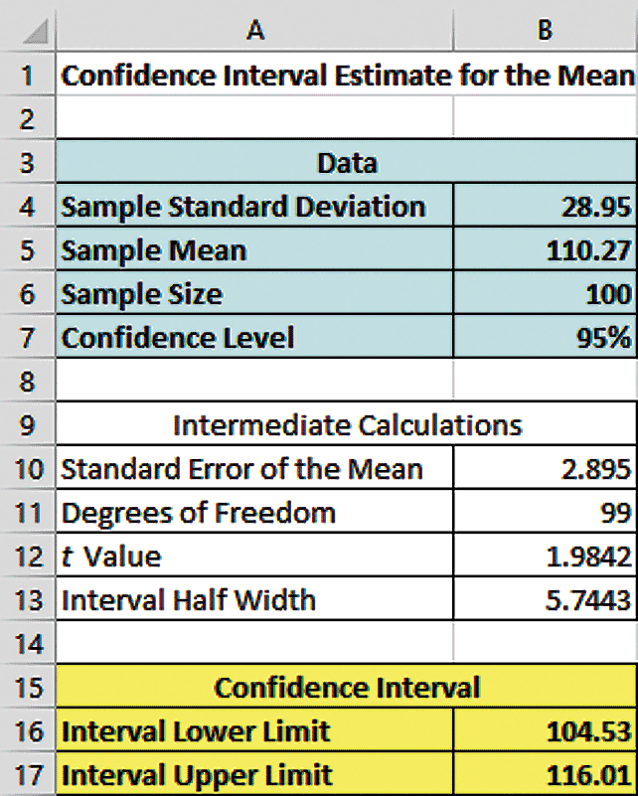
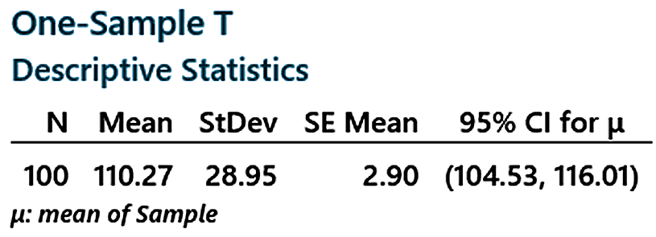
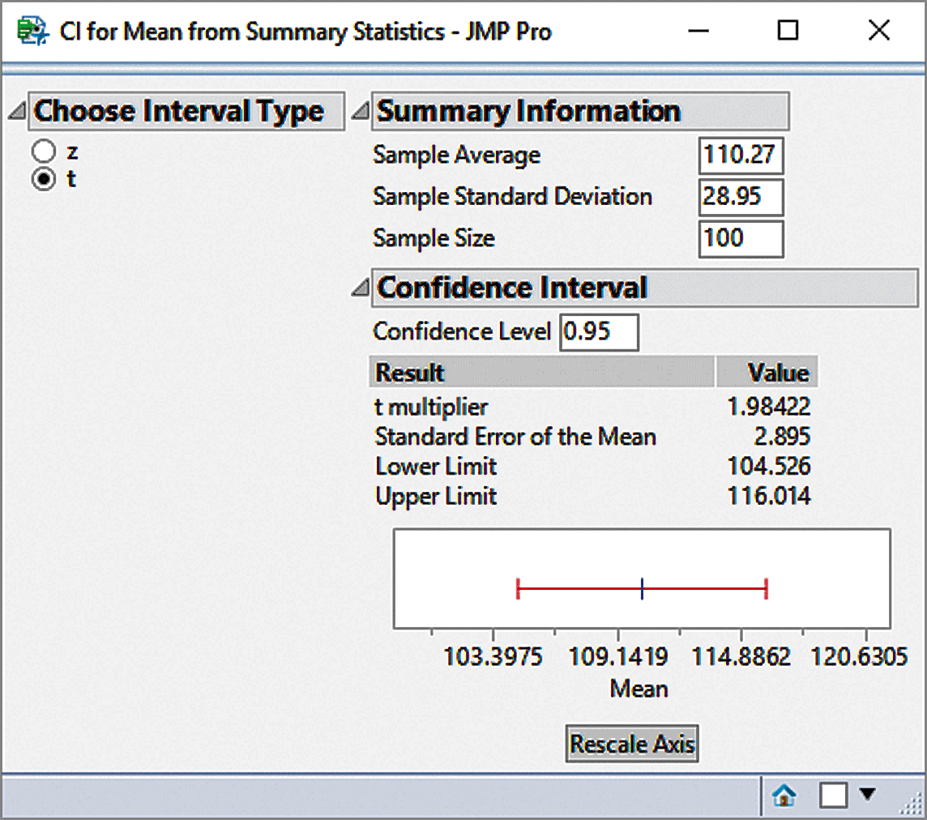
Example of Excel, Minitab, & JMP Confidence Interval Output
DCOVA

Slide 40
Confidence Intervals
DCOVA
Confidence
Intervals
Population
Mean
Population
Proportion
σ Known
σ Unknown

Slide 41
Confidence Intervals for the
Population Proportion, π
DCOVA
An interval estimate for the population proportion ( π ) can be calculated by adding an allowance for uncertainty to the sample proportion (p).

Slide 42
Confidence Intervals for the
Population Proportion, π
(continued)
DCOVA
Recall that the distribution of the sample proportion is approximately normal if the sample size is large, with standard deviation:
We will estimate this with sample data:

Slide 43
Confidence Interval Endpoints
DCOVA
Upper and lower confidence limits for the population proportion are calculated with the formula:
where
  Z_{α/2} is the standard normal value for the level of confidence desired
  p is the sample proportion
  n is the sample size.
Note: must have np > 5 and n(1-p) > 5.

Slide 44
Example
DCOVA
A random sample of 100 people shows that 25 are left-handed.
Form a 95% confidence interval for the true proportion of left-handers.

Slide 45
Example
DCOVA
(continued)
A random sample of 100 people shows that 25 are left-handed. Form a 95% confidence interval for the true proportion of left-handers.

Slide 46
Interpretation
DCOVA
We are 95% confident that the true percentage of left-handers in the population is between
16.51% and 33.49%.
Although the interval from 0.1651 to 0.3349 may or may not contain the true proportion, 95% of intervals formed from samples of size 100 in this manner will contain the true proportion.

Slide 47
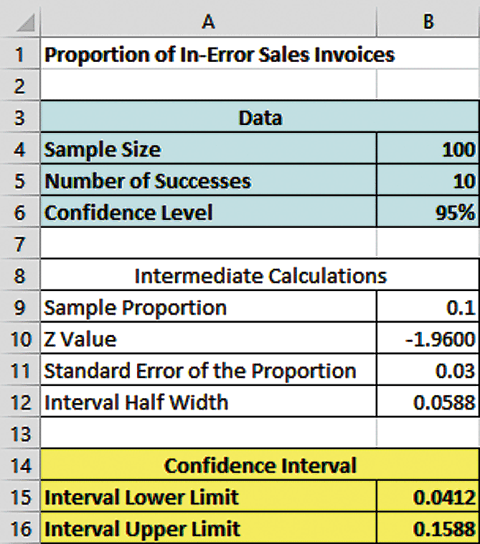
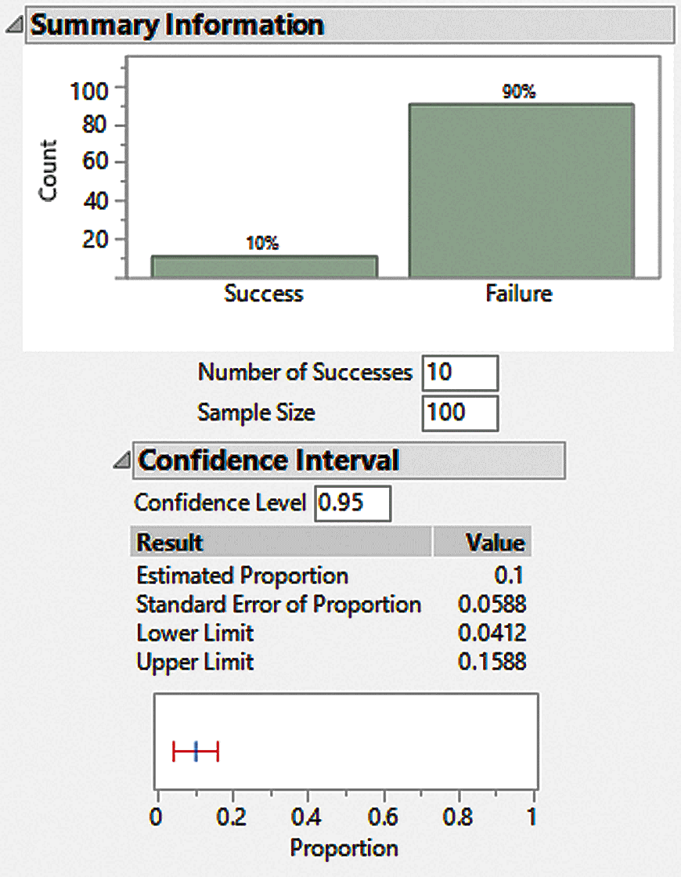
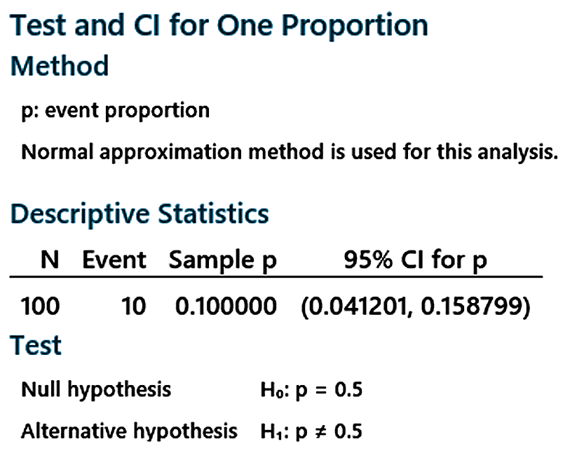
Example of Excel, JMP, & Minitab Confidence Interval for π
DCOVA

Slide 48
Thus far we’ve been given some stats and a sample and been asked to construct a confidence interval (which has been fun and easy…right?)
What if, instead, we started off with a specific (small?) range around the point estimate in mind…what could we do to make sure that our interval was equal to that desired interval?
  For example, what if we wanted our interval to be no wider than 5 units

Slide 49
Recall our conf interval:
Do we (maybe) have control of any of those terms?
Yes! (maybe). We can perhaps control n.

Slide 50
Idea: If we want the range of the conf int. to be, some specific amount, what if we solve for the n that would get it for us?

Slide 51
Sampling Error
DCOVA
The required sample size can be found to reach a desired margin of error (e) with a specified level of confidence (1 - α).
The margin of error is also called sampling error:
  the amount of imprecision in the estimate of the population parameter.
  the amount added and subtracted to the point estimate to form the confidence interval.

Slide 52
Determining Sample Size
DCOVA
Determining
Sample Size
For the
Mean
Sampling error (margin of error)

Slide 53
Determining Sample Size
(continued)
DCOVA
Determining
Sample Size
For the
Mean
Now solve for n to get

Slide 54
Required Sample Size Example
DCOVA
If σ = 45, what sample size is needed to estimate the mean within ± 5 with 90% confidence?
So the required sample size is n = 220
(Always round up)

Slide 55
Of course in real life, we probably won’t know sigma.
And note that if we are trying to figure out how big we are going to make the sample, we don’t yet even have an s to work with.

Slide 56
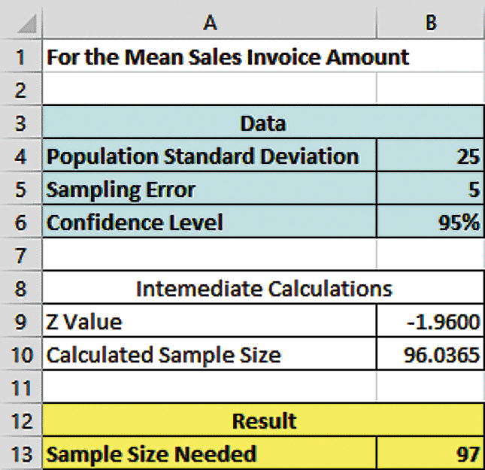
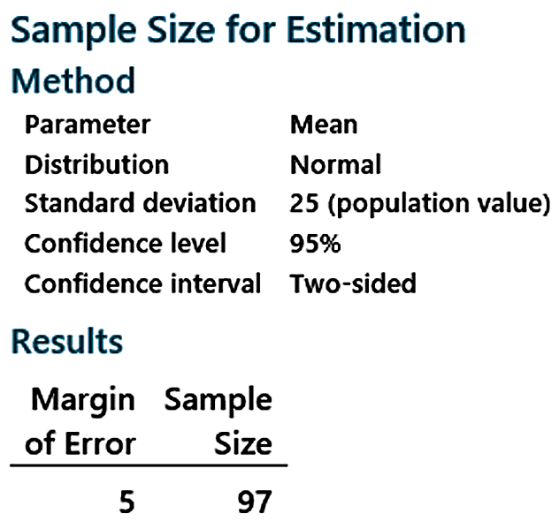
Example Excel & Minitab For Calculating Sample Size For The Mean
DCOVA

Slide 57
If σ is unknown
DCOVA
If unknown, σ can be estimated when using the required sample size formula.
  Use a value for σ that is expected to be at least as large as the true σ.
  Select a pilot sample and estimate σ with the sample standard deviation, S.

Slide 58
Determining Sample Size
(continued)
Determining
DCOVA
Sample Size
For the
Proportion
Now solve for n to get

Slide 59
Determining Sample Size
(continued)
DCOVA
To determine the required sample size for the proportion, you must know:
  The desired level of confidence (1 - α), which determines the critical value, Z_{α./2}.
  The acceptable sampling error, e.
  The true proportion of events of interest, π.
    π can be estimated with a pilot sample if necessary (or conservatively use 0.5 as an estimate of π.)

Slide 60
Required Sample Size Example
DCOVA
How large a sample would be necessary to estimate the true proportion of sales invoices containing errors in a large population within ±7%, with 95% confidence?
(Assume a pilot sample yields p = 0.15.)

Slide 61
Required Sample Size Example
(continued)
Solution:
For 95% confidence, use Z_{α/2} = 1.96
e = 0.07
p = 0.15, so use this to estimate π.
DCOVA
So use n = 100

Slide 62
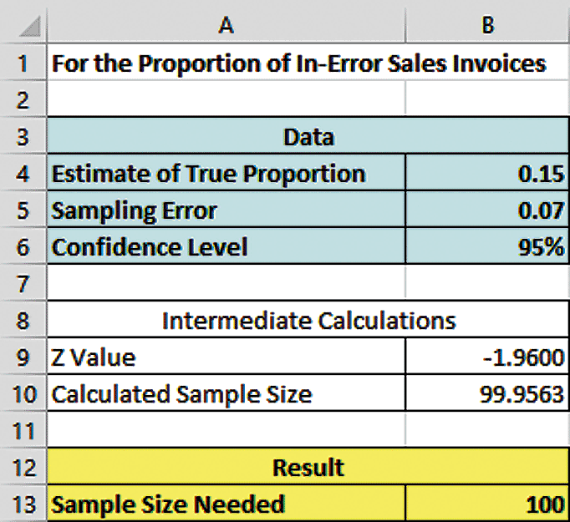
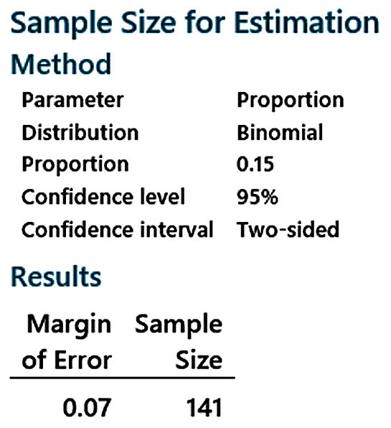
Example Excel & Minitab Output For Calculating Sample Size For A Proportion
DCOVA
Excel Uses A Normal
Approximation To Find n
Minitab Uses The Binomial
Distribution To Find n

Slide 63
Ethical Issues
A confidence interval estimate (reflecting sampling error) should always be included when reporting a point estimate.
The level of confidence should always be reported.
The sample size should be reported.
An interpretation of the confidence interval estimate should also be provided.

Slide 64
Chapter Summary
In this chapter we discussed:
The construction and interpretation of confidence interval estimates for the mean and the proportion.
The determination of the sample size necessary to develop a confidence interval for the mean and the proportion.

