Slide 1
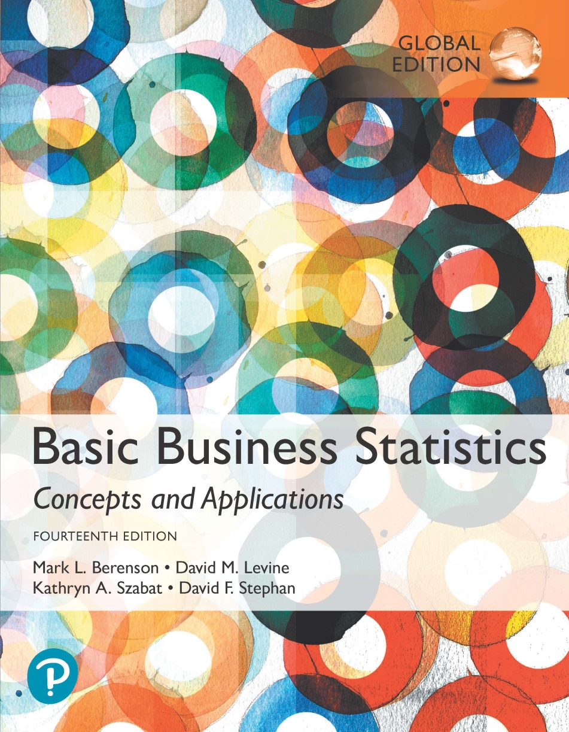
Chapter 13
Simple Linear Regression

Slide 2
Objectives
In this chapter, you learn:
To understand the usefulness of regression analysis.
To understand the meaning of the regression coefficients b₀ and b₁.
How to properly perform regression analysis.

Slide 3
Some usually unavoidable facts about research in business and the social sciences:
  1) We are usually interested in some form of the questions “how does X affect y?”
    How does education affect earnings?
    How does a product redesign affect sales?
    How does a new mkting campaign affect brand awareness?
    How does cap expenditures affect profitability?
  2) We usually must rely on observational data
    What problems does this cause?

Slide 4
If we are not running a tightly controlled experiment, there are many things happening all at once that can confound our results
  Many other things can be correlated with the treatment that could have some impact on the result
    Thus its hard to say if X affected Y…it could have been Z!
    And if Z is correlated with X, it may just look like X did it!

Slide 5
Examples:
  Use an agent or FSBO?
  Education and earnings? (Gender and earnings?)
  Treatment intensity and insurance status?
  etc.
Creating experiments is usually impossible, or at least way beyond our budget
We have to try and do our best with what we have: observational data

Slide 6
Main idea: How does X affect Y, controlling for A, B, C….
  How does gender affect a person’s salary, accounting for education, work experience, etc?
Linear Regression is our attempt at this: isolating the impact of one variable, while controlling for the effects of other confounding factors.

Slide 7
No question about it: this is imperfect. An experiment would be better.
But hey, we do our best with what we have.
If done well, regression analysis can probably tell us a lot.
This technique is used extensively.
We start our study of it with the simplest case: one independent variable

Slide 8
Regression Analysis Techniques Help Uncover Relationships Between Variables
DCOVA
Regression analysis is used to:
  Predict the value of a dependent variable based on the value of at least one independent variable.
  Explain the impact of changes in an independent variable on the dependent variable.
Dependent variable: the variable we wish to
predict or explain.
Independent variable: the variable used to predict or explain the dependent variable.

Slide 9
Preliminary Analysis – Scatter Plots
DCOVA
A scatter plot can be used to:
  Visualize the relationship between X and Y.
  Suggests a starting point for regression analysis.

Slide 10
Types of Relationships
DCOVA
Y
Y
Linear Relationships
X
X
Y
Y
Y
Curvilinear Relationships
X
X
X
Y
Y
No Relationship
X
X

Slide 11
In a regression you will have:
  One dependent variable
    The thing that gets affected/the result
      Ex: sales price of the house, GDP, salary for a worker
  Multiple independent variables (usually)
    The things that affect the dependent variable
      Ex: size of house, foreign investment, amount of education
  In regression, there is always one (and only one) dep var
  We will begin our discussion with a case of only one independent variable (we will add more later)

Slide 12
Simple Linear Regression Model
DCOVA
Only one independent variable, X.
Relationship between X and Y is described by a linear function.
  Recall y = mx + b
Changes in Y are assumed to be related to changes in X.

Slide 13
With linear regression, we assume that there is a relationship between x and y, and that that relationship is linear
  Later we can relax the assumption (a little bit) that the relationship is strictly linear. .
If we are using simple (one indep var) linear regression, we are implicitly assuming that the relationship between x and y can be represented as…

Slide 14
Simple Linear Regression Model
DCOVA
Population Slope
Coefficient
Random Error term
Population
Y intercept
Independent Variable
Dependent Variable
Linear component
Random Error
component

Slide 15
The basic idea: find the “best” line that fits a scatter plot
  “line of best fit”

Slide 16
Simple Linear Regression Model
Equation of a line:
Y = mX + b
m is slope = rise/run = ΔY/ΔX
β1 is slope
DCOVA
(continued)
Y
Observed Value of Y for X_{i}
ε_{i}
Slope = β₁
Predicted Value of Y for X_{i}
Random Error for this X_{i} value
Intercept = β₀
X_{i}
X

Slide 17
The Betas are population parameters (like mu, previously)
We assume those Betas are out there…we just can’t know them! (just like we assume mu is other there, unknowable)
We make guesses for the Betas from a sample
  In stats we call our guesses “estimates”
“b” is our estimate for Beta

Slide 18
Simple Linear Regression Equation (Prediction Line)
DCOVA
The simple linear regression equation provides an estimate of the population regression line.
Estimated (or predicted) Y value for observation i
Estimate of the regression
intercept
Estimate of the regression slope
Value of X for observation i

Slide 19
There are a lot of possible lines that we could draw through a cloud of data: which one is the “best”?
The is a standard, accepted way to generate these estimates
  i.e. there is a standard way to draw the line
It is our “ordinary least squares” (OLS) method
The OLS method will give us the one line, out of infinite possibilities, that “minimizes the sum of squared residuals”

Slide 20
This is the line that minimizes the sum/total of all the squared differences between each actual value of y and the predicted value.

Slide 21
Let’s say we have a cloud of data
I make a line that I think fits it best
You do the same
Whose line is “better”????
For each point, I measure the vertical distance between the point/observation and my line and square it. Then I add up all those squared distances and get a number.
You do the same.
Whoever’s line has a smaller “sum or squared residuals” is better.

Slide 22
The OLS line is THE line, out of all possible lines, the minimizes this “sum of squared residuals”
No one could find a line that makes that number smaller.

Slide 23
The Least Squares Method
DCOVA
b₀ and b₁ are obtained by finding the values that minimize the sum of the squared differences between Y and :
The coefficients b₀ and b₁, and other regression results in this chapter, are found using Excel or other software.
The calculations for b₀ and b₁ are not shown here but are available in the text.

Slide 24
Interpretation of the
Slope and the Intercept
DCOVA
b₀ is the estimated mean value of Y when the value of X is zero. (it is the vertical intercept of a linear relationship.)
b₁ is the estimated change in the mean value of Y as a result of a one-unit increase in X.
    b1 * ΔX = ΔY
To Ch13 XL

Slide 25
Simple Linear Regression Example
DCOVA
A real estate agent wishes to examine the relationship between the selling price of a home and its size (measured in square feet).
A random sample of 10 houses is selected.
  Dependent variable (Y) = house price in $1,000s.
  Independent variable (X) = square feet.

Slide 26
Simple Linear Regression Example: Data
DCOVA
House Price in $1000s (Y) | Square Feet (X)
245 | 1,400
312 | 1,600
279 | 1,700
308 | 1,875
199 | 1,100
219 | 1,550
405 | 2,350
324 | 2,450
319 | 1,425
255 | 1,700

Slide 27
Simple Linear Regression Example: Scatter Plot
DCOVA
House price model: Scatter Plot

Slide 28
We can generate our estimates for our betas by hand…but it’s a lot…better to let software do it.
  Just to check: how many betas are we estimating here?

Slide 29
Simple Linear Regression Example: Excel Output
DCOVA
Regression Statistics
Multiple R | 0.76211
R Square | 0.58082
Adjusted R Square | 0.52842
Standard Error | 41.33032
Observations | 10
ANOVA | df | SS | MS | F | Significance F
Regression | 1 | 18934.9348 | 18934.9348 | 11.0848 | 0.01039
Residual | 8 | 13665.5652 | 1708.1957
Total | 9 | 32600.5000
 | Coefficients | Standard Error | t Stat | P-value | Lower 95% | Upper 95%
Intercept | 98.24833 | 58.03348 | 1.69296 | 0.12892 | -35.57720 | 232.07386
Square Feet | 0.10977 | 0.03297 | 3.32938 | 0.01039 | 0.03374 | 0.18580
The regression equation is:

Slide 30
Simple Linear Regression Example: Graphical Representation
DCOVA
House price model: Scatter Plot and Prediction Line
Slope
= 0.10977
Intercept
= 98.248

Slide 31
Simple Linear Regression Example: Interpretation of b_{o}
DCOVA
b₀ is the estimated mean value of Y when the value of X is zero (if X = 0 is in the range of observed X values)
Because a house cannot have a square footage of 0, b₀ has no practical application

Slide 32
Simple Linear Regression Example: Interpreting b₁
DCOVA
b₁ estimates the change in the mean value of Y as a result of a one-unit increase in X.
Here, b₁ = 0.10977 tells us that the mean value of a house increases by 0.10977($1,000) = $109.77, on average, for each additional one square foot of size.

Slide 33
One useful function of an estimated regression: measuring marginal impacts
Another useful function: prediction
  How can a regression help us to predict the dep var?

Slide 34
Simple Linear Regression Example: Making Predictions
DCOVA
Predict the price for a house with 2,000 square feet:
The predicted price for a house with 2,000 square feet is 317.85($1,000s) = $317,850

Slide 35
Simple Linear Regression Example: Making Predictions
DCOVA
When using a regression model for prediction, only predict within the relevant range of data
Relevant range for interpolation
Do not try to extrapolate beyond the range of observed X’s

Slide 36
Computing b₀ & b₁
DCOVA
For small data sets, b₀ & b₁ can be calculated using a hand calculator
Where:

Slide 37
Computing b₀ & b₁ -- Home Prices
House | House Price in $1000s (Y) | Square Feet (X) | X² | Y² | XY
1 | 245 | 1,400 | 1,960,000 | 60,025 | 343,000
2 | 312 | 1,600 | 2,560,000 | 97,344 | 499,200
3 | 279 | 1,700 | 2,890,000 | 77,841 | 474,300
4 | 308 | 1,875 | 3,515,625 | 94,864 | 577,500
5 | 199 | 1,100 | 1,210,000 | 39,601 | 218,900
6 | 219 | 1,550 | 2,402,500 | 47,961 | 339,450
7 | 405 | 2,350 | 5,522,500 | 164,025 | 951,750
8 | 324 | 2,450 | 6,002,500 | 104,976 | 793,800
9 | 319 | 1,425 | 2,030,625 | 101,761 | 454,575
10 | 255 | 1,700 | 2,890,000 | 65,025 | 433,500
Total | 2865 | 17,150 | 30,983,750 | 853,423 | 5,085,975
DCOVA

Slide 38
Computing b₀ & b₁ -- Home Prices (Con’t)
DCOVA

Slide 39
We know our OLS line is the best we can do.
But is our best any good?
In other words, does the line we generated (via Excel) fit the data well, or not so well?
  Note that Excel will always give us something
  It might be helpful to evaluate if that something fits the data well or not so well

Slide 40
Think about this:
Y varies around the mean
  For each individual draw, sometimes Y is bigger than the mean by a lot, sometimes, only a little.
  Sometimes smaller than the mean by a lot, sometimes just a little.
  Maybe sometimes it is equal to (or super close) to the mean

Slide 41
SOME of this variation is (hopefully) explained by our x variable
  Different people earn different salaries
  SOME of this variation is explained by our x variable, level of education
But SOME of the variation is unexplained by the model
  You and I might have the same level of education, but our salaries won’t be exactly the same
    Maybe you have more/less experience, maybe you work more hours per year, maybe your dad owns the company, maybe you just got lucky/unlucky

Slide 42
So a portion of the total variation in y is explained by the indep var in our model (x).
The rest of the variation in y is from things that are not in the model or randomness
Idea: if a lot (ex: 90%) of the total variation in y is explained by the indep var, the model is a good fit!
  If only a little (ex: 10%) of the tot.variation in y is explained by the indep var, the model isn’t as good of a fit

Slide 43
“SST”= total variation in y
“SSR”= the variation in y explained by x
“SSE” the variation in y not explained by x
SST is composed of SSR+SSE

Slide 44
Measures of Variation
DCOVA
Total variation is made up of two parts:
Total Sum of Squares
Regression Sum of Squares
Error Sum of Squares
where:
= Mean value of the dependent variable
Y_{i} = Observed value of the dependent variable
= Predicted value of Y for the given X_{i} value

Slide 45
Measures of Variation
(continued)
DCOVA
SST = total sum of squares (Total Variation.)
  Measures the variation of the Y_{i} values around their mean Y.
SSR = regression sum of squares (Explained Variation.)
  Variation attributable to the relationship between X and Y.
SSE = error sum of squares (Unexplained Variation.)
  Variation in Y attributable to factors other than X.

Slide 46
Measures of Variation
(continued)
Y
DCOVA
Y_{i}
∧
∧
SSE = ∑(Y_{i} - Y_{i} )²
Y
_
SST = ∑(Y_{i} - Y)²
∧
Y
_
∧
_
SSR = ∑(Y_{i} - Y)²
_
Y
Y
X
X_{i}

Slide 47
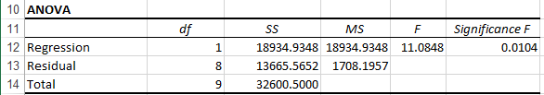
Excel Output Of The Measures Of Variation
DCOVA
SST = SSR + SSE
32,600.5000 = 18,934.9348 + 13,665.5652

Slide 48
Coefficient of Determination, r²
DCOVA
The coefficient of determination is the portion of the total variation in the dependent variable that is explained by variation in the independent variable.
The coefficient of determination is also called r-square and is denoted r².
note:
To Ch13 XL

Slide 49
Check your understanding:
i) unit of observation is a student
y is the student’s height in cm
x is the student’s height in inches
What will r-squared be?
ii) unit of observation is a student
y is the student’s height in cm
x is the # of tacos s/he has eaten in the last year
What will r-squared be?

Slide 50
Examples of Approximate r² Values
DCOVA
Y
Perfect linear relationship between X and Y.
100% of the variation in Y is explained by variation in X.
X
r² = 1
Y
X
r² = 1

Slide 51
Examples of Approximate r² Values
DCOVA
Y
0 < r² < 1
Weaker linear relationships between X and Y.
Some but not all of the variation in Y is explained by variation in X.
X
Y
X

Slide 52
Examples of Approximate r² Values
DCOVA
r² = 0
Y
No linear relationship between X and Y.
The value of Y does not depend on X. (None of the variation in Y is explained by variation in X.)
X
r² = 0

Slide 53
Simple Linear Regression Example: Coefficient of Determination, r² in Excel
DCOVA
Regression Statistics
Multiple R | 0.76211
R Square | 0.58082
Adjusted R Square | 0.52842
Standard Error | 41.33032
Observations | 10
ANOVA | df | SS | MS | F | Significance F
Regression | 1 | 18934.9348 | 18934.9348 | 11.0848 | 0.01039
Residual | 8 | 13665.5652 | 1708.1957
Total | 9 | 32600.5000
 | Coefficients | Standard Error | t Stat | P-value | Lower 95% | Upper 95%
Intercept | 98.24833 | 58.03348 | 1.69296 | 0.12892 | -35.57720 | 232.07386
Square Feet | 0.10977 | 0.03297 | 3.32938 | 0.01039 | 0.03374 | 0.18580
58.08% of the variation in house prices is explained by variation in square feet.

Slide 54
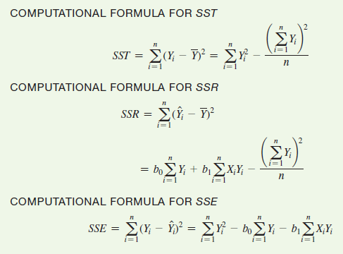
Sum Of Squares Computational Formulae
DCOVA
Actual
Mean
Predicted

Slide 55
Let’s think more about the “error term”, also called the “residual”
Recall that every point has an actual, observed value, and a predicated value from the regression line.
The difference is called the error or the residual
There will be an error(residual) value for each observation.
Thus, it can be viewed as a random variable with a mean and std deviation

Slide 56
Standard Error of Estimate
DCOVA
The standard deviation of the variation of observations around the regression line is estimated by:
Where
SSE = error sum of squares
n = sample size

Slide 57
Can be a little confusing b/c there is a “standard error for the regression” (as we just defined it) and also a standard error for each regression coefficient

Slide 58
Simple Linear Regression Example:
Standard Error of Estimate in Excel
DCOVA
Regression Statistics
Multiple R | 0.76211
R Square | 0.58082
Adjusted R Square | 0.52842
Standard Error | 41.33032
Observations | 10
ANOVA | df | SS | MS | F | Significance F
Regression | 1 | 18934.9348 | 18934.9348 | 11.0848 | 0.01039
Residual | 8 | 13665.5652 | 1708.1957
Total | 9 | 32600.5000
 | Coefficients | Standard Error | t Stat | P-value | Lower 95% | Upper 95%
Intercept | 98.24833 | 58.03348 | 1.69296 | 0.12892 | -35.57720 | 232.07386
Square Feet | 0.10977 | 0.03297 | 3.32938 | 0.01039 | 0.03374 | 0.18580
To Ch13 XL

Slide 59
Comparing Standard Errors
DCOVA
S_{YX} is a measure of the variation of observed Y values from the regression line.
Y
Y
X
X
The magnitude of S_{YX} should always be judged relative to the size of the Y values in the sample data.
i.e., S_{YX} = $41.33K is moderately small relative to house prices in the $200K - $400K range

Slide 60
Regression is a great tool
Used a lot…maybe too much!
You need to be sure that the assumptions about the model hold in your situation or the results can’t be trusted
Many, many, many people learn about regression and then start using it, without realizing (or caring) that the assumptions are violated.
  We have “fixes” for some of the violations, not all

Slide 61
Assumptions of Regression
L.I.N.E
DCOVA
Linearity:
  The relationship between X and Y is linear.
Independence of Errors:
  Error values are statistically independent.
  Particularly important when data are collected over a period of time.
Normality of Error:
  Error values are normally distributed for any given value of X.
Equal Variance (also called homoscedasticity):
  The probability distribution of the errors has constant variance.

Slide 62
Note that most of the things on the previous slide have to do with the behavior of the error term
So if we want to have a look at whether the assumptions are reasonable for our specific project, we’ll be looking closely at the residuals
Remember that the error term is a variable with a mean and std deviation
  There will be a value for the error for each obs
  We need to run the regression first to see it

Slide 63
Residual Analysis
DCOVA
The residual for observation i, e_{i}, is the difference between its observed and predicted value.
Check the assumptions of regression by examining the residuals:
  Examine for linearity assumption.
  Evaluate independence assumption.
  Evaluate normal distribution assumption.
  Examine for constant variance (homoscedasticity) for all levels of X. (Heteroscedasticity is a problem.)
Graphical Analysis of Residuals
  Can plot residuals vs. X.

Slide 64
Residual Analysis for Linearity
DCOVA
Y
Y
x
x
residuals
x
x
residuals
Not Linear
✓
Linear

Slide 65
The assumption of independence in the error term:
We assume that the value of the error for observation #1 is independent from the value of the error for observation #2 (and #3, 4, etc).
For cross-sectional data, this is usually not an issue...
…but for time series data it often is!

Slide 66
Time series data: when the observation is a unit of time
  Year, quarter, day, etc
Cross-sectional data: pretty much whenever the unit of observation is not a unit of time
  Sold home, student, volcanic eruption, etc.
In macroecon and finance, you use a lot of time-series data
  GDP=B0+B1(Foreign investment)
  Stock price= Bo+B1(GDP growth_rate)

Slide 67
It is with time series data that this assumption of error independence is so often violated…why?
Let’s say we’re working with: GDP= B0+B1(FDI)
In year one, the economy was booming
  FDI had an impact on GDP but lots of other stuff was pushing GDP up so for that year, the actual level of GDP was higher than predicted
Its likely the same stuff that was happening in year 1 might still be occurring in year 2, so the error for year 2 is also big/positive

Slide 68
The errors in year 1 and 2 were correlated
Now let’s say in year 3 a big recession hits and GDP is below the predicted amount.
The same forces that pushed us into recession may still be present in year 4.
So year 3 and 4 errors are correlated
Doesn’t have to be perfect correlation:
  Think: does knowing year x’s error give me any increased probability of predicting the error in year x+1?

Slide 69
Residual Analysis for Independence
DCOVA
Cyclical Pattern:
Not Independent
✓
No Cyclical Pattern Independent
residuals
X
residuals
X
residuals
X

Slide 70
Checking for Normality
DCOVA
Examine the Boxplot of the Residuals.
Examine the Histogram of the Residuals.
Construct a Normal Probability Plot of the Residuals.
Review ordered array of residuals, check stdev of residuals in one-third segments

Slide 71
Residual Analysis for Normality
DCOVA
When using a normal probability plot, normal errors will approximately display in a straight line.
Percent
100
0
-3 -2 -1 0 1 2 3
Residual

Slide 72
About the assumption of constant variance in the error term:
More likely to be an issue in cross-sectional data
Remember that the error is a random variable with a std dev
We assume the distribution/std error is constant for all values of x
  i.e. you’re just as likely to get an error that’s 2 std devs from the mean if x=150,000 as when x=800,000

Slide 73
This is often not the case
Say we’re looking at:
HomePrice=B0+B1(sqft)
For very small values of x, the price may not have a wide distribution (maybe the std error is only 50,000)
For very large values of x, the price may have a much wider distribution (maybe the std error is 300,000)

Slide 74
How can we see if this is a problem?
One way: Look for a pattern in the y and x scatter plot
Another way (that shows the same thing) Plot the errors against values of x

Slide 75
Residual Analysis for
Equal Variance
DCOVA
Y
Y
x
x
residuals
x
x
residuals
✓
Non-constant variance
Constant variance
To Ch13 XL

Slide 76
Residual Analysis: Checking For Linearity
DCOVA
RESIDUAL OUTPUT
 | Predicted House Price | Residuals
1 | 251.9232 | -6.9232
2 | 273.8767 | 38.1233
3 | 284.8535 | -5.8535
4 | 304.0628 | 3.9371
5 | 218.9928 | -19.9928
6 | 268.3883 | -49.3883
7 | 356.2025 | 48.7975
8 | 367.1793 | -43.1793
9 | 254.6674 | 64.3326
10 | 284.8535 | -29.8535
Linear Model Assumption Is Appropriate

Slide 77
Residual Analysis: Checking For Independence (con’t.)
DCOVA
RESIDUAL OUTPUT
 | Predicted House Price | Residuals
1 | 251.9232 | -6.9232
2 | 273.8767 | 38.1233
3 | 284.8535 | -5.8535
4 | 304.0628 | 3.9371
5 | 218.9928 | -19.9928
6 | 268.3883 | -49.3883
7 | 356.2025 | 48.7975
8 | 367.1793 | -43.1793
9 | 254.6674 | 64.3326
10 | 284.8535 | -29.8535
Independence Assumption Is Appropriate

Slide 78
Residual Analysis: Checking For Constant Variance (con’t.)
DCOVA
RESIDUAL OUTPUT
 | Predicted House Price | Residuals
1 | 251.9232 | -6.9232
2 | 273.8767 | 38.1233
3 | 284.8535 | -5.8535
4 | 304.0628 | 3.9371
5 | 218.9928 | -19.9928
6 | 268.3883 | -49.3883
7 | 356.2025 | 48.7975
8 | 367.1793 | -43.1793
9 | 254.6674 | 64.3326
10 | 284.8535 | -29.8535
Constant Variance Assumption Is Appropriate

Slide 79
When the error are correlated (not independent) we call that “autocorrelation”
Check: When are we on the lookout for autocorrelation? (What type of data?)
There is basic/standard test for this
  Excel does it automatically
It’s called the Durbin-Watson test (using the DW test stat)
  Does this really mean anything if your regression is cross-sectional?

Slide 80
Measuring Autocorrelation:
The Durbin-Watson Statistic
DCOVA
Used when data are collected over time to detect if autocorrelation is present.
Autocorrelation exists if residuals in one time period are related to residuals in another period.

Slide 81
To visually look for autocorrelation, you can plot the residuals over time and look for a pattern
Look at the residuals one at a time:
  If knowing one helps me guess where the next one might be-> darn it, we have autocorrelation
  If knowing one doesn’t help me guess where the next one will be-> maybe no autocorrelation

Slide 82
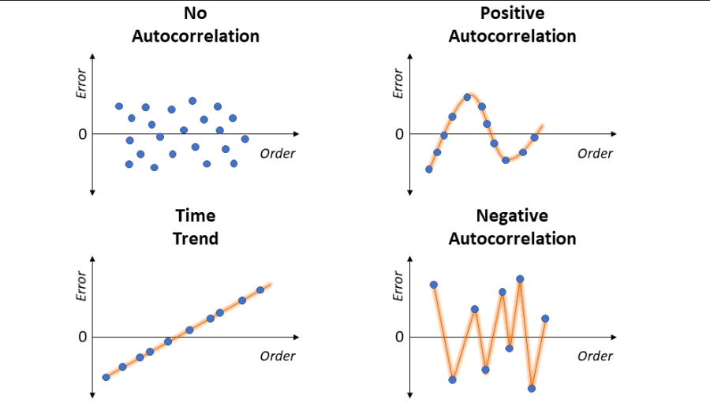

Slide 83
Autocorrelation
DCOVA
Autocorrelation is correlation of the errors (residuals) over time.
Here, residuals show a cyclical pattern, not random. Cyclical patterns are a sign of negative autocorrelation.
Violates the regression assumption that residuals are random and independent.

Slide 84
What do you need to know for the exam:
i) the DW stat tests for autocorrelation
ii) it has a range of 0-4
iii) If the DW is:
  close to 0, it means you might have positive AC.
  close to 4, you might have negative AC.
  close to 2, you might not have evidence of either.

Slide 85
The Durbin-Watson Statistic
DCOVA
The Durbin-Watson statistic is used to test for autocorrelation.
H₀: positive autocorrelation does not exist
H₁: positive autocorrelation is present
The possible range is 0 ≤ D ≤ 4.
D should be close to 2 if H₀ is true.
D less than 2 may signal positive autocorrelation, D greater than 2 may signal negative autocorrelation.

Slide 86
Testing for Positive Autocorrelation
DCOVA
H₀: positive autocorrelation does not exist
H₁: positive autocorrelation is present
Calculate the Durbin-Watson test statistic = D.
(The Durbin-Watson Statistic can be found using Excel.)
Find the values d_{L} and d_{U} from the Durbin-Watson table.
(for sample size n and number of independent variables k.)
Decision rule: reject H₀ if D < d_{L}
Reject H₀
Inconclusive
Do not reject H₀
0
d_{L}
d_{U}
2

Slide 87
Testing for Positive Autocorrelation
(continued)
DCOVA
Suppose we have the following time series data:
Is there autocorrelation?

Slide 88
Testing for Positive Autocorrelation
(continued)
DCOVA
Example with n = 25:
Excel/PHStat output:
Durbin-Watson Calculations
Sum of Squared Difference of Residuals | 3296.18
Sum of Squared Residuals | 3279.98
Durbin-Watson Statistic | 1.00494

Slide 89
Testing for Positive Autocorrelation
(continued)
DCOVA
Here, n = 25 and there is k = 1 one independent variable
Using the Durbin-Watson table, d_{L} = 1.29 and d_{U} = 1.45
selection depends on alpha, n, and # of indep vars
D = 1.00494 < d_{L} = 1.29, so reject H₀ and conclude that significant positive autocorrelation exists
Decision: reject H₀ since
D = 1.00494 < d_{L}
Reject H₀
Inconclusive
Do not reject H₀
0
d_{L}=1.29
d_{U}=1.45
2
To Ch13 XL

Slide 90
Usually, we want to find out “does x cause y?”
Proving causality isn’t possible, but seeing if two var’s move together is a decent first step.
In our regression equation, what would b1 equal if x had no predictive power of y whatsoever?
So to test if x has predictive power over y, it means we need to test the the coef on x is non-zero
  This is something we do all the time

Slide 91
Simple Linear Regression Example: Excel Output
DCOVA
Regression Statistics
Multiple R | 0.76211
R Square | 0.58082
Adjusted R Square | 0.52842
Standard Error | 41.33032
Observations | 10
ANOVA | df | SS | MS | F | Significance F
Regression | 1 | 18934.9348 | 18934.9348 | 11.0848 | 0.01039
Residual | 8 | 13665.5652 | 1708.1957
Total | 9 | 32600.5000
 | Coefficients | Standard Error | t Stat | P-value | Lower 95% | Upper 95%
Intercept | 98.24833 | 58.03348 | 1.69296 | 0.12892 | -35.57720 | 232.07386
Square Feet | 0.10977 | 0.03297 | 3.32938 | 0.01039 | 0.03374 | 0.18580
The regression equation is:

Slide 92
Inferences About the Slope
DCOVA
The standard error of the regression slope coefficient (b₁) is estimated by:
where:
= Estimate of the standard error of the slope.
= Standard error of the estimate.

Slide 93
Inferences About the Slope: t Test
DCOVA
t test for a population slope:
  Is there a linear relationship between X and Y?
Null and alternative hypotheses:
  H₀: β₁ = 0 (no linear relationship)
  H₁: β₁ ≠ 0 (linear relationship does exist)
Test statistic :
where:
b₁ = regression slope
coefficient
β₁ = hypothesized slope
S_{b1} = standard
error of the slope

Slide 94
Inferences About the Slope: t Test Example
DCOVA
Estimated Regression Equation:
House Price in $1000s (y) | Square Feet (x)
245 | 1400
312 | 1600
279 | 1700
308 | 1875
199 | 1100
219 | 1550
405 | 2350
324 | 2450
319 | 1425
255 | 1700
The slope of this model is 0.1098
Is there a relationship between the square footage of the house and its sales price?

Slide 95
Inferences About the Slope: t Test Example
DCOVA
H₀: β₁ = 0
H₁: β₁ ≠ 0
From Excel output:
 | Coefficients | Standard Error | t Stat | P-value
Intercept | 98.24833 | 58.03348 | 1.69296 | 0.12892
Square Feet | 0.10977 | 0.03297 | 3.32938 | 0.01039
b₁

Slide 96
Inferences About the Slope: t Test Example
DCOVA
H₀: β₁ = 0
H₁: β₁ ≠ 0
Test Statistic: t_{STAT} = 3.329
d.f. = 10- 2 = 8
Decision: Reject H₀.
α/2=.025
α/2=.025
There is sufficient evidence that square footage affects house price.
Reject H₀
Do not reject H₀
Reject H₀
-t_{α/2}
t_{α/2}
0
-2.3060
2.3060
3.329

Slide 97
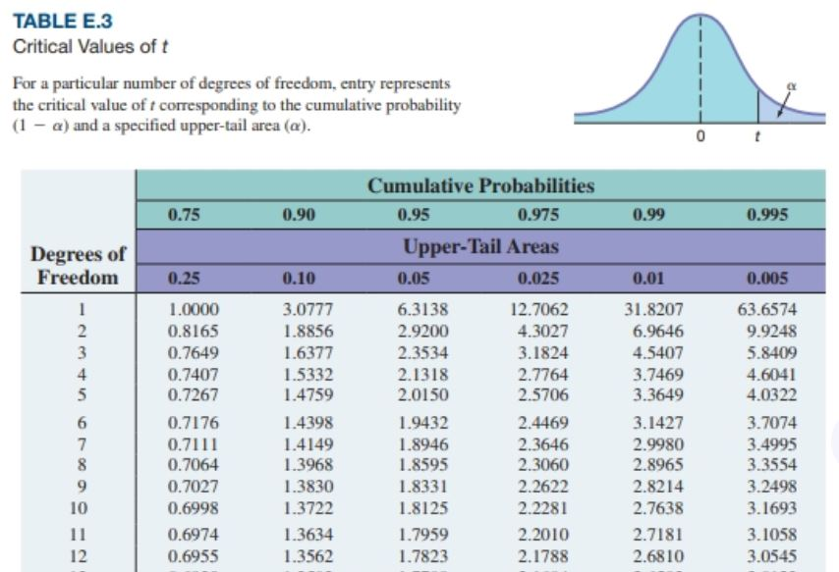

Slide 98
Inferences About the Slope: t Test Example
DCOVA
H₀: β₁ = 0
H₁: β₁ ≠ 0
From Excel output:
 | Coefficients | Standard Error | t Stat | P-value
Intercept | 98.24833 | 58.03348 | 1.69296 | 0.12892
Square Feet | 0.10977 | 0.03297 | 3.32938 | 0.01039
p-value
Decision: Reject H₀, since p-value < α.
There is sufficient evidence that square footage affects house price.

Slide 99
F Test for The Slope
DCOVA
F Test statistic:
where
where F_{STAT} follows an F distribution with 1 numerator and (n – 2) denominator degrees of freedom.

Slide 100
F-Test for The Slope
Excel Output
DCOVA
Regression Statistics
Multiple R | 0.76211
R Square | 0.58082
Adjusted R Square | 0.52842
Standard Error | 41.33032
Observations | 10
ANOVA | df | SS | MS | F | Significance F
Regression | 1 | 18934.9348 | 18934.9348 | 11.0848 | 0.01039
Residual | 8 | 13665.5652 | 1708.1957
Total | 9 | 32600.5000
With 1 and 8 degrees of freedom
p-value for the F-Test

Slide 101
F Test for The Slope
(continued)
DCOVA
H₀: β₁ = 0
H₁: β₁ ≠ 0
α = .05
df₁= 1 df₂ = 8
Test Statistic:
Decision:
Conclusion:
Critical Value:
F_{α} = 5.32
Reject H₀ at α = 0.05.
α = .05
There is sufficient evidence that house size affects selling price.
0
F
Do not
reject H₀
Reject H₀
F_{.05} = 5.32

Slide 102
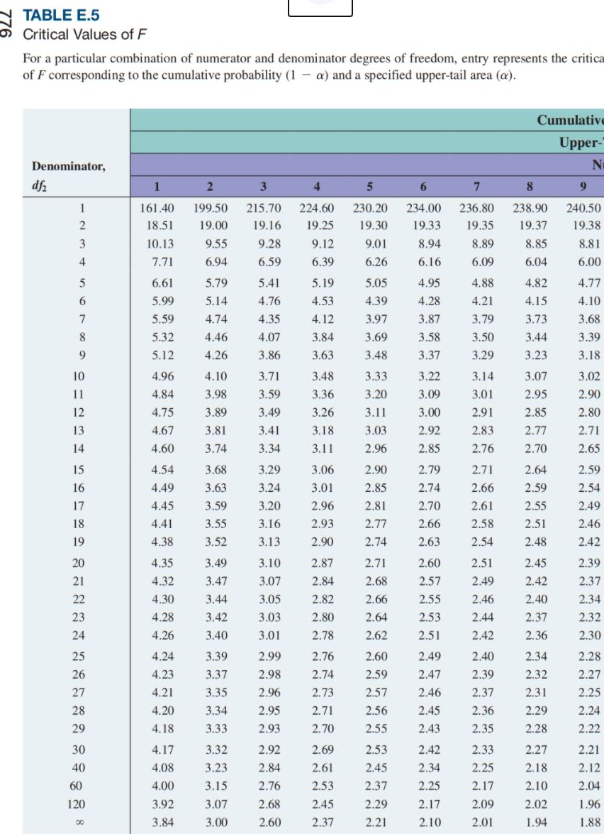
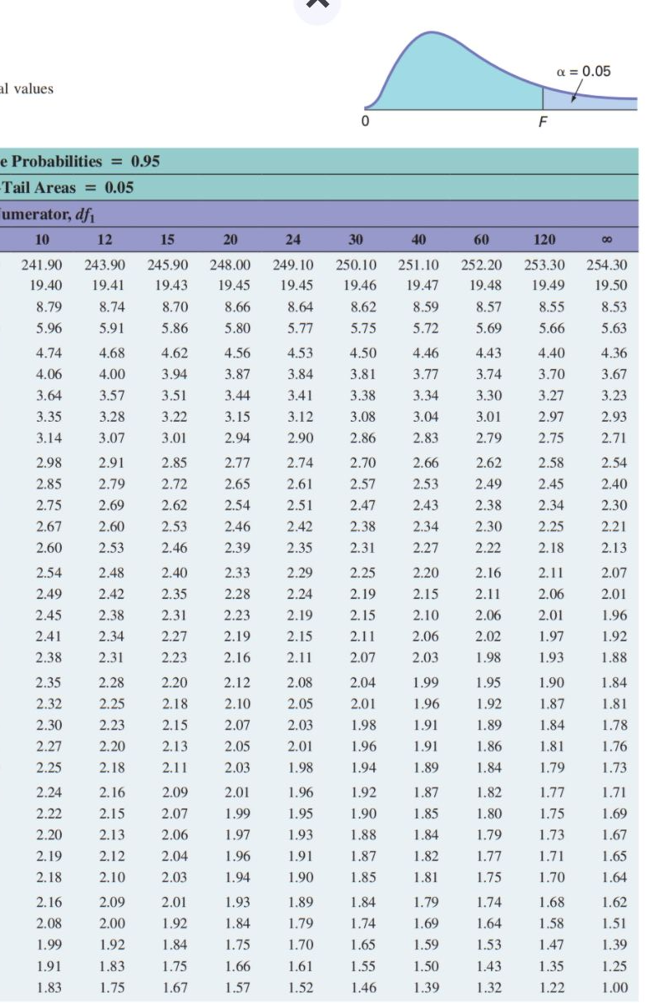

Slide 103
Pitfalls of Regression Analysis
DCOVA
Lacking an awareness of the assumptions of least-squares regression.
Not knowing how to evaluate the assumptions of least-squares regression.
Not knowing the alternatives to least-squares regression if a particular assumption is violated.
Using a regression model without knowledge of the subject matter.
Extrapolating outside the relevant range.
Concluding that a significant relationship identified always reflects a cause-and-effect relationship.

Slide 104
Seven Steps for Avoiding the Potential Pitfalls
DCOVA
Be clear about the problem or goal being investigated and the variables that need to be examined.
Construct a scatter plot of X vs. Y to observe the possible relationship.
Perform a residual analysis to check the assumptions:
  Plot the residuals versus X to check for violations of assumptions such as equal variance.
  Use a histogram, boxplot, or normal probability plot of the residuals to uncover possible non-normality.
  Plot the residuals versus time to check for independence. (This step is necessary only if the data are collected over time.)

Slide 105
Seven Steps for Avoiding the Potential Pitfalls
(continued)
DCOVA
If there are violations of the assumptions, use alternative methods to least-squares regression or alternative least-squares models.
If there are no violations of the assumptions, carry out tests for the significance of the regression coefficients and develop confidence and prediction intervals.
Refrain from making predictions and forecasts outside the relevant range of the independent variable.
Remember that the relationships identified in observational studies may or may not be due to cause-and-effect relationships (While causation implies correlation, correlation does not imply causation.)

Slide 106
Chapter Summary
In this chapter we discussed:
How to use regression analysis to predict the value of a dependent variable based on a value of an independent variable.
Understanding the meaning of the regression coefficients b₀ and b₁.
Evaluating the assumptions of regression analysis and know what to do if the assumptions are violated.
Making inferences about the slope and correlation coefficient.
Estimating mean values and predicting individual values.

