Slide 1
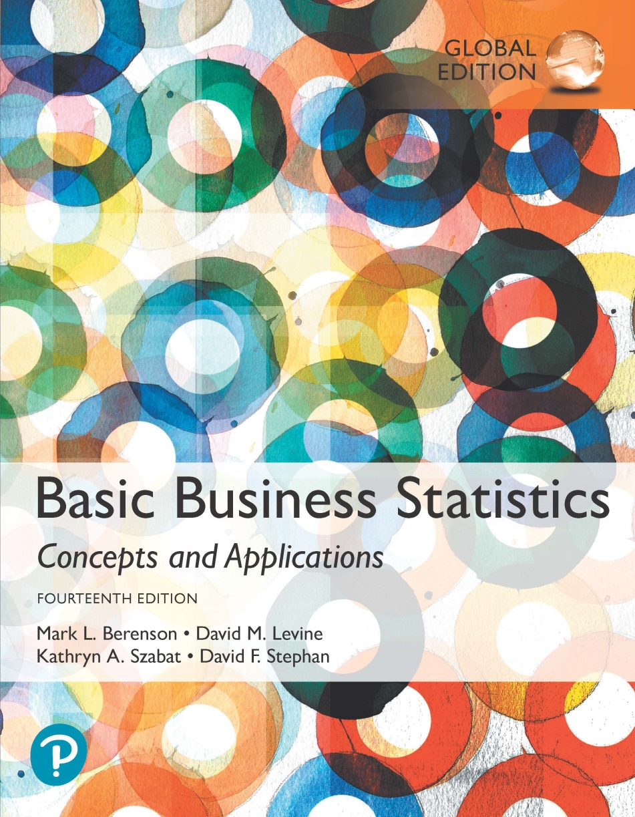
Chapter 14
Introduction to Multiple Regression

Slide 2
Thus far, we’ve focused on regression in the context of a single indep var.
This isn’t really all that useful.
Now we extend our regression model to having multiple independent variables.
This is very important b/c it allows us to examine the impact of a single variable holding all other variables constant

Slide 3
The Multiple Regression Model With k Independent Variables
DCOVA
Idea: Examine the linear relationship between
1 dependent (Y) & 2 or more independent variables (X_{i}).
Multiple Regression Model with k Independent Variables:
Y-intercept
Population slopes
Random Error
Where:
β₀ = Y intercept
β₁ = slope of Y with variable X₁, holding X₂, X₃, X_{4,} . . . , X_{k} constant
β₂ = slope of Y with variable X₂, holding X₁, X₃, X_{4,} . . . , X_{k} constant
β₃ = slope of Y with variable X₃, holding X₁, X₂, X₄,. . . , X_{k} constant
.
.
β_{k} = slope of Y with variable X_{k}, holding X₁, X₂, X₃,. . . , X_{k-1} constant
ε_{i} = random error in Y for observation i

Slide 4
Multiple Regression Model With 2 Independent Variables
DCOVA
Where:
β₀ = Y intercept
β₁ = slope of Y with variable X₁, holding X₂ constant
β₂ = slope of Y with variable X₂, holding X₁ constant
ε_{i} = random error in Y for observation i

Slide 5
Once again, we have Betas (pop parameters) that we will estimate with data and the OLS method.
bo is always the intercept (there is only ever one of those)
b1-bk are the slope coefficients for the k independent variables.

Slide 6
Multiple Regression Equation
DCOVA
The coefficients of the multiple regression model are estimated using sample data.
Multiple regression equation with k independent variables:
Estimated
(or predicted)
value of Y
Estimated
intercept
Estimated slope coefficients

Slide 7
Multiple Regression Equation With Two Independent Variables
DCOVA
Two variable model
Y
Slope for variable X₁
X₂
Slope for variable X₂
X₁

Slide 8
Example:
2 Independent Variables
DCOVA
A distributor of frozen dessert pies wants to evaluate factors thought to influence demand.
  Dependent variable: Pie sales (units per week)
  Independent variables: Price (in $)
    Advertising ($100’s)
Data are collected for 15 weeks.

Slide 9
Pie Sales Example
DCOVA
Week | Pie Sales | Price ($) | Advertising ($100s)
1 | 350 | 5.50 | 3.3
2 | 460 | 7.50 | 3.3
3 | 350 | 8.00 | 3.0
4 | 430 | 8.00 | 4.5
5 | 350 | 6.80 | 3.0
6 | 380 | 7.50 | 4.0
7 | 430 | 4.50 | 3.0
8 | 470 | 6.40 | 3.7
9 | 450 | 7.00 | 3.5
10 | 490 | 5.00 | 4.0
11 | 340 | 7.20 | 3.5
12 | 300 | 7.90 | 3.2
13 | 440 | 5.90 | 4.0
14 | 450 | 5.00 | 3.5
15 | 300 | 7.00 | 2.7
Multiple regression equation:
Sales = b₀ + b₁ (Price)
+ b₂ (Advertising).

Slide 10
Excel Multiple Regression Output
DCOVA
Regression Statistics
Multiple R | 0.72213
R Square | 0.52148
Adjusted R Square | 0.44172
Standard Error | 47.46341
Observations | 15
ANOVA | df | SS | MS | F | Significance F
Regression | 2 | 29460.027 | 14730.013 | 6.53861 | 0.01201
Residual | 12 | 27033.306 | 2252.776
Total | 14 | 56493.333
 | Coefficients | Standard Error | t Stat | P-value | Lower 95% | Upper 95%
Intercept | 306.52619 | 114.25389 | 2.68285 | 0.01993 | 57.58835 | 555.46404
Price | -24.97509 | 10.83213 | -2.30565 | 0.03979 | -48.57626 | -1.37392
Advertising | 74.13096 | 25.96732 | 2.85478 | 0.01449 | 17.55303 | 130.70888

Slide 11
The Multiple Regression Equation
DCOVA
Sales = 306.526 – 24.975(Price) + 74.131(Advertising)
Where:
Sales is in number of pies per week.
Price is in $.
Advertising is in $100’s.
b₁ = -24.975: Sales will decrease, on average, by 24.975 pies per week for each $1 increase in selling price, net of the effects of changes due to advertising.
b₂ = 74.131: Sales will increase, on average, by 74.131 pies per week for each $100 increase in advertising, net of the effects of changes due to price

Slide 12
Using The Regression Equation to Make Predictions
DCOVA
Predict sales for a week in which the selling price is $5.50 and advertising is $350:
Note that Advertising is in $100s, so $350 means that X₂ = 3.5.
Predicted sales is 428.6216 pies.

Slide 13
The Coefficient of Determination, r²
DCOVA
Reports the proportion of total variation in Y explained by all X variables taken together.

Slide 14
Coefficient of
Determination In Excel
DCOVA
Regression Statistics
Multiple R | 0.72213
R Square | 0.52148
Adjusted R Square | 0.44172
Standard Error | 47.46341
Observations | 15
ANOVA | df | SS | MS | F | Significance F
Regression | 2 | 29460.027 | 14730.013 | 6.53861 | 0.01201
Residual | 12 | 27033.306 | 2252.776
Total | 14 | 56493.333
 | Coefficients | Standard Error | t Stat | P-value | Lower 95% | Upper 95%
Intercept | 306.52619 | 114.25389 | 2.68285 | 0.01993 | 57.58835 | 555.46404
Price | -24.97509 | 10.83213 | -2.30565 | 0.03979 | -48.57626 | -1.37392
Advertising | 74.13096 | 25.96732 | 2.85478 | 0.01449 | 17.55303 | 130.70888
52.1% of the variation in pie sales is explained by the variation in price and advertising.

Slide 15
R² is a handy tool to quickly evaluate the fit of the model.
One thing to consider, though, is that adding indep variables to the model will always increase R², even if those variables don’t really have any explanatory power.
  Increasing R² that way isn’t very helpful
  By chance, every variable will have *some* correlation with every other variable (maybe just a tiny bit but not zero)

Slide 16
A result of this is that R² can be manipulated.
  Just start adding in more and indep vars, whether they make sense or not!
B/c of this, we want to be careful about how we interpret R²
Statisticians have come up with an adjustment to the traditional R² to account for the number of indep vars in the model.

Slide 17
Adjusted r²
(continued)
DCOVA
Shows proportion of variation in Y explained by X variables adjusted for the number of X variables:
  (where n = sample size, k = number of independent variables)
  Penalizes excessive use of unimportant independent variables.
  Smaller than r².
  Useful in comparing among models.
What happens as k increases?

Slide 18
One can’t push up adjusted R² by simply adding more vars.
In practice, we usually pay more attention to R² but if a model has a lot of indep vars, we might be interested to see what the adjusted R² looks like

Slide 19
In analyzing the overall usefulness of the model, R² and adjusted R² are good places to start.
The other “go to” item to look at is the result of the F-test that is generated by Excel with every regression you run.
Think of the F-test of a regression as an overall test of the validity of the regression model as a whole.

Slide 20
We will test for the significance of the individual slope coefficients (t-tests), but the F-test is a test of significance for the whole model.
The null is that the model is invalid/worthless.
The alt is that it at least has some validity.
Obviously we are usually hoping to reject the null
In this test, rejecting the null is generally pretty easy to do, so if we fail to reject the null, it means our model really isn’t explaining much

Slide 21
Important:
Note that “passing” the F-test doesn’t mean your model is great
  It just means that it’s not completely worthless
  This is a pretty low bar to clear

Slide 22
Is the Overall Model Significant?
DCOVA
F Test for Overall Significance of the Model.
Shows if there is a linear relationship between all of the X variables considered together and Y.
Use F-test statistic.
Hypotheses:
  H₀: β₁ = β₂ = … = β_{k} = 0 (no linear relationship)
  H₁: at least one β_{i} ≠ 0 (at least one independent
  variable affects Y)

Slide 23
F Test for Overall Significance
DCOVA
Test statistic:
where F_{STAT} has numerator d.f. = k and
denominator d.f. = (n – k - 1)

Slide 24
F Test for Overall Significance
(continued)
Test Statistic:
Decision:
Conclusion:
DCOVA
H₀: β₁ = β₂ = 0
H₁: β₁ and β₂ not both zero
α = .05
df₁= 2 df₂ = 12
Critical Value:
F_{0.05} = 3.885
Since F_{STAT} test statistic is in the rejection region (p-value < .05), reject H₀.
α = .05
0
F
There is evidence that at least one independent variable affects Y.
Do not
reject H₀
Reject H₀
F_{0.05} = 3.885

Slide 25
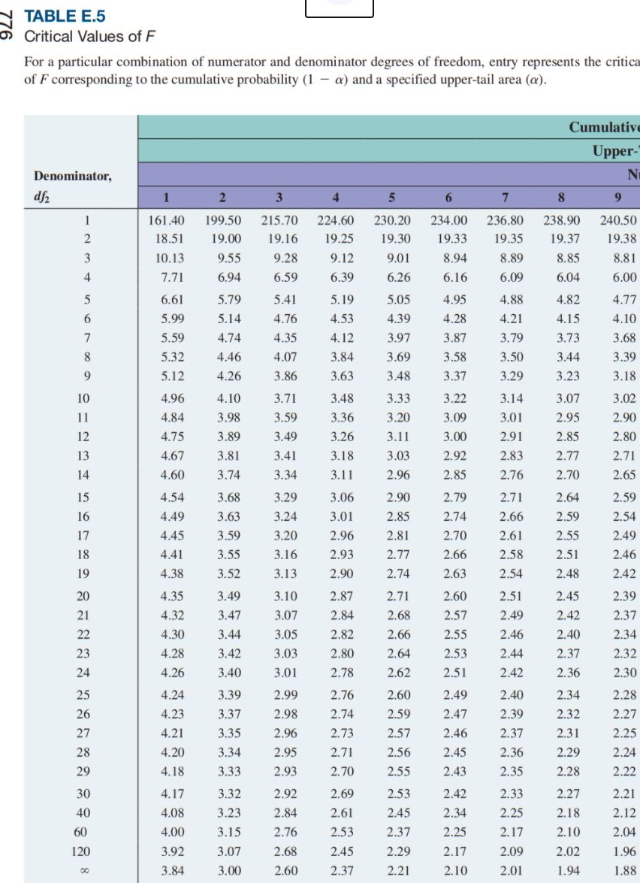
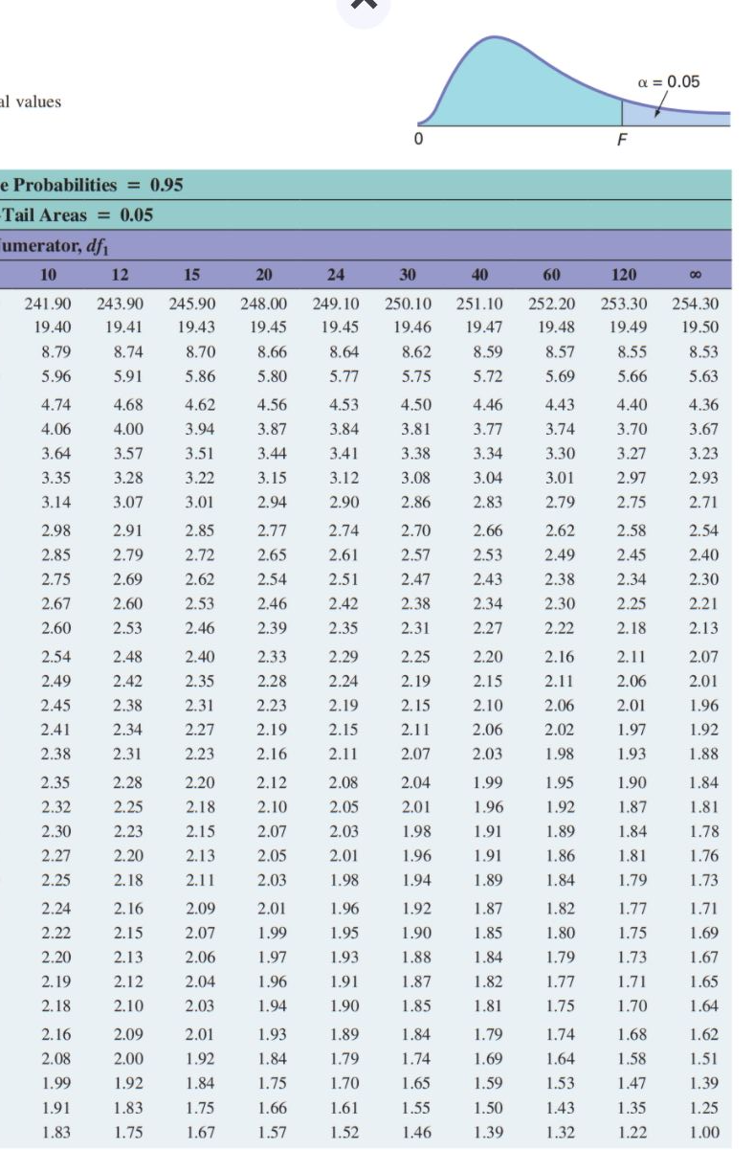

Slide 26
Residuals in Multiple Regression
DCOVA
Two variable model
Y
Sample observation
Y_{i}
Residual = e_{i} = (Y_{i} – Y_{i})
<
<
Y_{i}
x_{2i}
X₂
x_{1i}
The best fit equation is found by minimizing the sum of squared errors, Σe².
X₁

Slide 27
Multiple Regression Assumptions
DCOVA
Errors (residuals) from the regression model:
<
e_{i} = (Y_{i} – Y_{i})
Assumptions: white noise errors
The errors are normally distributed.
Errors have a constant variance.
The model errors are independent.

Slide 28
Residual Plots Used in Multiple Regression
DCOVA
These residual plots are used in multiple regression:
  Residuals vs. Y_{i}.
  Residuals vs. X_{1i}.
  Residuals vs. X_{2i}.
  Residuals vs. time (if time series data).
<
Use the residual plots to check for violations of regression assumptions.

Slide 29
When examining residuals, what are we looking for?
Basically, looking for any obvious pattern.
Nice and random looking→ good
Pattern of any type→ bad
Generally idea is that if the errors look like they depend on something else, that’s bad

Slide 30
Residual Plots For The Pie Sales Model
DCOVA
All these plots show little or no pattern so we can conclude the multiple regression model is appropriate for predicting pie sales.

Slide 31
Are Individual Variables Significant?
DCOVA
Use t tests of individual variable slopes.
Shows if there is a linear relationship between the variable X_{j} and Y holding constant the effects of other X variables.
Hypotheses:
  H₀: β_{j} = 0 (no relationship)
  H₁: β_{j} ≠ 0 (linear relationship does exist
  between X_{j} and Y)

Slide 32
Are Individual Variables Significant?
(continued)
DCOVA
  H₀: β_{j} = 0 (no linear relationship between X_{j} and Y)
  H₁: β_{j} ≠ 0 (linear relationship does exist
  between X_{j} and Y)
  Test Statistic:
  (df = n – k – 1)

Slide 33
Inferences about the Slope: t Test Example
DCOVA
From the Excel output:
H₀: β_{j} = 0
H₁: β_{j} ≠ 0
For Price t_{STAT} = -2.306, with p-value .0398.
For Advertising t_{STAT} = 2.855, with p-value .0145
d.f. = 15-2-1 = 12
= .05
t_{α/2} = 2.1788
The test statistic for each variable falls in the rejection region (p-values < .05).
Decision:
Conclusion:
α/2=.025
α/2=.025
Reject H₀ for each variable.
There is evidence that both Price and Advertising affect pie sales at α = .05.
Reject H₀
Do not reject H₀
Reject H₀
-t_{α/2}
t_{α/2}
0
-2.1788
2.1788

Slide 34
Confidence Interval Estimate for the Slope
DCOVA
Confidence interval for the population slope β_{j}
where t has
(n – k – 1) d.f.
Here, t has
(15 – 2 – 1) = 12 d.f.
Example: Form a 95% confidence interval for the effect of changes in price (X₁) on pie sales:
-24.975 ± (2.1788)(10.832)
So the interval is (-48.576, -1.374)
(This interval does not contain zero, so price has a significant effect on sales).

Slide 35
Thus far, we’ve only discussed numerical independent variables
Of course many important factors that could influence Y may be non-numerical
  Male/female
  Color
  Type of education (highschool, bach, masters, etc)
We definitely need a way to bring this type of variable into our regression model.

Slide 36
We can incorporate non-numerical variables into our model through the use of “dummy variables”
Convert a non-numerical variable into either
  a single binary variable (if only two options, like yes/no, left/right, on/off, etc.)
  a series of binary variables to account for the different possibilities if more than two
    i.e. color, which region the observation is from, etc.

Slide 37
We start with the simple case: when the variable is binary

Slide 38
Using Dummy Variables
DCOVA
A dummy variable is a categorical independent variable with two levels:
  yes or no, on or off, male or female.
  coded as 0 or 1.
Assumes the slopes associated with numerical independent variables do not change with the value for the categorical variable.
If more than two levels, the number of dummy variables needed is (number of levels - 1).

Slide 39
Dummy-Variable Example
(with 2 Levels)
DCOVA
Let:
Y = pie sales
X₁ = price
X₂ = holiday (X₂ = 1 if a holiday occurred during the week). (X₂ = 0 if there was no holiday that week).

Slide 40
Dummy variables are sometimes referred to as “intercept shifters”
  Why?

Slide 41
Dummy-Variable Example
(with 2 Levels)
(continued)
DCOVA
Holiday
No Holiday
Y (sales)
Different intercept
Same slope
b₀ + b₂
If H₀: β₂ = 0 is rejected, then
“Holiday” has a significant effect on pie sales.
b₀
Holiday (X₂ = 1)
No Holiday (X₂ = 0)
X₁ (Price)

Slide 42
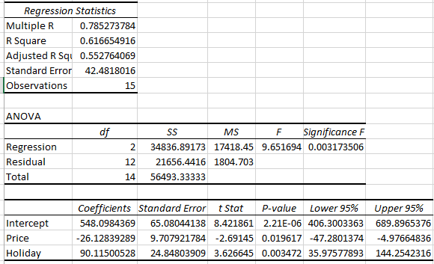
Dummy-Variable Example Excel
(continued)
DCOVA

Slide 43
Interpreting the Dummy Variable Coefficient (with 2 Levels)
DCOVA
Sales: number of pies sold per week
Price: pie price in $
Holiday:
1 If a holiday occurred during the week
0 If no holiday occurred
b₂ = 90.1: on average, sales were 90.1 pies greater in weeks with a holiday than in weeks without a holiday, given the same price.

Slide 44
Dummy-Variable Models
(more than 2 Levels)
DCOVA
The number of dummy variables is one less than the number of levels.
Example:
Y = house price ; X₁ = square feet.
If style of the house is also thought to matter:
Style = ranch, split level, colonial.
Three levels, so two dummy variables are needed.

Slide 45
What to remember:
There will always be one fewer dummy variables than possible values of the variable
The omitted one is the reference group

Slide 46
Say our observation is a worker and the variable we are interested in is education level
  Less than High School, High school, bachelors, masters, PhD/professional degree
  Five possible values so four dummy vars must be created
Which one should be the omitted one (i.e. the reference group)?
  It doesn’t really matter
  Maybe pick either the lowest, if there is an order, or the most common, if not

Slide 47
Side note: sometimes the variable will have an order, like the previous example
  Often people want to code the variable 1,2,3,4,5 or something like that, with each level corresponding to a level of education
  You probably don’t want to do that, usually
  Why?
  Also note that a lot of the time there won’t be an order anyway
    Green, brown, blue

Slide 48
Regardless: We interpret the coefs on the included categories against the omitted one.
Ex: Green, brown, blue
We decide to omit brown.
The coef on green is 1.5.
The interpretation is that if an observation is green, the dep var will be 1.5 units higher than one that is brown.

Slide 49
Another side note:
It’s a nice convention to name the dummy variable after what happens when it equals 1
Ex:
  Variable: gender
    FEMALE=1 if female, 0 otherwise
  Variable: color (green, brown, blue)
    GREEN=1 if green, 0 otherwise
    BROWN=1 if brown, 0 otherwise
    BLUE=1 if blue, 0 otherwise

Slide 50
Dummy-Variable Models
(more than 2 Levels)
(continued)
DCOVA
Example: Let “colonial” be the default category, and let X₂ and X₃ be used for the other two categories:
Y = house price
X₁ = square feet
X₂ = 1 if ranch, 0 otherwise
X₃ = 1 if split level, 0 otherwise
The multiple regression equation is:

Slide 51
Interpreting the Dummy Variable Coefficients (with 3 Levels)
DCOVA
Consider the regression equation:
For a colonial: X₂ = X₃ = 0
With the same square feet, a ranch will have an estimated average price of 23.53 thousand dollars more than a colonial.
For a ranch: X₂ = 1; X₃ = 0
With the same square feet, a split-level will have an estimated average price of 18.84 thousand dollars more than a colonial.
For a split level: X₂ = 0; X₃ = 1

Slide 52
An interesting application to dummy variables can allow us to have a little non-linearity in our linear regression.
Consider a basic housing price regression, with various independent variables including the number of bathrooms.
Might the marginal impact of an additional bathroom be non-linear?

Slide 53
Idea: rather than allow # of bathrooms to enter in the regression equation as a number, instead create a serious of dummy variables
  ONEBATH=1 if house has one bathroom, 0 otherwise
  TWOBATH=1 if house has two bathrooms
  THREEBATH=1 if house has three bathrooms
  FOURBATH=1 if house has four bathrooms
  FIVEPLUSBATHS=1 if house has 5+ baths
  (of course we make sure we omit one of the above)

Slide 54
What’s the point of the above?
Why do it this way?

Slide 55
Scenarios: Construct a regression model for each
The following are a few research questions. Pick three and for each, construct a regression model that might answer the question. In doing so think about:
  What is the unit of observation?
  What is the dependent variable?
  What are the independent variables?
  Are there any things you’d like to control for, but probably can’t? Why not?

Slide 56
1) Are religious people more generous?
2) Does being a vegetarian improve health?
3) What factors affect an Aalto student’s GPA?
4) What factors affect attendance at a local stadium/arena during sporting events?
5) Does the color of the car impact it’s resale value? If so, which color is worth the most?
6) What was the impact of COVID-related school closures on student learning?

Slide 57
Interaction Between Independent Variables
DCOVA
Hypothesizes interaction between pairs of X variables.
  Response to one X variable may vary at different levels of another X variable.
Contains two-way cross product terms.

Slide 58
Effect of Interaction
DCOVA
Given:
Without interaction term, effect of X₁ on Y is measured by β₁.
With interaction term, effect of X₁ on Y is measured by β₁ + β₃ X₂.
Effect changes as X₂ changes.

Slide 59
Interaction: Slope Dummy
DCOVA
Suppose X₂ is a dummy variable and the estimated regression equation is
= 1 + 2X₁ + 3X₂ + 4X₁X₂
Y
12
X₂ = 1:
Y = 1 + 2X₁ + 3(1) + 4X₁(1) = 4 + 6X₁
8
4
X₂ = 0:
Y = 1 + 2X₁ + 3(0) + 4X₁(0) = 1 + 2X₁
0
X₁
0
0.5
1
1.5
Slopes are different if the effect of X₁ on Y depends on X₂ value

Slide 60
Example of Interaction Term
DCOVA
Consider example of asking price of homes from pages 560 – 562.
Y = Asking Price of Homes.
X variables: Living Space and whether or not the house has a fireplace.
In model with no interaction you are assuming the effect of Living Space on Asking Price is the same whether or not the house has a fireplace.
If this is not true, the model needs an interaction term.

Slide 61
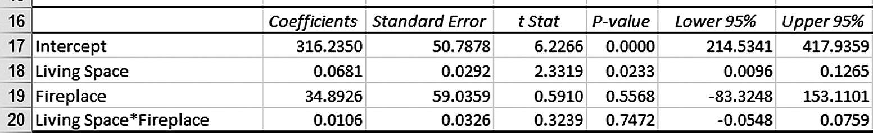
Excel, JMP, & Minitab Output From Interaction Model
DCOVA
Interaction is not significant.
Effect of Living Space on Asking Price does not depend on whether or not the house has a fireplace.

