Slide 1

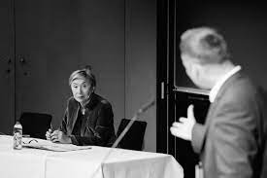
What is Research?
Max Ryynänen
max.ryynanen@aalto.fi
http://maxryynanen.net

Slide 2
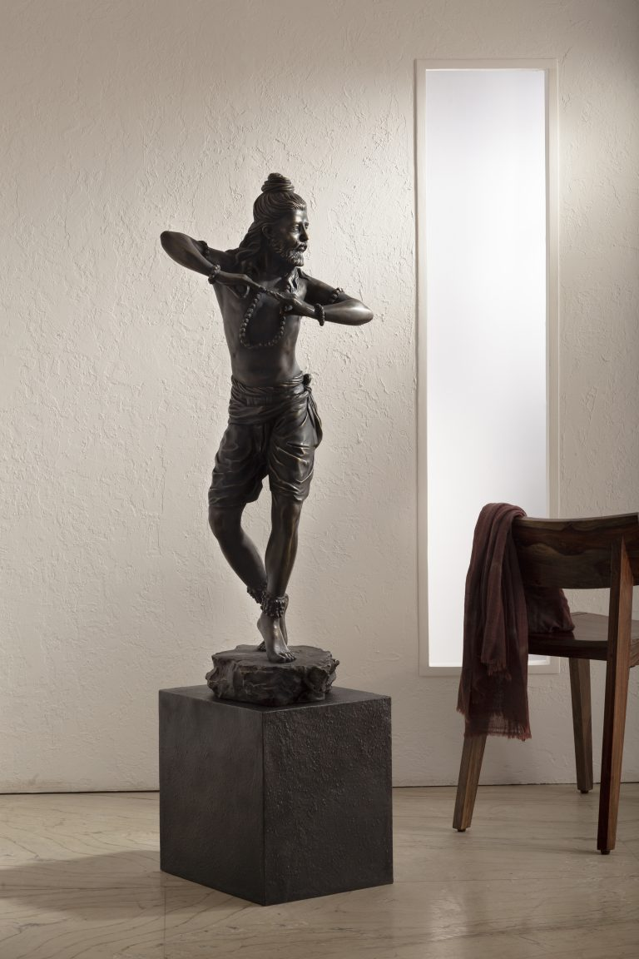
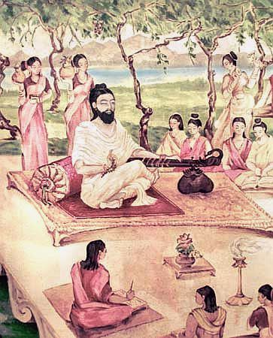
Natyasastra नाट्य शास्त्र
Bharata Muni (300BC – 300AD), descriptive
Abhinavagupta (950-1016), analytic

Slide 3

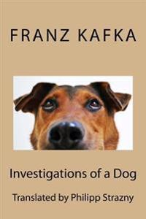
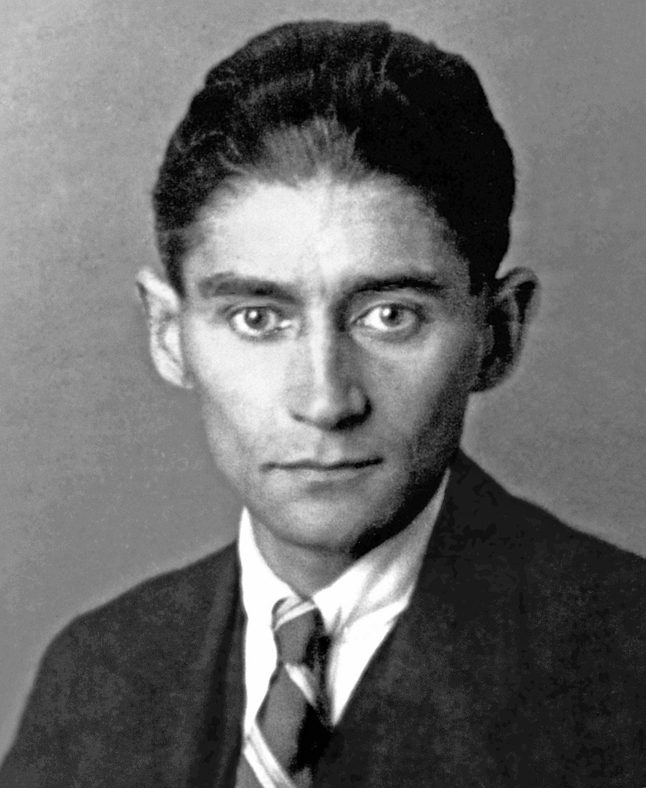
Franz Kafka, Investigations of a Dog (1922)

Slide 4
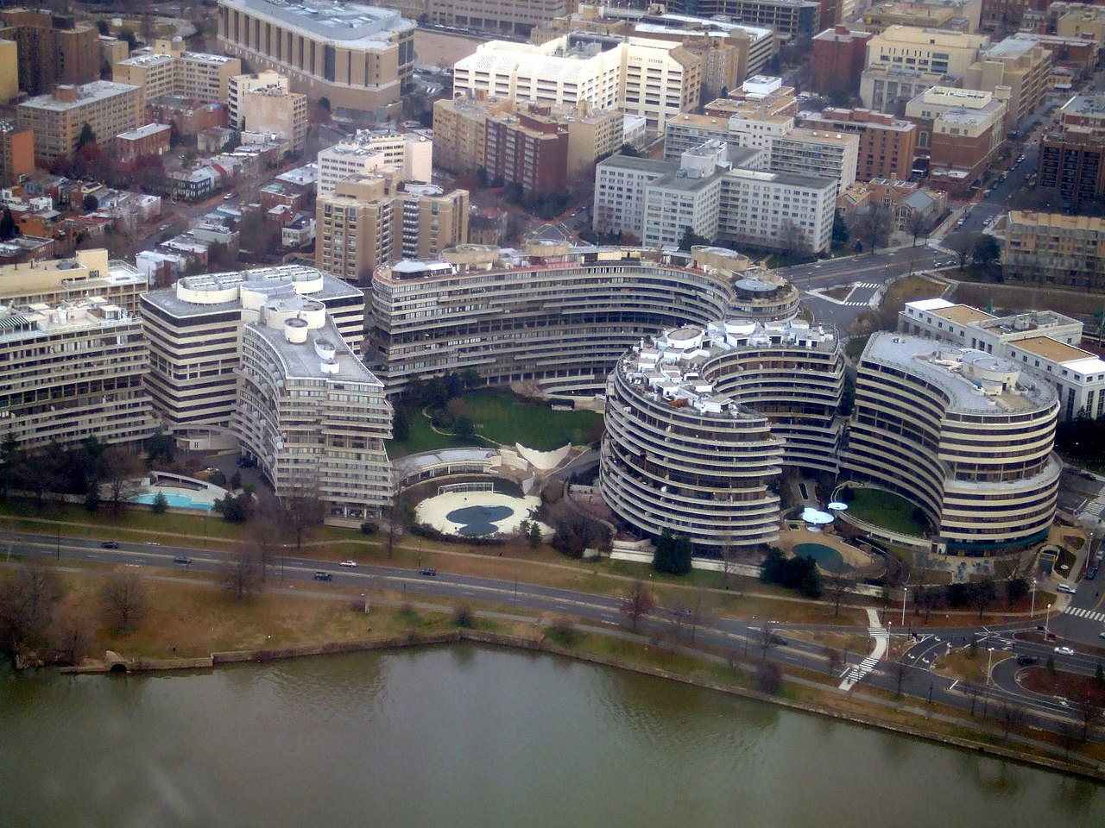
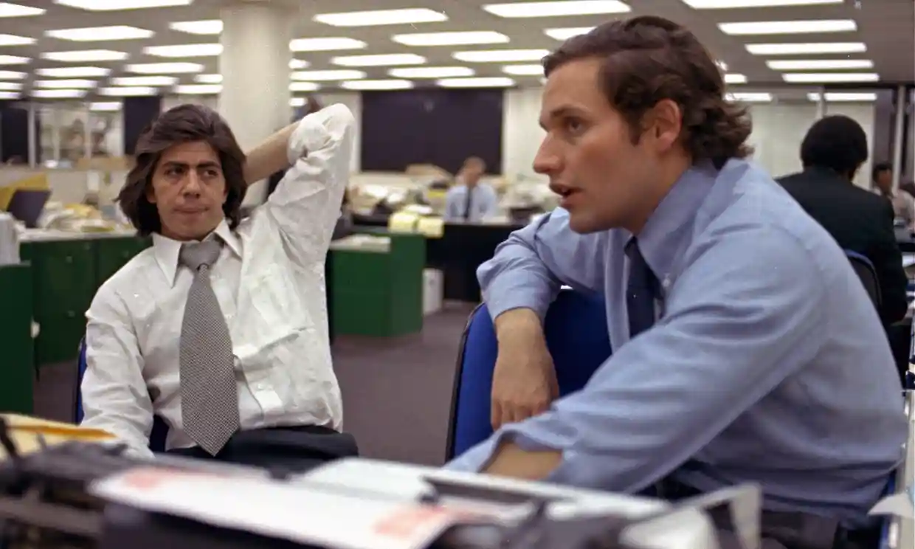
What is knowledge? Watergate (1972-1974). Investigative journalism. Difference to science and scholarship?
Investigative journalism
Woodward and Bernstein

Slide 5
Ajñana (अज्ञान)
Quite well-developed scepticism already 700BC
Ancient, radical Indian scepticism
Knowledge is relative
Hindu-, Jain-
Knowledge at all maybe not possible

Slide 6
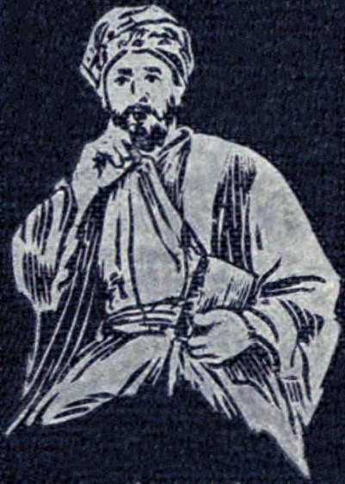
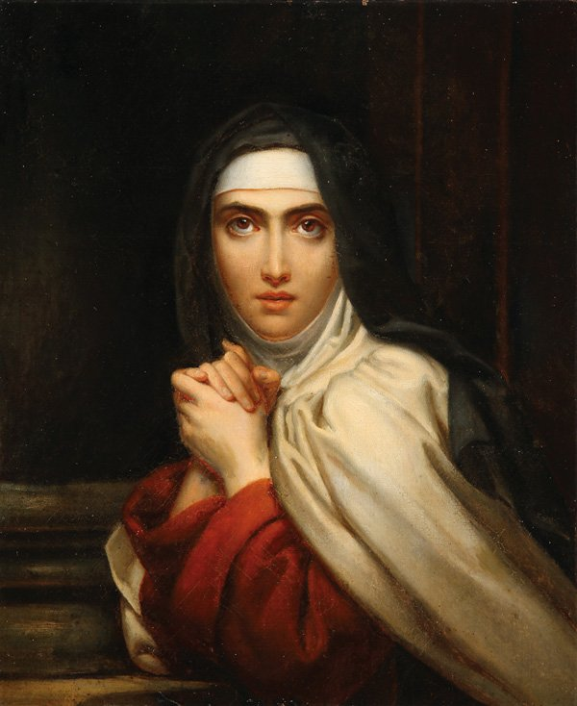
Scepticism as method
Al-Ghazzali (1057-1111)
Teresa de Avila (1515-1582, Spain (François Gérard‘s painting 1827))

Slide 7
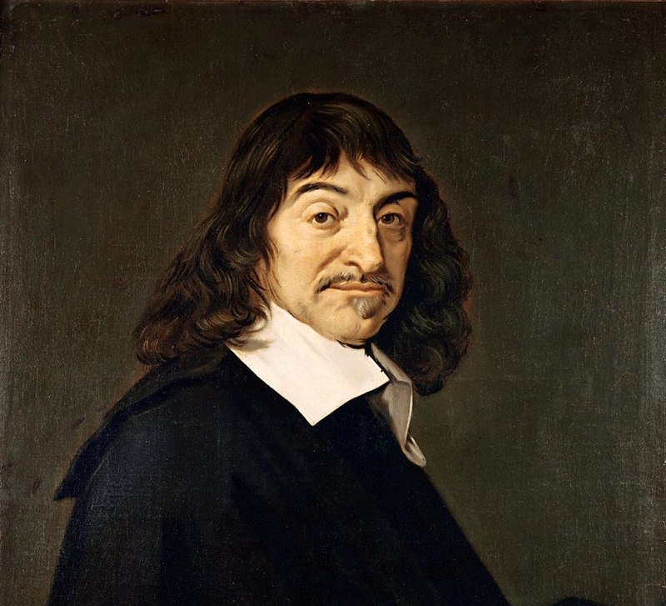
Rationalism
Renè Descartes (1596-1650, Portrait by Frans Hals)
1637 Discourse on the Method
Method of doubt and scepticism
Everyday scepticism (watching e.g. houses)

Slide 8
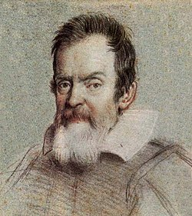
Empiricism
KEY IDEAS
Galileo Galilei (1564-1642)
Knowledge and/or justification comes from sensory experience
No innate ideas (Locke: tabula rasa)
Empiric Greek philosophers ~300 BC (Gorgias, Hippas vs. Plato, even Aristotle)
Bacon, Berkeley, Hume (1600-1750)

Slide 9
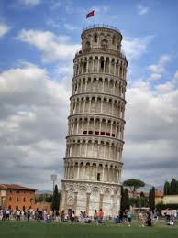
Empiricism in action
Galileo Galilei (1564-1642): objects fall with the same acceleration – vs. Aristotle’s claim that objects fall with speed proportional to their mass
Vs. rationalism

Slide 10
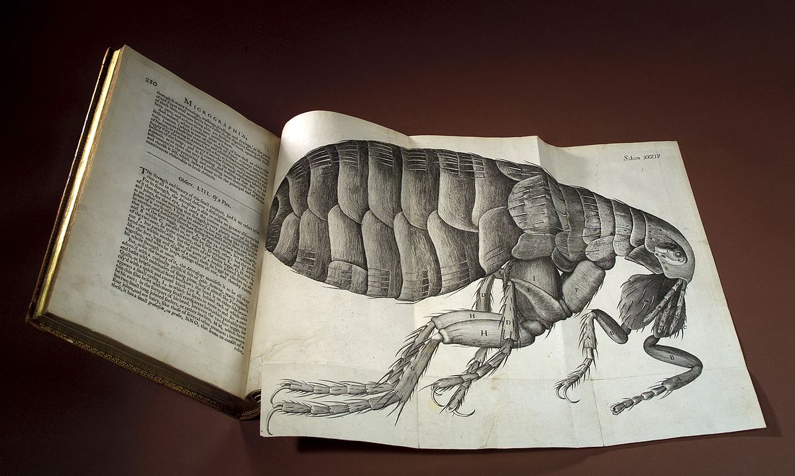
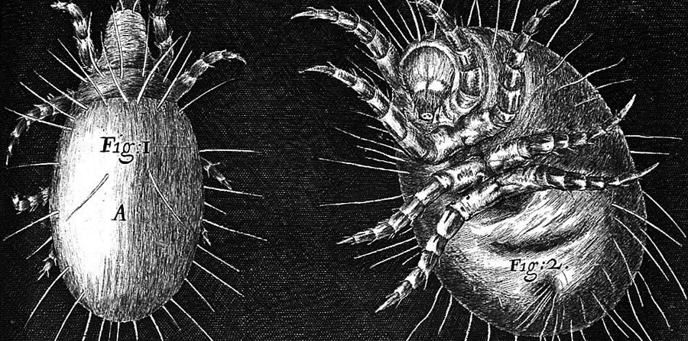
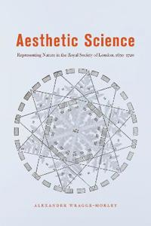
Royal Society of London 1650-1720
aesthetic experience had a central role in the emergence of what we now understand as scientific objectivity
Nature = God’s design
Experiencing that design would cause pleasure
Alexander Wragge-Morley, Aesthetic Science (2020)
Robert Hook, Flea (Micrographia, 1665)
Hook, Mites (1665)
Introduction to the role of art and design in the thinking of the work of the natural scientists of the Royal Society of London

Slide 11
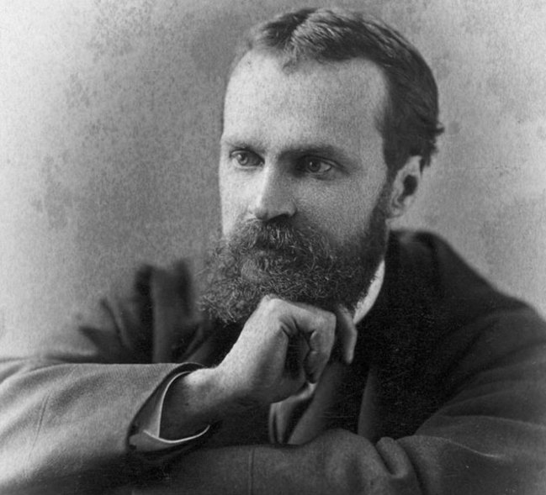
Belief and Knowledge (William James 1842-1910)
Religious experience
We base our way of being in the world by believing in things more than we realize
“China”
Anti-foundationalism (pragmatism)

Slide 12
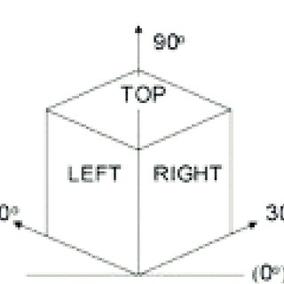
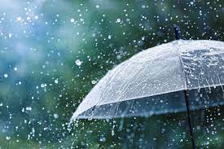
Phenomenology and Knowledge
Continuing the tradition of Descartes (Brentano, Husserl)
Intentionality, cultural understanding (knowledge vs. understanding)

Slide 13
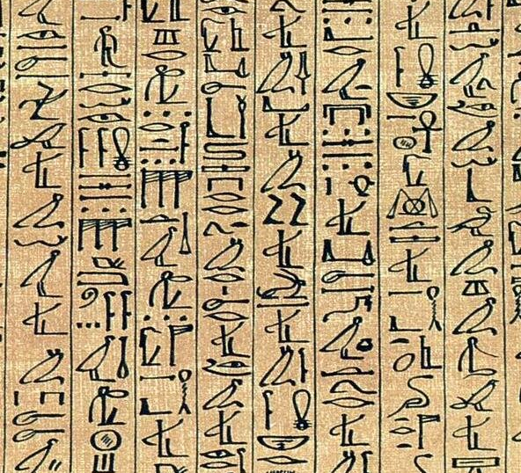
The Role of Writing (some types and thoughts)
Modeling with text what is done in the laboratory
Describing results of e.g. polls or interviews, and reflecting on how to interpret the results
Building knowledge through argumentation
Text in dialogue with artistic work in e.g. artistic research (even poetical)

Slide 14
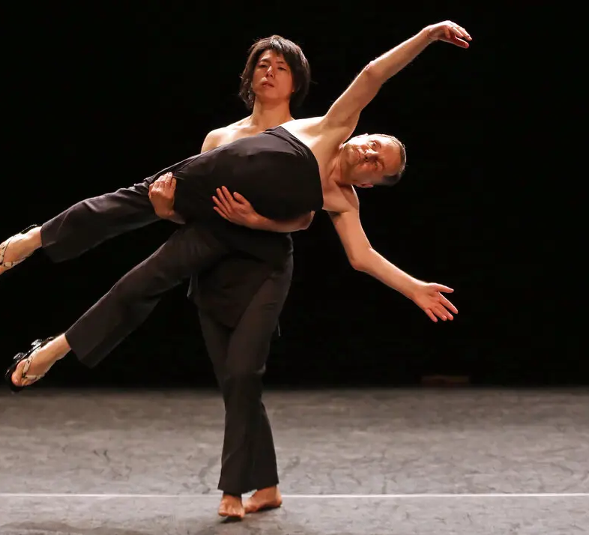
‘Writing with the body’ (Raimund Hoghe, RIP 2021)
What kind of signs and narrations you can do with the body?
What can different bodies write – and can a body that does not suit ideas of normality write differently?
Only allegorical? When is it meaningful to talk about writing?

Slide 15
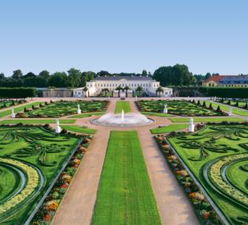
Art-based methods
Arts-informed scholarly work
Art offers ways of knowing that involve sensory perceptions and emotion
Image: Herrenhauser Garden at Hannover, where Gottfried Wilhelm Leibniz (1646-1716) worked – besides his philosophical and scientifical studies
Monadology 1714

Slide 16
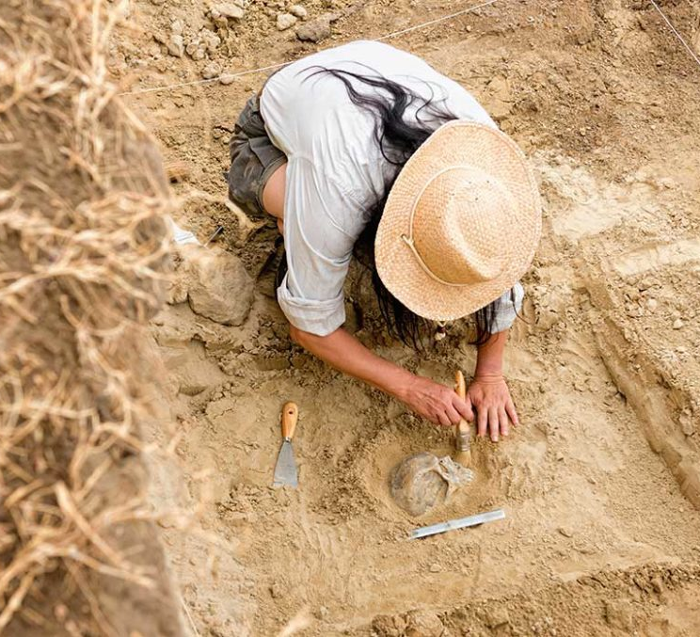
What is knowledge? How to present research results?
Evidence
Open for critique
Different traditions/ways
Epistemology (how to get knowledge)
Sources: perception, memory, testimony, reason
Truth and justification (conceptual definition)
Skepticism
Scientific community
Epistemologies (De Sousa Santos)

Slide 17
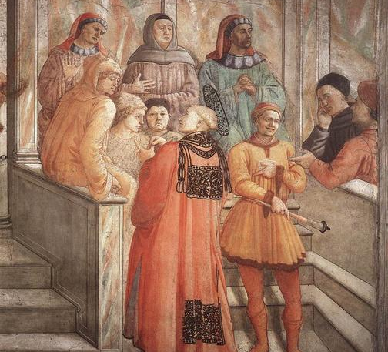
Orders of knowledge
Disciplines
Methods
Authorities
Testing truth-value
Image: Filippo Lippi, Disputation in the Synagogue (1452)

Slide 18
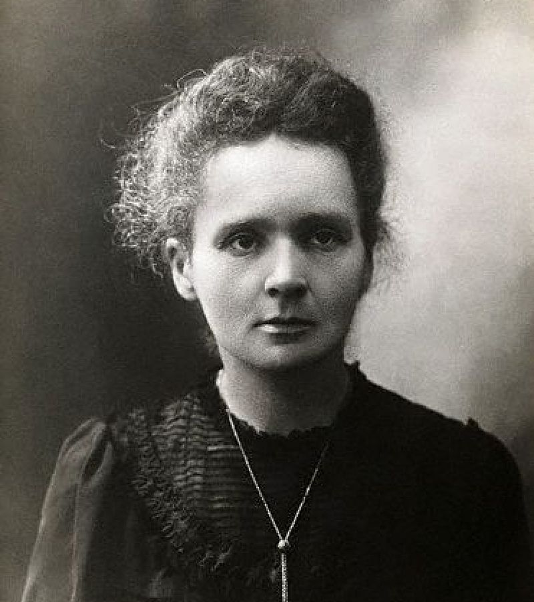
Natural sciences, human sciences, artistic research and the arts
Image: Marie Curie (1867-1934) in her laboratory
(Image: Wikipedia)

Slide 19
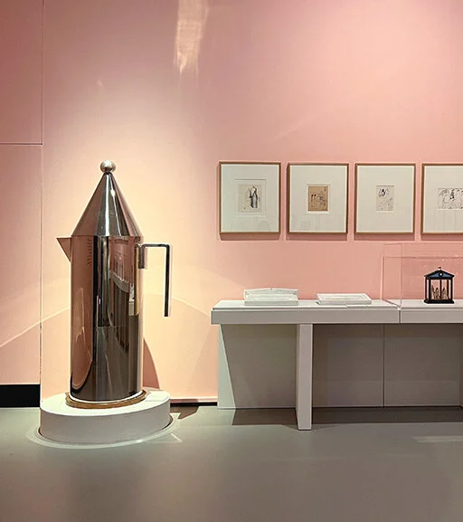
Research methods for art and design
Human-centered design methodologies (e.g. webpages; study of collaboration, empathy, experimentation)
(Background) research for exhibitions
Exhibition as research
Design as research (experimentality)
Image: Aldo Rossi (1931-1997) – a corner at Milan’s Museo del Novecento

Slide 20
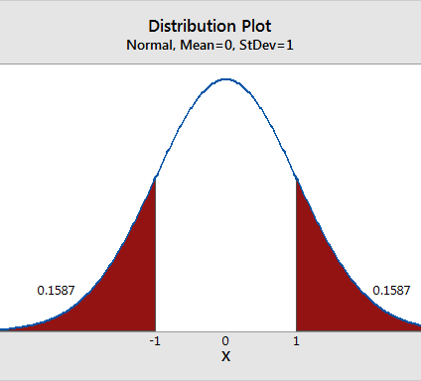
Quantitative methods
Measurements
Statistics
Data
Polls
Questionnaires
Surveys
Not always that “hard” as knowledge as many think

Slide 21
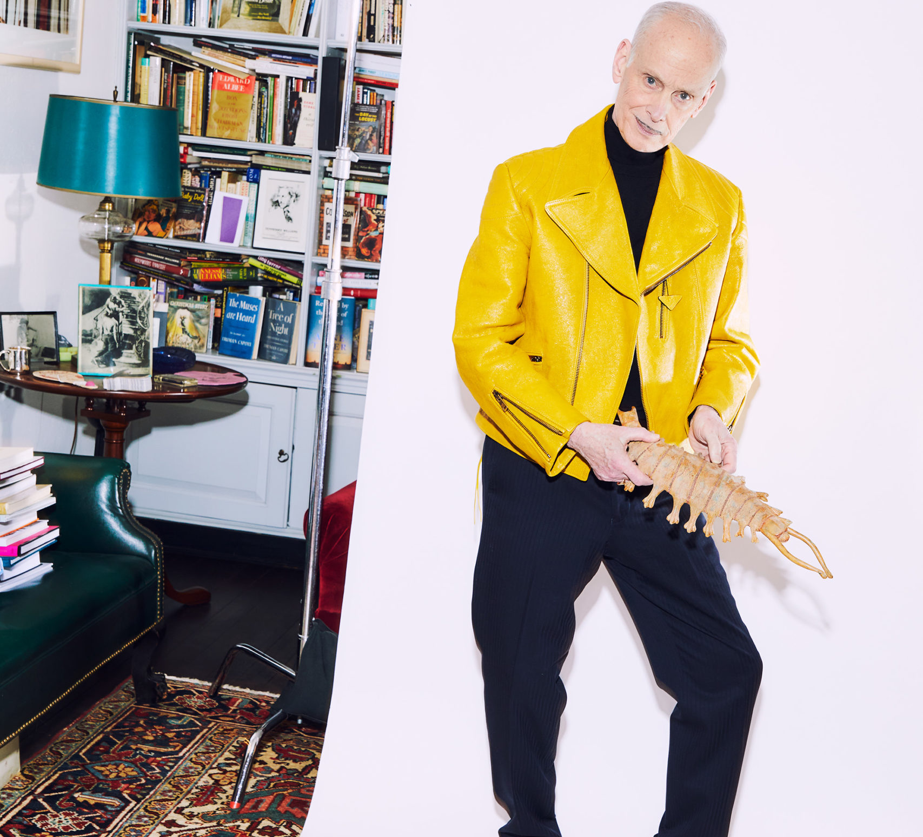
Most common qualitative methods
Participant observation
In-depth interviews
Study of focus groups
Non-numerical
Room for interpretation
Reflection
Dangers e.g. over-interpretation
(John Waters’s image from Interview, pic Charlie Engman: John Waters on Dirt, Scams, and Sensitivity Readers (interviewmagazine.com))

Slide 22

Visual methods
Photography as documentation
Visualizing facts (e.g. about space)
Image: Visualization of Black Hole (NASA)

Slide 23
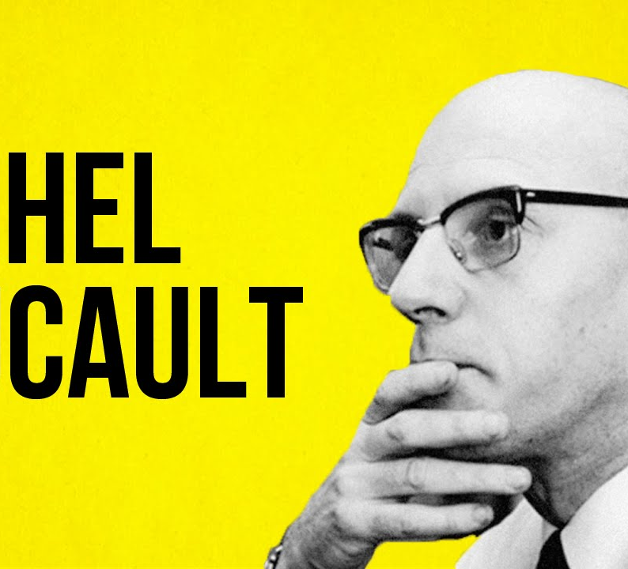
Discourse analysis
Leo Spitzer -> Michel Foucault
The Archeology of Knowledge (1969): meanings produced by language use and communication - production, change and negotiations of meaning (from the point of view of power and empowerment)

Slide 24
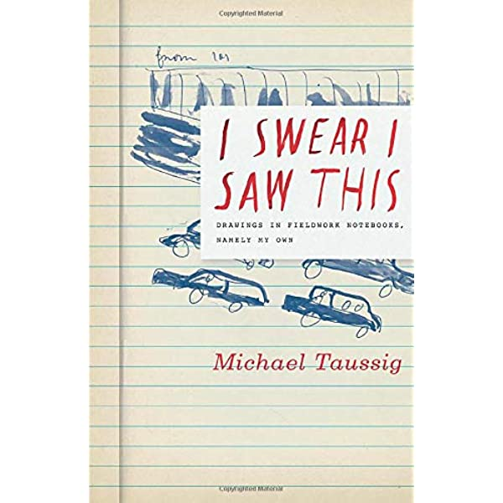
Ethnography and anthropology
Descriptive method (can be visual)
Study of human society and / or culture through participation and reflective perception
Fieldwork
Image: cover of I Swear I saw This by Michael Taussig (2011)

Slide 25
Frameworks (there is an endless amount)
Feminism, Queer and Anti-Binary thinking, gender studies
Intersectionality (Kimberlé Crenshaw, 1989)
Anthropocene (human impact on earth)
New Materialism (‘not just matter’)
Ecology
Activism

Slide 26
New materialisms and more-to-human methods (contemporary thinking)
Being a thing (Mario Perniola)
Elisabeth Povinelli: Geontologies
Life of things (Jane Bennett)

Slide 27
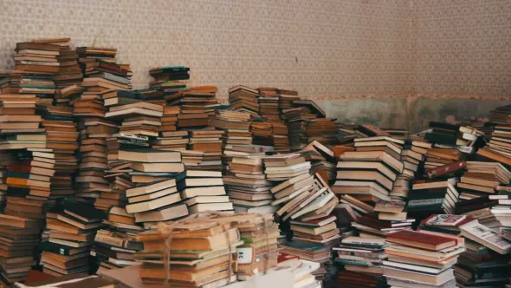
Thank you for listening

