Slide 1
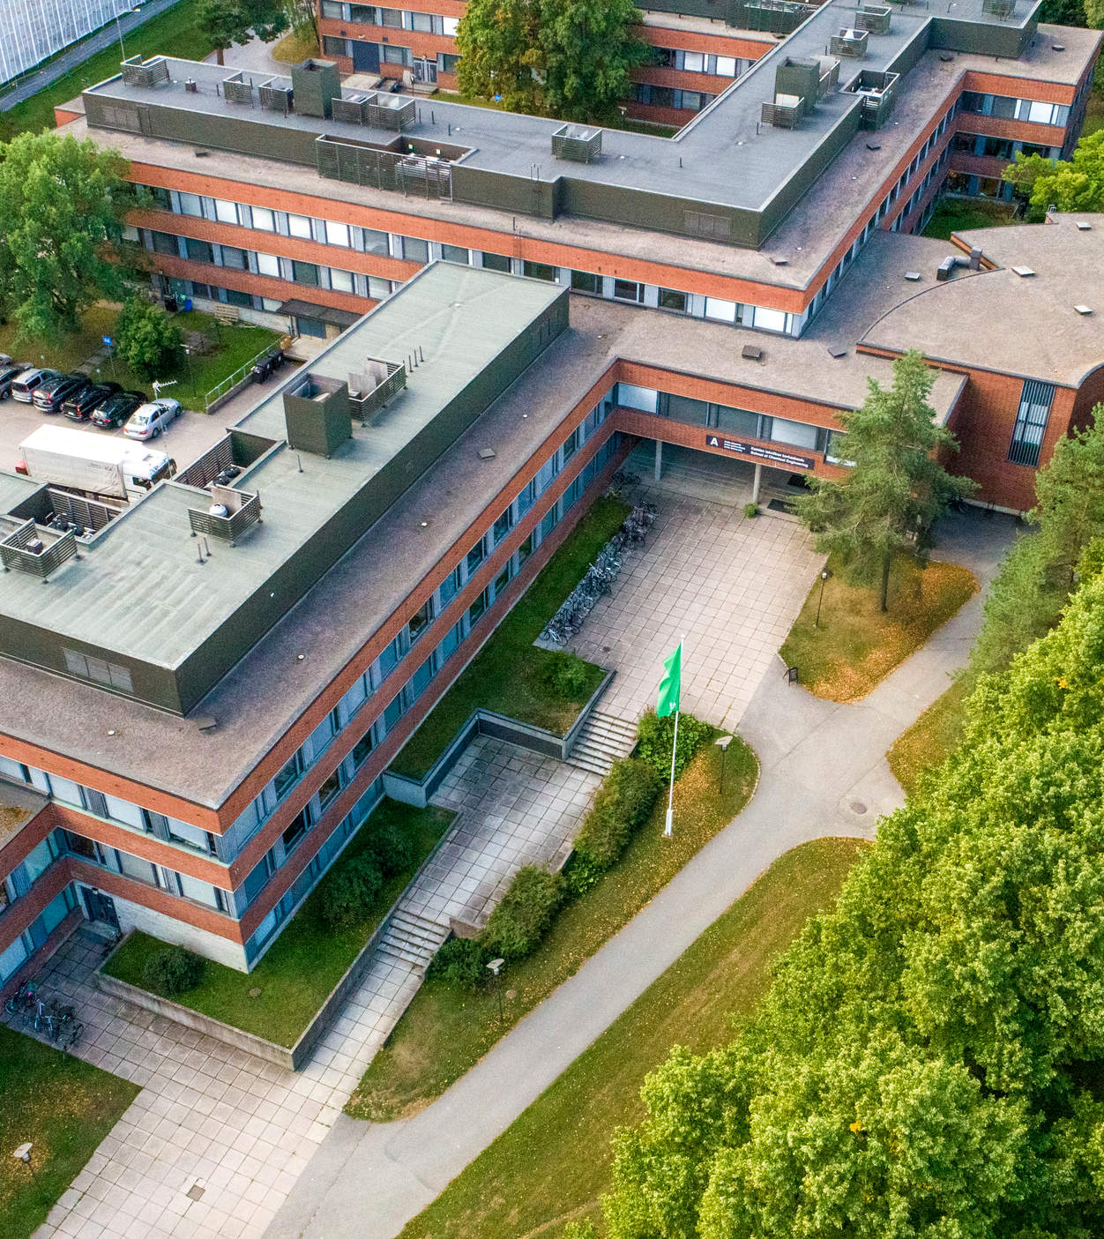
Maisteriopintoihin jatkaminen
Kemian ja materiaalitieteen pääainepalaute
CHEM oppimispalvelut
14.12.2023

Slide 2
Aiheet
Jatkaminen kandista maisteritasolle
Milloin aloittaa maisteriopinnot?
Maisterin portfoliouudistus

Slide 3
Programmes available if you graduate
after 24.6.2024
Master’s Programme in Bioproducts Engineering
Master’s Programme in Biotechnology
Master’s Programme in Chemical and Metallurgical Engineering
  Chemical and Process Engineering
  Sustainable Metallurgical Engineering
Master’s Programme in Chemistry and Materials Science
Programmes available if you graduate before 24.6.2024
Master’s Programme in Chemical, Biochemical and Materials Engineering
Biomass Refining
Biotechnology
Chemical and Process Engineering
Chemistry
Fibre and Polymer Engineering
Functional Materials
Sustainable Metals Processing

Slide 4
Other study options (Aalto joint programmes)
Master’s Programme in Life Science Technologies
  Major: Biosystems and Biomaterials Engineering
Joint programme with SCI and ELEC
Master’s Programme in Advanced Energy Solutions
  Major: Industrial Energy Processes
Joint Programme with ENG and ELEC
Master’s Programme in International Design Business Management
Joint programme with all Aalto schools
Master’s Programme in Creative Sustainability
Joint programme with BIZ and ARTS
Other study options (international joint programmes)
Master’s Programme in Advanced Materials for Innovation and Sustainability (EIT Raw Materials)
European partner universities
Master's Programme in Biological and Chemical Engineering
for a Sustainable Bioeconomy (Bioceb)
European partner universities
European Mining Course
Joint Programme with ENG + European partner universities

Slide 5
Continuing from bachelor to master at Aalto University
Option 1: Continuing in a programme & major that your study right is valid for
Option 2: Within Aalto schools of technology, you can under certain conditions continue your studies in a different school and degree programme than what your original study right was valid for.
Option 3: Applying via master’s admissions:
Aalto master’s admissions, application period: November 30, 2023 – January 2, 2024
International joint programmes: see programme-specific application periods

Slide 6
Option 1: Continuing in a programe & major that your right to study is valid for
Check the possibilities on your bachelor’s programme student guide page:
  Kemian tekniikan kandidaattiohjelma
  Aalto Bachelor’s Programme in Science and Technology
Check course requirements (depends on your bachelor major)
Write the programme (+ major, if applicable) in your graduation application (BSc)
  If you fulfil the requirements, your master level study right starts after graduation

Slide 7
Kemian tekniikan kandidaattiohjelma

Slide 8
Kemian tekniikan kandidaattiohjelma
The following 9 slides apply only to students in Kemian tekniikan kandidaattiohjelma.
Always check the requirements from the programme pages!
Note continuation, see student information page.

Slide 9
Jatkaminen Chemical, Biochemical and Materials Engineering -maisteriohjelmassa,
jos valmistuminen 24.6.2024 mennessä
Opetussuunnitelmat
2018-2020, 2020-2022, 2022-2024

Slide 10
Biotuotteet
Kynnyskurssi, joka täytyy suorittaa, jotta voi jatkaa kyseisessä DI-pääaineessa.
Chemistry
Functional Materials
*suositeltava kurssi, ei pakollinen
Epäorgaaninen kemia
Materiaalien mikrorakenne
Orgaaninen synteesi/
Orgaanisen synteesin perusteet
Materiaalien ominaisuudet
Yksikköoperaatiot
Biotechnology
Biotuotteet
Chemical and Process Engineering
Solu- ja molekyylibiologia
Process Design
Reaktiotekniikka
Suora polku
Suora polku
Process Design*
Biomass Refining
Fibre and Polymer Engineering
Sustainable Metals Processing

Slide 11
Kemia ja materiaalitiede
Kynnyskurssi, joka täytyy suorittaa, jotta voi jatkaa kyseisessä DI-pääaineessa.
Chemistry
Functional Materials
*suositeltava kurssi, ei pakollinen
Suora polku
Suora polku
Bioprosessitekniikka
Process Design
Biotechnology
Kemia ja materiaalitiede
Chemical and Process Engineering
Biochemistry
Yksikköoperaatiot
Solu- ja molekyylibiologia
Reaktiotekniikka
Industrial Biomass Processes*
Industrial Biomass Processes
Process Design*
Biomass Refining
Fibre and Polymer Engineering
Sustainable Metals Processing

Slide 12
Kemian tekniikka ja prosessit
Kynnyskurssi, joka täytyy suorittaa, jotta voi jatkaa kyseisessä DI-pääaineessa.
Chemistry
Functional Materials
*suositeltava kurssi, ei pakollinen
Epäorgaaninen kemia
Materiaalien mikrorakenne
Orgaaninen synteesi /
Orgaanisen synteesin perusteet
Materiaalien ominaisuudet
Bioprosessitekniikka
Biotechnology
Kemian tekniikka ja prosessit
Suora polku
Chemical and Process Engineering
Biochemistry
Solu- ja molekyylibiologia
Industrial Biomass Processes*
Industrial Biomass Processes
Suora polku
Biomass Refining
Fibre and Polymer Engineering
Sustainable Metals Processing

Slide 13
Jatkaminen uusissa maisteriohjelmissa, jos
valmistuminen 24.6.2024 jälkeen

Slide 14
Biotuotteet
Kynnyskurssi, joka täytyy suorittaa, jotta voi jatkaa kyseisessä DI-ohjelmassa.
Bioproducts Engineering
Suora polku
Vähintään kolme seuraavista
Epäorgaaninen kemia
Biotechnology
Biotuotteet
Orgaaninen synteesi / Orgaanisen synteesin perusteet
Chemistry and Materials Science
Solu- ja molekyylibiologia
Materiaalien mikrorakenne
Yksikköoperaatiot
Materiaalien ominaisuudet
Vähintään kaksi seuraavista
Metallurgian prosessit
Process Design
Reaktiotekniikka
Chemical and Metallurgical
Engineering

Slide 15
Kemia ja materiaalitiede
Kynnyskurssi, joka täytyy suorittaa, jotta voi jatkaa kyseisessä DI-ohjelmassa.
Bioproducts Engineering
Industrial Biomass Processes
Biotechnology
Solu- ja molekyylibiologia
Chemistry and Materials Science
Kemia ja materiaalitiede
Suora polku
Bioprocess Technology
Biochemistry
Yksikköoperaatiot
Vähintään kaksi seuraavista
Metallurgian prosessit
Process Design
Reaktiotekniikka
Chemical and Metallurgical
Engineering

Slide 16
Kemian tekniikka ja prosessit
Kynnyskurssi, joka täytyy suorittaa, jotta voi jatkaa kyseisessä DI-ohjelmassa.
Bioproducts Engineering
Industrial Biomass Processes
Vähintään kolme seuraavista
Solu- ja molekyylibiologia
Epäorgaaninen kemia
Biotechnology
Kemian tekniikka ja
prosessit
Orgaaninen synteesi / Orgaanisen synteesin perusteet
Chemistry and Materials Science
Bioprocess Technology
Biochemistry
Materiaalien mikrorakenne
Materiaalien ominaisuudet
Suora polku
Chemical and Metallurgical
Engineering

Slide 17
Yhteisohjelmat, joihin voi jatkaa ilman erillistä hakua

Slide 18
Yhteisohjelmat, joihin voi jatkaa ilman erillistä hakua
Kynnyskurssi, joka täytyy suorittaa, jotta voi jatkaa kyseisessä DI-ohjelmassa.
Life Science Technologies:
Biosystems and Biomaterials Engineering
Orgaaninen synteesi/
Orgaanisen synteesin perusteet *)
Advanced Energy Solutions:
Industrial Energy Processes
Kemian tekniikan kandidaattiohjelma
Suora polku
Solu- ja molekyylibiologia
Biochemistry **)
*) 2018-2020 opetussuunnitelman mukaan opiskeleville
**) 2020-2022 opetussuunnitelman mukaan opiskeleville

Slide 19
Aalto Bachelor’s Programme in Science and Technology – Chemical Engineering

Slide 20
Aalto Bachelor’s Programme in Science and Technology – Chemical Engineering
The following 3 slides apply only to students in Aalto Bachelor’s Programme in Science and Technology – Chemical Engineering
Always check the requirements from the programme pages!
Tuition-fee liable students who complete their Aalto bachelor's degree in normative time (i.e. three years or six terms) with a final grade point average of 3.80 or above, will receive upon application a full, category A scholarship for their Aalto Master's programme, covering 100% of their tuition fees for the normative duration of the master's programme (i.e. two years or four terms).
The scholarship is applied for in Sisu bachelor’s degree graduation request.
→ Read more on aalto.fi

Slide 21
Master’s programme in Chemical, Biochemical and Materials Engineering
The course that must be completed in order to proceed in the program.
Biomass Refining
Chemistry
Biotechnology
Highly recommended for students who started in 2019 or 2020
Compulsory for students who have started in 2021 or later
Elements of organic synthesis OR Organic Synthetic Chemistry
Highly recommended for students who started in 2019 or 2020
Compulsory for students who have started in 2021 or later
Cell and Molecular Biology (in Finnish, an exam offered in English)
Inorganic Chemistry or corresponding knowledge
Fibre and Polymer Engineering
Chemical Engineering
Chemical and Process Engineering
Only through minor “Teollinen prosessitekniikka”
Sustainable Metals Processing
Functional Materials

Slide 22
New CHEM master’s programmes
The course that must be completed in order to proceed in the program.
Bioproducts Engineering
No requirements
Nanomaterials
Biotechnology
Cell and Molecular Biology (in Finnish, an exam offered in English)
Chemical Engineering
Inorganic Chemistry (in Finnish, book exam available)
Chemistry and Materials Science
Fundamentals of Organic Chemistry (in Finnish or completed as independent work)
Process Design
Fluid Flow and Heat Transfer (in Finnish or completed as independent work)
Unit Operations (in Finnish or completed as independent work)
Chemical and Metallurgical
Engineering

Slide 23
Aalto joint programmes
The course that must be completed in order to proceed in the program.
No requirements
Life Science Technologies:
Biosystems and Biomaterials Engineering
For students who started in 2020 or before
Chemical Engineering
For students who started in 2021 or after
Cell and Molecular Biology
(in Finnish, an exam offered in English)

Slide 24
Option 2: Continue your studies in a different school and degree programme
Within Aalto schools of technology, you can under certain conditions continue your studies in a different school and degree programme than what your original right to study was valid for.
Continuing studies in a different school of technology after a Bachelor's degree (aalto.fi)
Write the programme (+ major, if applicable) in your graduation application (BSc)
  If you fulfil the requirements, your master level study right starts after graduation

Slide 25
Option 3: Applying via master’s admissions (CHEM offering)
Some Aalto programmes available only through master’s admissions:
  Creative Sustainability
    Joint programme ARTS-BIZ-CHEM
  International Design Business Management
    40 cr IDBM studies + compulsory CHEM minor
Aalto Master’s Admissions:
30 November – 2 January

Slide 26
Option 4: International joint programmes
Programme-specific admission instructions and schedules
Double or triple degree
Semester or year in another European university
Master’s Programme in Advanced Materials for Innovation and Sustainability (EIT Raw Materials)
European partner universities
Master's Programme in Biological and Chemical Engineering for a Sustainable Bioeconomy (Bioceb)
European partner universities
European Mining Course
Joint Programme with ENG + European partner universities

Slide 27
When to start master studies?
The following slides “When to start master studies” apply only to students who continue their studies at the School of Chemical Engineering with the original study right:
  Kemian tekniikan kandidaatti ja diplomi-insinööri
  CHEM: Aalto Bachelor's Programme in Science and Technology and M.Sc. (Tech)

Slide 28
When to start master studies?
Case 1: Graduating in ~3 years
Great! Your study right to master major will be confirmed after you graduate (BSc), and your master studies start next autumn.
Remember to attend the orientation in the end of August (week 35)!
Case 2: BSc degree almost finished in the beginning of academic year
You may start your master studies in autumn; prioritise finalizing your BSc degree.
As your study right will be confirmed only after getting the BSc degree, you might not have the right to register to all courses
Attend the master orientation in the end of August

Slide 29
When to start master studies?
Case 3: Plenty of bachelor studies left in the beginning of academic year & graduation in spring
Concentrate on finishing your bachelor studies
You may take some master level courses, if you have space in your calendar:
  Elective studies, minor studies…
  Master major courses offered in spring might have some prerequisite courses and/or restrictions in registration
Attend the orientation week in the autumn following your graduation

Slide 30
For information: Renewal of Master’s programmes
CHEM Master’s programmes and majors are being renewed with potential renewed programmes starting in autumn 2024
Work carried out in close collaboration with teaching staff & student reps
Aims of the renewal include:
  Ensuring that we have enough teaching resources and quality can be maintained when numbers of Master’s students are increasing.
  Making sure that teaching equips students for the working life of the (near) future even better
  Enabling smoother progression through studies by making study paths easier to follow

