Slide 1
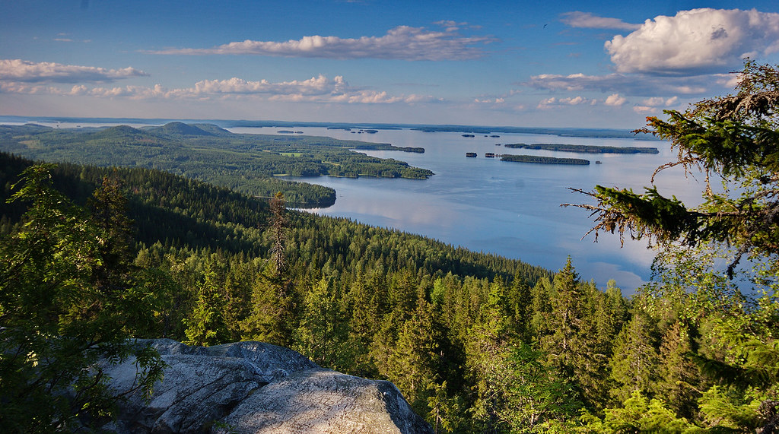
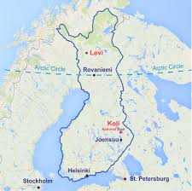
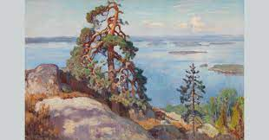
Get to know Finland
2nd meeting
Anja Keränen

Slide 2
Assignment 1: Presentation due 13.2.
MyCourses (instructions):
Presentations:
You will give a 10-minute presentation on a topic related to Finnish culture in the last lesson.
You will be in groups of 3-4 and everyone gives the presentation for their own group, not for the whole group.
It would be nice if you can visualize somehow your topic (e.g. PowerPoint, videos).

Slide 3
Assignment 1: Presentation due 13.2.
MyCourses (instructions):
Choose a topic and write your name and your presentation's topic after the theme in MyCourses.
1. History (a person, an event, an era..):
2.Geography (national Landscape(s), nature, places..):
3. Art and architecture (music, arts, film, literature..):
4. Technology:
5. Business (game industry, design..):
6. Culture (sauna, food, sports..):
7. Your own idea (please give the topic):

Slide 4
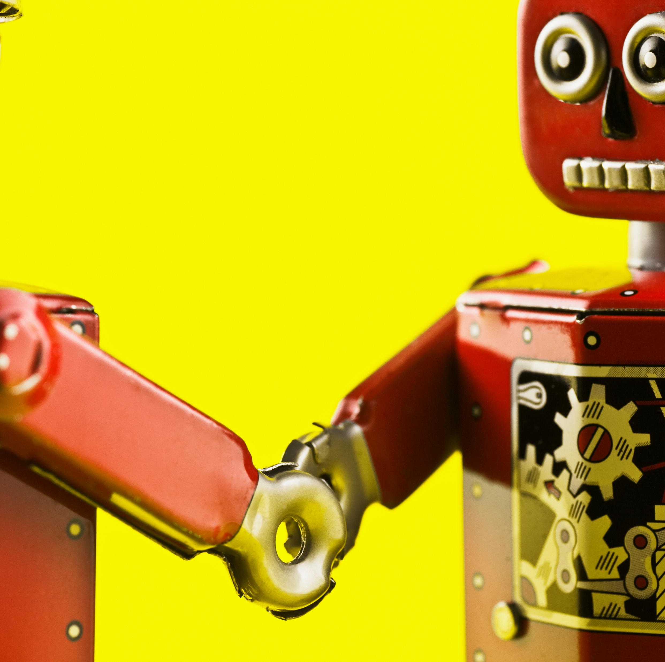
Lesson 2: communication and cultural competence
Today we will discuss..
.. Finnish communication culture
.. stereotypes
.. cultural competence.

Slide 5
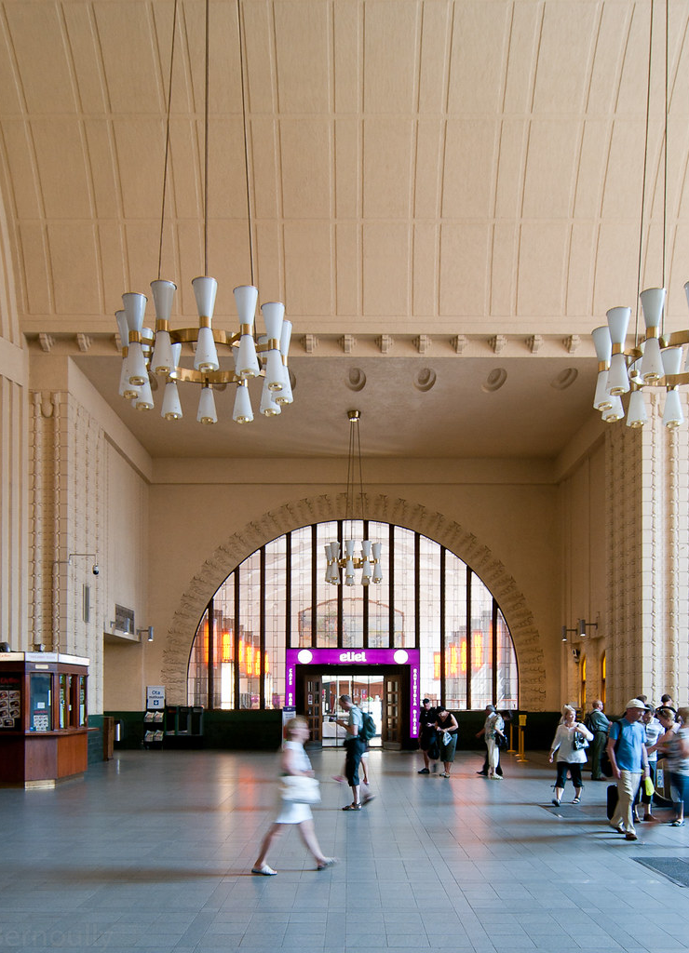
Group discussion: Observations
Haveyoulearnedsomethingnewabout Finns or Finland duringthepastweek?
Anything interesting, odd, or something else youmighthavenoticed?
This Photo by Unknown Author is licensed under CC BY-NC-ND

Slide 6
Finnish communication culture
1) Video
On being polite when greeting or discussing with someone in Finland
2) Group discussion
How would you compare the ways of discussing with or greeting someone (face-to-face, in an email etc.) in Finland and elsewhere?
What is similar, what is different?
What is regarded as polite communication?
Finns and “quietude”: In what ways can silence be interpreted in interaction? How do you feel about silence in conversation?

Slide 7
Finnish communication culture
comfortable silence
turn-taking – listening to others, avoiding interruption and overlapping speech
personal space
spare gestures
low hierarchy
straightforwardness
greeting someone: eye contact, brief and firm, no supporting gestures, informal
Notes:
Hiljaisuudesta: Only a myth?
“That’s just the way we are.”
Recycling of well-known stereotypes
Inevitable part of Finnishness?
How is silence perceived in social action

Slide 8
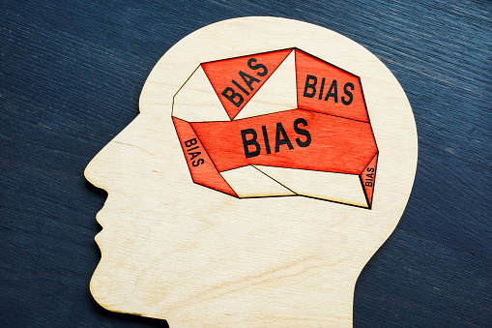
Stereotypes
Simplified perception of someone / group
Stereotypical thinking shapes the we way act and see reality
Stereotypes shape our social reality because they teach us to notice certain things in a certain way
Stereotypes can e.g. lead to individuals to underperform in different situations
The media also plays a great role in maintaining, or disrupting, stereotypes
(More on stereotypes, see e.g. Steele 2010)

Slide 10
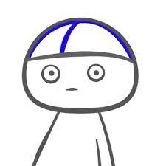
Finnish Nightmares
Finnish nightmares are comics about Matti, a man who feels himself awkward in social situations.
As described in the Finnish nightmares web page:
“Meet Matti, a stereotypical Finn who appreciates peace, quiet and personal space. Matti tries his best to do unto others as he wishes to be done unto him: to give space, be polite and not bother with unnecessary chit chat. As you might’ve guessed, it can’t always go that way.” (http://finnishnightmares.blogspot.com)
The comic is drawn by Karoliina Korhonen.

Slide 11
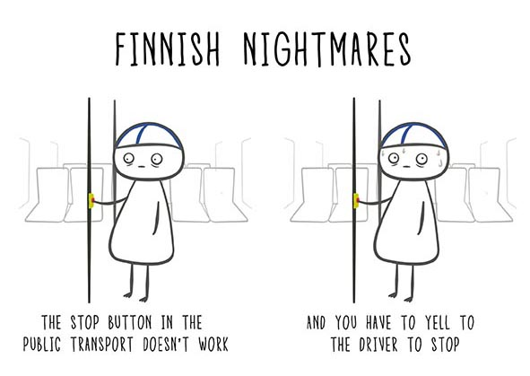
Finnish Nightmares
Group work:
See the Finnish nightmares comics in the course page and discuss:
How does the comic depict a “stereotypical Finn” Matti? What kind of stereotypes is the comic build on?
How does the comic depict the communication culture in Finland?
Think about the homework TEDtalk by Pellegrino Riccardi on crosscultural communication. What does it mean to say “minimum words, maximum message”?

Slide 12
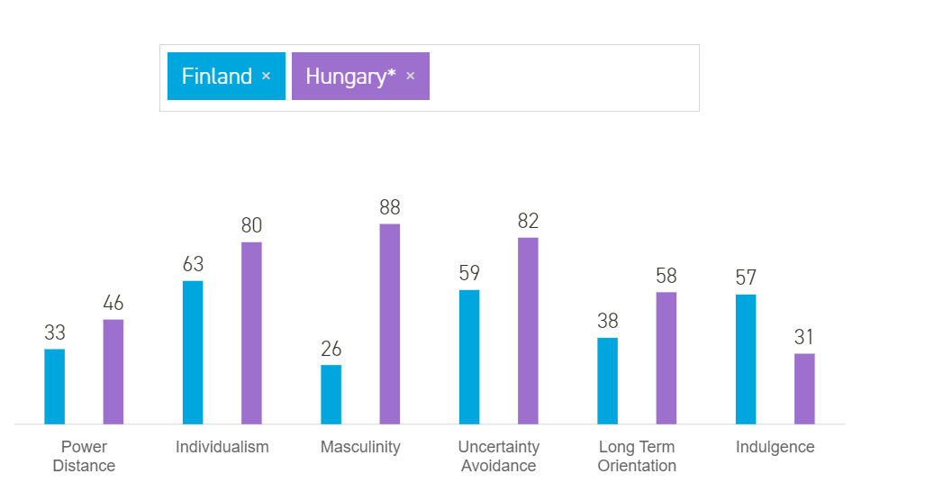
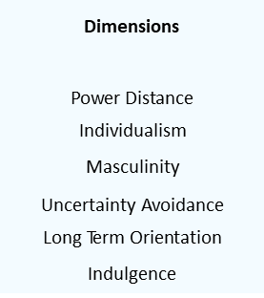
Group discussion:
Cultural dimensions
Which dimension was the most similar/different compared to Finland?
Is Hofstede’s model still a way to depict different cultures? Why, why not?

Slide 13
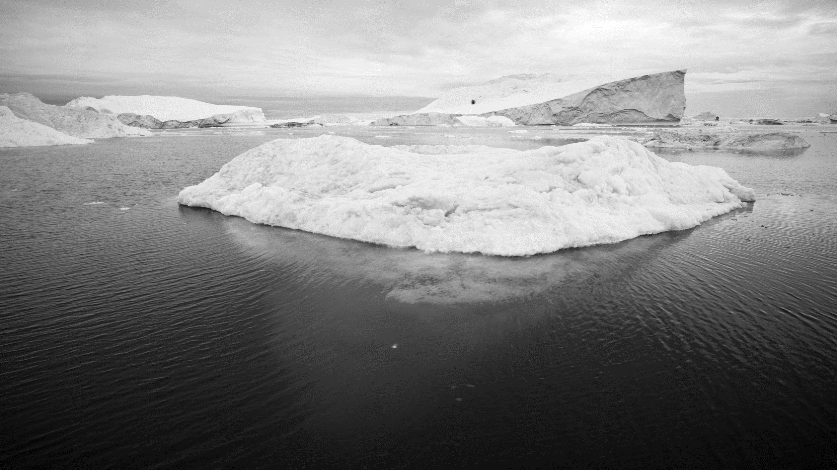
Culture and cultural competence
Cultural iceberg (Hall 1976): We can only see the tip of an iceberg – as of culture we can observe and see only a small piece that is part of a larger whole

Slide 14
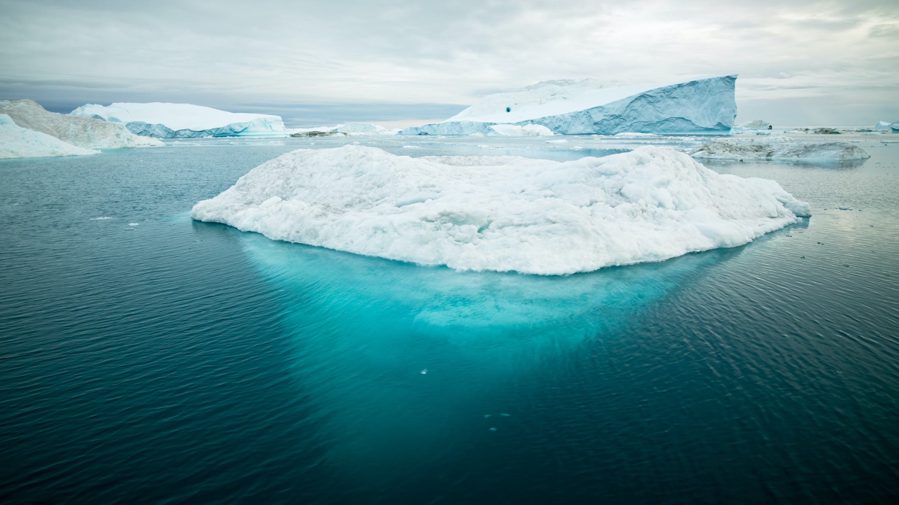
behaviour and artefacts
explicit
observable
accessible to senses
conscious
core values
beliefs implicit
attitudes
not directly observable
subconscious
difficult to change
(E.g. Hall 1976)

Slide 15
Cultural competence
Knowledge about different cultures helps to understand why people behave the way they do
This knowledge also leads to less misunderstandings with people who have a different cultural background
During your stay in Finland, you’ll gain a lot of cultural competence
→ When seeing new ways of living, behaving and thinking you also become aware of your own ways of thinking and living

Slide 19
Pre-tasks for lesson 3
1) Read the article A guide to Finnish customs and manners
Notice: You read only 4 chapters, not the whole article. Be prepared to summarize the main ideas of the chapters to your peers in the group.
Please see your group and which part of the article you read in the course page!
2) Read the article Finland a Society of Trust and write a few thoughts in the Discussion forum:
Things that you find similar and things that are different between your own country and Finland
Your thoughts about trust. What impact trust / lack of trust has in the society?
3) Interview a Finn (document in MyCourses)

Slide 20
1) Read the article: A guide to Finnish customs and manners
Notice: You read only 4 chapters, not the whole article. Be prepared to summarize the main ideas of the chapters to your peers in the group.
Please see your group and which part of the article you read below:
Group 1 read Identity, Religion, Gender, and Conversing:
Group 2 read Information Technology, Languages, Names and Titles, Greeting:
Group 3 read Eating, Drinking, Tipping, Smoking:
Group 4 read Visiting, Time and Seasons, Festivals, the Sauna:
2) Read the article Finland a Society of Trust and write a few thoughts in the Discussion forum:
Things that you find similar and things that are different between your own country and Finland
Your thoughts about trust. What impact trust / lack of trust has in the society?

Slide 21
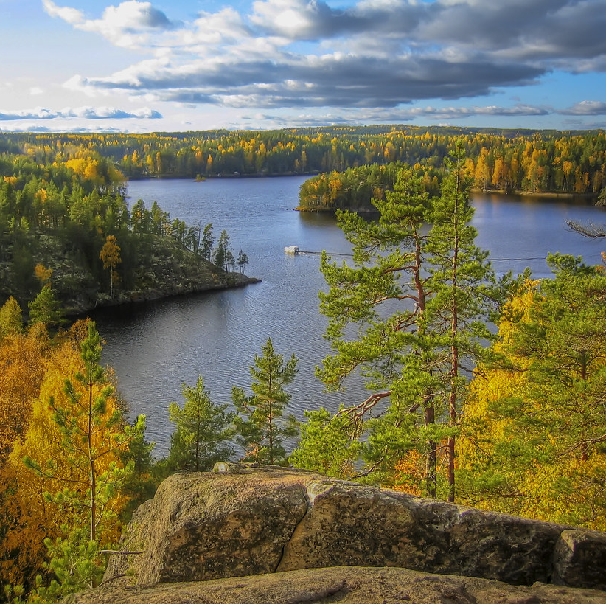
Hyvää loppuviikkoa!
Nähdään taas!

