Slide 1
Title of Presentation in Initial Capitals:
36 Points, Calibri Bold
Replace this box with key image to introduce talk’s scope, importance, or background
Name
Name
Name
Department
Institution
Date
Replace with
your Logo
Notes:
This file presents an assertion-evidence template for making effective slides for scientific presentations. Although much about the layout and typography contrasts sharply with the defaults of PowerPoint, these changes are done so to make the slides more effective at communicating technical information. The design advocated by this template arises from Chapter 4 of The Craft of Scientific Presentations, 2nd edition (Springer, 2013). The homepage for this template exists at the following website:
http://www.assertion-evidence.com/templates.html
Right now you are viewing the notes pages. To work on the slides, click on “Slide” under “View.” Tip: When creating a new presentation, save this file as the name of your presentation. Warning: You are more than welcome to use this template for your presentation slides. You may not, though, distribute this template for profit or distribute this template without giving credit to the source: http://www.assertion-evidence.com/
This slide is for the title slide of a presentation. Consider inserting an image that helps orient the audience to the title. You should not leave this slide until the audience feel comfortable with the title. Forcing yourself to spend more time with this slide is good because a common mistake in presentations is to leave the title slide too soon. Because of this mistake, many in the audience do not have the chance to comprehend the key details of the title. See pages 172-184 in The Craft of Scientific Presentations, 2nd ed. (CSP).

Slide 2
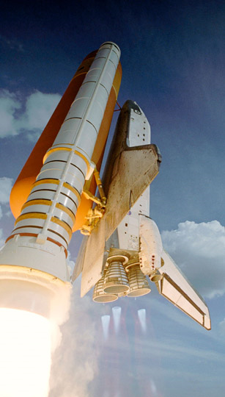


Space Exploration:
To Infinity and Beyond
Kim Harrison
Katie Kirsch
Engineering Ambassadors
Department of Mechanical Engineering
Penn State
[www.pw.utc.com]
Notes:
The beginning of a presentation is important for making the audience excited about and have the audience feel comfortable with the topic. If you are using a slide to open a presentation, include an image or series of images that provides a good entry point to the talk. An effective image helps orient the audience to the key words in the title. An effective image, such as what Kim Harrison and Katie Kirsch included, also gives you the opportunity to say a few things about your work—perhaps addressing the work’s importance or providing key background information. Forcing yourself to spend more time with this slide is good because a common mistake in presentations is not to leave the title slide on long enough. Because of this mistake, many in the audience do not have the chance to comprehend the key details of the title. On this slide, Katie tells a story about seeing the launch of a rocket carrying a satellite. That experience made her interested in space launches.
References:
Alley, Michael (2013). The Craft of Scientific Presentations, 2nd ed. New York: Springer-Verlag.
Alley, Michael (2016). Rethinking scientific 9resentations: The assertion-evidence approach. http://www.assertion-evidence.com.
Harrison, Kim & Kirsch, Kathryn (2010). Space exploration: To infinity and beyond. University Park: Penn State Engineering Ambassadors.
2

Slide 3
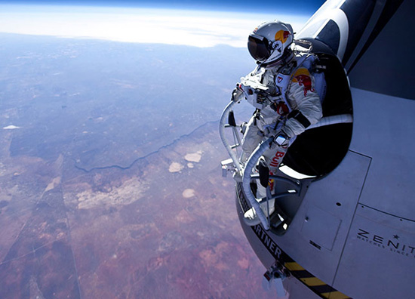

Taking Engineering to New Heights
Lauren Murphy
Sarah Krishner
Engineering Ambassadors
The Pennsylvania State University
3
Notes:
The beginning of a presentation is important for making the audience excited about and have the audience feel comfortable with the topic. If you are using a slide to open a presentation, include an image or series of images that provides a good entry point to the talk. An effective image helps orient the audience to the key words in the title. An effective image, such as what Lauren Murphy and Sarah Krishner included, also gives you the opportunity to say a few things about your work—perhaps addressing the work’s importance or providing key background information. Forcing yourself to spend more time with this slide is good because a common mistake in presentations is not to leave the title slide on long enough. Because of this mistake, many in the audience do not have the chance to comprehend the key details of the title.
References:
Alley, Michael (2013). The Craft of Scientific Presentations, 2nd ed. New York: Springer-Verlag.
Alley, Michael (2016). Rethinking scientific 9resentations: The assertion-evidence approach. http://www.assertion-evidence.com.
Murphy, Lauren & Sarah Krishner (2011). Taking Engineering to New Heights. University Park: Penn State Engineering Ambassadors.

Slide 4
This presentation focuses on… (complete sentence, but go no more than two lines)
Image for
Topic 1
Topic 1
Image for
Topic 2
Topic 2
Image for
Topic 3
Topic 3
Notes:
Mapping slide for the presentation (note that a background slide or a slide justifying the importance might precede this slide). A common mistake with mapping slides is to give the audience simply an unmemorable bulleted list of topics (including the names “Introduction” and “Conclusion” and “Questions”). Such a list is quickly forgotten after the slide is removed.
On a mapping slide, take the opportunity to show a key image or perhaps a representative image for each major section of the presentation. In the second case, each image would be repeated on the first visual of the corresponding section and would remind the audience that they have arrived to a major section of the presentation’s middle.
In regards to the names “Introduction” and “Conclusion,” every talk has those sections, and the names are ignored by audiences. So why state them? Also, for the divisions that you do have, find a logical and parallel grouping. Note that groups of two’s, three’s, and four’s are much easier to remember and are not so nearly intimidating as groups of five’s, six’s, and seven’s. See the discussion of mapping slides in The Craft of Scientific Presentations, 2nd ed. (pages 177-181).

Slide 5
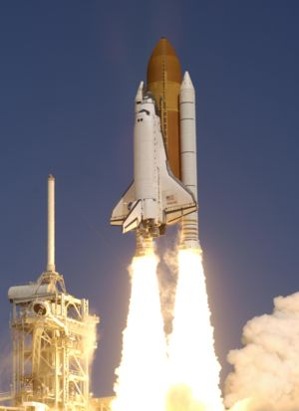
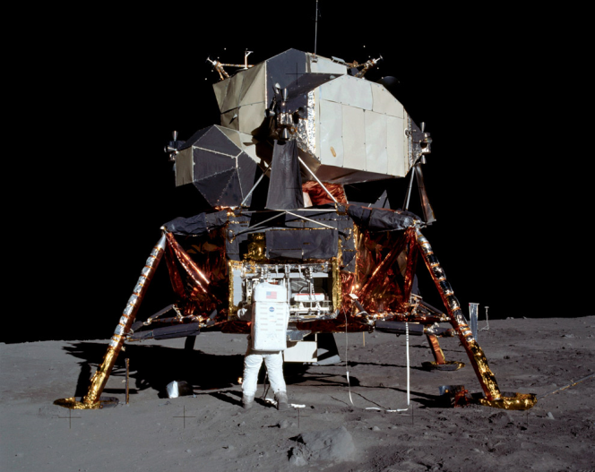
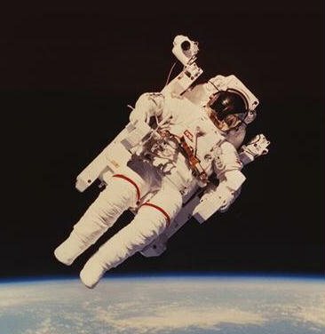
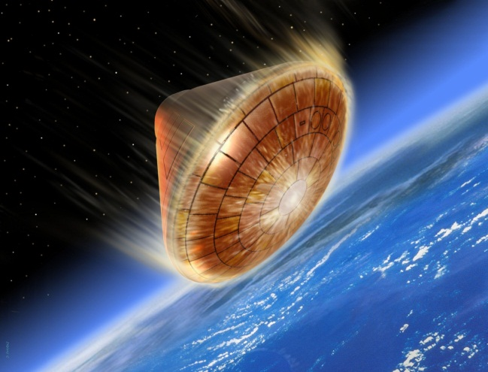
Newton’s laws help engineers fly astronauts to the moon and return them home safely
Propulsion
Landing
Re-entry
Exploration
Notes:
Here’s a mapping slide done the assertion evidence way. It relies on images, as opposed to bullet points. You should have no more than three to four sections on your mapping slide, because as we’ve learned, this is how many points people can remember at one time.
One thing you can do – if you’re giving a particularly long talk – is to come back to this slide as you move from one section to another, to help keep people grounded. You can highlight the picture or section that you’re on.
References:
Alley, Michael (2013). The Craft of Scientific Presentations, 2nd ed. New York: Springer-Verlag.
Alley, Michael (2016). Rethinking scientific 9resentations: The assertion-evidence approach. http://www.assertion-evidence.com.
Harrison, Kim & Kirsch, Kathryn (2010). Space exploration: To infinity and beyond. University Park: Penn State Engineering Ambassadors.

Slide 6
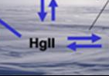
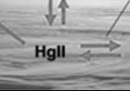
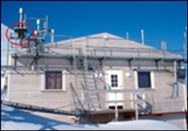
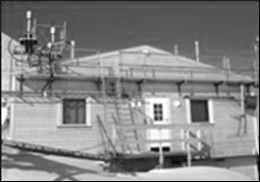
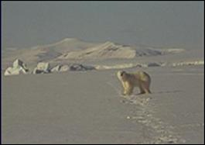
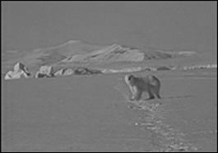
This talk traces what happens to mercury after it depletes from the atmosphere in arctic regions
Theory for mercury cycling
Measurements from Station
Environmental implications
Notes:
Sample mapping slide.
Reference:
Katrina Aspmo, Torunn Berg, and Grethe Wibetoe, “Atmospheric Mercury Depletion Events (AMDEs) in Polar Regions During Arctic Spring,” presentation (Oslo, Norway: University of Oslo, 16 June 2004).

Slide 7
Notes:
Blank slide for drafting mapping slide

Slide 8
This sentence headline makes an assertion on the first topic in no more than two lines
Image(s)
supporting
above assertion
If necessary, identify key assumption or background for audience—keep to two lines (18–24 point type)
Notes:
Body slide from the first section of the presentation’s middle. Consider having the first-topic image from the mapping slide repeated here. Use the headline (no more than two lines) to make an assertion about this topic. In the body of the slide, support that headline with images and with words, if necessary. See Chapter 4 of The Craft of Scientific Presentations, 2nd ed.
This slide shows one orientation for the image and text in the body of the slide. Other orientations appear in this template. Choose the one that best supports your headline assertion.
Some institutions will insist that you place an institutional logo on each slide. Other institutions recommend a logo on the first slide and the last. If you do place a logo on each slide, make sure that logo is at the bottom of the slide rather than the top. Placing the logo at the top (the place on a slide that receives the most emphasis) shifts the emphasis away from the work.

Slide 9

When an object is placed in a liquid, the liquid level rises
Notes:
Example assertion-evidence slide from an engineering ambassador presentation. The sentence headline succinctly states the main message of the slide. The message should be one or two lines—our research has found that headlines more than two lines are not read. The visual evidence in this case is an artistic drawing. Such evidence could be photographs, drawings, diagrams, graphs, films, or equations. Bulleted lists are shunned, because bullets do not show connections.
References:
Alley, Michael (2013). The Craft of Scientific Presentations, 2nd ed. New York: Springer-Verlag.
Alley, Michael (2016). Rethinking scientific 9resentations: The assertion-evidence approach. http://www.assertion-evidence.com.
Kurci, Emil (2016). Boats and Buoyancy. Worcester, MA: WPI, Engineering Ambassadors.

Slide 10
Notes:
Blank slide for drafting a body slide.

Slide 11
Notes:
Blank slide for drafting a body slide.

Slide 12
Notes:
Blank slide for drafting a body slide.

Slide 13
This sentence headline makes an assertion
on the second topic in no more than two lines
Call-out, if necessary: keep
to one or two lines
Call-out, if necessary: keep
to one or two lines
Image or equations supporting
the headline assertion
Call-out, if necessary: keep
to one or two lines
Notes:
Body slide from the second section of the presentation’s middle. For the first body slide of this second section, consider repeating the corresponding image (or equation) from the mapping slide. Use the headline to make an assertion about this topic. In the body of the slide, support that headline assertion with images and needed callouts. See Chapter 4 of The Craft of Scientific Presentations, 2nd ed.
This slide shows one orientation for the image and text in the body of the slide. Other orientations appear in this template. Choose the orientation that best supports your headline assertion.

Slide 14
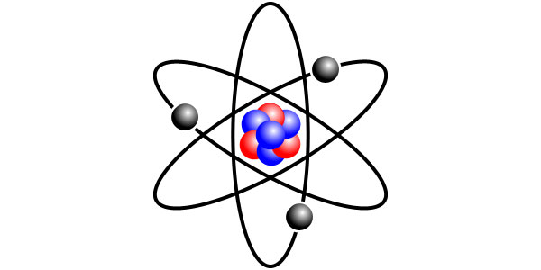

Nuclear energy is the energy that holds protons and
neutrons together in the nucleus of an atom
6,000,000,000,000,000,000,000,000,000,000,000,000,000
times the strength of gravity
Notes:
Example assertion-evidence slide from an engineering ambassador presentation. The sentence headline succinctly states the main message of the slide. The message should be one or two lines—our research has found that headlines more than two lines are not read. The visual evidence in this case is an artistic drawing. Such evidence could be photographs, drawings, diagrams, graphs, films, or equations. Bulleted lists are shunned, because bullets do not show connections.
References:
Alley, Michael (2013). The Craft of Scientific Presentations, 2nd ed. New York: Springer-Verlag.
Alley, Michael (2016). Rethinking scientific 9resentations: The assertion-evidence approach. http://www.assertion-evidence.com.
Atz, Emil, & Nomin Munkhbat (2016). Nuclear Power. Storrs, CT: University of Connecticut, Engineering Ambassadors.

Slide 15
Notes:
Blank slide for drafting a body slide.

Slide 16
Notes:
Blank slide for drafting a body slide.

Slide 17
Notes:
Blank slide for drafting a body slide.

Slide 18
Notes:
Blank slide for drafting a body slide.

Slide 19
This sentence headline makes an assertion
on the third topic in no more than two lines
Image supporting above assertion
Feature or call-out—no more than two lines
Feature or call-out—no more than two lines
Notes:
Body slide from the third section of the presentation’s middle. For the first body slide of this third section, consider repeating the corresponding image from the mapping slide. Use the headline to say state an assertion about this topic. In the body of the slide, support that headline with images and with needed callouts. See Chapter 4 of The Craft of Scientific Presentations, 2nd ed..
This slide shows one orientation for the image and text in the body of the slide. Other orientations appear in this template. Choose the orientation that best supports your headline assertion.

Slide 20
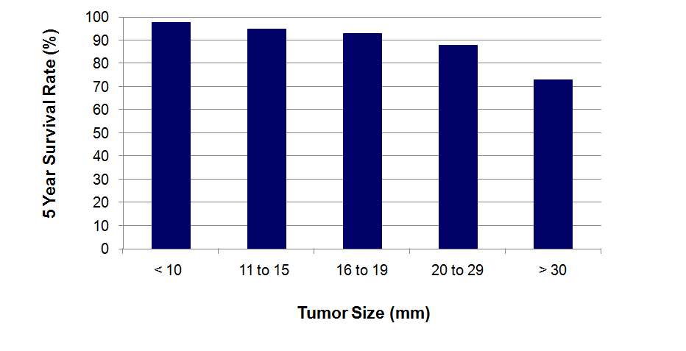

Early detection methods can identify small tumors
and therefore improve survival rates of patients
[Lai et al., 2007]
Notes:
20
This slide was created by Lauren Sawarynski, who earned her B.S. in Bioengineering at Penn State in 2010 and is now in the Physician Assistant Program at Yale Medical School.
Reference for data:
J.K. Lai, M.A. Martin, R. Meyricke, T. O’neill, and S. Roberts (2007, February). Factors associated with short-term hospital readmission rates for breast cancer patients in Western Australia: an observational study. J Am Coll Surg. 204 (2):193-200.
20

Slide 21
Notes:
Blank slide for drafting a body slide.

Slide 22
Notes:
Blank slide for drafting a body slide.

Slide 23
Notes:
Blank slide for drafting a body slide.

Slide 24
In summary, this sentence headline states the most important assertion of the presentation
Image that supports conclusion
Supporting point (no more than two lines)
Another supporting point (parallel to the first)
Questions?
Logo
Notes:
Conclusion slide. Use the headline (no more than two lines) to state your most important conclusion. Begin the headline with In summary or In conclusion to ensure that the audience knows they have come to the presentation’s end. Support that headline with an image and parallel points.
This slide should be your last slide. Audiences lose patience when they believe that they have come to the end, but other slides follow.
Notice that the word Questions appears at the bottom of this slide. That strategy is much more effective than burning a slide with just the word Questions. This slide allows the audience to look at the most important slide of the presentation during the question period. See The Craft of Scientific Presentations, 2nd ed., pages 182-183.

Slide 25

In summary, biomechanics is the science concerned with the internal and external forces acting on the human body
Engineers improve our—
health
happiness
safety
Questions?
Notes:
Sample conclusion slide from WPI Engineering Ambassadors.

Slide 26
Notes:
Blank slide for drafting a body slide.

Slide 27
Notes:
Blank slide for drafting a body slide.

Slide 28
Notes:
Blank slide for drafting a body slide.

