Slide 1
ELEC-E8423 - Smart Grid Modelling of electric vehicle charging load
Iina Ohrankämmen and Kasperi Haapanen
22.03.2022

Slide 2
Introduction
EV = Electric vehicle
BEV = Battery electric vehicle
PHEV = Plug-in hybrid electric vehicle
ICEV = Internal combustion engine vehicle
Contents:
EV penetration
Charging modes
Effects on the grid

Slide 3
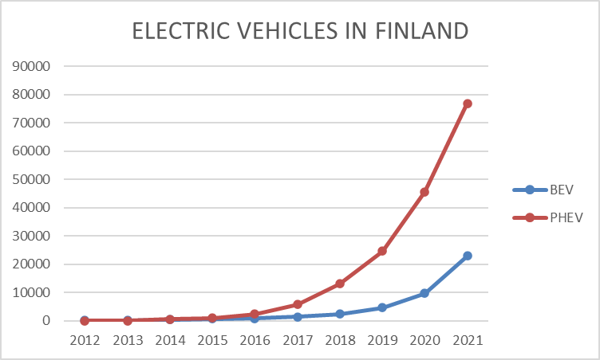
Context
The fleet of EVs is rising rapidly
Still around 3.6 % of total fleet (Finland, 2021)

Slide 4
Why is the change happening?
Price of electricity vs price of fuels
Total life cycle costs are cheaper
Climate concerns
Life cycle GHG emissions of BEV and ICEV with gasoline engine:

Slide 5
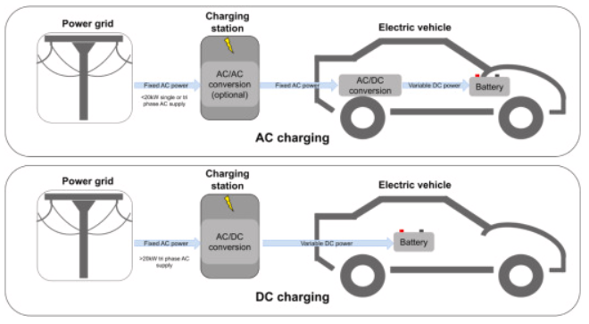
Strategies for charging

Slide 6
Charging types
The charging cable is connected directly to the power supply (for light vehicles, such as electric bike or moped only)
A separate charging unit is integrated in the connection cable, which contains the required control and protection devices
Charging is done by an AC charger installed in the AC mains using a control signal (the most common for BEV)
Charging is done by a DC charger connected to the AC or DC mains (fast charge)

Slide 7
Batteries
Battery types:
Li-ion, LiFePO4 are the most used
Lead acid, Nickel metal hydride, Nickel Cadmium, Lithium Polymer
Energy:
From 10 to 20 kWh for PHEV, from 20 to 100 kWh for BEV
BMW X3 plug in hybrid: 12,0 kWh, Tesla Model S : 100 kWh
What else to consider?
Costs, supply, specific energy, environment…

Slide 8
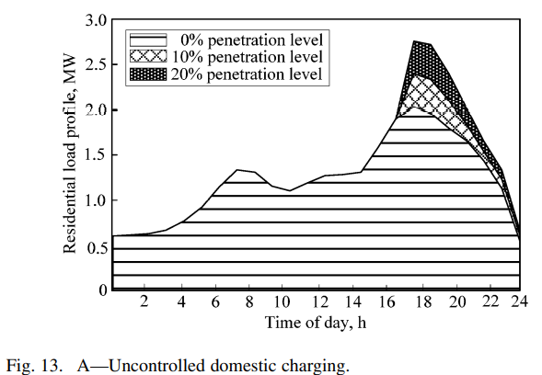
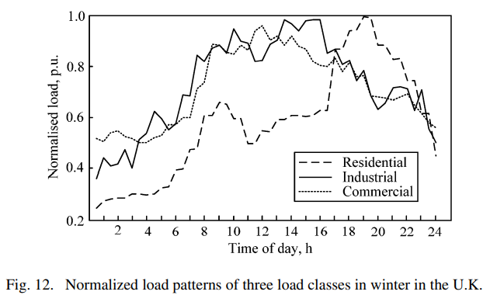
EV charging - effects on the grid
Worst case scenario
All vehicles start charging at the same time
Fixed electricity price

Slide 9
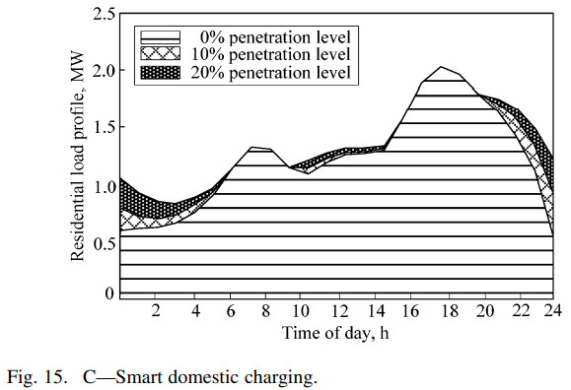
Solution…
Smart charging off-peak
Model optimized by minimizing charging costs
Real-time electricity price & traffic data used
Network load constraints

Slide 10
Conclusions
The EV fleet is growing rapidly due to climate concerns & rising fuel prices
Differences in charging methods between vehicles
Our power grid needs to sustain the charging which is possible with smart solutions

Slide 11
Source material used
Qian K., Zhou C., Allan M. and Yuan Y. 2011. Modelling of Load Demand Due to EV Battery Charging in Distribution Systems. IEEE Transactions on Power Systems. ((Web publication). Vol. 26:2. P. 802-810. ISSN 1558-0679. DOI 10.1109/TPWRS.2010.2057456.
Traficom. 2022. Liikennekäytössä olevat henkilöautot 31.12.2007-2021. Available: https://trafi2.stat.fi/PXWeb/pxweb/fi/TraFi/TraFi__Liikennekaytossa_olevat_ajoneuvot/030_kanta_tau_103.px/table/tableViewLayout1/?rxid=d44ee935-a646-4c12-85d6-766dc63e196d
Bauer, C., Hofer, J., Althaus, H-J., Del Duce, A. ja Simons, A. 2015. The environmental performance of current and future passenger vehicles: Life cycle assessment based on a novel scenario analysis framework. Applied Energy. (Web publication). Vol. 157. S. 871–883. ISSN 03062619. DOI 10.1016/j.apenergy.2015.01.019.
O.Jouini et.al. 2022. Too much or not enough? Planning electric vehicle charging infrastructure: A review of modeling options (Web publication). Volume 153, January 2022, 111719 https://doi.org/10.1016/j.rser.2021.111719
Pelegov D. 2018. Main Drivers of Battery Industry Changes: Electric Vehicles - A Market Overview (Web publication: https://doi.org/10.3390/batteries4040065
Falkman A. 2018. Energy Management in Smart Charging Systems for Electric Vehicles. Master Thesis. Lappeenranta University of Technology. (Web publication) Available at: https://lutpub.lut.fi/bitstream/handle/10024/158518/Diplomity%C3%B6%20Aarni%20Falkman.pdf?sequence=1&isAllowed=y

