Slide 1
ELEC-E8423 - Smart Grid Power markets in Nordic Countries: Frequency containment and frequency restoration reserves
Kaustav Dey
Laura Kanerva
20.4.2022

Slide 2
Introduction
Nordic Frequency Balancing Market structure
Frequency Reserve market production
Price levels
Smart grids and Frequency reserves
Challenges
Conclusion

Slide 3
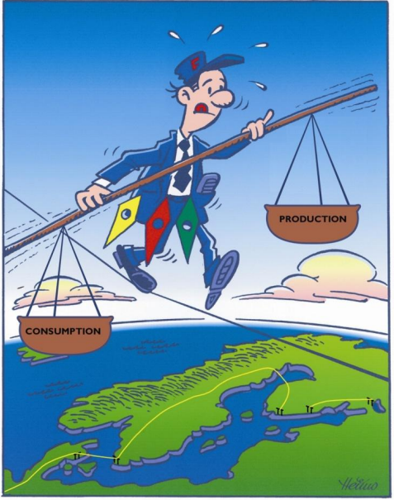
Nordic Frequency Balancing Market structure
Consumption and production must be equal to maintain frequency in 50 Hz.
Finnish TSO Fingrid procures reserves to balance deviations
Reserves can be power plants, consumption resources and energy storages
Finland, Sweden, Norway and East Denmark form Nordic joint system

Slide 4
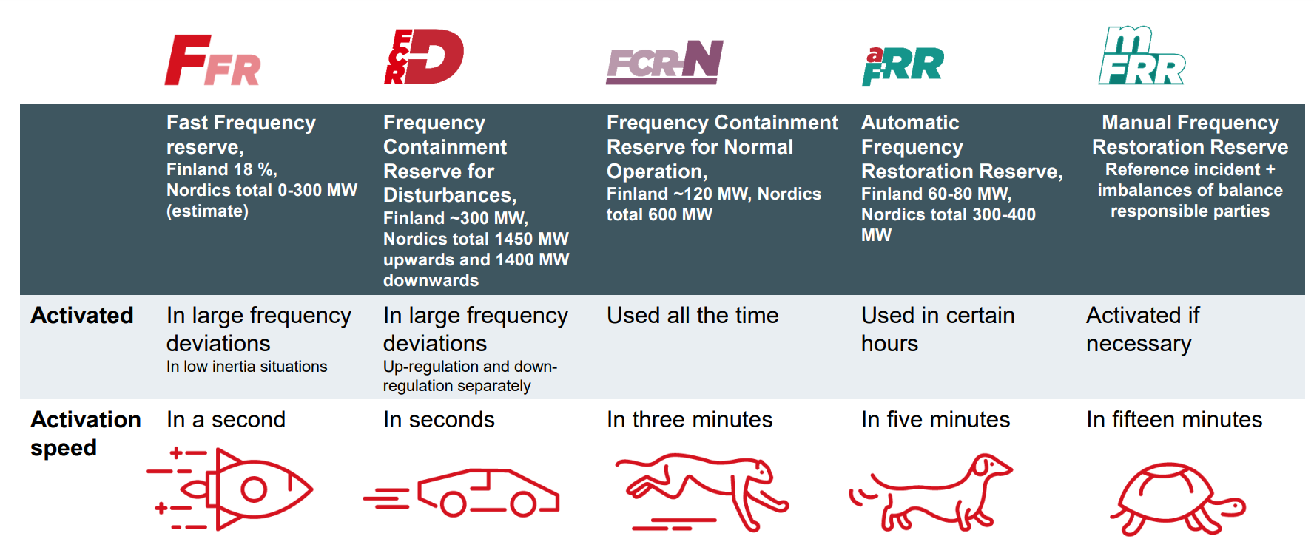
Frequency Reserve market products

Slide 5
Price levels
FFR
Dozens of €/MWh
FCR-D
Yearly market: up around 2 €/MWh
Hourly market: couple of €/MWh to dozens of €/MWh
FCR-D down
Yearly market: around 10 €/MWh
Hourly market: dozens of €/MWh
FCR-N
Yearly market: around 13 €/MWh
Hourly market: dozens of €/MWh
aFRR
Dozens of €/MWh

Slide 6
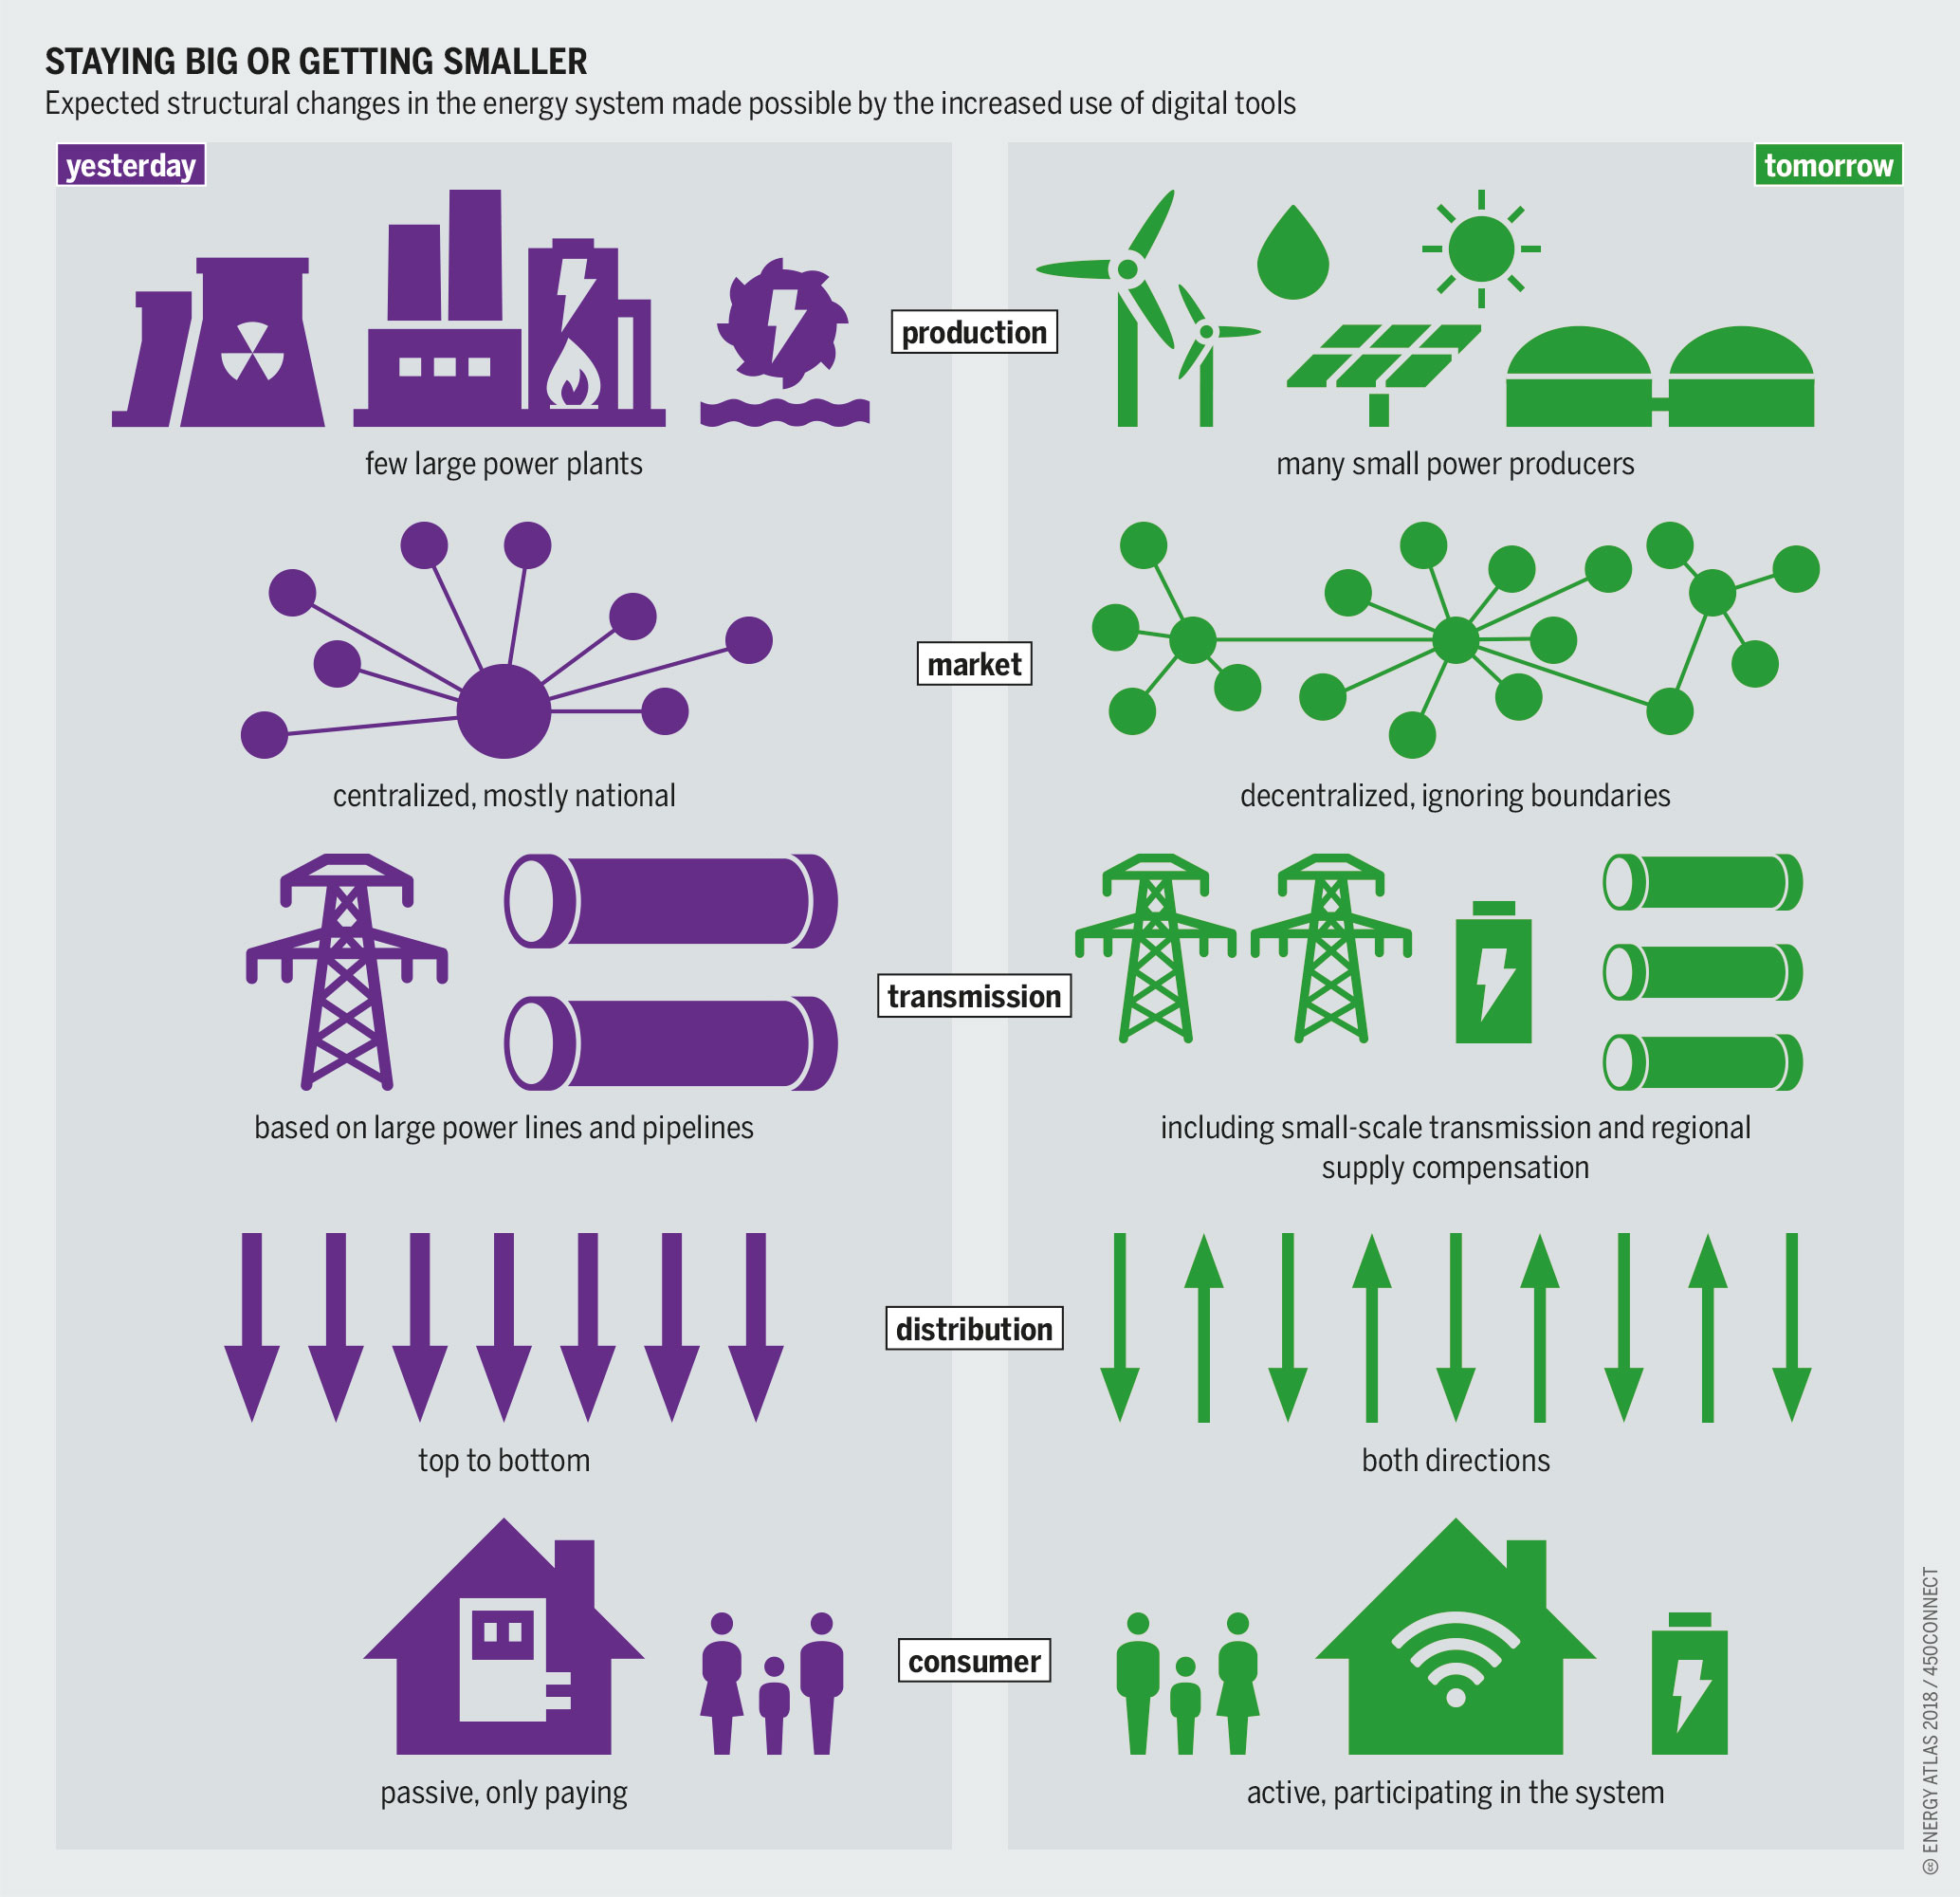
Smart grids and Frequency reserves
Smart grids -> high RES -> Frequency imbalance
Virtual intertia using energy storage systems
Consumer based UPS for frequency reserve
Different types of energy stroages like flywheel, Vanadium redox flow battery and Li-ion batteries

Slide 7
Challenges
Bidirectional flow of electricity will complicate frequency regulation
Heavy distributed generation impacts the inertia of the grid
Fossil fuel-based frequency reserves do not help in clean energy transition
Energy storage systems are still expensive

Slide 8
Conclusion
Frequency control and reserves will become more important in the future
Frequency reserves will have to be proportionally be dimensioned with increasing RES.
Fingrid purchases its frequency containment reserves from domestic as well overseas players

Slide 9
Source material used
https://www.fingrid.fi/globalassets/dokumentit/fi/sahkomarkkinat/reservit/reserve-products-and-reserve-market-places.pdf
https://www.fingrid.fi/en/grid/power-transmission/maintenance-of-power-balance/#frequency-measurement-data
https://smartgrid.ieee.org/bulletins/september-2019/frequency-stability-and-control-in-smart-grids
https://www.sciencedirect.com/science/article/pii/S0142061516000375

