Slide 1
ELEC-E8423 - Smart Grid Eletrical busses and their charging solutions
Eero Autio
Lauri Lavonen
05.04.2022
'

Slide 2
Introduction
Roughly 80 % of the Finnish bus traffic is publicly funded.
2019/1161 (EU) Directive, about clean vehicles in publicly founded transport must be followed.
The main points of directive:
Between 2021 and 2025 41% of the vehicles must be clean
Between 2025 and 2030 59 % of all new vehicles
+ 50 % of the clean vehicles must be “ zero emission vehicles”
Practically when speaking about busses “zero emission vehicles” are electric busses because hydrogen busses are not available in the markets.
Hydrogen, electric, electric – hybrid, natural gas and biofuels fulfills the clean vehicle standards.

Slide 3
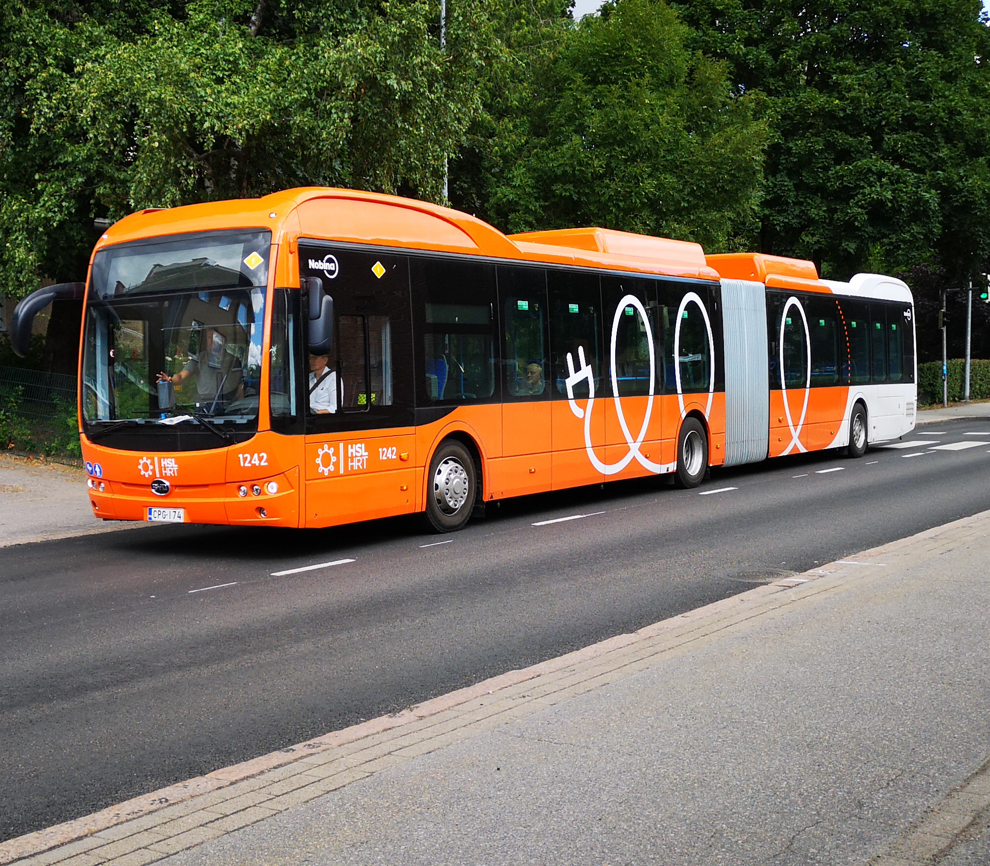
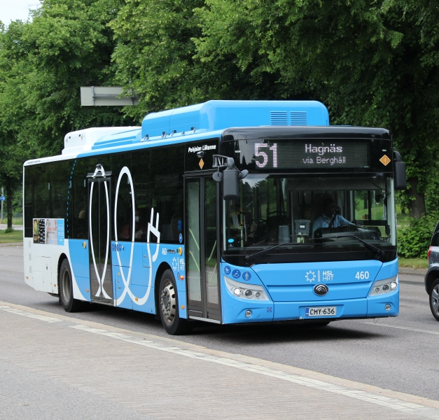
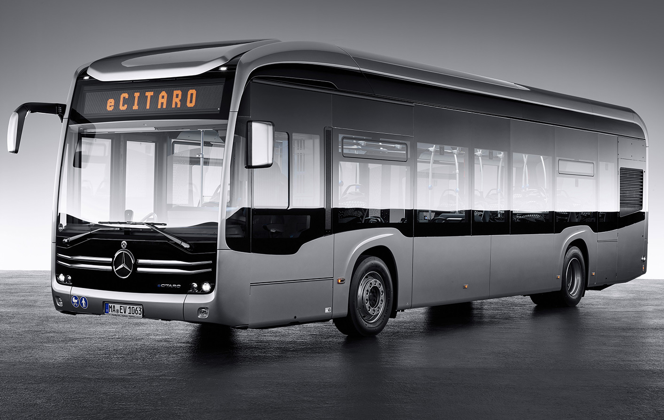
Electric busses
Most popular Electric busses in Finland:
BYD (Chines EV manufacturer)
Yutong (Chines EV manufacturer)
VDL, Volvo and Mercedes Benz (European manufacturers)

Slide 4
Techical specs of different EV busses
Model | BYD 12m ebus | Yutong E12 | VDL Citea SLE 120 electric | VDL Citea LLE Diesel
Battery size | 446 kWh | 422 kWh | 490 kWh | -
Range | 400 km | 400 km | 500 km | 2000 km
Price estimation | 400 000 € | 400 000 € | 500 000 € | 225 000 €
Consumption (kWh/100km) | 110 | 105 | 100 | 450
Manufacturing country | China | China | Netherlands | Netherlands

Slide 5
Techical specs of EV bus charging
Charger type | Slow charger | Fast charger | Hybrid car home charger
Charging power | 20 – 60 kW | 300 kW | 3,7-11 kW
Price with out assembly | 20 000 € | 150 000 – 300 000 € | 900 €
400 kWh battery charging time | 20 h - 6 h 40 min | 1 h 20 min | 108 h – 36 h
Location | Depot | Depot or bus station

Slide 6
EV bus charging in city bus transport
We wanted to compare the techincal charging solutions to the current energy consumption.
Estimations are based in the HSL area and compared to energy consumption in Helsinki

Slide 7
EV bus charging in city bus transport
HSL area has roughly 1300 busses
Scenario 1:
Fast chargers and simultaneous charging with 300 kW chargers:
Total charging power: 1300 * 300 kW * 1,66 h = 647 MWh
Combine charging power per hour: 1300 * 300 kW = 390 MWh
Scenario 2:
All busses charged during the night between 21:00 – 05:00
average charging power: 647 MWh / (8h * 1300) = 62 kW
Combined charging power per hour: 1300 * 62 kW = 81 MWh
Scenario 3:
2/3 of the busses are charged during the night between 21:00 – 05:00. The average remaining battery charge is 25 %.
average charging power: (0,75*647 MWh) / (8h * (1300*2/3) = 31 kW
Combined charging power per hour: 2/3 * 1300 * 31 kW = 26 MWh

Slide 8
Comparison of charging scenarios

Slide 9
Conclusions
- EU Directives:
Diesel busses Electric busses
- Modern EV busses have roughly 500 kWh batteries. They can be charged with up to 300 kW power.
- Charging of large EV bus fleets can have major effects to power-grid stability.
- Dynamic pricing, smart charging, and schedule planning are key solutions to charging problems.

Slide 10
Sources
https://www.helen.fi/helen-oy/vastuullisuus/ajankohtaista/blogi/2020/miten-korona-vaikuttaa
https://www.hsl.fi/hsl/sahkobussit
https://kuljetusnet.fi/vdl-esitteli-uuden-s%C3%A4hk%C3%B6-citea-malliston-ensimm%C3%A4iset-lahteen.html
Email interviev with Sami Ojamo (VDL) and Mikko Kytölä (Yutong)

