Slide 1
Role of DR, storages and hydrogen in future energy systems ELEC-E8423 - Smart Grid
Saied Amanpour
Zhineng Fei
12.03.2024

Slide 2
Introduction
As more unstable renewable energy sources are added to the grid, the imbalance between supply and demand increases.
Demand response (DR) and energy storage solutions have been developed to address this issue and are likely to play an important role in future energy systems.
Presentation contents:
Future Energy Systems
The Role of Energy Storage Systems
Case Study 1
Demand Response (DR)
Hydrogen Energy
Case Study 2
Conclusions
Source Material

Slide 3
Future Energy Systems
 | Pros | Cons
Renewable Energy Systems | - Abundant and clean sources of power - Reduces greenhouse gas emissions - Promotes energy independence - Creates job opportunities in the renewable energy sector | - Intermittency and variability require solutions for energy storage and grid balancing - High initial investment costs (though decreasing over time)
Distributed Energy Systems | - Reduces transmission losses - Improves grid resilience - Promotes energy self-sufficiency - Efficient integration of renewable energy sources | - Integration challenges with existing centralized grid infrastructure - Regulatory barriers and lack of standardized protocols for grid interconnection
Smart Grids | - Optimizes generation, distribution, and consumption of electricity - Improves grid reliability - Enables real-time monitoring and control - Facilitates integration of renewable energy sources and electric vehicles | - Requires significant investment to upgrade existing grid infrastructure - Potential resistance from traditional utilities - Privacy and cybersecurity concerns related to data sharing
Microgrids | - Enhances grid resilience - Provides backup power during outages - Supports community-based renewable energy projects | - High initial costs for implementation, especially in remote or island communities - Regulatory and policy barriers to widespread deployment
Hybrid Energy Systems | - Maximizes efficiency, reliability, and flexibility - Provides continuous power supply from multiple sources - Reduces dependence on single energy sources | - Requires careful design and optimization considering component interactions and control strategies - Integration challenges between different technologies
Carbon Capture and Storage (CCS) | - Mitigates climate change by capturing carbon dioxide emissions - Enables continued use of fossil fuels with reduced greenhouse gas emissions | - Expensive to implement - May reduce overall energy efficiency - Storage site selection and monitoring challenges to prevent leakage and ensure stability

Slide 4
The Role of Energy Storage Systems
Facilitating Renewable Energy Integration
By addressing the intermittency and variability of renewable energy sources.
Enhancing Grid Stability and Reliability
By providing frequency regulation, voltage support, and backup power during outages.
Enabling Energy Resilience and Security
By decentralizing power generation and distribution.
Optimizing Energy Use and Efficiency
By enabling demand response, load shifting, and peak shaving. They help manage energy consumption patterns, reduce peak demand charges, and lower overall energy costs.
Accelerating Electrification and Decarbonization
By enabling the transition to clean and sustainable energy sources while reducing CO2 emissions and combating climate change.

Slide 5
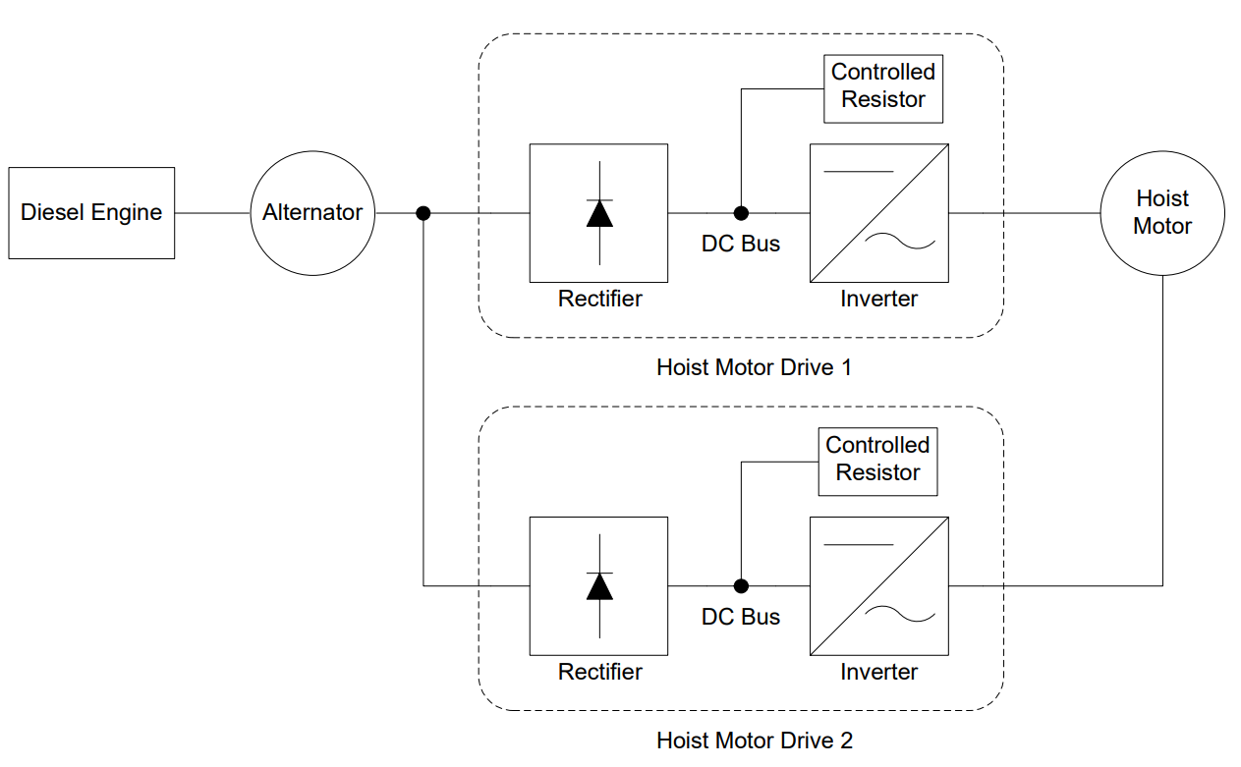
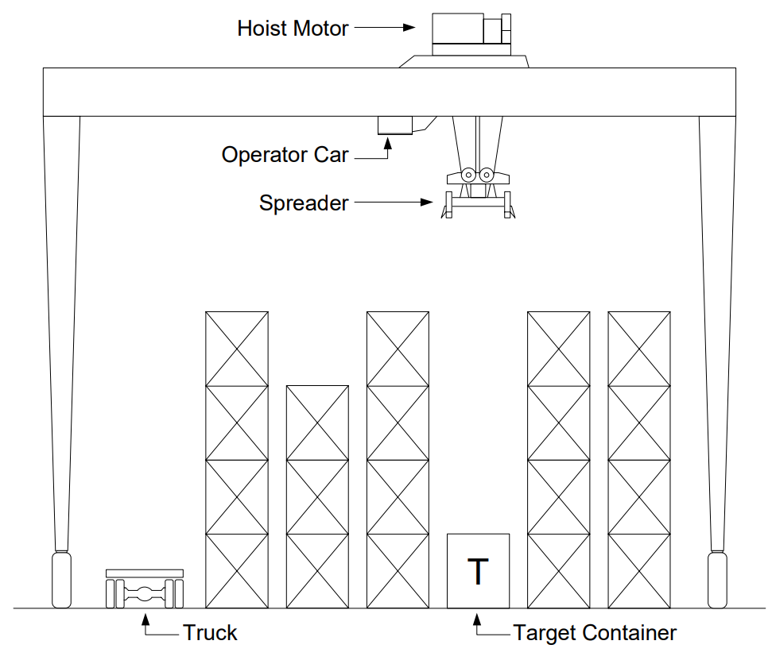
Case Study 1: RTG Crane

Slide 6
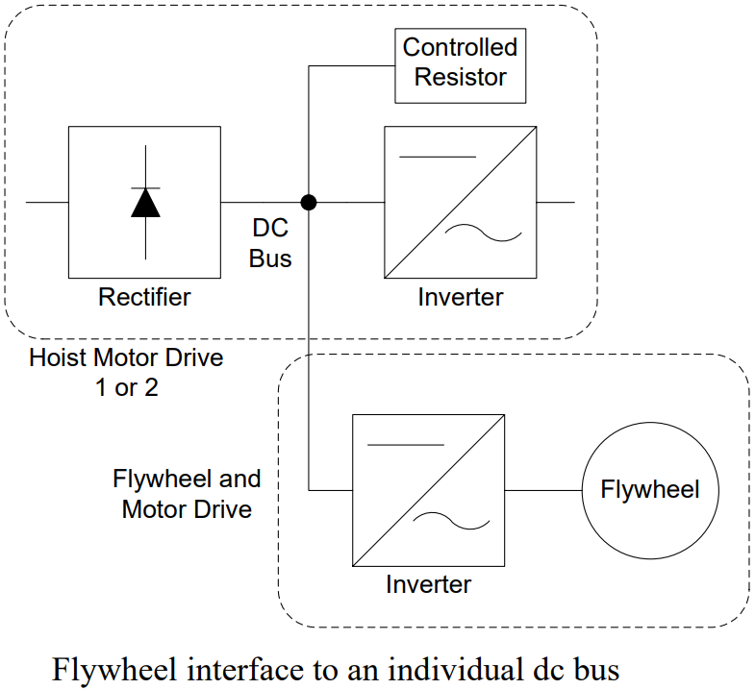
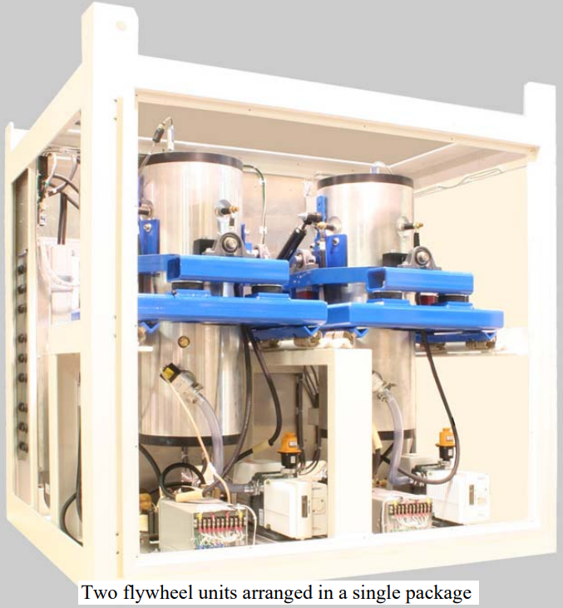
Case Study 1: Flywheel
Vycon
150 kW
0.3 kWh
RTE 80.1%

Slide 7
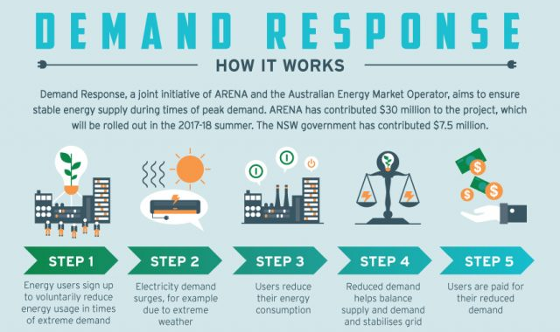
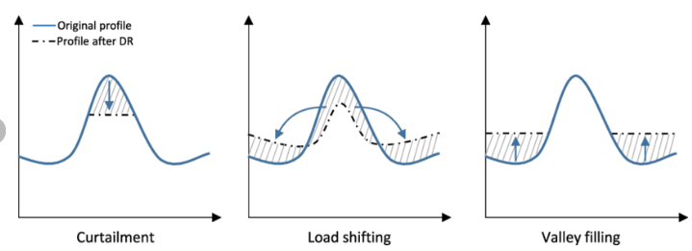
Demand Response
WHAT is DR:
Strategy employed in the energy sector.
Manage the balance between energy supply and demand.
HOW DR works:
Utilities Provide incentives (price/incentive based, like rebates or lower prices).
Consumers: reduce/shift consumption, use alternative sources (backup generators or battery storage).
WHAT are the benefits of DR:
Reduce cost: DR can lower electricity costs for both consumers and utilities.
Increase grid reliability: DR helps to prevent blackouts and other power outages.
Environmental benefits: DR increases the penetration of renewable energy.
Fig.1 Ways of participating demand response.
Fig.2 Demand response process.

Slide 8
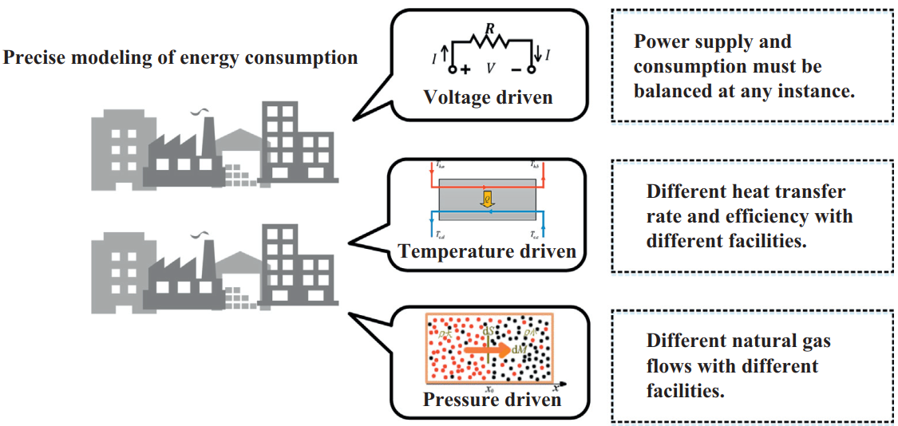
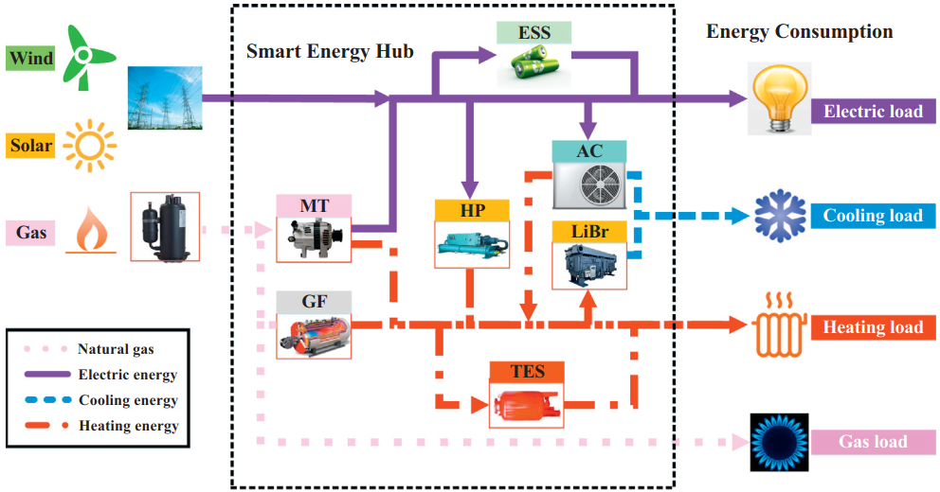
Demand Response
WHY Integrated Demand Response :
The conventional scope of DR cannot fully exploit the interaction capabilities of demand side resources, which limits the energy users in the electric power system.
Multi-energy systems: electricity, thermal energy, natural gas and other forms of energy; makes it possible for energy users to ﬂexibly switch the source of consumed energy.
Fig.3 Integrated Demand Response Modelling.
WHAT Integrated Demand Response :
Take the advantage of multi-energy complementarity.
Exploits the interaction capability of all DR resources while maintaining the consumers’ comfort.
Fig.4 Integrated Demand Response in multi-energy system.

Slide 9
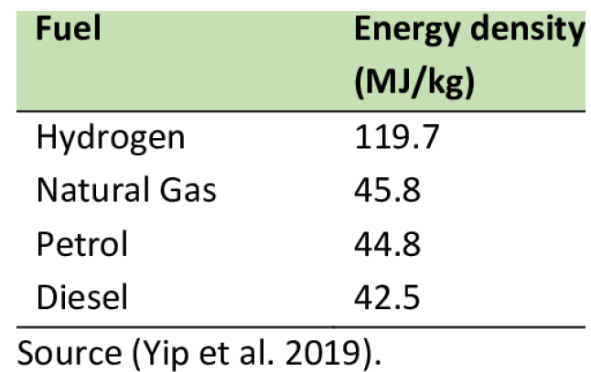
Hydrogen Energy
WHY Hydrogen:
High Energy Density: Energy carrier→ seasonal storage &suitable for transportation applications.
WHY Hydrogen:
Clean (environmentally friendly): Hydrogen reacts with oxygen to produce electricity and water as the only byproduct (No CO2).
Fig.5 High energy density.
Fig.6 Green hydrogen.

Slide 10
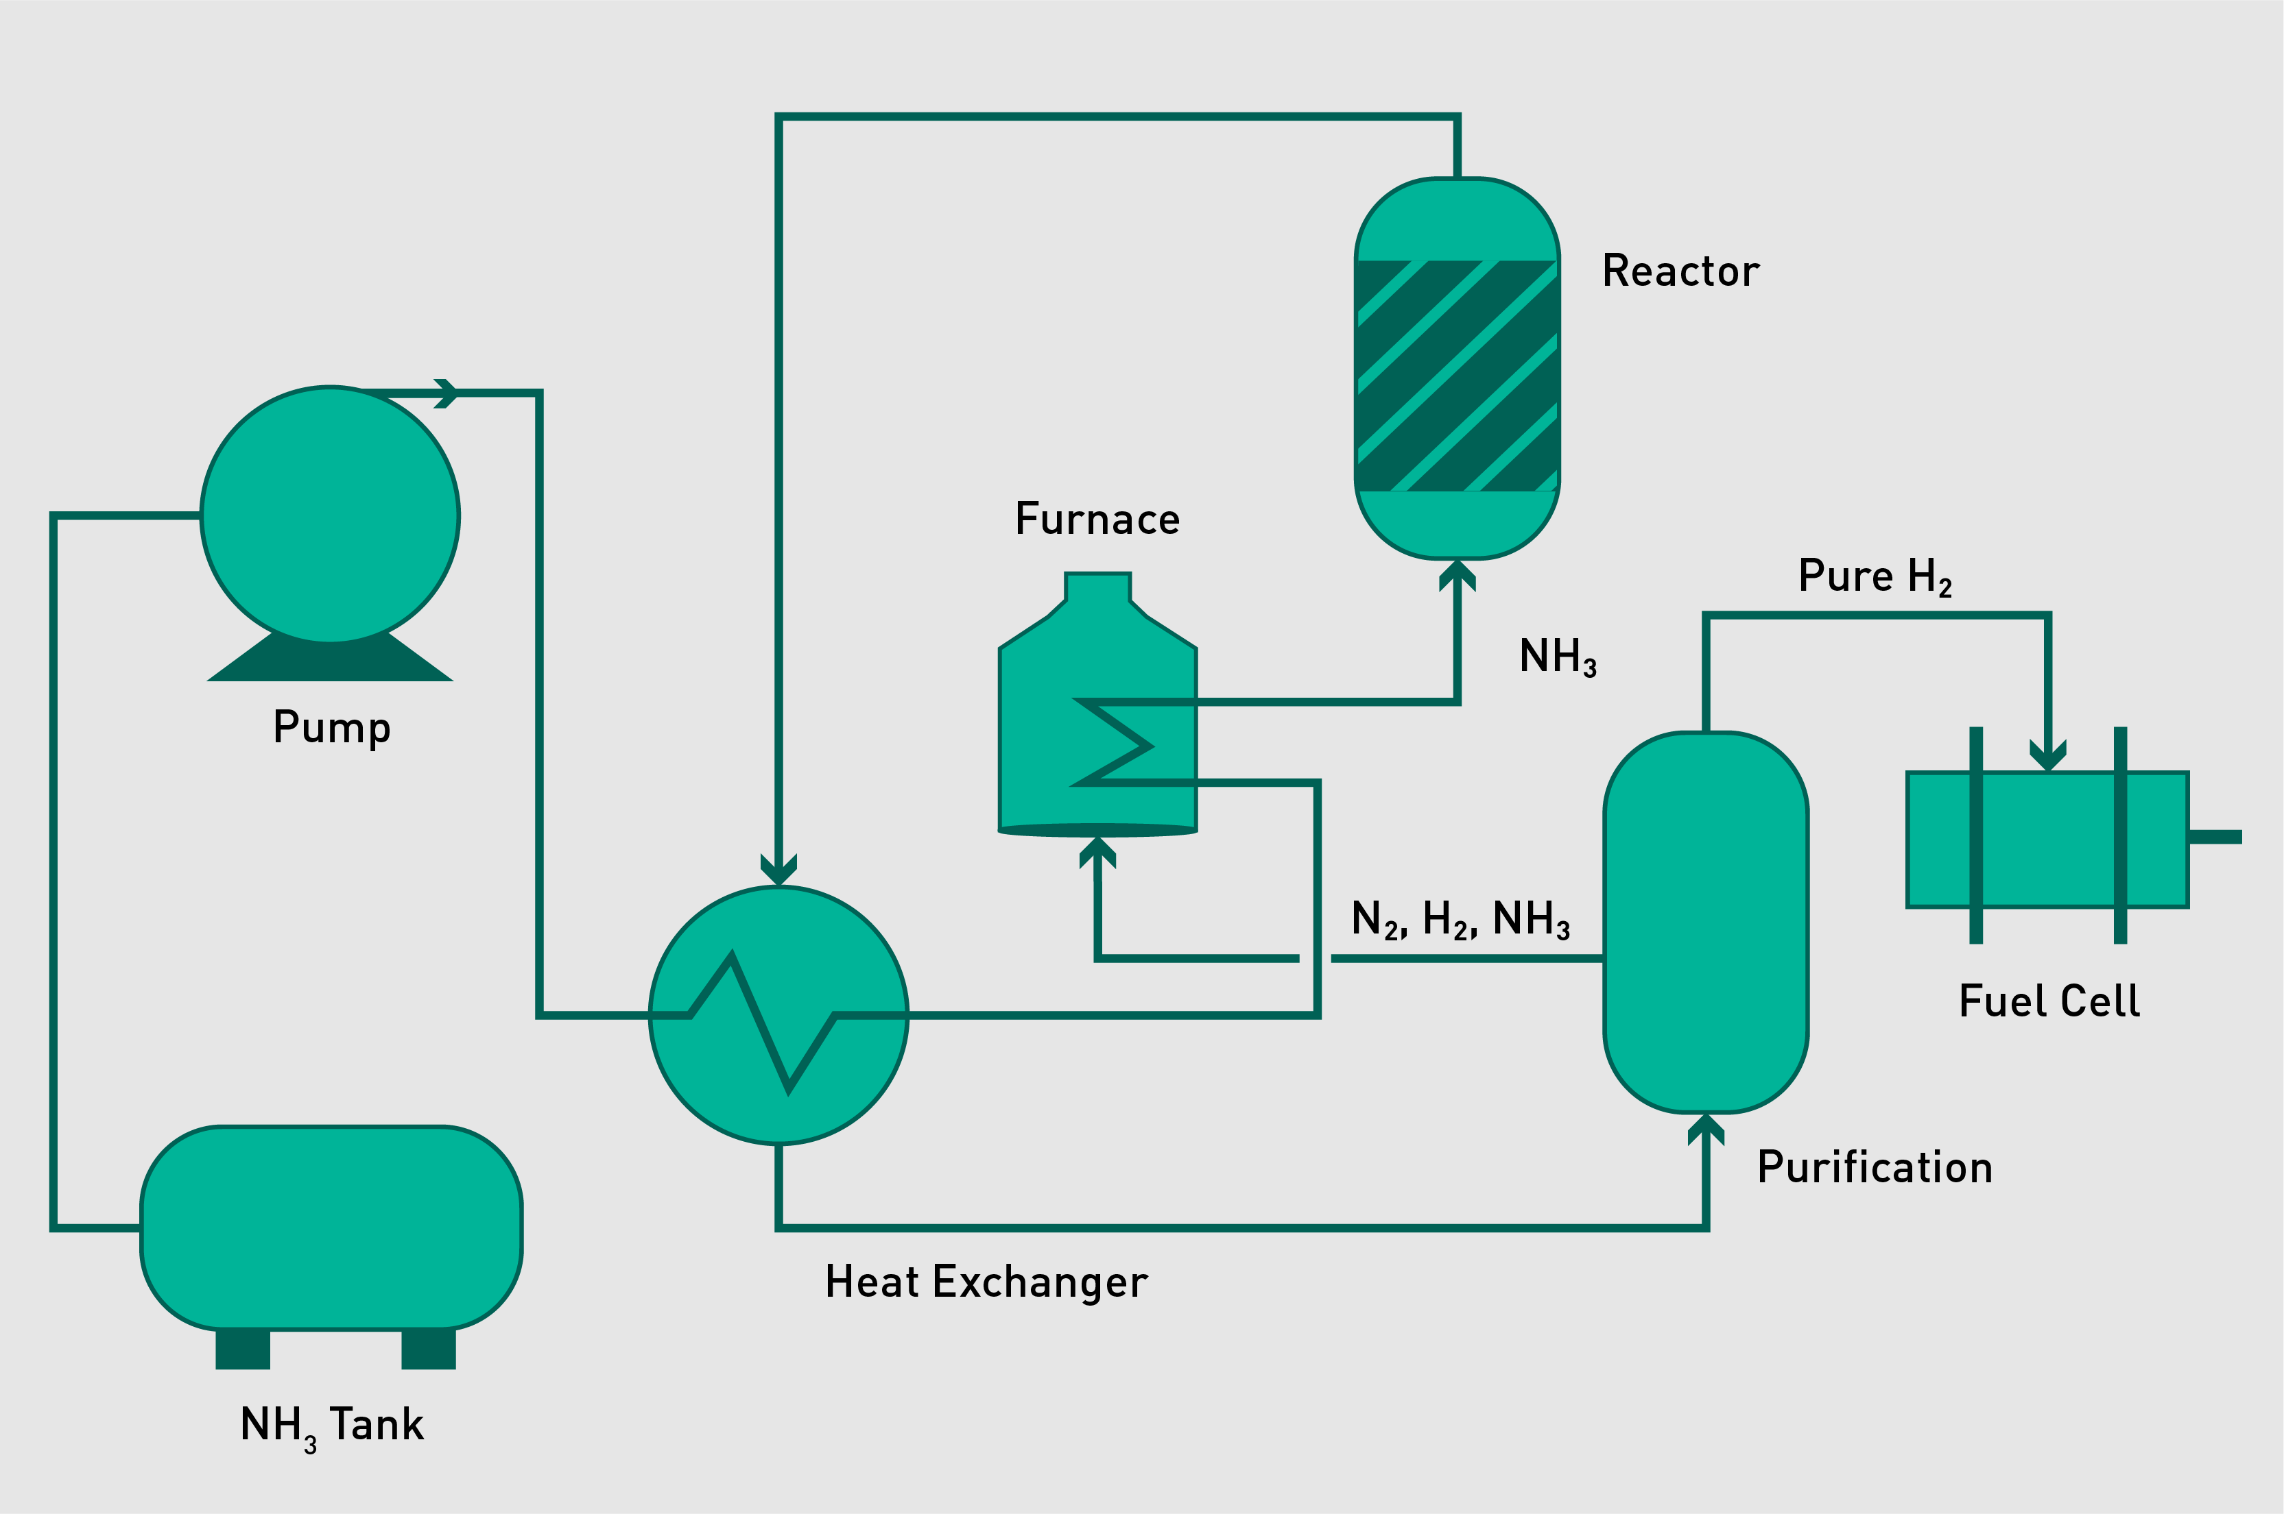
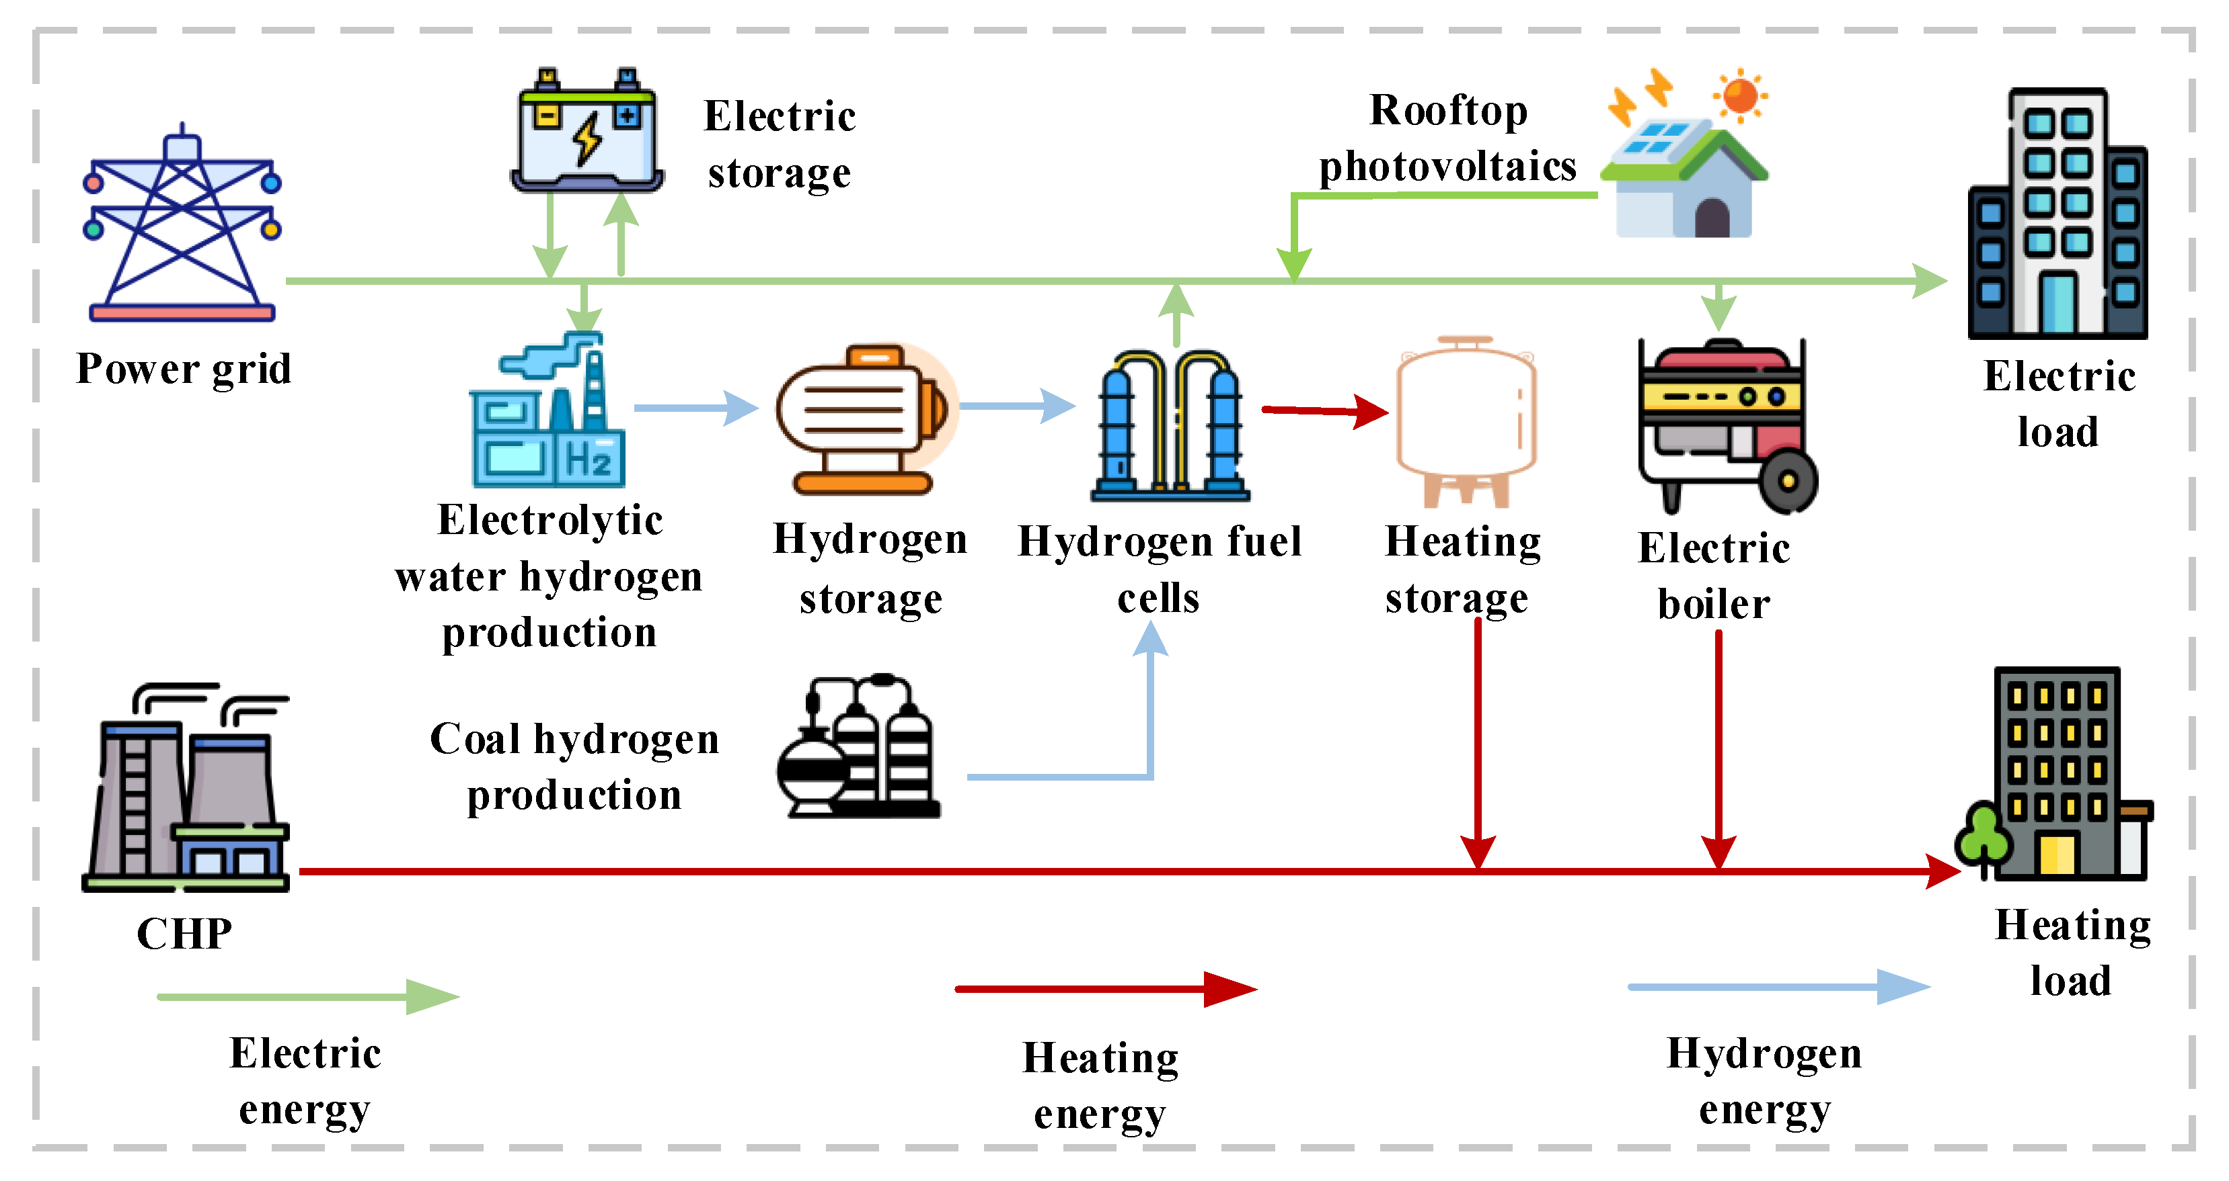
Hydrogen Energy
WHAT Hydrogen in future energy system:
A carbon-free fuel for fuel cells, enable industrial processes, transportation applications, etc.
Contribute to decarbonizing the energy sector and reducing greenhouse gas emissions.
Hydrogen with Electrolysers and Fuel cells, contribute to the flexibility enhancement.
Fig.7 Hydrogen for ammonia (NH3) production.
Fig.8 Hydrogen in multi-energy system.

Slide 11
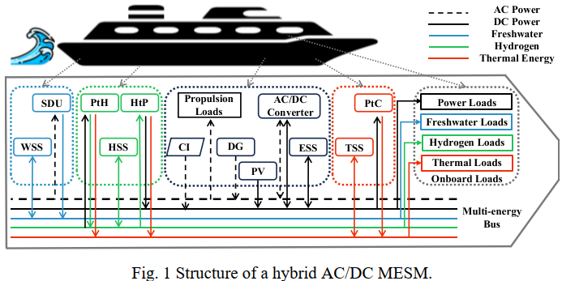
Case Studies 2
Multi-Energy Ship Microgrid
Storage: electric, thermal energy, freshwater and hydrogen storage.
Demand response: ship voyage scheduling.
Hydrogen: fuel cells, electrolysers and hydrogen storage.
W/T/E/HSS: Freshwater/ Thermal/
Electrical/ Hydrogen Storage System
SDU: Seawater desalination Units
PtH: Power to Hydrogen units
HtP: Hydrogen to Power units
CI: Cold Ironing
DG: Diesel generator
PV: PhotoVoltaic Cells
PtC: Power to thermal energy conversion units

Slide 12
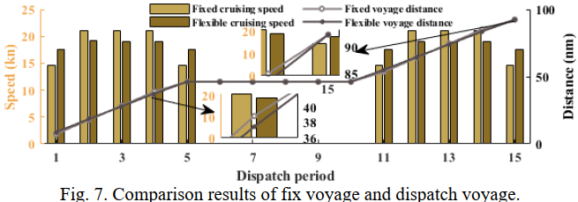
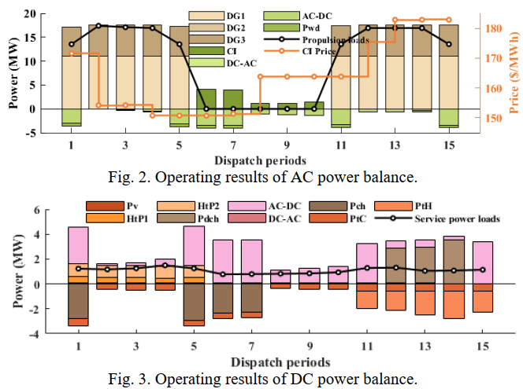
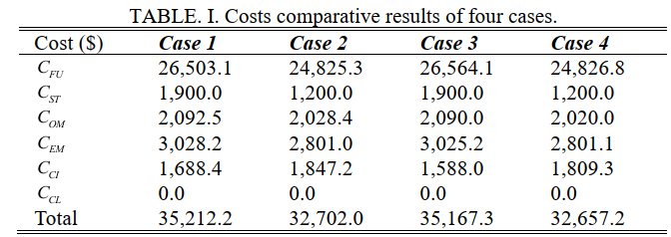
Case Studies 2
Case Studies
Route: Helsinki→Tallinn→ Helsinki
Multiple Energy Balance Results
Voyage Scheduling Results
Comparative Results

Slide 13
Conclusions
Energy storage systems are essential components of modern energy infrastructure, providing flexibility, resilience, and sustainability to support the transition to a clean and renewable energy future.
The experimental testing of the case study 1 shows that using electrical storage systems such as flywheels can greatly reduce fuel consumption and emissions output. Additionally, reduced peak power demand from the diesel engine increases engine life.
Demand response is an effective strategy to maintain the balance between electricity supply and demand, and It gradually evolves into intergrade demand response.
Hydrogen can play an important role in the future energy system, such as decarbonizing the energy sector and reducing greenhouse gas emissions.
Case study 2 based on a multi-energy ship microgrid is conducted to demonstrate the effective role of storage and demand response.

Slide 14
Source material used
1. Motta, Vinicius N., Miguel F. Anjos, and Michel Gendreau. "Survey of optimization models for power system operation and expansion planning with demand response." European Journal of Operational Research 312.2 (2024): 401-412.
2. https://arena.gov.au/blog/what-is-demand-response/
3. Wang, Jianxiao, et al. "Review and prospect of integrated demand response in the multi-energy system." Applied Energy 202 (2017): 772-782.
4. Z Fei, Z Li*. Coordinated Operation of A Green Multi Energy Ship Microgrid with Hydrogen and Seawater Desalination, IEEE PES General Meeting, 2024, USA. (Accepted).
5. M. M. Flynn, et al. "High-Speed Flywheel and Motor Drive Operation for Energy Recovery in a Mobile Gantry Crane". Center for Electromechanics, University of Texas, 2008.
6. https://chat.openai.com/

