Slide 1
ELEC-E8423 – Smart Grid Concentrating Solar Power and Its Comparison to Photovoltaics
Jenni Toivonen
Elmeri Pälikkö
23.04.2024

Slide 2
Introduction
Wind
Wave
Hydro
Bio
PV
CSP
Notes:
Most renewable energy is just a form of solar energy. Solar energy is growing ever more rapidly and can be split into photovoltaics, concentrated solar power, and solar heating and cooling applications. In this presentation, we will cover and compare photovoltaics and concentrated solar power as they are the most significant solar power applications on the power grid level.

Slide 3
Body of the presentation
Concentrated Solar Power (CSP)
Photovoltaics (PV)
Comparison of CSP and PV
Technical comparison
Economic

Slide 4
Concentrated solar power (CSP)
High temperature solar thermal collectors concentrate sunlight with mirrors and lenses to generate electricity via heat.
Global capacity 6618 MW with 1564 MW under construction
Storage
Concentrating system
Solar Receiver
Power Block
Back-up System
Notes:
The generation can be split into line and point systems. In line systems there is widespread working fluid which is heated and in point systems the solar power is focused on a single point in the central receiver. Parabolic through is the most common type of a plant, followed by solar towers.
CSP plants use only direct irradiation and therefore need a daily minimum of sunshine to produce electricity. This limits their use to hot, dry areas with clear skies and reduced dust. Thus, the most favourable areas for CSP resources are North Africa, southern Africa, the Middle East, north-western India, the south-western United States, northern Mexico, Peru, Chile, western China and Australia. Other regions, such as southern Europe and central Asia, may also have some CSP plant potential.
CSP Projects Around the World - SolarPACES
D.A. Baharoon et al. / Renewable and Sustainable Energy Reviews 41 (2015) 996–1027

Slide 5
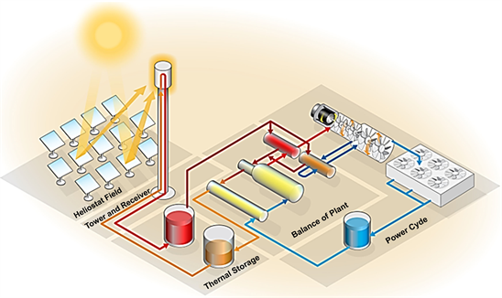
CSP
Inherent capacity to store heat energy for short periods for later energy production.
Offers flexibility and stability for the power system
Can also be equipped with backup power from combustible fuels.
Heat can also be used to supply industrial processes directly
e.g. water desalination through distillation
This Photo by Unknown author is licensed under CC BY.
Notes:
Thermal storage capacity can be further increased to ensure production when the sun is not visible. They provide natural inertia through the rotating turbines too and work essentially like traditional heat power plants.
Water shortages common in areas which are also rich in solar resource. Water desalination through distillation requires large amount of thermal energy which could be captured through CSP.

Slide 6
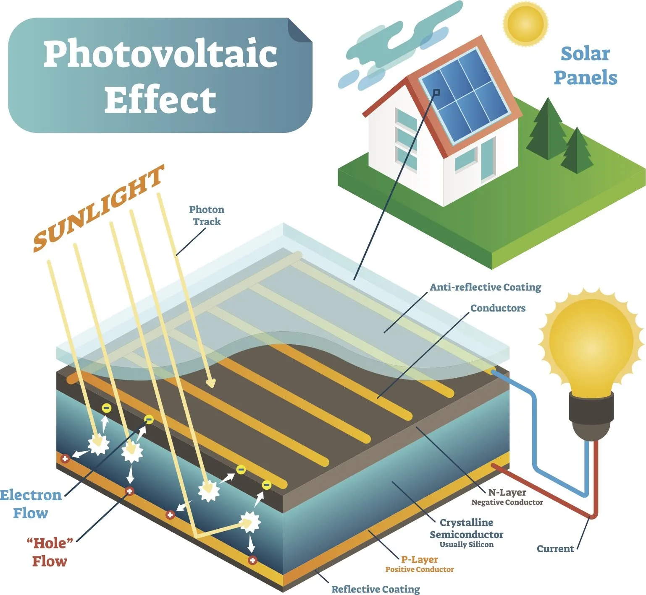
Photovoltaics (PV)
Direct conversion of light into electricity in advanced semiconductor devices
Mainly, silicon-based solar cells
Modular technology with a wide range of applications
The state of the art:
In 2023, solar PV accounted for 75% of the global renewable capacity additions (IEA, 2024)
The global cumulative PV installation is estimated to have crossed 600 GW
⇨ predicted exponential growth of 4500 GW by 2050
Picture Source: Smart Glass World (2022). What Is Photovoltaic Smart Glass? Smart Glass World. Available at: https://www.smartglassworld.net/what-is-photovoltaic-smart-glass
[Accessed 19 Apr. 2024].
Notes:
PV stands for light-electricity
Based on the photovoltaic effect: the generation of voltage difference at the junction of two materials in response to electromagnetic radiation
Sizing ranging from mWs to MWs
Currently, PV is one of the fastest-growing solar energy technology

Slide 7
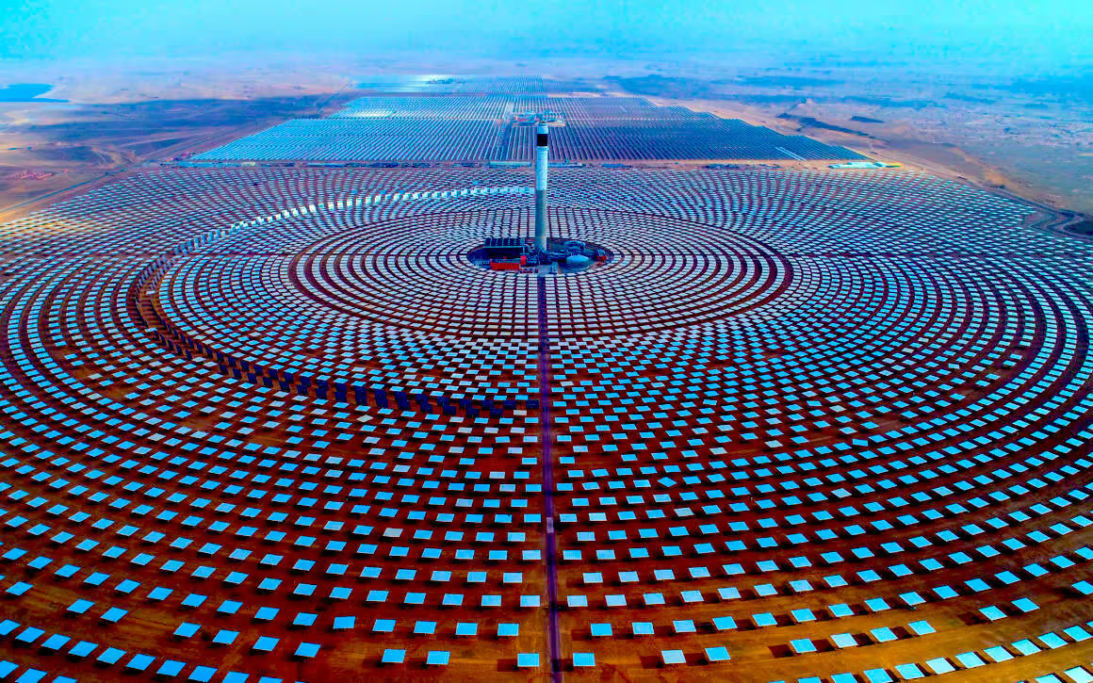
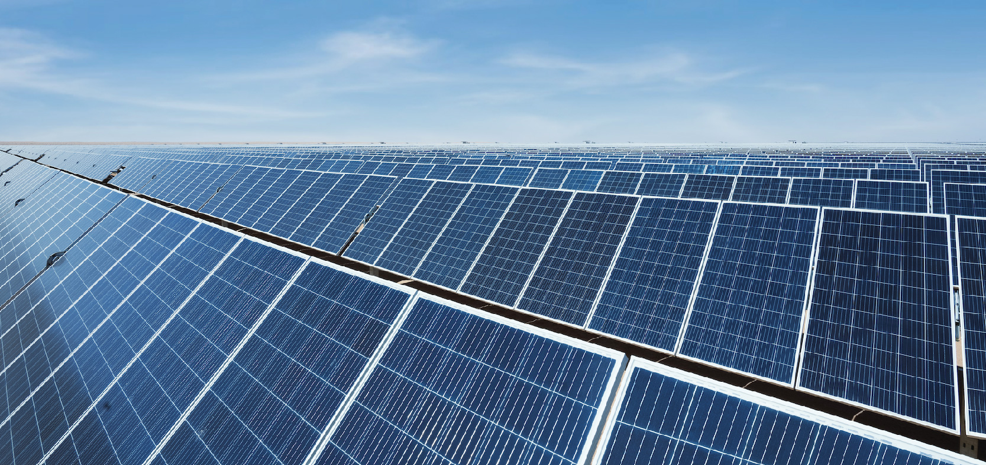
Comparison of CSP and PV
CSP systems
require substantial land due to the concentration of sunlight
can store surplus energy utilizing Thermal Energy Storage ⇨ cost-effective flexibility & grid stability
high energy efficiency, but can only use direct irradiation
large-scale utility plants ⇨ utility-scale power generation
PV systems
flexible in terms of land use
direct electricity production ⇨ requires a battery
varying efficiency
multiple residential & commercial applications
⇨ centralized & distributed power generation
Picture Sources:
SolarPACES (2018). How CSP Works: Tower, Trough, Fresnel or Dish - SolarPACES. [online] SolarPACES. Available at: https://www.solarpaces.org/how-csp-works/.
ACWA Power (2023). ACWA POWER | about Photovoltaic (PV) Power. [online] Acwapower.com. Available at: https://www.acwapower.com/en/projects/fuel-types/about-photovoltaic-pv-power/. [Accessed 19 Apr. 2024].
Notes:
CSP plants use only direct irradiation and therefore need a daily minimum of sunshine to produce electricity. This limits their use to hot, dry areas with clear skies and reduced dust. Thus, the most favourable areas for CSP resources are North Africa, southern Africa, the Middle East, north-western India, the south-western United States, northern Mexico, Peru, Chile, western China and Australia. Other regions, such as southern Europe and central Asia, may also have some CSP plant potential.

Slide 8
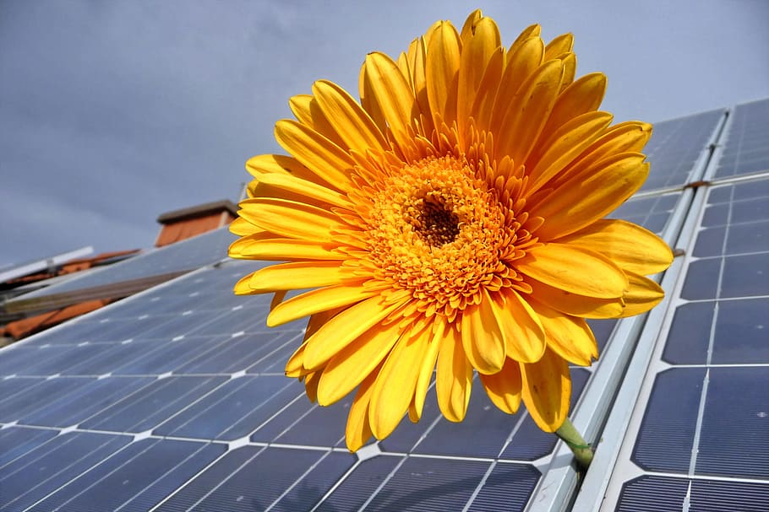
Cost Comparison of CSP and PV
The levelized cost of electricity (LCOE) for PV is competitive & less than that of CSP
CSP is competitive after sundown due to better storage options
Technological improvements, economies of scale, and improved manufacturing processes reduce cost trends for CSP & PV
Many investors opt to use PV over CSP
CSP requires high initial capital investments, as well as higher operational & maintenance costs
Notes:
Cost considerations are necessary in determining the feasibility and larger adoption of solar technologies.

Slide 9
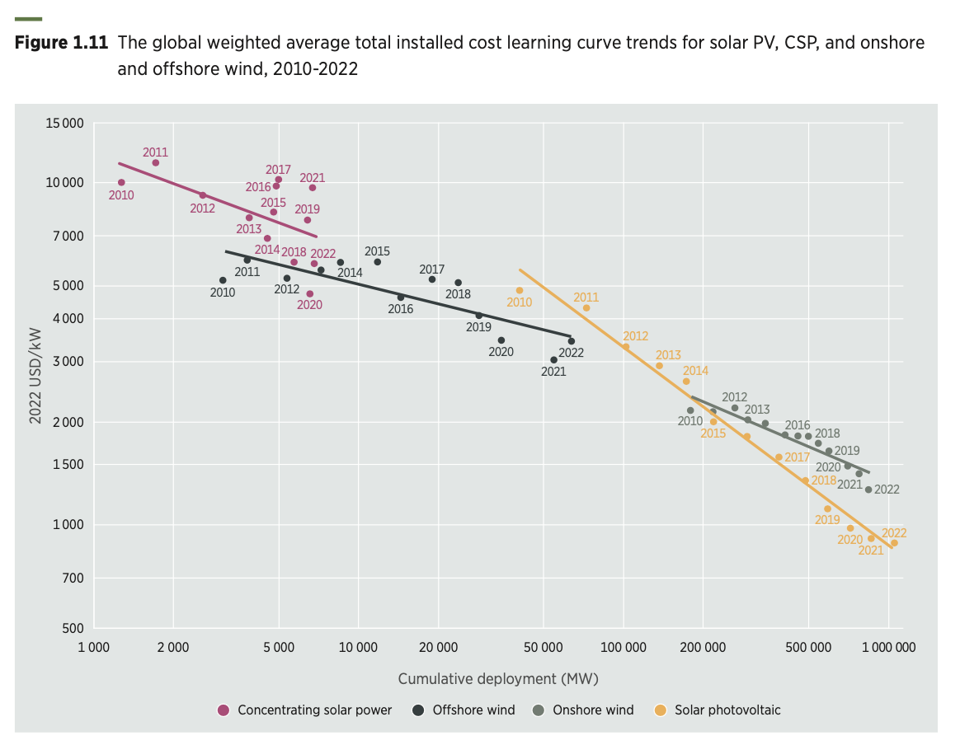
The learning rate for the LCOE
The average cost reduction for every doubling of cumulative installed capacity is higher for PV than CSP.
Cost / installed kW
(IRENA, 2023)
Notes:
The learning rate for the LCOE provides a function of how the components in the LCOE develop over time
the LCOE learning rate for solar PV was 38.2% (2010–2022) – only 5 percentage points higher than the learning rate for total installed costs
the LCOE learning rate for CSP was 36.7% – 2x the learning rate for total installed costs
For PV: higher module efficiency reduces installed cost by reducing surface area for the same power capacity

Slide 10
Conclusions
CSP and PV are both expected to grow in the future: PV more than CSP.
CSP can offer grid stability and flexibility
CSP and PV work best in hybrid form covering energy demands of different times of the day or completely different processes

Slide 11
Source material used
Ghosh, S. & Yadav, R. (2021). Future of photovoltaic technologies: A comprehensive review. Sustainable Energy Technologies and Assessments, 47, 101410. DOI: https://doi.org/10.1016/j.seta.2021.101410.
HeliosCSP (2023). A Comprehensive Comparison Of Photovoltaic (PV) And Concentrated Solar Power (CSP) Technologies In Terms Of Efficiency, Cost, And Environmental Footprint. [online] HeliosCSP - Portal de noticias de energía termosolar. Available at: https://helioscsp.com/a-comprehensive-comparison-of-photovoltaic-pv-and-concentrated-solar-power-csp-technologies-in-terms-of-efficiency-cost-and-environmental-footprint/#. [Accessed 19 Apr. 2024].
IEA (2024). Renewables 2023. Paris: IEA. Available at: https://iea.blob.core.windows.net/assets/96d66a8b-d502-476b-ba94-54ffda84cf72/Renewables_2023.pdf.
IRENA (2023). Renewable power generation costs in 2022. Abu Dhabi: International Renewable Energy Agency. Available at: https://mc-cd8320d4-36a1-40ac-83cc-3389-cdn-endpoint.azureedge.net/-/media/Files/IRENA/Agency/Publication/2023/Aug/IRENA_Renewable_power_generation_costs_in_2022.pdf?rev=cccb713bf8294cc5bec3f870e1fa15c2.
Sharma, V. K., Singh, R., Gehlot, A., Buddhi, D., Braccio, S., Priyadarshi, N. & Khan, B. (2022). Imperative Role of Photovoltaic and Concentrating Solar Power Technologies towards Renewable Energy Generation. International Journal of Photoenergy, 2022, 3852484. DOI: https://doi.org/10.1155/2022/3852484.
Singh, R., Kumar, S., Gehlot, A. & Pachauri, R. (2018). An imperative role of sun trackers in photovoltaic technology: A review. Renewable and Sustainable Energy Reviews, 82, 3263-3278. DOI: https://doi.org/10.1016/j.rser.2017.10.018.
D.A. Baharoon et al. / Renewable and Sustainable Energy Reviews 41 (2015) 996–1027

Slide 12
Conclusions
CSP and PV are both expected to grow in the future: PV more than CSP.
CSP can offer grid stability and flexibility
CSP and PV work best in hybrid form covering energy demands of different times of the day or completely different processes

