Slide 1
ELEC-E8423 - Smart Grid Electrical buses and their charging solutions
Milla Kondakov
Milja Korhonen
09.04.2024

Slide 2
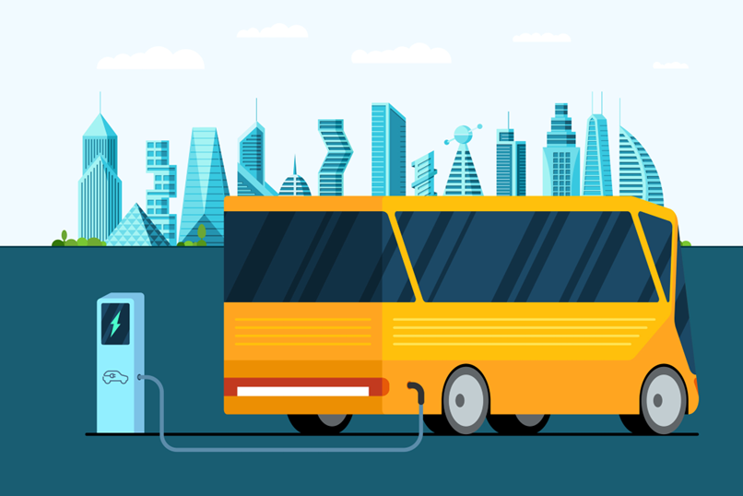
Body
Introduction
Benefits & Disbenefits
Charging
Future charging
Conclusions

Slide 3
Introduction
Clean Vehicle EU Directive (2019/1161) obligates that Finnish public transport vehicles must be clean
8/2021 to 12/2025 41%
1/2026 to 12/2030 59%
Electric buses
Battery-Electric Buses (BEB)
Plug-In Hybrid Electric Buses
Fuel Cell Electric Buses
Electrical charging options
Pantograph charging
Plug-In charging
(Wireless charging)
Fun Fact: There is 436 electric buses in HSL region & the first fully electric bus started test runs in November 2012 in Espoo

Slide 4
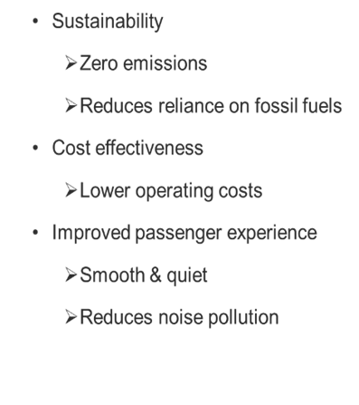
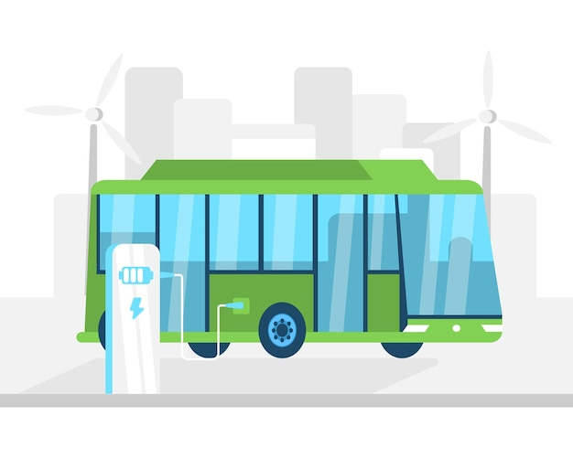
Benefits

Slide 5
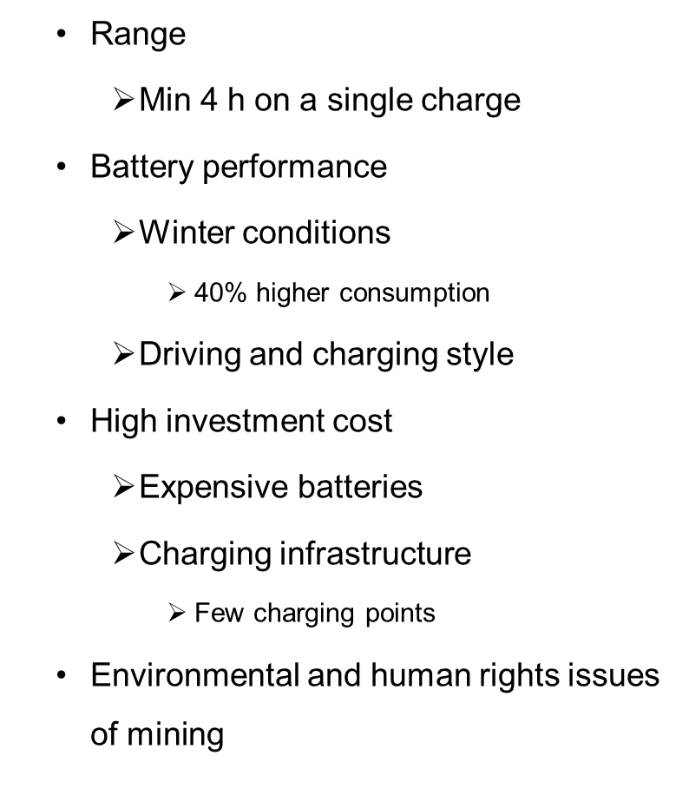
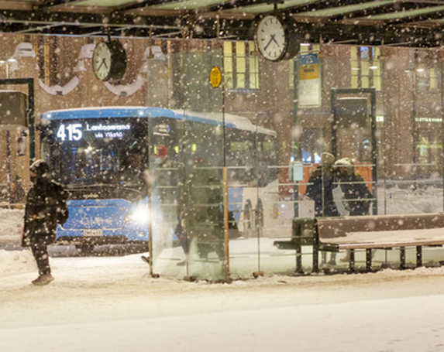
Disbenefits

Slide 6
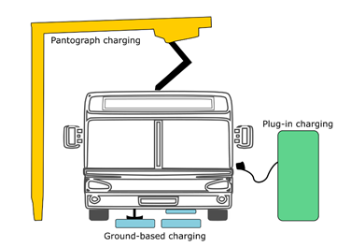
Charging
Slow and fast plug-in charging
Pantograph charging
(Wireless charging)
Charged during night at the depot and during the day at terminus
Demand peaks are at the same time than electricity demand peaks
Could be used as an energy storage?

Slide 7
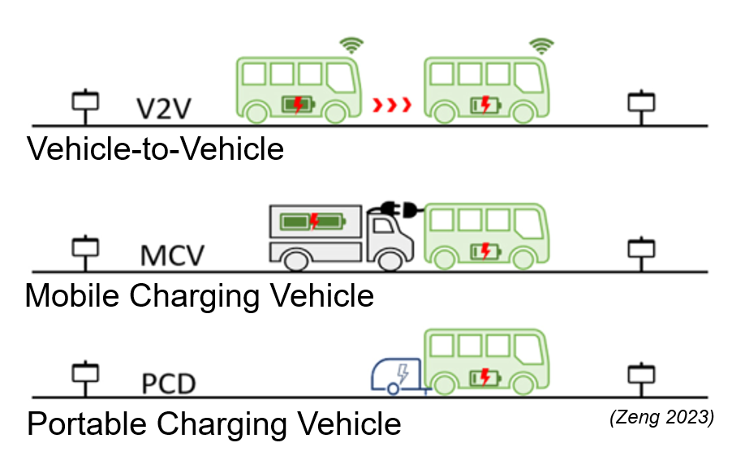
Charging options in the Future?
Wireless charging
- Charging lanes
- Charging pads
Charging stations
Stations for changing batteries

Slide 8
Conclusions
EU directive obligates to use clean vehicles in public transport
Sustainable and cost effective in long term
Problems with range, battery performance, high investment costs & environmental issues with mining
Plug-in charging and pantograph charging
Could be used as an energy storage

Slide 9
Source material used
European Commission, (2024). Clean Vehicles Directive. Available at: https://transport.ec.europa.eu/transport-themes/clean-transport/clean-and-energy-efficient-vehicles/clean-vehicles-directive_en
Plugit, (2024). Available at: (https://plugit.fi/sahkobussien-latausratkaisu-julkiselle-liikenteelle/
Vehviläinen, M., Lavikka, R., Rantala, S., Paakkinen, M., Laurila, J. & Vainio, T. (2022) Setting Up and Operating Electric City Buses in Harsh Winter Conditions. 12(6). 2762. Available at: https://doi.org/10.3390/app12062762
HSL, (2024). Electric Buses. Available at: https://www.hsl.fi/en/hsl/electric-bus
Chen, Z., Yin, Y. & Song, Z. (2018). A cost-competitiveness analysis of charging infrastructure for electric bus operations. Available at: https://doi.org/10.1016/j.trc.2018.06.006
Fei, F., Sun W., Iacobucci, R. & Schmöcker, J-D. (2023). Exploring the profitability of using electric bus fleets for transport and power grid services. Available at: https://doi.org/10.1016/j.trc.2023.104060.
Zeng, Z. & Qu, X. What’s next for battery electric bus charging systems. Communications in Transportation Research. 2023, vol. 3. Available at: doi:10.1016/j.commtr.2023.100094.
IS. 2024. Kylmyys laittoi Helsingin liikenteen sekaisin – tästä syystä bussit hyytyvät pakkaseen. Available at: https://www.is.fi/autot/art-2000010095828.html.
Yle. (2021). Sähköautot yleistyvät vauhdilla, mutta litiumakkuja varjostaa lapsityövoima ja ympäristötuhot. Available at: https://yle.fi/aihe/artikkeli/2021/05/19/sahkoautot-yleistyvat-vauhdilla-mutta-litiumakkuja-varjostaa-lapsityovoima-ja
Lebrouhi, B. E., Khattari, Y. Lamrani, B., Maaroufi, M., Zeraouli, T. & Kousksou, T. (2021). Key challenges for a large-scale development of battery electric vehicles: A comprehensive review. Available at: https://doi.org/10.1016/j.est.2021.103273

Slide 10
Thank you for your attention!

