Slide 1
ELEC-E8423 - Smart Grid Wind power generation variation and its modeling
Muhammad Rehan, Immanuel Williams

Slide 2
Introduction
Wind power has the potential to play a significant role in the global energy mix
In Finland, electricity production from wind power increased by 41 percent
14.1 percent of Finland’s electricity consumption was covered by wind power in 2022
Main problem: Intermittent in nature, forecasting

Slide 3
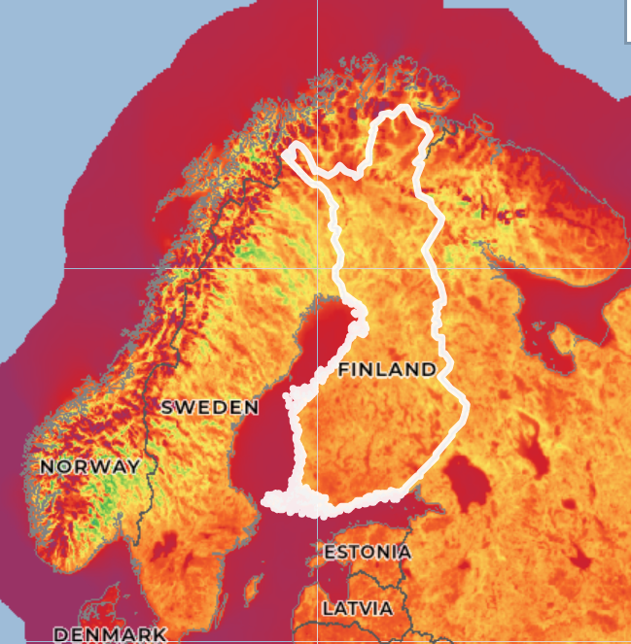
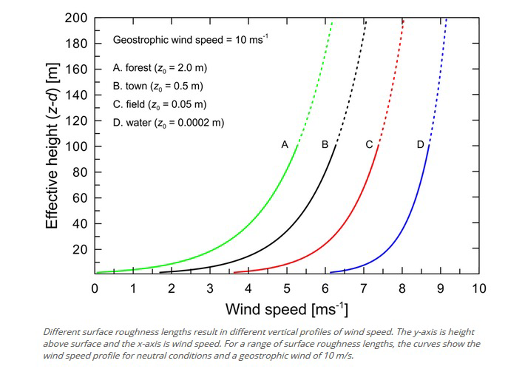
Wind speed variation
Approximate increase of speed with height: v₂ = v₁($\frac{H2}{H1} )$^{n}
Source: globalwindatlas.info

Slide 4
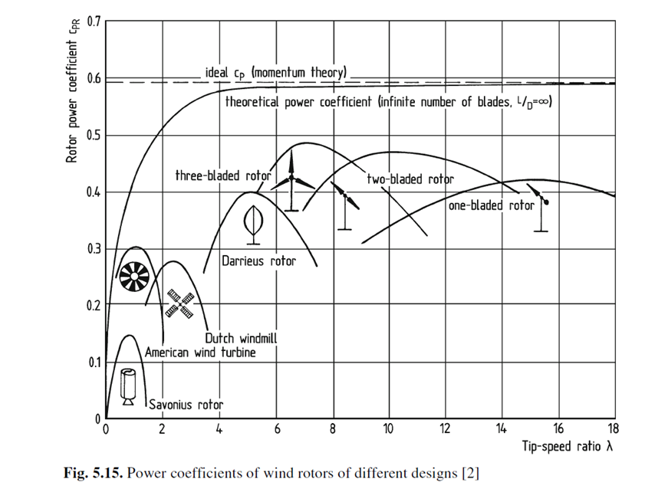
Wind power calculation – Cp Curves
Coefficient of Performance Cp = Rotor Power/Wind Power
Max Cp for Wind Turbines = 0.59 (Betz Limit)
For Vertical Axis Wind max theoretical Cp is lower than the Horizontal Axis Turbine

Slide 5
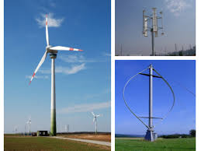
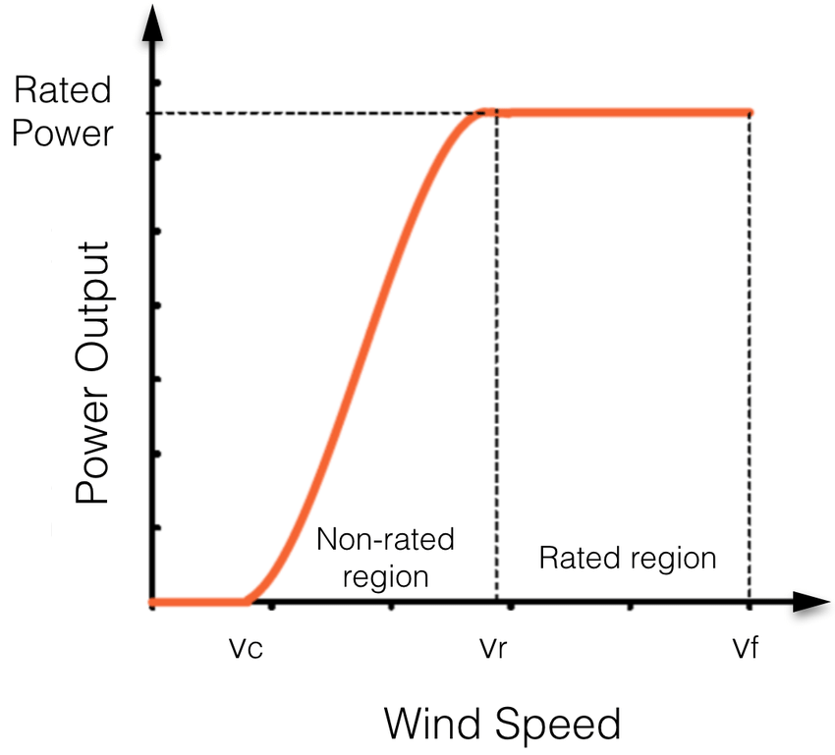
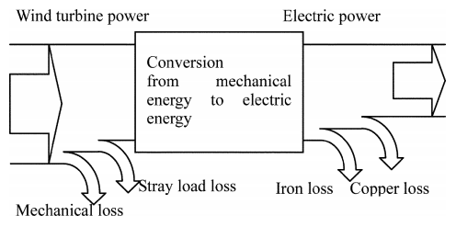
Wind power calculation – Power vs Speed Curves
Source: Dupont et al (2017)
Source: https://ca.audubon.org/conservation/wind-power
Wind power
Power output
Source: Inoue et al (2006)

Slide 6
Forecast of wind power
Why do we even need a forecast?
Wind power variation has enormous effects on the whole grid
Needed to install effective countermeasures against these effects
Without a forecast, a TSO has to assume that there is no wind generation
Types of forecasting
Very short term
Short term
Medium term
Minutes to hours
Controlling wind turbine
Up to 72 hours
Used by TSO
Up to following week
Scheduling maintenance
How is it used?
Used for trading/setting bids to the electricity market based on the view of the power production in the near future
Forecast tool needs a capability of at least 36 hours with hourly resolution

Slide 7
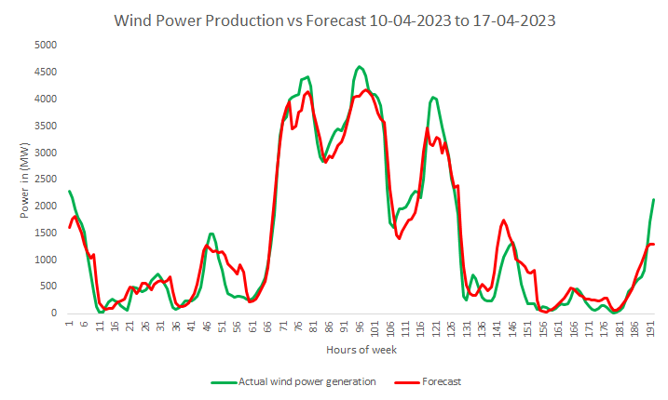
Types of wind power models
Source: Wang et. Al. (2021)

Slide 8
Conclusions
Wind speed variation depends on numerous factors like height and weather
TSOs have to know the exact wind power output hence forecasting is necessary
Forecasting is also necessary for grid stability
There are multiple forecasting models but hybrid models are the most popular among them.

Slide 9
Source material used
Yun Wang, Runmin Zou, Fang Liu, Lingjun Zhang, Qianyi Liu, A review of wind speed and wind power forecasting with deep neural networks, Applied Energy, Volume 304, 2021, 117766,
H. Holttinen, R. Hirvonen (2005) "Power system requirements for wind power" in Wind Power in Power Systems. New York: Wiley pp. 143-167.
Fingrid.fi
Globalwindatlas.info

