Slide 1
ELEC-E8423 - Smart Grid Solar power generation variation and its modeling
Ilari Huotari
Juho Hänninen
25.04.2023

Slide 2
Introduction
Motivation
Photovoltaic basics
Variable production
I-V characteristics, simulink PV module model
Forecasting and Modelling
Challenges
Conclusions

Slide 3
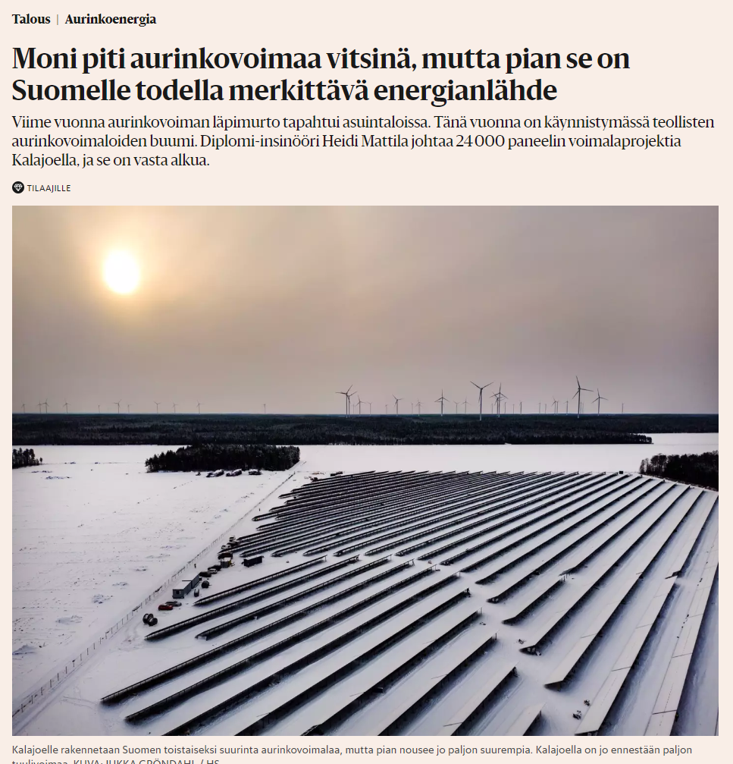
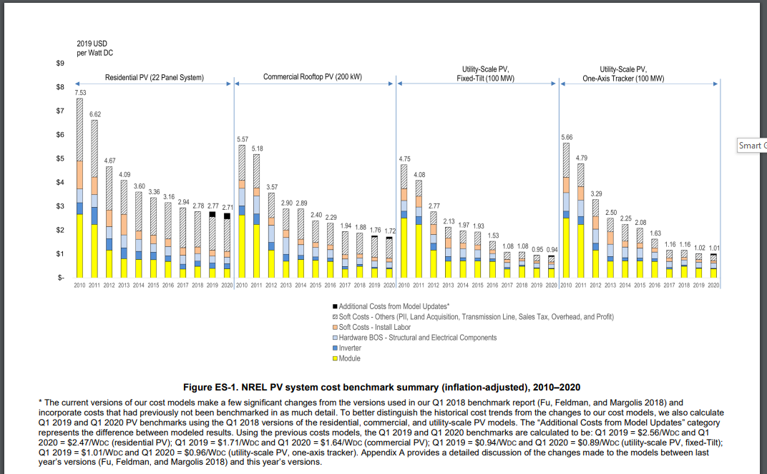
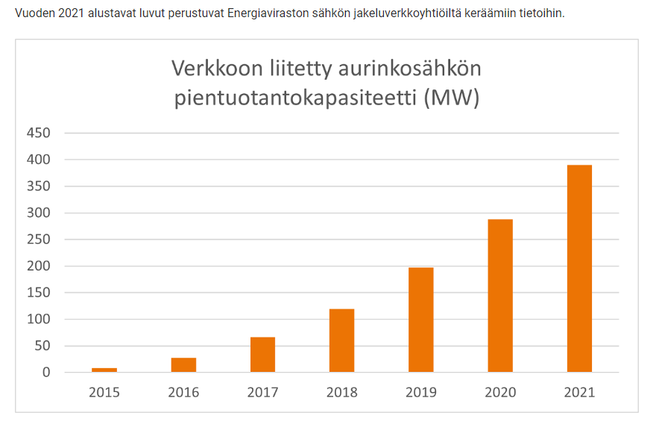
Motivation
According to fingrid by the year 2035 solar power generation capacity could amount 7 000-12 000 MW. Although ~10% of the peak power is the average amount.
Solar panels have become increasingly cheap in the last decade.
Has been mostly distributed generation (DG) in the form of rooftop solar panels
Large scale commercial production is at edge of profitability

Slide 4
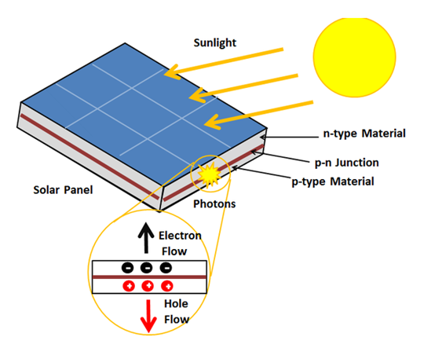
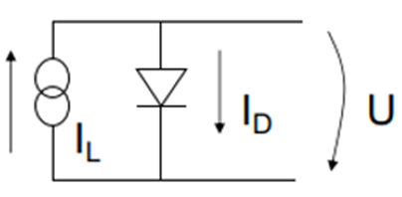
Photovoltaic basics
- Photons give energy to electrons in solar panel
and the bond to the atom breaks.
- Free valence electrons flow from n-type
Semiconductor to p-type.
- System works only if the Photon energy, E=hf
is same or higher than the energy needed to free
electron.
- Better efficiency when using multiple pn-junctions,
However more costly.
- Single cell power ~ 1-2W.
- Cells connect into modules and arrays.
- Modelled with simple equivalent circuit.

Slide 5
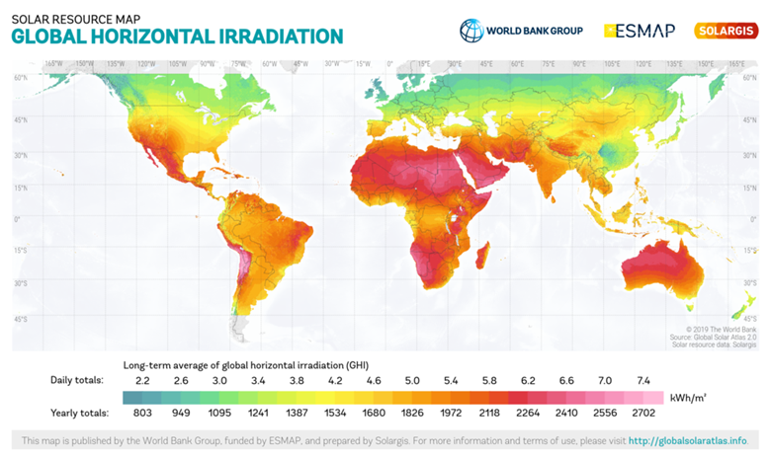
Variable production
Geographic location - Statistical data for irradiance
Time of day - night / day
Season - winter / summer, earths tilt
Local landscape - Buildings, mountains -> shading
Local weather -> forecasts
+ Variety of technical differences on
Solar panels

Slide 6
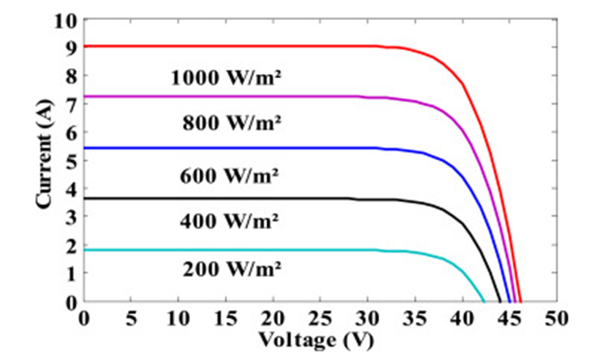
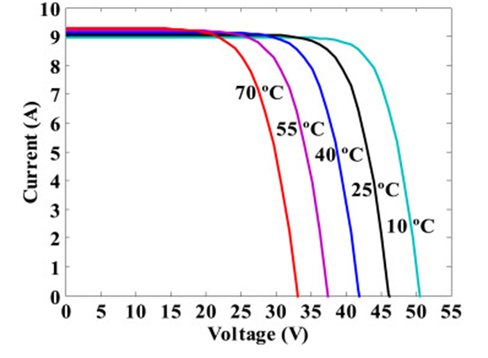
I-V characteristics, simulink PV module model
Input: Irradiance, Temperature Output: Current, voltage Solar cell:JAP72/320/4BB

Slide 7
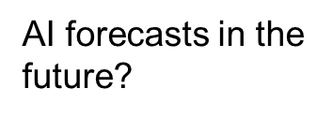
Forecasting and modelling
Nowcasting (forecasting 3–4 hours ahead)
- Need fast way to process data
- Sensors
Short-term forecasting (up to seven days ahead)
- Day-ahead important as the PV-producers must know how much electricity can be sold to market.
- Mathematical models, lots of variables (NWP – Numerical weather prediction)
Long-term forecasting (weeks, months, years)
- Climate, Statistics
- Butterfly effect, slight inaccuracy from start data makes huge errors on final product

Slide 8
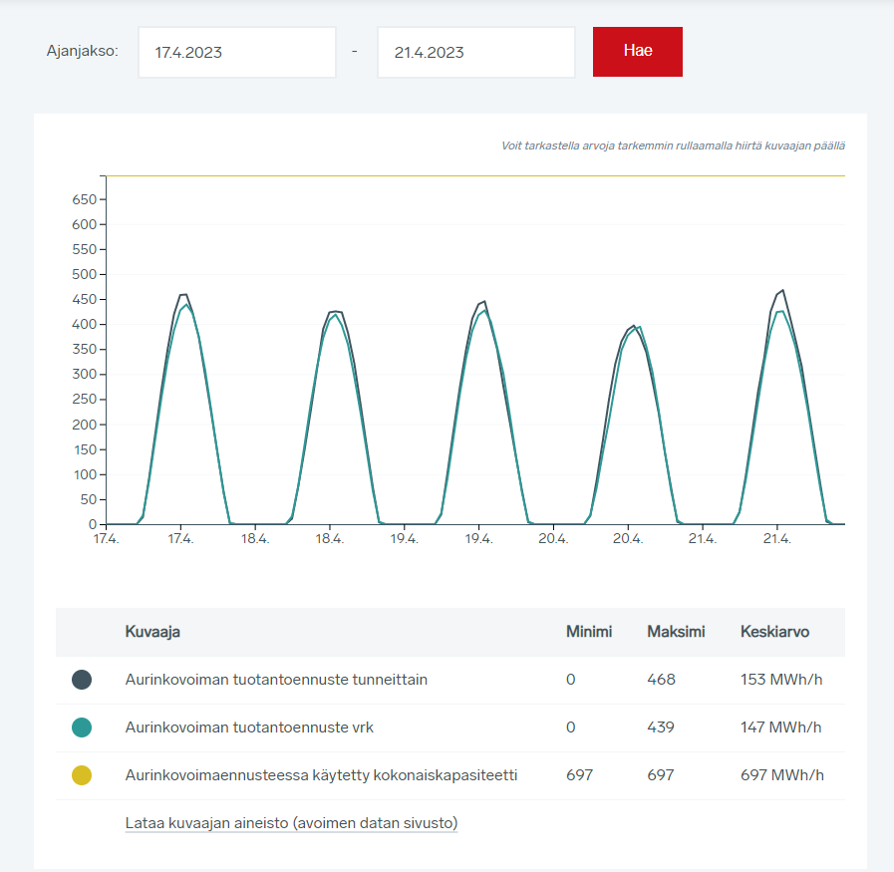
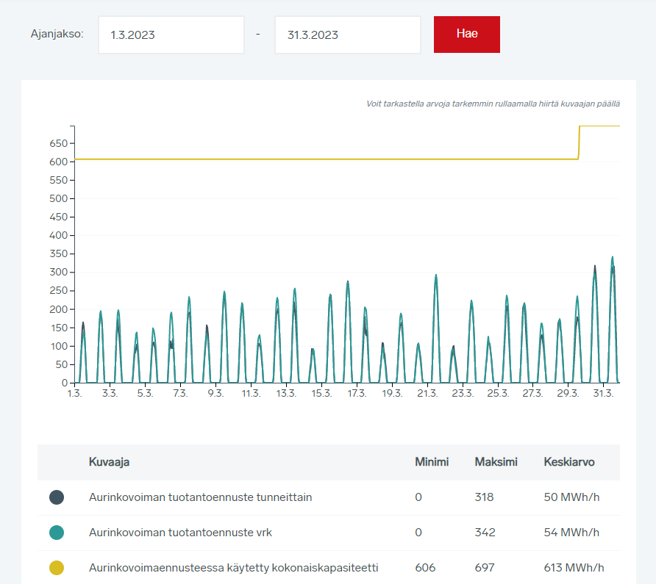
Challenges
Solar power does not provide inertia to the grid
DG can cause voltage rises in the distribution network
Requires power reserves
frequency and power balance
Accurate modelling and forecasting important
Storage options
hydrogen
batteries
EVs

Slide 9
Conclusions
Solar power generation is becoming increasingly relevant and large scale production is becoming economically viable
Variation in production is caused by time of day/year, weather, location and technical constraints of the solar panels
Accurate modelling is required to preserve balance in the power system

Slide 10
Source material used
Fingridin sähköjärjestelmä visio 2022 - tulevaisuuden järjestelmän skenaario luonnokset. Available: https://www.fingrid.fi/globalassets/dokumentit/fi/tiedotteet/ajankohtaista/fingrid_sahkojarjestelmavisio_2022_skenaarioluonnokset-final-korjattu-29.8.pdf
Moni piti aurinkovoimaa vitsinä, mutta pian se on Suomelle todella merkittävä energianlähde. https://www.hs.fi/talous/art-2000009386065.html?share=bada6520247934fb9a189339b771ce34
U.S. Solar Photovoltaic System and Energy Storage Cost Benchmark: Q1 2020. https://www.nrel.gov/news/program/2021/documenting-a-decade-of-cost-declines-for-pv-systems.html
Photovoltaic Cell. Energy education. University of Calgary. https://energyeducation.ca/encyclopedia/Photovoltaic_cell
Solar radiation basics. Office of energy efficiency & renewable energy. https://www.energy.gov/eere/solar/solar-radiation-basics
Solar photovoltaic modeling and simulation: As a renewable energy solution. Raj Kumar, S.K. Singh. Energy reports. Vol 4. P 701-702. 2018.
Global solar atlas. Irradiance world heat map. https://globalsolaratlas.info/map?c=11.609193,8.173828,3
Fingrid. Solar power. https://www.fingrid.fi/en/electricity-market-information/solar-power/
Modeling the Temporal Variations in the Output of Large Solar PV Power Plants. https://www.sciencedirect.com/science/article/pii/S1876610216306440?via%3Dihub

