Slide 1
ELEC-E8423 - Smart Grid Power and Energy Management in Micro Grids
Freshteh Akrami
Danish Ishaq
14.03.2023

Slide 2
Introduction
Some short comings of traditional grid infrastructure
Sub-stations with no stand-alone capability
Stability issues with increasing concentration of renewable energy sources
Losses due to remote located generation units
Solution?
One possibility is micro-grid which has distributed generation, stand-alone capacity, intelligent control and capacity to increase reliability of country-wide grid systems.

Slide 3
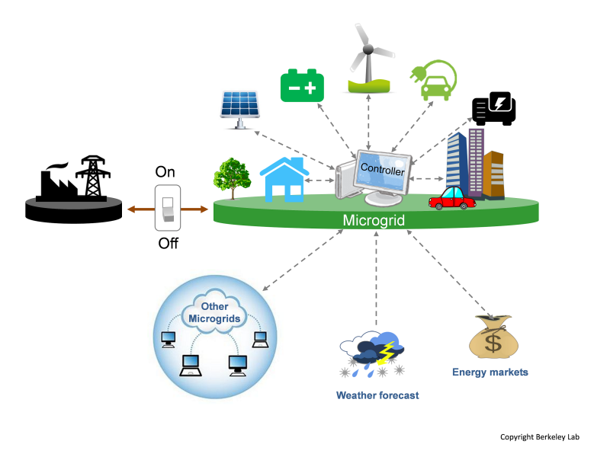
What is a Microgrid?
A system with its own distributed generation sources (DGs), Energy Storage Systems (ESS), Energy Management Systems (EMS) and numerous control systems.
Its capacity to work in Grid-Connected as well as Islanded mode of operation makes it a Micro-Grid.

Slide 4
Components of a Micro Grid
Energy Supply System
Renewable sources: PV, Wind, Small Hydro and Biomass Plant
Non-Renewable sources: Emergency Generator, Microturbine and Fuel Cell
Energy Storage Devices
Batteries, Thermal Storage usually for power balancing
Energy Management Systems/ Controllers
Utility grid connection
Provides backup system
Backup power source
Used for the power and energy balancing by generating power for residual loads
Loads
Controllable Loads: Electrical vehicles, Domestic hot water, etc.
Critical Loads: Illumination an application
https://www.youtube.com/watch?v=0b5EVRqEuI8&t=2s

Slide 5
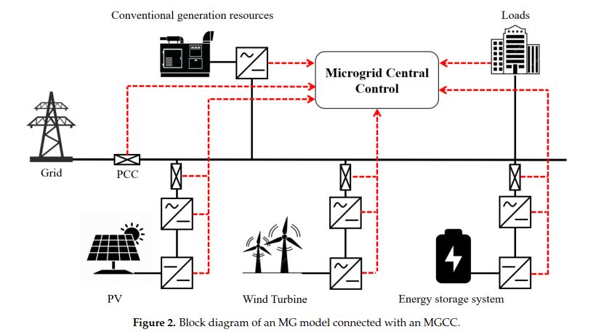
Structure of Microgrid

Slide 6
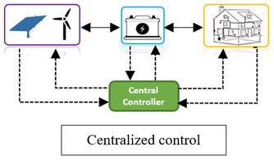
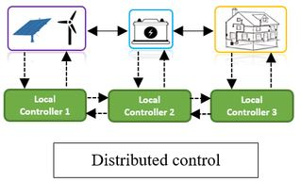
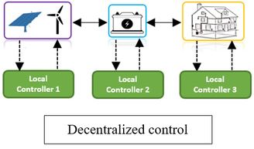
Micro-Grid Control Schemes
Centralized Control
Distributed Control
Decentralized Control

Slide 7
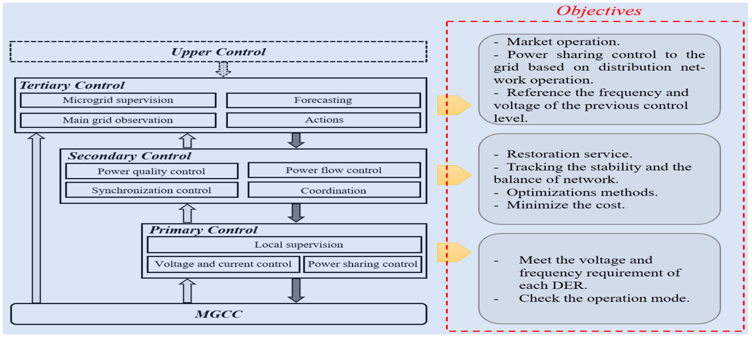
Hierarchal Control Structure
Hierarchal Structure of Control – This structure is followed by all control schemes

Slide 8
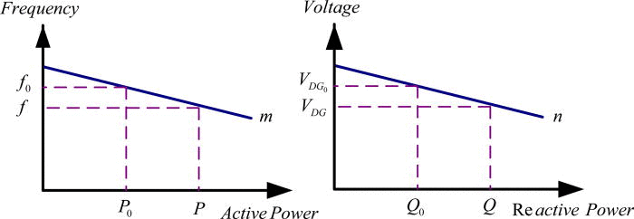
Heirarchal Control
Primary Level:
Based on local voltage and current measurements
Ensures power sharing between RESs
Uses various techniques like droop control

Slide 9
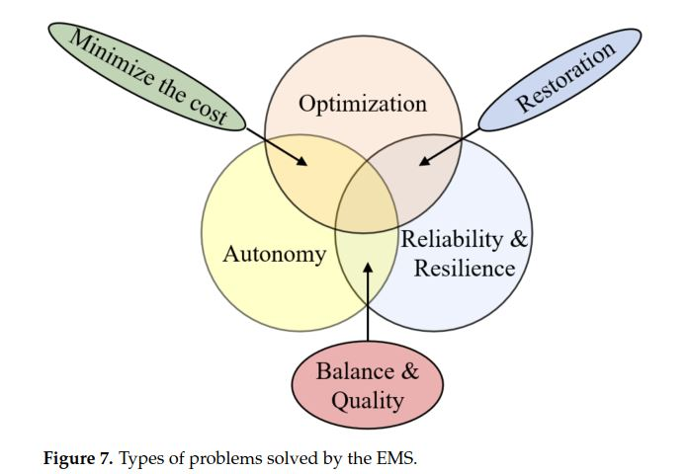
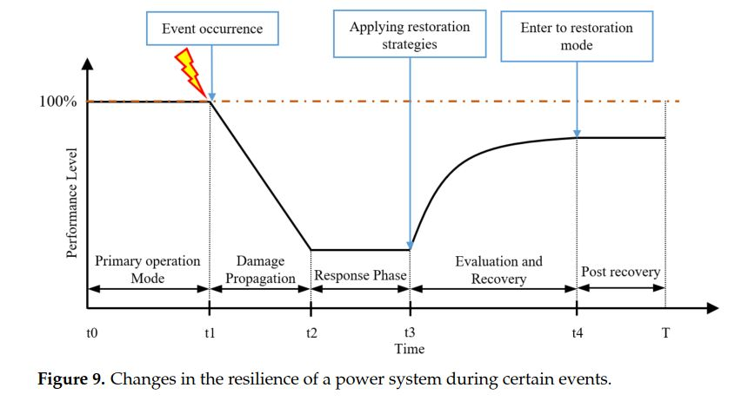
Power and Energy Balance - Control
Secondary control:
Addresses the short comings of primary level
Enhances power quality
Ensures economical operations
Eliminates V and f deviations caused by droop control at primary level

Slide 10
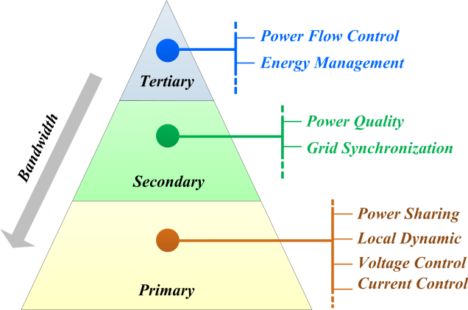
Power and Energy Balance- Management
Tertiary Control:
Ensures optimality in cost and efficiency between micro-Grid and primary grid
Forecasts and predicts future demand, meteorological and market dynamics
Slow dynamic response

Slide 11
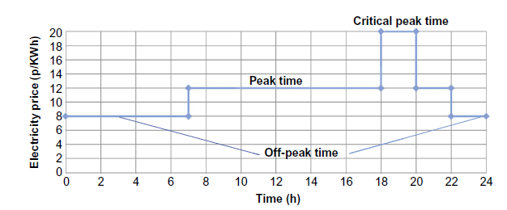
Demand and Storage
Demand Response by incentives:
Offered to customers depending on their behavior in the demand response programs.
Direct load control, curtailable service and demand bidding.
Demand Response by time:
Electricity prices vary according to the cost of generation and the demand for electricity. Customers can then decide on their consumption.
Flat pricing, ToU pricing, critical peak pricing and real time pricing.

Slide 12
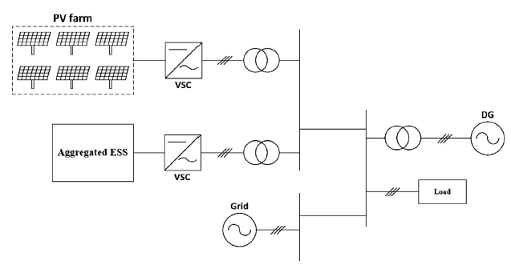
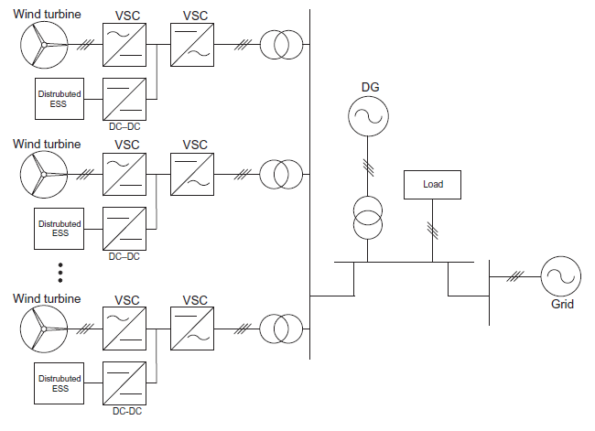
Demand and Storage
Aggregated Energy Storage System:
Big energy storage facility with dedicated housing in the microgrid. It usually has a large capacity to store a huge amount of energy and high-power output ability.
Distributed Energy Storage System:
Connected to an individual generation unit or a local load. This option is easier to maintain and escalate.
Energy storage system can either closer and connected to the generation side or the load side.

Slide 13
Benefits
Economical
Acting as an initiator of local retail market
Acting as a hedging tools against possible risks of price volatility
Technical
Reducing energy loss
Improving voltage quality
Relief of congested networks and devices
Increasing supply reliability
Environmental
Having tendency to renewable or low-emission fuels
Maintenance of more energy-efficient energy supply solutions
Electrification of remote or underdeveloped area
Making new investigation and job opportunities

Slide 14
Conclusions
The existing electricity network is changing from the passive network to the smart grid due to renewable energy sources.
Microgrid which is a part of the smart distribution grid having islanding operation is the future of the electrical power system.
Infrastructure and balance of energy and power of a Micro grid depends on its goals set by the different stakeholders.
Companies and communities in need of a reliable power source are looking to a microgrid system as an efficient, powerful, and ingenious solution.
These resilient, emergency-ready systems can lead to fewer blackouts and outages, generate more savings, and reduce dependence on fossil fuels.

Slide 15
Source material used
Zahraoui, Younes & Alhamrouni, Ibrahim & Mekhilef, Saad & Basir Khan, M. Reyasudin & Seyedmahmoudian, Mehdi & Stojcevski, Alex & Horan, B.. (2021). Energy Management System in Microgrids: A Comprehensive Review. Sustainability. 13. 10.3390/su131910492.
Natesan, Chitra & Ajithan, S.K. & Chozhavendhan, S. & Devendhiran, A.. (2015). Power management strategies in microgrid: A survey. International Journal of Renewable Energy Research. 5. 334-340.
Pamulapati, T., Cavus, M., Odigwe, I., Allahham, A., Walker, S. and Giaouris, D. (2023). A Review of Microgrid Energy Management Strategies from the Energy Trilemma Perspective. Energies, [online] 16(1), p.289. doi:https://doi.org/10.3390/en16010289.
‌
Y. Parag and M. Ainspan, “Sustainable microgrids: Economic, environmental and social costs and benefits of microgrid deployment,” Energy Sustain. Dev., vol. 52, pp. 72–81, 2019, doi: 10.1016/j.esd.2019.07.003.

Slide 16
Macro problems can be addressed with a micro solution.

