Slide 1
ELEC-E8423 - Smart Grid Demand Response in Power System Energy Balance Management
Sonja Nurmiainen & Emma Kuula
21.03.2023

Slide 2
Notes
What we want to include:
Different providers of demand response
Their charasteristics
Frequency control
Smart metring and automation of load shifting
Aggregation of demand response
Forecasting of production and consumption
Why would anyone participate in demand response?
Market benefits? Environmental consiousness?
Possible sources to use
https://www.sciencedirect.com/science/article/pii/S2352484723001130
https://www.sciencedirect.com/science/article/pii/S0360544223002876
https://www.sciencedirect.com/science/article/pii/S0306261922015744
https://www.sciencedirect.com/science/article/pii/S0098135422004021
https://www.sciencedirect.com/science/article/pii/S0301421520306315

Slide 3
Introduction
Define broad scope of the presentation and explain the key terms
Demand Response – A change in electricity consumption done by consumer to help keep the supply and demand in balance.
Typically, power systems are balanced by a local transmission system operator (TSO)
Fingrid
Shiftable loads (charging an electric vehicle, washing machine, etc.)
Interruptible loads (lights, paper machine)
Notes:
As everyone probably is already familiar with the idea of demand response, I will keep this part short. But just as a reminder demand response is defined as a change in electricity consumption done by consumer to help keep the supply and demand of electricity in balance.
Typically, this type of balancing in power systems is managed by the local transmission system operator, which in Finland of course is Fingrid. Fingrid has different ways to manage the system balance and we will go into those soon in this presentation. But just to give you a picture, one traditional way of reponsing to high electricity demand is by using peak power plants like some kind of boilers. In an ideal case with demand response, we could lower the need of electricity enough, so that starting the peak power plant wouldn’t be necessary at all.
Demand response can be divided into two main categories. Shiftable loads are not time dependent for example they can be something like charging an electric vehicle or turning on the washing machine. Interruptible loads can be used only during specified times, like in households lights or in industry many different processes can be used as interruptible loads for example paper machines.
So now that you have a picture of what demand response is, let’s move to balancing the power system

Slide 4
Power system balancing
The balance is indicated by the frequency of the grid
50 Hz (49.9-50.1 in a normal state)
> 50 Hz – production is greater
< 50 Hz – consumption is greater
Balancing energy market
Bids are activated in price order, technical conditions considered
Bids can be delivered and updated 45 minutes before each operating hour.
Separate up- and down-regulation bids.
Resreve capacity
Notes:
The market operators are responsible to try to plan and balance their production and consumption in advance. These plans, however, always deviate from what actually happens and, as the party responsible for the system, it is Fingrid's task to take care of the balance between consumption and production during each hour.
The balance at any given moment is indicated by the frequency of the electricity grid. If it goes bellow 50, we know that consumption is greater than production. Correspondingly, when the frequency exceeds the 50 Hz value, production is greater than consumption.
To keep the frequency constant Fingrid can do so by activating bids from the balancing power market in price order with the technical conditions considered. The bids can be delivered and updated 45 minutes before each operating hour and they are separated into up- and down-regulation bids.
Another way is by reserving capacity. Fingrid acquires different reserve products that react to changes in consumption and production at different levels of time. More about that a little bit later, but let’s first look at the next slide where we can see a little bit better how demand response fits into all of this balance management.

Slide 5
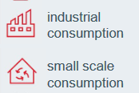
Providers of demand response
Notes:
So here you can see that demand side management can participate in the same market places as electricity production. for example only a few seconds' reduction in the power taken from the grid can be a way to provided balancing. In this case it would called down-regulation. With up regulation we would increase our consumption.
Here I wanted to bring up the different providers of demand response, so that you can understand who can participate in these market places.
These participants can be divided into industrial consumption and small scale consumption. On the industrial side we typically can have forestry, metal or chemical industry and small scale consumption can include households, aggregated neighbourhoods or small businesses like grocery stores.
To give you an even better picture let’s dive into that reserve capacity and how the providers of demand response fit into that.

Slide 6
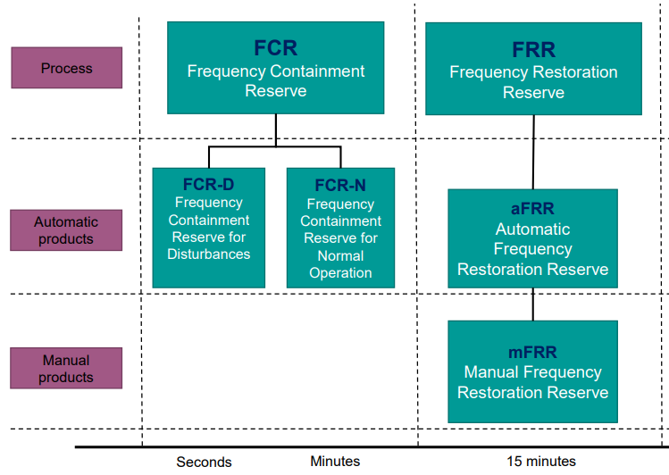
Reserve products in Finland
Notes:
Here in the picture you can see what types of demand side technologies work with each reserve products. On your left side we have frequency containment reserve for both disturbances and normal operation. It operates continuously to keep the frequency constant. Here we can use both of the previously mentioned participants for both up and down regulation. With the execption that in the reserve for disturbances we can only use small scale consumption for downregulation due to the interruptible nature of industrial consumption. Then on your right side we have frequency restoration reserve, where only industrial consumption can participate for upregulation. This reserve is only used in major disturbances.
Now Sonja will continue with the challenges that we can face especially with small scale consumption.

Slide 7
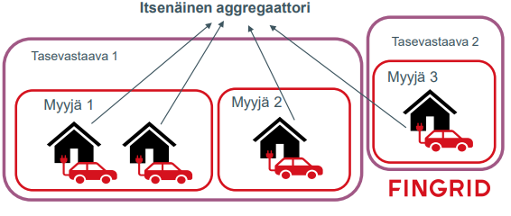
Aggregation and forecasting of demand and supply
Aggregation = combining several prosumers in order to have sufficient capacity for frequency response
Fingrid reserve market participation for independent aggregators
FCR-D and FFR minimum offer 1 MW (used in large frequency deviations)
Why aggregation is helpful?
Rapid frequency response service
Reduction of spinning reserve generators is achievable
Aggregated loads are easier to predict
Why predictable demand and supply is important
Reduced price volatility in electricity market
Less need for intraday market and
quick maneuvers
More RES can be implemented
Independent aggregator
Balance responsible party
Balance responsible party
Retailer
Retailer
Retailer
Notes:
Emma mentioned aggregation briefly – so what does it actually mean?
Aggregation means combining several prosumers together so that their summed production or consumption is significant enough that it can affect the grid balance. Most often this means that the prosumers can increase or decrease their load so that grid frequency deviations can be balanced.
Well who can participate in aggregation? In Finland Fingrid’s reserve markets accept aggregation offers of minimum 1 MW. Currently there is only regulation and clear rules for the reserve markets that are used only in the worst contingencies – FCR-D and FFR. That’s why it’s only possible to participate in these reserve markets.
Why are we even talking about aggregation, what’s the point of it? Aggregation provides fast frequency response service, because the prosumer loads can be disconnected quickly by turning a switch. Therefore there is less need to implement fast responding and expensive batteries or supercapasitors to the grid. Also, the spinning reserve – especially the fossil fuel plants running at part load – can be reduced with the help of aggregated demand response. Aggregation basically makes demand response more meaningful as the responsive loads become easier to predict as they participate in the market.
This leads us to the last point ”why predictable demand and supply is important?”. When upcoming consumption and production is well known, the market price volatility is reduced. Also, less quick manuevers to balance the supply and demand are needed. Accurate load forecasting has also traditionally been one of the cornerstones of implementing more renewable energy to the system.

Slide 8
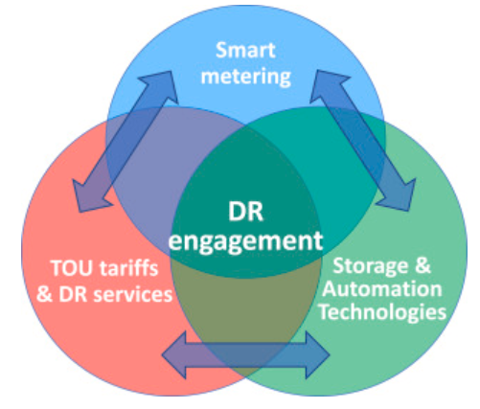
Smart metering and automation of load shifting
Current electricity meters only allow manual demand response
Automation in DR can deliver more convenience, predictability and reliability
Future meters: advanced smart meters
The meter has timely price- and power balance information
Household devices connected to the smart meter can be programmed to run automatically when electricity is cheap
UK study: 2/3 of customers would be willing to share meter data with 3rd parties to improve system or market efficiency
80% of households with smart meters would like to have incentive-based electricity price
Smart meters ultimately make themselves unnecessary?
Who is willing to invest in such technology?
Notes:
Moving on to smart meters and automated load shifting, that seem to be necessary for demand response to rech its full potential.
Currently most electric meters only allow manual demand response, but most people do not actually have the time and energy to investigate when they should be using their home appliances to have cheap electricity or benefit the grid. Automation could bring the needed convenience, and simulataneously make the demand response capacity more reliable and able to be aggregated.
In the future, the advanced smart meters could have timely information of the system electricity price as well as the grid power power balance. The household appliances should be also smart and connected to the meter, so that the power taken by the appliances can be varied according to price and power balance information. This however may raise a question: are people willing to have a third party controlling their power consumption in their own homes?
Quite surprisingly, a study conducted in the UK in 2021 suggests that 2/3 of consumers would be willing to give a 3rd party acces to their power consumption data to improve the energy system or market efficiency. Furthermore vast majority of households with smart meters would like to have an incentive-based electricity price. Sounds like good news for demand response capacity.
However, there is one big but with smart meters. It is that they may make themselves unnecessary. The benefits of smart meters are connected to the monetary savings of using cheap electricity, but what happens when all the smart meters make the price smooth by shifting loads approximately equal on each hour of the day? Who will invest in such a technology?

Slide 9
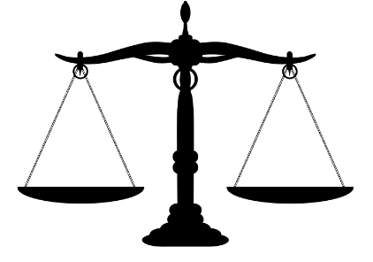
Benefits vs. challenges of demand response
Benefits
Environmental
More renewable energy integration without excessive investments
Could smart meters have information on time-of-use generation emissions?
Monetary
Reduces investment needs in distribution network
DR paticipants gain money from load shifting
Less volatile market price
Security of energy system, more reserve capacity left available
Challenges
Forecast inaccuracy in DR amount
What is the incentive to shift loads?
Smart meter investment challenges
Missing regulatory framework for smart appliances
Promised DR
Actual DR
Notes:
What is the takeaway from demand response in the system level? Let’s find out by comparing the benefits and challenges of demand response.
First of all, the environmental benefits of demand response are that more renewable energy can be implemented to the system without excessive investments to backup services and grid reinforcements. Moreover, the smart meters associated with demand response could have information about generation emissions of the time of use electricity.
The monetary benefits reach both, the (traditional) provider and customer side. Providers, such as DSOs need to invest less in distribution networks, as the electric loads can be curtailed and shifted to less congested hours. Simultaneously the customer side, meaning the demand response participants, save money by shifting loads or gain money by participating in reserve markets through aggregation.
Overall, the benefit is that security of the energy system is improved and more reserve capacity is available in the case of contingencies.
Then the challenges. It is still rather difficult to forecast the amount of demand response that is going to realize. This is the case with manual demand response that is not aggregated. This brings us to the next challenge that is the incentive for consumers to shift their loads. Is it the monetary profits, environmental aspects or social responsibility? However, the requlatory framework seems to be missing. Lastly, the smart metering challenges, that relate to investments and missing regulatory framework for smart home appliances. All in all, most of the challenges relate to missing regulations, which may not be a problem for long. At least the smart appliances have had preliminary discussion on EU regulation level.

Slide 10
Conclusions
DR providers: large and small participants, Fingrid
Aggregation
Demand response allows more RES integration and smooths market prices
Accurate demand response provides monetary savings in grid balance investments
There is room for development
Smart meters and automation
Notes:
Grid balance investment: no as huge need for peaking powerplants, batteries or supercapacitors nor grid reinforcements

Slide 11
Source material used
Potential of demand side response aggregation for the stabilization of the grids frequency: https://doi.org/10.1016/j.apenergy.2018.03.115
The Demand Response Technology Cluster: Accelerating UK residential consumer engagement with time-of-use tariffs, electric vehicles and smart meters via digital comparison tools: https://doi.org/10.1016/j.rser.2020.110701
Energy smart appliances’ interoperability. Analysis on data exchange from state-of-the-art use cases: https://op.europa.eu/en/publication-detail/-/publication/8dfe10cc-324a-11ed-975d-01aa75ed71a1/language-en/format-PDF/source-282455871
Tasevastaavapäivä 2022: https://www.fingrid.fi/globalassets/dokumentit/fi/ajankohtaista-tapahtumat/tasevastaavapaiva-14.3.22.pdf
Reserve products and reserve market places, Fingrid: https://www.fingrid.fi/globalassets/dokumentit/en/electricity-market/reserves/reserve-products-and-reserve-market-places.pdf
Source not used (access problems), but could be very useful: Active Electrical Distribution Network, https://doi.org/10.1016/C2020-0-02169-9

Slide 12
Other issues ….
Send the presentation to matti.lehtonen@aalto.fi for check latest the day before the scheduled presentation

