Slide 1
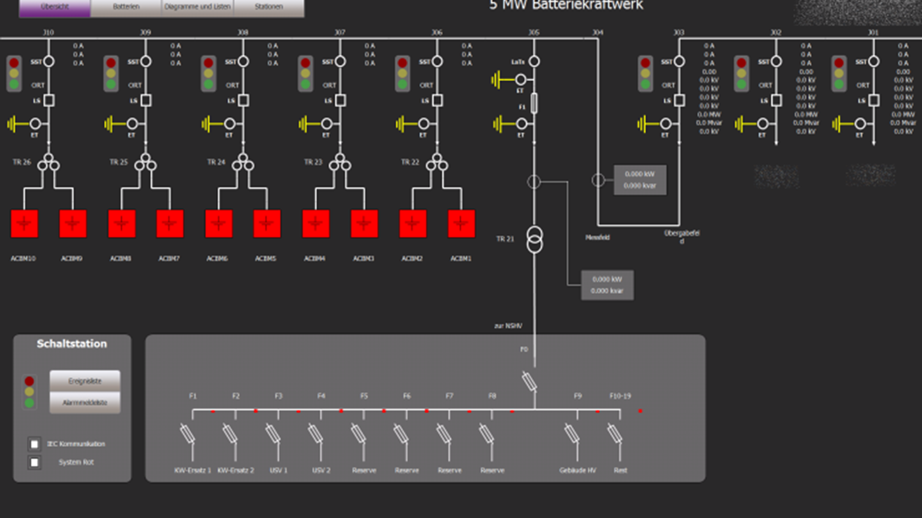
ELEC-E8423 - Smart Grid Monitoring and control in SG SCADA and NIS systems
Matias Aura
Semen Koveshnikov

Slide 2
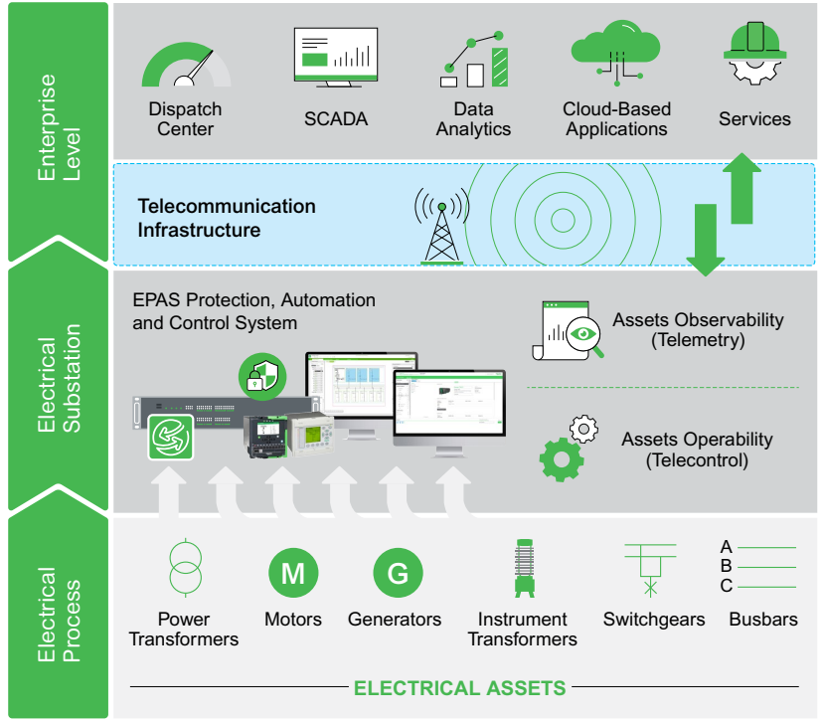
Introduction
SCADA – Supervisory Control And Data Acquisition
Control and data acquisition
System visibility
Data housing and management

Slide 3
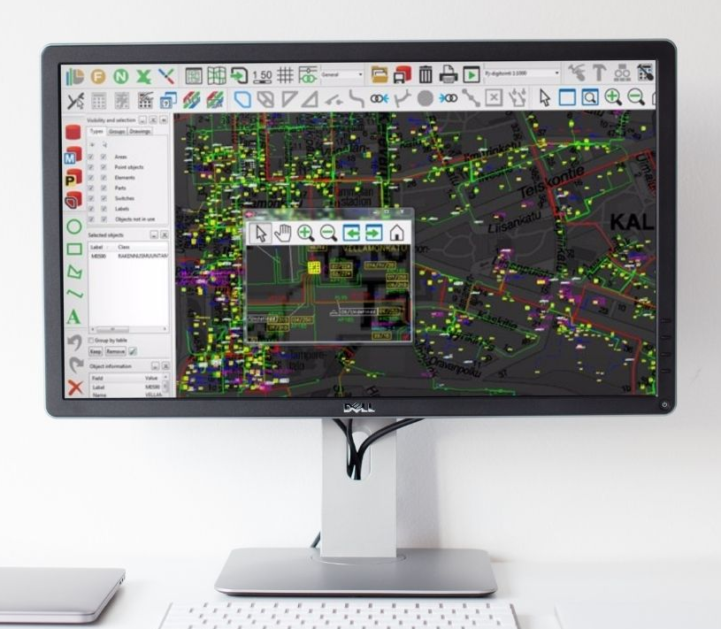
Introduction
NIS – Network Information System
Manages assets in a network by the creation of a smart virtual model
Variety of applications: distribution and transmission networks, water, gas, telecommunications, and street light networks
Typically embedded with Geographic Information System (GIS)
Utilized to make informed decisions about aspects of the network

Slide 4
You cannot control what you do not measure!
SCADA - Purpose

Slide 5
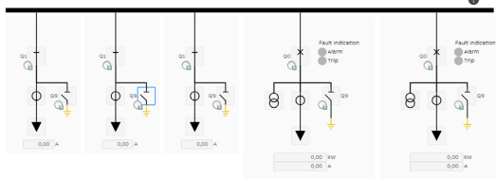
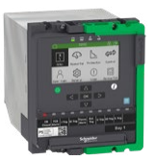
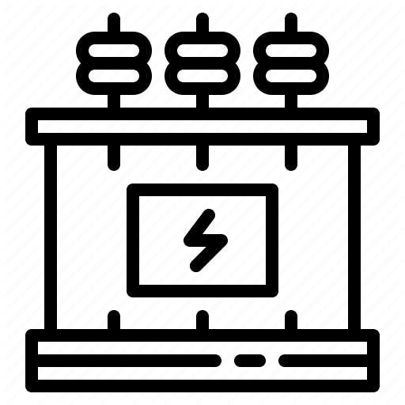
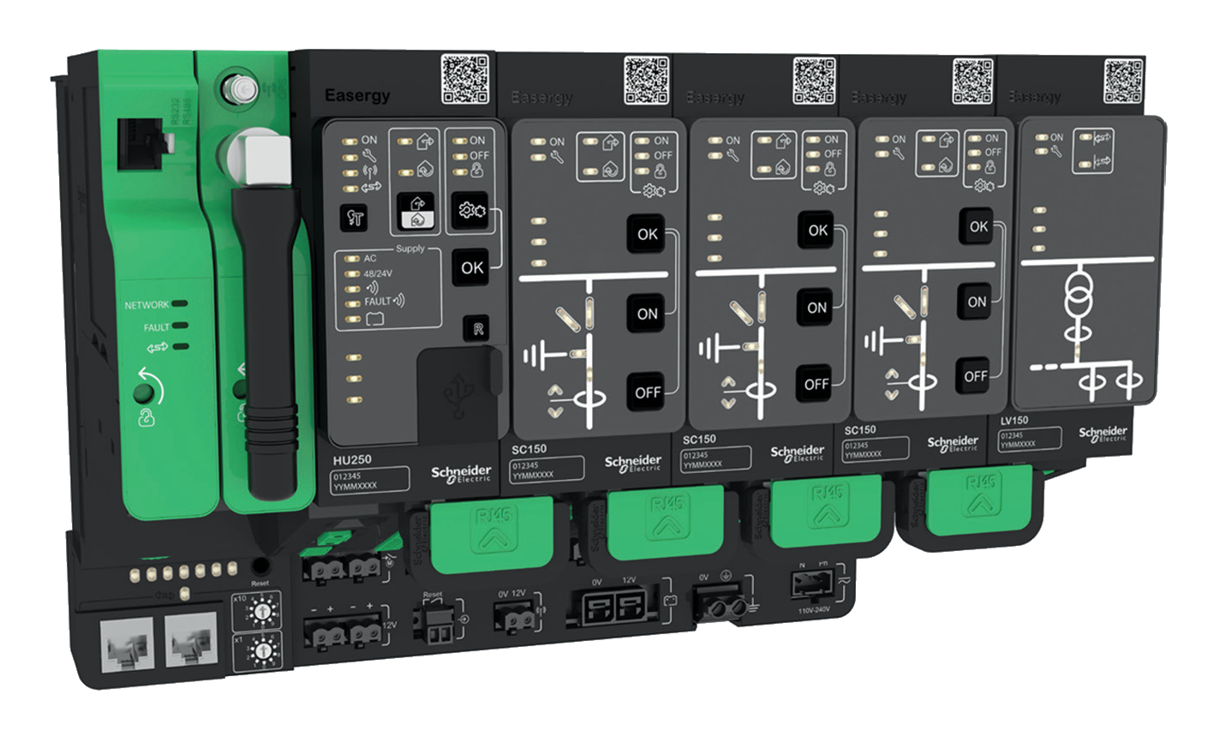
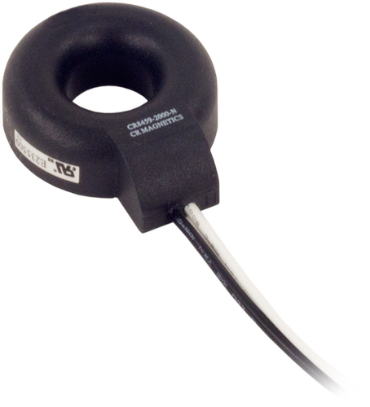
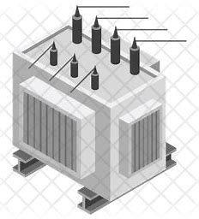
SCADA - Components
HMI – Single Line Diagram
Historians
Alarms
Analytics
Enterprise
Substation
Electrical process
RTU
Gateways
PLC
IED & Relays
Sensors
CT & VT
Transformer
VFD

Slide 6
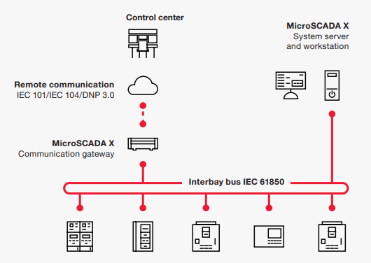
SCADA - Features
IEC61850 standard – current trend in communication and control of power utility
Digitization
IoT
Intelligence
Measurements
Connected devices
Sensing and monitoring
Flat data flow
Interconnectedness
Edge computing
AI support
Data analytics
Reporting

Slide 7
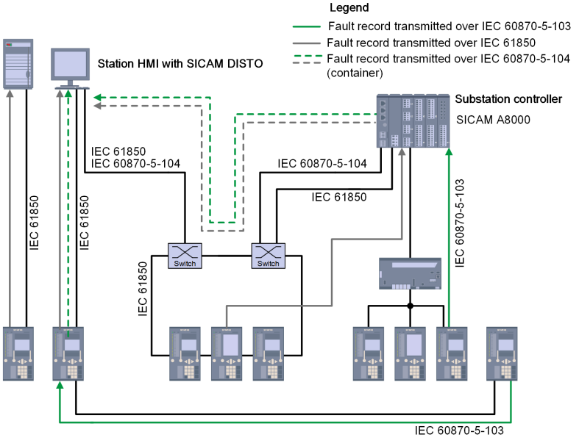
SCADA – Challenges and Threats
Cybersecurity
Data exchange
Connectivity
Confidentiality
High data rates
Network congestions
Reliability
Integrity
Availability
Equipment vendors
Communication protocols
Data models

Slide 8
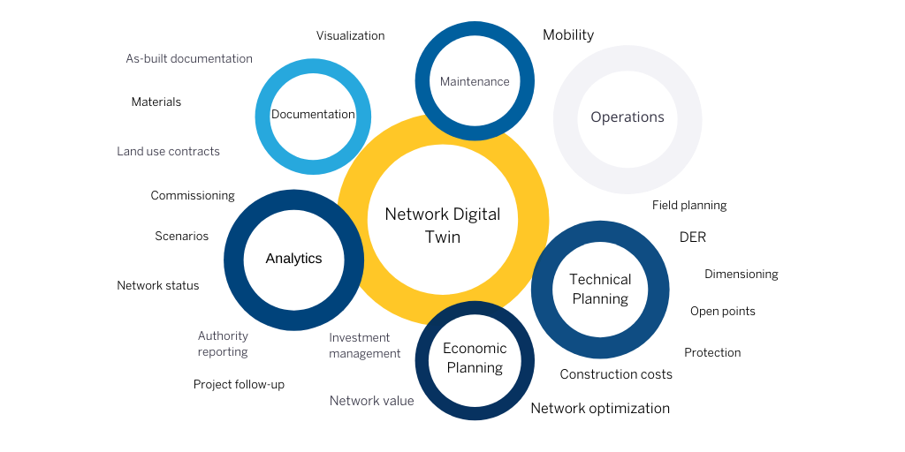
NIS Purpose
Design and Planning
Investment Planning
Asset Management
Optimize costs
Network Reliability
Power system Analysis
Identify network weaknesses
Determine optimal design
Maintenance
Real-time data access

Slide 9
Conclusion
SCADA | NIS
SG calls for advanced means of data acquisition, systems control and analysis. More and more technologies are being developed to facilitate the ubiquitous data gathering and transmission. Data: sensors, communication networks and protocols, data modelling (IEC61850, LPCT, 5G). Visualization: HMI, dashboards. Analysis: smart analytical tools (GHG reporting, metering data analysis). Control: intelligent self-operating systems (ADMS, EMS, asset management). | With the growth of prosumers, electrical vehicles, and other facets of smart grids, there is a growing need for accurate real-time intelligence and management of all assets in the distribution network. Analytics: Different scenarios, network status Visualization: Real-time network data for all users in a graphical user interface. Planning: Optimizing technical, reliability, and economic aspects.

Slide 10
Thank you for attention!

Slide 11
References
MicroSCADA X | Hitachi Energy
Power automation for HV/MV electrical networks (schneider-electric.com)
Proven Controls for Wind Offshore | Omnivise T3000 | Siemens Energy Global (siemens-energy.com)
MicroSCADA X for Substation Automation - brochure (abb.com)
SICAM Substaion Automation Catalog Edition 5 (siemens.com)
Power & Grid | Schneider Electric Global (se.com)
Utilities | Trimble (utilities.trimble.com)

