Slide 1
ELEC-E8423 - Smart Grid Role of DR, storages and hydrogen in future energy systems
Prabhat Ranjan, Sarkkinen Veikka
07.03.2023

Slide 2
Introduction
As more unstable renewable energy sources are added to the grid, the imbalance between supply and demand increases. Demand response (DR) and energy storage solutions have been developed to fight this issue, and are likely to play an important role in future energy systems.
Presentation contents:
DR in smart grids
The role of energy storage systems
Hydrogen in smart grids
Conclusions
Source material

Slide 3
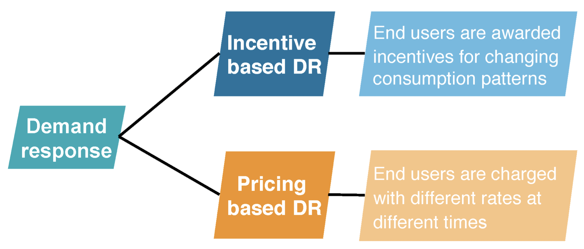
Demand response
Demand response (DR) is defined as changes in consumer’s consumption patterns due to electricity price or incentive payments
Important with high shares of VRE to balance supply and demand
Load management strategies with DR
Load curtailment (incentive based DR)
Load shifting (price based DR)
Own generation

Slide 4
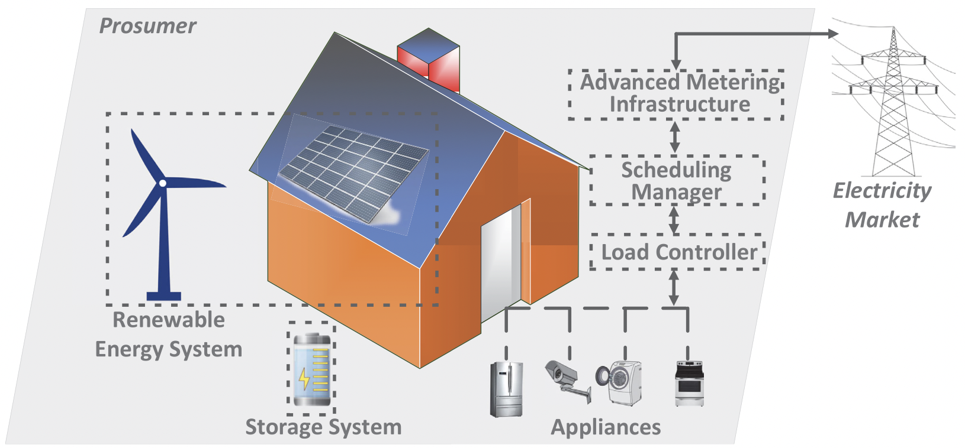
Demand response
Reliability benefits and system security:
Reduced system peak load and more efficient RE consumption
Added flexibility
High potential for increased flexibility and reduced bills from DR in electric space and water heating (in the Nordics)
Reduced market power and price volatility
Participants have higher influence on the
market
Future of DR:
From demand response to integrated demand response (IDR) in multi-energy systems (MES)
Change not only the energy consumption but also the type of energy consumed
IDR is provided by deep sector coupling, e.g. to control both electrical and thermal loads

Slide 5
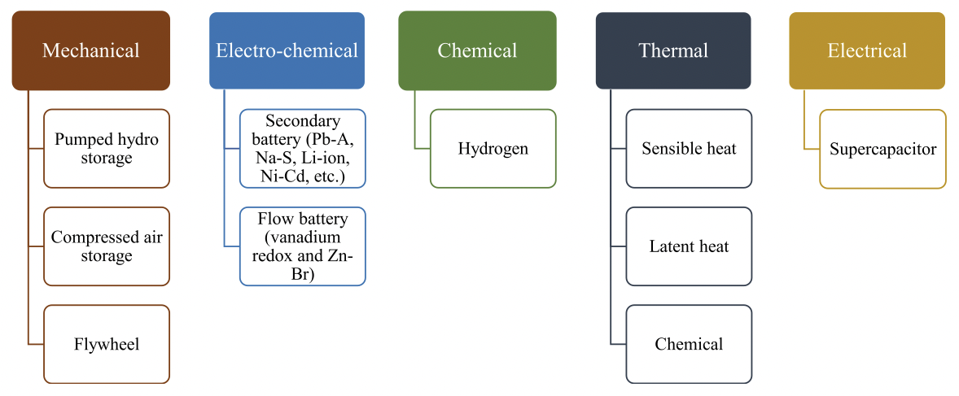
Storages
Important in future energy systems to balance VRE generation
Reduced system operating costs and increased stability
Charge during off-peak and discharge during peak
Most DR solutions are coupled with energy storage
Hydro, thermal and hydrogen for large-scale, battery storage for high power requirements, supercapacitors and flywheels for fast response purposes

Slide 6
Hydrogen energy
Hydrogen can be produced from e.g. fossil fuels, renewable energy, and nuclear energy
e.g. by gasification, electrolysis, steam reforming, and fermentation
Hydrogen is emission-free, and the most abundant and light element in the universe with a high energy density:
around 120 MJ/kg for hydrogen vs. 80 MJ/kg for natural gas
For electricity grid, hydrogen
storages are still too expensive
and inefficient
Hydrogen is distributed with:
pipelines
high-pressure tube trailers
liquefied hydrogen tankers
Research related to implementing hydrogen to society
Hydrogen energy in smart grid | - Renewable energy and hydrogen - Microgrid and hydrogen storage - Energy management
Hydrogen fuel cell electric vehicles
Hydrogen economy in smart grids | - Demand side management - Electricity market
Models for energy system in smart grids | - Energy management strategy - Other novel works

Slide 7
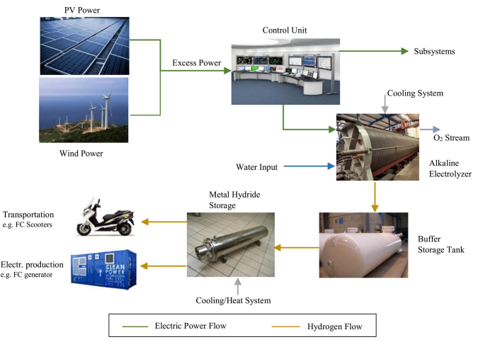
Hydrogen storages and trasport
Low density of hydrogen creates a technical issue for storage. Hydrogen storages are mostly still in a development phase, and only used as industry spare storages.
Hydrogen can be stored as
pressurized gas
cryogenic liquid
physically or chemically bonded to
appropriate solid-state material
Metal Hybrid Storages as a solid-state
storage system seem to show most
potential.
Challenges of integrating hydrogen
storages into smart grids are e.g.
long-term storage, trasport,
and integration strategies.

Slide 8
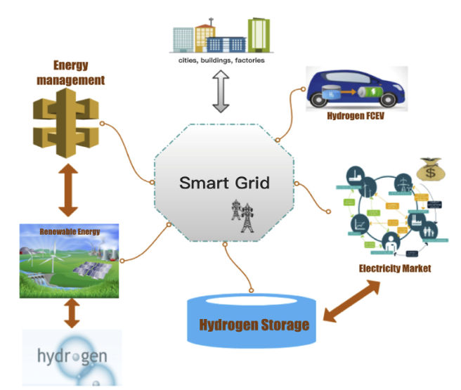
Hydrogen energy in the future
Hydrogen could be implemented to future smart grids as a medium, i.e. storage, transportation, and conversion
Usage of hydrogen energy in the future:
fuel cell in electric vehicles
hydrogen storages
energy management
satisfying peak usage, and the
unstable renewable energy,
in both supply and demand side
electricity markets
reducing peaks with hydrogen
storages and thus reducing costs

Slide 9
Hydrogen energy in the future
Hydrogen could be implemented to future smart grids as a medium, i.e. storage, transportation, and conversion
Power-to-X
Power to hydrogen
Power-to-X-to-Power
X = Hydrogen, inefficient
Usage of hydrogen energy in the future:
fuel cell in electric vehicles
hydrogen storages
energy management
satisfying peak usage, and the
unstable renewable energy,
in both supply and demand side
electricity markets
reducing peaks with hydrogen
storages and thus reducing costs

Slide 10
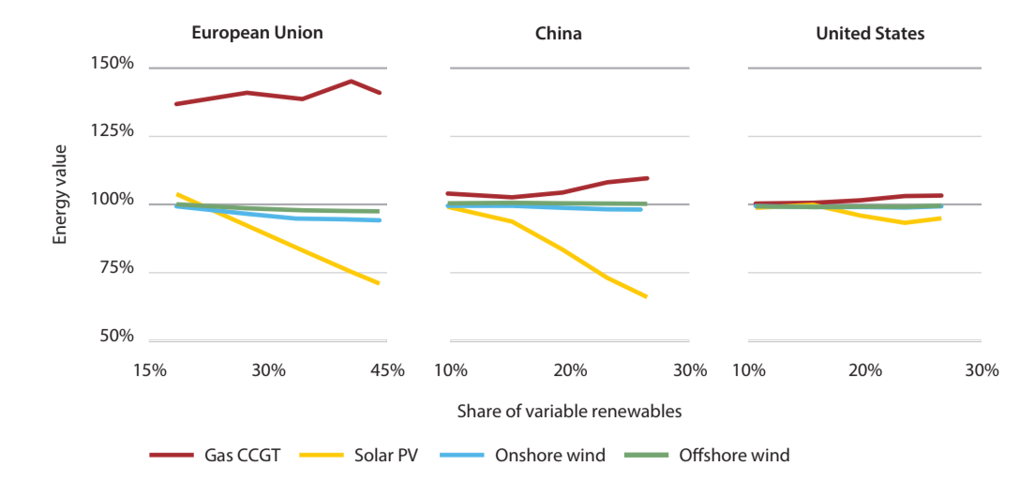
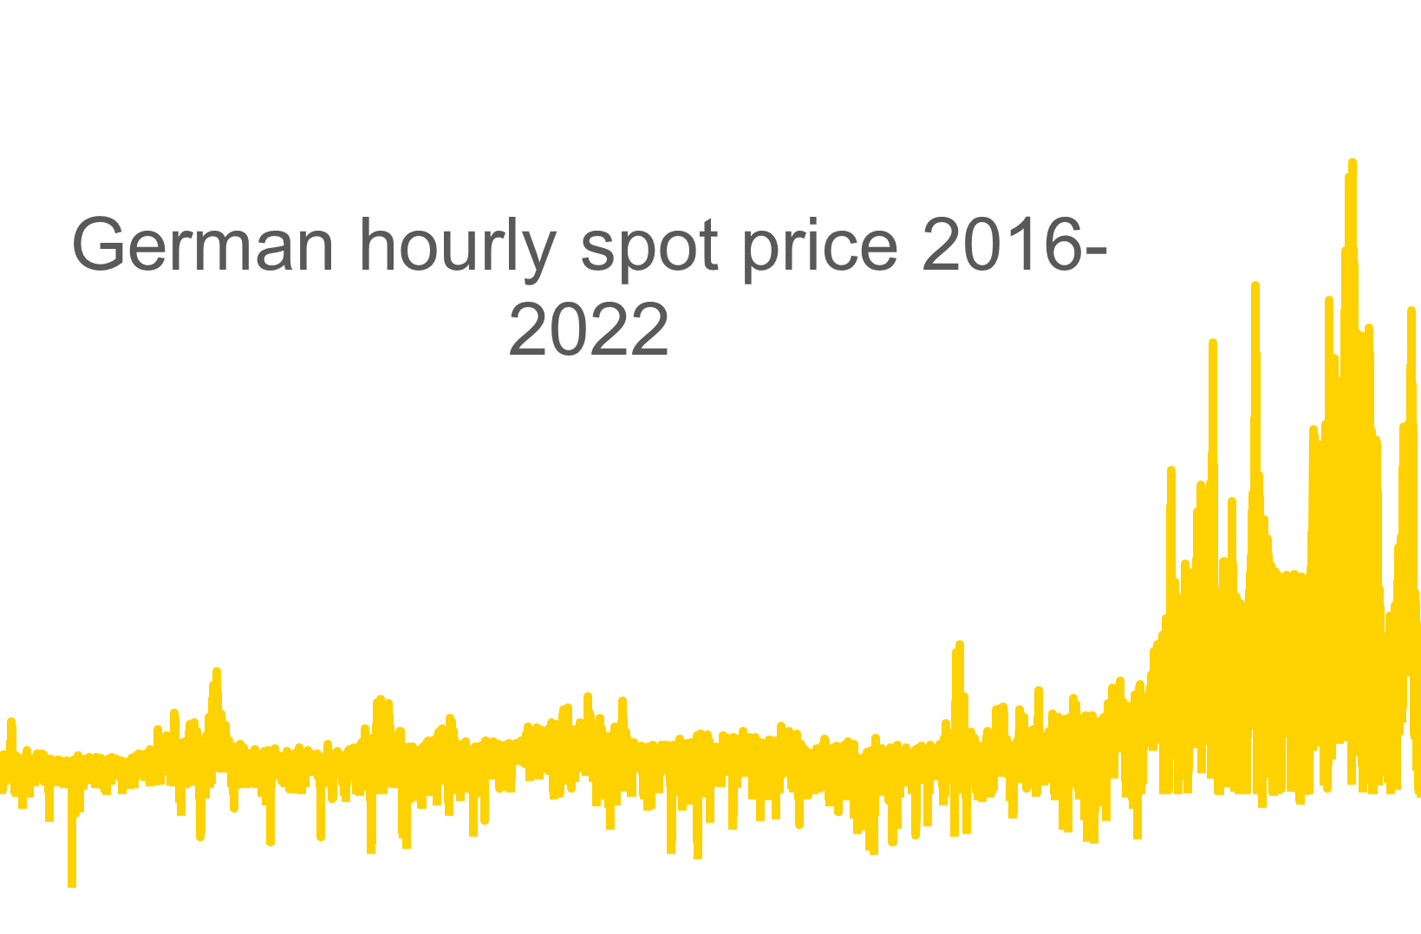
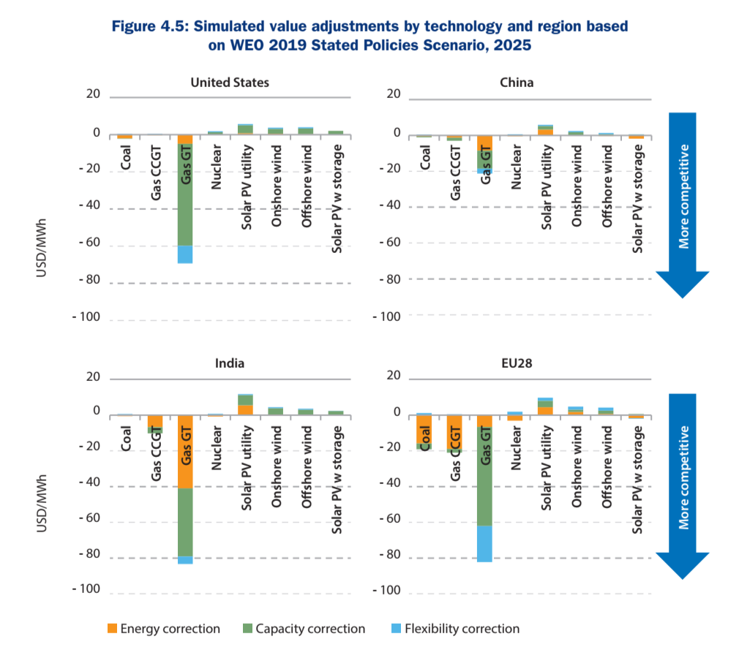
Something happened recently
2020-2022 was anomalous
Prices volatilities are off the charts
More renewables = More volatility
Flexibility becomes a precious commodity
Source: VaasaETT

Slide 11
Conclusions
DR and energy storages can help to balance the differences between supply and demand resulting from the increasing amount of variable renewable energy sources
In addition to improvements in grid stability, DR and energy storage solutions can bring cost benefits to consumers and producers
Hydrogen has a high energy density in comparison to other energy storages, and it can be produced of renewable sources
Hydrogen storages are still inefficient and expensive, and need more development before being able to replace e.g. natural gas in costs and efficiency

Slide 12
Source material used
Chen, Y. & Xu, P. & Gu, J. & Schmidt, F. & Li, W. 2018. Measures to improve energy demand flexibility in buildings for demand response (DR): A review. Energy & Buildings. Vol. 177. p. 125-139. DOI: 10.1016/j.enbuild.2018.08.003.
Huang, W. & Zhang, N. & Kang, C. & Li, M. & Huo, M. 2019. From demand response to integrated demand response: review and prospect of research and application. Protection and Control of Modern Power Systems. Vol. 4(12). 13 pages. DOI: 10.1186/s41601-019-0126-4.
Liu, Z. & Zhao, Y. & Wang, X. 2020. Long-term economic planning of combined cooling heating and power systems considering energy storage and demand response. Applied Energy. Vol. 279. 115819. DOI: 10.1016/j.apenergy.2020.115819.
Rahman, Md.M. & Oni, A.O. & Gemechu, E. & Kumar, A. 2020. Assessment of energy storage technologies: A review. Energy Conversion and Management. Vol. 223. 113295. DOI: 10.1016/j.enconman.2020.113295.
Robert, F.C. & Sisodia, G.S. & Gopalan, S. 2018. A critical review on the utilization of storage and demand response for the implementation of renewable energy microgrids. Sustainable Cities and Society. Vol. 40. p. 735-745. DOI: 10.1016/j.scs.2018.04.008.
Shariatzadeh, F. & Mandal, P. & Srivastava, A.K. 2015. Demand response for sustainable energy systems: A review, application and implementation strategy. Renewable and Sustainable Energy Reviews. Vol. 45. p. 343-350. DOI: 10.1016/j.rser.2015.01.062.

Slide 13
Source material used
Siano, P. 2014. Demand response and smart grids - A survey. Renewable and Sustainable Energy Reviews. Vol. 30. p. 461-478. DOI: 10.1016/j.rser.2013.10.022.
Vahid-Ghavidel, M. & Javadi, M.S. & Gough, M. & Santos, S.F. & Shafie-khah, M. & Catalao J.P.S. 2020. Energies. Vol. 13(17). 4332. DOI: 10.3390/en13174332.
Lin, R. H., Zhao, Y. Y., & Wu, B. D. (2020). Toward a hydrogen society: Hydrogen and smart grid integration. International Journal of Hydrogen Energy, 45(39), 20164–20175. https://doi.org/10.1016/j.ijhydene.2020.01.047
Abe, J. O., Popoola, A. P. I., Ajenifuja, E., & Popoola, O. M. (2019). Hydrogen energy, economy and storage: Review and recommendation. International Journal of Hydrogen Energy, 44(29), 15072-15086. doi:10.1016/j.ijhydene.2019.04.068
Dincer, I., & Acar, C. (2018). Smart energy solutions with hydrogen options. International Journal of Hydrogen Energy, 43(18), 8579-8599. doi:10.1016/j.ijhydene.2018.03.120
Eghbali, N., Hakimi, S. M., Hasankhani, A., Derakhshan, G., & Abdi, B. (2022). Stochastic energy management for a renewable energy based microgrid considering battery, hydrogen storage, and demand response. Sustainable Energy, Grids and Networks, 30 doi:10.1016/j.segan.2022.100652
Kavadias, K. A., Apostolou, D., & Kaldellis, J. K. (2018). Modelling and optimisation of a hydrogen-based energy storage system in an autonomous electrical network. Applied Energy, 227, 574-586. doi:10.1016/j.apenergy.2017.08.050

Slide 14
Source material used
Honarmand, M. E., Hosseinnezhad, V., Hayes, B., Shafie-Khah, M., & Siano, P. (2021). An Overview of Demand Response: From its Origins to the Smart Energy Community. IEEE Access, 9. https://doi.org/10.1109/ACCESS.2021.3094090
Huang, W., Zhang, N., Kang, C., Li, M., & Huo, M. (2019). From demand response to integrated demand response: review and prospect of research and application. Protection and Control of Modern Power Systems, 4. https://doi.org/10.1186/s41601-019-0126-4
Irtija, N., Sangoleye, F., & Tsiropoulou, E. E. (2020). Contract-Theoretic Demand Response Management in Smart Grid Systems. IEEE Access, 8. https://doi.org/10.1109/ACCESS.2020.3030195
Javadi, M. S., Gough, M., Mansouri, S. A., Ahmarinejad, A., Nematbakhsh, E., Santos, S. F., & Catalao, J. P. S. (2022). A two-stage joint operation and planning model for sizing and siting of
electrical energy storage devices considering demand response programs. Electrical Power and Energy Systems, 138. https://doi.org/10.1016/j.ijepes.2021.107912
Kirkerud, J. G., Nagel, N. O., & Bolkesjo, T. F. (2021). The role of demand response in the future renewable northern
European energy system. Energy, 235. https://doi.org/10.1016/j.energy.2021.121336
Mansour-Saatloo, A., Agabalaye-Rahvar, M., Mirzaei, M. A., Mohammadi-Ivatloo, B., Abapour, M., & Zare, K. (2020). Robust scheduling of hydrogen based smart micro energy hub with integrated demand response. Journal of Cleaner Production, 267. https://doi.org/10.1016/j.jclepro.2020.122041
Mitali, J., Dhinakaran, S., & Mohamad, A. A. (2022). Energy storage systems: a review. Energy Storage and Saving, 1(3). https://doi.org/10.1016/j.enss.2022.07.002
Rahman, M. M., Oni, A. O., Gemechu, E., & Kumar, A. (2020). Assessment of energy storage technologies: A review. Energy Conversion and Management, 223. https://doi.org/10.1016/j.enconman.2020.113295
Shewale, A., Mokhade, A., Funde, N., & Bokde, N. D. (2020). An Overview of Demand Response in Smart Grid and Optimization Techniques for Efficient Residential Appliance Scheduling Problem. Energies, 13. https://doi.org/10.3390/en13164266
Woo, T.-H., Ko, W., Ree, C.-H., & Park, J.-K. (2017). The incentive announcement effect of demand response on market power
mitigation in the electricity market. Renewable and Sustainable Energy Reviews, 76. https://doi.org/10.1016/j.rser.2017.03.035
Shaqsi, A. Z. A., Sopian, K., & Al-Hinai, A. (2020). Review of energy storage services, applications, limitations, and
benefits. Energy Reports, 6. https://doi.org/10.1016/j.egyr.2020.07.028

